Slide 1
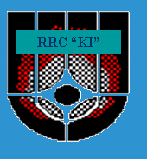
Long-term behavior of corium after the accident (using the data of the Chernobyl NPP accident)
“CHESS-2” – anticipated Project #3702

Slide 2
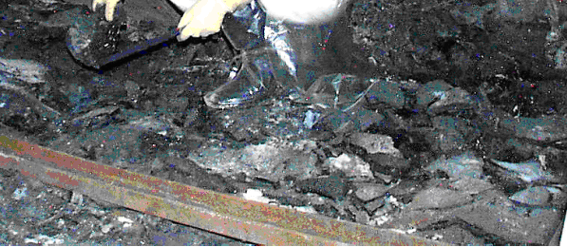
Why there is a need for performance of this Project?
The First Reason.
After spreading, 1200 t of “lava” inside the “Shelter” have been during 22 years under the impact of external (humidity, temperature) and internal (its own radioactive emanation) factors and have degraded gradually.

Slide 3
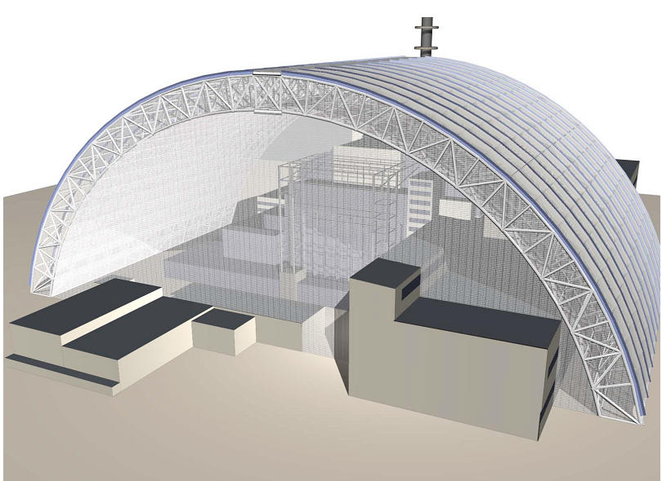
As intended presently, many more decades will pass prior to removal of “lava” out of the new confinement and its disposal.

Slide 4
The Project to be generated will make it possible to:
to determine a degree of destruction of lava (for T < 100 years)
optimize the development of a monitoring system for fuel-containing materials;
help in prevention of potential accidents;
contribute to the development of optimum lava-removal technologies;
and thus - diminish material expenses and the dose burden.

Slide 5
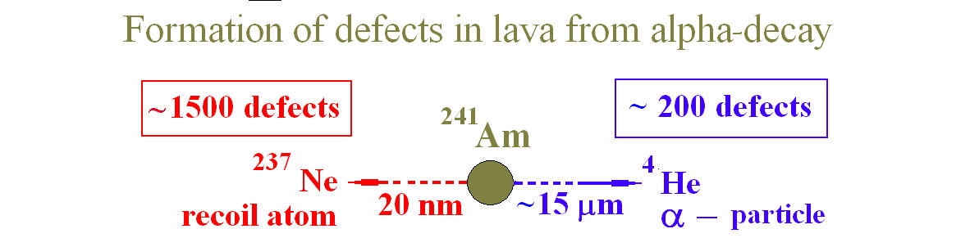
The Second Reason
The fact is that in 1997 – 2007 many articles were published discussing the possibility of soon (after three to four years) and violent (during weeks) transformation of the whole of 1200 t of Chernobyl’s “lava” into submicron (!) dust under the impact of its own α-activity accompanied with “catastrophic radioecological consequences!” (a quotation of the authors of such publications).

Slide 6
A proposal was put forward to stop all transformation activities at the “Shelter” and elaborate a fundamentally new “Shelter Implementation Plan”.
Early investigations on “lava” degradation conducted in 2003–2005 jointly by the Institute for Safety Problems of NPP-s of the National Academy of Sciences of Ukraine and RRC “Kurchatov Institute” were mainly aimed at checking up the statements on rapid character of such a degradation, which would supposedly occur in the near future.

Slide 7
Hypotheses about rapid degradation have not proved to be true, but the involved institutes have not come to a common conclusion on the character of long-term (> 30 years) “lava” behavior.
Now disputes proceed. The last year even there was the report to the President of Ukraine with the warning of possible rapid destruction of lava.

Slide 8
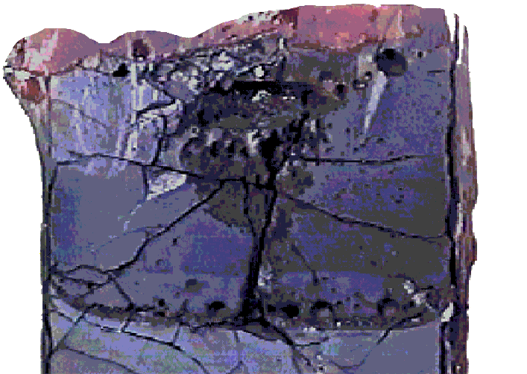
The Third Reason
Just as in case of Chernobyl, works on corium removal and disposal might begin not immediately after an accident and thus would require a protracted period of time. In such a case the Chernobyl’s model might be useful for the development of corium retention devices for PWR, BWR and VVER power projects.

Slide 9
The Project “CHESS-2” shall answer a series of specific questions.
What physical and chemical processes and what external and internal mechanisms may have effect on “lava” degradation? What is the role of self-irradiation?
Whether or not “lava” will transform into submicron fuel dust?
Whether or not soluble uranium compounds will be generated on “lava” basis?
What general recommendations on safe protracted storage of corium may be proposed?

Slide 10
We are sure, that contacts with experts of CEG-SAM is very important for us at performance of such Project.

