Slide 1

Long-term behavior of corium after the accident (using the data of the Chernobyl NPP accident)
RRC “KI”
“CHESS-2” – anticipated Project of the ISTC #3702

Slide 2
CONTENT
RRC “KI”
Objectives of new Project #3702 and its interface with Project #2916 (CHESS-1)
Tasks of the Project #3702
Interface with STCU Project # 4207 “Long-term prognosis of transformation of the fuel-containing materials (FCM) in Chernobyl Shelter”

Slide 3
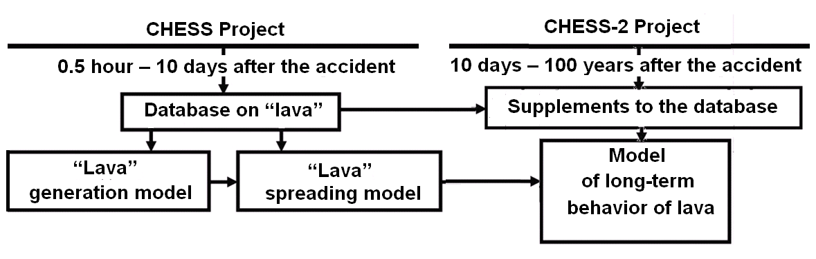
CHESS-1 and CHESS-2 interface
RRC “KI”

Slide 4
General objectives of CHESS Projects
RRC “KI”
Data acquisition on corium properties and its variations for all the time up today;
Simulation and long-term prediction of the behavior of “lava” up to 100 years ahead in the course of its storage in the “Shelter” under the new confinement
Elaborating recommendations on safety measures during storage and ultimate removal of “lava” from the “Shelter”

Slide 5
Practical application
RRC “KI”
In case of severe reactor accident resulted in corium formation, there is no practical opportunity to withdraw quickly fuel containing material outside the Unit, or properly isolate it (like in case of the ChNPP).
What can we expect from the accidental fuel inside the building from the viewpoint of the LFCM transformation?
How much time do we have before drastic measures for fuel withdrawal / isolation will be necessary?
What sort of corium will we have to the time of its withdrawal and disposal of?

Slide 6
Practical application (new)
RRC “KI”
Reaction to hypothesis of generation of hazardous amount of submicron aerosols by “lava” inside Sarcophagus – contribution to decision on ongoing Shelter-2 construction:
participation in planning and data processing of the experiments for studies of submicron aerosols in the Shelter;
forecast of submicron particles (if any) spreading over the Shelter from lava surface.

Slide 7
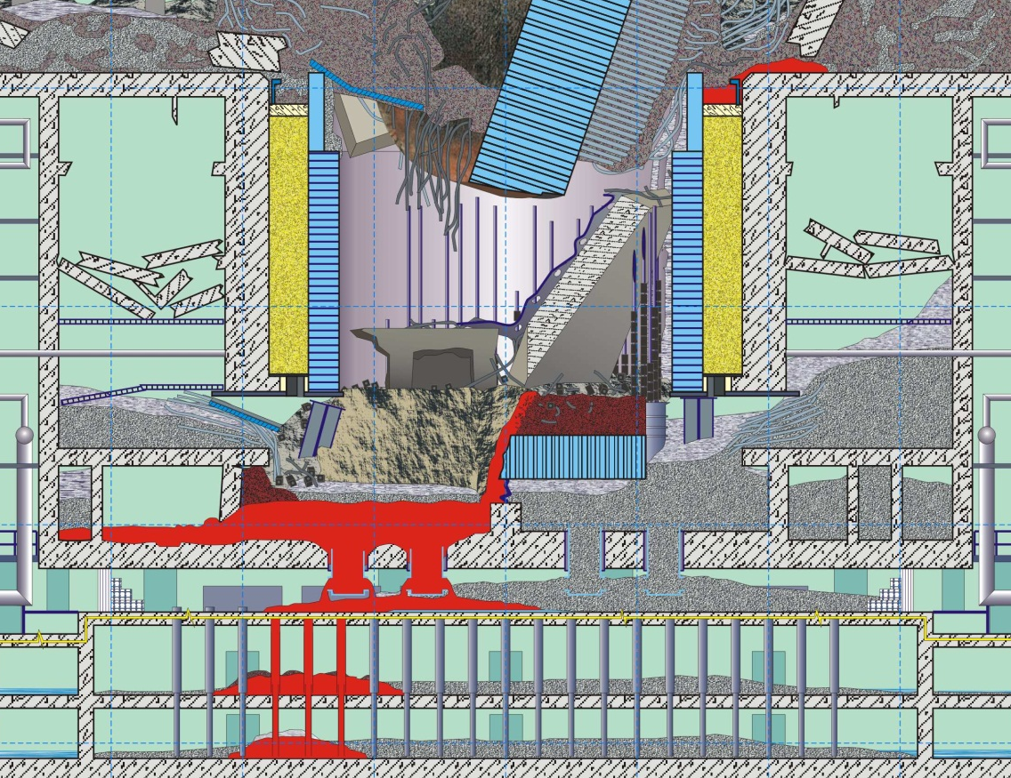
Chernobyl experience
RRC “KI”
Humidity
Chemical Interactions
Temperature
Self Irradiation
Destruction
Dust
Soluble Compounds

Slide 8
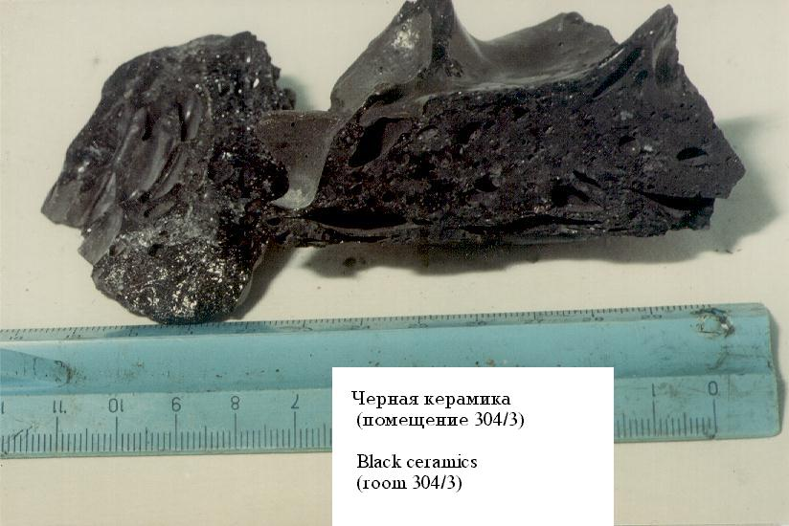
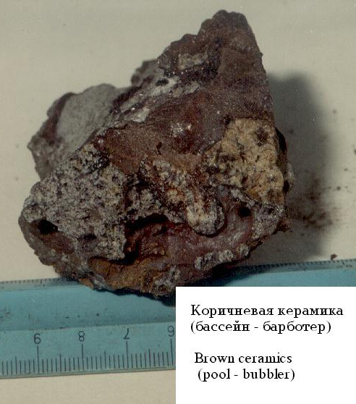
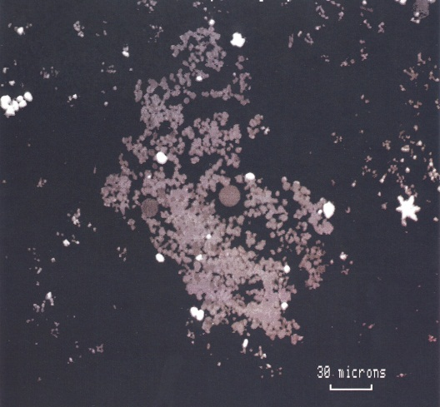
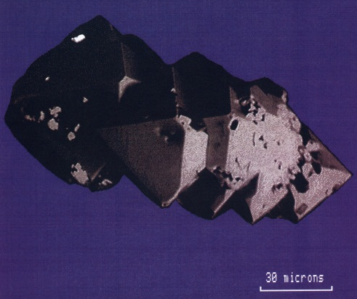
RRC “KI”
#3702 (Russia) | #4207 (Ukraine)
initial data acquisition and analysis
Description of macro-properties of Chernobyl “lavas”, their different types and forms (ceramics, pumice, slag, etc.) generated after corium solidification, of physical and chemical properties and factors influencing their distinctions
Identification of the main mechanisms of the Chernobyl HP formation and factors determining the differences between the HP types;
Classification of HP according to the physical and chemical characteristics (matrix, coefficients of the radionuclides fractionation, fuel burn-up, types of inclusions, chemical stability);
Modernization of the UIAR database “Hot particles” and its update with the obtained information
“Black lava”
“Brown lava”
Structure and physical and chemical properties of Chernobyl “lavas” at the micro-level (the main matrix and types of inclusions, distribution of radioactivity between the matrix and inclusions, etc.)

Slide 9
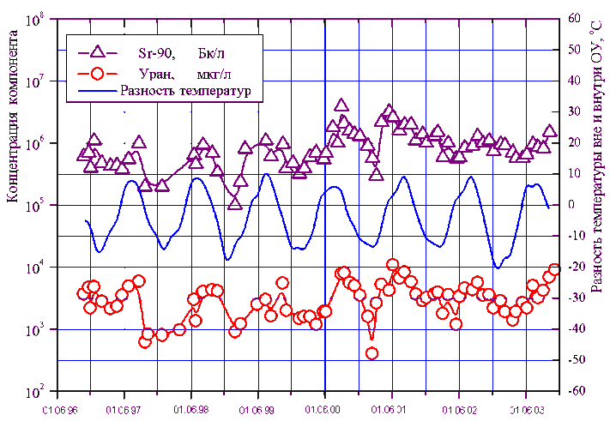
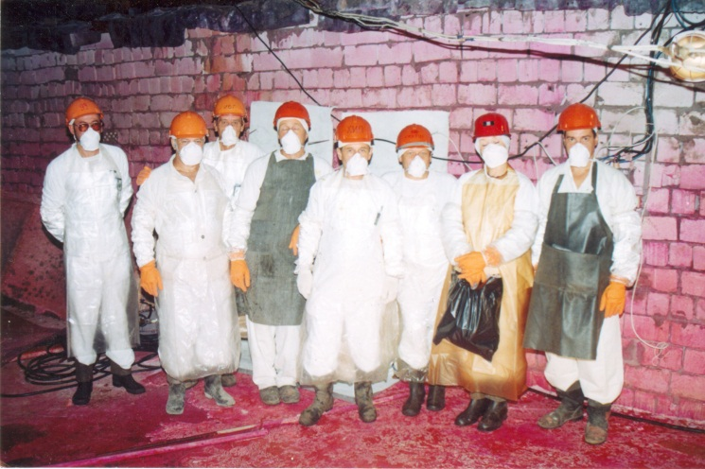
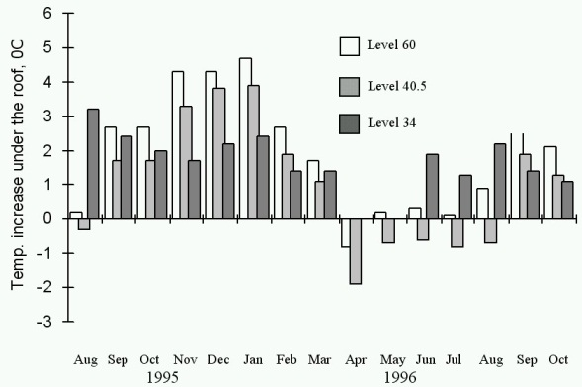
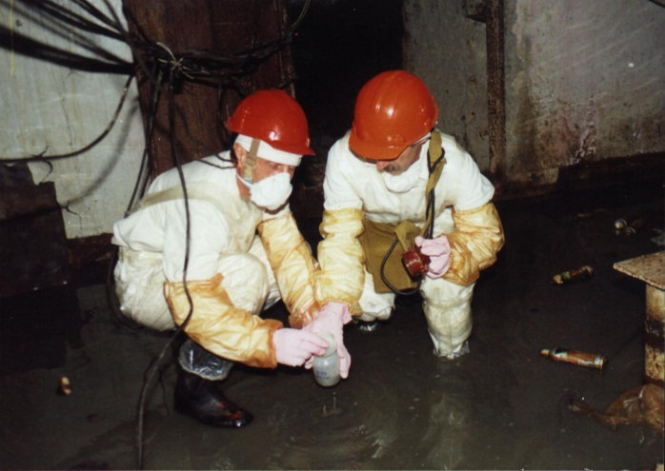
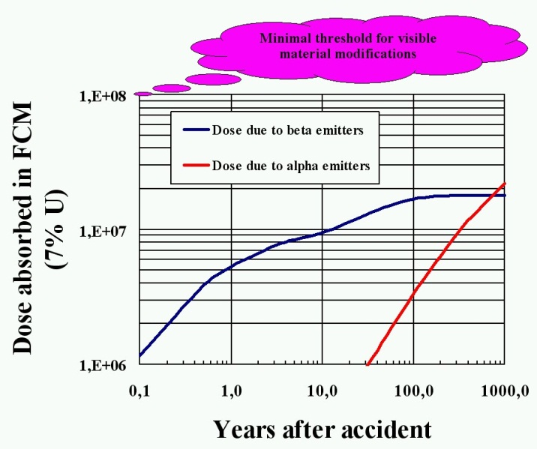
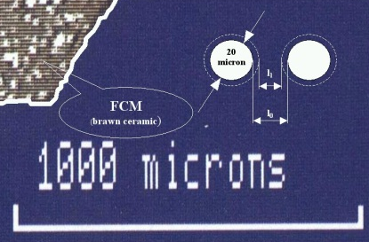
RRC “KI”
#3702 (Russia) | #4207 (Ukraine)
analysis of impacts on FCM
Examination of the effects of humidity regimens
Identification of the main sources of RA formation in Shelter;
Dependence of the airborne concentrations in the Shelter rooms on external factors including seasonal ones;
Examination of the effects of temperature
Radiation model of “lava” taking into account both external exposure and its own radioactivity. Special attention will be focused on dose buildup in “lava” material resulting from α-decay processes

Slide 10
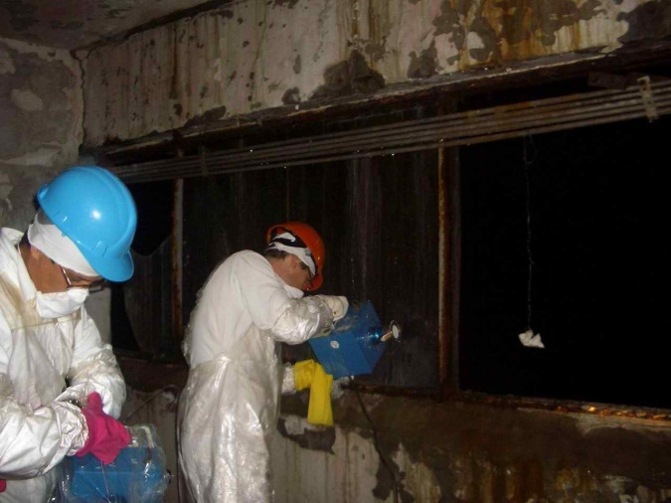
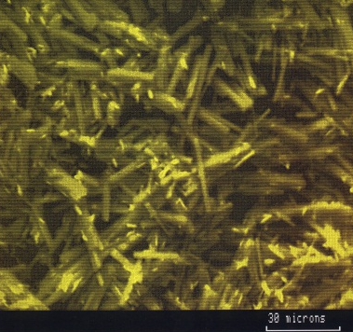
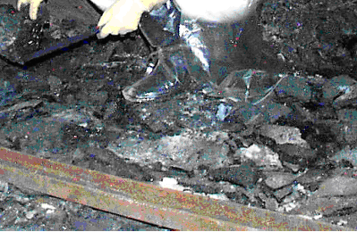
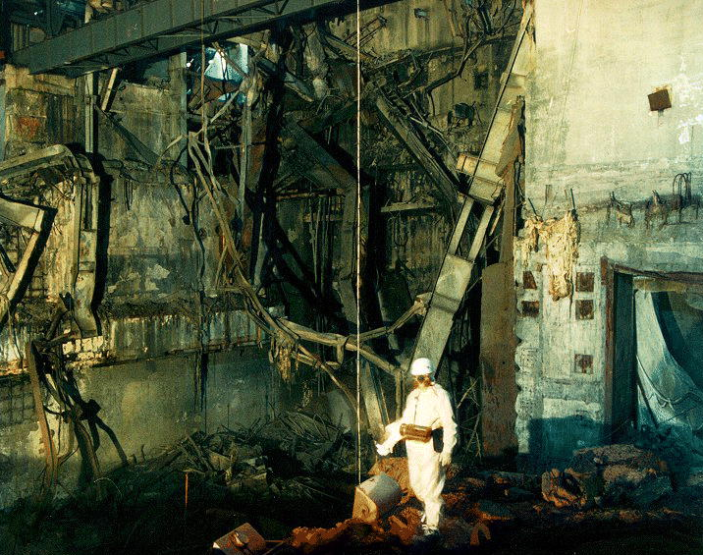
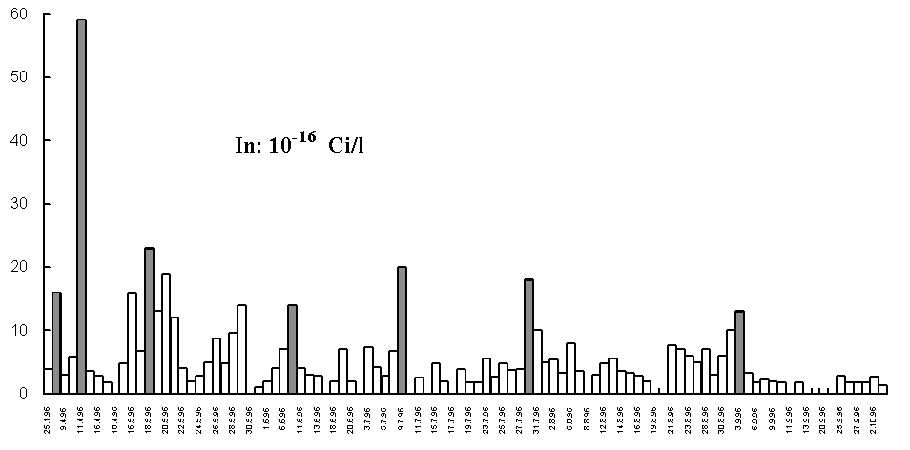
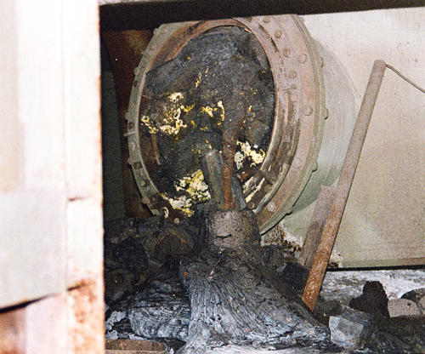
RRC “KI”
#3702 (Russia) | #4207 (Ukraine)
analysis of real data obtained
Determination of the RA characteristics (dispersal rates and radionuclide composition);
Evaluation of the possibilities to control the FCM state and destruction mechanism/rates.
Investigations at the “Shelter”

Slide 11
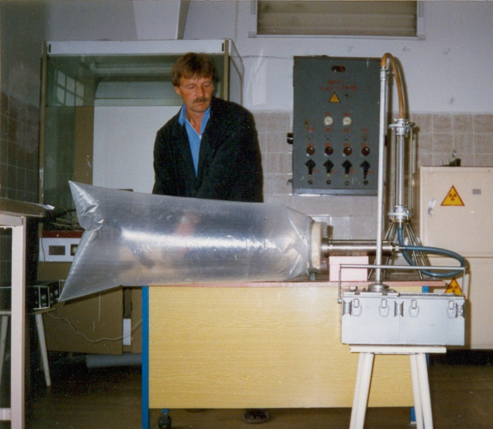
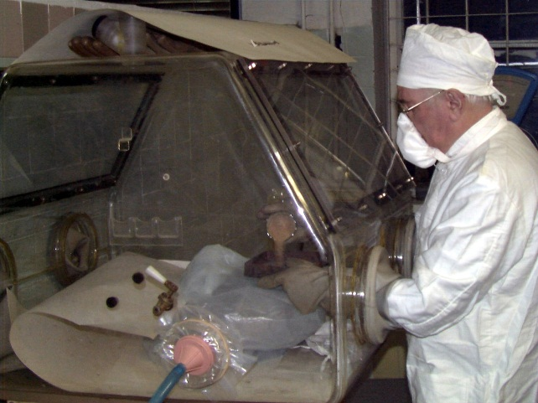
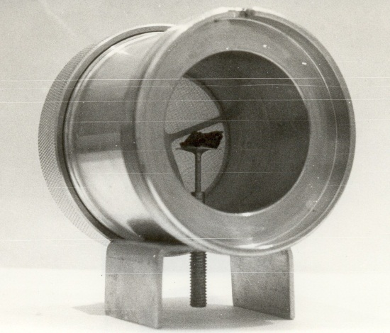
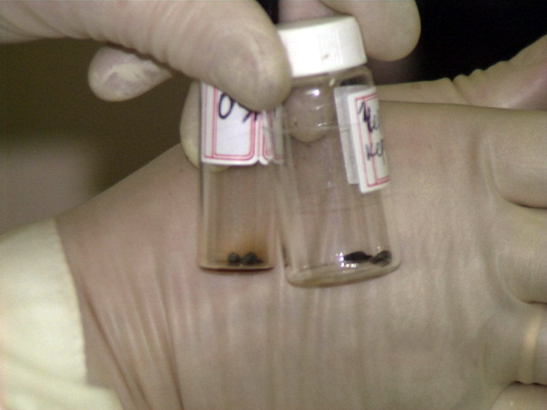
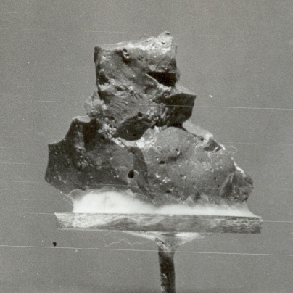
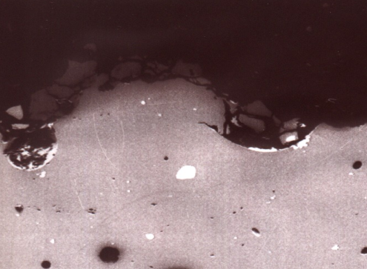
RRC “KI”
#3702 (Russia) | #4207 (Ukraine)
laboratory studies of the samples
Experimental studies of FP destruction rate, as a function of particle characteristics: matrix composition, oxidation level, and as a function of the medium:
air: humidity, temperature;
aqueous: composition, pH, temperature
Generalization of the results of monitoring of “lava” samples having been in laboratories and at special storages of RRC KI, Radium Institute, etc.

Slide 12
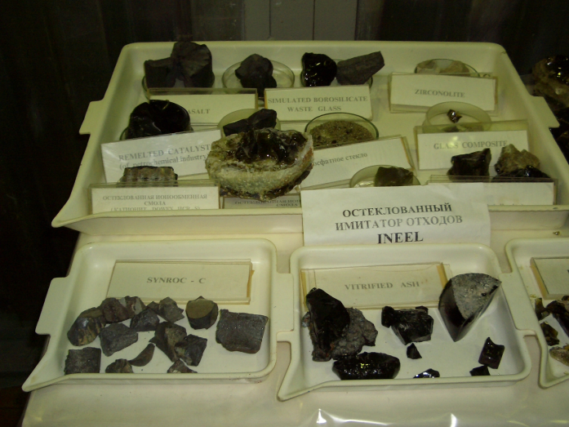
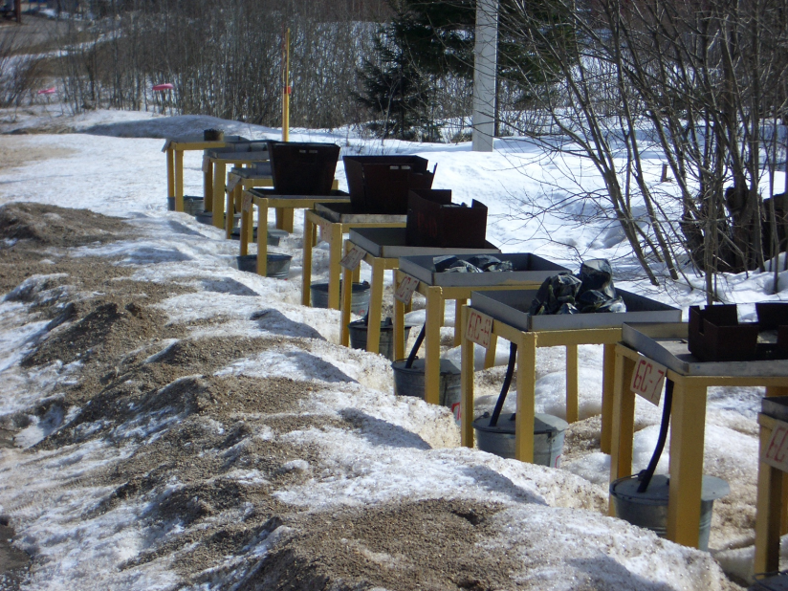
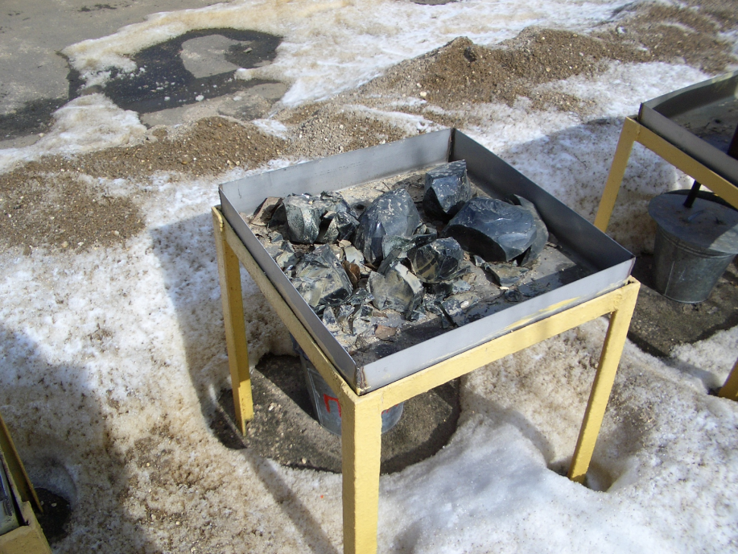
Task 4. Study of existing LFCM analogues and results of their studies under long-term storage
RRC “KI”
Collection and analysis of the data on vitrified waste;
Identification of waste types similar to “lavas” and their properties

Slide 13
Task 5. Model of the long-term behavior of corium
RRC “KI”
5.1. Establishing the dependence of dynamics of solidified corium behavior on variations in its internal composition and external conditions at present.
5.2. Usage of calculation, theoretical and experimental data obtained for vitrified waste to generate corium behavior model.

Slide 14
Resources required
RRC “KI”
Participating personnel 19 (13 “weapon” scientists);
Project duration 30 months;
Estimated cost 345,000 USD

