Slide 1
Progress report on the ISTC project #3813: Phase relation in corium systems
(PRECOS)
A.P. Alexandrov Research Institute of Technology
Presented by S. Bechta
17th CEG-SAM meeting
Madrid, Spain
March 29-31, 2010

Slide 2
Contents
  General information
  Project objectives
  PRECOS test matrix
  Scope of work in quarters 6 - 7
  Test results:
  - UO2-SiO2 system
  - UO2-CaO system
  - UO2-SiO2- FeO system
  Conclusions

Slide 3
PRECOS project general information
Project participants and coordination
Collaborators
FZK, Germany
IRSN,
France
JRC ITU,
EC
CEA,
France
Areva NP, Germany
Coordinator
ISTC, Moscow
Steering committee
Operation Agent: A.P. Alexandrov RIT, Russia
SPb State Electrotechnical University, Russia
IVTAN,
Russia

Slide 4
Project objectives
Experimental determination of:
liquidus – solidus temperatures
coordinates of reference points (eutectics, etc.)
solubility limits of solid solutions
compositions of liquids coexisting in the miscibility gap

Slide 5
PRECOS test matrix
Task | Composition | Atmosphere | Experimental data | Priority level | Pt N
1 | Different compositions in the U-Zr-Fe-O system | Argon | Selected points (liquidus, solidus, tie-lines in the miscibility gap) | 1 | 6
2 | ZrO₂ - FeO_{y} | Air and p_{O2} control | liquidus, solidus, solubility limits | 2 | 3
 | UO₂ - SiO₂ | Neutral | liquidus, solidus, solubility limits, eutectic point | 1 | 7
 | CaO - UO₂ |  |  | 1 | 7
3 | UO₂ – FeO – SiO₂ |  | liquidus, solidus, solubility limits, tie-lines in the miscibility gap, ternary eutectic point | 1 | 10
 | UO₂ – FeO – CaO |  | liquidus, solidus, solubility limits, ternary eutectic point | 1 | 10
 | ZrO₂ - FeO - SiO₂ |  | ternary eutectic point | 2 | 2
 | ZrO₂ - FeO - CaO |  | ternary eutectic point | 2 | 2
4 | Eutectic composition measurement of a realistic complex corium mixture | Argon or Air | System (atmosphere) proposed by: - French partners (1 system) German partners (1 system) - Russian partners (1 system) | 2 | 3

Slide 6
Scope of work in quarters 6-7
The laser pulse heating (LPH) experimental installation at IVTAN is
equipped with a system of high-speed video recording of the
specimen surface at 1000 frames/s
A new system of semi-transparent ceramics heating by the Nd:YAG
laser has been designed and realized for the above installation
ISC experimental installations have been transferred to SPb
SETU and assembled there. Their commissioning and adjustment are
underway. The electron microscope is equipped with the BRUKER
QUNTAX-200 microanalyzer. The company has solved the software-
and hardware-related problems of quantitative analysis
Experiments on the following systems have been performed:
  UO2-SiO2, UO2-CaO, UO2-SiO2-FeO
Experiments on the ZrO2-FeOy system are delayed due to the transfer
of the experimental installations from ISC to SETU, and those on the
ZrO2- U system – because IVTAN has not got yet a License to work
with uranium

Slide 7
Scope of work in quarters 6-7 (2)

Slide 8
UO2-SiO2 system: PRS9 test results
Experimental objectives
Determination of the liquidus temperature
Charge composition
Mol% 75UO2 + 25SiO2
Tliq
Tliq was measured 3 times by VPA IMCC with melt sampling
Samples

Slide 9
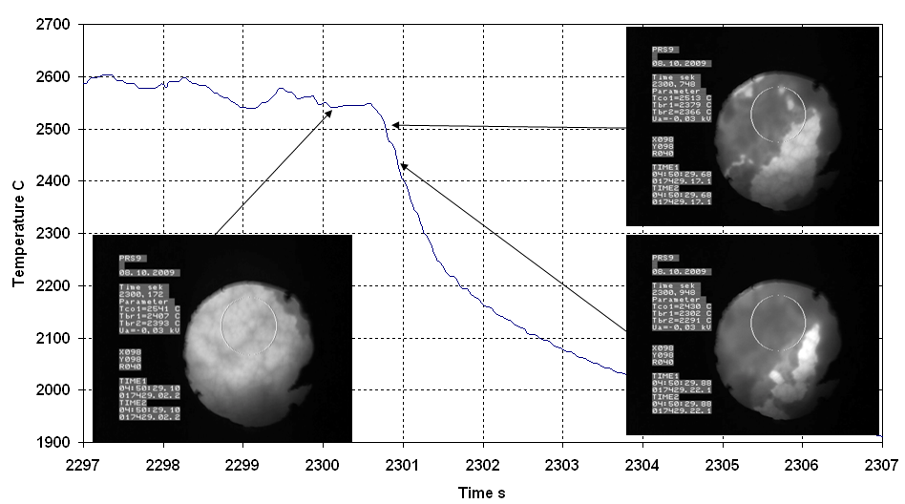
UO2-SiO2 system: PRS9 test results(2)
VPA IMCC: Example of thermogram # 3 from the test showing
melt surface images
    Results of Tliq measurements: 2560ºC, 2563 and 2550ºC ⇨
    Tliq=2558±40ºC

Slide 10
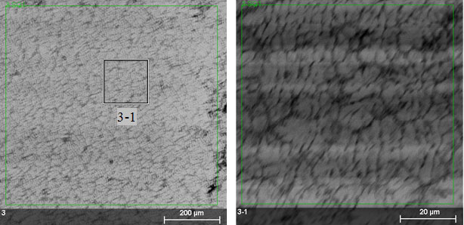

UO2-SiO2 system: PRS9 test results (2)
SEM/EDX of a melt sample
Dendritic microstructure
Quenched
sample
200µm
20µm
Sample | EDX | ChA
 | mol.%UO₂
№2 | 73.1 | 76.7
№3 | 70.2 | 77.0
The discrepancies between the EDX and
ChA results are being investigated

Slide 11
UO2-SiO2 system: GPRS 19-28,32 test results
Experimental objectives
Determination of the critical point of MG cupola
Determination of the liquidus point by the lever rule
Annealing, melting and quenching in the Galakhov microfurnace
Test | UO₂ content, mol% | Quenching T,ºС | Exposure time, min
GPRS19 | 70 | 2200 | 10
GPRS20 | 60
GPRS21 | 50
GPRS22 | 40
GPRS23 | 70 | 2300
GPRS24 | 60
GPRS25 | 19 | 2175
GPRS26 | 50 | 2300
GPRS27 | 19 | 2160
GPRS28 | 40 | 2300
GPRS32 | 19 | 2130
UO2 of >99.0 % purity, SiO2 of 99.99% purity, charge mass – 150 mg
SEM/EDX in progress but some results are already available

Slide 12
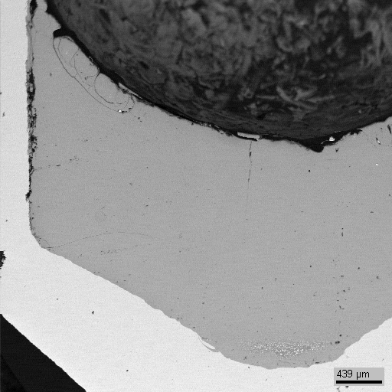
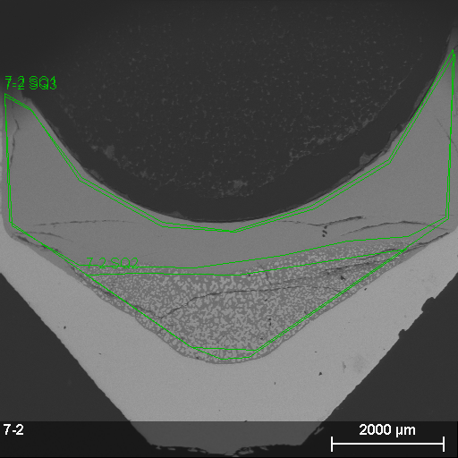
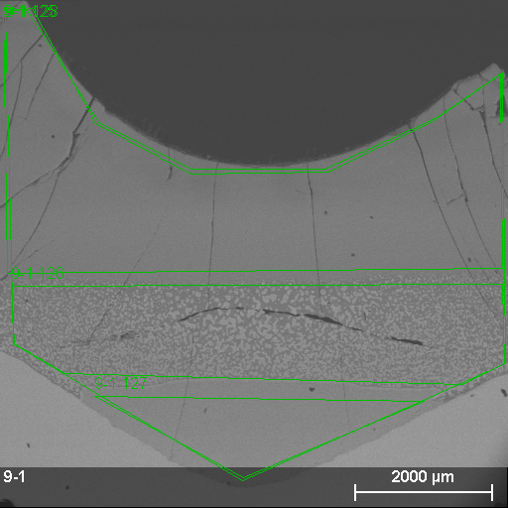
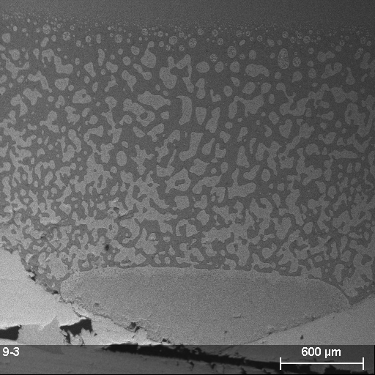
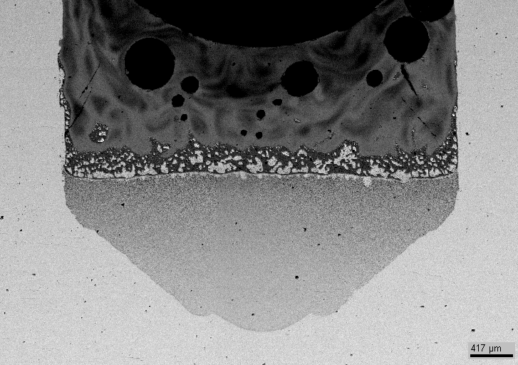

Critical point experiments (GPRS 18, 25, 27, 32)
Small crucibles, 10 min. exposure in the critical point expected temperature range, quenching
81.4 mol.% SiO2 by synthesis (the composition is close to the axis passing through the cupola top)
GPRS18
GPRS25
GPRS27
GPRS32
S(Q1)
S(Q2)
2200 °С
2175 °С
2160 °С
2130 °С
Above the critical point
Below the critical point
 | UO₂ | SiO₂
 | mol.%
S(Q1) | 18.6 | 81.4
S(Q2) | 21.3 | 78.7
Compositions of the upper and lower liquids are close to each other
GCORD4, 81.4 mol.% SiO2
1 min., 2200 °С
The results indicate critical point between 2200 and 2175°C

Slide 13
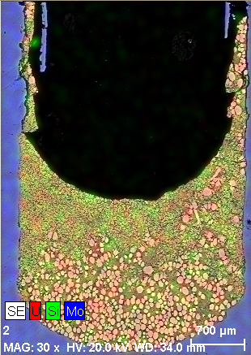
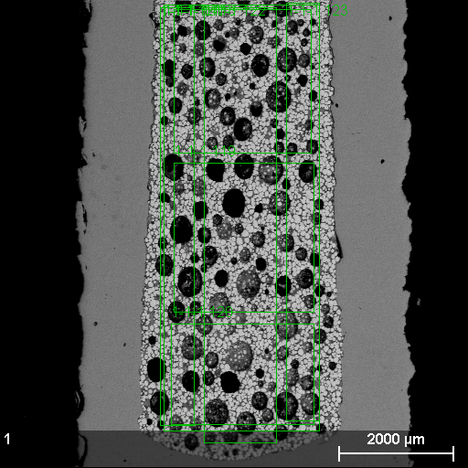
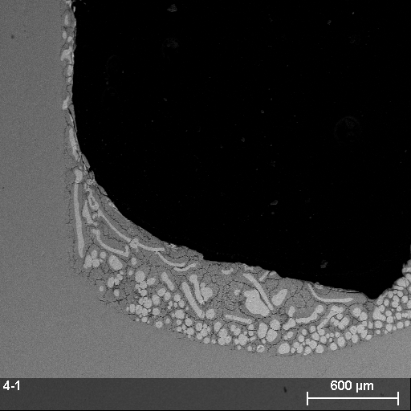
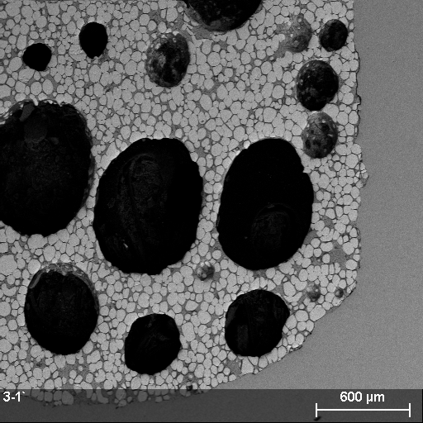
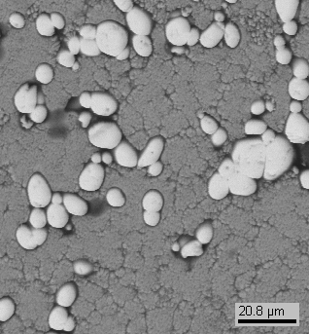
Liquidus experiments (GPRS 19-22)
10 min. exposure, quenching, T= 2200°С
GPRS22
GPRS21
GPRS20
GPRS19
60 mol.% SiO2
by synthesis
50 mol.% SiO2
by synthesis
40 mol.% SiO2
by synthesis
30 mol.% SiO2
by synthesis
Liquid phase composition measurements
60.5 mol.% SiO2
66.3 mol.% SiO2
64.4 mol.% SiO2
61.4 mol.% SiO2
A solid relict phase has been registered at the 2200°С isotherm in all
samples

Slide 14
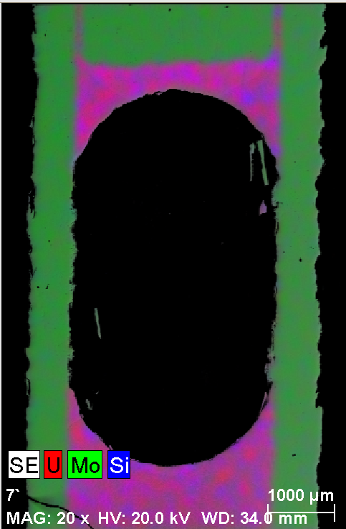
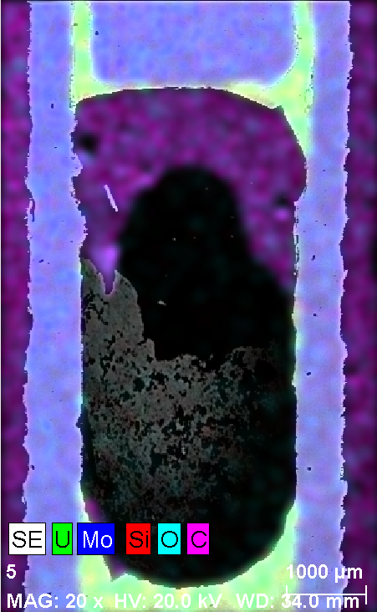
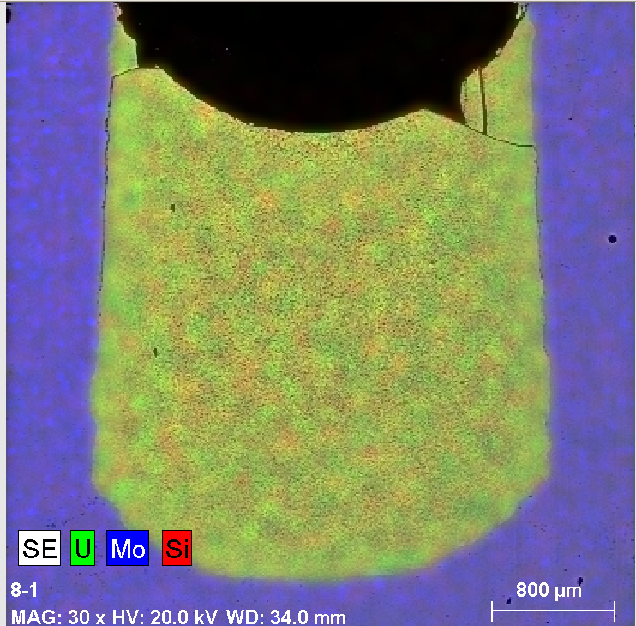
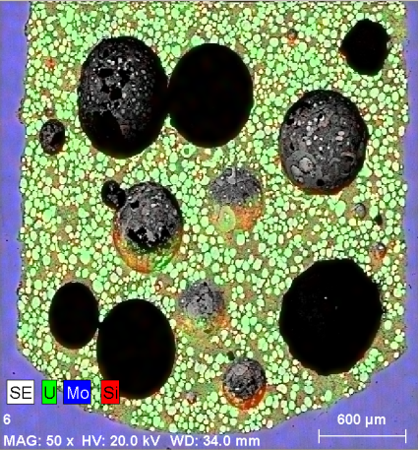
Liquidus experiments (GPRS 23,24,26,28)
Peculiarities: 10 min. exposure, quenching, T= 2300°С
GPRS28
GPRS26
GPRS24
GPRS23
60 mol.% SiO2
by synthesis
50 mol.% SiO2
by synthesis
40 mol.% SiO2
by synthesis
30 mol.% SiO2
by synthesis
Liquid phase composition measurements
Fully melted
Fully melted
Fully melted
60.4 mol.% SiO2
The liquidus line at the 2300°С isotherm passes between 30 and 40
mol.% SiO2

Slide 15
Test results on UO2 – SiO2 system
The MG boundaries have been specified (CORPHAD data revision)
The MG critical point is located between 1975 and 2200°С
Tliq was determined in PRS9 test by VPA IMCC
Liquidus point composition at 2300 C is between 30 and 40 mol % of silica

Slide 16
UO2 - CaO system: PRS 10 test results
Experimental objectives
Determination of the liquidus temperature
Determination of the components final solubility in the formed solid solutions
Charge composition
Mol% 36.2UO2 + 63.8CaO
Samples
Tliq
From 4000 s, the pool was pulled out from inductor at 8.5 mm/h for 2 hours. This has ensured close to equilibrium crystallization and the eutectic liquid displacement into the ingot upper part
Tliq was measured 2 times by VPA IMCC with melt sampling

Slide 17
UO2 - CaO system: PRS 10 test results (2)
VPA IMCC: Example of thermogram # 2 from the test showing
melt surface
    Results of Tliq measurements: 1876, 1880ºC, ⇨ Tliq=1878±30ºC

Slide 18
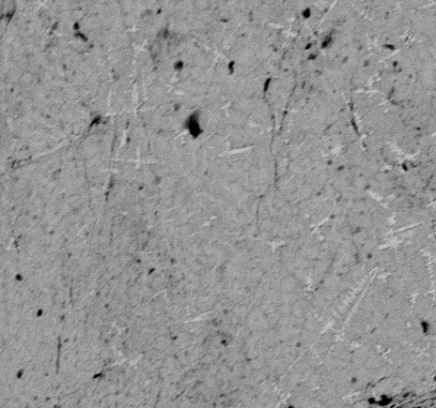
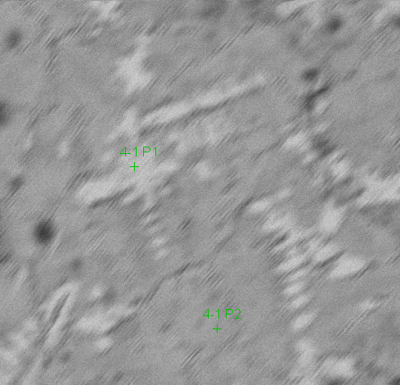
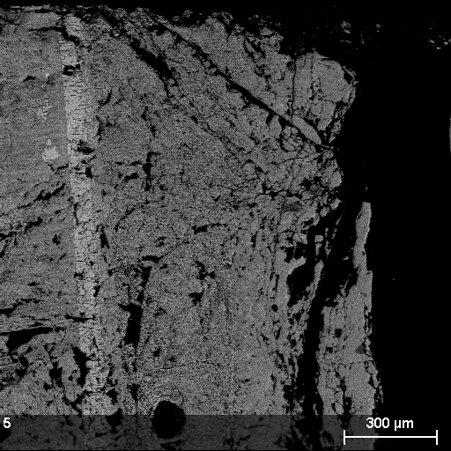
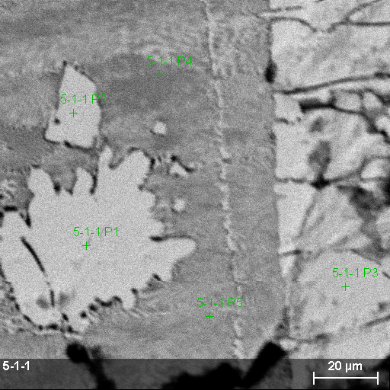
UO2 - CaO system: PRS 10 test results (3)
SEM/EDX analysis of the melt sample (top) and ingot periphery (bottom)
Dendritic microstructure of the melt sample
Primary crystallization phase
Quenched
sample
 | UO₂ | CaO
 | mol.%
P1 | 53.8 | 46.2
300µm
70µm
Sample | ChA | XRF | EDX
 | UO₂ mol.%
№1 | 38.1 | 41.4 | 34.9
№2 | 35.7 | 38.6 | 33.9
eutectic |  | UO₂ | CaO
EDX | mass % | 71.4±1.3 | 28.6±1.0
 | mol% | 34.1±0.4 | 65.9±0.8
1st phase |  | UO₂ | CaO
EDX | mass % | 87.3±1.4 | 12.7±0.5
 | mol% | 58.9±0.8 | 41.1±0.4
Compositions of melt samples of the unsaturated solid solution have been determined
There is a discrepancy between the results of SEM/EDX and (XRF+ChA)

Slide 19
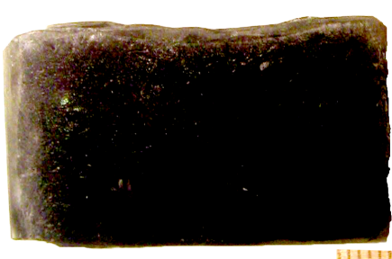
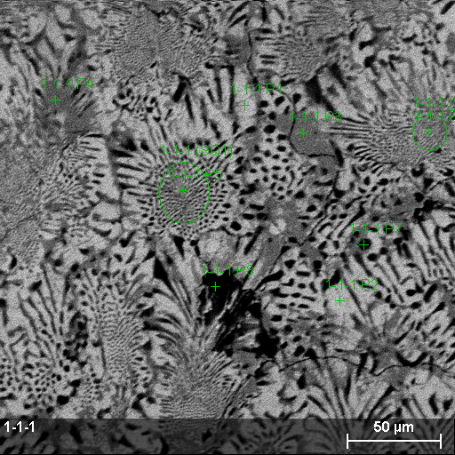
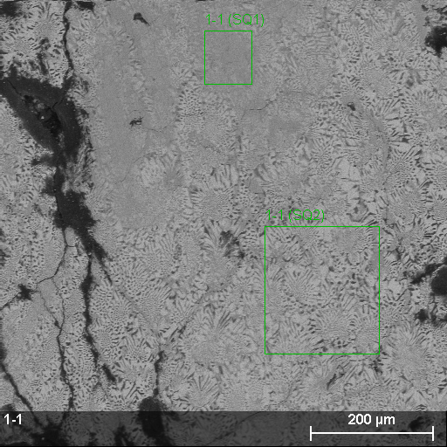
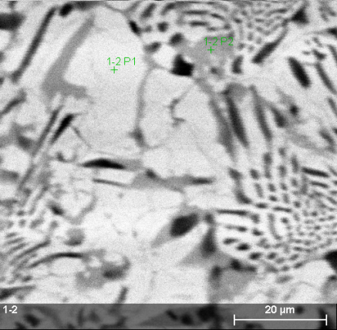
UO2 - CaO system: PRS 10 test results (4)
SEM/EDX analysis of the ingot (central zone)
Eutectic |  | UO₂ | CaO
EDX | mass % | 70.4±1.0 | 29.6±1.3
 | mol% | 33.1±0.2 | 66.9±1.3
2nd phase |  | UO₂ | CaO
EDX | mass % | 68.7 | 31.3
 | mol% | 31.3 | 68.7
1st phase |  | UO₂ | CaO
EDX | mass % | 83.3 | 16.7
 | mol% | 50.8 | 49.2
Phase mix |  | UO₂ | CaO
EDX | mass % | 61.0 | 39.0
 | mol% | 24.5 | 75.5
1st phase |  | UO₂ | CaO
EDX | mass % | 81.1 | 18.9
 | mol% | 47.2 | 52.8
Eutectic |  | UO₂ | CaO
EDX | mass % | 69.1±0.7 | 30.9±0.2
 | mol% | 31.8±0.3 | 68.2±0.3
Composition of the saturated solid solution
A eutectic crystallization zone with a final solid solutions has been formed.
Compositions of the eutectics and the solid solution have been determined

Slide 20
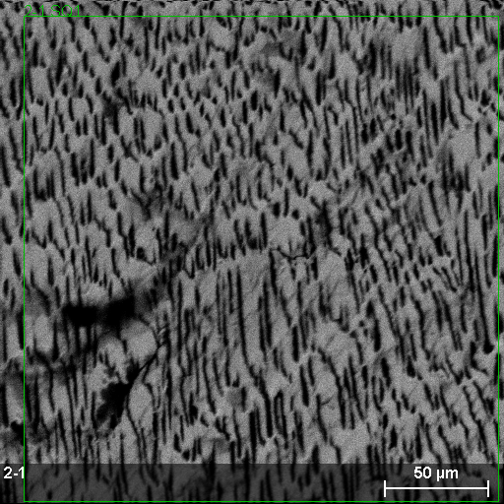
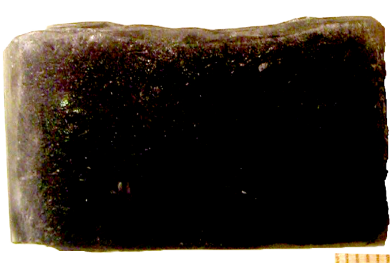
UO2 - CaO system: PRS 10 test results (5)
SEM/EDX analysis of the ingot (eutectic zone)
Eutectic |  | UO₂ | CaO
EDX | mass % | 72.0±1.8 | 28.0±1.4
 | mol% | 34.8±0.6 | 65.2±1.6
The eutectic composition has been determined by EDX in the eutectic crystallization
zone without solid solutions

Slide 21
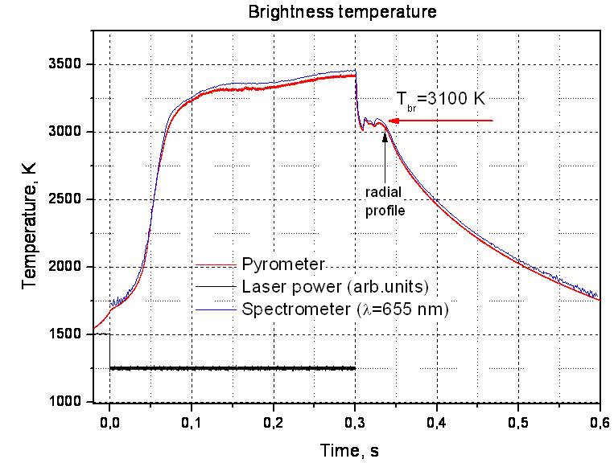
CaO Melting Point Measured by LPH in IVTAN
Experimental Thermogram LPH2
Peculiarities of CaO:
Low absorption coefficient below
1500-2000K
Boiling temperature of
approximately 3300K, which is
close to melting temperature
Specimens melting procedure:
- Preliminary heating up to 1750K
- Controlled heating with a
profiled laser pulse
- Coupling temperature
measurement with a high-speed
spectropyrometer
- Melt surface temperature fields
registration with a high-speed
camera
- Thermograms mathematical
processing
Supposing that ε=0.85-0.9→Tmelt= 3160 ± 30K
ε for CaO is to be refined later

Slide 22
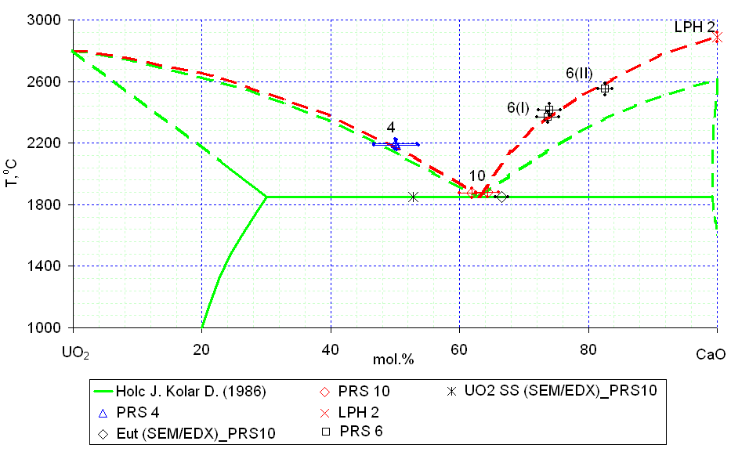
Test results on UO2 - CaO system
?
?
?
Tliq was determined in PRS10 test. The temperature of CaO melting was refined in LPH2
test SEM/EDX was used for determining compositions of the eutectics and the saturated
solid solution
In future, it is planned to measure Tliq for the UO2-rich compositions and perform a test
with the eutectic composition for measuring the eutectic temperature and check of CaUO3
and Ca2UO4 compounds

Slide 23
UO2-SiO2-FeO system:GPRS #33-36 test results
Experimental objectives
Determination of the liquidus temperature
Determination of the ternary eutectic point
Annealing, melting and quenching in the Galakhov
microfurnace (estimation of ternary eutectic position)
Test | Content, mol.% |  |  | Temperature, °С | Exposure time, min | Note
 | UO₂ | SiO₂ | FeO
GPRS33 | 5.0 | 70.0 | 25.0 | 1100 | 60 | Annealing
 |  |  |  | 2100 | 5 | Melting and quenching
GPRS34 | 10.0 | 80.0 | 10.0 | 1100 | 60 | Annealing
 |  |  |  | 1850 | 5 | Melting and quenching
GPRS35 | 20.0 | 73.0 | 7.0 | 1100 | 60 | Annealing
 |  |  |  | 1950 | 5 | Melting and quenching
GPRS36 | 1.7 | 65.5 | 32.8 | 1100 | 60 | Annealing
 |  |  |  | 1300 | 20 | Melting
 |  |  |  | 1300-900 | 240 | Cooling at 100°C/h
UO2 of >99.0 % purity, SiO2 of 99.99% purity, charge mass – 150 mg
Posttest analysis of the tests are underway

Slide 24
Joint publications with collaborators
V.I. Almjashev, M. Barrachin, S.V. Bechta, D. Bottomley, F. Defoort, M. Fischer, V.V. Gusarov, S. Hellmann, V.B. Khabensky, E.V. Krushinov, D.B. Lopukh, L.P. Mezentseva, A. Miassoedov, Yu.B. Petrov, S.A. Vitol. Eutectic crystallization in the FeO1,5–UO2+x–ZrO2 system // Journal of Nuclear Materials, 389, p. 52-56 (2009).
S. Bakardjieva, M. Barrachin, S. Bechta, D. Bottomley, L. Brissoneau, B. Cheynet, E. Fischer, C. Journeau, M. Kiselova, L. Mezentseva, P. Piluso, T. Wiss. Improvement of the European thermodynamic database NUCLEA // Journal of Progress in Nuclear Energy, 52, p. 84-96 (2010).
V.I. Almjashev, M. Barrachin, S.V. Bechta, D. Bottomley, F. Defoort, M.Fischer, V.V. Gusarov, S. Hellmann, V.B. Khabensky, E.V. Krushinov, D.B.Lopukh, L.P. Mezentseva, A. Miassoedov, Yu.B. Petrov, S.A. Vitol. Phase equilibria in the FeO1+x –UO2 –ZrO2 system in the FeO1+x-enriched domain // Journal of Nuclear Materials (2010). Accepted Manuscript, doi: 10.1016/j.jnucmat.2010.02.020

Slide 25
Concluding remarks
The temperature of CaO melting has been significantly
refined for the CaO-UO2 system
With exception for ZrO2-FeOy, other binary systems are
studied in accordance with the Work Plan. The works are
close to completion
Study of the UO2-SiO2-FeO ternary system have been
started
Plans for quarters # 8 - 9:
Complete the UO2-SiO2 and UO2-CaO systems and start a paper
preparation
Continue study of the ZrO2-FeOy system
Continue investigations of the UO2-SiO2-FeO system
Start study of the CaO-UO2- FeO system
Continue study of the U-Zr-O system by LPH

