Slide 1
International Science and Technology Center
Progress Report on the ISTC Project # 3876
Thermal Hydraulics of U-Zr-O molten pool under oxidising conditions in multi-scale approach (crucible - bundle - reactor scales)
Short title: THOMAS
(Thermal Hydraulics of Oxidising Melt in Severe (↔) Accidents)
Presented by
M.S. Veshchunov (IBRAE)
17th Meeting CEG-CM
Madrid, Spain
CIEMAT
March 29-31, 2010

Slide 2
General Information
Leading Institution: | IBRAE, Moscow
Duration: Commencement: | 3 years October 2008

Slide 3
Non-CIS Collaborators
FZK | Forschungszentrum Karlsruhe GmbH | Germany Karlsruhe
ITU | European Commission Joint Research Centre Institut für Transurane | Germany Karlsruhe
IRSN | Institut de Radioprotection et de Sûreté Nucléaire | France Cadarache
CEA | Commisariat à l’Energie Atomique | France Cadarache
IVS Trnava | Inžinierska výpočtová spoločnosť Trnava, s.r.o., | Slovak Republic

Slide 4
Project Objectives
On the base of analysis of available test data from small - and large - scale experiments, to develop a mechanistic description of U-Zr-O molten pool behaviour in oxidising conditions.
For this purpose, to carry out a tight coupling of the two advanced numerical tools developed within the previous ISTC Project #2936: the SVECHA physico-chemical (molten pool oxidation) model and the 3D thermo-hydraulic code CONV.
This will allow extension of thermal hydraulic consideration of oxidised melt from small scales (crucible tests) up to a large scale (reactor pressure vessel), including an intermediate scale corresponding to molten pools in bundle tests.
As a result, improved interpretation of the Phebus FP bundle tests observations of corium melt oxidation, as well as transposition of thermal hydraulic consideration from test to reactor scale, are foreseen.
The developed and verified models will be further used for benchmarking and improvement of simplified models of various system codes such as ICARE/CATHARE, ASTEC or Russian severe accident code SOCRAT.

Slide 5
Technical Schedule
Task 1. Development and Improvement of the Physico-Chemical Model for the U-Zr-O Melt Oxidation on the Base of New Crucible Tests (1-6 QUATERS)
Task 2. Development and Improvement of the Unified Thermal Hydraulic Technique (CONV Code) for Simulation of Multiphase Processes in Complex Domains of Convectively Stirred Melt (1-6 QUATERS)
Task 3. Tight Coupling of the Two Advanced Tools: the Physico-Chemical (Molten Pool Oxidation) Model and the Thermo-Hydraulic Code CONV, for Realistic Mechanistic Description of U-Zr-O Molten Pool Behaviour in Oxidising Test Conditions (7-10 QUATERS)
Task 4. Extension of the Thermal Hydraulic Consideration of Oxidised Melt from Small Scale (Crucible Tests) up to a Large Scale (Reactor Pressure Vessel), Including an Intermediate Scale Corresponding to Molten Pools in the Bundle Tests (11-12 QUATERS)

Slide 6
2-d Molten Pool Oxidation Model
(Mass Transfer)
Mass flux matches
x₄
x₃
U-Zr-O melt
x₂
(Zr,U)O₂ oxide
FeO
VS
x₁
r₁
r₂
r₃
r₄
Mass balances
Additional layers

Slide 7
2-d Molten Pool Oxidation Model
(Heat Transfer)
Heat flux matches
melt
boundary layer
Oxide crust
FeO
VS
T
Heat balance
T_{mp}
T_{int}
T_{ox}
T_{s}
T_{out}
L_{ox}
L_{FeO}
R_{mp}
r

Slide 8
Oxygen diffusion through solid crust (UO₂+ZrO₂ melt)
Zr-O phase diagram considered as pseudo-binary for U-Zr-O
T
T₊
t = 0
c_{O}
T₋
Solution of diffusion equation ⇒
c_{min}(T₊)
c_{min}(T₋)
J_{ox}
U-Zr-O melt
(U,Zr)O₂
FeO
x
VS

Slide 9
VS oxidation model
T=1273 K
SVECHA model
Parabolic correlation from METCOR tests (15 Kh2NMFA steel)
“Oxygen starvation” regime: oxygen flux J_{ox} through the crust (above calculated) is rate controlling during relatively long period of interactions

Slide 10
Physical mechanisms of enhanced VS corrosion at high temperatures
“Flowering” mechanism
Cracks and tears
Melt
Melt
Melt
Crust
Tensile stresses
Crust
Compressive stresses
Eutectics
FeO
FeO
VS
VS
Initial position of Fe boundary
Low temperatures
High temperatures

Slide 11
Physical mechanisms of enhanced VS corrosion at high temperatures
“Flowering” mechanism
Owing to volumetric expansion of oxidized VS confined by solid crust, high tensile stresses are induced in crust leading to its tearing and/or cracking;
At low temperatures (no FeO-crust eutectics formation) corium melt penetrates into tears/cracks, immediately freezes and thus heals them over;
At high temperatures eutectic melt is extruded through the tears/cracks into the corium (owing to high compressive stresses in eutectic melt)
This provides rather small mean thickness of the eutectic layer during corrosion process, which in calculations can be neglected in the first approximation
Numerical evaluation with the SVECHA mechanical deformation module confirms this mechanism, which is qualitatively similar to the “flowering” mechanism for cladding in fuel rods

Slide 12
Simulation of crust growth and VS corrosion under typical low-temperature scenario
Temperature scenario #1
(Interpretation of METCOR tests)
Comment: lacking details of METCOR test conditions and results, direct simulations were not attempted

Slide 13
Simulation of crust growth and VS corrosion under typical high-temperature scenario
Normal (left) and enhanced ×2 (right) oxygen diffusivity in crust (owing to crust cracking)

Slide 14
Development of the 1-D numerical module for U-Zr-O corium melt - steel oxidation
Transformation of the 2-D stand-alone numerical model (for the simplified geometry of the tests) into the 1-D corium melt - steel oxidation model, in order to describe local interactions at the corium-steel interface (in the geometry of the pressure vessel)
This allows to exclude a simplified description of the heat and mass exchange between the U-Zr-O corium melt and crust, and to use (in future) detailed thermo-hydraulic approach of the CONV code
Development of the interface between the 1-D module (melt–steel oxidation) and the 2-D thermo-hydraulic code (U-Zr-O corium melt)
Implementation of the 1-D oxidation module into the 2-D thermo-hydraulic code:
  coupling through the heat and oxygen mass fluxes;
  bulk (U, Zr, O) concentrations and temperature of the melt in the boundary thermo-hydraulic spatial mesh are inputs for 1-D oxidation module;
  oxidation module is called for each thermo-hydraulic spatial mesh at the melt-solid interface;
  – in progress (to be completed during 7-8th Quarters)

Slide 15
1D model for U-Zr-O corium melt - steel oxidation
U-Zr-O corium melt temperature and composition evolutions are calculated in 2-D thermo-hydraulic code
Oxidation module calculates the solid phases thicknesses, temperatures and U, Zr, O fluxes into melt
Oxidation module is coupled with 2-D thermo-hydraulic code through the heat flux and oxygen mass flux at the melt-solid interface

Slide 16
Conclusions (1)
Task 1 of ISTC Project #3876 is under development in accordance with the Project Technical Schedule
A preparatory work for implementation of the physico-chemical interactions model, developed in the previous stage of the Project, in the thermo-hydraulic code CONV was carried out:
  The 2-D corium melt – steel oxidation code was transformed into the 1-D module;
  The interface program unit for coupling of the melt – steel oxidation 1-D module with the corium melt 2-D thermo-hydraulic code was developed;
  Implementation of the 1-D oxidation module into the 2-D thermo-hydraulic code is in progress and will be completed during 7-8th Quarters.

Slide 17
Part 2. Scope of Current Activities
Task 2.: Development and Improvement of the Unified Thermal Hydraulic Technique (CONV Code) for Simulation of Multiphase Processes in Complex Domains of Convectively Stirred Melt
  Subtask 2.4.: Improvement of the turbulence model: coordination of algebraic model with large eddy simulation approach. Selection of a set commutative filters for a LES approach of a turbulence modeling and its implementation in CONV code. Adaptations of a code in view of requirements of the design LIVE facility.

Slide 18
Fulfilled works
For improvement of turbulence modeling at extremely high Rayleigh numbers LES approach was included in CONV code.
The set of commutative filters for LES approach was chosen.
An adaptation of a code in view of requirements of the design LIVE facility was carried out.
The modified version of CONV code was tested on such experimental tests as Backward-facing step flow and T-junction thermal mixing test.

Slide 19
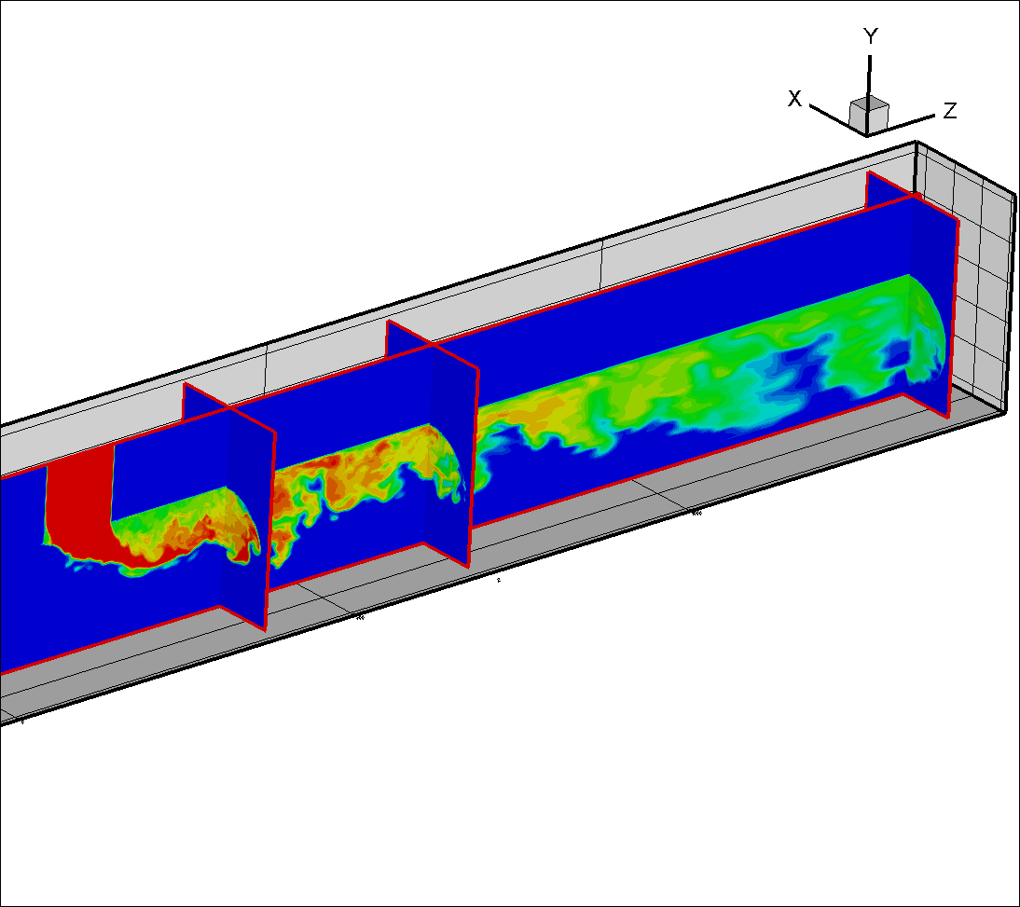
T-junction experiments
Johan Westin, Pascal Veber, et. al, 2008,
Proc. ICONE16, USA, paper ICONE16-48731.
Failures of structures due to high-cycle thermal fatigue have occurred in several nuclear plants around
the world, for different reactor types.
Many of these have been associated with mixing zones where hot and cold streams meet, and particularly near
T-junctions.
As the hot and cold streams from the main and
branch pipes meet, shear instabilities produce
turbulent eddies, causing temperature fluctuations
on the pipe walls downstream of the junction.
A typical value ΔT between the hot/cold streams is 16ºC.
Mean velocity:U
Turbulence: uv
Re~10⁵
hot
Root-Mean Square
cold

Slide 20
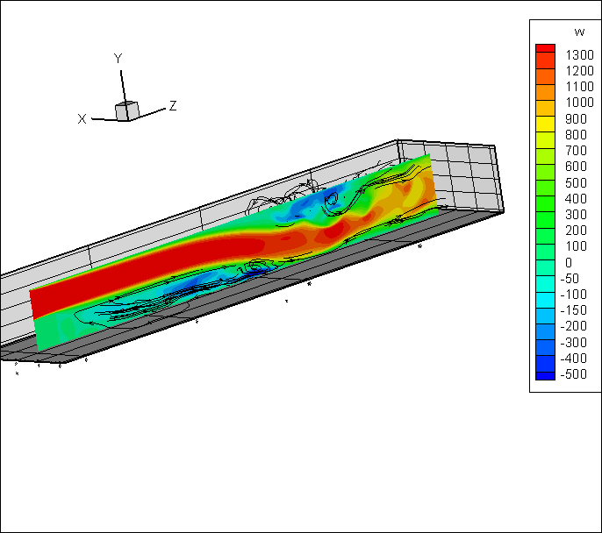
Backward-facing step flows (BFS) at Re=5100
Jovic S, Driver DM, Backward-facing step measurement
at low Reynolds number //
NASA Technical memorandum. - 1994. - №.108807.
3D field of W-velocity
comparison of average velocity along flow (U) and tangential velocity (W)

Slide 21
Adaptation of CONV code in view requirements of LIVE facility
The CONV code was adapted for simulation of stratified convection in the LIVE conditions, namely for simulation and estimate of the focusing effect.
The modified version of CONV code was tested on LIVE facility experiments and in all cases the good agreement was obtained. Results were published in:
  Proceedings of 13th International Topical Meeting on Nuclear Reactor Thermal Hydraulics (NURETH-13) September 27 - October 2, 2009, Kanazawa, Japan (V.Chudanov, A.Palagin and F.Kretzschmar, LIVE test FSt4: experimental results and simulation by CONV code, Paper N13P1076, CD-ROM)
  Progress in Nuclear Energy 52 (2010) 46–60 (M. Buck, M. Buerger, A. Miassoedov, X. Gaus-Liu, A. Palagin, L. Godin-Jacqmin, C.T.Tran, W.M. Mad, V. Chudanov, The LIVE program –Results of test L1 and joint analyses on transient molten pool thermal hydraulics).
Moreover, the parallel version of CONV code in MPI technology was developed for carried out calculations of LIVE experiments for <=256 processors.

Slide 22
Conclusions (2)
The numerical experiments at the choice of a set of commutative filters for LES approach are finished. The CONV code was modernized by inclusion of LES approach for turbulence modeling.
The CONV code was adapted for simulation of stratified convection in the LIVE conditions. Moreover, the parallel version of CONV code in MPI technology was developed for carried out calculations of LIVE experiments for <=256 processors.
Modernized software on the accessible tests was validated and for all cases a good agreement of numerical predictions with experiment was obtained. Results were published.
Preparatory work with the code sources for implementation of melt oxidation model, and also interface (input files) for insert of physico-chemical melt oxidation model for modeling of thermal hydraulic behavior of U-Zr-O melt under oxidizing for small and medium scale experiments in code CONV 2D has been commenced.

