Slide 1

Progress Report on the ISTC project #833.2
“Investigation of corium melt interaction with NPP reactor vessel steel”
(METCOR-2)
A.P. Alexandrov Research Institute of Technology
Presented by S. Bechta
9th CEG-SAM Meeting

Slide 2
Contents
METCOR project general information
Experimental matrix
Tests with suboxidized corium
Conclusions on tests with suboxidized corium
Tests with oxidized corium in air and steam
Conclusions on tests with oxidized corium
Reporting
Publications
Plans for concluding of the project
Proposals for studies continued within a new project
Conclusions

Slide 3
METCOR project general information
Project objectives:
Qualification and quantification of physicochemical phenomena
of corium melt interactions with reactor vessel steel
Experimental data application:
Analysis of in-vessel corium retention (IVR)
Analysis of ex-vessel retention (EVR) in the core catcher of a cold
crucible type

Slide 4
METCOR project general information
Project participants and coordination
Collaborators
FZK, Germany
FORTUM, Finland
ITU,
EK
CEA,
France
Framatome ANP, Germany
FZR, Germany
IRSN,
France
Coordinator
ISTC, Moscow
Steering committee
Operation Agent: A.P. Alexandrov RIT, Russia
ISC RAS,
Russia
SPb Electrotechnical State University, Russia
*⁾ Should be finished in May 2006

Slide 5
Experimental matrix of METCOR
Phase 1: Tests with fully oxidized melts

Slide 6
Experimental matrix of METCOR
Phase 2: Tests with suboxidized corium and
tests with oxidized corium in steam

Slide 7
Tests with suboxidized corium
Experimental methodology: Furnace section
Technology of the
induction melting in a
cold crucible
Atmosphere – high-purity
argon
Long-term expositions in
a stationary regime
On-line measurements:
specimen temperature
melt surface temperature
specimen ablation depth
electric parameters
power in the furnace
components
1 – pyrometer shaft; 2 – cover; 3, 18, 19 – electromagnetic screens; 4 – quartz tube; 5 – crucible sections; 6 – inductor; 7 –melt; 8 – acoustic defect; 9 – fused ZrO₂ grains; 10 – ZrO₂ powder insulation; 11 – vessel steel specimen; 12 – top specimen calorimeter; 13 – bottom specimen calorimeter; 14 – kaolin wool insulation; 15 –ultrasonic sensor; 16 – thermocouples; 17 – crust; 20 – cylindrical support of the specimen

Slide 8
Tests with suboxidized corium (continued)
Experimental methodology: Methods of posttest analyses
Calculation of the whole electromagnetic system
Power deposition in the melt and its electric resistivity are determined
Measured electric parameters of the system and power deposited into the furnace
components are used in the numeric modeling.
Integrated calculation of the electromagnetic system and melt
thermohydrodynamics
Radial heat flux distribution in the specimen top is determined.
Calculations of the whole electromagnetic system and boundary conditions on the
crucible and specimen surfaces are used.
Calculation of the specimen temperature conditions
Results of previous calculations, boundary conditions on the crucible surface and
specimen calorimeters are used. The adequate agreement between calculations and
thermocouple measurements is achieved by varying heat flux into the specimen and
thermal resistance of the specimen side insulation.
Physicochemical analysis of the ingot, specimen and interaction zone
XRF; SEM/EDX; optical microscopy; chemical analyses.
Elemental and mass balances, initial and final compositions of the system and its
components are determined.

Slide 9
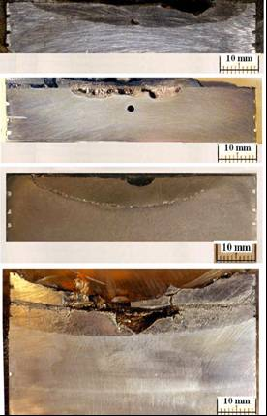
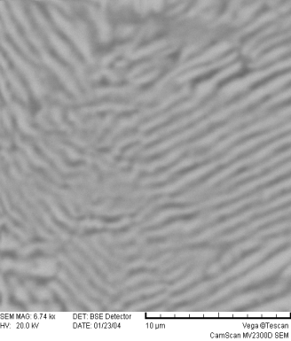
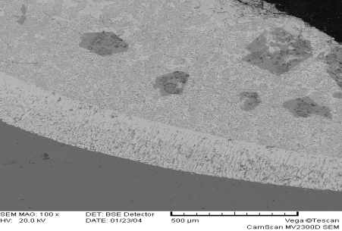
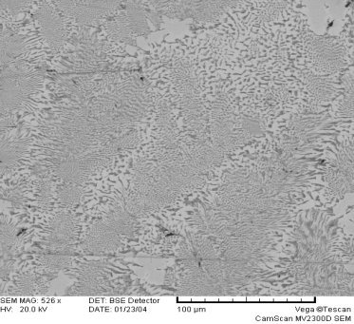
Tests with suboxidized corium (continued)
Corrosion kinetics and final depth
Corrosion depth vs. time
Axial sections of specimens
MC6
Acoustic
defect
MC7
MC8
Shrinkage
cavity
T_{eut}~1090ºC (DTA)
EDX images of interaction zone
MC9
Chip
500 µm
100 µm
10 µm

Slide 10
Tests with suboxidized corium (continued)
Characteristics of Interaction zone
Temperature field in the specimens
B – interaction zone boundary;
1 - 800°C, 2 – 900°C, 3 – 1000°C, 4 – 1100°C,
5 – 1200°C, 6 – 1300°C, 7 – 1400°C

Slide 11
Tests with suboxidized corium (continued)
Empirical correlation for ablation kinetics
3 periods of ablation:
incubation, fast ablation, transition
(the last one is neglected in the
model)
fast ablation resulting in saturation
, mm/s
1090 ≤ T_{int} ≤ 1440°C – temperature
on the ablation front
incubation period
- oxidic melt
t_{inc}=8000+200 (70-C_{n}), s
30 ≤ C_{n} ≤ 70
- metallic melt
t_{inc}=0
Kinetics of specimen corrosion

Slide 12
Tests with suboxidized corium (continued)
Example of plant application [E. Altstadt and H.G. Willschütz, 2006]:
For VVER-1000 – type reactor, low pressure scenario, homogeneous molten pool, initial temperature of corium is 1500K. Calculation 1 – without physicochemical interactions Calculation 2 – the interactions have been evaluated by the empirical correlations
Mass of ablated vessel steel vs. time
Lower head region after 20 h
a) ablation depth of the lower head from the
сalculation 2, grey: ablated steel
b) temperature conditions of the vessel
Blue: calculation 1, red calculation 2
the evaluated thickness of undamaged vessel wall is much smaller,
if the vessel steel ablation is taken into account
vessel strength calculations are in progress

Slide 13
Conclusions on tests with suboxidized corium
The depth of eutectic melting (dissolution) of steel is limited
by the position of isotherm ∼ 1090 °C
The proposed empirical correlation enables to calculate the
approximate corrosion rate, which decreases as the steel
temperature on the interaction front is reduced, and to
evaluate the thickness of unaffected vessel wall
First evaluations show the effect of corium/steel
physicochemical interaction on the mass of ablated steel,
vessel wall thickness and temperature

Slide 14
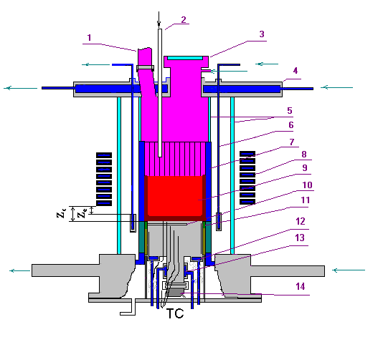
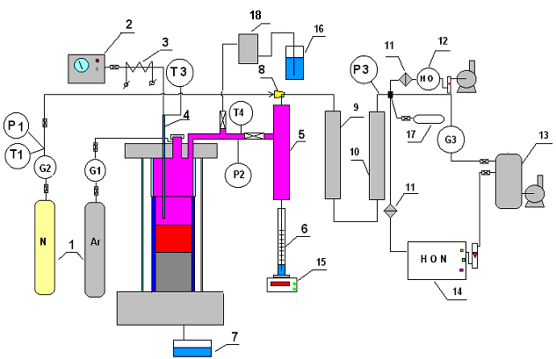
Tests with oxidized corium in air and steam
Methodology
Furnace schematics
Gas-aerosol sampling system
1 – tanks with Ar,N2; 2 – steam generator; 3 – heated steam supply line; 4 – quartz tube for steam supply into the furnace; 5 – steam condenser; 6 – condensate collector; 7 – condensate drop catcher; 8 - ejector;
9 – large-area filter (LAF); 10 – silica gel drier; 11 – medium-area filter (MAF); 12 – electrochemical sensors of oxygen and hydrogen; 13 – vacuum receiver; 14 – mass-spectrometer; 15 – weight sensor 16 – hydro lock; 17 – vacuum gas burettes; 18 - medium-area filter (MAF).
1 – steam vent from the furnace; 2 – steam line;
3 – lid; 4- water-cooled cover; 5 – quartz tube;
6– water-cooled electromagnetic screen;
7 – crucible sections; 8 – inductor; 9 – melt;
10 – acoustic defect; 11 – thermal insulation of the specimen; 12 – top specimen calorimeter; 13 – bottom specimen calorimeter; 14 – US sensor.

Slide 15
Tests with oxidized corium in air and steam (continued)
Methodological peculiarities of experiments in steam:
furnace design has been changed in order to minimize
steam condensation on cool surfaces
superheated steam is supplied from electricity-heated
steam generator
mass-spectrometer is used for determining the steam-
gas composition at the furnace exit
temperature measurements of the melt surface are made
discretely during the short-term replacement of steam
with air

Slide 16
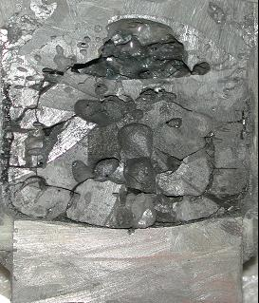
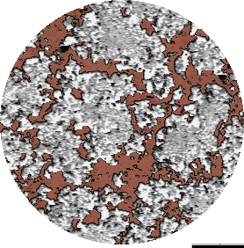
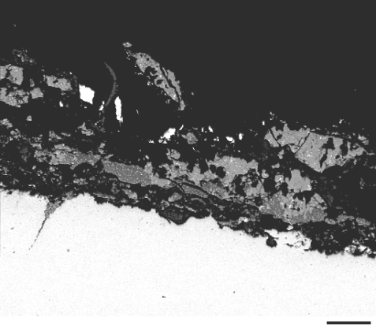
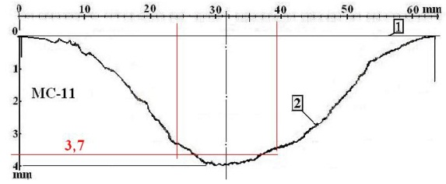
Tests with oxidized corium in air and steam (continued)
Kinetics and final depth of specimen ablation in MC 11
Bulk corium
FeO_{y}
U_{1-x}Zr_{x}O_{2+y}ss
40μm
FeO_{y} corrosion layer
~100μm
40μm
– – - boundaries of regimes
within one regime the corrosion rate is practically
constant (just like in air)
during a temperature increase on the specimen
surface the corrosion rate grows
1– initial position of the specimen surface
2 – final position of the specimen surface
average ablation depth in the sighting spot of the US sensor – 3.7 mm – practically coincides with direct US measurements during the test completion

Slide 17
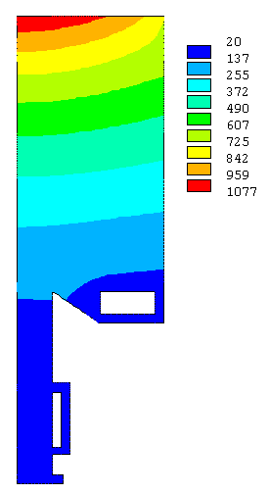
Tests with oxidized corium in air and steam (continued)
Specimen temperature conditions in MC11
Т, °С
h, mm
Regime №2

Slide 18
Tests with oxidized corium in air and steam (continued)
Summary of experimental results in air and steam
In all experiments the corrosion kinetics is controlled by the
diffusion of Fe ions through the corrosion layer of Fe oxides having
thickness δ; and it can be described by the Tamman equation
where
E_{a} – activation energy; R – universal gas constant; A – numerical coefficient;
q – heat flux from corium to steel; λ – heat conductivity of corrosion layer;
ΔT – temperature difference of the corrosion layer of FeO_{y}

Slide 19
Tests with oxidized corium in air and steam (continued)
Two different types of corrosion kinetics depending on the interaction conditions and crust morphology
Corrosion layer and corium layer are solid
Eutectic melting of corrosion layer on the interface with corium
2.1 UO_{2+x}-ZrO₂-FeO_{y} corium: T_{surf}≥1050°C
1.1 UO_{2+x}-ZrO₂-FeO_{y} corium: T_{surf}<1050°C
1.2 C-100 (UO_{2+x}-ZrO₂) corium: T_{surf}<1200°C
Corium Melt
Corrosion Layer of FeOy
T=T_{eut}
(1340 ºC)
δ=H
Corium Melt
T_{sol}
Vessel Steel Cooled from Outside
T_{surf}
H
Corium Crust
T<T_{eut} (1340 ºC)
δ
Corrosion Layer of FeOy
2.2 C-100 corium: T_{surf}≥1200°C
Vessel Steel Cooled from Outside
Corium Melt
T_{surf}
H
Corium Crust
T=T_{eut}
(1340 ºC)
δ
Corrosion Layer of FeOy
CORPHAD data:
- Teut=1339ºC in UO_{2+x}-FeO_{y}-ZrO₂
system in air
Vessel Steel Cooled from Outside
Liquid sublayer
T_{surf}

Slide 20
Tests with oxidized corium in air and steam (continued)
Corrosion kinetics for case 1
Arrhenius plot for corrosion rate
W/q,
(mm/h)/(MW/m²)
1000/T_{surf}, 1/K
Segments of straight lines having a large angle of slope are shown conditionally in order
to determine the temperature, at which the corrosion regime is changed
The activation energy for the 1st corrosion regime is approx. 70 kJ/mol, and it is the same
for air or steam atmosphere. The corrosion rate for corium C-100 is approx. two times
higher than for UO_{2+x}- ZrO₂- FeO_{y}

Slide 21
Tests with oxidized corium in air and steam (continued)
Corrosion kinetics for case 2
Corrosion rate vs. inverse corrosion layer thickness
Where:
T_{surf} – temperature on the steel surface;
T_{eut} – eutectic temperature in the UO₂+x-ZrO₂-FeO_{y} system;
C – coefficient
Corrosion rate practically does not depend on changes in the diffusion coefficient in the corrosion layer
Corrosion rate for corium C-100 is lower than for UO_{2+x}-ZrO₂-FeO_{y}

Slide 22
Conclusions on tests with oxidized corium
It has been established that corrosion characteristics are very
sensitive to corium composition and not so sensitive to the
replacement of air by steam above the melt
Two different corrosion regimes are possible depending on
the interaction conditions
First of them is described by the Arrhenius equation
Second regime is controlled by the eutectic melting of corrosion
layer on its interface with corium. The corrosion rate is linearly
dependent on the inverse corrosion layer thickness
Produced results enable to refine the methodology of vessel
steel corrosion calculations for the IVR conditions in the studied
range of parameters

Slide 23
Reporting: 2nd phase

Slide 24
Publications
S.V. Bechta, V.B. Khabensky, V.S. Granovsky, E.V. Krushinov, S.A. Vitol,
V.V. Gusarov, V.I. Almiashev, D.B. Lopukh, W. Tromm, D. Bottomley, M. Fischer,
G. Cognet, O. Kymäläinen.
New Experimental Results on the Interaction of Molten Corium with Reactor Vessel Steel //Proceedings of ICAPP’04, Pittsburgh, PA USA, June 13-17, 2004, Paper 4114
S.V. Bechta, V.B. Khabensky, S.A. Vitol, E.V. Krushinov, V.S. Granovsky,
D.B. Lopukh, V.V. Gusarov, A.P. Martinov, V.V. Martinov, G. Fieg, W. Tromm,
D. Bottomley, H. Tuomisto.
Corrosion of vessel steel during its interaction with molten corium
Part 1: Experimental // to be published in Nucl. Eng. Des., reg. LO/NED#679,2005
S.V. Bechta, V.B. Khabensky, S.A. Vitol, E.V. Krushinov, V.S. Granovsky,D.B. Lopukh, V.V. Gusarov, A.P. Martinov, V.V. Martinov, G. Fieg, W. Tromm,
D. Bottomley, H. Tuomisto.
Corrosion of vessel steel during its interaction with molten corium
Part 2: Model development // to be published in Nucl. Eng. Des., reg. LO/NED#680,2005
S.V. Bechta, V.B. Khabensky, V.S. Granovsky, E.V. Krushinov, S.A. Vitol,
V.V. Gusarov, V.I. Almiashev, D.B. Lopukh, W. Tromm, D. Bottomley, M. Fischer,
P. Piluso, A. Miassoedov, E. Altstadt, H.G. Willschütz, F. Fichot.
Experimental Study of Interactions Between Suboxidized Corium and Reactor Vessel Steel //to be published in Proceedings of ICAPP’06, Reno, NV USA, June 4-8, 2006, Paper 6054

Slide 25
Plans for concluding of the project
Complete MC 11 analyses
Deadline: Mart 2006
Release MC10&11 reports
Deadline: April 2006
Release METCOR.2 annual report (3rd year)
Deadline: May 2006
Release METCOR.2 final report
Deadline: July 2006
Finish METCOR paper preparation
Deadline: 2006
Final project meeting combined with kick-off meeting of the next project
June 2006, St Petersburg

Slide 26
Experimental matrix* for a new project
*)To be included into Work Plan of a new project for the period of 01.07.2006 - 30.06.2009

Slide 27
Conclusions
VVER steel corrosion mechanisms have been clarified
The developed correlations can be used in the analyses of IVR with
oxidized and suboxidized coria under different above-melt atmospheres
Finalization of corrosion studies requires the following experiments
- for oxidized corium:
in the temperature range of the specimen surface exceeding
1200 ºC,
- for suboxidized corium:
at the vertical orientation of the specimen surface
- for vessel steel used in European reactors

