Slide 1

Main results of the completed ISTC project #833.2. “Study of corium melt interaction with NPP reactor vessel steel” (METCOR-2) and status of the ISTC project #3592 (METCOR-P)
A.P. Alexandrov Research Institute of Technology
Presented by S. Bechta
11th CEG-SAM meting
Dresden, Germany
March 7-9, 2007

Slide 2
Contents
METCOR project:
General information
Project meetings
Experimental matrixes
Experimental methodology
Tests with suboxidized corium
Tests with oxidized corium
Reporting
Publications
Conclusions
METCOR-P project:
General information
Experimental matrix for the METCOR-P project
Interaction at vertically positioned interface
Interaction at molten corium oxidation transients
Interaction of molten corium with European vessel steel
Short-term plans

Slide 3
METCOR project general information
Project objectives:
Qualification and quantification of physicochemical
phenomena of corium melt interactions with reactor
vessel steel
Experimental data application:
Analysis of in-vessel corium retention (IVR)

Slide 4
METCOR project general information
Project participants and coordination
Collaborators
FZK, Germany
FORTUM, Finland
ITU,
EK
CEA,
France
Framatome ANP, Germany
FZR, Germany
IRSN,
France
Coordinator
ISTC, Moscow
Steering committee
Operation Agent: A.P. Alexandrov RIT, Russia
ISC RAS,
Russia
SPb Electrotechnical State University, Russia

Slide 5
Meetings of METCOR.2 projects
▼ 1st meeting of the Steering Committee, 3 October 2002, Karlsruhe, Germany
▼ 2nd meeting of the Steering Committee, 29 January 2003,
Aix-en-Provence, France
▼ 3rd meeting of the Steering Committee, 16 September 2003, St. Petersburg, Russia
▼ 4th meeting of the Steering Committee, 10 February 2004, Paris, France
▼ 5th meeting of the Steering Committee, 14 September 2004, Dimitrovgrad, Russia
▼ 6th meeting of the Steering Committee, 12 July 2005,
St. Petersburg, Russia
▼ 7th meeting of the Steering Committee, 14 June 2006,
St. Petersburg, Russia
Last project meeting will be held in SPb, May 31, 2007

Slide 6
Experimental matrix of METCOR
Phase 1: Tests with fully oxidized melts

Slide 7
Experimental matrix of METCOR
Phase 2: Tests with suboxidized corium
and tests with oxidized corium in steam

Slide 8
Experimental methodology: Furnace section
Technology of the
induction melting in a
cold crucible
Atmosphere: air, steam,
argon
Long-term expositions in
a stationary regime
On-line measurements:
specimen temperature
melt surface temperature
specimen ablation depth
electric parameters
power deposition in the furnace components
1 – pyrometer shaft; 2 – cover; 3, 18, 19 – electromagnetic screens; 4 – quartz tube; 5 – crucible sections; 6 – inductor; 7 –melt; 8 – acoustic defect; 9 – fused ZrO₂ grains; 10 – ZrO₂ powder insulation; 11 – vessel steel specimen; 12 – top specimen calorimeter; 13 – bottom specimen calorimeter; 14 – kaolin wool insulation; 15 –ultrasonic sensor; 16 – thermocouples; 17 – crust; 20 – cylindrical support of the specimen

Slide 9
Experimental methodology: Posttest analyses
Calculation of the whole electromagnetic system
Power deposition in the melt and its electric resistivity are determined
Measured electric parameters of the system and power deposited into the furnace
components are used in the numeric modeling
Integrated calculation of the electromagnetic system and melt
thermohydrodynamics
Radial heat flux distribution in the specimen top is determined.
Calculations of the whole electromagnetic system and boundary conditions on the
crucible and specimen surfaces are used
Calculation of the specimen temperature conditions
Results of previous calculations, boundary conditions on the crucible surface and
specimen calorimeters are used. The adequate agreement between calculations and
thermocouple measurements is achieved by varying heat flux into the specimen and
thermal resistance of the specimen side insulation
Physicochemical analysis of the ingot, specimen and interaction zone
XRF; SEM/EDX; optical microscopy; chemical analyses.
Elemental and mass balances, initial and final compositions of the system and its
components are determined

Slide 10
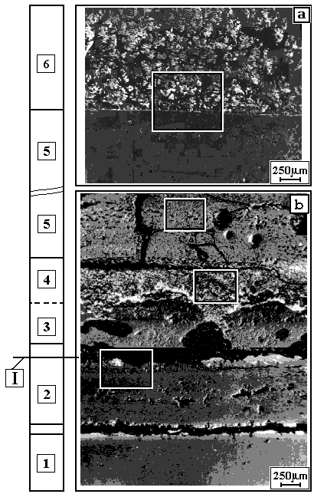
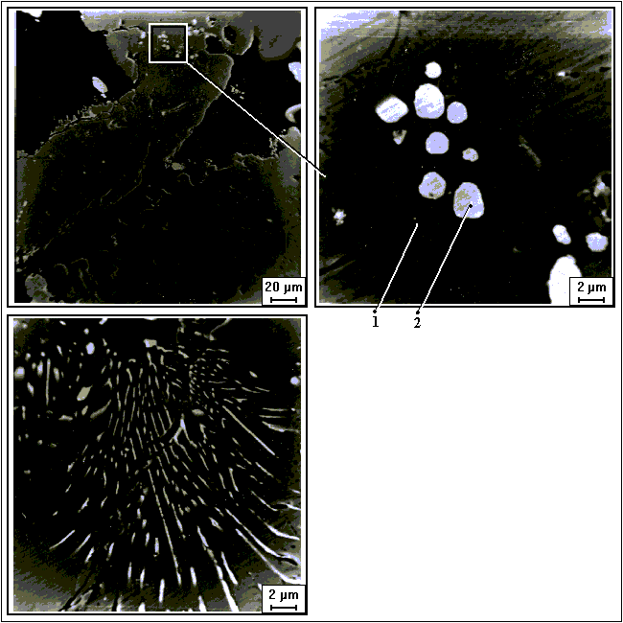
Tests with oxidized corium
Identified phenomenon of steel corrosion: surface oxidation of vessel steel; the rate of oxidation is controlled by Fe⁺ diffusion through the corrosion layer; corrosion layer thickness is sensitive to the corium composition and heat flux
Example of corrosion and coexisting layers in MC-2
corium
oxidic
layers
Elemental phase composition
Element/ Phase 1 Phase 2
oxide w% w%
U Mα - 83.78
Zr Kα - 0.243
Fe Kα 70.00 3.85
O 29.00 12.11
UO₂ - 95.00
ZrO₂ 0.30 0.40
Fe₂O₃ 99.70 4.6
steel

Slide 11
Tests with oxidized corium (continued)
Experimental data in form of Arrhenius plot
16UO₂-64ZrO₂-20FeO
Air
56UO₂-24ZrO₂-20FeO
70UO₂-30ZrO₂
Steam
56UO₂₋24ZrO₂-20FeO
Corrosion rates in air and in steam are similar
Decrease of corrosion rate following increase of iron oxides content in corium melt
Intensification of corrosion after reaching eutectic temperature of the interface between
corrosion layer and corium

Slide 12
Tests with oxidized corium (continued)
Corrosion model: modified Tamman equation for:
UO_{2+x}- ZrO₂ - FeO_{y} corium
FeO_{y}=20…30%, U/Zr=0.11…1.05
UO_{2+x}- ZrO₂ (С-100 corium),
U/Zr ≈ 1.0
Before eutectic melting of corrosion layer
T_{s}=720…1050ºC
q =0.30…1.15 MW/m²
T_{s} = 1035…1235ºC
q = 0.95…1.1MW/m²
W – mm/h; q - MW/m² ; T - K

Slide 13
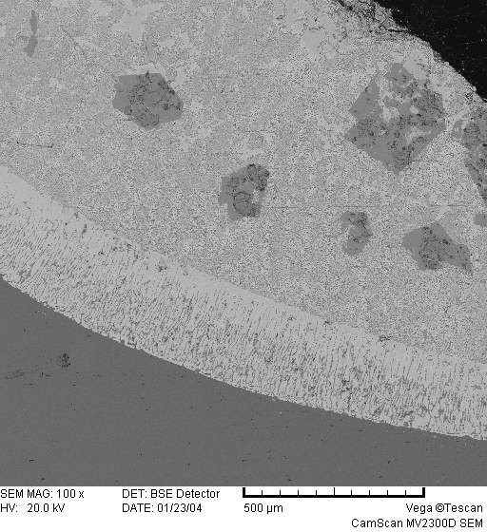
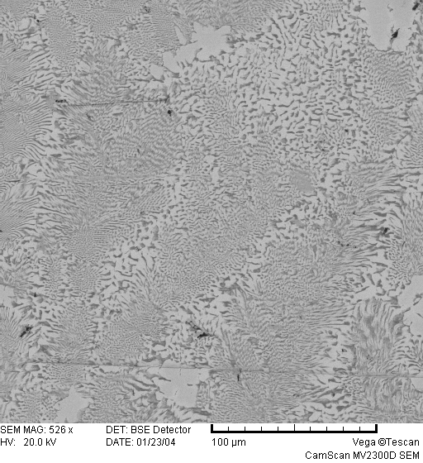
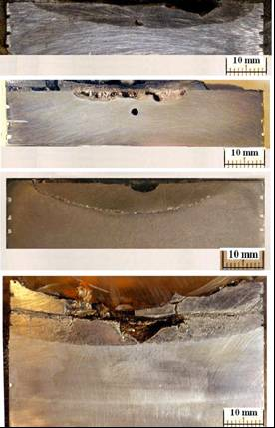
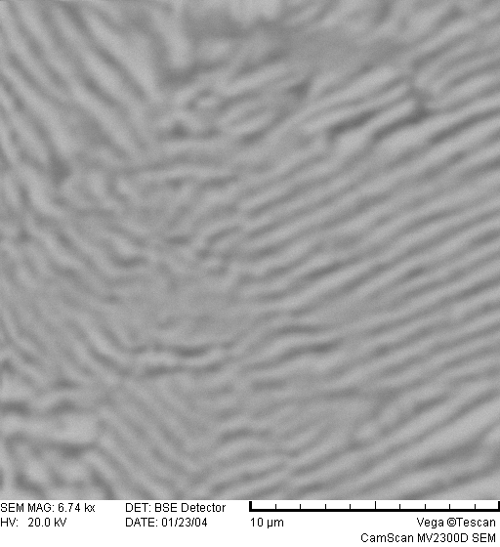
Tests with suboxidized corium
Identified phenomenon of steel corrosion: U, Zr, O partitioning (similar to MASCA) and partial eutectic melting (dissolution) of the vessel steel , IZ depth is limited by the position of isotherm 1090 ºC
Axial sections of specimens
EDX images of Interaction Zone
МС6
Acoustic
defect
МС7
МС8
500 µm
100 µm
DTA of IZ in MC-8
Shrinkage
cavity
МС9
T_{eut}~1090ºC (DTA)
10 µm
Chip

Slide 14
Tests with suboxidized corium (continued)
Model of ablation kinetics
2 main periods of ablation:
incubation and fast ablation
Incubation period:
- oxidic melt
t_{inc}=8000+200 (70-C_{n}), s
30 ≤ C_{n} ≤ 70
- metallic melt
t_{inc}=0
fast ablation resulting in saturation
, mm/s
T_{int} – current temperature of steel surface 1090 ≤ Тint ≤ 1440°C
T_{B} – final temperature of steel surface after interaction termination
(1090 ºC for reactor application)

Slide 15
Reporting

Slide 16
METCOR papers
S.V. Bechta, V.B. Khabensky, S.A. Vitol, E.V. Krushinov, D.B. Lopukh, Yu.B. Petrov, A.Yu. Petchenkov, I.V. Kulagin, V.S. Granovsky, S.V. Kovtunova, V.V. Martinov, V.V. Gusarov. Experimental studies of oxidic molten corium – vessel steel interaction // Nucl. Eng. Design 210 (2001) 193-224.
S.V. Bechta, V.B. Khabensky, V.S. Granovsky, E.V. Krushinov, S.A. Vitol, V.V. Gusarov, V.I. Almiashev, D.B. Lopukh, W. Tromm, D. Bottomley, M. Fischer, G. Cognet, O. Kymäläinen. New Experimental Results on the Interaction of Molten Corium with Reactor Vessel Steel //Proceedings of ICAPP’04, Pittsburgh, PA USA, June 13-17, 2004, Paper 4114
S.V. Bechta, V. B. Khabensky, V.S. Granovsky, E.V. Kroushinov, S.A. Vitol, V.V. Gusarov, V.I. Almiashev, L.P. Mezentseva, Yu.B. Petrov, D.B. Lopukh, M. Fischer, D. Bottomley, W. Tromm, M. Barrachin, E. Altstadt, P. Piluso, F. Fichot, S. Hellmann, F Defoort. CORPHAD and METCOR ISTC projects / Proc. of the first European Review Meeting on Severe Accident Research (ERMSAR-2005), Aix-en-Provence, France, 14-16 November 2005
S.V. Bechta, V.B. Khabensky, S.A. Vitol, E.V. Krushinov, V.S. Granovsky, D.B. Lopukh, V.V. Gusarov, A.P. Martinov, V.V. Martinov, G. Fieg, W. Tromm, D. Bottomley, H. Tuomisto. Corrosion of vessel steel during its interaction with molten corium. Part 1: Experimental // NED, vol.236, 2006, pp 1810-1829

Slide 17
METCOR papers (continued)
S.V. Bechta, V.B. Khabensky, S.A. Vitol, E.V. Krushinov, V.S. Granovsky,D.B. Lopukh, V.V. Gusarov, A.P. Martinov, V.V. Martinov, G. Fieg, W. Tromm, D. Bottomley, H. Tuomisto. Corrosion of vessel steel during its interaction with molten corium. Part 2: Model development // NED, vol.236, 2006, issue 13, pp 1362-1370,
S.V. Bechta, V.B. Khabensky, V.S. Granovsky, E.V. Krushinov, S.A. Vitol, V.V. Gusarov, V.I. Almiashev, D.B. Lopukh, W. Tromm, D. Bottomley, M. Fischer, P. Piluso, A. Miassoedov, E. Altstadt, H.G. Willschütz, F. Fichot. Experimental Study of Interactions Between Suboxidized Corium and Reactor Vessel Steel // Proceedings of ICAPP’06, Reno, NV USA, June 4-8, 2006, Paper 6054
In preparation (draft titles):
Interactions of oxidized corium melt with vessel steel of VVER reactor (Analysis of the tests done in air and steam )
Corrosion of VVER vessel steel in conditions of in-vessel corium melt retention (Summarized results of the 1st and 2nd phases of METCOR, examples of plant application)

Slide 18
Conclusions
VVER steel corrosion mechanisms have been clarified for different
melt compositions and interaction conditions
Simple correlations have been developed to be used in the IVR analyses
Note:
METCOR project did not examine the full range of IVR conditions, in particular, vessel steel composition and surface spatial orientation

Slide 19
METCOR-P project
Investigation of Corium Melt Interaction with NPP
Reactor Vessel Steel (#3592 METCOR-P)
Work plan of ISTC proposal has been prepared in the end of METCOR
and approved by the project collaborators
Actuality and principle technical content of METCOR-P have been
discussed during:
  7th meeting of the METCOR Steering Committee, 14 June 2006,
  St. Petersburg, Russia
  10th CEG-SAM meeting, Kurchatov-City, Republic of Kazakhstan,
  September 5-8, 2006
The project was approved for funding during ISTC GB#41 in
December 2006
Contract agreement between ISTC and NITI is expected to be signed
in May 2007

Slide 20
METCOR-P project general information
Investigation of Corium Melt Interaction with NPP
Reactor Vessel Steel (#3592 METCOR-P)
Project participants and coordination
Collaborators
FZK, Germany
FORTUM, Finland
JRC ITU,
EK
CEA,
France
AREVA NP,
Germany
FZD, Germany
IRSN,
France
KAERI,
Korea
Coordinator
ISTC, Moscow
Steering committee
Operation Agent: A.P. Alexandrov RIT, Russia
ISC RAS,
Russia
SPb Electrotechnical State University, Russia

Slide 21
Objectives of METCOR-P project
Qualification and quantification of physicochemical phenomena of corium melt interactions with reactor vessel steel with particular interest to:
Spatial orientation of interaction surface
Corium oxidation transients
Vessel steel composition of European reactors

Slide 22
Experimental matrix for the METCOR-P project

Slide 23
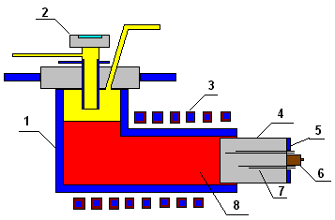
Furnace schematics (1)
Interaction at vertically positioned interface
1 – crucible section;
2– water-cooled pyrometer shaft;
3 - inductor;
4 – vessel steel specimen;
5 – top calorimeter of the specimen;
6 – ultrasonic sensor
7 – K-type thermocouples;
8 - melt;
+
Convenient specimen position
Applicability of ultrasonic sensor
-
Large pool volume
Possible crust on the surface within
pyrometer sighting spot
Complex sealing of furnace volume

Slide 24
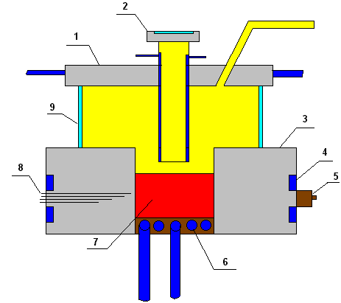
Furnace schematics (2)
Interaction at vertically positioned interface
1 – water-cooled cover;
2 – water-cooled pyrometer shaft;
3 – vessel steel specimen;
4 – calorimeter of the specimen;
5 – ultrasonic sensor
6 –inductor;
7 - melt;
8 – K-type thermocouples;
9 – quartz tube;
+
Developed interaction surface
Applicability of ultrasonic sensor
-
Low efficiency of inductor
Shallow molten pool
Complex sealing of inductor

Slide 25
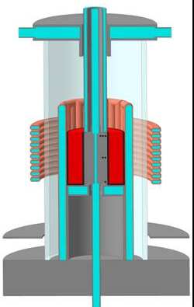
Furnace schematics (3)
Interaction at vertically positioned interface
Lid
Water cooled screen
Quartz tube
Cold crucible
Melt
Inductor
TC hot junctions
Vessel steel specimen
Bottom calorimeter
+
Simple design
Tested crucible
High efficiency factor of furnace
-
Not enough space for ultrasonic sensor

Slide 26
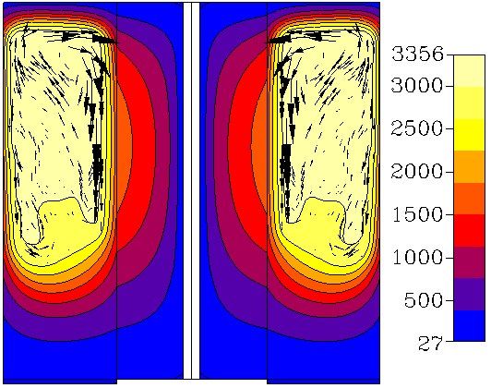
Interaction at vertically positioned interface
Pre-test DNS of molten pool and vessel specimen

Slide 27
Interaction at molten corium oxidation transients
Vessel steel ablation during molten corium oxidation by steam (1)
Principle test procedure
Furnace schematics corresponds to MC 11 with steam
Specimen surface is positioned horizontally
С-30 melt is prepared in the inert atmosphere
Melt is exposed during 10 hours in order to form the
interaction zone
Steam is supplied into the furnace after ablation saturation
Evolution of interaction zone is estimated by thermocouple
readings, ultrasonic sounding and post test analysis

Slide 28
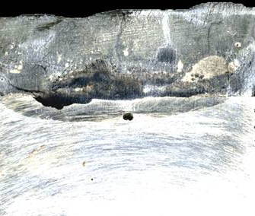
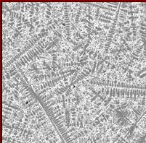
Interaction at molten corium oxidation transients
Vessel steel ablation during molten corium oxidation by steam (2)
Experiment MC6
 | U | Zr | Fe | Cr
mass.% | 25.6 | 4.8 | 58.3 | 2.3
mol.% | 6.1 | 3.0 | 56.7 | 2.5
 | Ni | Mn | Si | O
mass.% | 0.7 | 0.5 | 0.3 | 7.5
mol.% | 0.7 | 0.5 | 0.6 | 26.8
Interaction zone approximately corresponds to MC 6
What happened with IZ after oxidation?
Heat release?
Further corrosion?

Slide 29
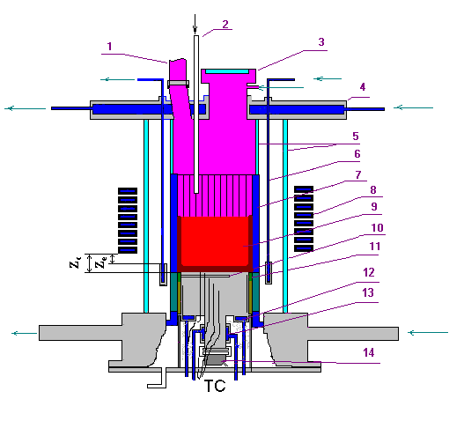
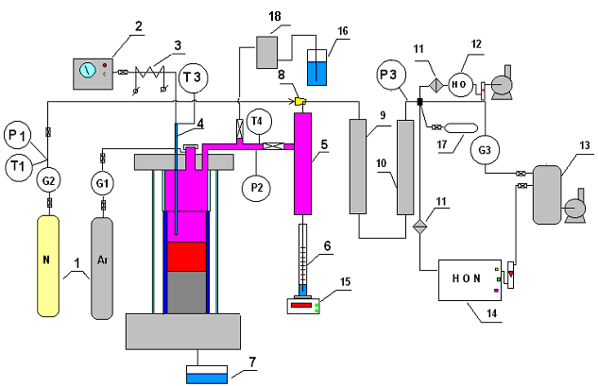
Vessel steel ablation during molten corium oxidation by steam (3)
Interaction at molten corium oxidation transients
Furnace schematics in MC-11
System of gas/steam supply and removal
1 – tanks with Ar, N₂; 2 – steam generator; 3 – heated steam supply line; 4 – quartz tube for steam supply into the furnace; 5 – steam condenser; 6 – condensate collector; 7 – condensate drop catcher; 8 - ejector;
9 – large-area filter (LAF); 10 – silica gel drier; 11 – medium-area filter (MAF); 12 – electrochemical sensors of oxygen and hydrogen; 13 – vacuum receiver; 14 – mass-spectrometer; 15 – weight sensor 16 – hydro lock; 17 – vacuum gas burettes; 18 - medium-area filter (MAF).
1 – steam vent from the furnace; 2 – steam line;
3 – lid; 4- water-cooled cover; 5 – quartz tube;
6– water-cooled electromagnetic screen;
7 – crucible sections; 8 – inductor; 9 – melt;
10 – acoustic defect; 11 – thermal insulation of the specimen; 12 – top specimen calorimeter; 13 – bottom specimen calorimeter; 14 – US sensor.

Slide 30
Interaction at molten corium oxidation transients
Corium surface oxidation influence on the heat fluxes into the vessel (1)
Methodology
Melt-induced thermal loads on the surface of water-cooled probe are
determined during oxidation transient. Melt interaction with vessel steel is
not examined
Oxidation rate is determined by on-line measurement of the gas flow-rates
and compositions

Slide 31
Interaction at molten corium oxidation transients
Corium surface oxidation influence on the heat fluxes into the vessel (2)
Measurements of sideward heat flux distribution during pool surface oxidation
1
2
3
Calorimetry + calculation of heat flux profile from the measured temperature profile of water
4
5
6
1 –electromagnetic screen
2 – water-cooled probe
3 – cold crucible
4 –melt
5 – hyperthermocouple of differential type
6 –inductor
7 – bottom calorimeter
7

Slide 32
Interaction of molten corium with European vessel steel
Provisional GEMINI2 calculations of Russian and French steel mixtures with corium by C. Journeau, CEA
Conditions
GEMINI2 + NUCLEA04
no Mn, Mo, V, Cu and S in the database (were replaced by Fe)
MC8 corium (62.1 g U, 18.4g Zr, 16.6g O)
equal corium (97g) and steel (100g) mixtures
Results
Eutectic temperature :
1200 ºC for 15Kh2NMFA steel
1100 ºC for 16MND5 steel
Difference about 100 ºC

Slide 33
Interaction of molten corium with European vessel steel
Experimental conditions
Repetition of basic METCOR tests with specimens of vessel
steel from European reactors
Proposals
Bottom-placed specimen with horizontal surface
Repetition of test conditions of MC 6 and MC 9
16MND5 steel

Slide 34
Short-term plans
Activities for 1st and 2nd quarter:
  Pre-test calculations
  Design of new IMCC furnace for tests with vertical wall
  Manufacture of furnaces and specimens
  Pre-testing
Conceptual design of a new experimental installations, test
procedures and type of European vessel steel will be discussed
with collaborators at the METCOR-P project meeting, May 31,
St Petersburg

