Slide 1
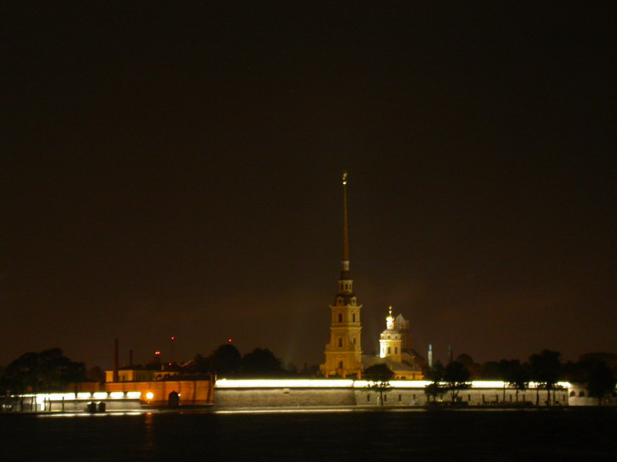
International Science and Technology Center (ISTC)
A.P. Alexandrov Research Institute of Technology (NITI)
4rd METCOR-P Project meeting
June 1, 2010, St. Petersburg,
OKTYABRSKAYA Hotel

Slide 2
Meeting Agenda
09:30 | Welcome word and organizational issues | V. Khabensky | 10 min
09:40 | Status of the METCOR-P project | V. Khabensky | 20 min
10:00 | Interaction of corium melt with European vessel steel in the oxidizing atmosphere. МСР-4 test | V. Granovsky | 50 min
10:50 | Coffee break |  | 20 min
11:10 | Interaction of suboxidized corium melt with European vessel steel. МСР-5 test | V. Granovsky | 40 min
11:50 | МСР-6 preparation. Oxidation kinetics of metallic melt containing uranium and zirconium | A. Sulatsky | 30 min
12:20 | Discussion | All | 40 min
13:00 | Lunch
14:00 | COLOSS investigations of liquefied zircaloy interactions with irradiated fuel | D. Bottomley | 50 min
14:20 | Numerical modeling of suboxidized corium melt oxidation | S. Smirnov | 40 min
15:00 | Interaction at molten corium oxidation transients. Proposals on МСР-7 test | E. Krushinov | 20 min
15:20 | Preparations for МСР-8 test. Interaction of metallic melt with vertically positioned vessel steel specimen | A. Sulatsky | 40 min
16:00 | Coffee break
16:20 | Planned publications | V. Khabensky | 10 min
16:40 | Next meeting | All | 10 min
16:50 | Closing speech | V. Khabensky

Slide 3
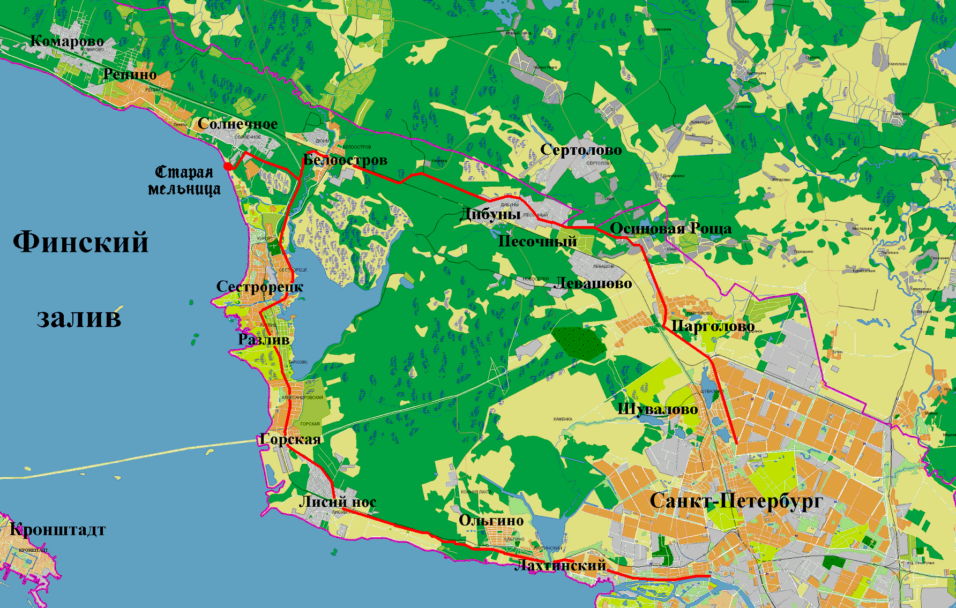
Announcements
For the June 1:
Informal dinner will be held in Keisen restaurant at 6:30 p.m. Address: Blokhina str. 3, SPb
For the June 3 :
Meet at 10:00 AM in the lobby of the
Oktyabrskaya Hotel
An excursion to the Russian
Museum, followed by a bus
trip to the shore of the Gulf of
Finland and a lunch at a
Caucasian restaurant
"U Kamina" ("Near the Fireplace“),
and then an excursion to the
Memorial Estate “Penaty” - the
home of an outstanding Russian
painter I.E. Repin (by bus from
the restaurant).

