Slide 1
Thermal and mechanical analyses of the VVER-1000 RPV in an IVR scenario considering corrosion effects
Eberhard Altstadt
2nd METCOR-P Meeting, St. Petersburg, July 9, 2008

Slide 2
Corium pool configurations
Configuration 1: suboxidized pool
melt segregation (metal and oxide layer)
oxide mass: 64 t, metal mass: 116 t
pool height 2.2 m (1 m + 1.2 m)
Configuration 2: fully oxidized pool
homogeneous melt
mass: 210 t
pool height: 3.1 m

Slide 3
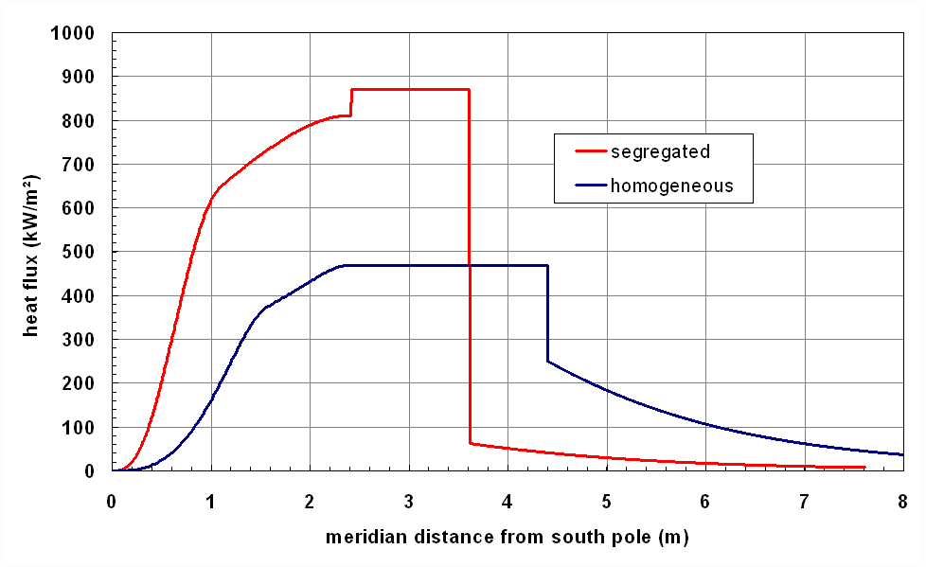
Internal heat fluxes (calc. by Russian colleagues)

Slide 4
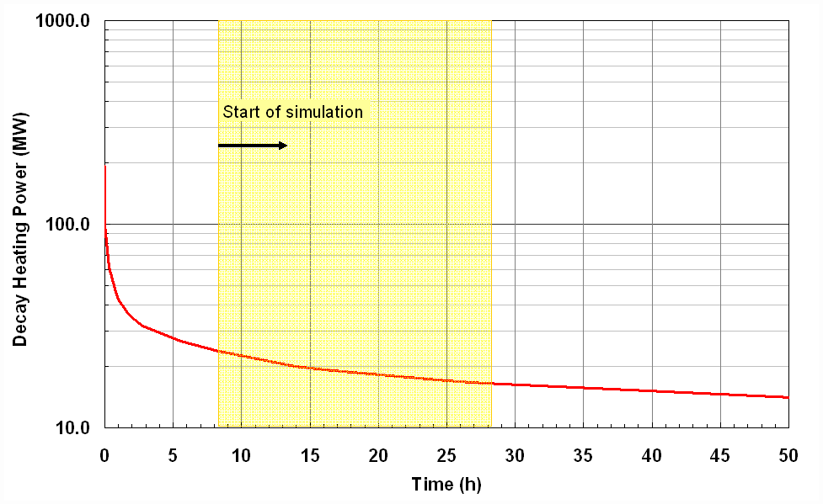
Decrease of the internal heat flux

Slide 5
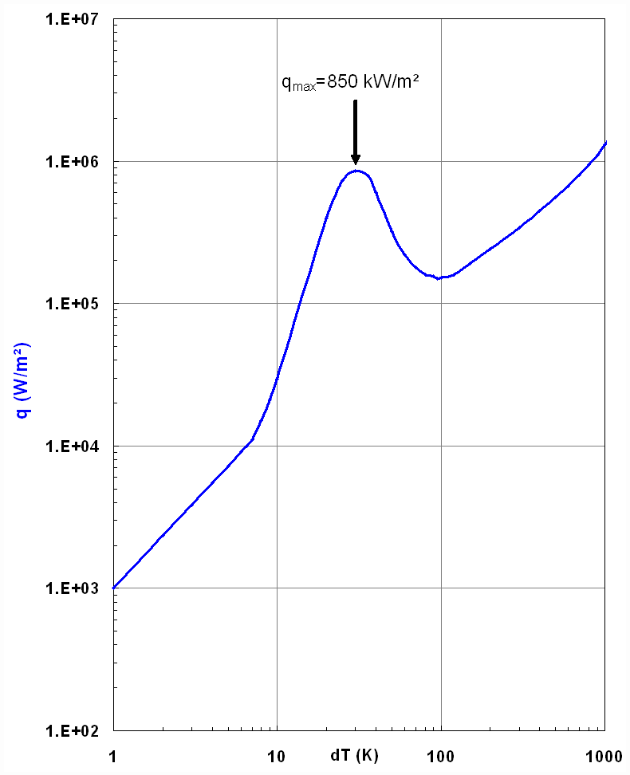
External thermal boundary condition
T_{w,e} = f (q, T_{water})

Slide 6
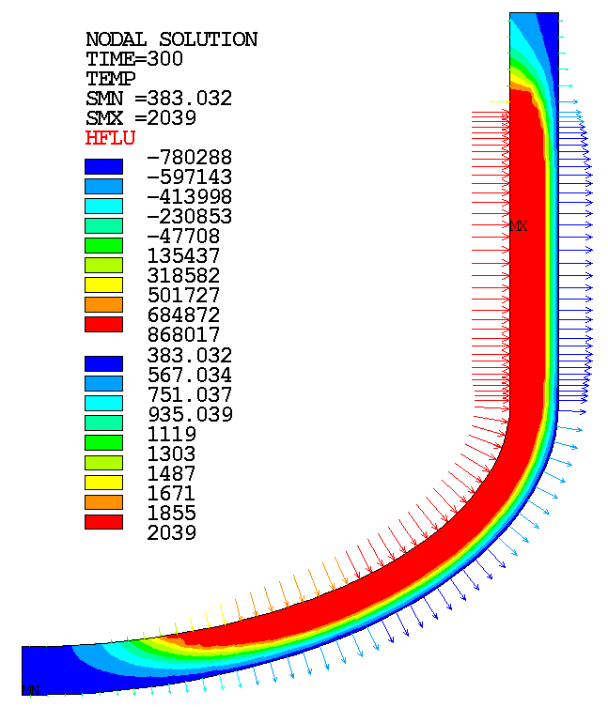
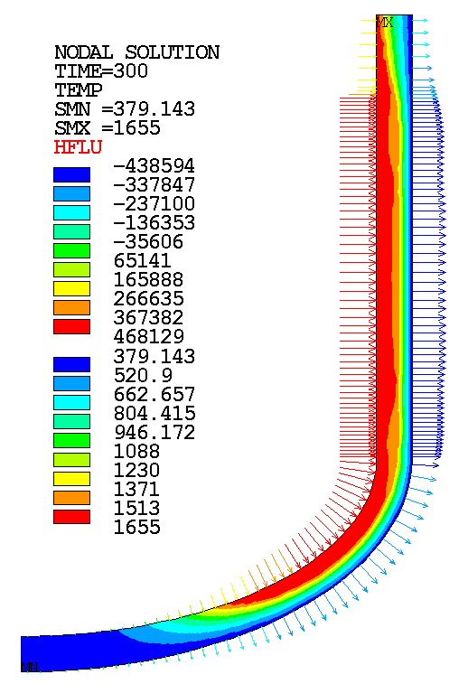
Temperatures and heat fluxes
segregated pool
homogeneous pool

Slide 7
Analysis of four scenarios
A: segregated pool without corrosion
B: segregated pool with corrosion
C: homogeneous pool without corrosion
D: homogeneous pool with corrosion

Slide 8
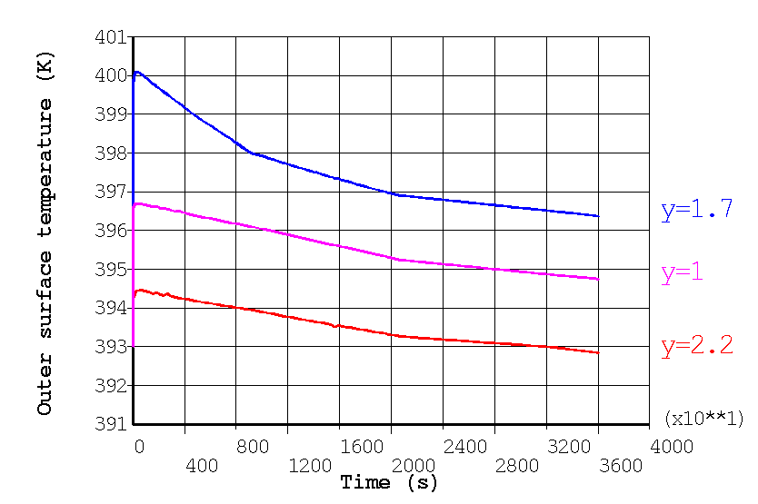
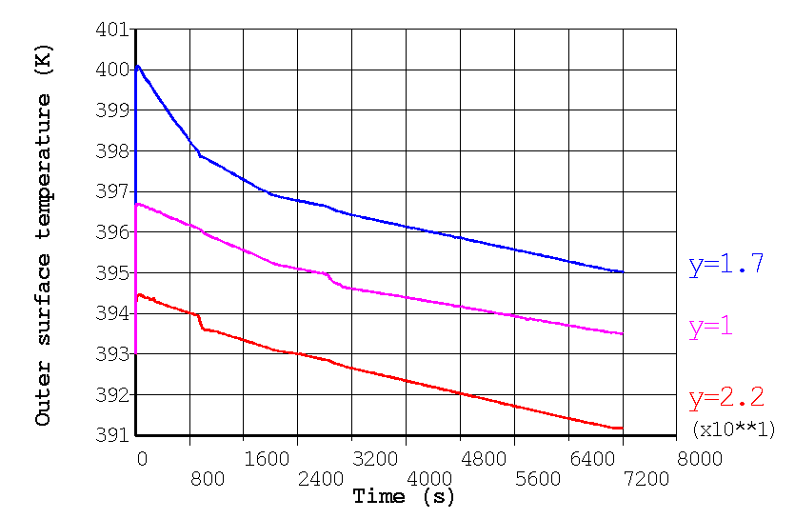
Outer temperatures vs. time
Scenario A
Scenario B

Slide 9
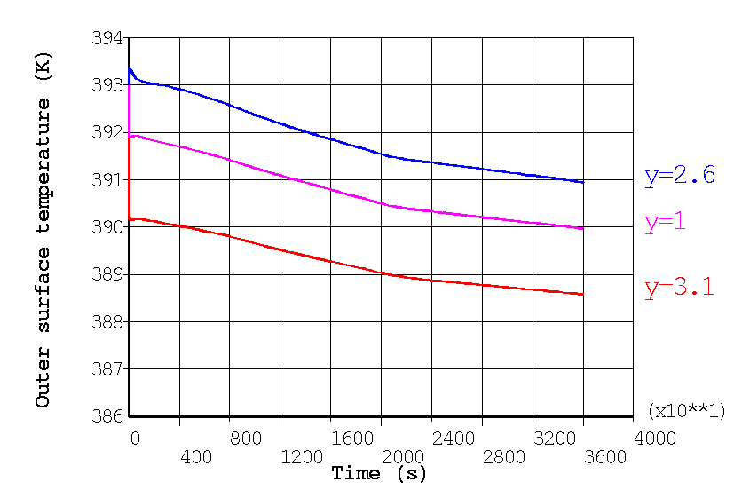
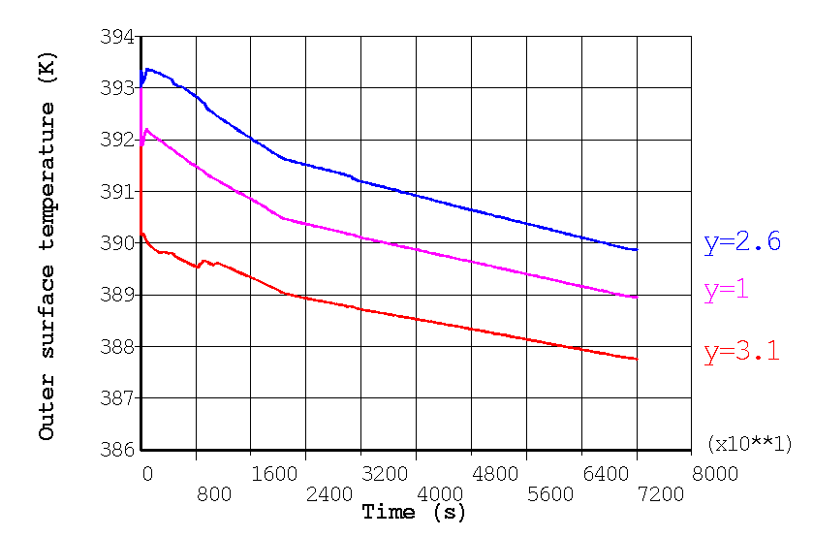
Outer temperatures vs. time
Scenario C
Scenario D

Slide 10
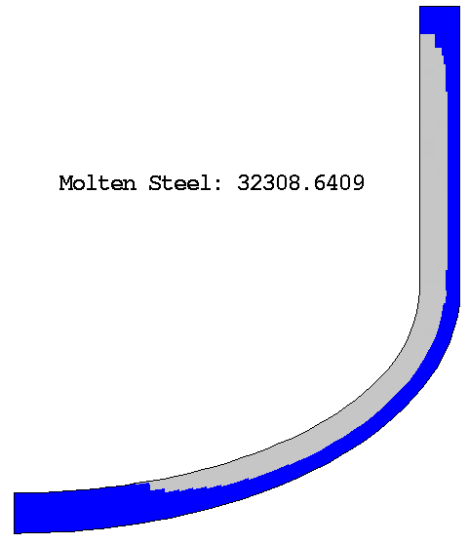
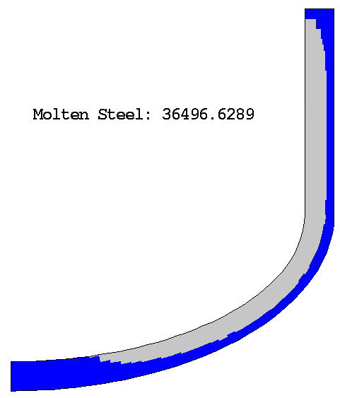
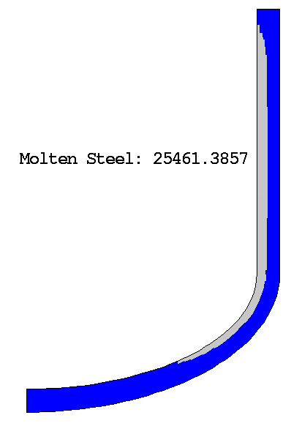
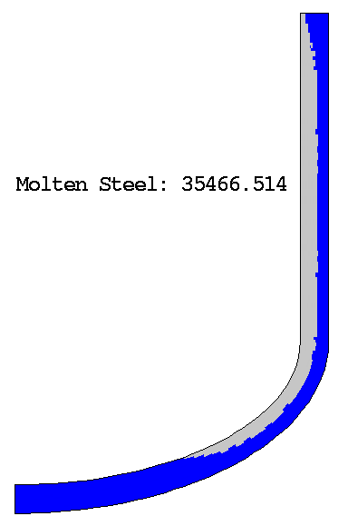
Final ablation
A
B
C
D

Slide 11
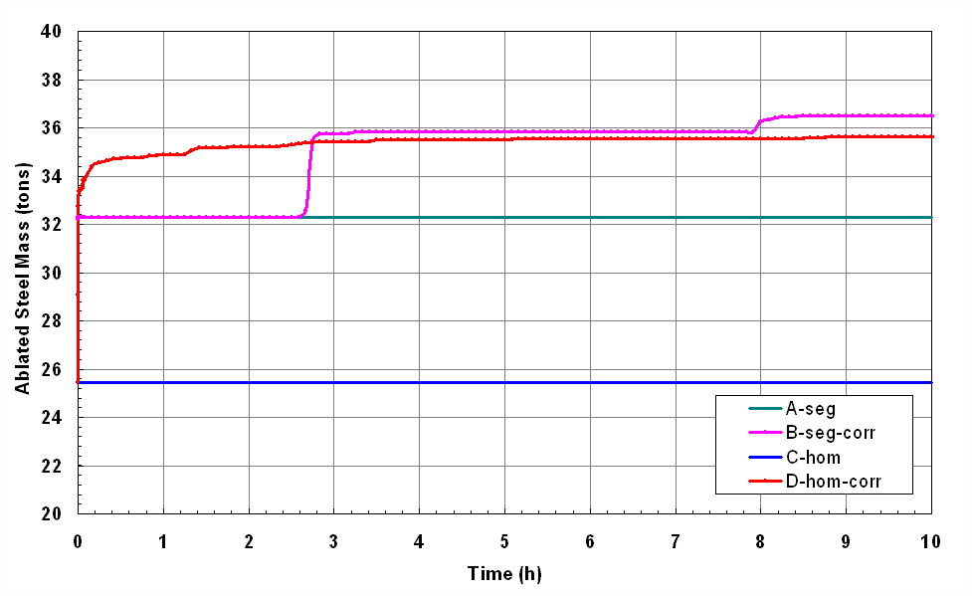
Ablation kinetics

Slide 12
Mechanical calculations
Elastic-plastic material behaviour
Material configuration: final ablation state
Temperature field from t = 300 s
Weight of vessel and melt pool
Increasing internal pressure until vessel failure
Failure criterion: allowable stress σ_{max} (T)

Slide 13
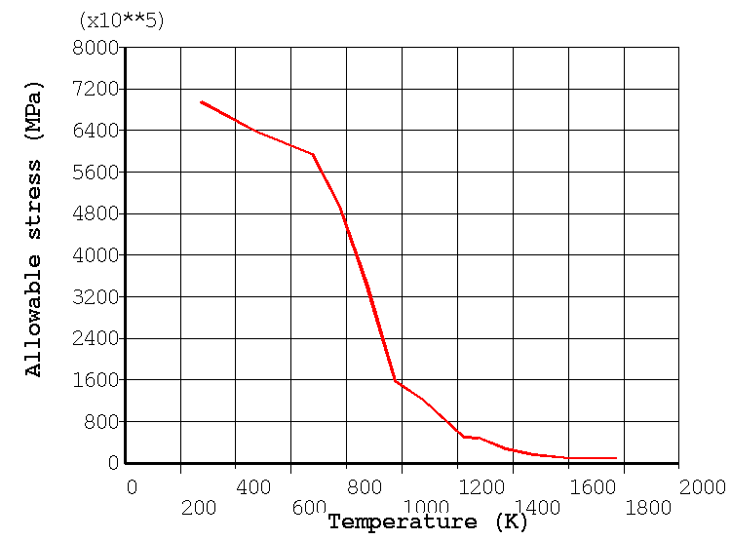
Allowable stress

Slide 14
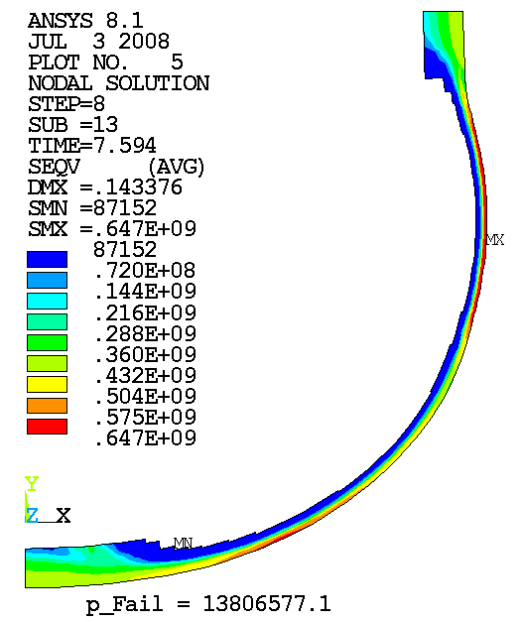
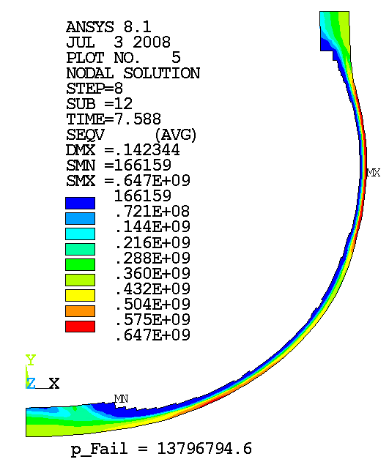
Stress at failure pressure (segregated pool)
B
A

Slide 15
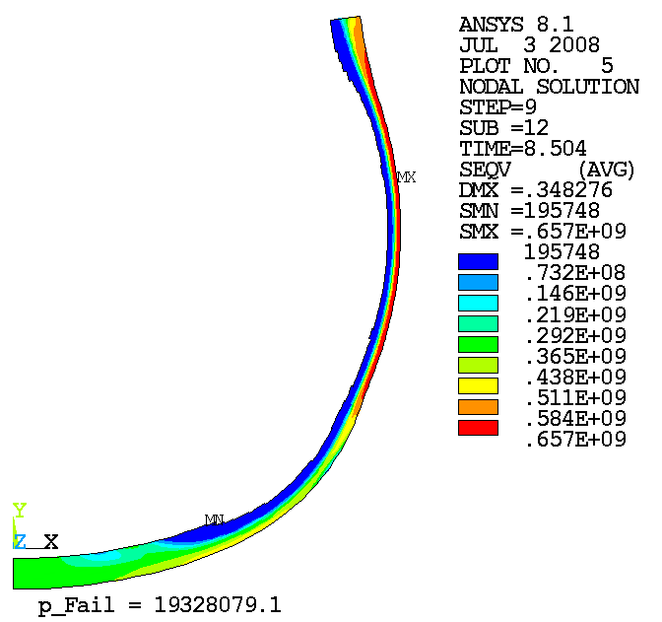
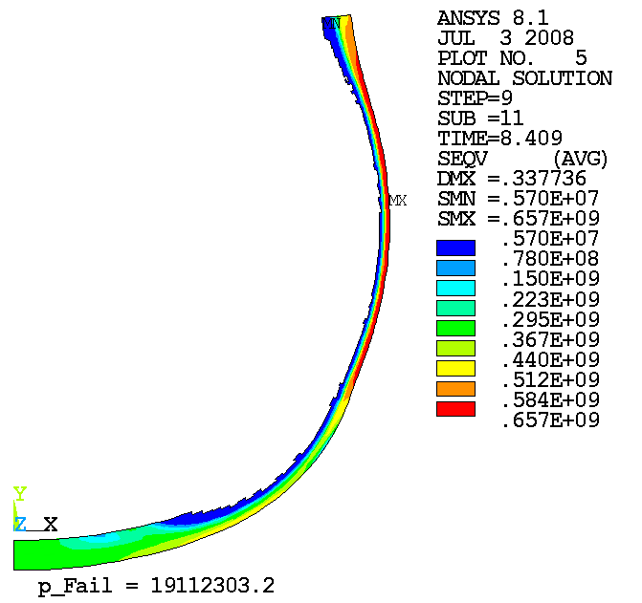
Stress at failure pressure (homogeneous pool)
D
C

Slide 16
Main results - overview
Scenario | A | B | C | D
Pool configuration | segregated | segregated | homogeneous | homogeneous
Corrosion | no | suboxidized | no | oxidized
ablated steel mass | 32.3 t | 36.5 t | 25.5 t | 35.5 t
T_{max,out} | 400 K | 400 K | 393 K | 393 K
min. wall thickness | 60 mm | 50 mm | 100 mm | 70 mm
p_{Failure} | 13.81 MPa | 13.80 MPa | 19.33 MPa | 19.11 MPa

Slide 17
Allowable stress and characteristic temperatures
T_{allow,cr}
T_{B}
T_{liq}

Slide 18
Conclusions
Corrosion leads to significantly higher ablation
Corrosion effect more pronounced in the homogeneous (oxidized) pool
Due to the higher peak heat flux the segregated pool configuration is more critical
The vessel strength is almost not influenced by the corrosion
load is carried by the cold outer region of the vessel wall

Slide 19
Model of corrosion damage
NITI correlation for fast corrosion stage
T2
T1
interface
T3
Element killed if D_{corr} ≥ 1
h_{el}

