Slide 1
Analysis of molten corium oxidation kinetics in METCOR-P, MASCA and EVAN experiments
A.P. Alexandrov Research Institute of Technology
ISTC METCOR-P Project
#3592
Presented by A. Sulatsky
3rd METCOR-P meeting
May 27, 2009, St. Petersburg

Slide 2
Contents
Objectives
Relevance
Matrix of experiments used in the analysis
Data of Pr1-MC5, MA7, MA9, STFM-Ox, Pr1-EV1, EV1, MCP-3 tests
Summary of experimental results
Simplified analytical model
Future studies
Conclusions

Slide 3
Objectives
Qualification of melt oxidation phenomenon

Slide 4
Relevance
Composition and structure of molten pool are very sensitive to the oxygen potential in the system
In-vessel corium pool can be oxidized by water, steam and air getting into the vessel; this principally changes the molten pool evolution

Slide 5
Test Matrix
Test | Project | OA | Short Description
 |  |  | Objectives | Initial melt | Oxidizer
Pr1-MC5 | METCOR (ISTC) | NITI | Pretest for MC5, one of the objectives – effect of melt oxidation by air when inert atmosphere is replaced by air | C31 | air
MA7 | MASCA (OECD) |  | Influence of oxidizing conditions on the components repartitioning between suboxidized and metallic parts of the melt | C32+SS
MA9 | MASCA (OECD) |  |  |  | steam
STFM-Ox1…9 | MASCA (OECD) | NPO “Lutch” |  | С26…67+iron | water droplets
Pr1-EV1 | EVAN (ISTC) | NITI | Release of low-volatile FP in the inert and oxidizing atmospheres | C70 | oxygen
EV1 | EVAN (ISTC)
MCP-3 | METCOR-P (ISTC) |  | Steam oxidation effect on interaction zone | C31 | steam

Slide 6
Pr1-MC5 Test
Pretest for MC5
No steel specimen
Experimental objectives:
1. Study possibilities of molten corium superheating versus liquidus temperature at its oxidation from С32 to С100
2. Maintain molten corium in a superheated condition in a wide oxidation range
3. Study the process of suboxidized melt oxidation when the inert atmosphere is replaced with air
Experimental conditions:
1. Charge: corium C31, U/Zr = 1.2 (1800 g)
2. Initial atmosphere – Ar
3. Oxidizer – air
4. Melt surface temperature during oxidation – 2500…2600°С
5. Air flow rate – 2.5, 4, 10, 15 and 24.4 l/min

Slide 7
Pr1-MC5 Test (2)
Oxygen content in furnace gases asymptotically reaches
a constant level, which can be attributed to the constant oxidation rate
The asymptotic character can be explained by transport and buffer volume delay

Slide 8
MA7 Test
Experimental objectives:
1. Determine phenomena taking place at melt oxidation, in particular, the secondary inversion of layers
2. Evaluate final oxidation index and corresponding compositions of oxidic and metallic ingot parts
3. Evaluate oxidation rate and aerosol release rates
Experimental conditions:
1. Two-liquid molten pool
2. Charge: corium C32, U/Zr = 1.2 (1800 g) + SS (200 g)
3. Initial atmosphere – Ar
4. Oxidizer – air
5. Air flow rate – 10 l/min
6. Melt surface temperature in the oxidation regime ≈2500°С
6. Condition for the oxidation and test termination – reverse
inversion of the melt

Slide 9
MA7 Test (2)
Furnace gas composition
Rates of oxygen and nitrogen
absorption by the melt
0 – air is supplied into the
furnace and analytical
gas line is connected to
the mass spectrometer
1 – crust is observed on the
melt surface
2 – furnace heating is
disconnected
  Two parallel reactions: 1. Zr + O₂ = ZrO₂ 2. 2Zr + N₂ = 2ZrN
  Without surface the oxidation rate is closed to constant: 0.045 (±0.002) g/s for O₂
  and 0.144 (±0.002) g/s for N₂:
  The interaction process is controlled by the supply of air to the melt surface
  If the crust is formed, the absorption rate of the both components is below
  0.04…0.06 g/s, it decreases as the crust grows

Slide 10
MA9 Test
Experimental objectives:
1. Determine phenomena at melt oxidation, in particular, secondary inversion of layers
2. Determine final oxidation index and corresponding compositions of oxidic and metallic ingot parts
3. Evaluate oxidation rate and aerosol release rates
Experimental conditions:
1. Two-liquid molten pool
2. Charge: corium C32, U/Zr = 1.2 (1800 g) + SS (200 g)
3. Initial atmosphere – Ar
4. Oxidizer – steam
5. Melt surface temperature in the oxidation regime ≈2520°С
6. Steam flow rate – 0.23 g/s
7. Condition for the oxidation and test completion – no hydrogen
release

Slide 11
MA9 Test (2)
Oxidation kinetics in MA-9 determined from steam mass balance
1 – mass of incoming steam
2 – mass of collected condensate
3 – mass of steam at the furnace
outlet, transport delay
is considered
4 – start of steam supply
5 – disconnection of steam
Rate of steam absorption by the melt is 0.12 (±10%) g/s
Rate does not depend on the concentration of unoxidized Zr
and U in the melt
Notes:
Можно заметить, что запаздывание по моменту подачи пара (140…160 с), отличается от запаздывания по прекращению подачи пара (70…100 с). Это можно объяснить некоторым различием теплогидравлических процессов заполнения и осушения конденсатора.

Slide 12
STFM-Ox Tests
9 test series carried out in the NPO “Lutch”
Experimental objectives:
Study melt stratification and
distribution of major species (U,
Zr, O, Fe) between layers in
oxidizing atmosphere
Experimental conditions:
1. Two-liquid molten pool
2. Total mass of the charge: (up to 500 g)
3. Charge composition: corium C26÷C67,
U/Zr = 0.92…1.3 + iron (0.6…20 mass.%)
4. Initial atmosphere – He
5. Oxidizer – steam (droplet water supply
to the pool surface)
6. Water flow rate – 0.011 g/s
7. Melt surface temperature in the oxidizing
regime – 2500…2600°С

Slide 13

STFM-Ox Tests (2)
Typical result (STFM-Ox4)
C32, U/Zr = 1.2, m_{Fe}/m_{Σ} = 0.05
2600°C, t₁=30 min
Final corium C85
It has been found that the process of oxygen absorption by molten corium has a constant rate up to ~ C85
Further on, after the corresponding drop in zirconium content in the melt, hydrogen generation decreases (contradictionally to MA, METCOR and EVAN tests)

Slide 14
Pr1-EV1 and EV1 Test
Experimental objective:
Determine quantitative characteristics of low-volatile FP release in the conditions of inert and oxidizing atmospheres
Experimental conditions:
1. Charge: corium C70, U/Zr = 1.2
(1600 g – Pr1-EV1, 1700 g – EV1)
2. Initial atmosphere – Ar
3. Oxidizer – argon-oxygen mixture with a fraction of O₂ 20 vol.%
4. Flow rate of argon-oxygen mixture – 10 l/min
5. Melt temperature during oxidation 2540…2700°С
6. Condition for the oxidation and test completion – oxidation index
of C100 is reached

Slide 15
Pr1-EV1 and EV1 Test (2)
Results of gas analysis and amount of oxygen absorbed by the melt
1 – oxygen content in the supplied mixture
2 – oxygen content in furnace gases
3 – oxygen absorbed by the melt
Oxygenation Rate
Pr1-EV1: 9.3 mg/s (±3%) – at the 1st stage
7.3 mg/s (±3%) – at the 2nd stage
EV1: 15 mg/s (±5%) – at the both stages

Slide 16
Pr1-EV1 and EV1 Test (3)
Oxygen absorption rate does not depend on the content of reducer (Zr) in the melt and on the reducer itself – after full oxidation of Zr oxidation of UO₂ started
Difference between Pr1-Ev1 and EV1 absorption rates is explained by different furnace designs, and, at certain oxidation stages in Pr1-EV1, by the presence of pyrometer shaft, which was introduced at the 2nd stage of this experiment. This caused changes in hydrodynamics and mass exchange.

Slide 17
MCP-3 Test
Experimental objective :
Qualification and quantification of steam oxidation effect on
the interaction zone
Experimental conditions:
1. Charge: corium C31, U/Zr = 1.2 (1820 g)
2. Oxidizer – steam, carrier gas – nitrogen
3. Steam flow rate – 400 g/h
4. Melt surface temperature in the oxidation regime ≈2400°С
Experimental Procedure
Stage | Time interval, s | Description
A | 0…38300 (≈ 11 h) | Molten pool and interaction zone formation
B | 38300…42500 | Temperature of the vessel steel is decreased, crust above the interaction zone is formed
C | 42500…44300 | Molten pool is oxidized by steam
D | 44300…49200 | Specimen temperature is increased, crust above the interaction zone is dissolved
E | 49200…50960 | Interaction zone and specimen are oxidized

Slide 18
MCP-3 Test (2)
Concentration and Release of Hydrogen
Steam Ingress
C
D
E
Blowing of furnace
Constant melt oxidation rate, which does not depend on Zr concentration
Different permeability of the melt surface and bottom
crusts – at stages C oxygen from the furnace top had a free access to the melt through the surface crust; and at stages C and D oxygen did not get into the interaction zone through the bottom crust
Average rates of
hydrogen liberation:
7.3 mg/s – at stage C
3.7 mg/s – at stage E
Hydrogen liberation rates at the steady regime:
9.9 mg/s – at stage C
5.1 mg/s – at stage E

Slide 19
MCP-3 Test (3)
Power into Cold Crucible (Q_{ccr})
and Bottom Calorimeter (Q_{cl1})
Thermocouple Readings
and Anode Voltage
A B C D E
A B C D E
Redistribution of heat fluxes into the cold crucible and bottom calorimeter at the molten pool oxidation, and a corresponding growth of thermocouple readings
Possible reason: certain suppression of convection in the molten pool caused by the heat of oxidation reaction in the surface layer of the pool

Slide 20
Summary of experimental results
Oxidation rate is not influenced by:
– concentration of reducer (Zr) in the melt (in most experiments and regimes. The only exclusion – some experiments of the
STFM-Ox series, in which, beside a period with constant oxidation rate, its drop was observed at high oxidation index when Zr concentration decreased)
– type of a reducer (final oxidation of uranium oxides when Zr was depleted in Pr1-EV1 and EV1)
If the surface crust is absent, the oxidation rate does not depend on the type of oxidizer too (oxygen and nitrogen absorption in MA7 is in proportion to their volumetric fractions)
Oxidation rate depends on:
– method and flow rate of oxidant supply into the furnace
– oxidant concentration in the above-melt atmosphere
– hydrodynamics of gas and melt

Slide 21
Simplified analytical model
There are 2 immiscible phases with a boundary between them
There are 2 components in these phases: X in the 1st phase and Y in the 2nd with corresponding molar concentrations in the C_{X} and C_{Y} volume
A heterogenic chemical reaction of the 2nd order takes place between these components on the interphase surface : X + Y = XY
The equilibrium conditions are in place, i.e. the rate of chemical reaction is equal to the molar flows of components X and Y to the surface: j = j_{X} = j_{Y}
C_{X}, C_{Y}, β_{X}, β_{Y} and k(T) are assumed
Phase 2
C_{Y}
j_{Y}=β_{Y}∙(C_{Y}–C_{Y,i})
C_{Y,i}
j=k(T)∙C_{X,i}C_{Yi}
C_{X,i}
j_{X}=β_{X}∙(C_{X}–C_{X,i})
Phase 1
C_{X}
System of three equations with three unknowns {j, C_{X,i},C_{Y,i}}:

Slide 22
Simplified analytical model (2)
Solution:
where
– maximum flux values
Dimensionless solution:
Extreme cases:
Kinetic stage – reaction rate is controlled (limited) by the chemical kinetics itself
1.
Transport stage – reaction rate is controlled (limited) by supply reacting components
2.
2 options:
Reaction rate is limited by the limited availability of the component

Slide 23
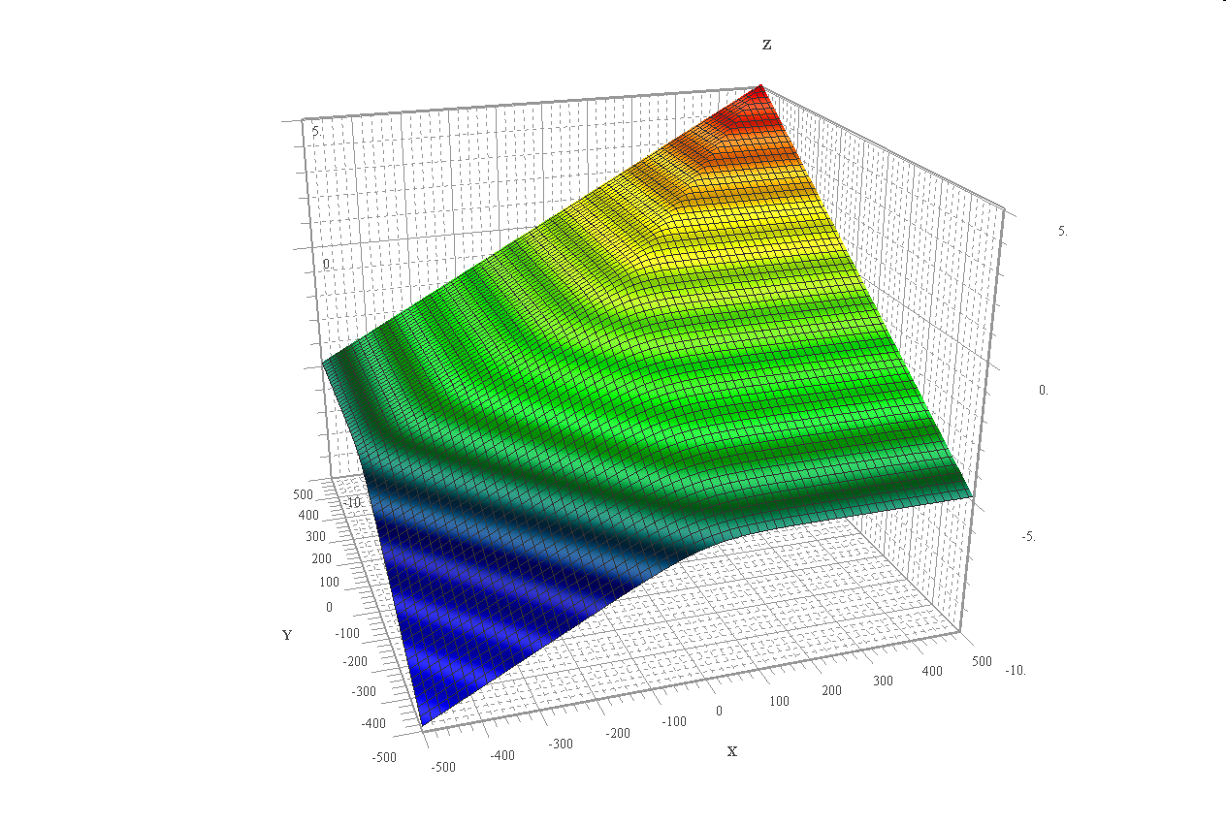
Simplified analytical model (3)
“STFM-Ox tests”
transport stage
transport stage
time
time
“METCOR,
EVAN and
MA tests”
С_{X,1}
С_{X,0}
С_{X,3}
С_{X,2}
kinetic stage

Slide 24
Simplified analytical model (4)
The proposed model enables to explain:
Independence of the oxidation rate both from the reducer concentration in the melt, which was observed in most of the tests, and from the reducer type (in Pr1-EV1 and EV1)
Dependence of the oxidation rate from the conditions of oxidant supply to the melt and oxidant concentration in the furnace atmosphere
Melt oxidation peculiarities in STFM-Ox tests
Sensitivity of oxidation rate to the presence or absence of crust on the melt surface due to a changed effective mass transfer coefficient β_{Y}

Slide 25
Future studies
Computer modeling (CFD, etc.) of hydrodynamics and mass transfer of oxidizer and reducer to the melt surface in a specified geometry of the gas volume and pool
Experimental study of oxidant diffusion through the crust formed on the melt surface
Kinetics stage of melt oxidation is untypical both for SA and test conditions. Kinetics stage study is unnecessary

Slide 26
Conclusions
Completed analysis of experimental data on melt oxidation kinetics revealed main factors, which influence this phenomenon
A simplified analytical model is proposed, which explains essential experimental results
Experimental study of oxygen diffusion through melt surface crust is pointed

