Slide 1
Progress Report on the ISTC project #3592
“Investigation of Corium Melt Interaction with NPP Reactor Vessel Steel”
(METCOR-P)
A.P. Alexandrov Research Institute of Technology (Russia)
Prepared by V. Khabensky and V. Granovsky
Presented by S. Bechta
19th CEG-SAM meeting
Pisa, Italy
March 14-16, 2011

Slide 2
Contents
Essential information
Objectives of test MCP-8
Interaction of the vertically positioned vessel steel specimen with metallic melt U-Zr-SS. Test MCP-8
Primary conclusions
Reporting
Publications

Slide 3
METCOR-P project general information
Investigation of Corium Melt Interaction with NPP
Reactor Vessel Steel (#3592 METCOR-P)
Project participants and coordination
Collaborators
FZK, Germany
FORTUM, Finland
JRC ITU,
EU
CEA,
France
AREVA NP,
Germany
Coordinator
ISTC, Moscow
Steering committee
Operation Agent: A.P. Alexandrov RIT, Russia
SPb Technological University, Russia
SPb Electrotechnical State University, Russia

Slide 4
METCOR-P experimental matrix
Post test analyses of MCP-6, 7 and 8 tests are in progress

Slide 5
Objectives of test MCP-8
Determine corrosion kinetics of vertically positioned vessel steel specimen at its interaction with SS-Zr-U melt
Test parameters :
SS-U-Zr melt corium
15Kh2NMFA vessel steel
Pure argon above the melt
10 h exposition

Slide 6
Furnace schematics
1 – cooled ss cover
2 – quartz tube
3 – cooled copper screen
4 – specimen
5 – inductor
6 – bottom calorimeter
7 – supporting screen
8 – crucible sections
9 – crucible collector
– melt
– USS
10
11

Slide 7
TC locations in the specimen
Underside view of specimen
Coordinates of hot junctions

Slide 8
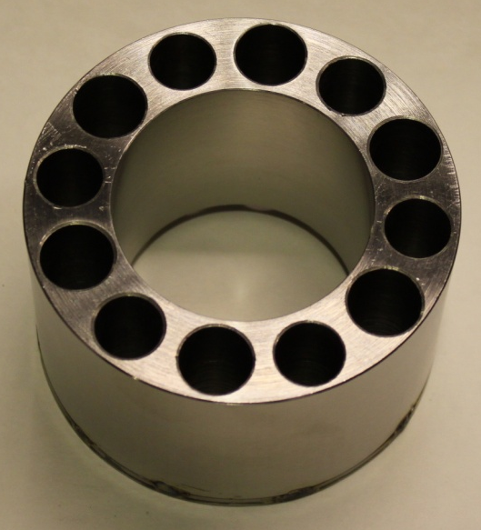
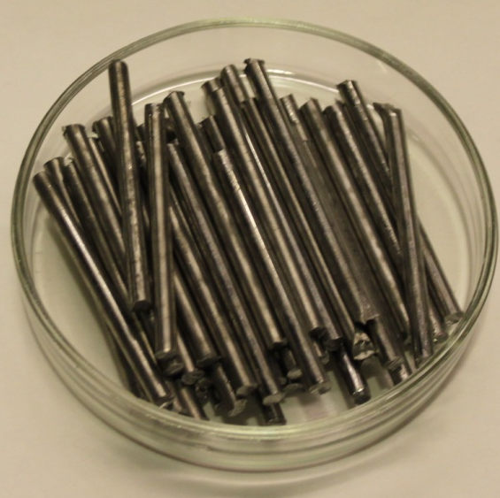
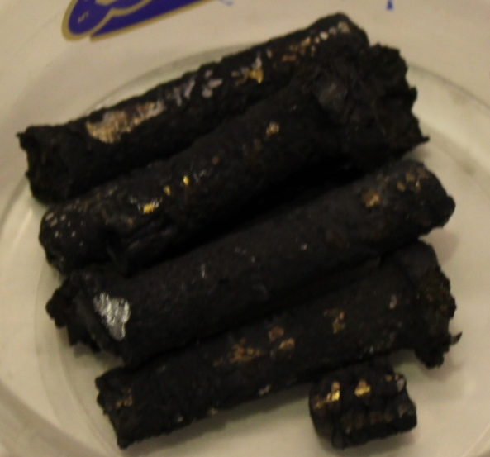
Crucible charge
SS
Zr
U

Slide 9
Test procedure
Time, s | Stages in the experimental procedure
0-300 | Furnace deoxygenation by argon flow
300-7200 | Formation of the molten pool. Increase of power in the melt to get 1400 ºC on the specimen surface
7200-39300 | Keeping constant specimen temperature by inductor voltage control during ~ 10 hr
39300-41000 | Heating disconnection, melt solidification and ingot cooling in argon

Slide 10
Test results: TC readings
Damaged thermocouples continue to operate but in wrong way
(new junction is formed to replace the defect one)

Slide 11
Test results: Power extracted from the crucible, specimen and bottom calorimeter
Practically constant power into the specimen

Slide 12
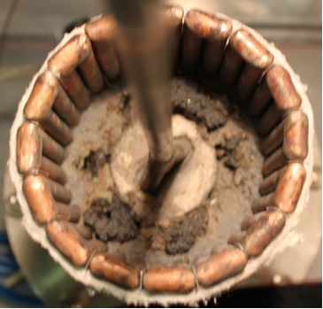
Test results: Ingot view during furnace disassembling
Specimen
Metallic corium ingot
Crust on metallic ingot

Slide 13
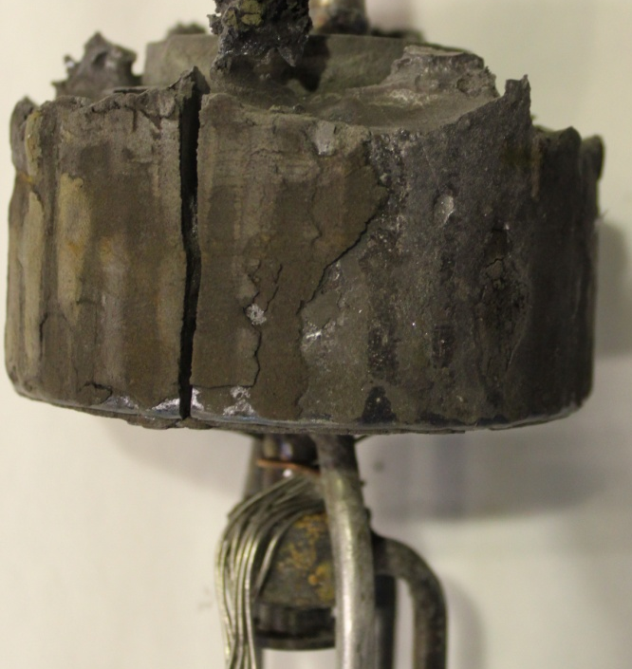
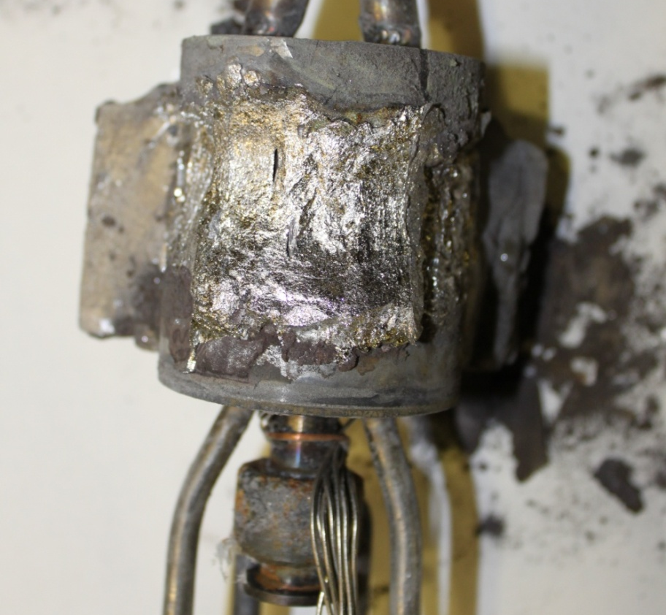
Test results: Ingot side views
Ingot
Specimen
Specimen surface with corium
USS calorimeter
TC cable

Slide 14
Posttest analysis
Corrosion kinetics
h, mm
•
t, s
• - direct posttest measurement
— - posttest processing of on line measurements
- - - - to be specified

Slide 15
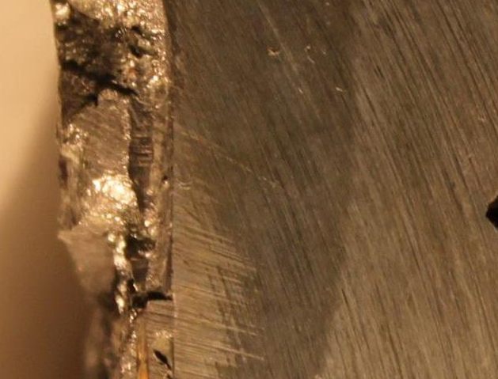
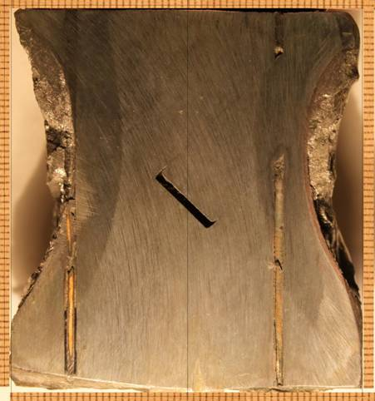
Posttest analysis (2)
Specimen axial section
2
1
2
3
Acoustic ‘mirror’
Acoustic defect
Thermocouple
1 – Steel of initial structure; 2 – Zone of thermal influence 3 - Interaction zone
Maximum corrosion depth – 9 mm at the elevation of 40 mm

Slide 16
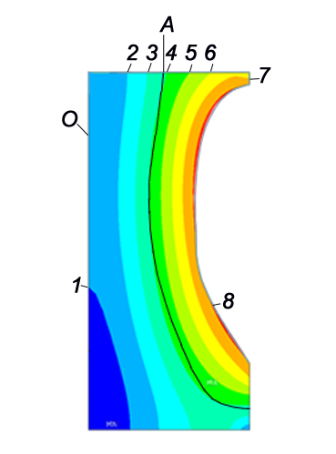
Posttest analysis (3)
Temperature field of the specimen axial section
O –specimen axis
А – isotherm of Fe-Fe₃C eutectoid formation (727°C)
1 – 400; 2 – 500; 3 – 600; 4 – 700; 5 – 800; 6 – 900; 7 – 1000; 8 - 1100 °C
Temperature of corrosion
boundary final position in the
range of 1050…1150 °C

Slide 17
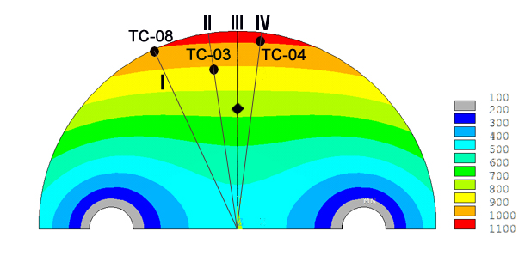
Posttest analysis (4)
Temperature field of the specimen cross section
(elevation 30 mm; specimen radius reduced to 18 mm)
T, °C
Radial distribution III
r, m
Radial distribution II
T, °C
Radial distribution IV
T, °C
Radial distribution I
T, °C
r, m
r, m
r, m

Slide 18
Primary conclusions
The final maximal ablation depth h = 9 mm
The temperatures of corrosion boundary final position is in the range of 1050-1150ºC
Physicochemical analyses are in progress

Slide 19
Reporting
  ✓ First three reports have been sent to ITU
✓ ✓ Two reports have been sent to ISTC
* The report is in Export control

Slide 20
Reporting (2)

Slide 21
Reporting (3)
The experimental part of the project has been completed.
5 thematic reports (МСР-1, МСР-2, МСР-3, МСР-4, МСР-5) and 2 annual reports (for 1st and 2nd years) have been prepared.
3 remained thematic reports (МСР-6, МСР-7 and МСР-8) are in progress and will be completed in May, 2011.
The final project report is in progress and will be completed in May, 2011.

Slide 22
METCOR-P new publications
1. Granovsky V.S., Khabensky V.B., Bechta S.V., Vitol S.A., Krushinov E.V., Kotova S.Yu., Sulatsky A.A., Gusarov V.V., Almjashev V.I., Barrachin M., Bottomley D., Fischer M., Piluso P., Miassoedov A., Tromm W. Effect of temperature gradient on element partitioning in corium pool during in-vessel retention // English version is in preparation
2. Sulatsky A.A., Granovsky V.S., Khabensky V.B., Krushinov E.V., Vitol S.A., Kotova S.Yu., Fischer M., Hellmann S., Tromm W., Miassoedov A., Bottomley D., Piluso P., Kymalainen O., Barrachin M. Oxidation kinetics of corium pool // English version is in preparation

