Slide 1



Progress report on the ISTC project #3813: Phase relation in corium systems
(PRECOS)
A.P. Alexandrov Research Institute of Technology
ETU
Saint-Petersburg
SPbSIT (TU)
Presented by S. Bechta
19th CEG-SAM meeting
Pisa, Italy
March 14-16, 2011

Slide 2
Contents
  General information
  Project objectives
  PRECOS test matrix
  Scope of work in quarters 10 - 11
  Test results:
  UO₂-SiO₂- FeO system
  UO₂-CaO- FeO system
  Concluding remarks
  ! IVTAN test results will be presented separately by Prof. M. Sheindlin

Slide 3
PRECOS project general information
Project participants and coordination
Collaborators
FZK, Germany
IRSN,
France
ITU,
EU
CEA,
France
Areva NP, Germany
Coordinator
ISTC,
Moscow
Steering committee
Operation Agent: A.P. Alexandrov RIT, Russia
IVTAN,
Russia
SPb State
Technological University, Russia
SPb State Electrotechnical University,
Russia

Slide 4
Project objectives
Experimental determination of:
liquidus – solidus temperatures
coordinates of reference points (eutectics, etc.)
solubility limits of solid solutions
compositions of liquids coexisting in the miscibility gap

Slide 5
PRECOS test matrix
Task | Composition | Atm | Experimental data | Priority level | Number of tests scheduled /carried out
1 | U-Zr-Fe-O | Argon | Selected points (liquidus, solidus, tie-lines in the miscibility gap) | 1 | 6/8¹
2 | ZrO₂ - FeO_{y} | Air and p_{O2} control | liquidus, solidus, solubility limits | 2 | 3/3²
 | UO₂ - SiO₂ | Neutral | liquidus, solidus, solubility limits, eutectic point | 1 | 7/(5³+40⁴)
 | CaO - UO₂ |  |  | 1 | 7/7³
3 | UO₂ – FeO – SiO₂ |  | liquidus, solidus, solubility limits, tie-lines in the miscibility gap, ternary eutectic point | 1 | 10/(2³+9⁴)
 | UO₂ – FeO – CaO |  | liquidus, solidus, solubility limits, ternary eutectic point | 1 | 10/(2³+1⁴)
 | ZrO₂ - FeO - SiO₂ |  | ternary eutectic point | 2 | 2/0
 | ZrO₂ - FeO - CaO |  | ternary eutectic point | 2 | 2/0
4 | Eutectic composition measurement of a realistic complex corium mixture | Argon or Air | System (atmosphere) proposed by: - French partners (1 system) German partners (1 system) - Russian partners (1 system) | 2 | 3/0
Notes: 1-LPH (Zr-O), 2- HTM, 3- VPA IMCC, 4- VPA in Galahov microfurnace
According to the 3rd Project meeting decisions these systems will be excluded from the test matrix for a more detailed study of systems having higher priority

Slide 6
Scope of work in quarters #10-11

Slide 7
UO₂ – FeO – SiO₂ system: PRS 13 test results
Experimental objectives
T_{liq} determination by VPA IMCC
Determination of the ternary eutectic composition
Charge composition
mol.% 30.00 UO₂ + 46.67 FeO +23.33 SiO₂
Test procedure
T_{liq} was measured 4 times by VPA IMCC with melt
sampling
Eutectic core was synthesized by slow melt
crystallization

Slide 8
UO₂ – FeO – SiO₂ system: PRS 13 test results (2)
Measured liquidus temperature and compositions
of melt samples

Slide 9
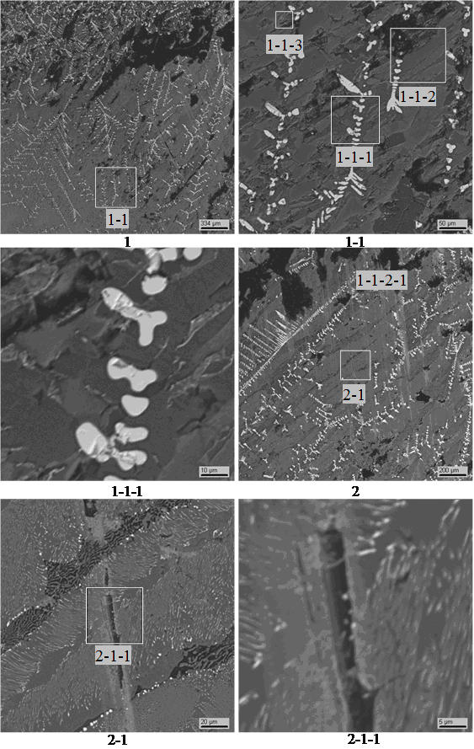
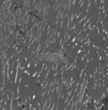
UO₂–FeO–SiO₂ system: PRS 13 test results (3)
SEM/EDX of eutectic core
Eutectic |  | UO₂ | FeO | SiO₂
14 fields | mass % | 10.3 ± 1.2 | 63.3 ± 3.0 | 26.4 ± 2.5
 | mol% | 2.8 ± 0.3 | 64.9 ± 3.1 | 32.3 ± 3.0
SS
6 μm
Inclusions of UO₂ base solid solution were
identified in the eutectic core
Eutectic compositions were determined in 14
ss-free regions and the data were averaged
The sample cut out from the eutectic core had
unknown content of the ss

Slide 10
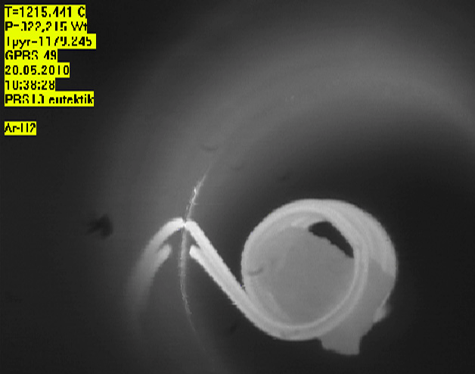

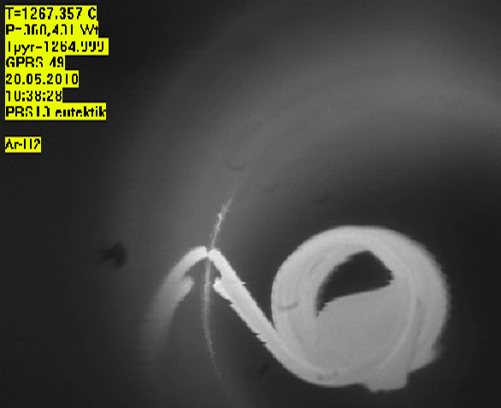
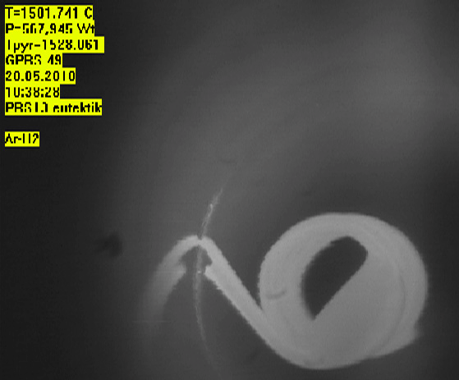
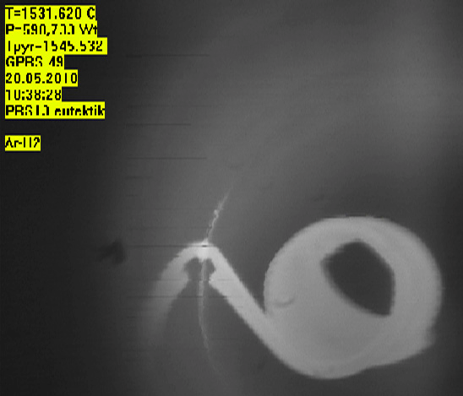
UO₂ –FeO-SiO₂ system: PRS 13 test results (4)
T_{eut} determination in the Galakhov microfurnace
Sample cut out from the eutectic core of the ingot
1179°C
1191°C
1264°C
Tsol= 1191°С≈Teut
Tliq=1545°С
1528°C
1545°C

Slide 11
UO₂-FeO-SiO₂ system: test results (5)
Eutectic points
e1 composition was
determined by SEM/EDX
e2 and e3 ternary
eutectics are expected in
the system
e2 eutectic core was
synthesized in PRS16
tests
Next test will be objected
on e3 determination
UO₂
e3?
Fe₂SiO₄
e2?
e1

Slide 12
UO₂ – FeO – SiO₂ system: PRS 16 test results (6)
Experimental objectives
T_{liq} determination by VPA IMCC
Determination of the e2 ternary eutectic composition
Charge composition
mol.% 10 UO₂ + 70 FeO +20 SiO₂
The pool was pulled out from the inductor at 9 mm/h for 4.5 hours starting at 4646 s. This has ensured close to equilibrium crystallization and eutectic core formation in the ingot upper part
T_{liq} was measure 3 times by VPA IMCC with melt sampling

Slide 13
UO₂ – FeO – SiO₂ system: PRS 16 test results (7)
VPA IMCC: Example of thermogram #1 showing melt surface
    First solid phase was not detected at the melt surface. Consequently Tliq was
    not determined
    Melt samples were used for VPA GM

Slide 14
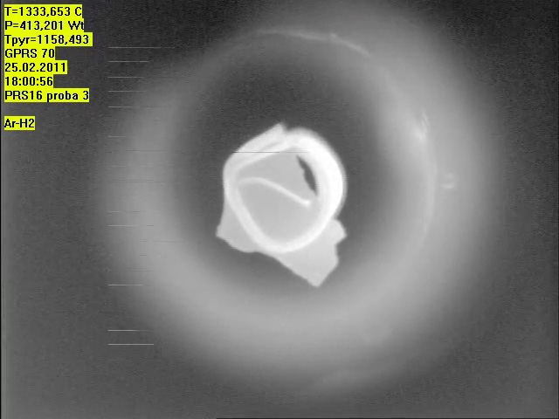
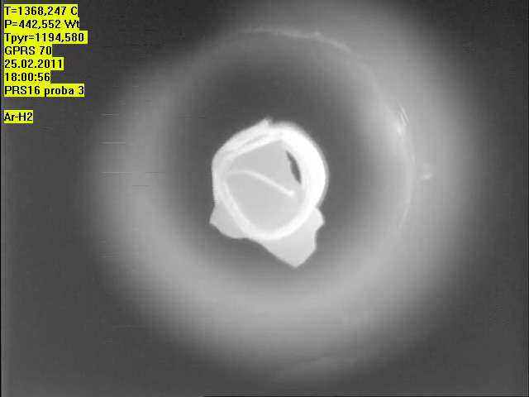
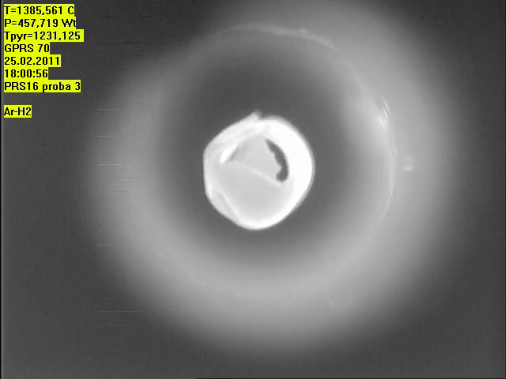
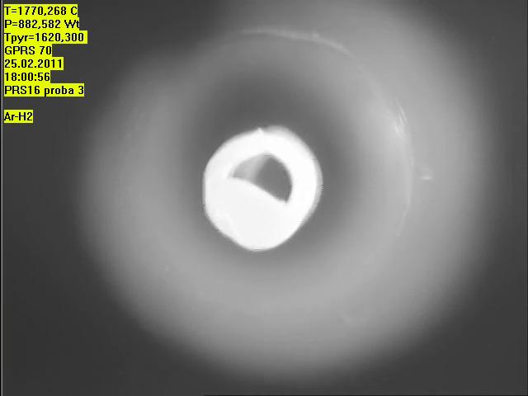
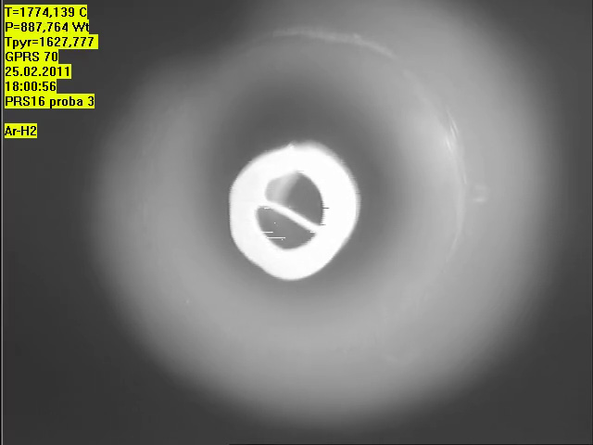
UO₂ –FeO-SiO₂ system: PRS 16 test results (8)
T_{sol} and T_{lig} determination in the Galakhov microfurnace
Sample #3
1158°C
1194°C (deformation start)
1231°C
Tsol= 1194°С
Tliq=1627°С
Close temperatures
for other samples
1620°C
1627°C (complete spreading)

Slide 15
UO₂-FeO-SiO₂ system: GPRS #59-64 test results (9)
Experimental objectives
Study of tie lines and miscibility gap boundaries
Annealing, melting and quenching in the Galakhov microfurnace
Test | Content, mol.% |  |  | Tempera-ture, °С | Exposure time, min | Note
 | UO₂ | SiO₂ | FeO
GPRS59 | 5.0 | 77.0 | 18.0 | 1100 | 60 | Annealing
 |  |  |  | 1750 | 10 | Melting and quenching
GPRS60 | 5.0 | 77.0 | 18.0 | 1100 | 60 | Annealing
 |  |  |  | 1850 | 10 | Melting and quenching
GPRS61 | 10.0 | 78.0 | 12.0 | 1100 | 60 | Annealing
 |  |  |  | 1750 | 10 | Melting and quenching
GPRS62 | 10.0 | 78.0 | 12.0 | 1100 | 60 | Annealing
 |  |  |  | 1850 | 10 | Melting and quenching
GPRS63 | 15.0 | 79.0 | 6.0 | 1100 | 60 | Annealing
 |  |  |  | 1750 | 10 | Melting and quenching
GPRS64 | 15.0 | 79.0 | 6.0 | 1100 | 60 | Annealing
 |  |  |  | 1850 | 10 | Melting and quenching
UO₂ of >99.0 % purity, SiO₂ of 99.99% purity, FeO of >99.0 % purity,
charge mass – 150 mg, molybdenum crucibles ∅ 6 mm
SEM/EDX in progress

Slide 16
UO₂-FeO-SiO₂ system: test results (10)
Eutectic point e1 has been determined to belong to
UO₂-Fe₂SiO₄ section of the diagram.
e2 and e3 ternary eutectics are expected in the
system
Tliq of PRS 13 composition has been measured by
VPA IMCC. Tliq of PRS 16 composition has been
determined by VPA GM and will be checked by DTA
The performed annealing tests confirm miscibility
gap in a fairly narrow region adjacent to the SiO₂
corner of the diagram

Slide 17
UO₂ – FeO – CaO system: PRS 14 test results
Experimental objectives
T_{liq} determination by VPA IMCC
Determination of eutectic composition
Charge composition
mol.% 6UO₂ + 75FeO +19CaO
Test procedure
T_{liq} was measured 3 times by VPA IMCC with melt
sampling
Eutectic core was formed in the ingot

Slide 18
UO₂ – FeO – CaO system: PRS 14 test results (2)
Liquidus temperatures and compositions of melt samples measured by XRF and ChA
* - determined from residue
Tliq was measured 3 times by VPA IMCC but video record of one
measurement was not interpreted.
The results of corium samples XRF and chemical analysis were found
to differ significantly
XRF results are believed to be more accurate, since the content of CaO
was not determined by chemical analysis, but calculated from the residue

Slide 19
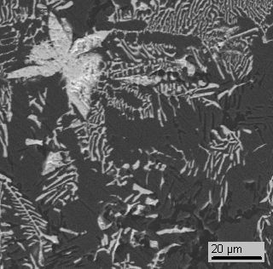
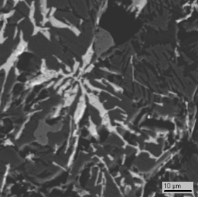
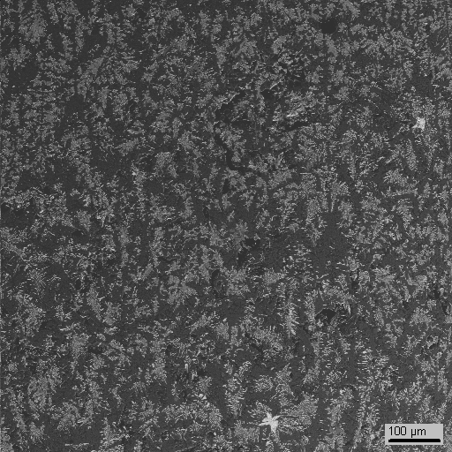
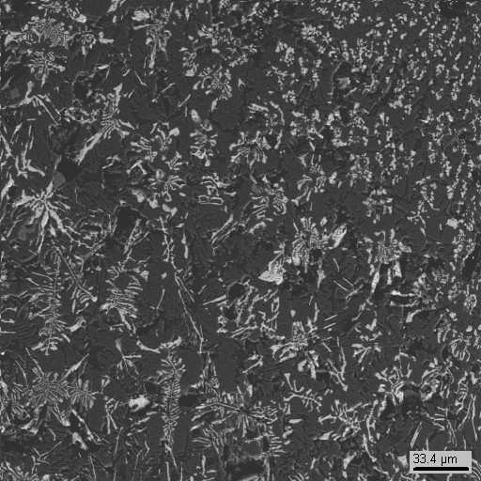
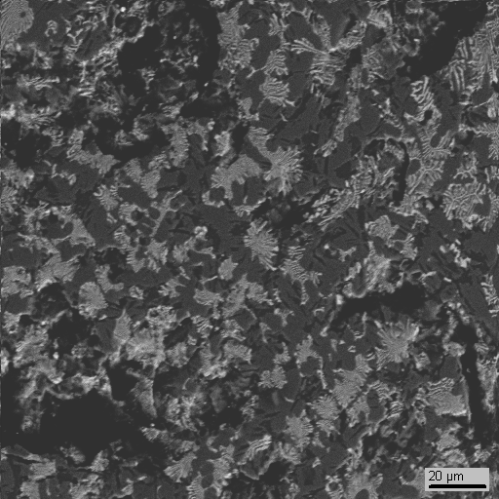
UO₂ – FeO – CaO system: PRS 14 test results (3)
SEM/EDX of the melt samples
Sample 2
Sample 3
Sample 1
20 μm
40 μm
60 μm
200 μm
40 μm
Composition |  | UO₂ | FeO | CaO
Averaged | mass % | 13.3±1.0 | 73.0±0.9 | 13.7±0.4
 | mol% | 3.8±0.3 | 77.5±0.5 | 18.7±0.4
Local composition (averaging square about 1000 μm)
The results of SEM/EDX on Ca content confirm the XRF results

Slide 20
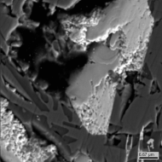
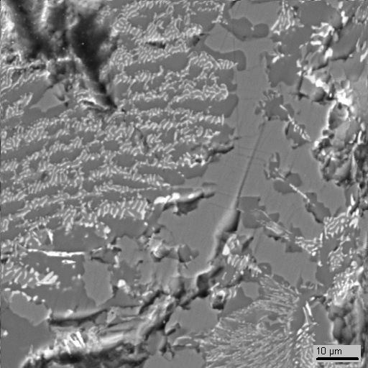
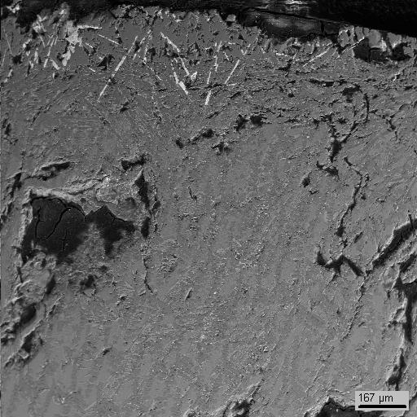
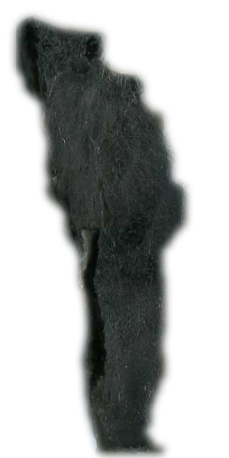
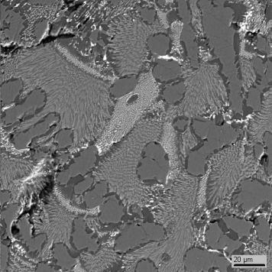
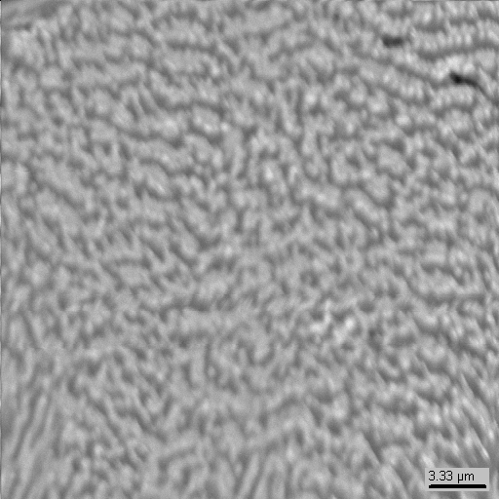
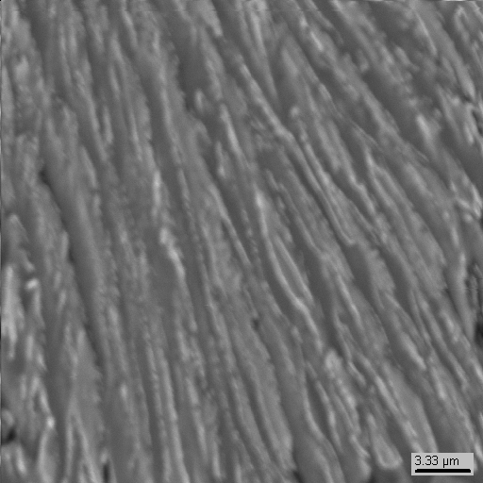
UO₂ – FeO – CaO system: PRS 14 test results (4)
CaUO₃
SEM/EDX of the eutectic core
FeO
CaO⋅2FeO
15 μm
1 sm
ingot
250 μm
6 μm
Eutectic |  | UO₂ | FeO | CaO
Average of 8 sections | mass % | 10.4 ± 0.3 | 62.5 ± 0.6 | 27.1 ± 0.7
 | mol% | 2.8 ± 0.1 | 62.5 ± 0.7 | 34.7 ± 0.8
6 μm

Slide 21
UO₂ – FeO – CaO system: PRS 15 test results(5)
Experimental objectives
T_{liq} determination by VPA IMCC
Confirmation of eutectic composition
Charge composition
mol.% 13UO₂ + 50FeO +37CaO
From 4575 s, the pool was pulled out from the inductor at 9 mm/h for 4.5 hours. This has ensured close to equilibrium crystallization and the eutectic core formation in the ingot upper part
T_{liq} was measured 3 times by VPA IMCC with melt sampling

Slide 22
UO₂–FeO–CaO system: PRS 15 test results (6)
VPA IMCC: Example of thermogram 1 from the test
showing melt surface
    Results of T_{liq} measurements: 1516, 1516, 1511oC

Slide 23
UO₂ – FeO – CaO system: PRS 15 test results (7)
Liquidus temperatures and compositions of melt samples measured by XRF and ChA
* - determined from residue
XRF result seems more accurate since the content of CaO was directly
measured and confirmed by SEM/EDX

Slide 24
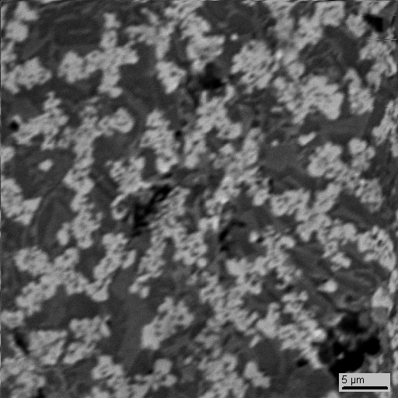
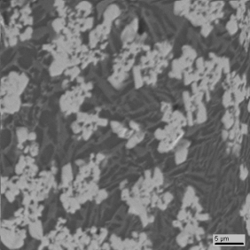
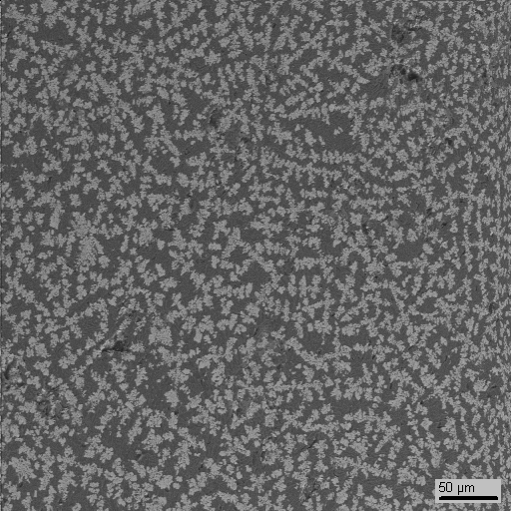
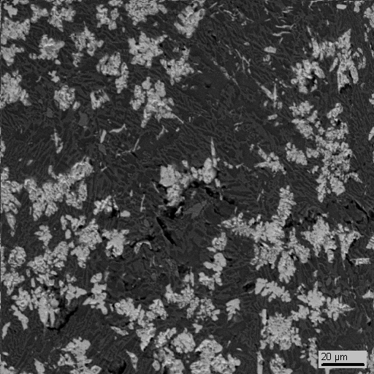
UO₂ – FeO – CaO system: PRS 15 test results (8)
SEM/EDX of melt samples
Sample 2
Sample 1
Sample 3
20 μm
15 μm
100 μm
40 μm
Composition |  | UO₂ | FeO | CaO
Averaged for 3 section | mass % | 30.6±2.2 | 45.7±2.9 | 23.6±0.9
 | mol% | 9.7±0.8 | 54.3±2.6 | 36.0±1.8
Notes:
Слава. Если известно буллит о фазе первичной кристаллизации и микроструктуре пробы

Slide 25
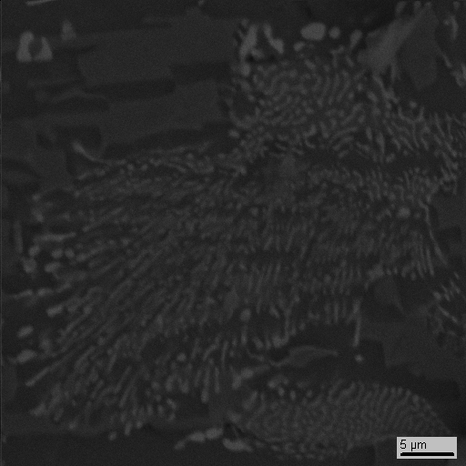
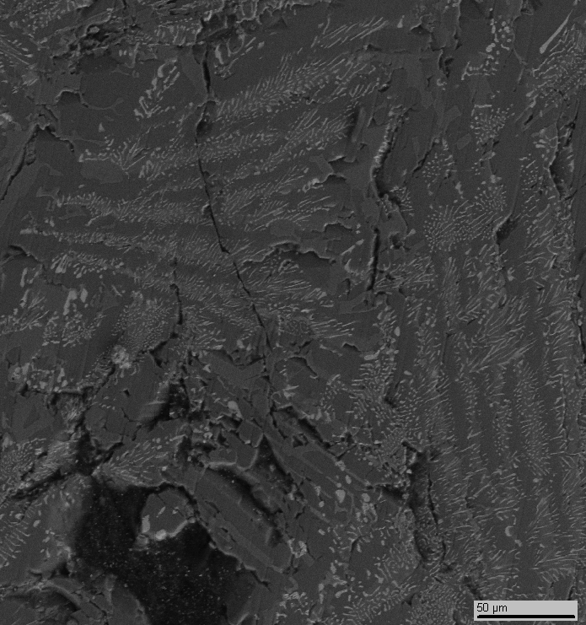
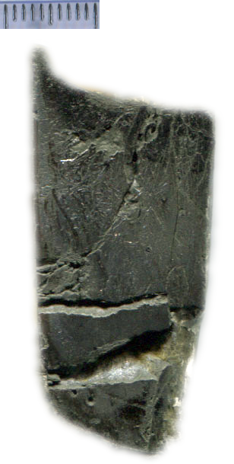
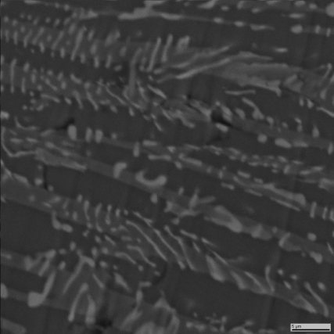
UO₂ – FeO – CaO system: PRS 15 test results (9)
SEM/EDX of eutectic core
FeO
CaFeO₂
10 μm
1 cm
50 μm
ingot
6 μm
Eutectic |  | UO₂ | FeO | CaO
9 sections averaged | mass % | 11.3 ± 2.0 | 59.6 ± 2.7 | 29.1 ± 1.3
 | mol% | 3.0 ± 0.6 | 59.7 ± 2.2 | 37.3 ± 1.8

Slide 26
UO₂ – FeO – CaO system: PRS 15 test results (10)
UO₂
Eutectic point
0.2
0.8
PRS14
5
0.4
0.6
CaUO₃
0.6
0.4
1
8
7
8
±
3
0
0.8
0.2
Averaged eutectic composition in PRS 14 and 15 tests
PRS15
PRS14
PRS14
1
3
3
5
±
5
CaO
1
1
0
8
FeO
0.2
0.4
CaFeO₂
0.6
0.8
CaO⋅2FeO
Eutectic |  | UO₂ | FeO | CaO
 | mass % | 10.9 ± 2.3 | 61.1 ± 3.3 | 28.1 ± 2.0
 | mol% | 2.9 ± 0.7 | 61.1 ± 2.9 | 36.0 ± 2.6

Slide 27
UO₂-FeO-CaO system: GPRS 66 test results (11)
Experimental objectives
Charge composition
Validation of eutectic composition
mol.% 15UO₂ + 80FeO +5CaO
Annealing, melting and crystallization in the Galakhov microfurnace
UO₂ of >99.0 % purity, SiO₂ of 99.99% purity, FeO of >99.0 % purity,
charge mass – 150 mg, molybdenum crucibles ∅ 6 mm
SEM/EDX in progress

Slide 28
UO₂-FeO-CaO system: test results (12)
Tliq of PRS 14 and 15 compositions has been
determined by VPA IMCC
Single eutectic point has been found.
Its composition has been determined. It will be
checked by SEM/EDX of GPRS 66 ingot section
Measurements of Tsol and final solubility are in
progress

Slide 29
Joint publication with collaborators within the reported quarters
V.I. Almiashev et al, Ternary eutectics in the systems FeO–UO₂–ZrO₂ and Fe₂O₃–U₃O₈–ZrO₂ // Radiochemistry, 2011, V. 53, N 1, P. 13–18

Slide 30
Concluding remarks
The Project has been prolonged for 6 months without
additional funding
Work scope for quarters # 12 - 13
Complete study of the next systems:
ZrO₂-FeO_{y} (by LPH in IVT RAN)
UO₂-SiO₂-FeO
CaO-UO₂-FeO
U-Zr-O systems (by LPH in IVT RAN)
Start eutectic composition measurement of a realistic complex corium mixture
Collaborators are kindly requested to provide German
and French partner compositions of complex corium
mixtures

