Slide 1

Parameter SF4 planning analyses by EU partners:
status and plans
Jon Birchley, PSI
CEG-SAM 15th Meeting
10-12th March 2009
PSI Villigen, Switzerland

Slide 2
  Outline
  Background
  Objectives of PARAMETER SF4
  Target test condiditons
  Status of pre-test planning support by EU partners
  Sample calculations
  Conclusions

Slide 3
  Background
  PARAMETER SF4 will investigate air ingress
  Following action placed at 13th CEG-SAM, PSI undertook to coordinate European pre-test planning support
  Participating organisations: FZK, PSI*, EDF*, GRS*, IRSN*, AEKI (* → performing code calculations)
  PARAMETER meeting at Podolsk, July 2008
    first scoping calculations presented
    SF4 agreed as approximate counterpart to QUENCH-10 (Q-10)
  Task Group set up: discussion meeting at FZK, September 2008
    FZK gave review of Q-10 and status of air oxidation knowledge
    objectives and schedule for planning analyses defined
    outcome reported at 14th CEG-SAM
    further exchange at FZK, November 2008
  Supported during 2008 by EU in frame of SARNET

Slide 4
  Objectives
  Conduct PARAMETER SF4 as an approximate counterpart to Q-10
    build on past experience and knowledge already gained
    compare PWR/VVER materials and configuration
  Enable air oxidation in such a way to include a significant period of oxygen starvation
    investigate ZrN formation and its effect on reflood
  Achieve successful reflood without significant excursion and without melting/degradation
    preserve bundle morphology for optimal post-test inspection
    don‘t upset ISTC/LUCH colleagues ….
    …. by proposing an experiment that destroys their facility

Slide 5
  Guideline test parameters
  Power steam/Ar flow to follow SF3 during early stages to reach temperature plateau T_{max} = ca. 1200 °C (as Q-10)
  Pre-oxidation in steam to δ_{ZrO2} ≤ ca. 300 μm (ca. 500 μm in Q-10)
  Power reduction to decrease T_{max} to ca. 900 °C (as Q-10)
  Switch to air flow at ca. 0.8 – 0.9 g/s (as Q-10 scaled by ratio of cladding perimeter)
  Initiate reflood at T_{ref} = ca. 1750 °C (ca. 1900 °C in Q-10)
    aim to achieve oxygen starvation, avoid excursion
    possibly decrease air flow at T < T_{ref} if oxygen not fully consumed
  Reflood with bottom injection
    suggested injection ca. 40 g/s (as Q-10 and SF3)
    higher rate may be needed (100 g/s ?) to avoid reflood excursion

Slide 6
  Status of analyses
  Proposed schedule: first calculations to ISTC in March 2009, final calculations June 2009
    use SF3 data for model benchmarking (not yet available)
    PSI distributed nominal test conditions for partners to construct model
  EDF analyses with MAAP4
    first calculations performed
  PSI analyses with local versions of SCDAP/RELAP5
    first calculations performed
    simulation of air oxidation but oxygen consumption not modelled
    hope to remove limitation with possible future version of SCDAPSim
  GRS analyses in progress with ATHLET-CD
  IRSN analyses with ICARE/CATHARE planned in collaboration with Kurchatov Institute

Slide 7
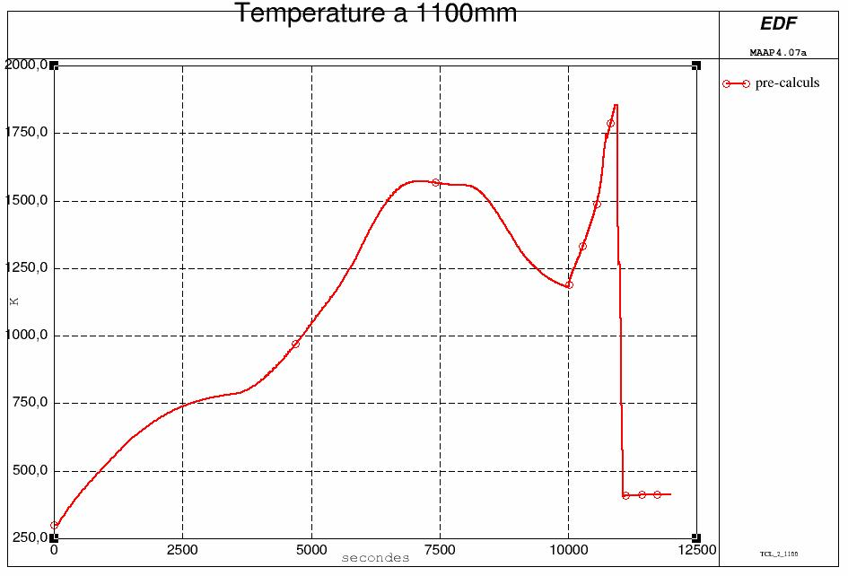
  Sample EDF MAAP4 calculation
pre-oxydation
from 1500 to 10000s
air ingress from
10000 to 11000s
e_{ZrO2} ~380µm

Slide 8
  Sample PSI SCDAP calculation

Slide 9
  Effect of injection rate on temperature

Slide 10
  Effect of injection rate on oxidation

Slide 11
  Conclusions
  First calculations by EDF and PSI suggest target transient can be achieved
    pre-oxidation range 300 – 400 μm
    Oxygen starvation indicated with air flow 0.8 g/s
    need to study in more detail with alternative air oxidation correlations
    40 g/s injection leads to delay before reflood cooling
    higher injection rate would reduce risk of excursion
  Calculations from GRS and IRSN/KI awaited
  SF3 data eagerly awaited for benchmarking
  FZK providing important information on air oxidation
    model developments in progress
    possibility to use in later SF4 analyses

Slide 12
  Acknowledgments
  The coordination has been supported during 2008 by the European Commission in the frame of SARNET
  PSI efforts have been funded by Swissnuclear
  ☺

