Slide 1


Impact of Fukushima on Future Severe Nuclear Accident Research
D. Bottomley¹ & J. Stuckert²
¹ EC-DG-JRC Institut für Transurane
Postfach 2340, 76125 Karlsruhe, Germany
² IMF-III, KIT-Campus nord
Hermann-von-Helmholtz Pl. 1,
76125, Karlrsruhe, Germany

Slide 2
Impact of Fukushima on SAM Research
Outline
Introduction
Examples of typical Severe Accident research at ITU
  TMI-2 (Three Mile Island-unit 2)
  Phebus PF Fission Product projects
  COLOSS, Revaporisation Projects (small scale tests)
Fukushima – outline & proposed areas for examination
Final Comment

Slide 3
1) Three Mile Island (TMI-2)
TMI-2 Examination was an OECD-NEA led consortium under the initiative of the US Dept. of Energy (US-DOE) involving most major European national research institutes
INEL Idaho (as principal contractor) had extracted and examined the samples from TMI-2. It then shipped samples to N. American & European institutes :
AECL Canada, PSI Würenlingen,
Argonne National Lab Studsvik,
FZK-Karlsruhe, CEA Saclay,
JRC-ITU Karlsruhe, AEA Windscale
as well as JAERI Japan.
The principal aims of the examination were to establish:
- what was corium (& other phases) composition
- what temperatures were reached
- what conditions (oxygen potentials) prevailed
hence what degradation reactions were likely

Slide 4
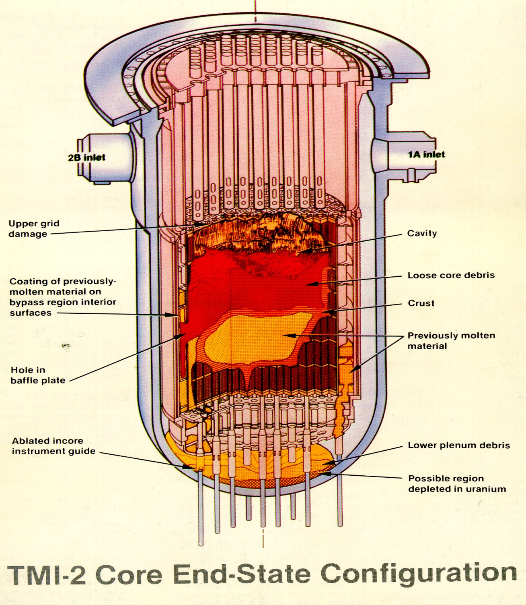
Positions of ITU samples
fuel rod remnant
C7 3-35
debris samples
H8 7.2-7.9
upper crust
D8-P2,3
lower crust
N5-P1-E
O7-P4
core bore rocks
G12-P2-E, G12-P6-E, G12-P9-B, G12-P10-A

Slide 5
TMI-2 Accident
Conditions during accident
1) Max. Temperature
- Edge of reactor T < 800°C
- Agglomerate T~1500°C
(stainless st. mp)
- fully molten core T= 2000-2500°C
(some molten UO₂ seen T=2850°C)
2) Cool-down
core - slow ( 2-54 h)
Agglomerate- more rapid & variable
Edge of core - transient rise in temp.;
only slight degradation
Phases formed
Core - a UO₂ fuel and Zry cladding melt:
U,Zr-containing ceramic with a U-rich phase, a Zr-rich phase and
smaller amounts of Fe,Ni,Cr oxides & Ag nodules
Agglomerate -mixed metallic and ceramic phases
from fuel /cladding /structure interactions
eg. (U,Zr)O₂ phases, (Fe,Ni)-Zr-U oxides, Ni-Fe-Sn metal,
Ni,Fe partially oxidised nodules, & occasional Ag metal nodules

Slide 6
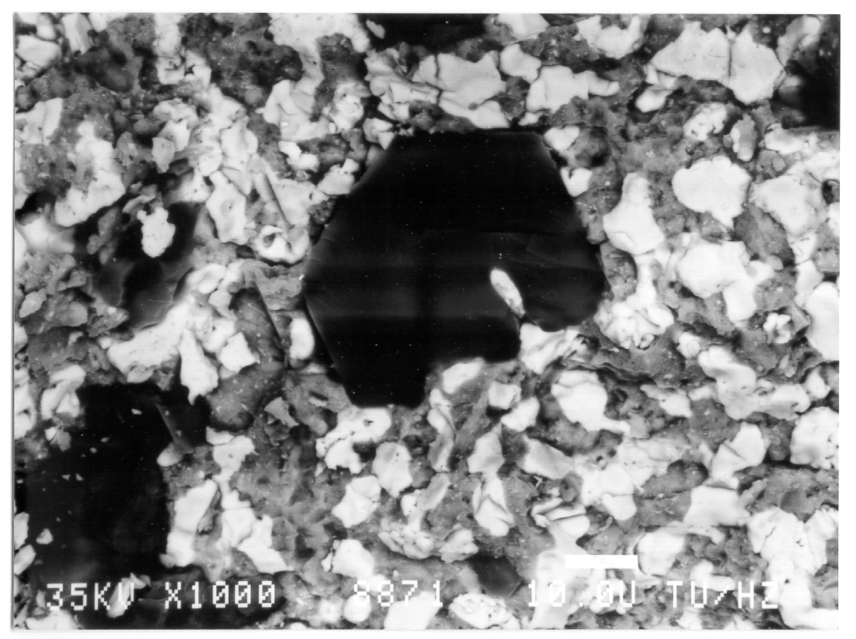
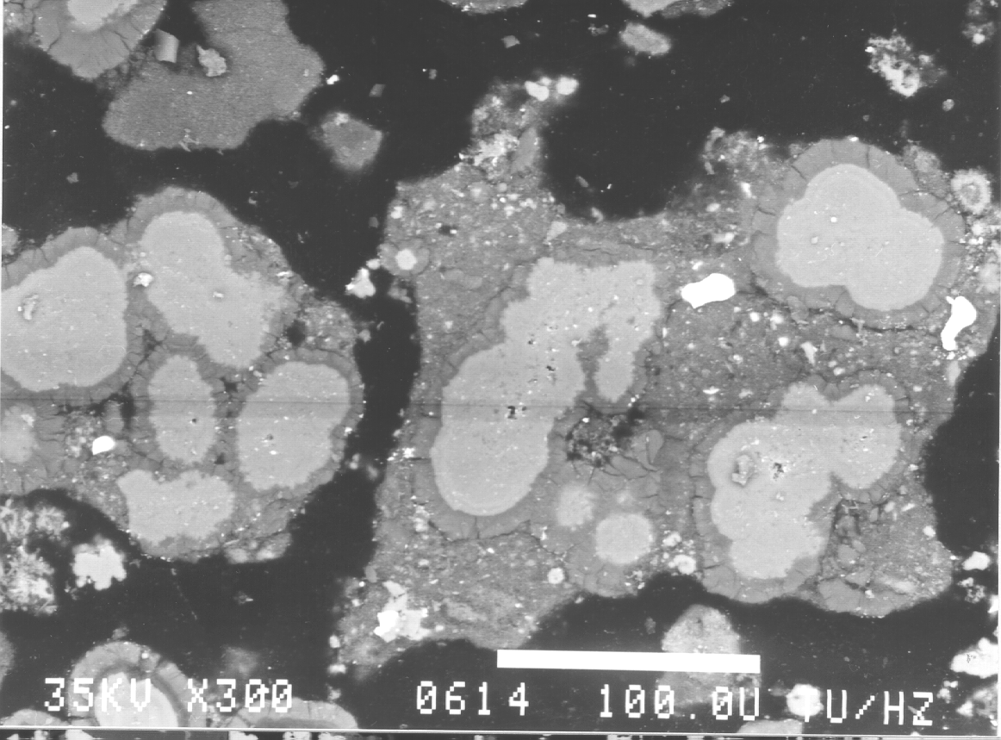
TMI -2 Sample Analysis
U-rich phase
Zr-rich phase
ferrous-rich
phase
Core bore rock G12-P9-B- 1000x
Back-scattered image showing dense (U-rich) and less dense (Zr-rich) and light (Fe,Ni,Cr-rich) phases in the fully molten rock
Agglomerate crust O7-P4-EA
Fe-Ni nodules wtith pure Fe metallic core (lighter centres) surrounded by Fe-Ni oxide crust (darker zones) due to preferential oxidation (BEI-1000x)

Slide 7
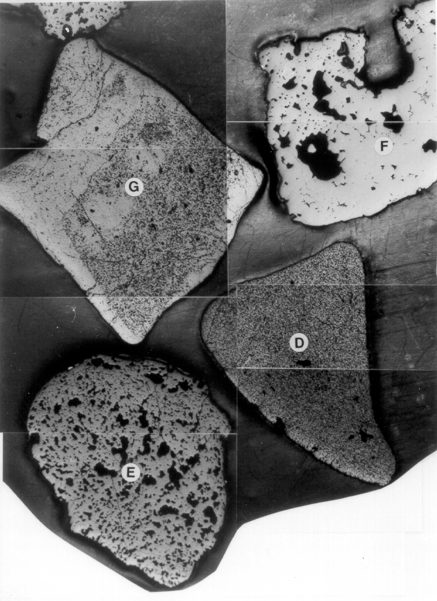
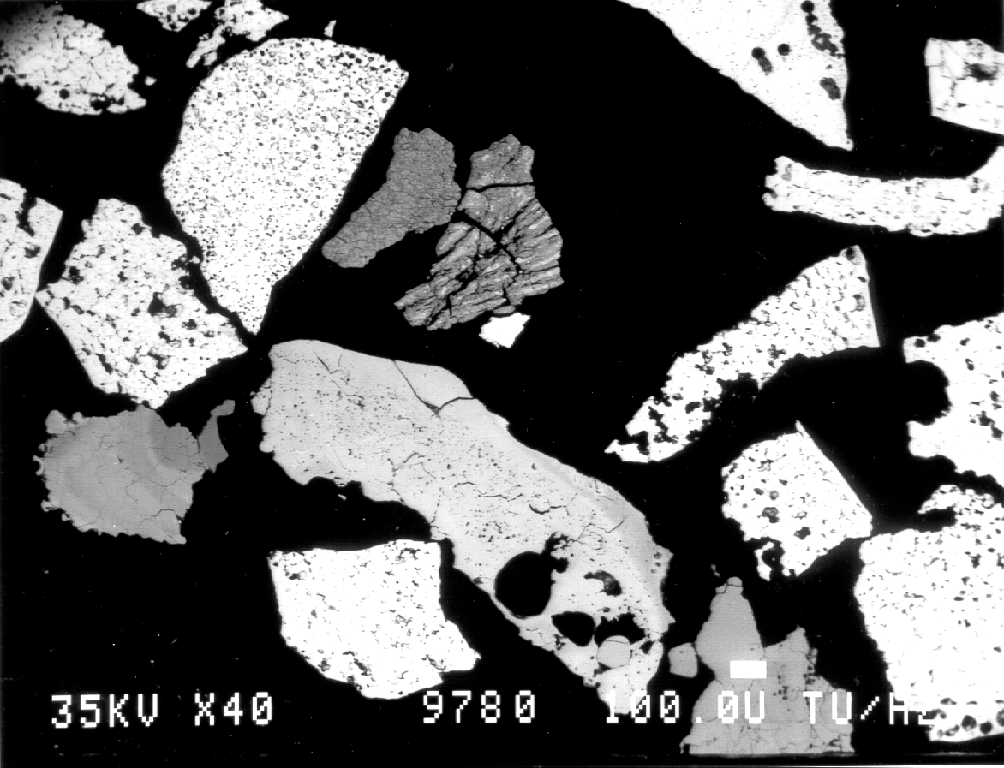
TMI -2 Sample Analysis
White pieces are UO₂
banded structure is zircaloy interacted with steels or Ni-based alloys
Long grey piece is zircaloy-UO₂ mixture
Macroscopic photo of various
debris pieces (approx. 5x)
Debris H8-7-5-1 located on the upper agglomerate (40x)

Slide 8
Phebus PF
TESTS
  FPT0: (base-line test) degradation of a trace-irradiated, 20 x 1m fuel rod bundle under a steam atmosphere (Dec ‘93).
  FPT1: degradation of irradiated fuel rods (23 GWd/tU*) under steam (July ‘96).
  FPT4: examination of the late stages of an accident - steam degradation of a debris bed of pieces of irradiated fuel (33 GWd/tU*) and oxidised cladding.
  Low volatile fission products were particularly investigated (July ‘99).
  FPT2: degradation of irradiated fuel bundle (35 GWd/tU*) with a period of low steam flow, to see the effect of reducing conditions (Oct. 2000).
  FPT3: degradation of irradiated fuel bundle with B₄C absorber present in the reactor (compared to Ag- In- Cd for previous tests) - (Oct 2004).
    ITU’s contributions:
    i) sectioning of degraded bundle
    ii) microscopic examination & analysis of phases at selected points
to establish the principal interactions.
iii) examination of fission product samples from filters of primary circuits

Slide 9
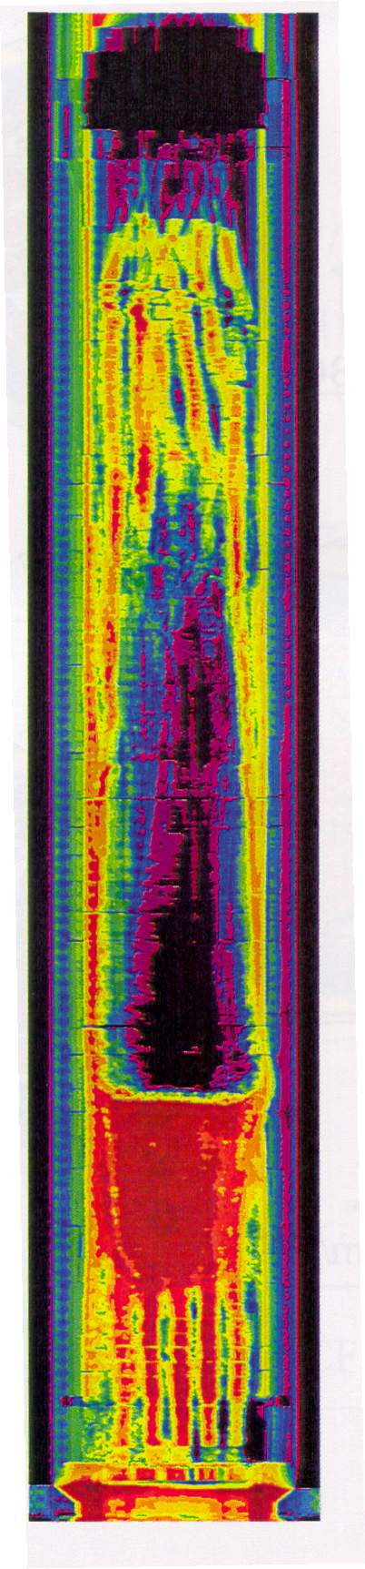
Phebus: Post Irradiation Examination (PIE)
Degraded upper bundle
c) FPT2
False colour tomography of FPT0, FPT1 & FPT2 bundles showing the formation of dense molten pools (red) at 1/4 height with central cavities (black) above them.
Note greater attack in FPT2 (reducing conditions) than in FPT1 (oxidising conditions)
In FPT0 the initial degradation was greater than in next 2 tests
Central Cavity
Corium pool
(IRSN Cadadrache)

Slide 10
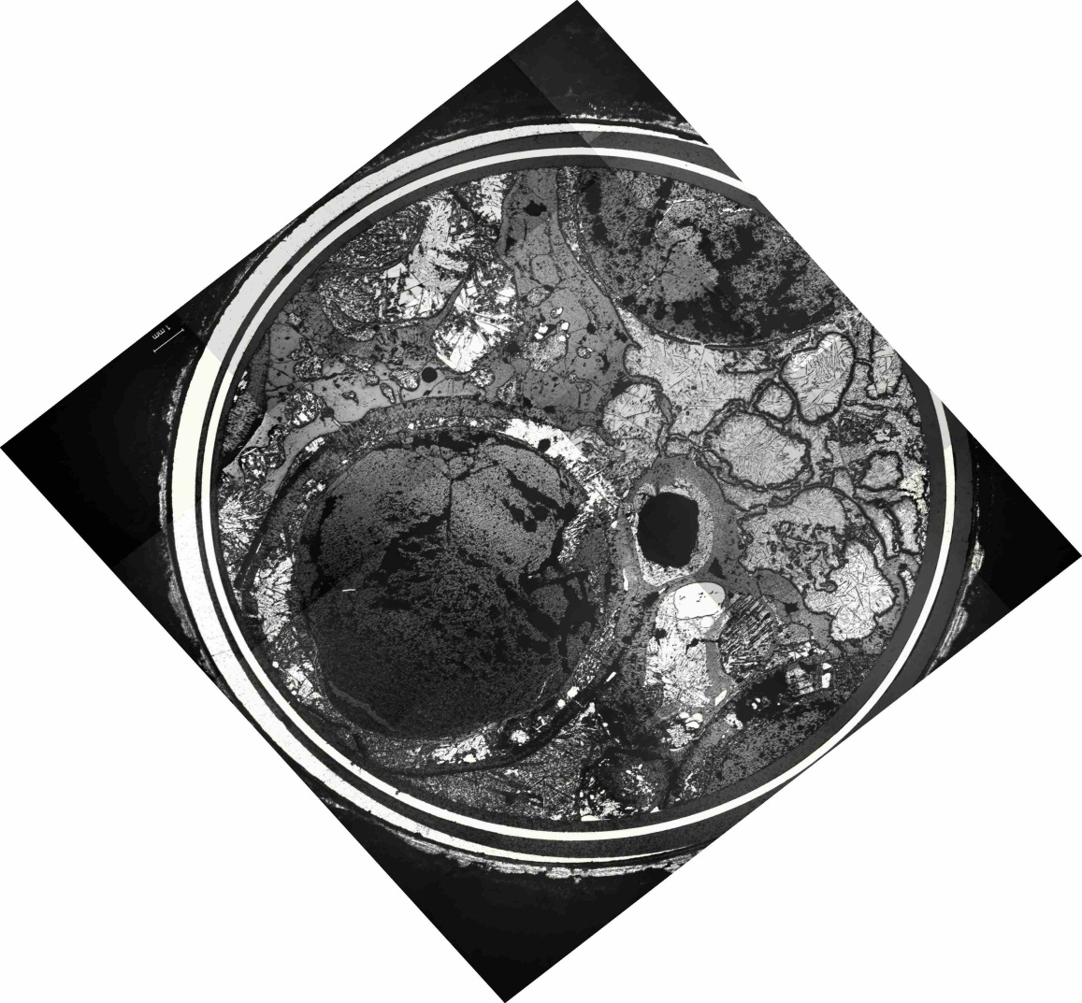
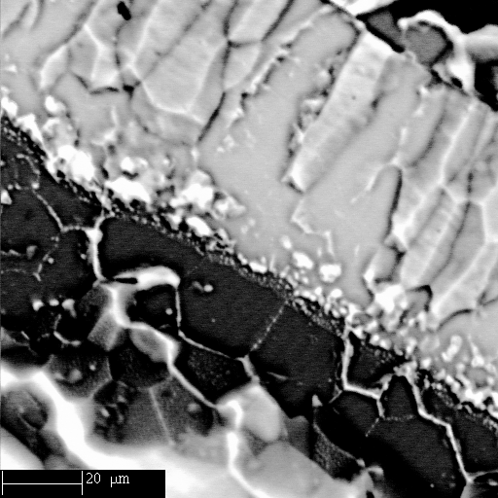
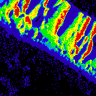
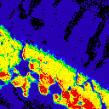
Phebus FPT2- PIE beneath the corium pool
Zr-rich cladding
U-rich zone in fuel edge attached to cladding
Absorbed Electron Image
Zr image
U image

Slide 11
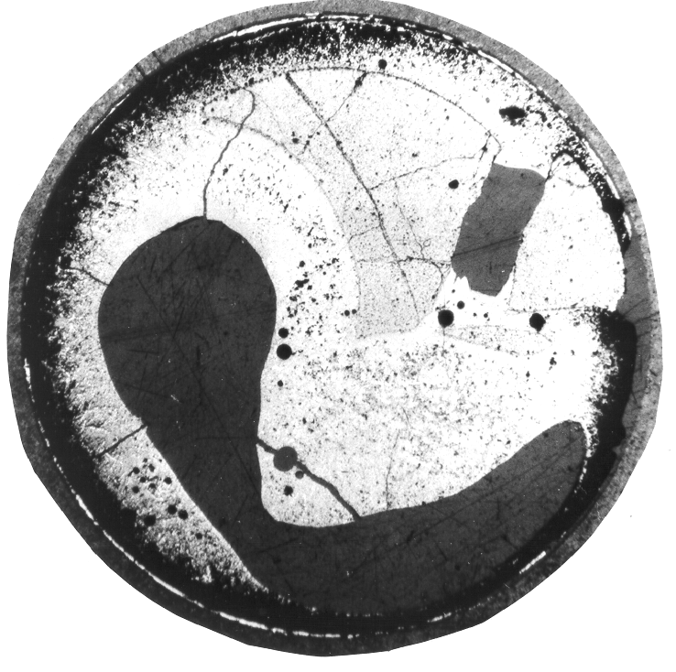
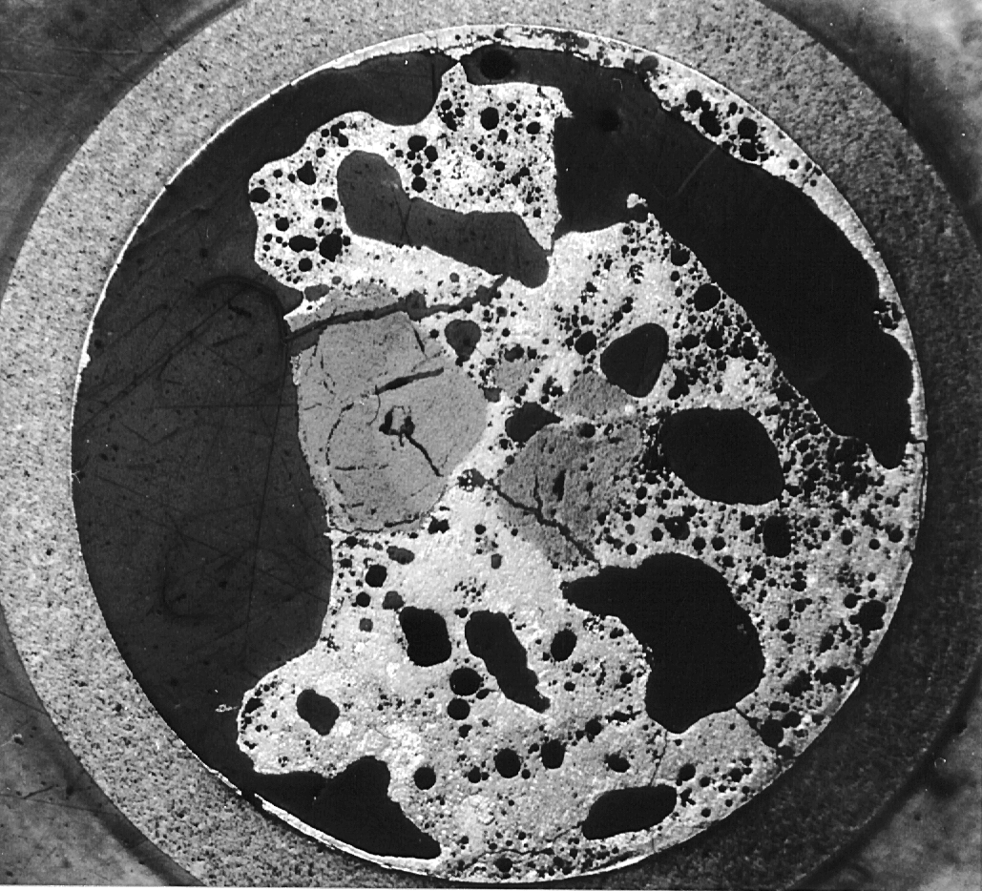
CIT Results
2000°C -190s non-irradiated fuel
2000°C -190s irradiated fuel (53 GWd/tU
-see irregular break-up of fuel and pores
Comparison of dissolution of irradiated and non-irradiated fuel

Slide 12
SCA Revaporisation Project
Cs-137 γ-activity loss of the upper vertical line sample during slow ramping
to 1000°C under a flowing steam atmosphere
1
ΔΤ₁₋₂ = 550-690°C
85% of activity lost
2

Slide 13
Fukushima Impact
9.0 Earthquake followed by Tsunami 30 mins later resulted in a combination of events unforeseen in any scenario.
This resulted in an effective total black out (TSB) without much hope of back-up supply, given the destruction of the surrounding infrastructure.
The emergency cooling systems of the units 1, 2 & 3 managed with difficulty but steadily there was an increase in the RPV pressure and a drop in water level in RPVs. Also falling water levels in spent fuel pools.
The need for venting to the containments of each of the reactors became clear and request was eventually granted. Following the venting there was a series of H₂ explosions, including the unit 4 building that contained no fuel.
Operators noted that the water levels fell to the bottom of the reactor. Thus there is substantial fuel overheating in the RPV.
Finally sea water was pumped into the RPV circuits. Earlier attempts were hindered as the internal pressures were quite high.

Slide 14
Discussion
Much information available from the Japanese and from elsewhere.
What can we do to help the Japanese
& also fill existing gaps in the current state of the art ?
Unfortunately the Japanese are not present to give their plans.
Japanese researchers seem likely to make contact soon with research organisations in Europe & Russia
However we can begin by identifying important issues and preparing proposals to the Japanese.
(possibly different European & Japanese priorities:VVER-BWR vs. PWR,
Results of EU operator stress tests)

Slide 15
Areas for examination ?
Total station black-out: 8-24 hour was previous accepted scenario (2- 7 days may be necessary)
Source Term -semi-volatile releases (ie. Ba/Sr)
Quenching & Molten Concrete Core Interaction (MCCI) – extent not known but information would be extremely helpful, as some MCCI mechanisms are not understood
Hydrogen explosions (& Recombiners & Containments). What data available on this problem (didn’t happen in TMI-2, Paks nor Chernobyl). Need to assess what happened and re-evaluate H₂ mobility in a complex-compartmented structure (especially BWR’s).
Spent Pool accidents (scenarios)
How hot did the fuel get? sea-water effects.
Salt water effects on primary circuit & irradiated fuel integrity:
general corrosion or pitting corrosion,
irradiation products (Na-22),
  irradiated fuel leaching or dissolution effects: the last is totally unknown

Slide 16
Areas for examination ?
Wider or long term issues
Environmental monitoring of air, waters around reactors, accumulations
Remediation
Full reporting and data compilation from all investigations.
Final Comment
Proposal:
to select our highest priority research areas in preparation for discussion with Japanese researcher, with a view to making a joint research programme.

