Slide 1
CEG-SAM Webpage Status
Presented by A. Miassoedov
Forschungszentrum Karlsruhe GmbH
Institute for Nuclear and Energy Technologies

Slide 2
CEG-SAM Status
Website is hosted by GRS (thanks!) and now fully operational
Each CEG-SAM member received unique user name and password
Structure similar to the SARNET portal
Flexible management policy, e.g.
  Unique account for each user
  Different write/read permissions for each user
  Possibility to a add links, documents, discussions, etc.
Each ISTC project has its own workspace
  Different access rights for different project workspaces

Slide 3
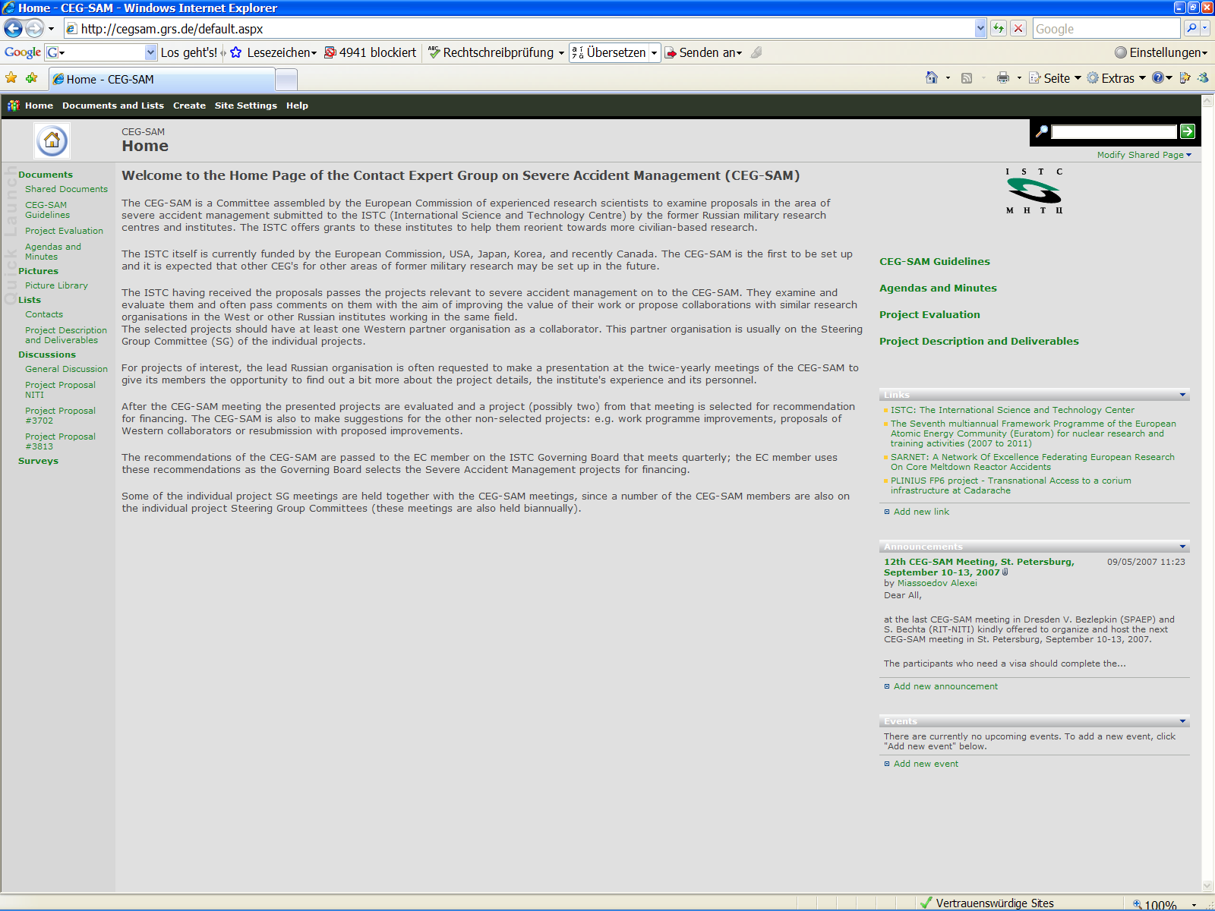

Slide 4
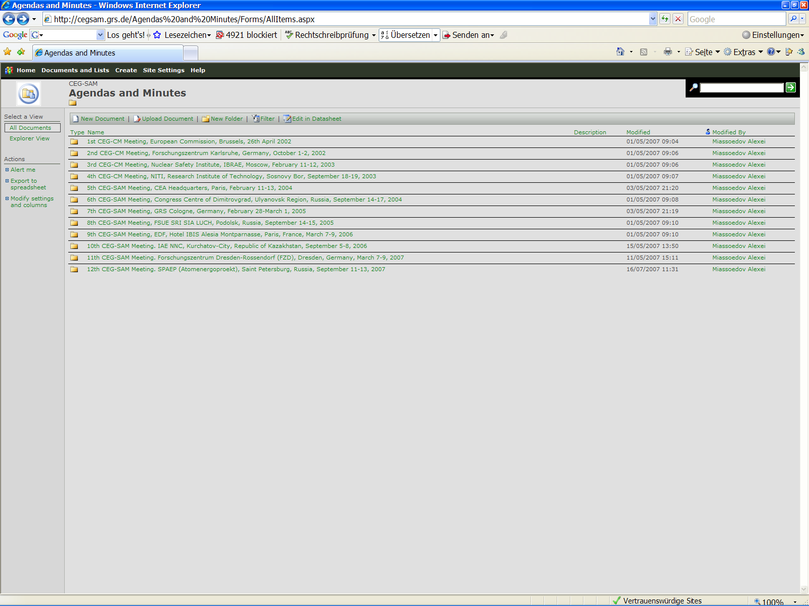

Slide 5
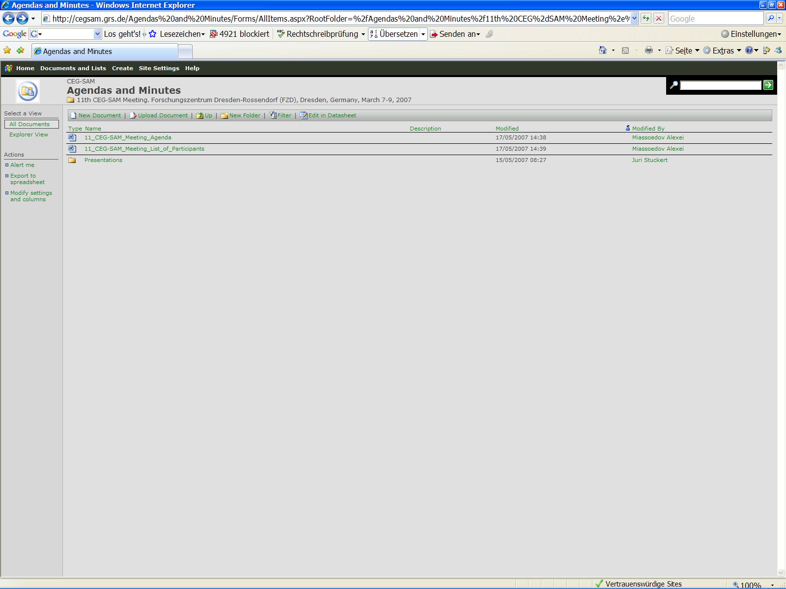

Slide 6
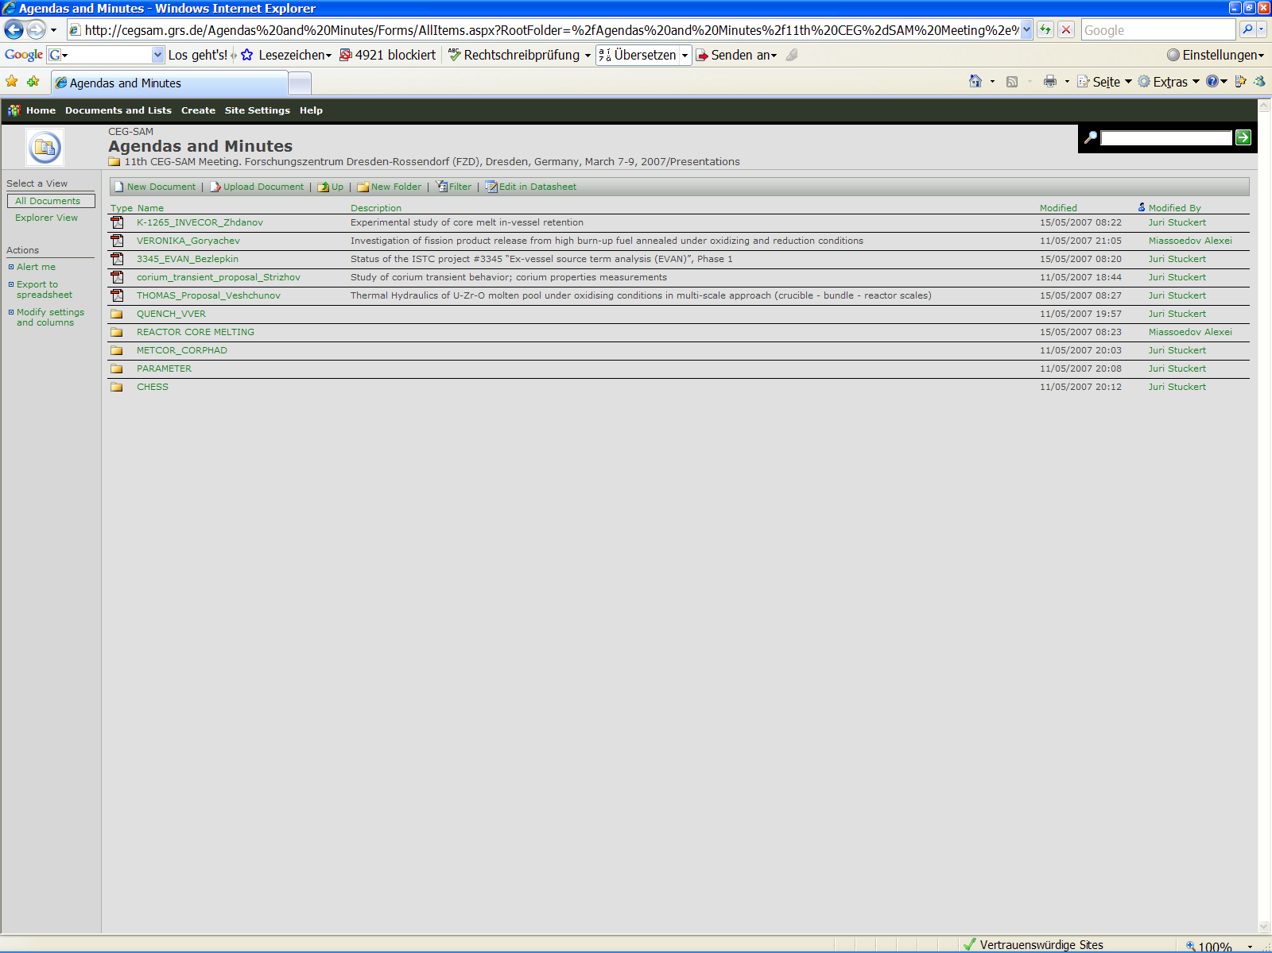

Slide 7
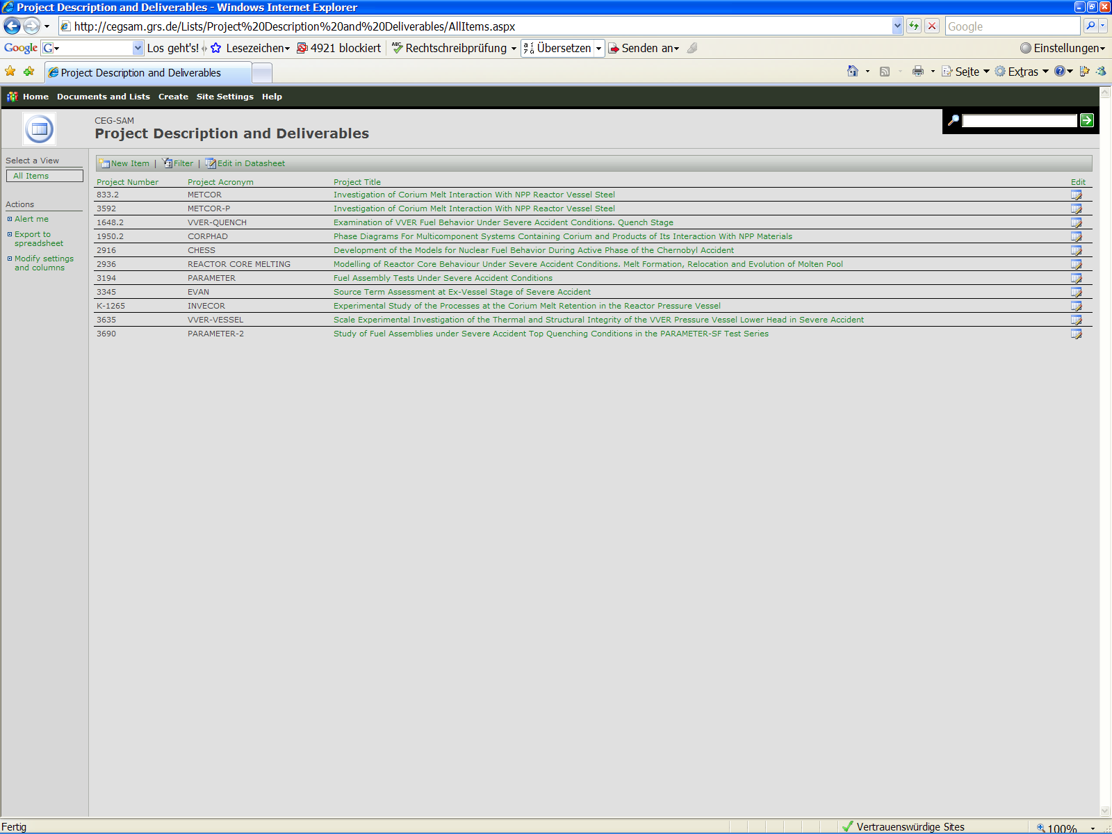

Slide 8
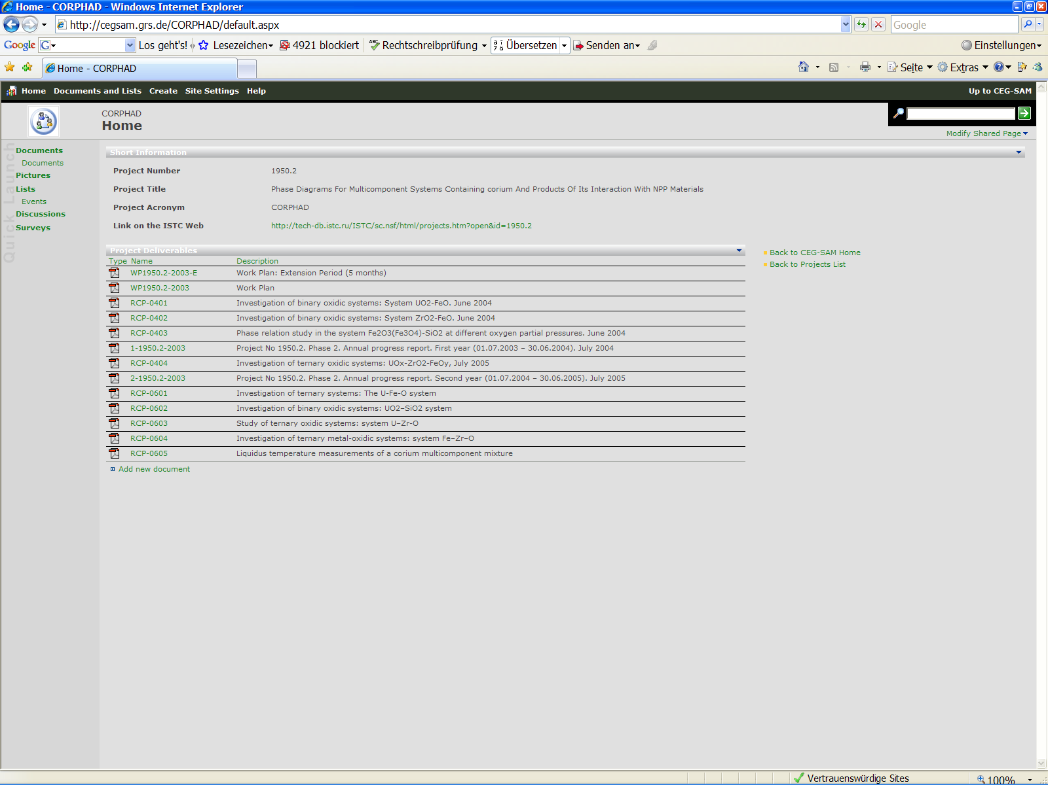
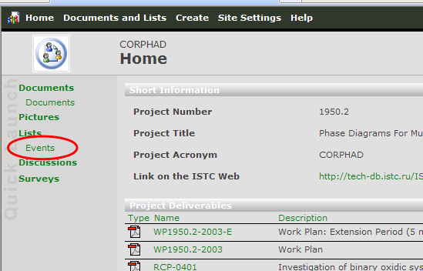
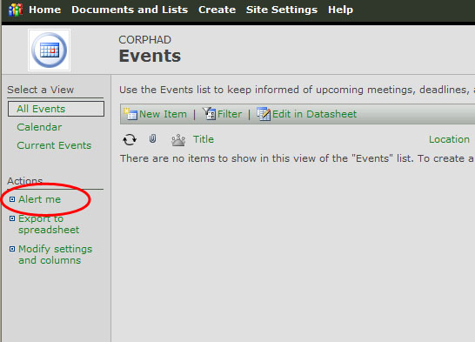

Slide 9
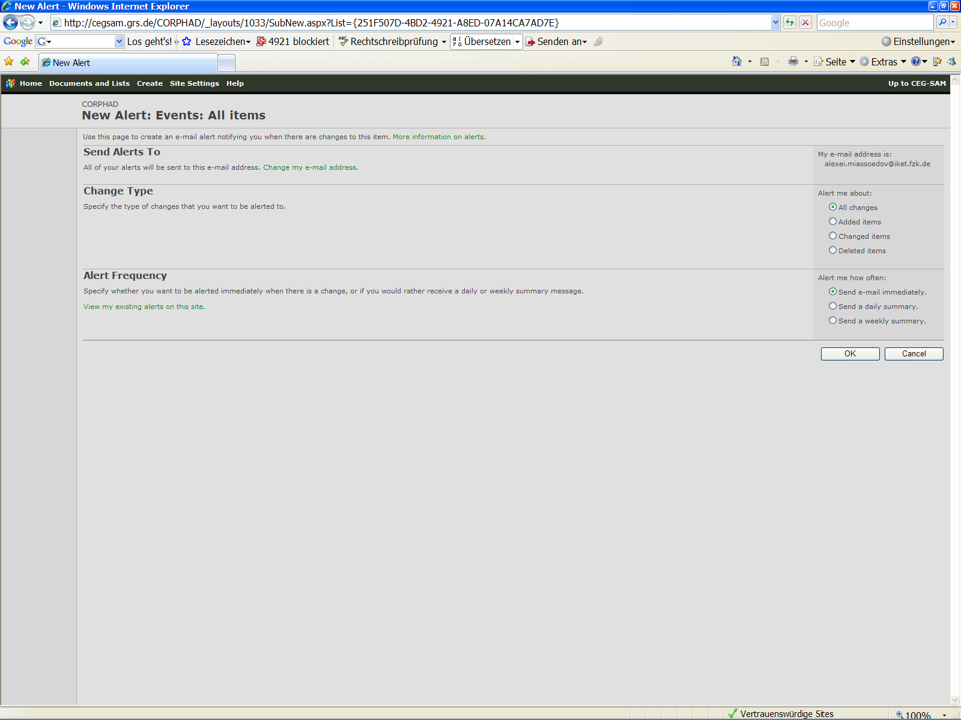
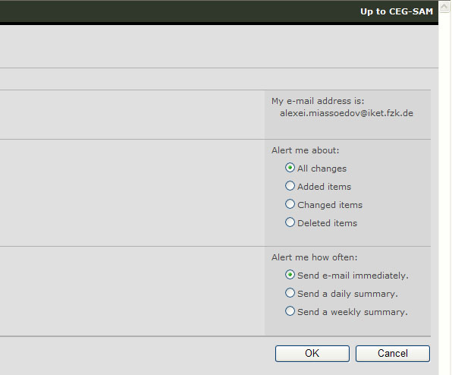

Slide 10
To Do
Russian project Co-ordinators should have read and write permission for their project workspace:
Keep the project documentation/deliverables updated
Upload presentations from the progress meetings

