Slide 1

ISTC Project #2916 (CHESS)
Analysis of fuel-containing mass (FCM) behaviour during the active phase of the Chernobyl accident / Chernobyl lessons”
A.Borovoi, S.Bogatov, V.Strizhov
6-th CEG-CM meeting
Dimitrovgrad, September 14-17, 2004
RRC “KI”

Slide 2
Background
The project was reviewed by ISTC CEG-CM group (January 2004)
The revisions were made on the basis of CEG-CM recommendations
Revised Project was presented at the 5-th CEG-CM Meeting and approved

Slide 3
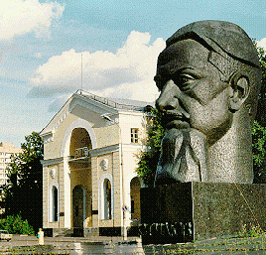
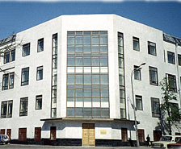
Participating Institutions:
RRC “KI”
Russian Research Center “Kurchatov Institute” (RRC KI)
Nuclear Safety Institute of Russian Academy of Sciences (NSI)
Project manager: Borovoi A.A. Project Sub-manager Strizhov V.

Slide 4
Collaborators
Gesellschaft für Anlagen- und Reaktorsicherheit (GRS) GmbH
Institut de Radioprotection et de Sûreté Nucléaire
Forschungszentrum Karlsruhe GmbH
Institute für Transurane
Commisariat a l′energie atomique - CEA

Slide 5
Objectives of the Project:
RRC “KI”
Analysis of current physical and chemical state as well as spatial location of fuel containing materials (FCM);
Analysis of the accident scenario using available analytical models and data;
Determine directions of future research on the problem

Slide 6
Task 1. Collection, verification and analysis of initial data on nuclear fuel behavior
Task 1.1 Development of initial data sets (geometry, initial and boundary conditions) for different stages of accident , development of scenarios for fuel behaviour during different stages of accident (corium formation, corium spreading, corium structural materials interactions)
Task 1.2 Assessment of the graphite impact on the accident progression (burning, heat generation, etc.)
Results of the Task will be summarized in the report
Expected completion date: 12 months

Slide 7
Task 2. Development of the database for the modeling of FCM behavior in the 4-th Unit
Task 2.1 Preparation of data on the location of FCM in the 4-th Unit
Task 2.2 Development of the database on corium compositions
Task 2.3 Elaboration of the variety of possible scenarios during corium spread and its interaction with structural materials
Results of the Task will be summarized in the report
Expected completion date: 18 months

Slide 8
Task 3. Determining U and Zr concentrations in metallic melts in the compartments below the reactor
Investigations on uranium and zirconium concentrations (& where possible carbon) in metallic melts formed during the accident
  Use of up-to-date and calibrated measuring technique to get quantitative results
Results of the Task will be summarized in the report
Expected completion date: 27 months

Slide 9
Task 4. . Application of the existing computational models for evaluation of the FCM state at Unit 4
Task 4.1 Determination of the key parameters and preparation of initial data sets for specific models and codes
Task 4.2 Computational analysis of calculations of the FCM behavior and comparison of results to experimental data and to complementary analysis
Results of the Task will be summarized in the report
Expected completion date: 27 months

Slide 10
Task 5. Development of the final report on the Project
Task 5.1 Identification of the lack of phenomena knowledge and lack of data necessary for code use and validation, their prioritisation
Task 5.2 Development of proposal for the Step 2 on the base of performed analyses and evaluations
Results of the Task will be summarized in the report
Expected completion date: 30 months

Slide 11
Time schedule of the project

