Slide 1
Progress Report on the ISTC project #1950.2
“Phase Diagrams for Multicomponent
Systems Containing Corium and Products of its Interaction with NPP Materials”
(CORPHAD.2)
A.P. Alexandrov Research Institute of Technology
Presented by S. Bechta
10th CEG-SAM Meeting

Slide 2
Contents
Project general information
Experimental matrix of CORPHAD Project
Scope of work in the 12-13 quarters
Zr-Fe-O system
UO₂-SiO₂ system
Complex corium mixture
Papers
Plans for the final period of the Project
Conclusions

Slide 3
CORPHAD project general information
Project participants and coordination
Collaborators
FZK, Germany
IRSN,
France
ITU,
EK
CEA,
France
Framatome ANP, Germany
Coordinator
ISTC, Moscow
Steering committee
Operation Agent: A.P. Alexandrov RIT, Russia
ISC RAS,
Russia
RRC Kurchatov
Institute, Russia
SPb Electrotechnical State University, Russia
*) Should be finished in November 2006

Slide 4
Experimental matrix of CORPHAD Project
    *) On agreement with collaborators the test was replaced by two experiments in
    the Zr-O-Fe system

Slide 5
Scope of work in the 12-13 quarters

Slide 6
Zr-Fe-O system: CORD44
Experimental objectives
Determine liquidus temperature
VPA IMCC
Fragment of the experimental thermogram showing the melt surface
T_{liq}
    T_{liq} was measured three times: 1770 ºC, 1780 ºC and 1790 ºC ⇨ T_{liq}=1780 ºC
Notes:
In accordance wit the CORD33 posttest analysis the miscibility gap area is smaler than the calculated one, and the determined tie-line is on the boundary edge. For this reason it was decided to shift the CORD39 initial charge composition deeper into the gap.

Slide 7
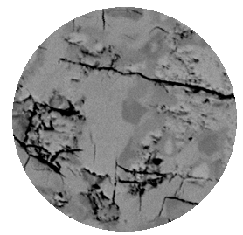
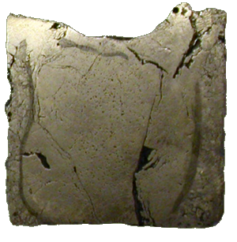
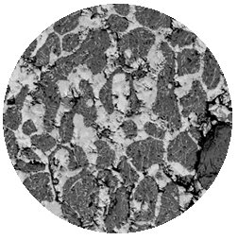
Zr-Fe-O system: CORD44
SEM/EDX
Cation composition of the melt quenched from liquidus temperature
 | Zr | Fe
mol. MeO_{x}% | 66.3 | 33.7
10 μm
Co-crystallization of refractory phases
1cm
 | Zr | Fe
mol. MeO_{x}% | 80.7 | 19.3
30 μm

Slide 8
Zr-Fe-O system: CORD45
Experimental objectives
Determine liquidus temperature
VPA IMCC
Fragment of the experimental thermogram showing the melt surface
T_{liq}
    T_{liq} was measured two times: 2505 ºC and 2535 ºC ⇨ T_{liq}=2520 ºC
Notes:
In accordance wit the CORD33 posttest analysis the miscibility gap area is smaler than the calculated one, and the determined tie-line is on the boundary edge. For this reason it was decided to shift the CORD39 initial charge composition deeper into the gap.

Slide 9
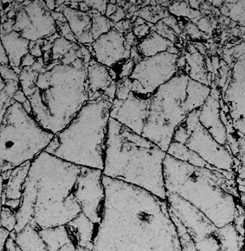
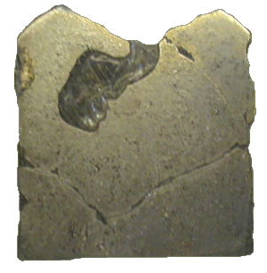
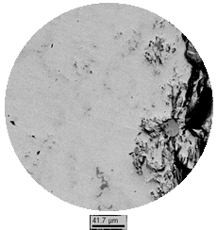
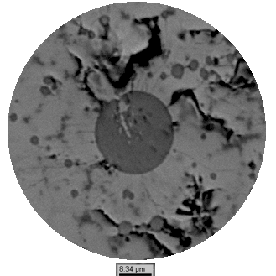
Zr-Fe-O system: CORD45
SEM/EDX
ZrFe₃(O)
ZrO₂
30 μm
0.5 mm
Melt sample
1cm
 | Zr | Fe
mol. MeO_{x}% | 26.1 | 73.9
10 μm
Uniform ingot structure, Fe/Zr cation ratio - 1:3
The presence of ZrO₂ globules concentrated in the samples rapidly quenched
during melting indicates melt immiscibility

Slide 10
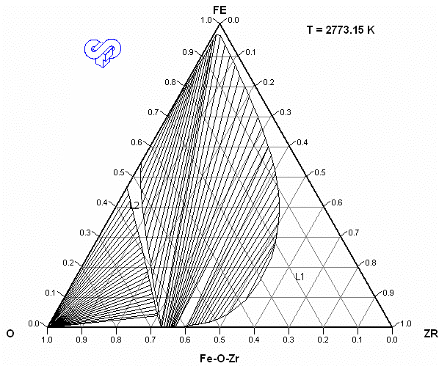
Zr-Fe-O system
Concluding remarks
Miscibility gap was observed in CORD33 and CORD39 tests
CORD45
T_{liq}=2793K (at.% 29.9 Zr – 61.1 Fe - 9 O)
CORD39
Tie line (T_{melt}=2773K)
heavy “metallic” liquid, at.% 45.1Zr –31.5Fe –23.4O
light “oxidic” liquid , at.% 44.4Zr –7.1Fe –48.5O
2773K
T_{liq}=2763K (at.% 45.4 Zr – 25.8 Fe – 28.8 O)
CORD33
Tie line (T_{melt}=2693K)
light “metallic” liquid, at.% 51.5 Zr –24.3 Fe –24.2 O
heavy “oxidic” liquid, at.% 47.9 Zr –4.9 Fe –47.2 O
T_{liq}=2655K (at.% 48.7 Zr – 19.7 Fe – 30.6 O)
CORD35
T_{liq}=2637K (at.% 48.7 Zr – 19.7 Fe - 30.6 O)
CORD44
T_{liq}=2053K (at.% 62.8 Zr – 18.6 Fe - 18.6 O)
Depending on position of the figurative point in the miscibility gap, relation between the densities
of oxidic and metallic liquids may differ (in CORD33, oxide density was higher than that of metal)
Compositions of liquids coexisting in the miscibility gap of CORD39 indicate that the gap is
narrower than calculated using GEMINI-2/NUCLEA-05
Notes:
In comparison with thermodynamic calculation the miscibility gap is a little narrower.

Slide 11
UO₂-SiO₂ system
Published phase diagrams
T, °C
T, °C
2800
2200
2600
L
2000
L
UO₂ + L
SiO₂
+
L
2400
1800
2200
L₁ + L₂
1650
2000
2070±10
1600
UO₂ + L
UO₂ + SiO₂
1800
1719±10
1400
UO₂ + SiO₂
UO₂
20
40
60
80
SiO₂
1600
mol % SiO₂
UO₂
20
40
60
80
SiO₂
UO₂ – SiO₂ phase diagram by S.M. Lang et al., Nat. Bur.
Stand., Circular 568. 1956
mol % SiO₂
Phase diagram by Lungu S., Romanian J. of Physics. 1962. V. 7. N 4. P. 419
Test objectives
  Define whether the miscibility gap exists in the system or not
  Determine the miscibility gap boundary
  Evaluate monotectic temperature

Slide 12
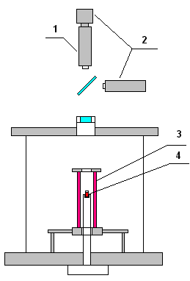
UO₂-SiO₂ system
Experimental setup:
Galakhov microfurnace
Sample quenching
SEM/EDX analysis
  1 – pyrometer;
  2 – video cameras;
  3 – W heating tube;
  4 – Mo crucible
  Atmosphere – Ar + H₂(4 vol. %)
  Total gas pressure – up to 3 atm
  Mass of the samples – 50-150 mg
  Stepwise heating
  Heating rate – 1-8°C/min
  Exposure time – 1 min
  The error of pyrometer temperature
measurements is ±1 relative %

Slide 13
UO₂-SiO₂ system
Charge composition
Composition of all samples, % | UO₂ | SiO₂
mass | 50.7 | 49.3
mol | 18.62 | 81.38
Test characteristics

Slide 14
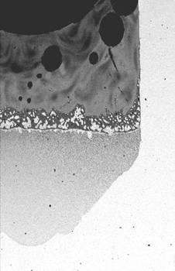
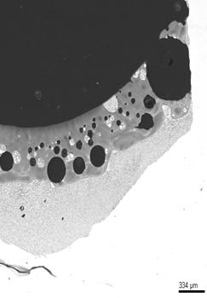
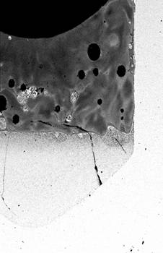
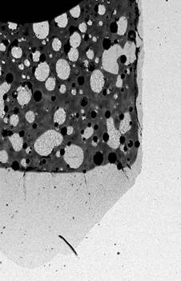
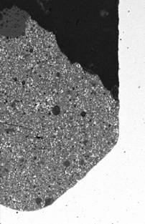
UO₂-SiO₂ system
Macrostructure of quenched ingots
2200°C
2140°C
2140°C
2080°C
2000°C
No quenching
GCORD 1-5
Stratification in the system above 2000°C

Slide 15
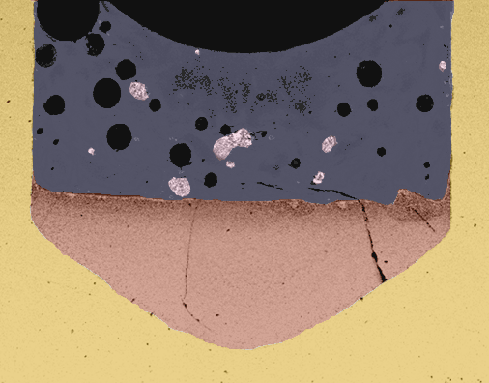
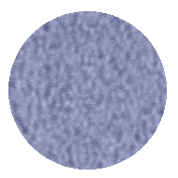
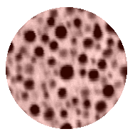
UO₂-SiO₂ system
Microstructure of GCORD3 ingot
Light
liquid
Heavy
liquid
3 μm
Mo crucible
1mm
No interaction with Mo crucible in accordance with EDX data
Large quantity of gas pores in the layer corresponding to light liquid
Presence of heavy liquid globules in the light liquid

Slide 16
UO₂-SiO₂ system
First results
T, °C
2800
The miscibility gap was found to exist in the UO₂ – SiO₂ system
The miscibility gap boundary was estimated
The monotectic temperature was found to be in the 2000-2080°C temperature range
L
2600
Initial composition
2400
L₁ + L₂
2200
2080
2140
2000
2070±10
UO₂ + L
1800
1719±10
UO₂ + SiO₂
1600
UO₂
20
40
60
80
SiO₂
mol % SiO₂

Slide 17
Complex corium mixture
Experimental objectives
Determine liquidus temperature
Charge composition
Mass %, 54.2UO₂ – 17.9ZrO₂ – 13.7SiO₂ – 7.6FeO – 3.8CaO – 1.5Cr₂O₃ – 1.3Al₂O₃
VPA IMCC
Fragment of the experimental thermogram showing the melt surface
T_{liq}
T_{liq} = 2020 °C
Posttest analysis of samples and ingot is underway

Slide 18
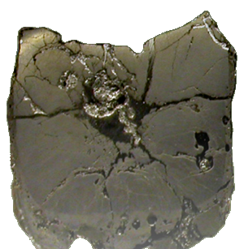
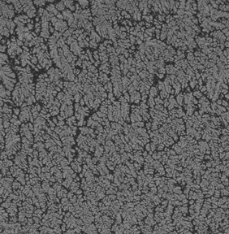
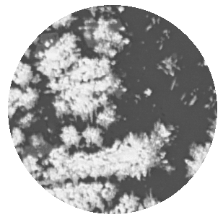
Complex corium mixture
SEM/EDX
5 μm
0.3 mm
1cm
 | UO₂ | ZrO₂ | SiO₂ | CaO | AlO_{1.5} | FeO | CrO_{1.5}
mass.% | 45.81 | 12.65 | 22.00 | 6.23 | 2.70 | 8.62 | 1.99
mol.% | 17.88 | 10.82 | 38.60 | 11.71 | 5.58 | 12.64 | 2.76

Slide 19
CORPHAD Papers
Bechta S.V., Krushinov E.V., Almjashev V.I., Vitol S.A., Mezentseva L.P., Petrov Yu.B., Lopukh D.B., Khabensky V.B., Barrachin M., Hellmann S., Froment K., Fischer M., Tromm W., Bottomley D., Defoort F., Gusarov V.V. Phase diagram of the ZrO₂–FeO system. // J. Nucl. Mater. Vol. 348, p.p. 114-121 (2006)
Mezentseva L.P., Popova V.F., Almjashev V.I., Lomanova N.A., Ugolkov V.L., Bechta S.V., Khabensky V.B., Barrachin M., Hellmann S., Gusarov V.V. Phase diagrams of the SiO₂–Fe₂O₃(Fe₃O₄) systems in different gas atmosphere. // J. Europ. Ceram. Soc., prepared for publication
Bechta S.V., Krushinov E.V., Almjashev V.I., Vitol S.A., Mezentseva L.P., Petrov Yu.B., Lopukh D.B., Khabensky V.B., Barrachin M., Hellmann S., Froment K., Fischer M., Tromm W., Bottomley D., Gusarov V.V. UO₂–FeO phase diagram. // J. Nucl. Mater., 2006. in press
Bechta S.V., Krushinov E.V., Almjashev V.I., Vitol S.A., Mezentseva L.P., Petrov Yu.B., Lopukh D.B., Khabensky V.B., Barrachin M., Hellmann S., Gusarov V. V. Phase relations in the ZrO2--FeO system. // Russian J. Inorg. Chem. 2006. V. 51. N 2. P. 325-331. (Eng.)
Bechta S.V., Krushinov E.V., Almjashev V.I., Vitol S.A., Mezentseva L.P., Petrov Yu.B., Lopukh D.B., Khabensky V.B., Barrachin M., Hellmann S., Gusarov V. V. Phase and chemical transformations in the SiO₂–Fe₂O₃(Fe₃O₄) systems at various oxygen partial pressure. // Russian J. Inorg. Chem. 2006. V. 51. N 1. P. 125-133. (Eng.)

Slide 20
Plans for the final period of the Project
Completion of posttest analysis
Report on the U-Zr-O system including CORD41 (U-O system)
Report on the Zr-Fe-O system
Report on the U-Fe-O system
Report on the UO₂-SiO₂ system
Report on the complex corium mixture
Final report with the attachments
Deadline: March 2007

Slide 21
Conclusions
Experimental part of the project is in progress
The Zr-Fe-O system was found to have a narrower miscibility gap than calculated using GEMINI2+NUCLEA05
Stratification in the UO₂ – SiO₂ system has been established, the first data confirm the diagram version of Lungu S. and Romanian J., 1962. The estimate of monotectic temperature and miscibility gap boundaries has been made
Liquidus temperature of the prototypic multi-component corium has been determined
The produced systematic data characterize the crystallization pattern of oxidic and metal-oxidic systems

