Slide 1
Progress Report on the ISTC project #1950.2
“Phase Diagrams for Multicomponent
Systems Containing Corium and Products of its Interaction with NPP Materials”
(CORPHAD.2)
A.P. Alexandrov Research Institute of Technology
Presented by S. Bechta
9th CEG-SAM Meeting

Slide 2
Contents
Project general information
Experimental matrix of CORPHAD Project
Scope of the work in the 10-11 quarters
Zr-Fe-O system
U-Zr-O system
U-Fe-O system
U-O system
Papers
Plans for the period till the end of the Project
Conclusions

Slide 3
CORPHAD project general information
Project participants and coordination
Collaborators
FZK, Germany
IRSN,
France
ITU,
EK
CEA,
France
Framatome ANP, Germany
Coordinator
ISTC, Moscow
Steering committee
Operation Agent: A.P. Alexandrov RIT, Russia
ISC RAS,
Russia
RRC Kurchatov
Institute, Russia
SPb Electrotechnical State University, Russia
*) Should be finished in November 2006

Slide 4
Experimental matrix of CORPHAD Project

Slide 5
Scope of work in the 10-11 quarters
Complete the assembly of the Rasplav-4 facility with a 5.28 MHz HF generator for
tests in the UO₂-SiO₂ system
Complete Task 2, three last tests with ternary metal-oxidic systems with miscibility
gap have been performed:

Slide 6
Zr-Fe-O system: CORD39
Experimental objectives
Determine liquidus temperature
Determine miscibility gap shape above T_{liq}
VPA IMCC
Fragment of the experiment thermogram showing melt surface
    T_{liq} was measured three times: 2490 ºC, 2453 ºC and 2457 ºC ⇨ T_{liq}=2490 ºC
    during the second and third measurements the efficient blowing of aerosols was not achieved
    melt temperature is close to the Fe boiling temperature → Fe evaporation
Notes:
In accordance wit the CORD33 posttest analysis the miscibility gap area is smaler than the calculated one, and the determined tie-line is on the boundary edge. For this reason it was decided to shift the CORD39 initial charge composition deeper into the gap.

Slide 7
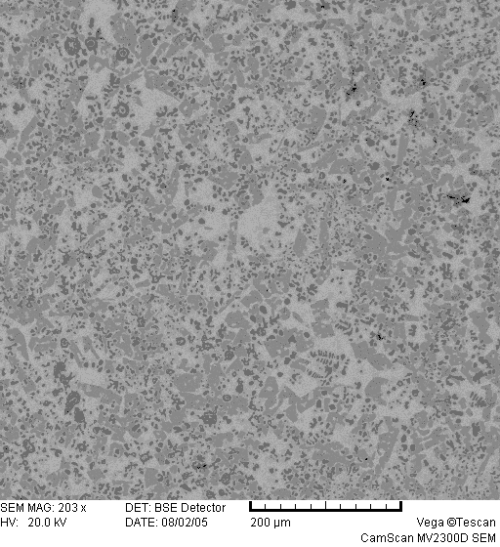
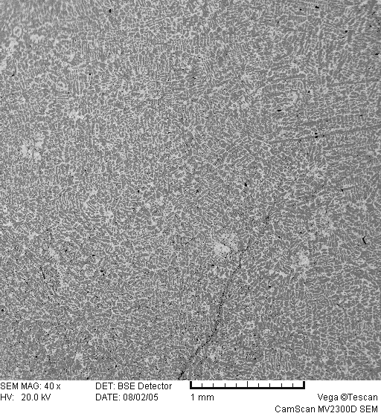

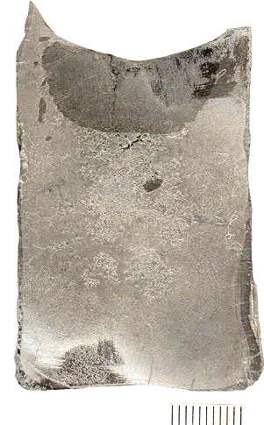
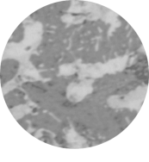
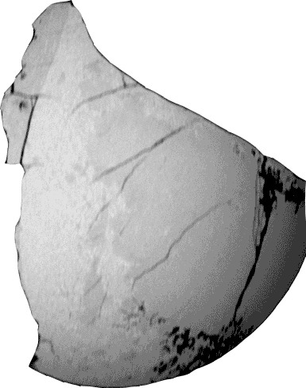
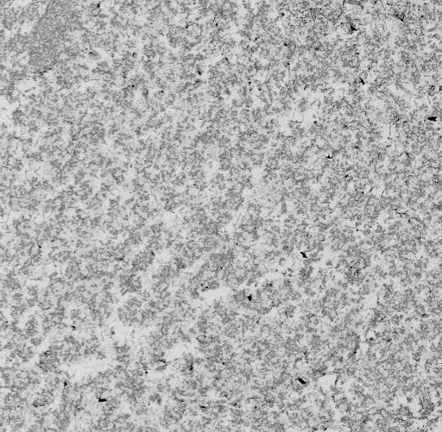
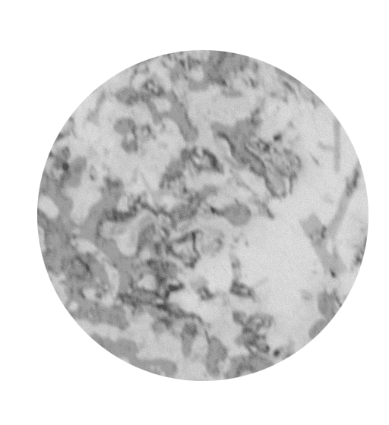
SEM/EDX
Zr-Fe-O system: CORD39 (continued)
ZrO₂ and Fe calibrated data
 | Zr | Fe | O
mass % | 61.3 | 30.7 | 8.0
mol.% | 39.0 | 31.9 | 29.1
 | Zr | Fe | O
mass % | 73.6 | 7.3 | 19.1
mol.% | 37.9 | 6.1 | 56.0
Frozen
liquid
“Oxidized part”
ZrFe(O)
ZrO₂
20 μm
200 μm
1 mm
“Metallized part”
 | Zr | Fe | O
mass % | 64.5 | 25.0 | 10.5
mol.% | 39.0 | 24.8 | 36.2
400 μm
20 μm
ZrO₂
ZrFe₂(O)
Zr₂Fe(O)
1cm
The oxidized liquid was located in the middle of the pool, as is evidenced by melt samples
Notes:
During crystallization, the oxidic liquid, as the most refractory, undergoes monotectic transformation. ZrO2 and metallized liquid crystallize from it, the latter freezes fast, without decompositioning, that is it is quenched. The metallized liquid decomposes into the intermetallic phases containing oxygen and ZrO2, which is the phase of primary crystallization . которая застывает не успев разложится т.е. закаляется.

Slide 8
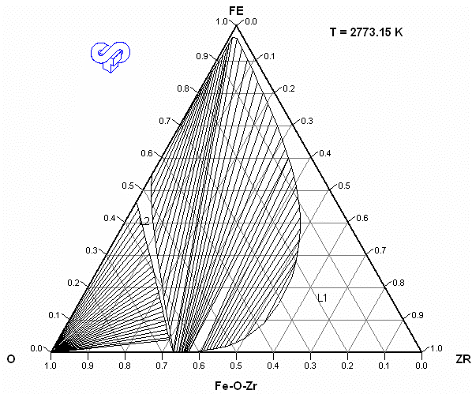
Zr-Fe-O system
Concluding remarks
Miscibility gap was observed in CORD33 and CORD39 tests
CORD39
Tie line (T_{melt}=2773K)
heavy “metallic” liquid, at.% 45.1Zr –31.5Fe –23.4O
light “oxidic” liquid , at.% 44.4Zr –7.1Fe –48.5O
2773K
T_{liq}=2763K (at.% 45.4 Zr – 25.8 Fe – 28.8 O)
CORD33
Tie line (T_{melt}=2693K)
light “metallic” liquid, at.% 51.5 Zr –24.3 Fe –24.2 O
heavy “oxidic” liquid, at.% 47.9 Zr –4.9 Fe –47.2 O
T_{liq}=2655K (at.% 48.7 Zr – 19.7 Fe – 30.6 O)
CORD35
T_{liq}=2637K (at.% 48.7 Zr – 19.7 Fe - 30.6 O)
Depending on position of the figurative point in the miscibility gap, the relation between densities
of the oxidic and metallic liquids may differ (in CORD33, oxide density was higher than that of metal
It is important to continue the study of this system in order to determine boundaries of the gap
more precisely
Notes:
In comparison with thermodynamic calculation the miscibility gap is a little narrower.

Slide 9
U-Zr-O system: CORD42
Test objectives:
To determine liquidus temperature by VPA IMCC
To determine the composition of oxidic and metallic liquids in the miscibility gap
VPA IMCC results: example of thermogram with pool surface frames
T_{liq} = 2390 °C

Slide 10
U-Zr-O system: CORD42 (continued)
Axial section of the ingot
Boundary
“Oxidized” part
“Metallized” part

Slide 11
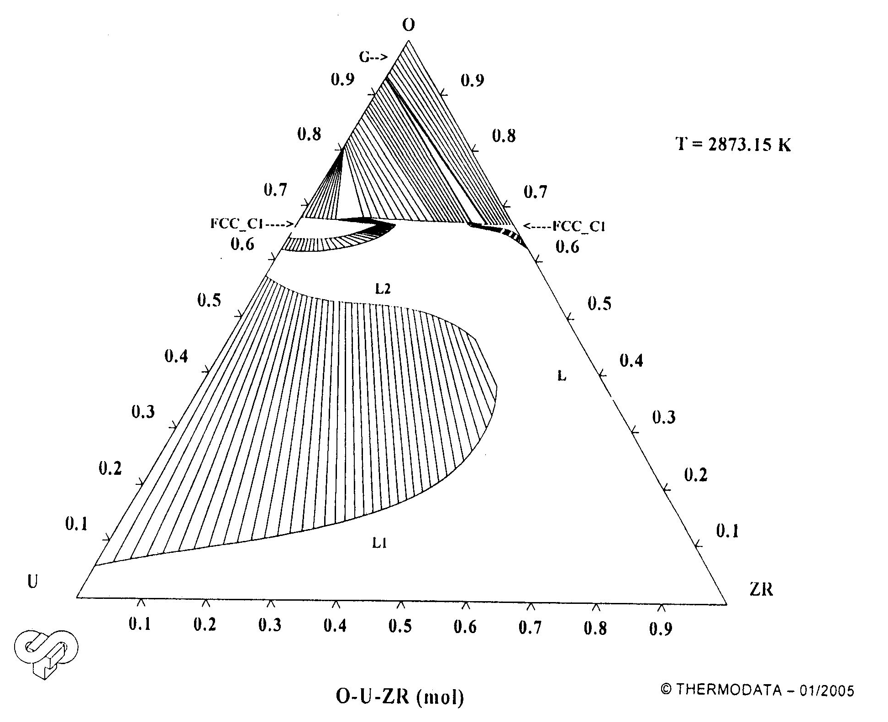
U-Zr-O system
Concluding remarks
Miscibility gap was observed in CORD37 and CORD42 tests
CORD29 T_{liq}=2734K at.% 19.8U – 17.2Zr – 63.0O
CORD28-ll T_{liq}=2637K at.% 12.9U – 43.9Zr – 43.2O
2673К
CORD34 T_{liq}=2578K at.% 21.5U – 34.7Zr – 43.8O
CORD28-l T_{liq}=2665K at.% 7.7U – 53.7Zr –38.6 O
CORD37
?
T_{liq}=2601K at.% 32.5U – 28.2Zr – 39.3O
Tie line CORD37 (T_{melt}=2673K)
light “oxidic” liquid, at.% 21.7U –27.7Zr –50.5O
heavy “metallic” liquid, at.% 33.5U –42.7Zr –23.7O
CORD42 T_{liq}=2663K at.% 40U – 25Zr – 35O
Tie line CORD42 (T_{melt}=2843K)
Tie line for the CORD42 composition has not been determined yet – posttest analysis is underway
The obtained data show the gap to be less extended than predicted by calculations.
Additional tests are required for specifying the gap boundaries at different compositions and quenching temperatures.

Slide 12
U-Fe-O system: CORD40 (60U + 20Fe + 20O)
Test objectives
Determine liquidus temperature of specified composition
Determine tie-line in the miscibility gap
VPA IMCC: experimental thermogram with melt surface frames
T_{liq} = 2515 °C
Notes:
The experiment was conducted in the 6th quarter, Two slides with experimental objectives and liquidus temperature measurements are shown as a reminder

Slide 13
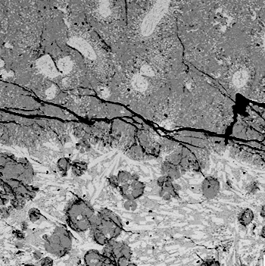
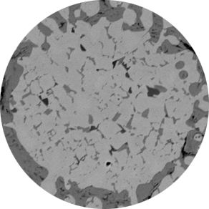
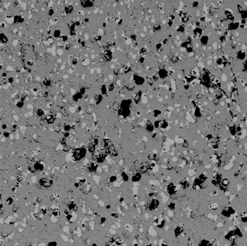
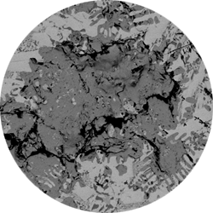
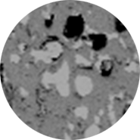
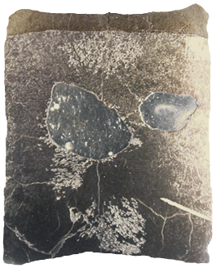
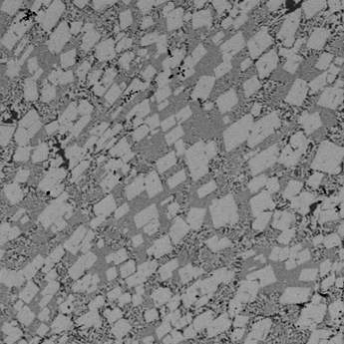
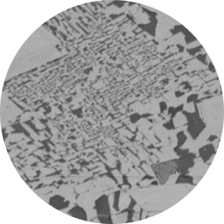
U-Fe-O system: CORD40 (continued)
SEM
Metalic globules in oxide matrix
“Oxidized part”
500 μm
100 μm
Ox-in-Met
Pore
UO_{2-x}
UFe(O)
200 μm
“Metallized part”
eutectic-like area
UFe₂O
UO_{2-x}
U₆Fe(O)
1cm
Notes:
SEM analysis has determined the presence of metallic droplets in the oxidic part and oxidic ones in the metallic part of the crystallized ingot. The most refractory oxidic liquid undergoes monotectic transformation during crystallization. UO_{2-x} and metallized liquid crystallize from the liquid, it freezes without decomposition, that is it is quenched. которая застывает не успев разложится т.е. закаляется. The metallized liquid decomposes into the intermetallic phases containing oxygen and UO_{2-x}, which is the phase of primary crystallization

Slide 14
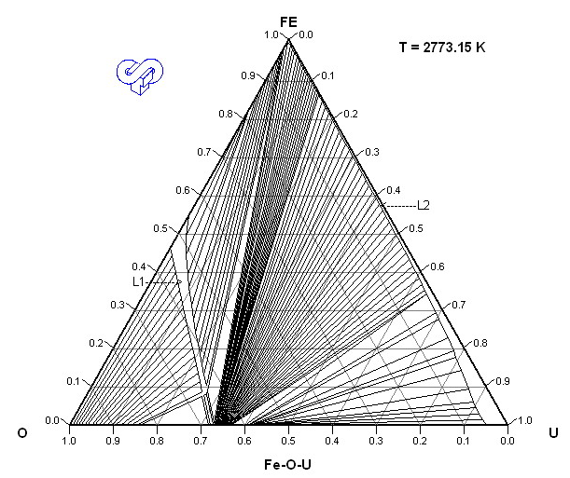
U-Fe-O system
Concluding remarks
Stratification into two liquids is observed in the experiment
CORD40
T_{liq}=2788K at.% 60U – 20Fe – 20O
Tie-line (T_{melt}=2823K)
light “oxidic” liquid, at.% 42.1U –0.9Fe –56.0O
heavy “metallic” liquid, at.% 62.4U –33.7Fe –3.9O
Oxygen content in metallized part of the ingot was measured by carbothermic reduction (ASTM E-1569)
LECO analyzer was used
No problems with thermodynamic modeling of the U-Fe-O system in its metal-oxidic region
due to the low solubility of iron in urania and oxygen in metal
Further studies of tie- lines in the miscibility gap of this system are not quite important. Measurements of
eutectic temperature and composition would be useful

Slide 15
U-O system: CORD41
Methodological test objectives:
Determine T_{liq} of specified composition, at% 60U – 40O
Determine tie-line in the miscibility gap
Compare with other authors’ data
VPA IMCC: experimental thermogram with melt surface frames
T_{liq} = 2515 °C

Slide 16
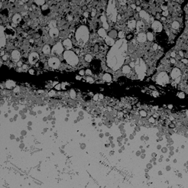
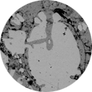
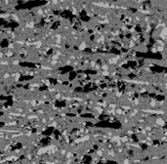
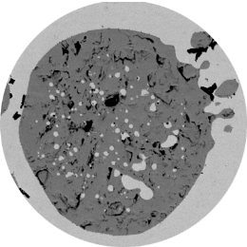
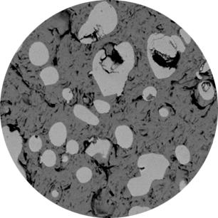
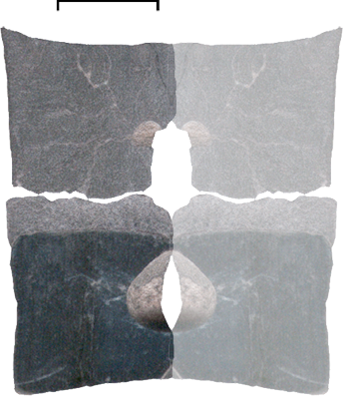
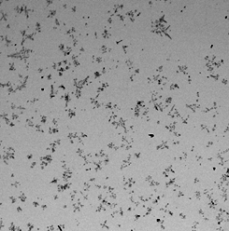
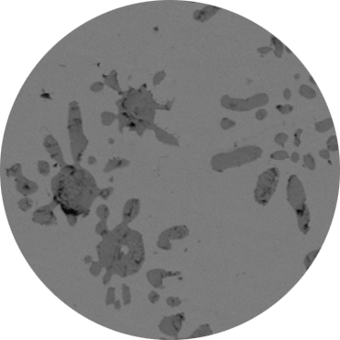
U-O system: CORD41 (continued)
SEM
Metallic globules in oxide matrix
Oxidized
part
500 μm
150 μm
Pore
Ox-in-Met
UO_{2-x}
U(O)
Metallized
part
Image analysis:
U – 93.27 vol.%, UO₂ – 6.65 vol.%,
pore - 0.08 vol.%
Overall composition:
U – 93.5 at.%
O – 6.5 at.%
500 μm
UO_{2-x}
U(O)
Notes:
По данным SEM анализа зафиксировано наличие капель - металлических в оксидной и оксидных в металлической частях закристаллизованного слитка. По предварительным данным физико-химического анализа содержание кислорода в оксидной части составляет 59.5 %(ат) , а в металлической части ниже предела обнаружения используемых методов. Для определения -уточнения области существования купола расслаивания в настоящее время проводится WDS микроанализ металлических и оксидных капель

Slide 17
U-O system
Concluding remarks
Miscibility gap was observed in the test
CORD40
T_{liq}=2515ºC at.% 60U – 40O
Tie line (T_{melt}=2670ºC)
light “oxidic” liquid, at.% 40.5U – 59.5O (Chemical analysis of oxidized part bulk)
heavy “metallic” liquid - analysis in progress
Image analysis metallized part: U – 93.5 at.%
O – 6.5 at.%
Coordinates of the tie-line left point have not been determined yet – metal samples are still analyzed
The data of C.Gueneau, Edwards and Martin concerning a very big miscibility gap were
confirmed and efficiency of the methodology proved

Slide 18
CORPHAD Papers
Bechta S.V., Krushinov E.V., Almjashev V.I., Vitol S.A., Mezentseva L.P., Petrov Yu.B., Lopukh D.B., Khabensky V.B., Barrachin M., Hellmann S., Froment K., Fischer M., Tromm W., Bottomley D., Defoort F., Gusarov V.V. Phase diagram of the ZrO₂–FeO system. // J. Nucl. Mater. Vol. 348 (2006), p.p. 114-121
Mezentseva L.P., Popova V.F., Almjashev V.I., Lomanova N.A., Ugolkov V.L., Bechta S.V., Khabensky V.B., Barrachin M., Hellmann S., Gusarov V.V. Phase diagrams of the SiO₂–Fe₂O₃(Fe₃O₄) systems in different gas atmosphere. // to be published in J. Europ. Ceram. Soc.,
Bechta S.V., Krushinov E.V., Almjashev V.I., Vitol S.A., Mezentseva L.P., Petrov Yu.B., Lopukh D.B., Khabensky V.B., Barrachin M., Hellmann S., Froment K., Fisher M., Tromm W., Bottomley D., Gusarov V.V. UO₂–FeO phase diagram. // J. Nucl. Mater., in press

Slide 19
Plans for the period till the end of the Project
U-Fe- Zr-O system
Two tests to be carried out and report prepared
Complex corium mixture
A test to be carried out and report prepared
UO₂-SiO₂ system
Two tests to be carried out and report prepared
Final report

Slide 20
Conclusions
Methodological tests aimed at determining monotectic temperature and tie-line in the miscibility gap of the U-O system have shown the following:
- the measured monotectic temperature agrees with previously published data of Edvards (1966) and Gueneau (1997)
- temperature and compositions of the coexisting liquid phases can be specified after the posttest analysis of samples is completed
Monotectic temperatures and compositions of coexisting liquids above these temperatures have been measured in the miscibility gap of Zr-Fe-O, U-Fe-O, U-Zr-O systems
In the U-Fe-O, U‑Zr‑O systems the oxidized liquids have a lower density and are located on top of the pool. In the Zr-Fe-O system the inversion of oxidized and metallized layers has been observed in one of the tests
The experimental data can be used for the optimization of NUCLEA database if the content of oxygen in the oxidized and metallized parts of the system is specified. The work is in progress

