Slide 1

CORPHAD
Programme Status
A.P. Alexandrov Research Institute of Technology
ISTC CORPHAD Project
#1950
Presented by S. Bechta
5th CEG-CM Meeting

Slide 2
ISTC
PROJECT # 1950.2
Phase Diagrams for Multicomponent Systems Containing Corium and Products of its Interaction with NPP Materials
( CORPHAD )
PHASE 1: 1 August 2001 - 30 April 2002
PHASE 2: 1 July 2003 - 30 June 2006

Slide 3
CORPHAD project general information
Project participants and coordination
Collaborators
FZK, Germany
IRSN,
France
ITU,
EK
CEA,
France
Framatom ANP, Germany
Coordinator
ISTC, Moscow
Steering committee
Operation Agent: A.P. Alexandrov RIT, Russia
ISC RAS,
Russia
RRC Kurchatov
Institute, Russia
SPb Electrotechnical State University, Russia

Slide 4
CORPHAD project focus
Project objective:
Experimental study of phase diagrams of corium/NPP material mixtures
Experimental data output
  Liquidus and solidus temperatures versus components concentration
  Temperature-concentration regions of the miscibility gap
  Coordinates of eutectic, dystectic and other characteristic points
  Solubility limits
Reactor application
  Thermodynamic database optimisation
  Thermodynamic code validation
  Corium behaviour modelling

Slide 5
CORPHAD phase 2 test matrix
Task | Composition | Temperature range, °C | Atmosphere | Measurement method | Priority level
 | UO₂- FeO ^{4),5)} | Up to 3000 | Argon |  | High
 | UO_{2±X} - FeO_{y} ^{4),5)} | Up to 3000 | Air | Galakhov | Middle-Low
 | ZrO₂ – FeO ⁴⁾ | Up to 3000 | Argon | Microfurnace | High
1 | UO₂ – Cr₂O₃ ⁵⁾ | Higher than 2400 | Argon | IMCC VPA¹⁾ | Middle
 | SiO₂– Fe₂O₃ | Up to 2000 | Air/Oxygen | DTA²⁾ HTM³⁾ | Middle
 | UO₂– SiO₂ | Up to 2500 | Argon |  | Middle-Low
 | (BaO,SrO) - UO₂ ⁴⁾ | Up to 3000 | Argon |  | Low
 | Eutectic composition ⁴⁾⁵⁾ of UO₂– ZrO₂-FeO |  | Argon |  | High
 | Eutectic composition⁵⁾ of UO_{2+x} – ZrO₂-FeO_{y} |  | Air | HTM | Middle
2 | U-O-Fe | Up to 2500 | Argon | IMCC VPA | High
 | Zr-O-Fe |  | Argon | DTA | High
 | U-O-Zr |  | Argon | Galakhov | High
 | UO₂ – ZrO₂-SiO₂ (CaO)⁷⁾ |  | Argon | Microfurnace | Middle
3 | Quaternary system Different composition in U-Zr-Fe-O system | Up to 2600 | Argon | IMCC VPA, Galakhov by air HTM | High
 | Corium oxidation kinetic test⁶⁾: C-32 (U-Zr-O) | Up to 2600 | Argon replacement | IMCC | High
4 | Corium oxidation kinetic test: 90%C-32 + 10%Fe |  | by air
5 | Eutectic composition measurement of a prototype complex corium mixture | Up to 2500 | Argon | IMCC VPA DTA, Galakhov Mkrofurnace HTM | High
In progress
finished
proposed to cancel
Notes: 1.Induction Melting in a Cold Crucible with Visual Polythermal Analysis; 2. Differential Thermal Analysis; 3. High Temperature Microscopy; 4. Determination of the solubility limit; 5.Determination of the eutectic composition and temperature; 6.Decision concerning these tests will be taken upon completing first three stages of the project; 7.For tests with CaO the decision will be based on ENTHALPY project results.

Slide 6
Work per each test
IMCC test preparation and carrying out; primary analysis of findings
Physico-chemical posttest analysis of samples
Samples preparation for the analyses by other methods, e.g. Galakhov furnace, HTM, DTA and DSC
Pre- and posttest calculations using thermodynamic codes
Integrated analysis and experimental data finalization

Slide 7
Current list of activities
Task 1 – Investigation of binary systems
  ZrO₂ – FeO system phase diagram
  UO₂ – FeO system phase diagram
  SiO₂ – Fe₂O₃ system phase diagram
Task 2 – Investigation of ternary systems
  First results of Tliq measurements for the system U – Zr – O

Slide 8
Scope of the technical work during the 1st and 2nd quarter
New IMCC furnace designed for UO₂ – FeO system has been built
High temperature thermoanalyser for simultaneous DTA/DCC has been installed:
  -SETSYS Evolution TAG 24 (up to 2400° C in inert atmosphere)
More sensitive XRF analyzer has been installed:
  - SPECTROSKAN MAKS – GV (elements from Na to U)
TIGEL facility has been modernized in RRC KI

Slide 9
The scope of studies carried out during the 1st and 2nd quarters of CORPHAD Project

Slide 10
3rd CORPHAD Project Meeting
List of presentations:
Project status
Phase diagram of the ZrO₂ – FeO system
Phase diagram of the UO₂ – FeO system
Measurement results of liquidus temperature in the U-Zr-O system
Phase diagram of the SiO₂ – Fe₂O₃ system
Experimental matrix proposals for the period until next meeting
Preliminary melting point measurements of the U-Zr-O system using a modified set-up with Laser Heating

Slide 11
Phase diagram of the ZrO₂ – FeO system
T, °С
2710
2700
2700
2500
Liquid
2500
2300
2347
CCVPA New technique
2300
c-ZrO₂
2100
2100
IVTANTHERMO
DTA
1900
>1800
1900
Galakhov microfurnace
1700
1700
CCVPA
t-ZrO₂
SEM/EDX
1500
1500
1377
W.A.Fischer, A.Hoffman, Archiv Eisenhüttenw.,
28 №739, 1957
1300
1300
m-ZrO₂
<1172
1172
1100
1100
FeO 20 40 60 80 ZrO₂
mass %

Slide 12
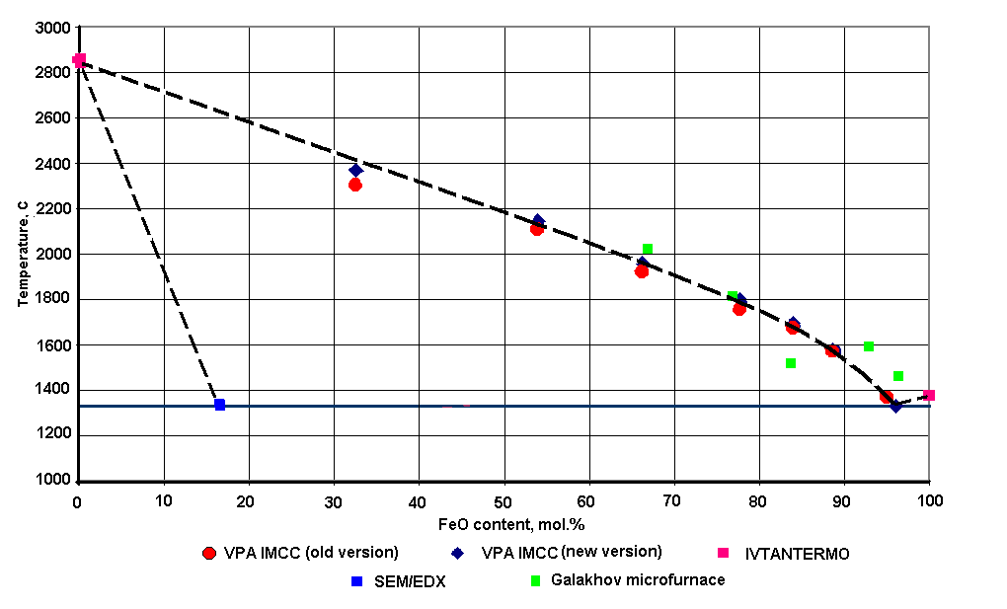
Phase diagram of the UO₂ – FeO system
liquid
FeO/UO₂ ss +liquid
FeO/UO₂ ss
The error of pyrometer temperature measurements is ±1 relative %
The error of FeO concentration measurements is ±3 relative %

Slide 13
Phase diagram of the SiO₂ – FeO_{y} system
SiO₂
10
90
eutectic composition:
79.55 mass% Fe₃O₄ according Muan diagram
86.50 mass% Fe₃O₄ according present investigation
20
80
30
70
40
cristobalite
60
2 – 92 mass% Fe₂O₃
4 – 90 mass% Fe₂O₃
12 – 89 mass% Fe₂O₃
13 – 88 mass% Fe₂O₃
14 – 87 mass% Fe₂O₃
50
50
60
40
2 FeO⋅SiO₂
fayalite
30
1200
1300
80
20
– air
1400
magnetite
14
wustite
1500
– oxygen
90
iron
13
hematite
10
12
4
2
2
FeO
FeO⋅Fe₂O₃
Fe₂O₃
10
20
30
40
50
60
80
90
mass %

Slide 14
Phase diagram of the SiO₂ – Fe₂O₃ system
T, °С
IVTANTHERMO
1800
Liquid
1800
New compositions
1723
Experimental error - ±25°C
1700
1700
Eutectic point:
1470°C
89 mass% Fe₂O₃
1440°C
88 mass% Fe₂O₃
1600
1600
HTM
1539
1535
1500
1500
1470
DTA
1400
1440
1400
1375
DTA (decomposition)
(Fe₃O₄)
Fe₂O₃ 20 40 60 80 SiO₂
mass %
6 Fe₂O₃ → 4 Fe₃O₄ + O₂

Slide 15
Fusion diagram of Fe₃O₄-SiO₂ system
T, °С
Two
liquids
1723
1700
1700
IVTANTHERMO
New compositions
1597
1600
1600
1550
Quenching
1500
1500
1400
1430
1400
1300
1300
Fe₃O₄ 20 40 60 80 SiO₂
mass %

Slide 16
Results of liquidus temperature in the U-Zr-O system

Slide 17
Future plans
Concussions and recommendations of the 3rd CORPHAD Project Meeting
1) Concerning Task 1 it was agreed to delete the low and middle priority systems UO_{2+-x} –FeOy , UO₂-Cr₃O₃ and (Ba, SrO)-UO₂ from the test matrix. This was accepted as it had been agreed previously that the high-priority systems should be studied in a more profound and detailed manner.
2) As regards the UO₂-SiO₂ system, it was convened to keep it for the time being, check the available phase diagram information and their quality before making a final decision. It will be decided at the next meeting whether some tests are valuable to be carried out, possibly in the UO₂-rich domain.
3) Possible investigations of the “ternary” systems of Task2 (UO₂-ZrO₂-SiO₂), UO₂-ZrO₂-CaO) will be discussed and decided after the completion of Task 1.

Slide 18
Future plans
To complete the prossesing of experimental data for the UO₂ – FeO
system
Deadline: October 2004
To perform 2 IMCC tests for the ZrO₂ – FeO system
Deadline: October 2004
To perform 2 tests for the U - O – Zr system in RRC KI
Deadline: October 2004
To prepare reports on the diagrams of UO₂ – FeO; ZrO₂ – FeO;
SiO₂ – Fe₂O₃
Deadline: October 2004
To perform a test on determining eutectics composition of the
UO₂ - ZrO₂ – FeO system
Deadline: end of 2004
To prepare tests in the U – O – Fe system
Deadline: end of 2004

