Slide 1

Analysis of fuel containing mass behaviour during the active phase of the Chernobyl accident
A.Borovoi, S.Bogatov, V.Strizhov
5-th CEG-CM meeting
Paris, February 9-13, 2004.
RRC “KI”

Slide 2
Background
The first presentation was made at the CEG-CM -3 meeting;
The first version of project was prepared and reported at the 4-th meeting
The project was reviewed by ISTC CEG-CM group (January 2004)
The revisions were made on the basis of recommendations

Slide 3
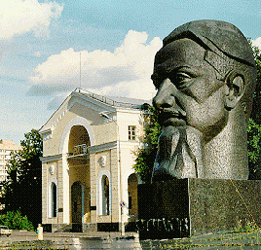
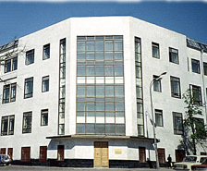
Participating Institutions:
RRC “KI”
Russian Research Center “Kurchatov Institute” (RRC KI)
Nuclear Safety Institute of Russian Academy of Sciences (NSI)
Foreign collaborators: Gesellschaft für Anlagen- und Reaktorsicherheit (GRS) mbH, Germany,
Institut de Radioprotection et de Sûreté Nucléaire (IRSN), France

Slide 4
Changes to the project
Old title: "Development of models for nuclear fuel behaviour during the active phase of Chernobyl accident”
New title: "Analysis of fuel containing mass (FCM) behaviour during the active phase of the Chernobyl accident"

Slide 5
Objective of the Project:
RRC “KI”
Analysis and interpretation of the FCM behavior during an active phase of Chernobyl accident accounting for a wide spectrum of available data with the use of extended models

Slide 6
The major tasks
Task 1. Accumulation, assessment and analysis of initial data for different stages of accident progression.
Task 2. Development of the database for the modeling of FCM behavior in the 4-th Unit
Task 3. Additional measurements of the compositions of metal melts
Task 4. Use of the existing model for the evaluation of the FCM state in the 4-th Unit
Task 5. Development of the final report on the Project

Slide 7
Task 1. Accumulation, assessment and analysis of initial data for different stages of accident progression
Task 1.1 Development of initial data sets (geometry, initial and boundary conditions) for different stages of accident
Task 1.2 Development of scenarios for fuel behaviour during different stages of accident (corium formation, corium spreading, corium structural materials interactions)
Task 1.3 Assessment of the graphite impact on the accident progression (burning, heat generation, etc.)

Slide 8
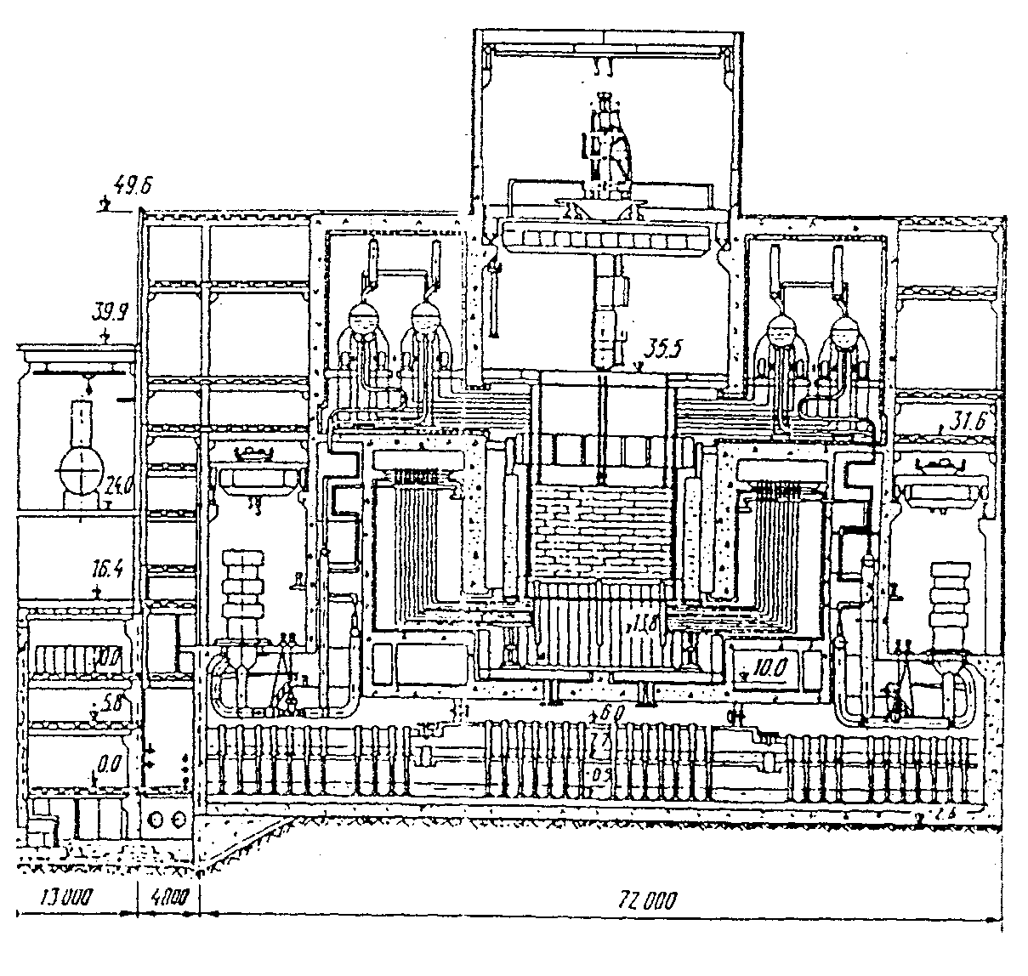
General view of RBMK NPP

Slide 9
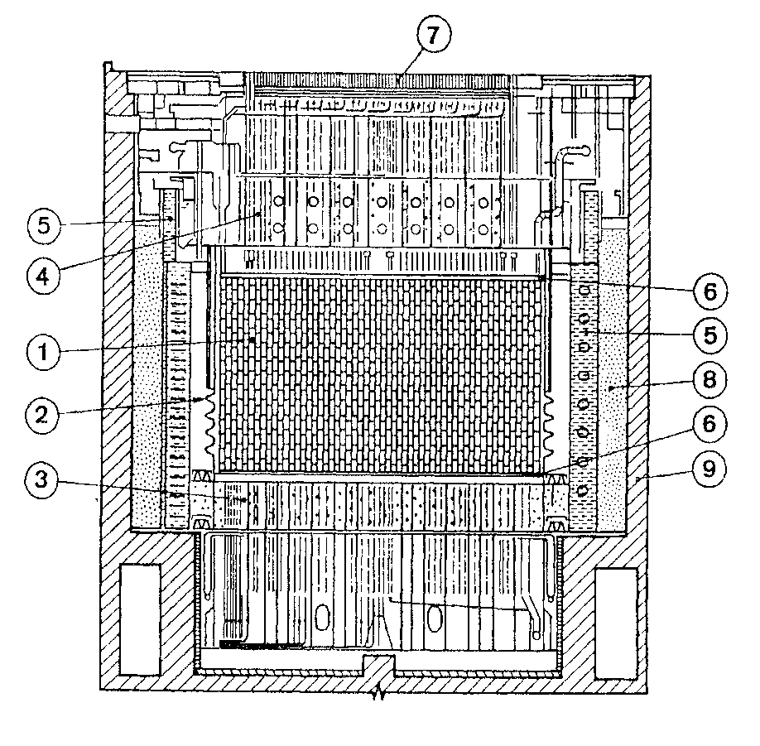
RBMK reactor main structures
Core
Reactor vessel (shroud)
Lower support structure
(scheme “OR”)
Upper reactor vessel head
(scheme “E”)
Annual water tank (scheme “L”)
Steel graphite base plate
Channel shield plugs
Sand filling
Concrete reactor cavity walls

Slide 10
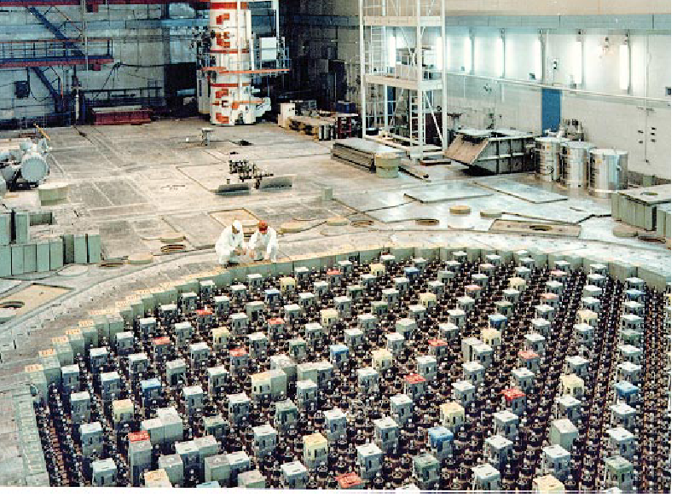
Development of a database on initial and boundary conditions
RRC “KI”
Materials near the core
Graphite 2000 t
Zr-1%Nb cladding 43 t
Zr-2.5%Nb central pipe 6 t
Zr-2.5%Nb channel pipes 126 t
Supporting scheme “OR” Σ 1422 t
Serpentine 489 t
Black steel 233 t
X18H10 202 t
X10H1M 498 t

Slide 11
Formation of melt
Timing of events
Location: under reactor room 305/2 (elevation 9 m)
  Initial melt was formed in the south-eastern part of the reactor after interaction with the serpentine filling of the “OP” scheme
  Spreading of the melt in horizontal direction (through the breach in the wall between rooms 305/2 and 304/3)
  Spreading in the vertical directions (through the steam outlet valves of the accident localization system)
  Interaction with the concrete

Slide 12
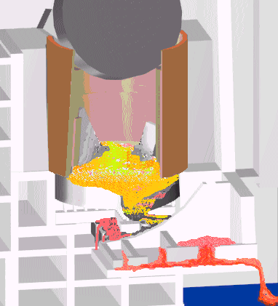
Melt formation scenario
RRC “KI”
Initial melt was formed in the south-eastern part of the reactor after interaction of damaged fuel with the serpentine filling the scheme“OR” (bottom reactor lid) and concrete.
305/2

Slide 13
Comments of CEG-CM group
Impact of graphite as heat source and its influence on material properties
Some aspect can be analyzed such as:
  Graphite burning
  Heat source
Influence on the material properties hardly can be assessed as no measurements of carbon were made

Slide 14
Task 2. Development of the database for the modeling of FCM behavior in the 4-th Unit
Task 2.1 Preparation of data on the location of FCM in the 4-th Unit
Task 2.2 Development of the database on corium compositions

Slide 15
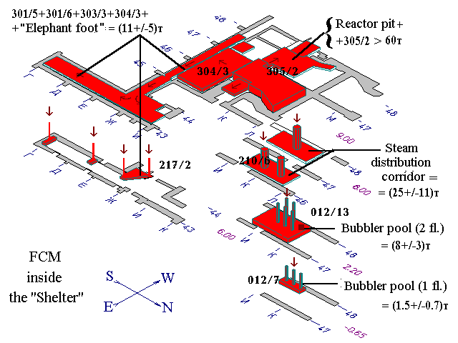
The main streams of LFCM
RRC “KI”
305/2
*We know practically nothing about LFCM on upper levels

Slide 16
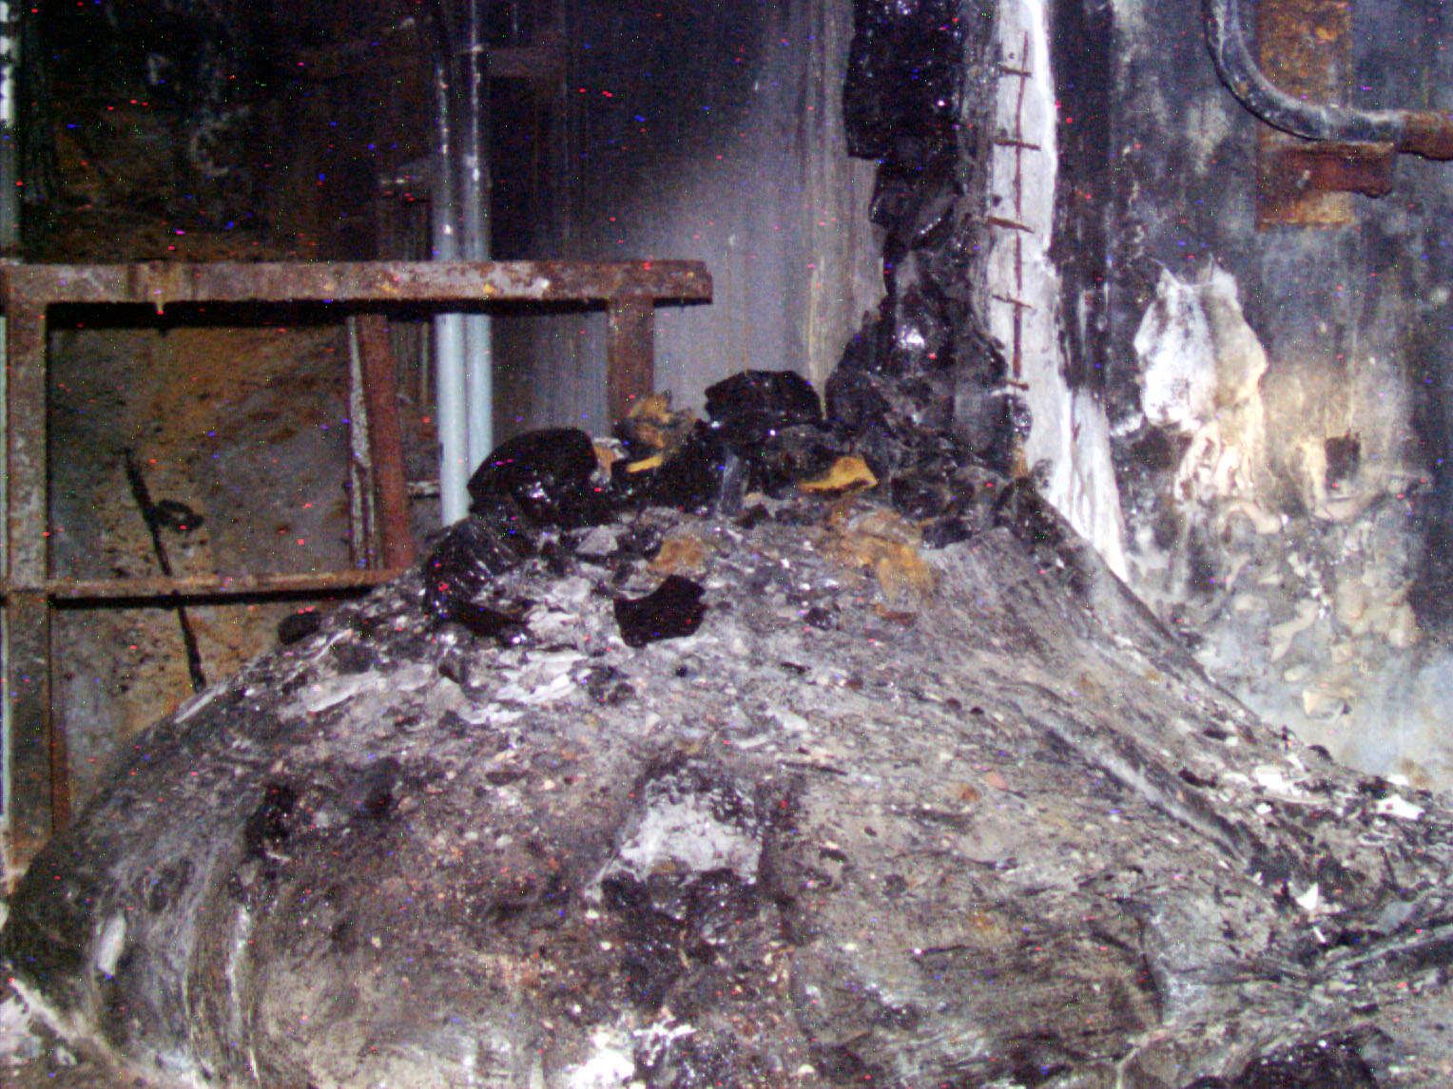
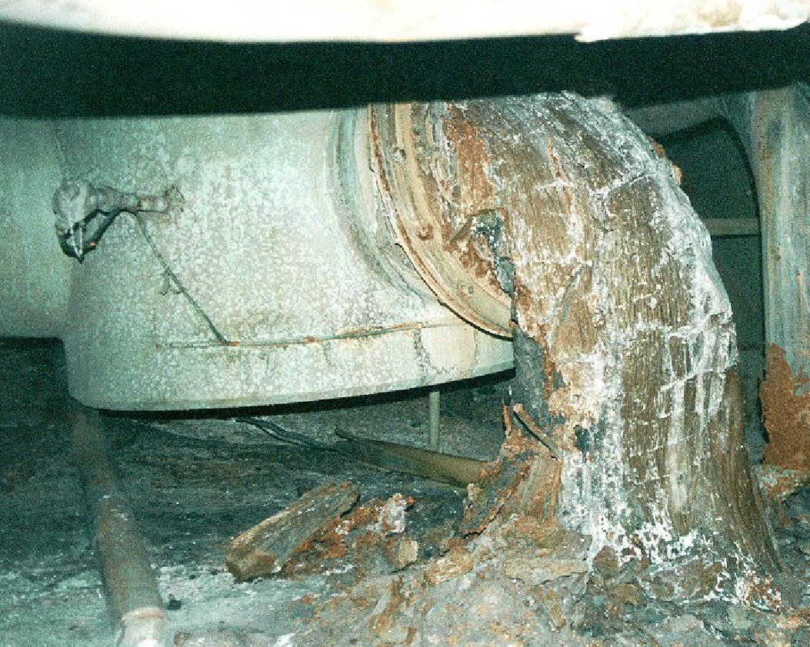
Assessment of location of FCM inside shelter
RRC “KI”
Lava-like FCM

Slide 17
Core and structural materials in the LFCM

Slide 18
Task 3. Additional measurements of the compositions of metal melts
This is the only task dealing with the new measurements
  New data indicated that some amount of uranium may be extracted from the fuel
  These measurements may provide additional data on the distribution of FCM in the shelter

Slide 19
Task 4. Use of the existing model for the evaluation of the FCM state in the 4-th Unit
Task 4.1 Determination of the key parameters and preparation of initial data sets for specific models and codes
Task 4.2 Performance of calculations of the FCM behavior and comparison of results of analysis to experimental data and code to code comparisons (if available)

Slide 20
Phenomena to be modelled
Interaction of corium with the structural materials (serpentine, steel structures under reactor)
Spreading along horizontal surfaces and vertical channels
Interaction with the concrete structures

Slide 21
Advances in CFD computations
3D numerical approach for solving of CFD problems was developed
New high-speed algorithms for solving CFD problems using high-power PC are developed
  Modified Preconditioned Richardson Method with Fast Fourier Transformation (FFT) is used for solving of pressure equation
  The approach gives significant acceleration in comparison with standard Preconditioned Conjugate Gradient Methods (PCGM)
These advances allows simulation of aformentioned phenomena in 3D approach

Slide 22
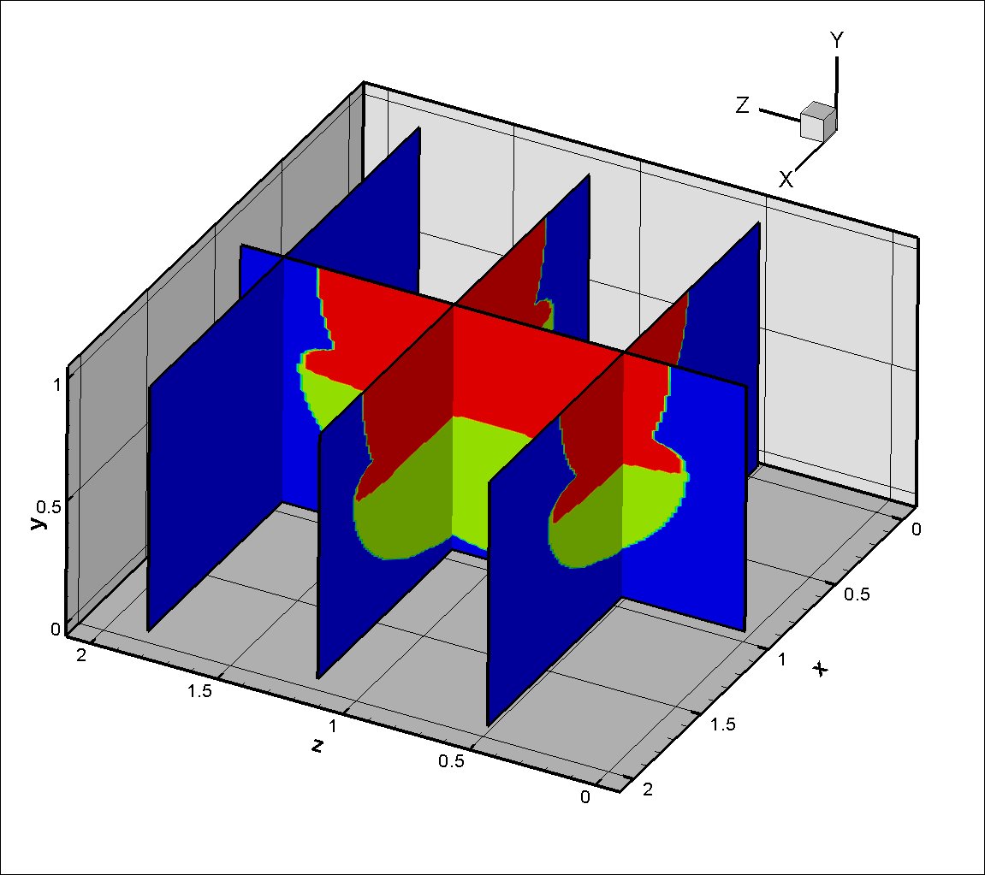
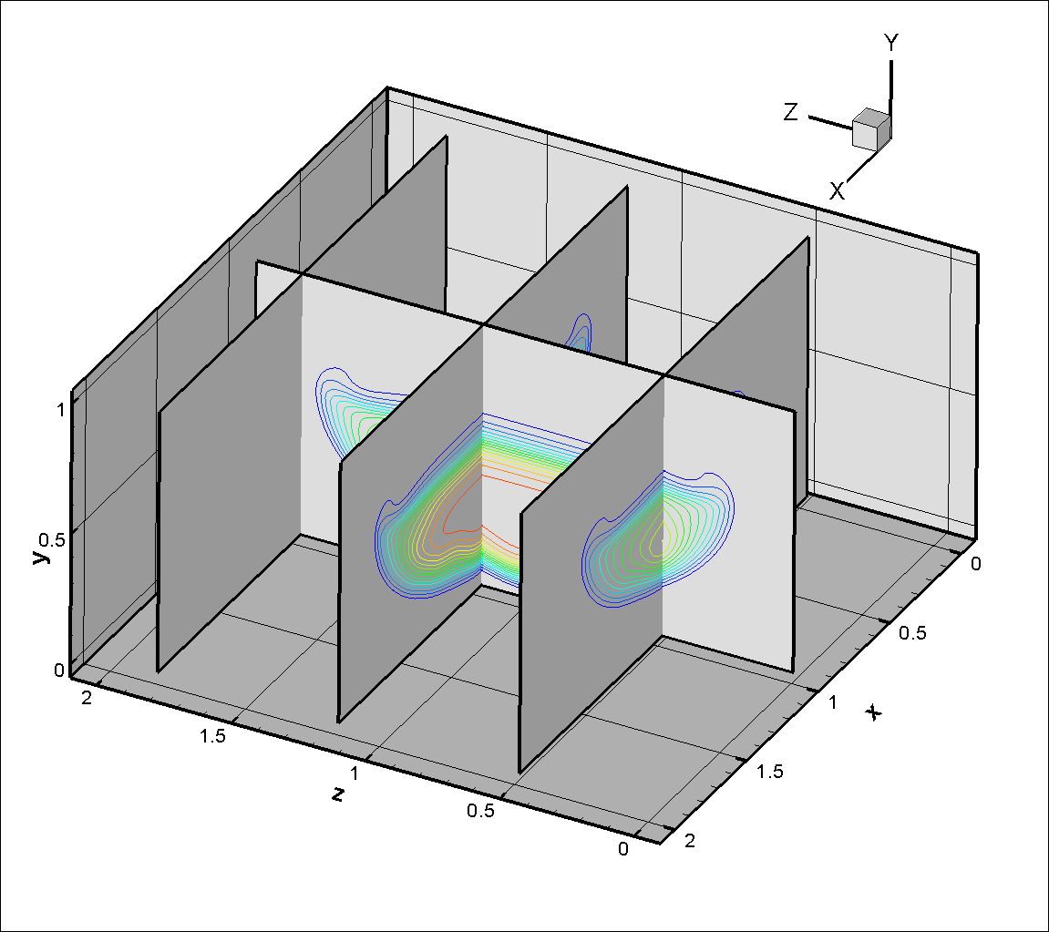
3D MCCI calculations

Slide 23
3D spreading of molten corium
1)
3)
2)
4)

Slide 24
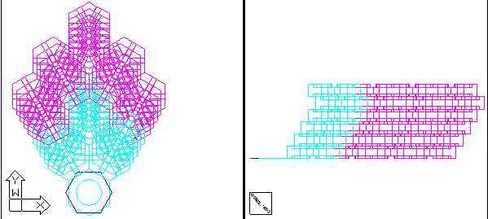
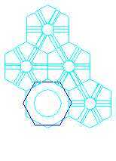
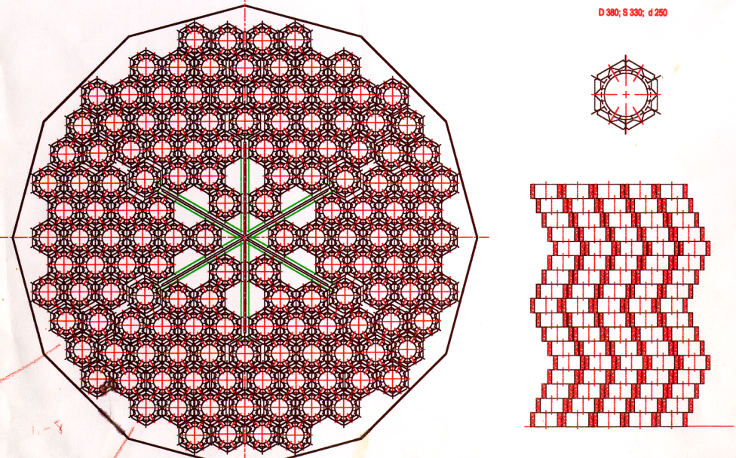
Advances in the 3D computations
3D multiblock &
solid-state grids generation

Slide 25
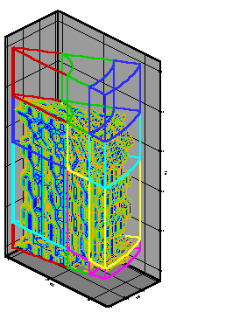
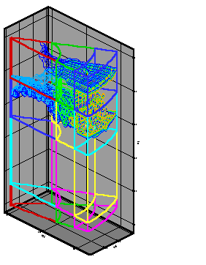
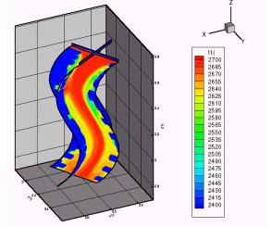
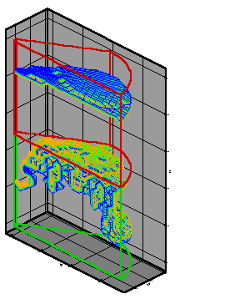
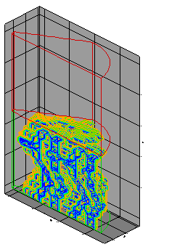
3D modeling of molten corium spreading

Slide 26
Task 5. Development of the final report on the Project
Task 5.1 Identification of the lack of phenomena knowledge and lack of data necessary for code use and validation, their prioritisation
Task 5.2 Development of proposal for the Step 2 on the base of performed analyses and evaluations

Slide 27
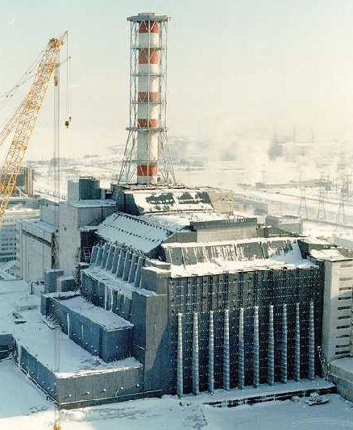
Relevance of the Work:
RRC “KI”
Solution of real practical problems that will be posed in future during the transformation the Shelter into ecologically safe system
Shelter Implementation Plan (SIP) assumes:
stabilization of building structures;
creation of new safety confinement, that shall presume dismantling work inside and, may be – withdrawal of damage nuclear fuel.

Slide 28
Relevance of the Work:
RRC “KI”
Solution of the safety problems of general nuclear industry
Obtained results will be of interest for the prognosis of long term corium behavior in the melt localization systems (core-catchers) which are being developed for some NPP concepts with PWR (EPR, VVER-1000)

Slide 29
General Information on the Project
RRC “KI”
Participating personnel 19 (12 “weapon” scientists);
Project duration 24 months;
Estimated cost 318,000 USD

Slide 30
Follow-up project
Analytical and modelling activity
  Improvements of input decks and models
  Adjustment of key corium parameters
Final inter-code comparisons (added to be consistent with Step 1)
Evaluation of corium effects in the Chernobyl accident
  Masses of melts in inaccessible zones, damage to the building, estimate the FCM composition in lower structures
Feedback of Chernobyl results in accident situations with core catchers

