Slide 1
Scope of Current Activities
Task 3: Tight Coupling of the Two Advanced Tools: the Physico-Chemical (Molten Pool Oxidation) Model and the Thermo-Hydraulic Code CONV, for Realistic Mechanistic Description of U-Zr-O Molten Pool Behaviour in Oxidising Test Conditions
Subtask 3.2: Preparatory work with the code sources for implementation of melt oxidation model, and also interface (input files) for insert of physicochemical melt oxidation model for modeling of thermal hydraulic behavior of U-Zr-O melt under oxidizing for small and medium scale experiments in code CONV 2D.

Slide 2
State at the beginning of the current quarter
The choice of a set of commutative filters and implementation of the LES approach in CONV code are finished. The CONV code is adapted for LIVE facility conditions. The parallel version of the CONV code in MPI standard was developed for the carried out calculations of the cluster machines with < =256 processors.
Preparatory work with the code sources for implementation of melt oxidation model, and also interface (input files) for insert of physicochemical melt oxidation model for modeling of thermal hydraulic behavior of U-Zr-O melt under oxidizing for small and medium scale experiments in code CONV 2D is continued.
Testing the modernized version of CONV code was continued on such tests as T-junction thermal mixing test usage of parallel version of the CONV code. A good agreement for the finest grids up to 40 millions nodes was obtained.
Fulfilled work

Slide 3
Modernization of CONV code
Designing the interface program unit for the representation of a minimum parameter set for melt – steel oxidation 1-D module is continued.
The given set includes an additional orthogonal grid, on which the quasi one-dimensional melt oxidation model will be solved.
Besides the parameter set includes characteristics of materials, participating during oxidation, which with the help of the interface program will be transformed to a set of entering files for CONV code, taking into account of chemical structure (component and amount moles), property (thermal capacity, thermal conduction, denseness, viscosity), temperature cooperating steel and melt for an interchanging with melt oxidation model.

Slide 4
Modernization of CONV code#2
The implementation of the melt - steel oxidation 1-D module into 2-D thermo-hydraulic multidimensional CONV code began:
The automatic construction module of the Cartesian grid and additional quasi one-dimensional orthogonal grid for the melt-steel interface boundary was developed.
The results obtained for quasi one-dimensional grid are used as boundary conditions for the basic calculated grid in CONV code.
Sketch of calculated domain
The Cartesian grid
Quasi one-dimensional orthogonal grid

Slide 5
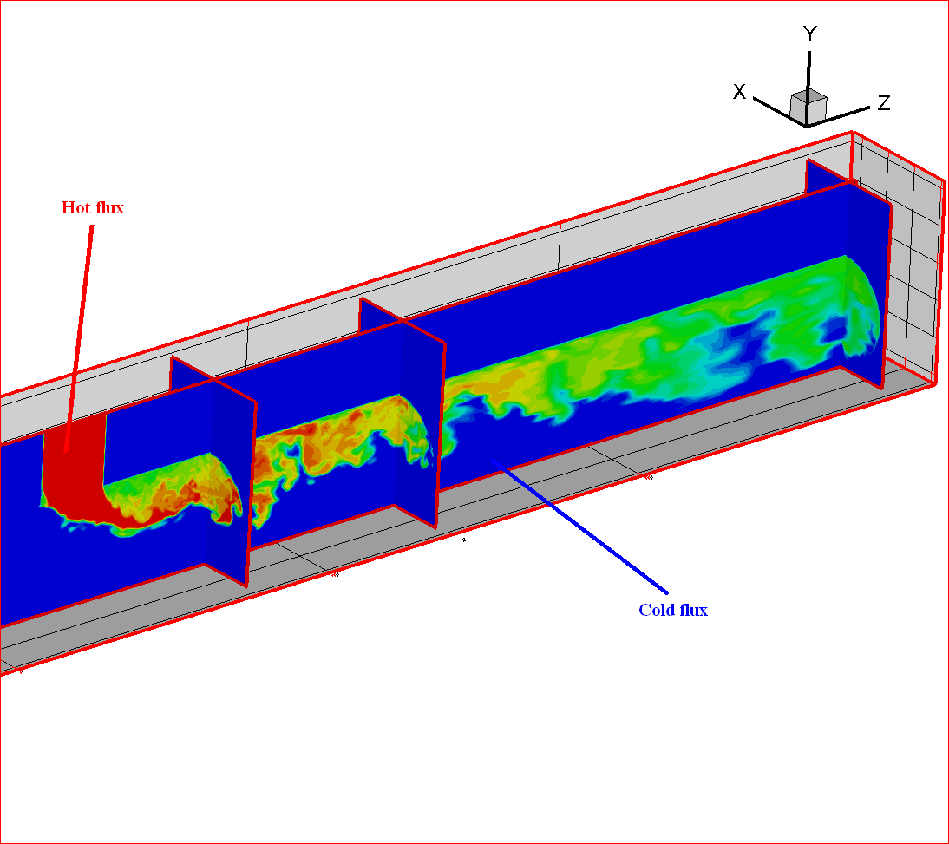
Testing of modernized CONV code: T-junction thermal mixing flow
Test feature:
a hot flux from a vertical pipe is poured into a horizontal pipe with a cold flux.
Computational geometry
IBRAE numerical predictions and results (Mahaffy, CFD4NRS-3, OECD/NEA workshop, Washington, 14-16 september, 2010) were compared.
IBRAE predictions at grid with 12 million nodes are marked by a dashed line (12M).
IBRAE predictions at grid with 40 million nodes are marked by a solid line (40M).
Mahaffy predictions were obtained at grid with 7 million nodes and marked by stars (7M). Experimental data are marked by circles.
A coincidence of numerical predictions and experiment is satisfactory. Failure to take account of some effects and usage of a rough grid are responsible for the observed divergence.

Slide 6
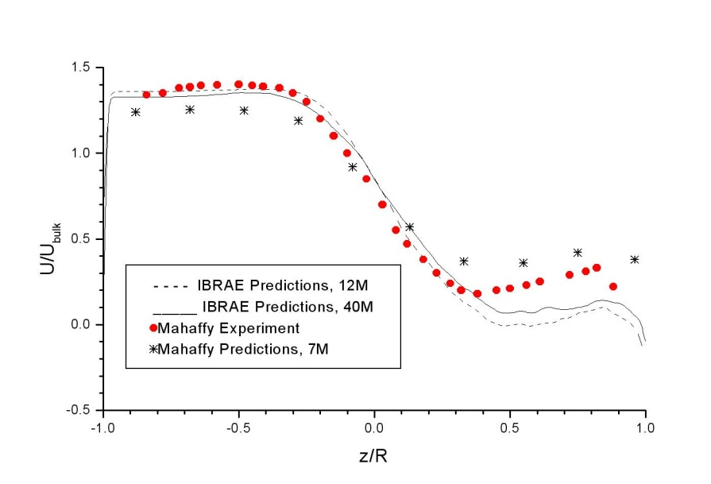
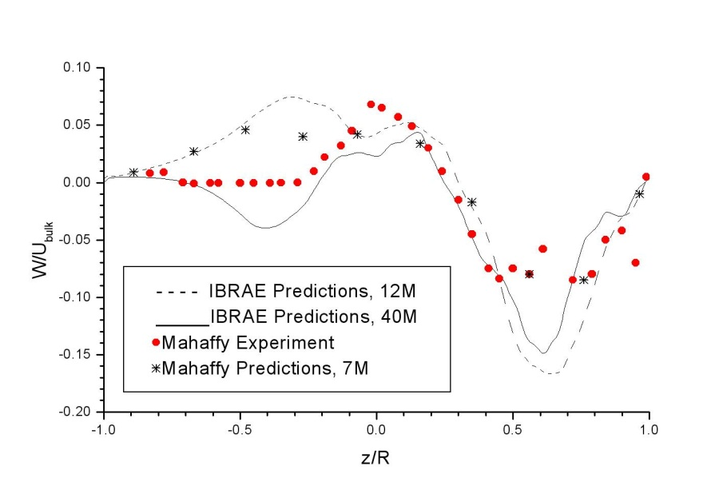
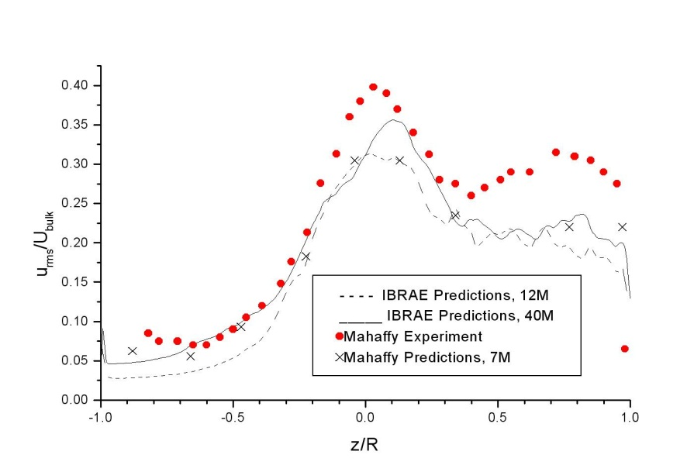
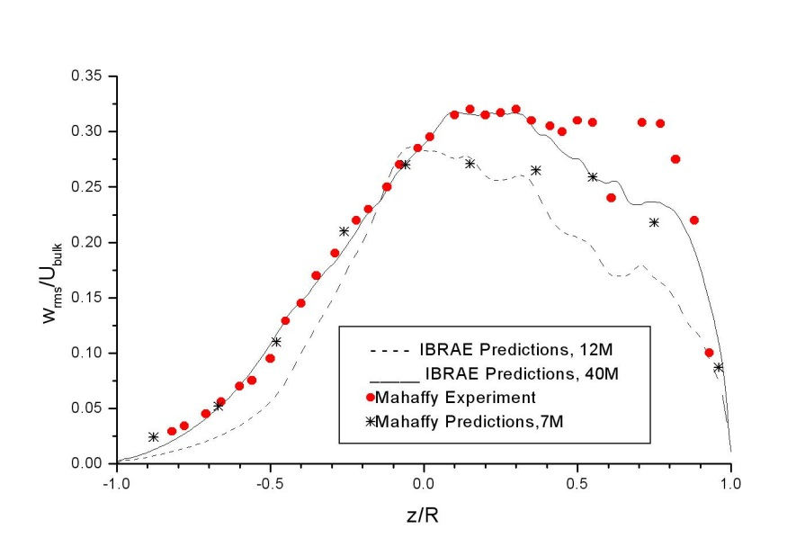
T-junction flow #2
Time averaged values for U - (a) and W – (b) versus z/R at x/D=1.6.
a)
b)
RMS of the velocity x and z component fluctuations versus z/R at x/D=1.6.
c)
d)

Slide 7
Conclusions
The project of the coordinated interface of the oxidizing module for inclusion in 2-D thermo-hydraulic code CONV is developed, including an additional orthogonal grid and material characteristics.
Update of the interface program unit for coupling of the melt – steel oxidation 1-D module with the corium melt 2-D thermo-hydraulic code was realized.
The work will be continued in 8 quarter and will be finished by issue of the technical report.

