Slide 1
International Science and Technology Center
Progress report on the ISTC project #3876 on “Thermo-Hydraulics of U-Zr-O Molten Pool under Oxidising Conditions in Multi-Scale Approach (THOMAS)”
part #2
Presented by
V.V. Chudanov (IBRAE)
16th CEG-SAM meeting, Moscow, IBRAE
September 8-9, 2009

Slide 2
Scope of Current Activities
Task 2.: Development and Improvement of the Unified Thermal Hydraulic Technique (CONV Code) for Simulation of Multiphase Processes in Complex Domains of Convectively Stirred Melt
Subtask 2.3.: Conducting of numerical experiments for the choice of optimum turbulence model (algebraic type) using results of both convection in a cavity with the walls with different temperatures and convection of a heat-generating fluid, and model implementation in the CONV code.

Slide 3
Contents
Choice of optimum turbulence model:
  Approximating turbulence model
  Algebraic turbulence model (Bolduin-Lomax)
Motivation of model choice
Validation aspect
Further development
  Improvement of the turbulence model: large eddy simulation approach will be combined with algebraic turbulence model

Slide 4
Motivation
In our case for a convection of a heat-generating fluid in interesting range of Rayleigh number the approximating (algebraic) turbulence model was proposed and calibrated.
The choice of algebraic models is stipulated by conceptual simplicity.
They seldom call unexpected numerical difficulties.
However always it is necessary to remember a problem of incompleteness. The algebraic models will well work only for flows, for which they were adjusted in details.
Extrapolation outside of the established database, for which the algebraic model was calibrated, does not enough hope.

Slide 5
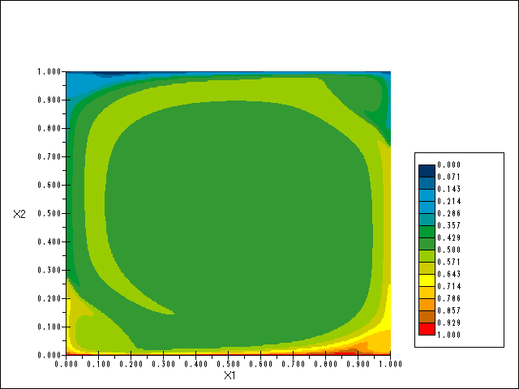
Validation aspect
Approximating turbulence model
Convection
in a cavity with the walls under different temperatures:
Benard convection
Temperature field
  f(Ra) - function of Rayleigh number, calibrated by numerical calculations of natural convection in а cavity with walls of different temperature.
Comparison with Goldstein’s correlation Ra=10⁵ −10¹⁰
  ν^{T}- turbulence viscosity
  Reloc -local Reynolds number
  Recrit- critical Reynolds number
  Ra- Rayleigh number
  PrT- turbulent Prandtl number

Slide 6
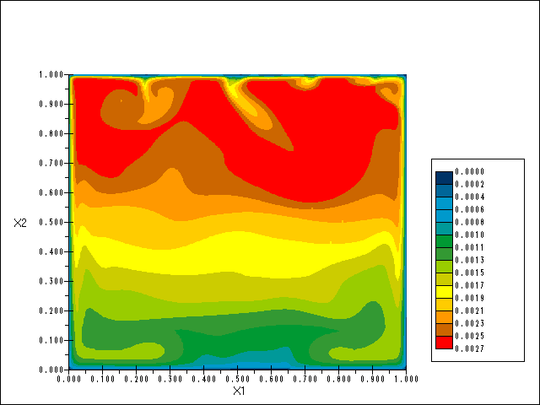
Validation aspect#2
Approximating turbulence model
Convection in a heat generating fluid:
comparison with Mayinger’s experiments,
Ra=10⁸ −10¹⁴
Nusselt number at the upper boundary
  f(Ra) - function of Rayleigh number, calibrated by numerical calculations of natural convection in а cavity with walls of different temperature.
Temperature field

Slide 7
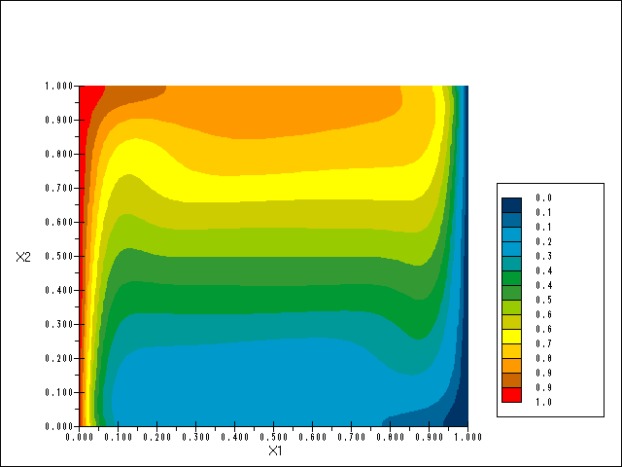
Validation aspect#3
Algebraic turbulence model (Bolduin-Lomax)
Inner layer
Temperature field
Convection
in a cavity
with the walls
under different temperatures
Outer layer
Comparison with Jacob’s correlation, Ra=10⁷ −10¹²
Closure coefficients
The function Fkleb is Klebanoff’s intermettency function with δ replaced by ymax/Ckleb and w is the magnititude of the vorticity vector.
(from book “Turbulence modeling for CFD” by David C.Wilcox, 2004)

Slide 8
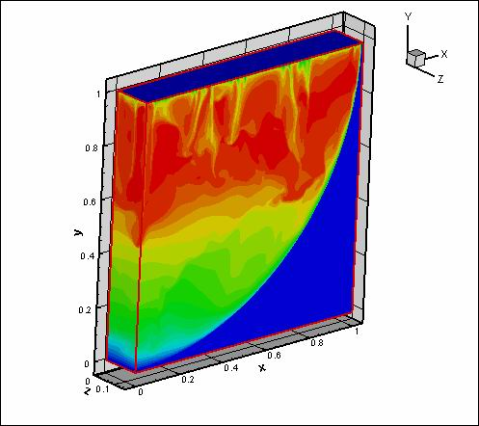
Validation aspect#4
Algebraic turbulence model (Bolduin-Lomax)
Inner layer
Convection in
a heat generating fluid:
comparison with
Mayinger’s experiments,
Ra=10⁸ −10¹⁴
Nusselt number at the side boundary
Outer layer
Closure coefficients
The function Fkleb is Klebanoff’s intermettency function with δ replaced by ymax/Ckleb and w is the magnititude of the vorticity vector.
(from book “Turbulence modeling for CFD” by David C.Wilcox, 2004)

Slide 9
Local conclusions
CFD + algebraic models
Bolduin-Lomax model is applied for explicit boundary layer (sidewall boundary)
At the upper wall (non-stationary temperature layer + vortices' structure) we recommend to use approximated turbulence model
While using of algebraic models a calculated grid with cell size near the boundary 1/Nu is required.

Slide 10
Further development
  Improvement of the turbulence model:
    large eddy simulation approach will be combined with algebraic turbulence model .
    Selection of a set of commutative filters for a LES approach of a turbulence modeling and its implementation in the CONV code.
  The work will be carried out within 5-6 quarters and completed by release of the report.

Slide 11
LES and QDNS general and dynamic Smagorinsky’s model

Slide 12
3D Lid-driven cavity flow at Re=10000
Prasad, A. and Koseff, J., 1989, J. Physics of Fluids A, Vol. 1, № 2, pp 208–218.
U/U_{w} -velocity along the vertical centerline
500uv/U²_{w} along the vertical centerline
10u_{rms}/U_{w} - along the vertical centerline
Velocity field

Slide 13
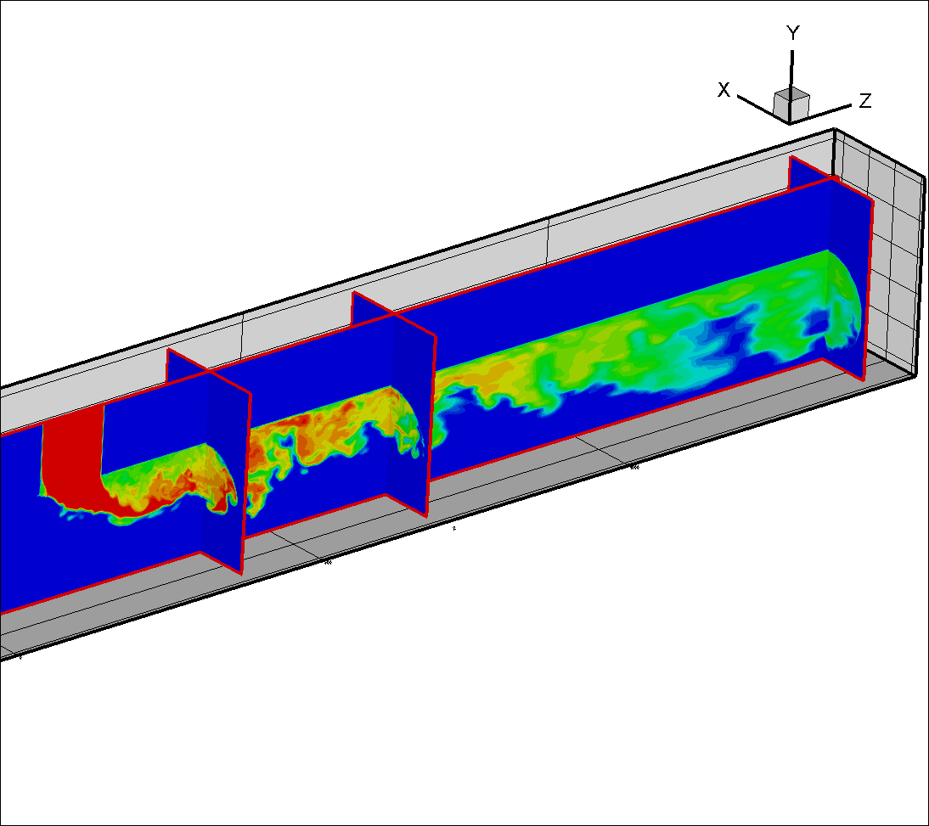
T-junction experiments
Johan Westin, Pascal Veber, et. al, 2008,
Proc. ICONE16, USA, paper ICONE16-48731.
Mean velocity:U
Failures of structures due to high-cycle thermal fatigue have occurred in several nuclear plants around
the world, for different reactor types.
Many of these have been associated with mixing zones where hot and cold streams meet, and particularly near
T-junctions.
As the hot and cold streams from the main and
branch pipes meet, shear instabilities produce
turbulent eddies, causing temperature fluctuations
on the pipe walls downstream of the junction.
A typical value ΔT between the hot/cold streams is 16ºC.
Turbulence: uv
Re~10⁵
Root-Mean Square
hot
cold

Slide 14
T-junction experiment #2
Johan Westin, Pascal Veber, et. al, 2008,
Proc. ICONE16, USA, paper ICONE16-48731.
Non-dimensional mean temperatures near the wall
Development of the velocity fluctuations
(u-component)
Critical parameters for analyses are
* mean velocity,
* velocity fluctuations (root mean square),
* mean temperature
and
*temperature fluctuations.
Non-dimensional temperature fluctuations
near the wall
Development of the velocity fluctuations
(w-component)

Slide 15
Conclusions
The numerical experiments at the choice of optimum turbulence model are finished.
The CONV code is modernized by inclusion of approximating turbulence model and QDNS approach.
Validation the modernized software on the accessible tests was carried out, for all cases a good agreement of numerical predictions with experiment was obtained.
The implementation of LES approach in CONV code will be continued. Preliminary validation of modernized code is conducted.

