Slide 1
Update on SARNET2
Presented by B. Clément (IRSN)

Slide 2
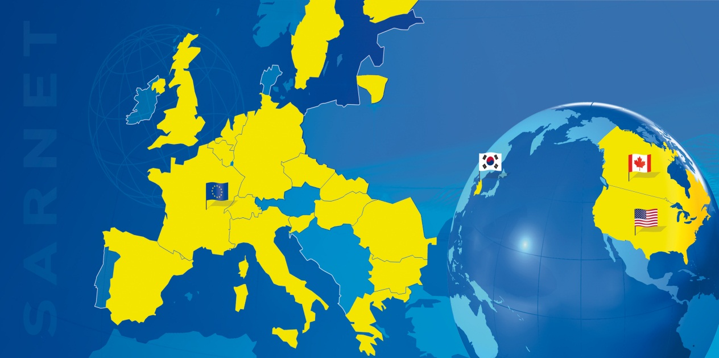
General features
Severe
Accident
Research
NETwork of excellence
www.sar-net.eu
SARNET2 Project in 7th EC Framework Programme (follow-up of SARNET FP6 2004-2008), coordinated by IRSN
Started April 1st, 2009 for 4 years
≈ work of 40 persons-year per year
≈ 8,5M€ effort per year
≈ 1,5M€ per year funded by EC
  22 countries (European Union, Switzerland, Canada, USA, South-Korea, India)
  43 organizations (BARC, India, from Oct.2011)
    22 Research organizations
    7 Universities
    7 Industry/Utilities
    7 Safety authorities or Technical supports
  ≈ 230 researchers (+ PhD)

Slide 3
Research priorities
6 issues remain open with high priority:
  Core coolability during reflooding and debris cooling,
  Ex-vessel melt pool configuration during MCCI (Molten Core Concrete Interaction) & ex-vessel corium coolability by top flooding,
  Melt relocation into water & ex-vessel FCI (Fuel Coolant Interaction),
  Hydrogen mixing and combustion in containment (flame acceleration),
  Oxidising impact on source term (Ru oxidising conditions or air ingress for HBU and MOX fuel elements),
  Iodine chemistry in RCS and in containment.

Slide 4
Work-Packages
WP1: NoE Management, incl. updates of the research priorities,
WP2: Spreading of Excellence (courses, ERMSAR conferences, mobility of researchers)
WP3: Information Systems (web, ACT, DATANET)
WP4: ASTEC (capitalisation of knowledge, assessment, extension to BWR and CANDU)
WP5: corium and debris coolability (core reflooding..)
WP6: MCCI
WP7: steam explosion and hydrogen combustion in containment
WP8: oxidising impact on source term (Ru, HBU and MOX fuel), iodine chemistry in circuit and containment
R&D
The WP5 to 8 cover the 6 high-priority issues defined by SARP in SARNET.

Slide 5
Main meetings in the last six months
Mar. 29-30, 2011: WP8 on Source Term.
April 8, 2011: 2nd meeting of Steering Committee.
June 27 – July 1, 2011: WP5-6 joint meeting.
June 28, 2011: WP7-1 meeting.
June 2011: 2nd SARP meeting

Slide 6
Main events in the last year
April 2011: ASTEC V2 Training Course n°2 for beginners.
May 2-5, 2011: paper on a general presentation of SARNET2 at ICAPP’11 conference in Nice (France),
  Several associated papers by partners on ongoing work in the WPs.
June 2011: SARNET2 newsletter N°4.

Slide 7
Main next milestones (1/2)
Oct. 27, 2011: 6th Management Team meeting.
Nov. 29, 2011: 3rd SARP meeting.
Jan. 9-13, 2012: WP5 and WP6 meetings.
Nov. 2011: publication of a general paper in the Special issue "Severe Accident Analysis in Nuclear Power Plants" of the Journal Science and Technology of Nuclear Installations.
Nov. 2011: edition by ELSEVIER of the textbook “NUCLEAR SAFETY IN LWRs: SEVERE ACCIDENT PHENOMENOLOGY” (600 pages, 45 authors).
5th ERMSAR conference in March 2012, hosted by GRS in Cologne (held in the same time and location than the General Assembly). For the 1st time, “open” conference to papers from non–SARNET members.

Slide 8
Main next milestones (2/2)
Evaluation of the Fukushima impact on R&D priorities:
  The SARP group will account for it when updating the priorities as defined in 2007, with the final deadline of early 2013, at SARNET2’s end;
  Moreover an internal long-term process has been launched in some WPs by sharing the partners’ analyses of phenomenology and mitigation aspects.

Slide 9
A few technical outcomes in the last year
Continuous intensive storage of exp. data in DATANET database, in particular by KIT.
Increase of synergy between the 3 different exp. programmes on debris reflooding (PEARL in IRSN, QUENCH-Debris in KIT, DEBRIS in IKE). Good results of the PRELUDE IRSN exp. that prepare at a smaller scale the PEARL experiments.
Progress of understanding the origin of the different cavity shapes in MCCI with (an)isotropy depending on the type of concrete (limestone, siliceous).
Success of 5 benchmarks between simulation codes (LP or CFD) on containment experiments. New benchmarks on source term are starting (Phebus FPT3, THAI Iod13-14).
Good progress on Ruthenium transport in primary circuit (experiments, modelling).
Synthesis of ASTEC V2.0 assessment by 27 partners.

