Slide 1

European approach on the NPP safety stress tests in the post-Fukushima situation. Examples of application to France and Germany
B. Clément (IRSN)
M. Sonnenkalb (GRS)

Slide 2
Content
Comments on Fukushima Accident
European Stress test
Application to France
German national Stress Test

Slide 3
General Comments on Fukushima Accident
Accident Severity
  The “beyond design” Fukushima Daiichi accident consequences are extremely severe
  But they could have been really worst
    Accident consequences have been minimised by the meteorological conditions (direction of the wind towards sea) for a large part of the radioactive releases
    Melting of fuel in the deactivation pools would have induced more severe consequences (cliff edge effect)

Slide 4
General Comments on Fukushima Accident
Three levels of failure regarding the defence in depth concept
  The accident initiating type of event (earthquake + tsunami) was included in the plant design but the amplitude of the event was “beyond the design” and has conducted to a cliff edge effect
  The accident management procedures, the available equipment and maybe the staff were not sufficient to maintain the long term core cooling (despite all efforts made by the operator teams) during these extreme situations
  Core melts after SBO on Fukushima reactors 1, 2, 3 have lead systematically to hydrogen combustion in the reactor building and large releases (limited by retention in the suppression pool)

Slide 5
Additional Safety Review Process in the EU
1st Lessons from the Fukushima Accident
  The design is not appropriate for such an external event
  Simultaneous long term loss of core cooling and electrical supply
  Failures concerning all reactors on a same site
National and international responses
  March 17th: German “Bundestag” asked German Government to organise a safety review of German NPPs by an independent expert group; BMU asked RSK to perform this within 2 month; GRS led the process
  March 23rd: French Prime Minister asked French Safety Authority to organise a complementary safety review of French plants
  March 24-25th: European Council meeting
European Stress Tests - Definition proposed by WENRA (April 21st)
  Used as a starting point by French Safety Authority and extended to non reactor facilities
  In Germany performed in addition to national stress test for all NPPs
  May 25th: definition accepted by ENSREG and EC

Slide 6
Additional Safety Review Process in the EU
European Responses
  March 24-25th: European Council meeting
  April 21st: Definition of Stress Tests proposed by WENRA (Western European Nuclear Regulators’ Association)
  May 25th: definition approved by ENSREG (European Nuclear Safety Regulators Group) and EC
  Reassessments to be made by licensees before October 31st
  Independent review by regulatory bodies with final national reports before December 31st
  December 8th 2011: preliminary presentation of national reports to the European Council
  March-April 2012: Peer Review of national reports
  June 2012: presentation to the European Council

Slide 7
Technical Scope of Stress Tests - Focus
Initiating Events
  Earthquake
  Flooding
Consequence of loss of safety functions for any initiating event conceivable at the plants site
  Loss of electrical power including station black-out
  Loss of ultimate heat sink
  Combination of both
Severe Accident Management (SAM) issues
  Means to protect from and to manage loss of core cooling function
  Means to protect from and to manage loss of cooling function in the fuel storage pool
  Means to protect from and to manage loss of containment integrity

Slide 8
Technical Scope of Stress Tests – Information required
Three main aspects
  Provisions taken in the design basis and plant conformance to design requirements
  Robustness of the plant beyond its design basis
  Any potential for improvement likely to improve the considered level of defence-in-depth
Protective measures aimed at avoiding extreme scenarios
  Means to maintain the three fundamental safety functions
  Possibility of mobile external means and the conditions of their use
  Any existing procedure to use means from one reactor to help another one
  Dependence of one reactor on the functions of another reactor on the same site

Slide 9
Technical Scope of Stress Tests – Information required
For severe accident management, identification of
  Time before damage of the fuel becomes unavoidable (for PWR and BWR, time before water level reaches the top of the core and time before fuel degradation
  For spent fuel pool, time before pool boiling, time up to when adequate shielding against radiation is maintained, time before water level reaches top of fuel elements, time before fuel degradation

Slide 10
Earthquake
Design Basis
  Earthquake against which the plant is designed (DBE)
  Provisions to protect the plant against the DBE
  Plant compliance with its current licensing basis
Evaluation of Margins
  Evaluation of the range of earthquake severity above which loss of fundamental safety functions or severe damage to the fel becomes unavoidable
    Indicate the weak points and specify any cliff edge effect according to earthquake severity
    Indicate if any provisions can be envisaged to prevent these cliff edge effects or to increase robustness of the plant
  Range of earthquake severity the plant can withstand without losing containment integrity
  Earthquake exceeding DBE and consequent flooding exceeding DBF

Slide 11
Flooding
Design Basis
  Level of design basis flood (DBF) and reasons for choice
  Methodology to evaluate DBF, sources for flooding, validity of data in time
  Conclusion on adequacy of design basis
Evaluation of Margins
  Level of flooding that the plant can withstand without severe damage to the fuel (core or fuel storage)
    Depending on time between warning and flooding, indicate whether additional protective measures can be envisaged/implemented
    Indicate weak points and specify any cliff edge effect, identifying which building and equipments will be flooded first
    Indicate if any provisions can be envisaged to prevent these cliff edge effects or to increase robustness of the plant

Slide 12
Loss of electrical power and ultimate heat sink
Loss of off-site power (LOOP)
  Description of design and internal back-up power sources
  Indicate how long on-site sources can operate without external support
  Specify provisions needed to prolong the time of on-site power supply
  Indicate any envisaged provisions to increase robustness of plant
Loss of off-site power and of off-site back-up power sources (SBO)
  LOOP + loss of ordinary back-up sources
  LOOP + loss of ordinary back-up sources + loss of any diverse back-up sources

Slide 13
Loss of electrical power and ultimate heat sink
Loss of off-site power and of off-site back-up power sources (SBO)
  Information on battery capacity and duration
  Information on design provisions for these situations
  Indicate how long the site can withstand a SBO without external support before severe damage to fuel becomes unavoidable
  Specify which (external) actions are foreseen to prevent fuel degradation
    Equipment already present on site, available off-site, near-by power stations, time necessary to have above systems operating,
    Availability of human resources for exceptional connections
    Identification of cliff edge effects
  Indicate if any provisions can be envisaged to prevent these cliff edge effects or increase robustness of the plant

Slide 14
Loss of electrical power and ultimate heat sink
Loss of primary ultimate heat sink (UHS)
  Description of design provisions to prevent loss of UHS (various water intakes, alternative UHS...)Consider loss of primary UHS (water from river or sea) and loss of primary and alternative UHS
  Indicate how long the site can withstand the situation without external support before severe damage to fuel becomes unavoidable
  Information on design provisions for these situations
  Specify which (external) actions are foreseen to prevent fuel degradation
    Equipment already present on site, available off-site, near-by power stations, time necessary to have above systems operating,
    Availability of human resources
    Identification of cliff edge effects and when they occur
  Indicate if any provisions can be envisaged to prevent these cliff edge effects or increase robustness of the plant

Slide 15
Loss of electrical power and ultimate heat sink
Loss of primary ultimate heat sink (UHS) and SBO
  Indicate how long the site can withstand a loss of main UHS + SBO the situation without external support before severe damage to fuel becomes unavoidable
  Specify which (external) actions are foreseen to prevent fuel degradation
    Equipment already present on site, available off-site, time necessary to have above systems operating,
    Availability of human resources
    Identification of when cliff edge effects occur
  Indicate if any provisions can be envisaged to prevent these cliff edge effects or increase robustness of the plant

Slide 16
Severe Accident Management
Accident Management measures currently in place at various stages - loss of the core cooling function
  Before occurrence of fuel damage in RPV or pressure tubes
    Last resorts to prevent fuel damage
    Elimination of possibility of fuel damage at high pressure
  After occurrence of fuel damage in RPV or pressure tubes
  After failure of RPV or pressure tubes
Accident Management measures and plant design features for protecting integrity of containment function after occurrence of fuel damage
  Prevention of H2 deflagration or detonation taking into account venting process
  Prevention of containment over-pressurisation – if release needed, assess whether it needs to be filtered and describe availability of means to estimate amount of radioactivity released into the environment

Slide 17
Severe Accident Management
Accident Management measures currently in place at various stages - loss of cooling function of storage pool
    Last resorts to prevent fuel damage
    Elimination of possibility of fuel damage at high pressure
  After occurrence of fuel damage in RPV or pressure tubes
  After failure of RPV or pressure tubes
Accident Management measures and plant design features for protecting integrity of containment function after occurrence of fuel damage
  Prevention of H2 deflagration or detonation taking into account venting process
  Prevention of containment over-pressurisation – if release needed, assess whether it needs to be filtered and describe availability of means to estimate amount of radioactivity released into the environment

Slide 18
Severe Accident Management
Accident Management measures and plant design features for protecting integrity of containment function after occurrence of fuel damage
  Prevention of re-criticality
  Prevention of basemat melt through
  Need for and supply of AC and DC power and compressed air for equipments used for protecting containment integrity
Accident Management measures in place to mitigate loss of containment integrity
Accident Management measures in place at the various stages of a scenario of loss of cooling function in the fuel storage
  before/after losing adequate shielding against radiation
  before/after uncover of the top of fuel in the pool
  before/after occurrence of fuel degradation

Slide 19
Severe Accident Management
Requirements for each topic at each stage
  Identify any cliff edge affect and evaluate time before it
  Assess the adequacy of existing management measures and evaluate the potential for additional measures; in particular concerning:
    Suitability and availability of required instrumentation
    Habitability and accessibility of the vital ares of the plant
    Potential H2 accumulations in other buildings than containment
  Need for and supply of AC and DC power and compressed air for equipments used for protecting containment integrity

Slide 20
Severe Accident Management
Aspects to be addressed
  Organisation of the licensee to manage the situation
  Possibility to use existing equipment
  Provisions to use mobile devices
  Provisions for and management of supplies
  Management of radioactive releases, provisions to limit them
  Management of workers’ doses, provisions to limit them
  Communication and information systems, long-term post-accident activities

Slide 21
Severe Accident Management
Evaluation of accident management measures
  Considering what could be the situation on site
  Extensive destruction of infrastructure around the plant including the communication
  Facilities (making technical and staff support from outside more difficult)
  Impairment of work performance (accessibility and habitability of main and secondary control rooms, plant emergency centre) due to high local dose rates
  Feasibility and effectiveness of accident management measures under the conditions of external hazards(earthquakes, floods)
  Unavailability of power supply
  Potential failure of instrumentation
  Potential effects from the neighbouring plants at site
  Licensee should identify which conditions could prevent staff from working in control rooms/crisis centre and what measures could avoid such conditions to occur

Slide 22
Example of application to France
Decision making
  March 25th: French Prime Minister asked French Safety Authority (ASN) to organise a complementary safety review in France
  Stress tests definition proposed by WENRA, validated by ENSREG and adopted by EC used as a starting point by ASN – extended to non reactor facilities – issue of subcontractors’ management also added
Schedule
  May 5th: notification by ASN to utilities
  June 1st: utilities sent methodology reports for review by IRSN
  July 6th: IRSN presented its conclusions to the French Permanent Advisory Group
  July 7th: French Permanent Advisory Group provided its recommendations to ASN
  End July: ASN decision sent to utilities

Slide 23
Example of application to France
Schedule
  September 15th: Reports received from utilities (reports from EDF, COGEMA, CEA, ILL publicly available on ASN web site) – beginning of review by IRSN
  September 15th: French interim report sent to EC by ASN
  November 8 - 10th: IRSN will present its conclusions to French Permanent Advisory Group
  November 12th: French Permanent Advisory Group provides its recommendations to ASN
  End December 2011: decision by ASN

Slide 24
Example of application to Germany - Stress Test
German Ministry BMU asked the German Reactor Safety Commission RSK in agreement with the local German Authorities to perform a plant specific Safety Check within a short time period (End of March to Mid of Mai 2011)
Goal: check the robustness of the NPPs design and the implemented Accident Management measures against extended challenges not considered so far
GRS was asked to manage the process with support from local TÜV and other German organizations
final report was issued by RSK on May 16, 2011

Slide 25
Example of application to Germany – SAM review
Review of the necessary scope of Accident Management Measures (AMM) and their effectiveness under further-reaching assumptions incl. external hazards.
Analyze to what extent additional AMM for a further reduction of the residual risk might be useful and possible.
Review extent and quality of pre-planning for postulated event sequences:
  non-availability of the cooling chain for cooling of the fuel assemblies in the reactor core as well as in the spent fuel pool
  massive fuel assembly damage up to core meltdown
  non-availability of electricity supply for longer time
  hydrogen formation and explosion risk
  restricted availability of personnel
  inaccessibility due to high radiation levels
  substantial destruction of the infrastructure
An extensive list of issues was set up and served as a basis for the review procedure.

Slide 26
Example of application to Germany – SAM Findings
The Accident Management concept should be further developed so as to ensure the effectiveness of the AMM even in the event of external hazards.
Improvements are to be made related to:
  accessibility of the power plant and power plant buildings,
  operability of the AMM under SBO conditions
  availability of the remote shutdown and control station
  re-establishing of supply of alternating current within a plant-specifically determined grace period
  external-hazard-protected layout of standardized feed points on the outside of the buildings for the supply of the emergency power bus-bars and, where necessary, of emergency power bus-bars supplying the emergency feed water system (inter-connectable in the building).
  external-hazard-protected provision of mobile emergency power generators with sufficient capacity for supplying one redundant residual-heat removal train or for recharging batteries.

Slide 27
Example of application to Germany - Findings
Improvement with regard to injection possibilities for core cooling and for ensuring sub-criticality:
  External-hazard-protected provision of mobile pumps and other injection equipment (hoses, connectors, couplings, etc.) as well as of boric acid, with required grace periods for provision and delivery at the scene.
  Assurance of a water intake that is independent of the receiving water and available even after an external impact (physical separation if necessary).
  Check additional possibilities of injecting water into the steam generators, reactor pressure vessel and the containment (in the latter case also with consideration of higher back-pressures) without the need to enter areas with high risk potential (dose rate, debris load) and to be able to compensate local destruction (e.g. by permanent and physically separated injection paths).
  Optimization of the BWR accident management measure of steam-driven high-pressure injection in a SBO to prevent the high-pressure path during core melt (maintaining of a sufficient pressure suppression capability at increased temperature in the pressure suppression pool).

Slide 28
Example of application to Germany - Findings
Increased consideration of the wet storage of fuel assemblies in the accident management concept, taking the following aspects into account:
  Possibilities of injecting water into the wet storage facility for fuel assemblies without the need to enter areas with high risk potential (dose rate, debris load) and to be able to compensate local destruction (e.g. by permanent and physically separated injection paths).
  To ensure evaporation cooling: updating of the safety demonstrations for the spent fuel pool, setdown pool, reactor cavity seal liner, which are at boiling temperature.
In addition: minimizing the risk of hydrogen combustion for BWR spent fuel pool areas, which are outside the containment in the reactor building.

Slide 29
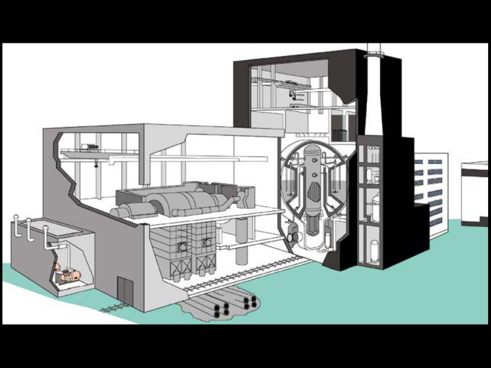
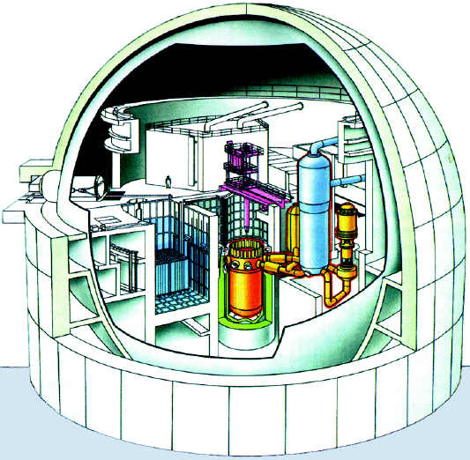
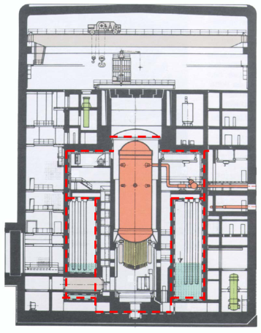
Decision of German Government
„Atomgesetznovelle“ of July 31, 2011
  Shut down of four (all) BWR-69 NPPs
  Shut down of four older PWR
In operation now:
  2 BWR type 72 units
  7 PWR of 3rd and 4th generation

