Slide 1


State Scientific Center RF
Institute of Physics and Power Engineering
(Obninsk, Russia)
Thermophysics division

Slide 2
Project proposal to ISTC:
“Development of the multicomponent medium models and three dimensional code for numerical simulation of corium spreading”
Experience of the codes development
A model of multicomponent medium can be used as a base for development of the local spatial models of process description, existing under accident with core melting. There is a certain experience of applying such model as the part of two-dimensional DINCOR computer code developed in IPPE.

Slide 3
Description of the multicomponent medium
is carried out by means of one velocity approach with use
a drift model to take into account a separation of the medium
components
Averaged characteristics of the medium:
Momentum conservation and continuity equations:

Slide 4
Conservation of the components taking into account separation and sources of the components:
Conservation of energy with separation of the components:
Energy deposition including heat release in chemical reactions:

Slide 5
Separation model
Velocity of a component defined as a sum of averaged velocity of medium and velocity of component separation :
Velocities of the components separation defined taking into account buoyancy forces:

Slide 6
The model of multicomponent medium have been used as a base of two-dimensional code DINCOR.

Slide 7
Cod DINCOR intended for numerical simulation the transient processes:
• hydrodynamics of liquid and gaseous components of medium;
• heat transport and heat exchange;
• melting-solidification of the medium components;
• chemical interactions between components.
There are the several versions for the specialized tasks solution distinguished by taken into account thermo hydraulic and chemical processes : DINCOR-DGR, DINCOR-SPR, DINCOR-HYDR etc.

Slide 8
Examples of two-dimensional calculations by DINCOR code using a multicomponent medium model

Slide 9
0 sec. 22 sec.
CORVIS experiment
BWR drain line model melting by iron melt

Slide 10
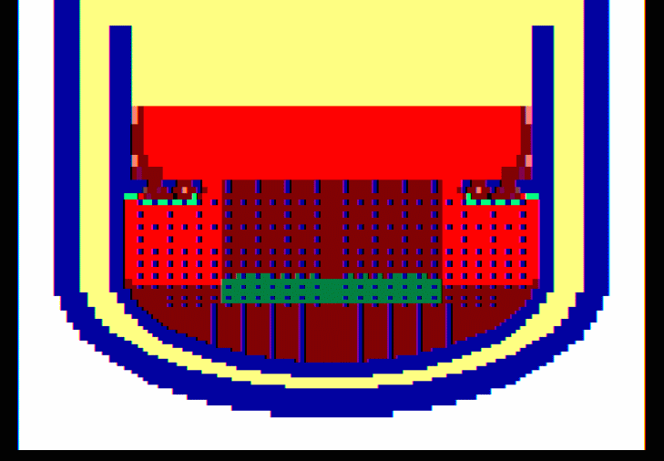
Lower plenum elements melting of VVER-1000

Slide 11
Materials melting and melt relocation inside of a corium catcher for VVER-1000
Size of the numerical grid:
158*310=48 980 cells

Slide 13
Three-dimensional version of the code is in process of development and includes the following stages:
Development the local mathematical models of liquefaction and solidifying of materials under front melting and melting on account of inner sources.
Verification of the models on experimental data of melting simple materials (lead, paraffin, iron, and etc.) and reactor materials (uranium dioxide, steel and etc.)
Development the models of no mixing components of multicomponent medium; testing and verifying the models on experimental data.

Slide 14
Development of numerical procedures for solving the correlations of multicomponent medium with considering processes of dissolutions, melting, and chemical interactions.
Integration the procedures of solving the correlations of multicomponent medium in one computer code.
Development the models of dissolution and chemical interaction of the multicomponent medium components; testing and verifying the models on experimental data.

Slide 15
The part of work already has been done:
Module of the code for calculation of a
multicomponent medium hydrodynamics is
developed.
Test calculations have shown code
workability and effectiveness of numerical
algorithm.

Slide 16
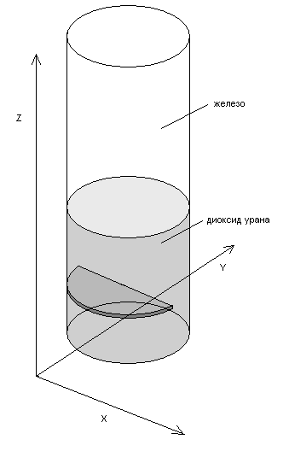
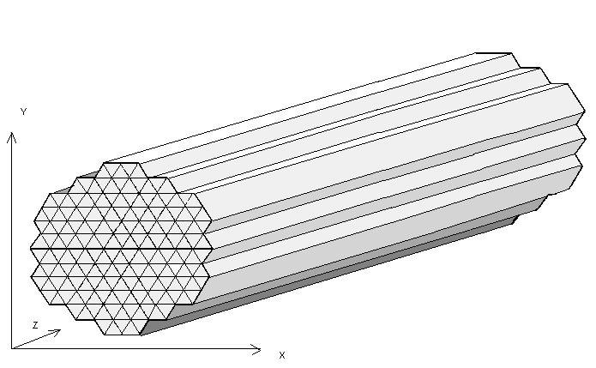
Testing of three-dimensional code version using triangular prizmatic numerical grid
Gravity force

Slide 17
Dynamics of the components interface inside channel with blockage

Slide 18
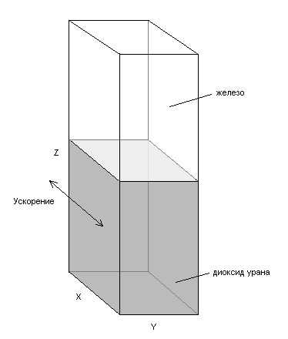
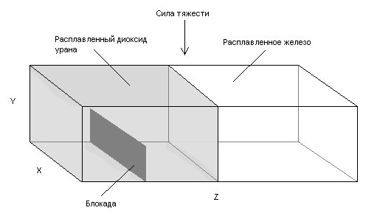
Testing of the three-dimensional code version using rectangular numerical grid
Gravity force

Slide 19
Testing of the three-dimensional code version using rectangular numerical grid
Gravity force

Slide 20
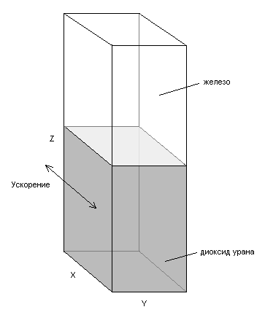
Fluctuation of the components interface
forced by horizontal acceleration of the vessel
acceleration

Slide 21
List of main publications
Кумаев В.Я., Леончук М.П.. Численное моделирование трехмерного течения теплоносителя в пучках твэлов. М., Атомная энергия, т.60, вып.6, 1986г., с. 382-386.
Кумаев В.Я., Леончук М.П., Дворцова Л.И.. Методика численного расчета трехмерных течений теплоносителя в пучках стержней. Препринт ФЭИ, ФЭИ-1733, 1985 г.
V. Kumayev, Investigation on Spatial Thermal Hydrodynamics of Reactor Elements Melting, Corium Formation and Cooling for VVER-type Reactors. Vienna, IAEA-J7-TC-779.2, Working Material of TCM on Accident Management Procedures, Garching, Germany, 5-9 September,1994
Кумаев В.Я., Леончук М.П.. Программа DINCOR для расчета плавления, окисления и растворения твэлов реакторов ВВЭР. Димитровград, ГНЦ РФ НИИАР, Матема-тическое и физическое моделирование ядерных реакторов и петлевых установок, проблемы верификации, 1996г., с.128-134
Кумаев В.Я., Лебезов А.А., Астахов В.К., Лукин А.В. Разработка кода DINCOR-DGR для численного моделирования динамики плавления элементов и корпуса реактора ВВЭР-1000 кориумом в процессе тяжёлой аварию. Труды научно-практического семинара «Вопросы безопасности АЭС с ВВЭР», Санкт-Петербург, 12-14 сентября, 2000 г.

Slide 22
List of main publications
Кумаев В.Я., Лебезов А.А., Астахов В.К. Разработка кода DINCOR-DGR для численного моделирования динамики плавления элементов и корпуса реактора ВВЭР-1000 кориумом в процессе тяжелой аварии. “Обеспечение безопасности АЭС с ВВЭР”, сборник тезисов докладов 2-ой Всероссийской научно-технической конференции, Подольск, 19 – 23 ноября 2001 г., с. 111 – 112.
Кумаев В.Я., Астахов В.К., Лебезов А.А.. Физико-математические модели для описания гидродинамики и теплопереноса в многокомпонентных расплавах с внутренними источниками тепловыделения и химическими реакциями. Отчёт ФЭИ, инв. .№ 10975, 2002 г.
Кумаев В.Я., Зарюгин Д.Г., Лебезов А.А. Разработка структуры и общего алгоритма первой версии трехмерного кода расчета динамики многокомпонентной среды. Отчет ФЭИ, 2003 г.
Кумаев В.Я., Лебезов А.А., Мильшин П.В. Тестирование первой версии кода на решении задач трехмерной динамики многокомпонентной среды с плавлением-затвердеванием. Отчет ФЭИ, инв. .№ 11303, 2003 г.

