Slide 1


DEVELOPMENT OF CORIUM XRF ANALYSIS: EXPERIENCE, PROBLEMS AND THEIR SOLUTIONS
B.Kalinin, Yu.Sergeev, S.Vitol
A.P. Alexandrov Research
Institute of Technology
SPb State University
NPO ‘Spectron’
International Science and Technology Center
Presented by B. Kalinin
2nd PRECOS project meeting
May 26, 2009, St. Petersburg

Slide 2
Introduction
In the experimental studies of severe accident phenomena it is necessary to determine corium composition in the samples:
cut from the ingot
taken from the melt
aerosol deposits (on filters, surfaces of IMCC components)
dissolved (e.g., in the studies of FP leaching)
In comparison to alternative analytical methods XRF has the following advantages:
express results and quick sample preparation
the method is not destructive
a large number of simultaneously determined elements (multi-element analysis)
high sensitivity and a wide range of determined concentrations (from 0.0001 to 100 %mass.)

Slide 3
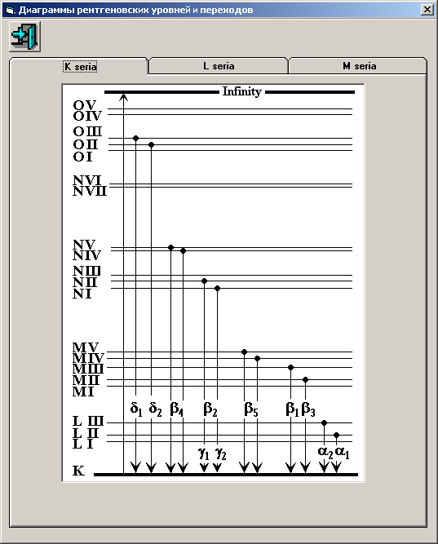
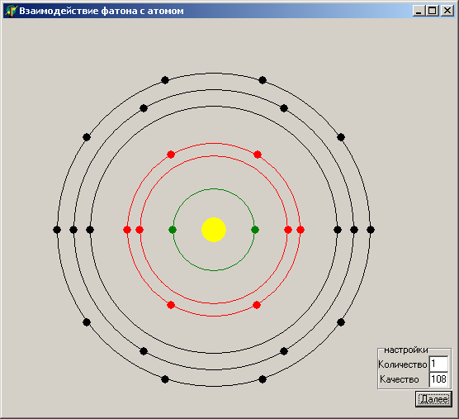
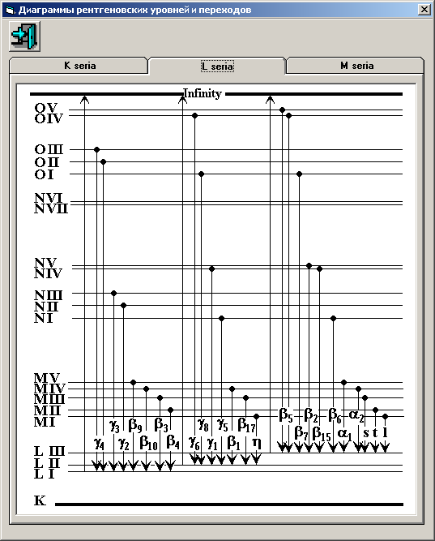
X-Ray emission schematics
Electronic cells of atom
К-series
L-series

Slide 4
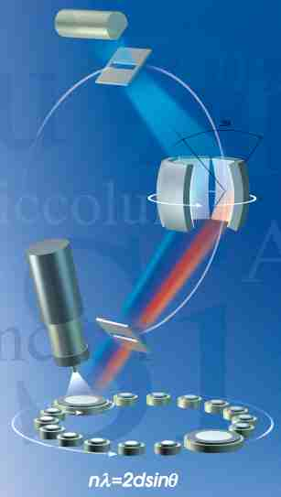
X-ray-optical scheme of spectrometer
Detector
Exit aperture
Focal circle
X-ray tube
Qualitative analysis
Crystal
analyzer
Entrance aperture
Sample
Quantitative analysis
Content, mass fraction %
Counting rate pulse/sec.
Data
procession
Counter

Slide 5
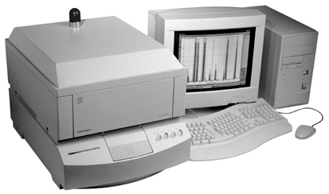
X-ray spectrometer
SPECTROSCAN MAX-GV

Slide 6
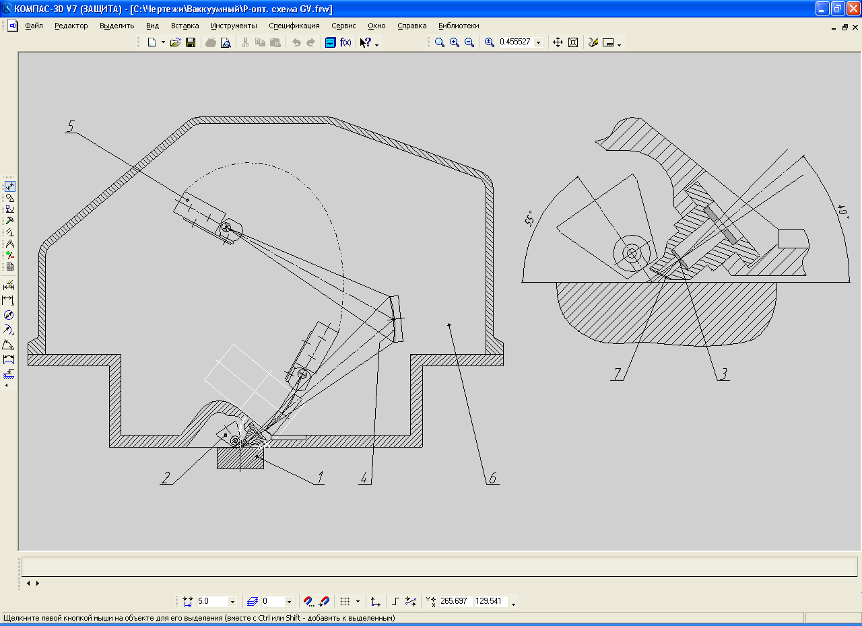
X-ray optical schematics of spectrometer SPECTROSCAN MAX-GV
sample
tip of X-ray tube with lateral emission window
window of vacuum chamber
crystal-analyzer
detector
vacuum chamber
window Be

Slide 7
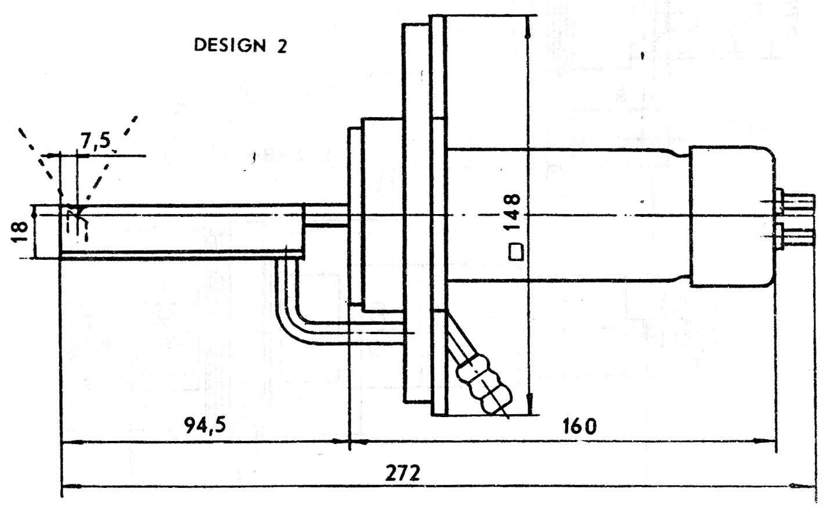
X-ray tube BHV17
Fluorescence excitation conditions
BHV 17
anode Pd (Cr)
window Be 0,145 мм
angle of electron incidence to anode 20°
SPECTROSCAN MAX-GV
angle of incidence ϕ=55°
angle of selection/collection φ=40°

Slide 8
Software of SPECTROSCAN MAX–GV spectrometers
QUALITATIVE ANALYSIS
Determination of element inventories in the specimens using their characteristic lines
QUANTITAVE ANALYSIS
C_{i} – element mass fraction
F_{j} - is chosen from: I_{j}, I_{i}×I_{j}, I_{i} ⁄ I_{j} series
I_{i}, I_{j} - intensities of measured lines
a_{ij} - empirical coefficients
K_{ij} – – theoretical coefficients of influence
- mass fraction of elements in a standard sample
METHOD OF FUNDAMENTAL PARAMETERS
C_{i} х F(C,C_{ue},P) = A_{i} х I_{i},
C –evaluated concentrations
C_{ue} - concentrations of undetermined elements
P – function of fundamental parameters
I_{i} - measured intensity
A_{i} - instrument factor

Slide 9
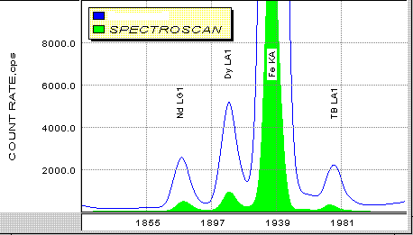
X-ray spectrum of magnetic alloy produced by the industrial crystal-diffraction spectrometer in comparison with a spectrum of the same alloy measured by spectrometer SPECTROSCAN MAX-GV

Slide 10
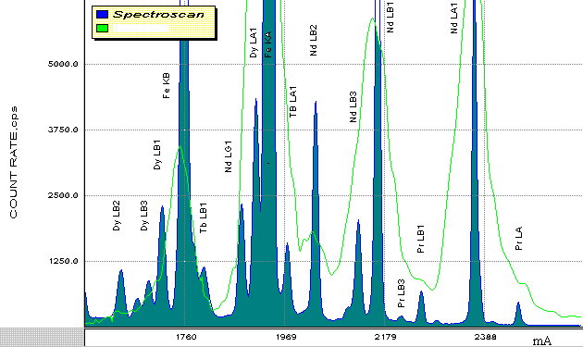
X-ray spectrum of magnetic alloy produced by the energy dispersion spectrometer in comparison with a spectrum of the same alloy measured by spectrometer SPECTROSCAN MAX-GV

Slide 11
Peculiarities of analyzed corium system
In-Vessel corium:
•UO₂ (fuel )
•Zr (shells of fuel elements and construction components)
•ZrO₂ (oxidized shells of fuel elements )
•Fe-Ni-Cr metals and oxides (components of the vessel and in-vessel instrumentation)
•Ru, La, Sr, Ba …... (low-volatile fission products)
•B, C, In, Ag (Gd, Ti, Dy) (Absorbers materials )
Approximately 11 elements, which form about 250 phases
Ex-vessel corium:
Materials of the reactor core UO₂, Zr/ZrO₂, Fe/FeO
Si, Al, Mg, Ca oxides (concrete)
Special materials (refractory and other materials)
About 15 elements, which form more than 500 phases
Main problems, which limit the element measurement accuracy:
- transient composition of samples due to oxygen (aliovalent oxides, metal-oxidic systems)
- different matrixes, in which elements are determined (light, heavy, ceramics, glass, metal-like)
- absence of metrologically attested standards for corium systems

Slide 12
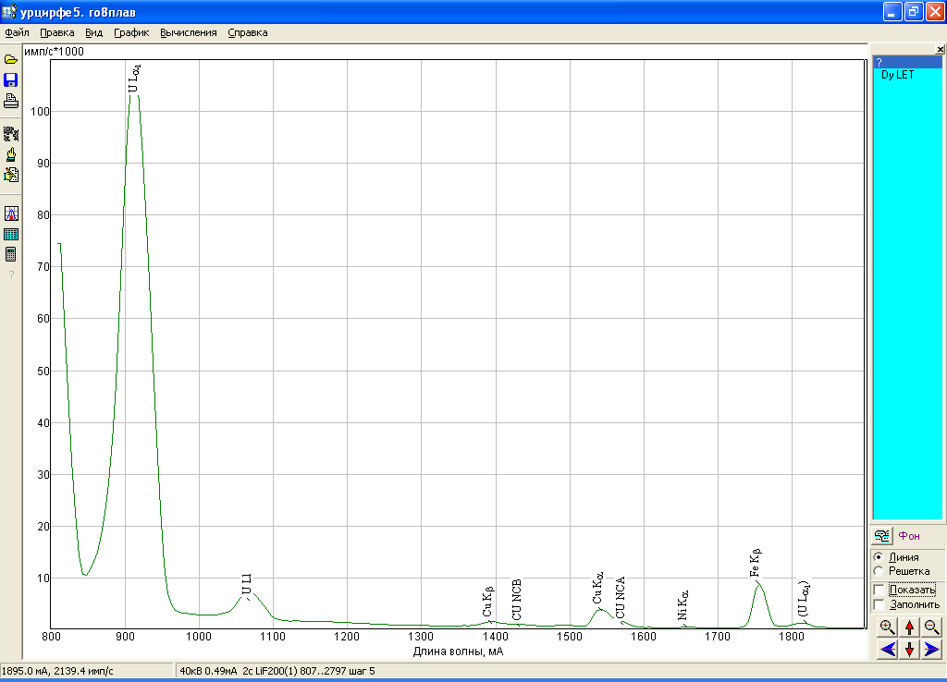
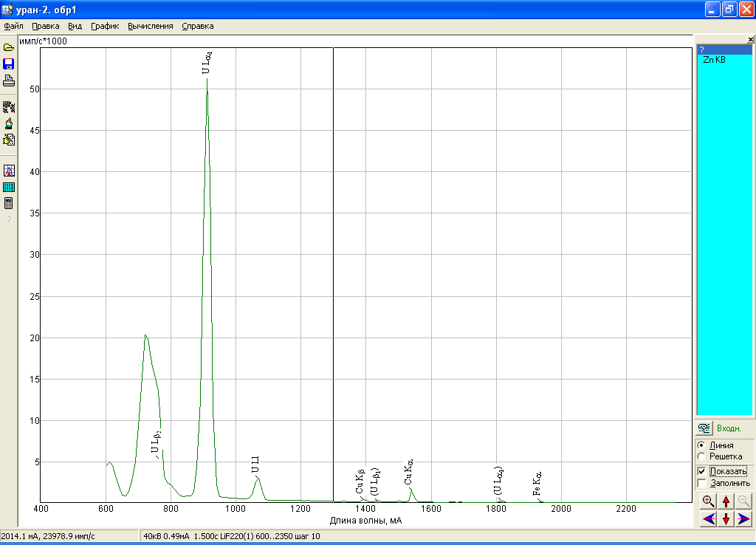
X-ray spectra of uranium samples produced by crystal-analyzers:
LiF200
LiF220

Slide 13
Relationship between analytical spectometer characteristics and metrological parameters of analysis
Metrological parameters of quantitative XRF:
statistical detection limit C₀ in terms of criterion 3σ
counting rate J and concentration C
differential sensitivity η - counting rate per percentage of element content change
instrumental reproducibility of measured element content σ_{С}
Expressed using main analytical characteristics
of X-ray spectrometer:
integral sensitivity J₀ (counting rate on a clean element)
contrast (K- ratio of integral sensitivity to the background counting rate)
basic instrumental error A₀
theoretical coefficients P (absorption factors) for the studied material at known fluorescence excitation conditions
measurement conditions Т (exposition)

Slide 14
Calculation of metrological parameters of analysis
Differential sensitivity
Instrumental error of analysis
Detection limit
Absorption factor

Slide 15
Absorption factor
- Absorption factor (absorption properties of filler versus detected element, additional excitation taken into account),
and - coefficient of weakening in the filler and in the detected element for the primary (1) and fluorescent (i) radiation,
where ϕ and φ incidence angles of primary and selection of fluorescent radiation (spectrometer geometry characteristics).
In practice P is calculated by formula:
where J₀ and J are calculated by the program of theoretical intensities

Slide 16
Calculation of spectral superposition on analytical line U Lα1
Superpositions YKa 0.8 I/s, ZrKa 0.1 I/s
С=46.48%, Р=0.434, Rel.=0.667
40кV 0.2mА (0-910.7-0)mА I100%=64767 I/s

Slide 17
Calculation of spectral superposition on analytical line Ni Kα
Superpositions (YKa) 165.1 I/s, DyLb3 57.3 I/c, DyLb2 2.8 I/s
С=0.18%, Р=1.85, Rel.=0.000971
40kV 4mА (0-1659.3-0)mА I 100%=5571327 I/s

Slide 18
XRF conditions for С-50 corium samples and analytical characteristics of analysis

Slide 19
Metrological parameters of XRF for С-50 corium sample

Slide 20
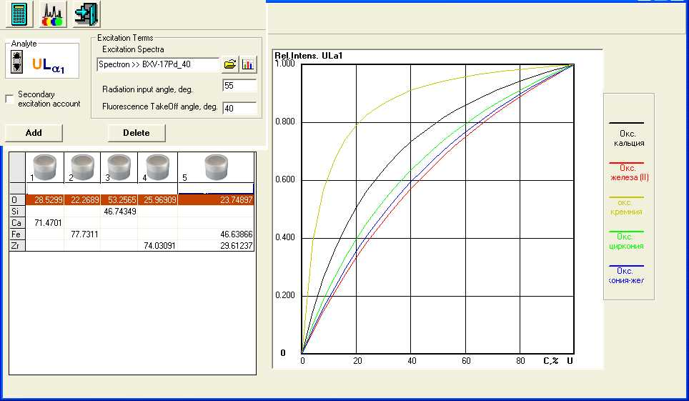
Uranium calibration lines for different fillers
CaO
FeO
CaO
FeO
SiO₂
ZrO₂
ZrO₂-FeO
SiO₂
ZrO₂
ZrO₂-FeO

Slide 21
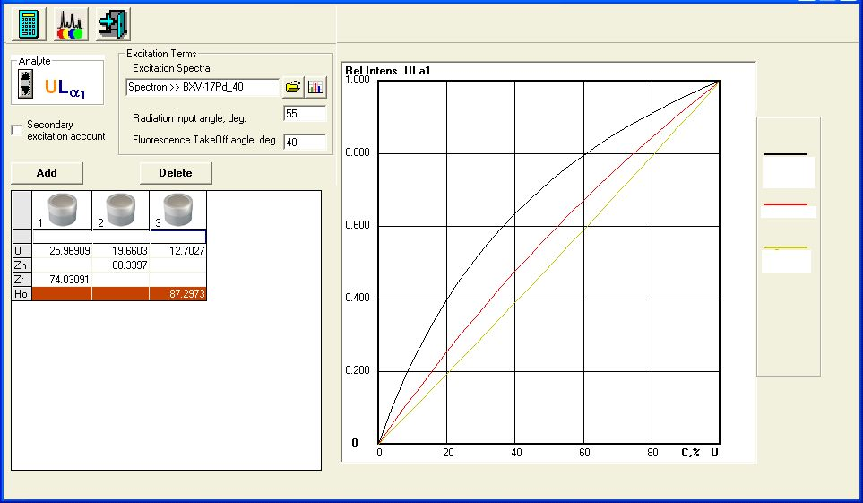
Improvement of uranium calibration characteristics by its dilution with zinc oxide and holmium oxide
ZrO₂
ZnO
ZrO₂
ZnO
Ho₂O₃
Ho₂O₃

Slide 22
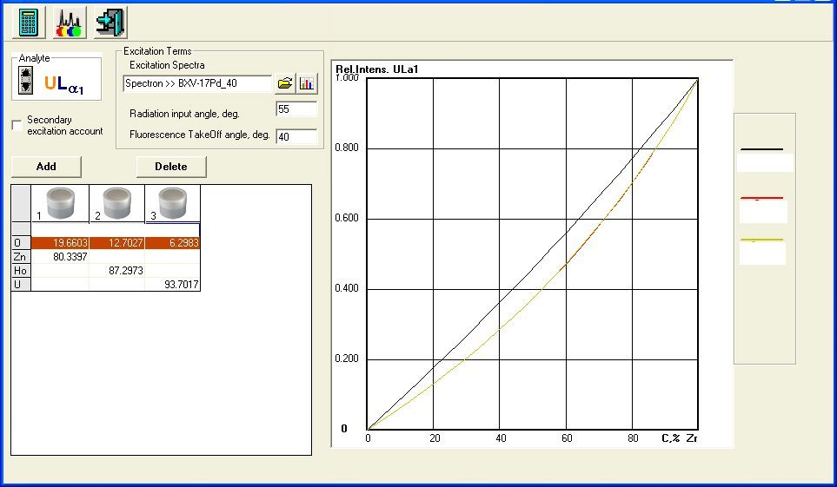
Improvement of zirconium calibration characteristics by its dilution with zinc oxide and holmium oxide
ZnO
Ho₂O₃
ZnO
Ho₂O₃
UO₂
UO₂

Slide 23
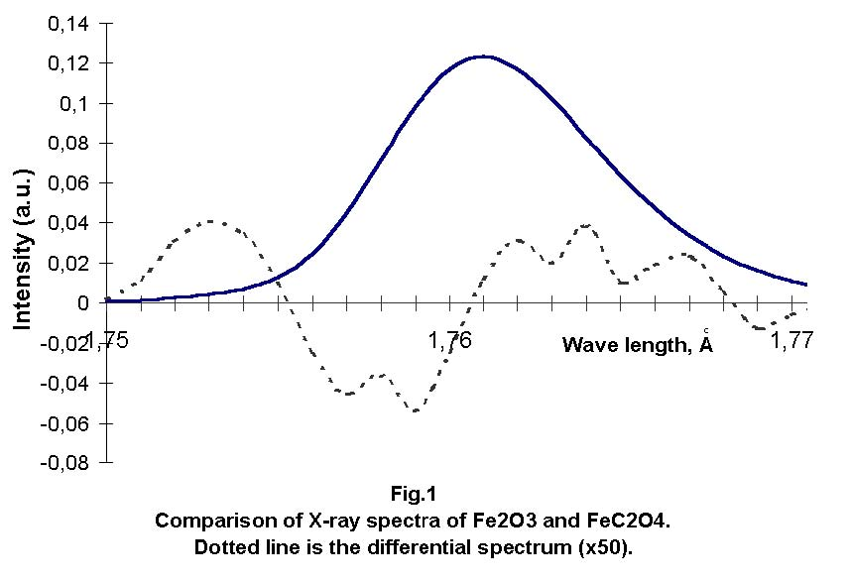
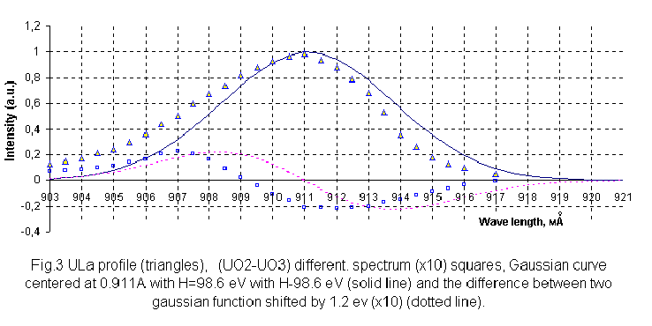
Usability of portable x-ray spectrometer for discrimination of valence states
In the transition from Fe₂O₃ to FeC₂O₄. Line shift was 0.25eV
U Lα line shift at the transition from UO₃ to UO₂

Slide 24
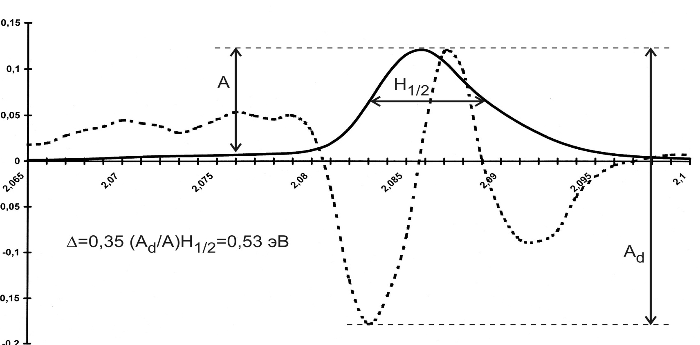
Qualitative estimation of chemical shift of X-ray spectrum
J, a.u.
eV
Wave length, Aº
Comparison of X-ray spectra of Cr₂O₃ and K₂CrO₄. Dotted line is the differential spectrum (x 50)
A and Ad – amplitudes of initial and differentiated spectra,
H_{1/2} – average half-width of initial characteristic line

Slide 25
Conclusions
Analytical characteristics of Spectroscan MAX – GF spectrometer have been analyzed for the quantitative XRF of corium
Theoretical studies for the optimization of corium XRF and evaluation of its metrological parameters have been completed:
  Determined: optimal operation modes of the X-ray spectrometer
  Proposed: to use overlap-free analytical lines of determined elements
  Proposed: to use heavy solvent (ZnO or Ho₂O₃ ) to improve metrological parameters of the analysis and optimize sample preparation.
THE WAY to determine uranium and iron valence in corium samples has been found

