Slide 1
S. Guentay
Containment thermal-hydraulics of current and future LWRs for severe accident management
ERCOSAM
17. CEG-SAM Meeting
March 29-31, 2010
CIEMAT, Madrid

Slide 2
Outline
  Containment hydrogen issue
  ERCOSAM: addressing better understanding margins for hydrogen management possibilities
  Project partners
  Administration
  Project efforts & costs

Slide 3
Containment hydrogen issue
The presence of a stratification in a NPP containment is a source of concern, as pockets of hydrogen in high concentration could lead to a deflagration or detonation risk which might challenge several equipment necessary for safety functions and even the containment structural integrity.
The objectives of ERCOSAM:
establish whether in a test sequence representative of a severe accident in a LWR, well chosen from existing plant calculations, a hydrogen (helium) stratification can be established during part of the transient starting from the initiation of the loss of coolant accident (LOCA) blowdown until the end of bulk hydrogen release from the reactor vessel into the containment,
how this stratification can be broken down by the operation of Severe Accident Management systems (SAMs); sprays, coolers and Passive Auto-catalytic Recombiners (PARs).

Slide 4
ERCOSAM: addressing better understanding margins for hydrogen management possibilities (1)
Two tier approach
Experiments in four containment simulators with very small to very large scales at conditions scaled down prototypical accident conditions in real plants
Planning, pre- and post test calculations using 3D, CFD and lumped parameter codes to gain improved confidence in the codes for future plant safety analyses (PSA L2, plant behavior, assessment and design of SAM measures for hydrogen management)

Slide 5
ERCOSAM: addressing better understanding margins for hydrogen management possibilities (2)
Experiments planned at
“small scale” TOSQAN (IRSN, Saclay),
"medium scale" in the MISTRA (CEA, Saclay),
“large scale”in PANDA (PSI, Villigen) and
"nearly prototypical scale" in the KMS¹ (NITI, St Petersburg).
1: Depends on the financing by ROSATOME, currently only code benchmark analysis with different codes are foreseen

Slide 6
ERCOSAM: addressing better understanding margins for hydrogen management possibilities (3)
Volume = 7m3, Diameter 1.5m, Height 4.8m
Main injection lines (lower centred (1), lower off centred (2), upper off centred (3) for steam and incondensable gas) Volume = 99.5m3, Diameter = 3.8m, Height = 7.4m, Compartmented volume

Slide 7
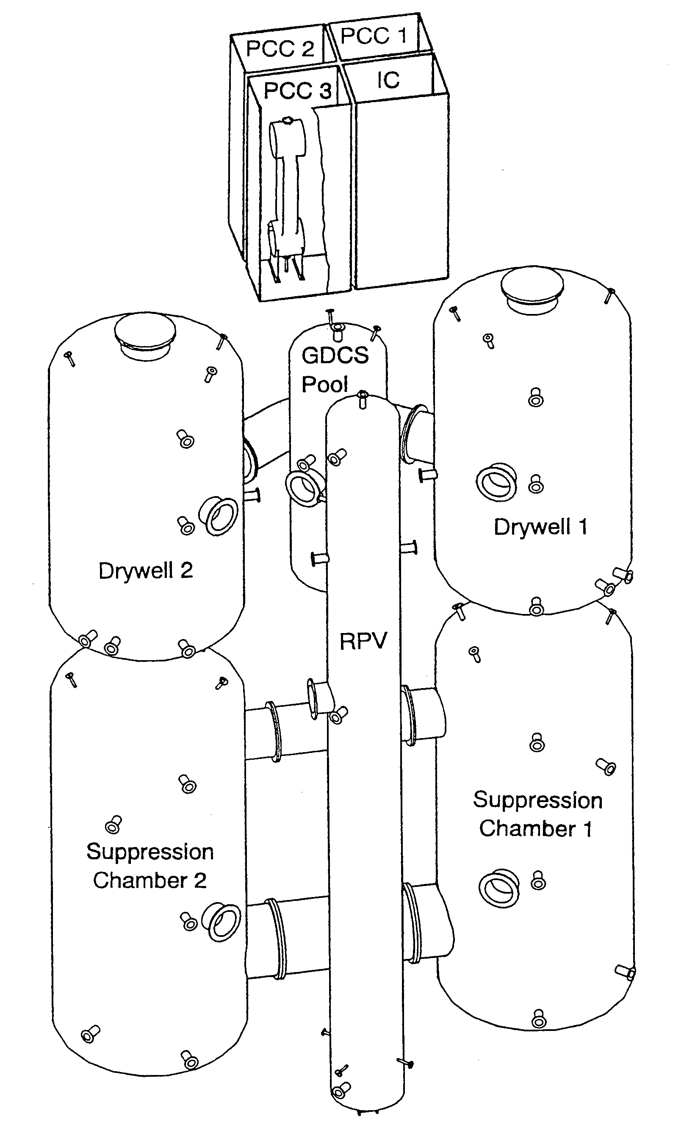
ERCOSAM: addressing better understanding margins for hydrogen management possibilities (5)
Volume = 1920m3, Diameter = 12m, Height of the cylinder = 10.9 m
Volume of the upper drywell vessels = 2 x 90m3, Diameter = 4m, Height = 8m

Slide 8
ERCOSAM: addressing better understanding margins for hydrogen management possibilities (6)
Tests with planned 5 distinct phases
Containment Pressure
Phase I
Phase II
Phase III
Phase IV
LOCA Blowdown
Core damage producing H2
Post core damage phase
SAM Mitigation phase
Interaction of induced convective flows with H2 distribution
Stabilization of H2 distribution in containment
Steam injection in containment air space
H2 and steam release into containment
No more release of H2 and steam into containment
No more release of H2 and steam into containment
Time

Slide 9
Test and analytical program

Slide 10
Project partners
ERCOSAM
PSI
IRSN
CEA
NRG
KIT
AECL
SAMARA
IBRAE
SPbAEP
IPPE
NITI
Consortium Agreement
Coordination Agreement

Slide 11
Administration
Project duration: 4 years
Project structure
PROJECT STRATEGIC COMMITTEE
Chair: EU-Coordinator
Proposal line
Executive line
Proposal line
Executive line
ERCOSAM
SAMARA
Management Board
Executive line
Proposal line
Management Team
Management
EC
Project manager
Project manager
WP leaders
ROSATOM
Executive line
Executive line
WP 1
WP 2
WP 3
WP 4
WP 5
WP 1
WP 2
WP 3
WP 4
WP 5

Slide 12
ERCOSAM Project efforts & cost

