Slide 1
ISTC project #3345:
Ex-Vessel Source Term ANalysis (EVAN)
Status and Workplan Presentation
Vladimir Bezlepkin, Yuri Leontiev (SPAEP)
8th Meeting of EU-ISTC Contact Expert Group on Severe Accident Management (CEG-SAM)
14-16 September 2005
Podolsk, Russia

Slide 2
Presentation Outline
Introduction
Overall Project Description
Project Tasks Breakdown
Schedule, costs, and status
Conclusions

Slide 3
Overall Project Description
Name: Ex-Vessel Source Term ANalysis (EVAN)
ISTC Field Codes: ENV-MRA, FIR-EXP, FIR-MOD
Goal: research of the processes affecting fission product release to PWR containment atmosphere at ex-vessel stage of severe accident
Notes:
Comprises: Assessment of consequences of late phase fission product release to the PWR containment atmosphere at the ex-vessel stage of the severe accident for real systems

Slide 4
Project tasks list
WP1/Task 1: Analysis of Severe Accident Scenarios (SPAEP, IBRAE)
WP2: Molten pool/core catcher FP release
  Task 2: Experimental investigations (NITI)
  Task 3: Theoretical and numerical modeling (IBRAE)
WP 3: Primary aerosol transport/deposition
  Task 4: Experimental investigations (NPO CKTI)
  Task 5: Theoretical and numerical modeling (SPAEP, IBRAE)
WP 4: Containment parameters impact on iodine species behaviour
  Task 6: Experimental investigations (VNIPIET)
  Task 7: Theoretical and numerical modeling (VNIPIET, SPAEP)

Slide 5
Partner organisations (Name and location)
SPAEP (Research and Design Institute ATOMENERGOPROEKT, St.Petersburg)
IBRAE (Nuclear Safety Institute of Russian Academy of Science, Moscow)
NITI (Alexandrov Research Institute of Technology, Sosnovy Bor)
NPO CKTI (Polzunov Scientific & Development Association on Research and Design of Power Equipment, St.Petersburg)
VNIPIET (All-Russian Design and Research Institute of Complex Power Technology, St.Petersburg)

Slide 6
Task 1: Analysis of Earlier Results of Severe Accident Scenarios Calculations.
Participants: SPAEP, IBRAE
Analysis of plant calculations results for VVER and PWR applications
  Data provided by foreign collaborators (Western LWRs, VVER-1000, Phebus (ISP-46), SARNET (PSA-2 and OPTSAM data)
  Data alrady available to Russain participants (VVER-640, VVER-1000)
Providing bounding parameters ranges for experiments (Tasks 2, 4, 6)
Justification of applicability of the proposed results for validation of models

Slide 7
Task 1 research team
SPAEP: Dr.Bezlepkin and specialists from NPP safety research department
  VVER-640 and VVER-1000 R&D programmes
  Full-fledged safety cases development for NPP designs
IBRAE: Prof. Strizhov, Dr.Kiselev and other specialists from severe accident research
  Integral computer code developments
  Accident sequence analyses for VVER and PWR
  Severe accident code assessments

Slide 8
Task 2: Experiments on Fission Product Release from Molten Pool
Research team: NITI (Prof. V.Khabensky, Dr.S.Bechta, Dr.V.Gusarov, S.Vitol and others)
Low-volatile FP release from molten pool during its transition from sub-oxidized (C-30) to fully-oxidized (C-100) state
FP release from molten pool/core catcher in case of FP-contaminated water supply onto the melt surface.

Slide 9
Task 2: Experiments on Fission Product Release from Molten Pool
Tools used for task implementation:
  RASPLAV experimental facilities at NITI for investigation of high-temperature processes in corium equipped with aerosol sampling system
  Various pieces of equipment for preparing experiments, carrying out the post-test analysis and processing of experimental results
Deliverables: Reports on experiments for analysis of in-containment source term from molten pool/core catcher

Slide 10
Proposed test matrix EVAN–FP1/2
Low-volatile FP release during core melt oxidation | UO₂ – ZrO₂ - Zr, U/Zr(at) = 1.2, С-32 transition to C-100, 1-2 kg, Т_{liq}+(50-100)°C FP: Ru, Mo, Ce, La, Sr, Ba | Oxidation in air(1) and steam (2) environment Duration: 2 quarters per test

Slide 11
Proposed test matrix EVAN–FP3/4
Low-volatile FP release during water supply onto melt surface | UO₂ – ZrO₂ - Zr, U/Zr(at) = 1.2, С-100, 1-2 kg, Т_{liq}+(50-100)°C FP: Ru, Mo, Ce, La, Sr, Ba | Demineralised water supply onto melt surface (3) Contaminated water supply onto melt surface (H₃BO₃, FPs CsI, etc.) Duration: 2 quarters per test

Slide 12
Task 3: Analytical support of FP release experiments
Participants: IBRAE
Pre-test calcs for experiments and follow-up analysis
Justification of applicability of the proposed results for validation of models

Slide 13
Task 4: Experimental investigation of selected aerosol transport problems for severe accident conditions
Research team: NPO CKTI (Dr.Krektunov group, multiphase flows and diagnostics)
Deposition/resuspension of aerosols in primary circuit pipes in turbulent flows
Revaporization of deposited Cs species
Different aerosol types (Ni, CsI, Ni/CsI)

Slide 14
Task 4: Investigation of selected aerosol transport problems for severe accident conditions
Tools used for task implementation:
  Existing test rigs at NPO CKTI
Deliverables: Reports on experimental results for in-containment source term assessment and for by-pass sequences analysis

Slide 15
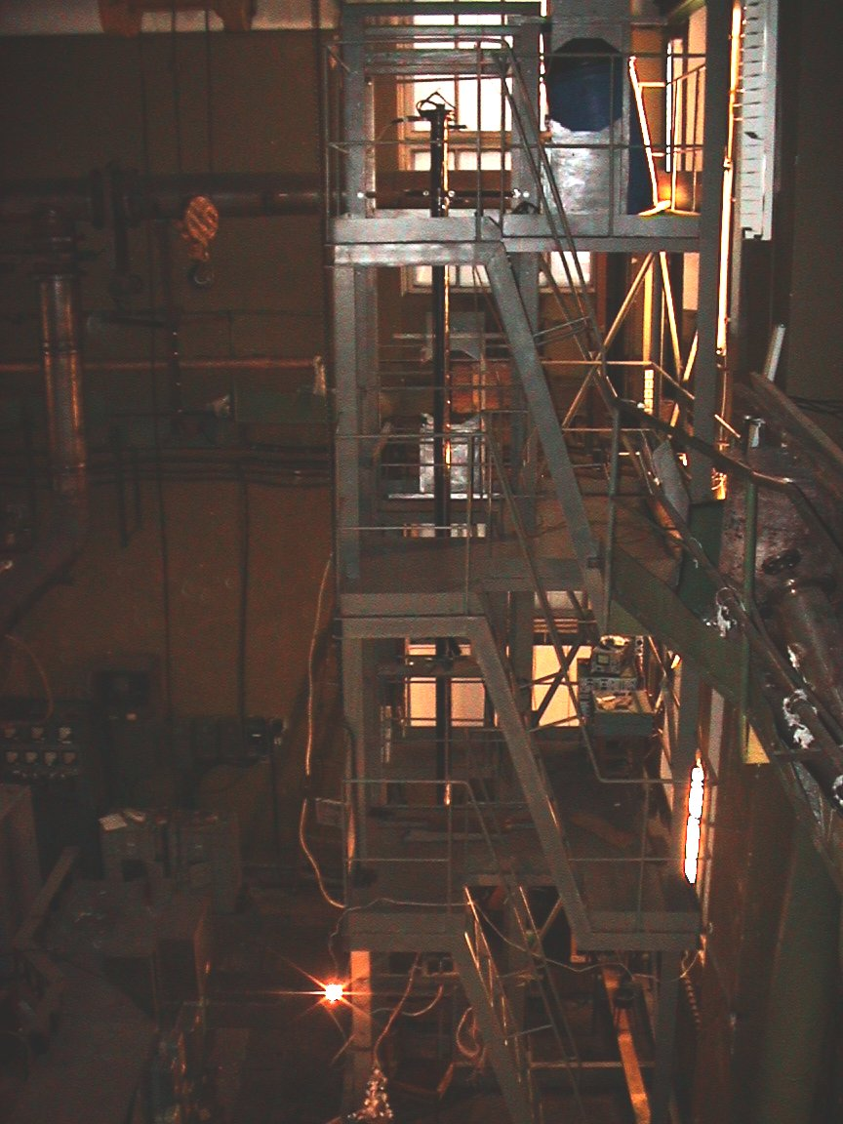
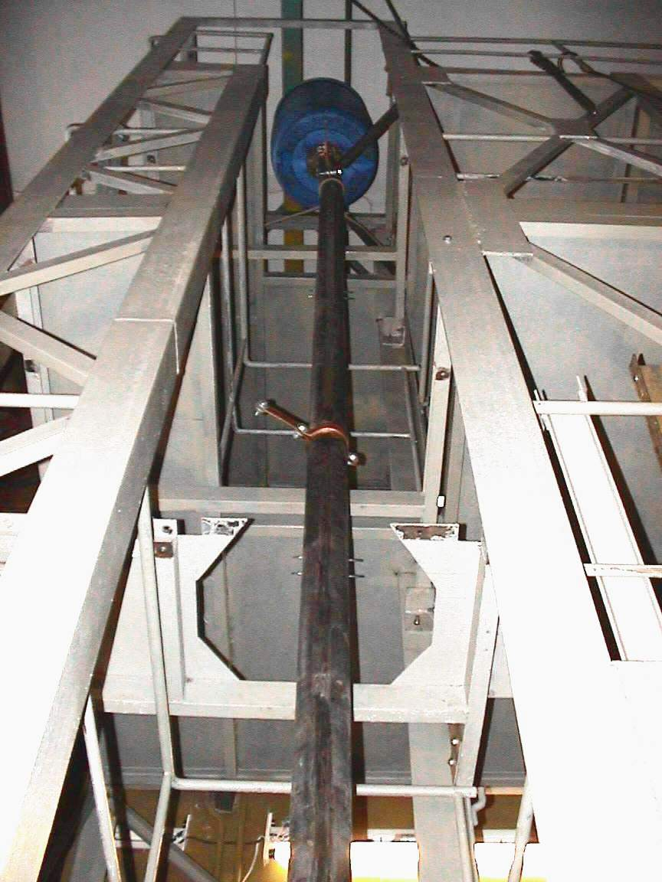
Setup Overview (during installation)
Side view
Front view

Slide 16
Instrumentation for velocity field measurements
1 – metalworks;
2 – instrumentation;
3 – working section;
4 – control panel;
5 – maintanance floor
Each instrumentation set includes:
-suspension system;
- LDA optical module;
-remote controlled drive;
- LDA data gathering and processing system

Slide 17
Laser-Doppler Anemometer

Slide 18
Desktop for laser-Doppler Velocity Meters Instrumentation
Velocity Profile Measurements On-line
Velocity Profile Measurements Results

Slide 19
Desktop for data gathering and processing system for heat measurements
плотностей тепловых потоков
Pipe wall temperature indications
Heat flux density indications

Slide 21
Proposed test matrix EVAN–AER1-3
Aerosol deposition/ resuspension tests | Vertical and horizontal pipes, Re-4000-10000, Aerosols like CsI, metal particles, and reference aerosol (to be specified during elaboration of the workplan) | Inert (N2) and steam environment Ambient inert conditions, or superheated steam Duration 6 quarters for 3 tests (estimated)

Slide 22
Proposed test matrix EVAN–AER4
Deposition and revap of Cs | Vertical or horizontal pipe, Re-4000-10000, Aerosols like CsOH, CsI (decided upon later after discussions with collaborators) | Steam environment, Ambient inert conditions, or superheated steam(160 deg C) Wall temperatures up to 600-700 deg C Duration 2 quarters for 1 test (estimation)

Slide 23
Task 5: Analytical Support of Experiments
SPAEP computational mechanics group in NPP safety research department
  Mechanistic aerosol kinetics models coupled to 2D and 3D CFD models
IBRAE severe accident research lab
  integral aerosol models coupled to RATEG/SVECHA/GEFEST code
Deliverables: reports on pre-test calcs for experiments and follow-up analysis, justification of applicability of the expt results for validation of models

Slide 24
Experiments on Containment Parameters Impact on Volatile Iodine Species Behaviour: Task 6
Participants: VNIPIET (experimental teams for iodine chemistry research)
Applicable for new/existing designs (NPPs with VVER)
Experiments on containment sump solution
  sludge, cable pyrolysis products (Cl⁻ radicals),
  irradiation and high temp. (up to 150°C)
impact on water/gas phase volatile iodine species content and proportioning

Slide 25
Proposed test matrix EVAN–I1-2
SLUDGE EFFECT on iodine content and speciation | Sludge composition: ferric sludges (FeOOH, Fe₃O₄, Fe₂O₃); Si-sludges (H₂SiO₃·nH₂O); Fe/Si=10; m/V=0; 1 g/l; 5 g/l. T=25; 50; 100 ºC; pH=7-8; H₃BO₃=0; 16 g/l; C_{I}=10⁻⁶-10⁻⁷ and <10⁻⁸ mol/l; γ-irradiation – 0; 3 kGy/h
ORGANIC MATERIALS EFFECT on iodine content and speciation | Organic acids. 10⁻³ mol/l. Sludges Fe/Si (m/V – on results Test I1); T=25; 50; 100, 150 ºC; pH=7-8; H₃BO₃=0; 16 g/l; C_{I}=10⁻⁶-10⁻⁷ and <10⁻⁸ mol/l; γ-irradiation – 0; 3 kGy/h

Slide 26
Proposed test matrix EVAN–I3-4
CABLE INSULATION PYROLYSIS PRODUCTS EFFECT on iodine content and speciation ( Cl−-ions and organic impurities effect) . | C_{Cl-}=10⁻⁴-10⁻³ mol/l; C_{organic acid}=0; 10⁻³ mol/l; Sludges Fe/Si; pH=7-8; H₃BO₃=0; 16 g/l; C_{I}=10⁻⁶-10⁻⁷ and <10⁻⁸ mol/l; γ-irradiation – 0; 5 kGy/h
COMBINED IMPURITIES EFFECT in water phase on iodine content and speciation | Polymeric paints (1 epoxy, 1 organosilicate), organic acids, 10⁻³ mol/l; Cl⁻-ion, 10⁻³ mol/l; sludges Fe/Si; pH=7-8; H₃BO₃=0; 16 g/l; C_{I}=10⁻⁶-10⁻⁷ and <10⁻⁸ mol/l; γ-irradiation – 0; 5 kGy/h

Slide 27
Methods of iodine analysis

Slide 28
Methods of iodine analysis

Slide 29
Task 7: Analytical Support of Experiments
Participants: VNIPIET, SPAEP
  Severe accident containment iodine behaviour model developed by VNIPIET/SPAEP
  Codes for solution рН and Е_{h} (redox) calculation, published data, iodine databases.
Pre-test calcs for experiments and follow-up analysis
Justification of applicability of the proposed results for validation of models

Slide 30
EVAN Project Schedule and Costs
After Cologne meting (Feb 2005) and consultations with collaborators a two-phase approach was chosen.
  Phase 1 (1 year) Mounting/installation, pilot expertiments and analysis — first tests from the test matrices mentioned, then
  Phase 2 (2 years) More detailed testing & analysis selected on the evaluation of Phase 1 results
Cost Phase 1 Phase 2 Total
(1 year) (2 years)
  Total 480k$ 560k$ 1,040k$

Slide 31
Thanks
To our collaborators who already provided support letters for EVAN (IRSN, VTT, ITU, GRS)
To other experts who are willing to do it (PSI, CEA and others)
To SARNET experts for their help and advice
To all our Russian colleagues from the various Institutes supporting SPAEP (NITI, IBRAE, VNIPIET, NPO CKTI)
To our presiding members (L.Tocheny, M.Hugon, and P.Hoffman) for their dedication and support
To our LUCH host for hospitality

