Slide 1
Status of ISTC proposal:
Ex-Vessel Source Term ANalysis (EVAN)
Proposed Experimental and Modelling Capabilities
ISTC CEG-CM Meeting,
September 2004
Dimitrovgrad, Russia

Slide 2
Presented by
Yuri Leontiev
Head of Radiological Safety Lab
Research and Development Department
Institute ATOMENERGOPROEKT (SPAEP)
phone: +7 (812) 567-95-03
fax : +7 (812) 567-92-40
e-mail: yuri.leontiev@nio.spbaep.ru

Slide 3
Presentation Outline
Introduction
Proposal Status
Overall Project Description
  Main results expected
  Project tasks list
  Institutes involved
  Needs for CEG consulting/advice
Project Tasks Breakdown
Conclusions

Slide 4
Overall Project Description
Name: Ex-Vessel Source Term ANalysis (EVAN)
ISTC Field Codes: ENV-MRA, FIR-EXP, FIR-MOD
Goal: investigation of some ex-vessel stage phenomena (late phase) with high impact on the source term/consequences identified by earlier international research (for example, in FP4 STU project).
Notes:
Comprises: Assessment of consequences of late phase fission product release to the PWR containment atmosphere at the ex-vessel stage of the severe accident for real systems

Slide 5
Project tasks list
Task 1: Reference severe accident scenario choice and analysis
Task 2: Local aerosol behaviour analysis
Task 3: Molten pool FP release analysis
Task 4: Iodine species behaviour analysis
Task 5: Environmental source term assessment and consequences analysis

Slide 6
Partner organisations (Name and location)
SPAEP (Research and Design Institute ATOMENERGOPROEKT, St.Petersburg)
NITI (Alexandrov Research Institute of Technology, Sosnovy Bor)
IHPCDB (Institute for High Performance Computing and Data Bases, Polytechnical University, St.Petersburg)
VNIPIET (All-Russian Design and Research Institute of Complex Power Technology, St.Petersburg)
KRI (Khlopin Radium Institute, St.Petersburg)

Slide 7
Partner organisations (Applicable field of expertise)
SPAEP (Design of NPPs with VVER and FBR, safety assessment, SA research, R&D programs)
NITI (PWR SA research, experimental facilities, EU and ISTC projects)
IHPCDB (CFD codes development, supercomputer applications, applied software engineering, INTAS grants, ISTC projects)
VNIPIET (Design of NPPs with GMR, radiochemistry, radwaste treatment, experimental facilities, ISTC projects)
KRI (Dose and risk analysis, EIA, ISTC projects)

Slide 8
Currect Proposal Status
Russain side | CEG-CM/ISTC
Pre-proposal presentation at 5th CEG-CM mtg, 02/2004 | CEG comments received 06/2004
Comments response 08/2004 | Follow-up comments 09/2004
Comments considered. ISTC project proposal prepared. To do before submitting to ISTC: input from collaborators; Minatom approval letter; workplan agreement.

Slide 9
Expected CEG contribution
(TBD in smaller workgroup)
Proposals on collaborators
Linking with other EU and ISTC projects
Discussion on project goals
Choice of plant/site of interest
Adjusting scope of work

Slide 10
Task 1 in Brief
Choice and analysis of the reference accident sequence
Input data for late phase in-containment and environmental source term assessment:
  for both new and existing NPP designs
  in-vessel phase analysis – unified (“frozen”) approach

Slide 11
Choice and Analysis of the Reference Accident Sequence: Task 1 (1)
Participants: SPAEP, NITI
Stages:
  Analysis of fission products build-up and decay in the irradiated fuel
  Justification of choosing the reference accident sequence. Analysis of in-vessel severe accident stage (reactor plant analysis)
  Analysis of corium behaviour in the reactor cavity (if necessary, including interaction with sacrificial material)
  Containment parameters analysis

Slide 12
Choice and Analysis of the Reference Accident Sequence: Task 1 (2)
Tools used for task implementation:
  SAPPHIRE and RC codes, libraries of reaction rate constants and core neutron fields
  RATEG/SVECHA/GEFEST, MELCOR codes. Expert analysis
  CORCAT, DINCOR codes
  CUPOL-M lumped parameter code
Deliverables: Report on input data for ex-vessel phase source term assessment

Slide 13
Task 2 in Brief
Aerosol turbulent/laminar transport (2D/3D CFD coupled) and deposition modelling for severe accident conditions
  Aerosol transport results for local containment areas of interest (melt location etc.)
  Recommendations for aerosol models in lumped parameter containment codes

Slide 14
Numerical Modelling of Local Aerosol Deposition Processes: Task 2 (1)
Participants: SPAEP, IHPCDB
Analysis of aerosol transport and kinetics for the area above the molten pool
Analysis for turbulent/laminar aerosol transport and deposition for generic/characterisitc containment geometries and conditions
Analysis of the parameters used for constitutive relations in the aerosol models for lumped-parameter codes
Notes:
Assessment of the characteristic ranges and recommendations for choice of the parameters used for constitutive relations in the aerosol models for lumped-parameter codes used for severe accident environmental source term analysis.

Slide 15
Numerical Modelling of Local Aerosol Deposition Processes: Task 2 (2)
Tools used for task implementation:
  2D and 3D CFD models coupled with aerosol kinetics models
Deliverables: Report on generic numerical models for aerosol transport and deposition for severe accident conditions

Slide 16
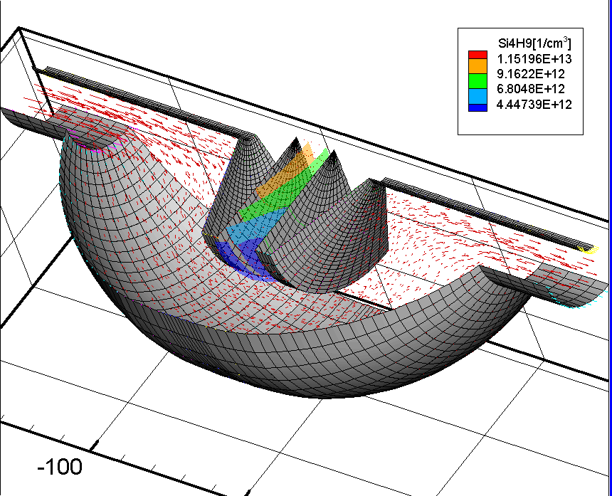
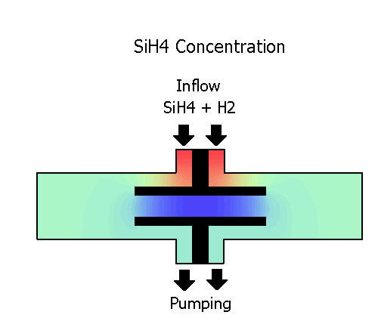
IHPCDB CFD models example
REAF3D software package for LINUX cluster. Modelling of Si films growth in PECVD chemical reactor

Slide 17
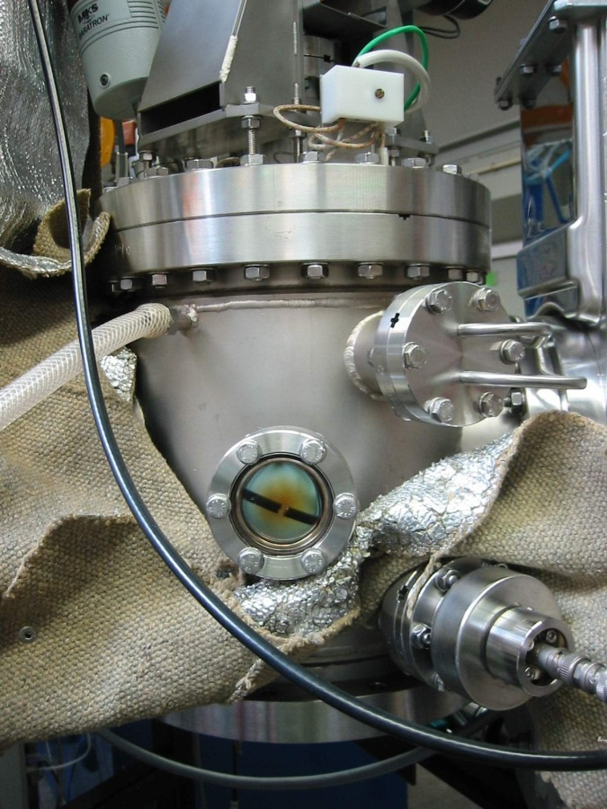
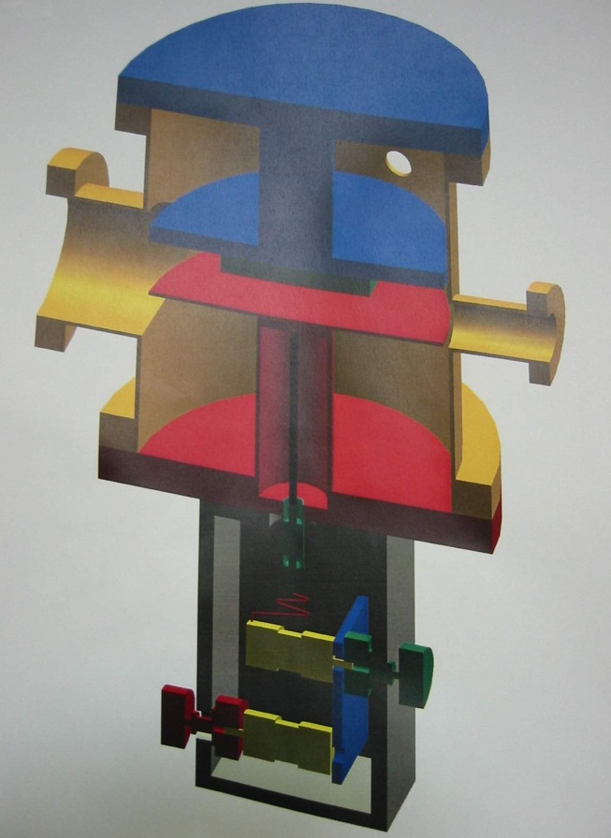
Si-based films: widespread material in modern microelectronics (ubiquitous in semiconductor devices like flat panel displays, solar cells, photodetectors etc.)
PECVD: one of the most popular technologies for silicon film production
Why simulate:
Optimization of deposition rate and growing film properties/composition; understanding these complex multi-physics processes
Typical parameters:
Pressure
0.1-1.0 Torr
Applied power
5-10 W
Effective power
2.5-5 W
Discharge frequency
50 MHz
Flow rate
10-30 sccm (SiH4+H2)
Gas temperature
300 K
Substrate temperature
520 K

Slide 18
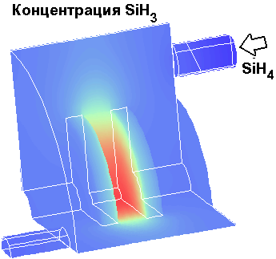
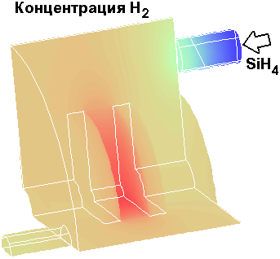
Calculation results

Slide 19
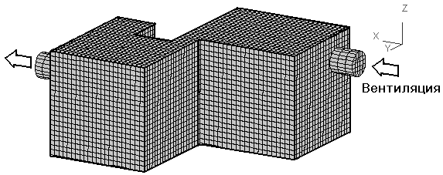
IHPCDB CFD models example
VICON-3 software package. Modelling of ventilation processes

Slide 20
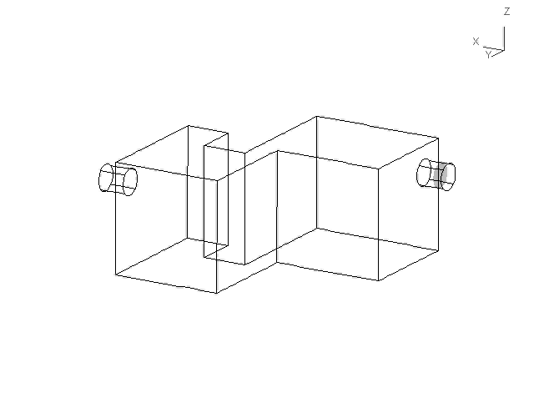
Clean air concentration isosurface evolution

Slide 21
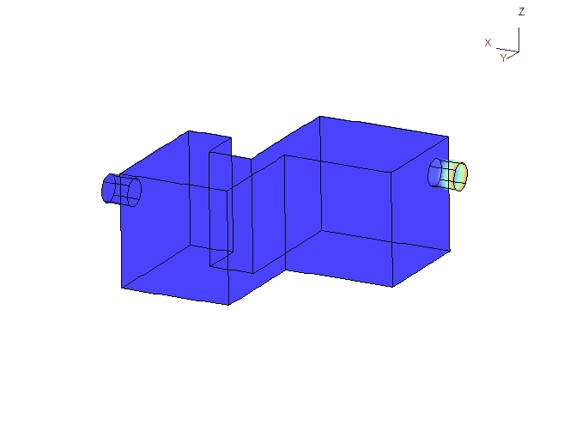
Clean air concentration field evolution
Clean Air
Contaminated Air

Slide 22
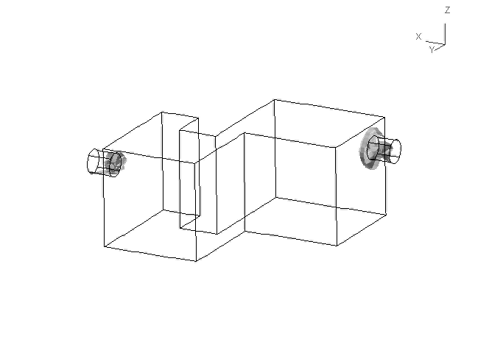
Air Stream Vortex Structure
(constant vortex factor isosurface evolution)

Slide 23
IHPCDB aerosol modelling results

Slide 24
Task 3 in Brief
Molten pool FP release expts
Experimental data on MPFPR for/with:
  C30- to C-100 transition
  Water supply onto the melt
  FP aerosols transport from melt location over containment volumes
Assessment of in-containment source term from molten pool

Slide 25
Experiments on Fission Product Release from Molten Pool:
Task 3 (1)
Participants: SPAEP, NITI
FP (mainly Cs) release from molten pool with FP-contaminated water supply onto the melt surface.
Low-volatile FP release from molten pool during its transition from sub-oxidized (C-30) to fully-oxidized (C-100) state

Slide 26
Experiments on Fission Product Release from Molten Pool:
Task 3 (2)
Tools used for task implementation:
  RASPLAV experimental facilities for investigation of high-temperature processes in corium equipped with aerosol sampling system
  Various equipment for preparing experiments, carrying-out the post-test analysis and processing of experimental results
Deliverables: Reports on experiments

Slide 27
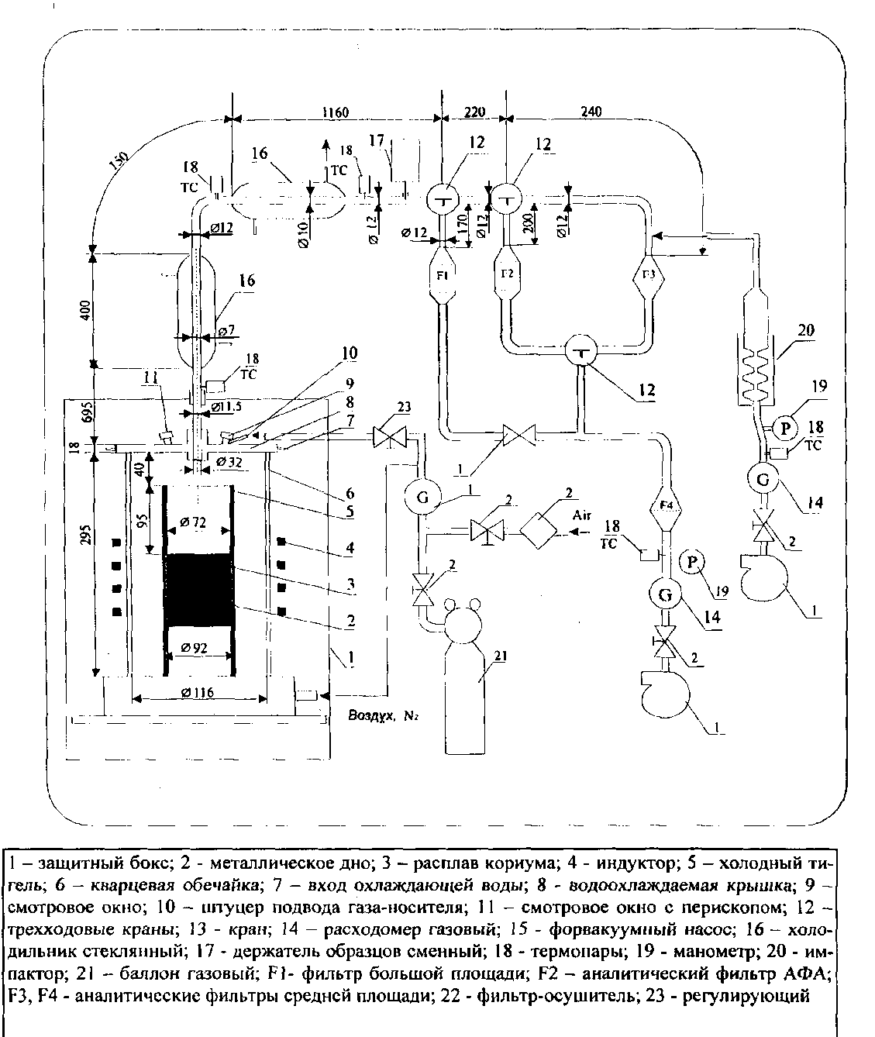
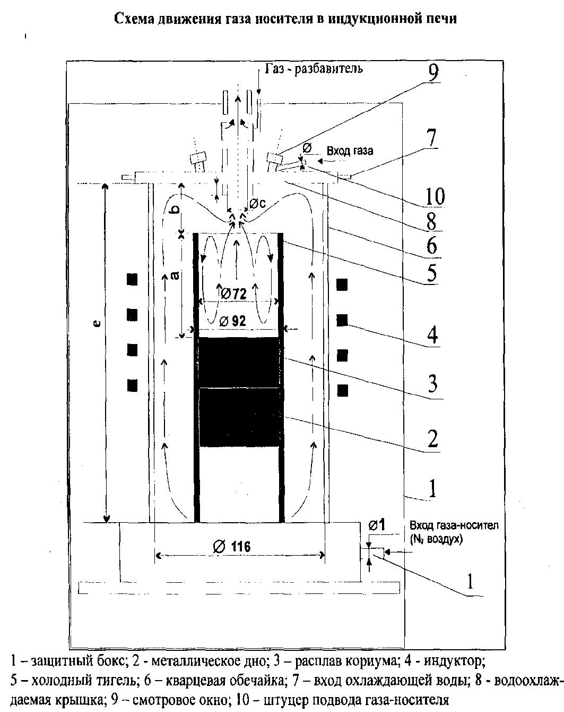
NITI FP release aerosol sampling

Slide 28
Task 4 in Brief
Volatile iodine species behaviour
Experimental and analytical data
  Impact of sump solution on volatile iodine species present in the containment atmosphere
  Containment atmosphere conditions and paint effects onto I behaviour
  Applicable for new/existing designs (NPPs with VVER)

Slide 29
Assessment of Containment Parameters Impact on Volatile Iodine Species Behaviour: Task 4 (1)
Participants: SPAEP, VNIPIET, NITI
Experiments on containment sump solution/sludge effect on gas phase volatile iodine species content and proportioning
Experiments for determination of the water/gas phase partitioning coefficients of water solution components
Notes:
Uncertainty analysis of content and proportioning of the gas phase iodine species for severe accident conditions. Recommendations on choice of numerical models and rate constants values for severe accident environmental source term assessment

Slide 30
Assessment of Containment Parameters Impact on Volatile Iodine Species Behaviour: Task 4 (2)
Tools used for task implementation:
  VNIPIET and NITI experimental setups for iodine chemistry research
  Severe accident containment iodine behaviour model developed by VNIPIET/SPAEP
  Codes for solution рН and Еred-ox calculation, published data, iodine databases.
Deliverables: Analytical report and reports on experiments research results

Slide 31
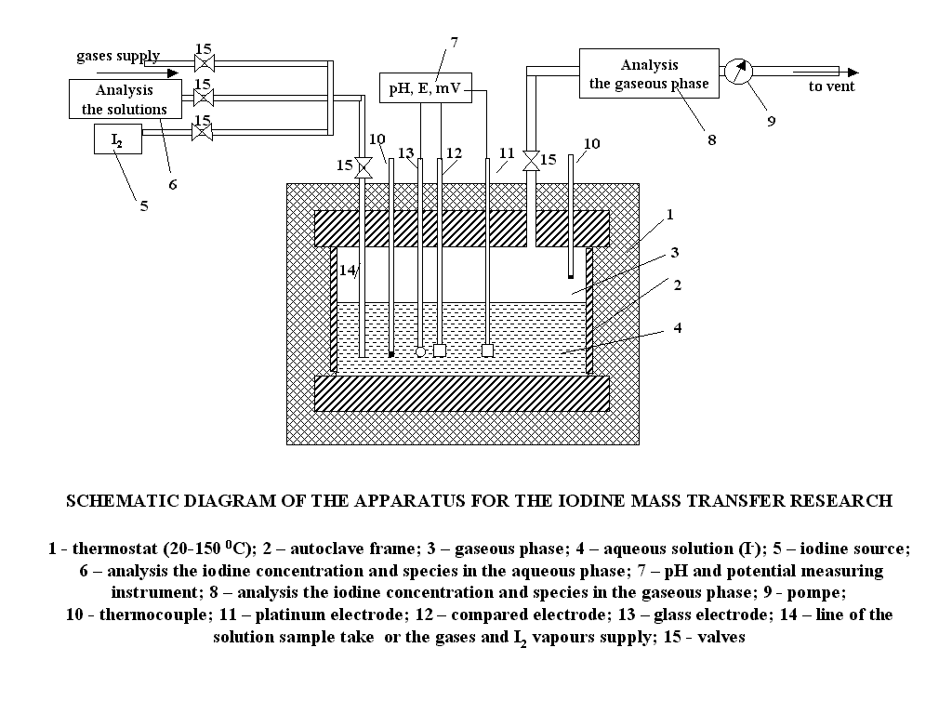

Slide 32
Task 5 in Brief
Assessment of environmental source term (EST) and its consequences
Analysis of SA radiological impact
  Consistent estimation of late phase EST
  Can be site-specific or generic/probabilistic
  Analysis of severe accident consequences mitigation measures

Slide 33
Accident Environmental Release and Doses Assessment: Task 5 (1)
Participants: SPAEP, KRI
Stages:
  Analysis of containment processes and environmental source term assessment for the reference scenario
  Analysis of compliance for scope and amount of environmental source term results for application in risk assessment studies
  Dose assessment for population due to severe accident (reference NPP site)
Notes:
(based on previous tasks results and recommendations)
(based on MACCS and PC-COSYMA techniques, Russian materials, and international documents on PSA-2 and PSA-3 requirements)

Slide 34
Accident Environmental Release and Doses Assessment: Task 5 (2)
Tools used for task implementation:
  ASTRA-C and MELCOR codes
  MACCS and PC-COSYMA codes
  Expert analysis
Deliverables: Report on radiological consequences of the reference severe accident scenario for reference NPP site

Slide 35
Conclusions and thanks
To NIIAR host
To A.Zurita, L.Tocheny, D.Bottomley and CEG-CM experts
To our Russian colleagues

Slide 36
Expected CEG contribution
(TBD in smaller workgroup)
Proposals on collaborators
Linking with other EU and ISTC projects
Discussion on project goals
Choice of plant/site of interest
Adjusting scope of work

