Slide 1

EVAN ISTC Project # 3345, TASK 1:
The analysis of severe accidents for the NPP with WWER-type reactors.
A choice of boundary conditions for experimental programs
Presented by Valery Sidorov
(SPbAEP, Russia)
March 4, 2008, Budapest, Hungary

Slide 2
The main aims of TASK 1
the analysis of project approaches and models for calculations of radiological consequences of severe beyond-design-basis accidents for nuclear power plants with VVER reactors
the analysis of aerosols release condition during severe accident of VVER with 1-d and 3-d code calculations
the analysis of the fission product (FP) build up in the fuel, FP release from the fuel and from the molten pools
numerical simulation of aerosol particles kinetics and its behavior during severe accidents

Slide 3
Sub-task: the analysis of project approaches and models for calculations of radiological consequences of severe beyond-design-basis accidents for nuclear power plants with VVER reactors
The aims of analysis:
to identify the most important factors influencing the accidental releases magnitude
to estimate the main uncertainties of design calculations
to show the way to correct design calculations by best estimate models
to find the experiment parameters for Task 2, 4, 6
Review of the project approaches and models was executed for: “NPP-91” project with WWER-1000, EUR, NRC and IAEA recommendations for LWR NPP

Slide 4
Main sources of uncertainties of accidental release estimates L – low, M – medium, H- high level
Group of phenomena | Uncertainty | Sensitivity | Note
Accumulation of FP in fuel | L | M | Calculation of fission products accumulation is performed according to the well verified methodic
Release of FP from fuel under heating and melting | L-M | M-H | Uncertainty for fuel model of VVER is related with evaluation of release of Ru forms and effects of fuel oxidation on fission products release.
Aerosol transport and retention in the primary circuit | M-H | M-H | For analysis of severe accident consequences with containment bypass related with significant releases.
Release of low volatile FP from molten pools (in-vessel) | H | M | Uncertainty for fuel model of VVER is related with evaluation of release of Ru forms and effects of fuel oxidation on fission products release. Conservative assumptions were used in the design calculations.
Release of low volatile FP from molten pools at the ex-vessel stage | M | L | A core catcher preventing core-concrete interaction and decreasing aerosol release at ex-vessel stage.
Aerosol behavior in the containment | M | M-H | Design calculations are taking account only Brownian and gravity coagulation and gravitation sedimentation.
Iodine chemistry | M-H | M-H | level of uncertainty is connected with pH maintaining in containment. High sensitivity of results to parameters determining release of organic iodine forms. Conservative assumptions were used in the design calculations.
Release routs and failure mode effects | M | H | Sensitivity level is related to parameters determining leak rate and mode of containment leakage

Slide 5
NPP-91 with WWER-1000
Point estimate diagram showing accidental releases of reference nuclides for various states of protective barriers/localizing systems

Slide 6
Fractions of radionuclide retention in coolant system for PWR reactors (EUR recommendation)
FP group | Low-pressure scenario | High-pressure scenario
Xe | 0.0 | 0.0
I, Cs | 0.15 | 0.70
Te | 0.20 | 0.50
others | 0.20 | 0.50

Slide 7
FP release inside containment at various phases of LOCA’s accident

Slide 8
The boundary conditions for “Iodine” experiments research
NPP-91 project: “Iodine” problem solved by controlling pH level in the containment at all stage of accident (by discharging KOH/NaOH solution) -- рН > 7
Design assumption for iodine release inside containment under conditions of pH control in the containment above the value
(EUR recommendation):
I (aerosol form) – 95%
I (molecular form) – 4,85%
I (organic form) – 0,15%
Conditions in the containment after accident with aerosol release
(CUPOL calculations and design assumptions)
Parameter | Value
Temperature of medium | Up to 120-160 degr. С
Gamma-radiation dose rate during 24 hours after beginning accident (integral dose) in air in water | 1-70 кGr/h (360 кGr/day) 2-25 кGr/h (170 кGr/day, up to 500 кGr/30 days)
Н₃ВО₃ concentration in water | 15-16 g/l
рН in water | 4-8
Iodine sorption at polymer facing, steel corrosion products and the core catcher materials can reduce the calculating iodine release.
High level of uncertainty and high sensitivity of results to parameters determining release of organic iodine forms causes to experimental study iodine behavior in containment .

Slide 9
The main factors influencing accident FP releases :
high level of uncertainties at assessment of FP release from fuel for the elements referred to Ru group (Ru, Mo, Tc)
aerosol deposition and resuspension in reactor equipments at primary-to-secondary leaks accidents
iodine sorption at polymer facing, steel corrosion products and the core catcher materials can reduce the calculating iodine release
correct calculating simulation of aerosol transport at containment and inter-containment space

Slide 10
Sub-task: the analysis of the fission product (FP) build up in the fuel, FP release from the fuel and from the molten pools
The analysis of FP buildup during normal operation and during accident
The comparison of FP buildup models and codes for FP buildup calculations
The reviews of FP molten pool release models
The reviews of conditions effecting the aerosol formation (reactor aerosols’ morphology, aerosol formation model)

Slide 11
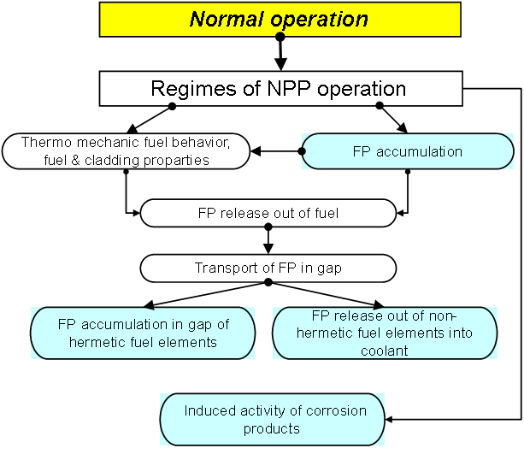
Activity buildup during reactor plant normal operation
Codes for calculations of FP and actinides accumulation:
- BONUS package (Brief Overview of NUclides Species),
- RADIONUCLIDE

Slide 12
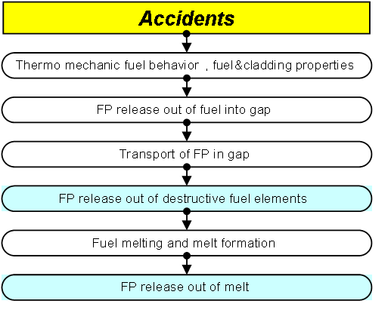
FP release during severe accident
Codes for calculations of FP release from the solid fuel into the gas gap :
- CORSOR, CORSOR-М
- CORSOR-BOOTH

Slide 13
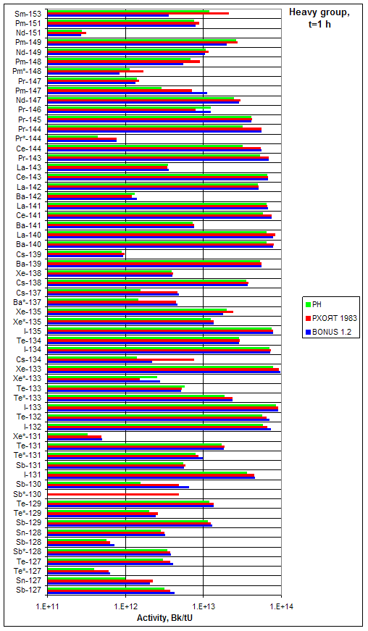
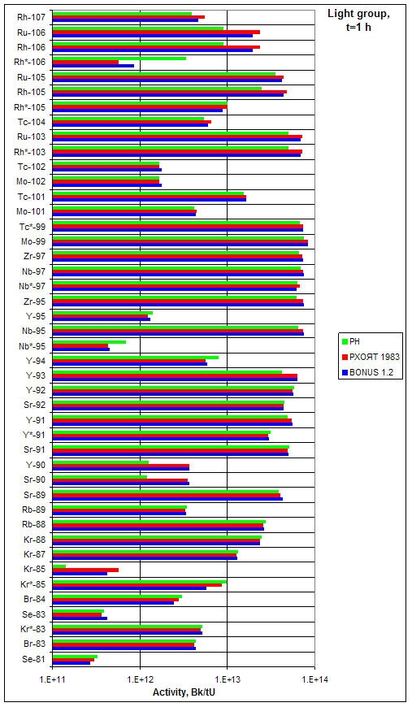
Activity of the “light” and “heavy” group nuclides, by 1 hour after VVER-1000 shutdown (green – RN, blue – BONUS, red – [ANSI/ANS-5.1-1994]

Slide 14
Comparison of FP release from the fuel for long-lived isotopes by the end of 3 year campaign and during the accident

Slide 15
Aerosol formation model
The groups with various behavior in the reactor coolant circuit
1. Inert:
Xe, Kr – noble gases (NG*)
2. Volatile:
I, Br – halogens (actively react with Cs and form CsI, CsBr) (CI*).
Cs, Rb – alkaline metals (react with water and form CsOH, RbOH) (CH*)
Te, Se, Sb – Te group (TE*)
3. Non-volatile:
Ba – alkaline earth (BA*)
Sr – alkaline earth (SR*)
Ru, Rh, Pd, Mo, Tc, Nb – noble metals (RU*)
La, Nd, Eu, Yb, Pm, Sm – rare earth elements (LA*)
Ce, Np, Pn – Ce croup (CE*)
4. Besides the FP, also structural materials aerosols are formed (PI*)

Slide 16
Aerosol formation model
Mapping of the groups/classes for FP release and RCS transport

Slide 17
Aerosol formation model
The groups of the aerosol phase states
steam in the atmosphere (phase 1);
aerosols in air (phase 2);
steam condensed at surfaces of the wall and aerosols (both at “native” CI aerosols, and at “alien” aerosols) (phase 3);
aerosols deposited onto surfaces (phase 4);
aerosols chemisorbed by the steel surfaces of the pipes and structures of the RCS (phase 5);
resuspended aerosols (phase 6).

Slide 18
The most essential factors influencing the aerosol generation during severe accidents
The above conditions were analyzed in calculations of severe accidents

Slide 19
Sub-task: the conditions of radioactive release during severe accident
The analysis of coolants properties in the reactor unit in primary circuit during a severe accidents with code SOCRAT
The analysis of corium parameters in the melting pool
Evaluative calculation of fission products behavior during LOCAs and SGTR with containment bypass with code SOCRAT
Numerical modeling of convective flow above a surface of melt corium in reactor vessel with 3-D CFD code

Slide 20
Severe Accident code SOKRAT
(reactor plant analysis)
RATEG — best-estimate code , which can be used for calculate of thermal and hydraulic processes in primary and secondary circuit
  Two-fluid 1D thermal-hydraulic flow
  1D and 2D heat conductivity
SVECHA — realistic simulation of core degradation phenomena
  hydrogen generation
  flowing materials models
GEFEST— realistic simulation of core debris behavior in the reactor bottom chamber
  Vessel-corium interaction
  Vessel deformations and failure
BONUS— fission product accumulation
RELIZ— fission product release in a gap from fuel road
GAPREL— fission product release in coolant
PROFIT— fission product relocation in the primary circuit, release in a break
Fission Products’ Behavior Flowchart in SOKRAT Code

Slide 21
The design diagram of NPP with WWER-1000
Gas removal system
Steam
generator
Steam
generator
Pressurizer
Reactor
Hot leg
Cold leg
Core

Slide 22
The analysis of aerosols release condition in primary circuit
Parameters of coolant in hot leg during LOCAs
Pipelines | Diameter, m | Length, m |  | Arrangement | Velocity, m/s | Pressure in the primary side, МPа | Pressure in the containment, МPа
Break Dnom 346, time 1400 – 4100 s,
Hot leg | 0,85 |  | 7,0 | horizontal | 2,5 – 7,6 | 0,305 – 0,31 | 0,29 – 0,3
 |  |  |  |  | 37 | 0,42
Break Dnom 25, time 15 000 – 21 500 с,
Hot leg | 0,85 | 7,0 |  | horizontal | 0,8 – 1,6 | 0,62 – 1,33 | ~ 0,35
Parameters of coolant in EGRS and ruptured SG tubes during SGTR

Slide 23
Numerical modeling of convective flow above a surface of melt corium in reactor vessel by means of 3-D code
Fields of velocities in a longitudinal section for (z=0) and above melt surface (y=0.1м), time t=600с

Slide 24
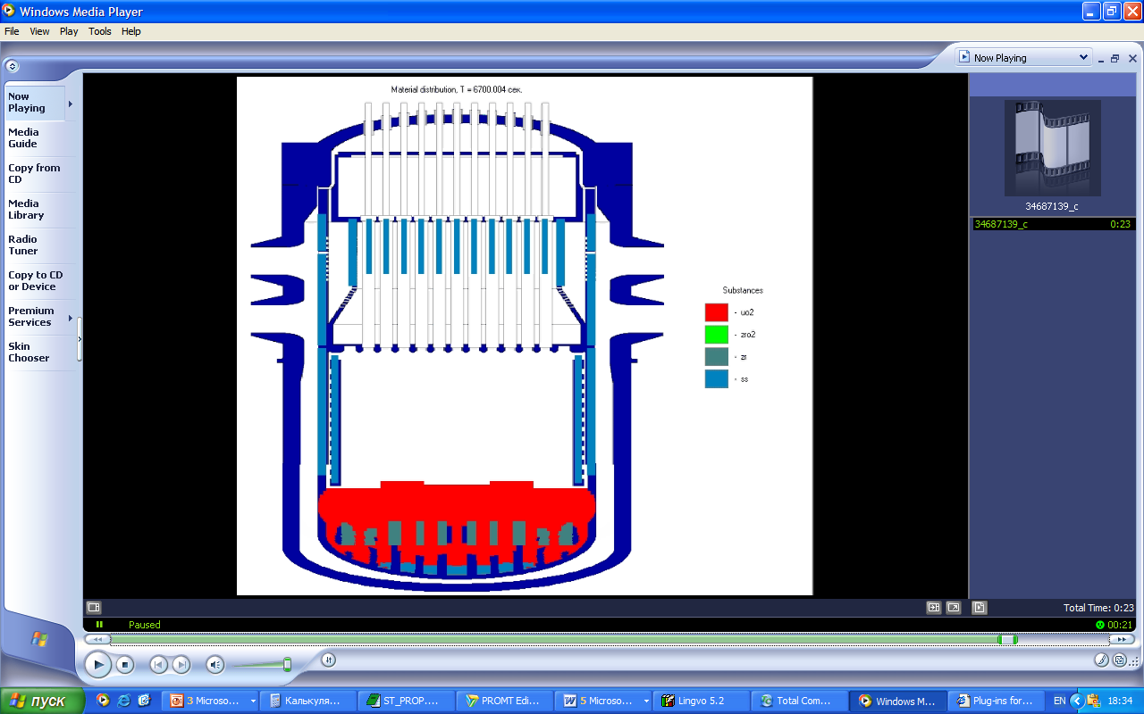
The analysis of aerosols release from molten-pool in the reactor vessel
Temperature and mass share of materials in molten-pool
Time, s | Temperature of corium, К | UO₂, Mass share % | ZrO₂ Mass share % | Zr Mass share % | Steel Mass share %
9 000 | 3 005 | 71,1 | 10,7 | 5,1 | 13,0
10 000 | 2920 | 56,1 | 8,4 | 40 | 31,5
11 000 | 2620 | 48,6 | 7,3 | 3,5 | 40,0
Weight-part concentration of FP in molten-pool at time 9000 s
FP | SrO | BaO | CeO₂ | La₂O₃ | Ru | Mo
Mass share, % | 0.1218 | 0.2001 | 0.3915 | 0.174 | 0.3045 | 0.4002

Slide 25
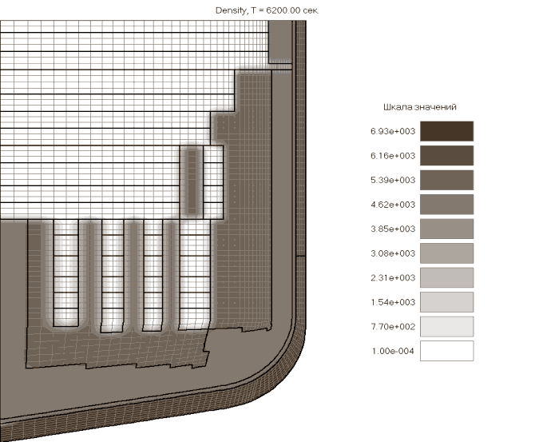
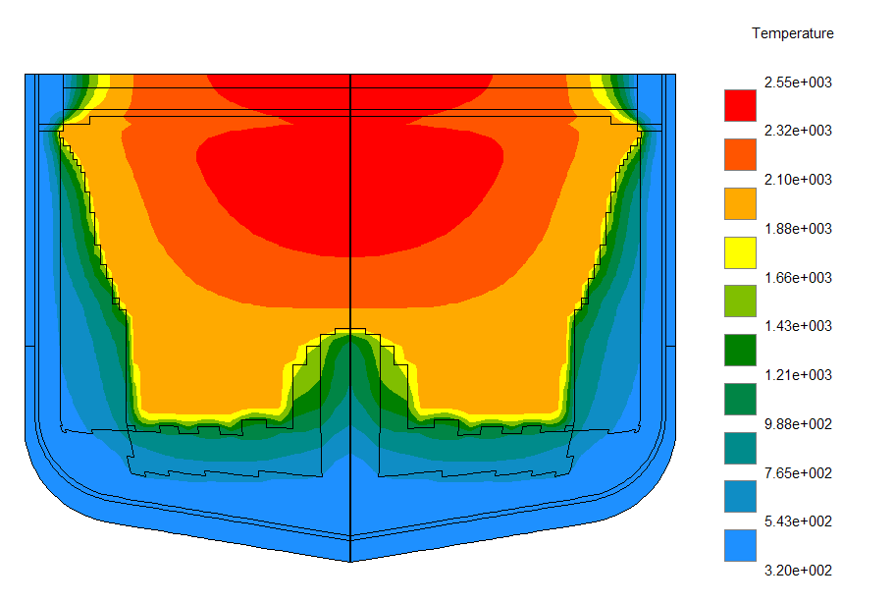
The analysis of aerosols release condition in the core catcher
Accident – large break (Dnom 346) in case of
rupture of PRZR surge line accompanied by a complete blackout
Finite element-based division of the core catcher
There are three factors causing decrease of an aerosols release from core catcher in comparison with the same release from the reactor vessel:
- Temperature and fission products concentration in the core catcher more low, than in the reactor.
- After water feeding in the core catcher
the crust on the melt surface is formed
- The water over the melt keeps a part of aerosols.
For experimental investigation of fission products release the parameters relevant for molten pool in the reactor vessel are chosen.
Temperature distribution in a core catcher

Slide 26
Calculation of fission products behavior
by means of code SOKRAT. LOCA Dnom346
Fission product behavior of class CI
during severe accident
Time dependences of release I, Mo and Te
from fuel
Weights of all aerosols
which have left from the primary circuit
Weights of the aerosols which have left
the primary circuit for aerosols of the various sizes

Slide 27
The analysis of aerosols behavior in ruptured SG tubes during SGTR with containment bypass
 | Unit | Value
Input dates
length of tube | м | 11,07
Diameter | м | 0,013
Roughness |  | 1е⁻⁵
Time interval | s | 3300
Density of FP | kg/m³ | 4000
Source of aerosol | gr/s | 1,82
Results of calculations
Mass of FP (sedimentation in 1 tube) | kg | ~ 1,96
Time before tubes blockade | s | 1300

Slide 28
Sub-task: numerical simulation of aerosol particles kinetics and its behavior during severe accidents in the containment
Code ZTV: aerosol dynamics and deposition processes simulation
Multicomponent aerosols condensation block: Jacobson, M.Z. (1997). Numerical Techniques to Solve Condensational and Dissolutional Growth Equations When Growth is Coupled to Reversible Reactions, Aerosol Sci. Technol. 27: 91-498.
Multicomponent aerosols coagulation block: Semi-implicit version of (Stankova E.N., Zatevakhin M.A. The modified Kovetz and Olund method for the numerical solution of stochastic coalescence equation. Proceedings 12th International Conference on Clouds and Precipitation, Zurich, 19-23 August 1996, P. 921-923)
Particles deposition model includes gravitational settling (sedimentation), Brownian diffusion, diffusiophoresis, thermophoresis

Slide 29
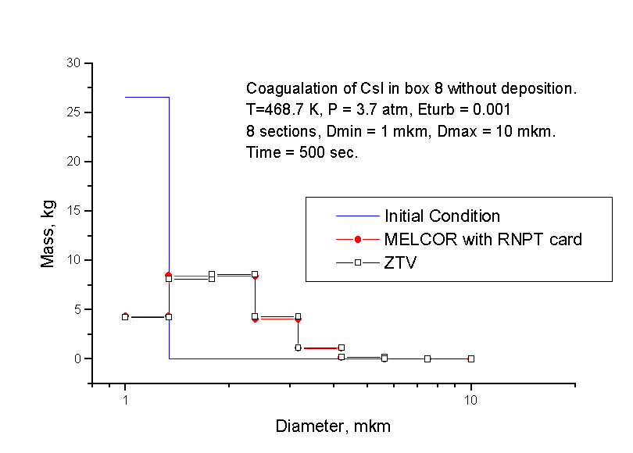
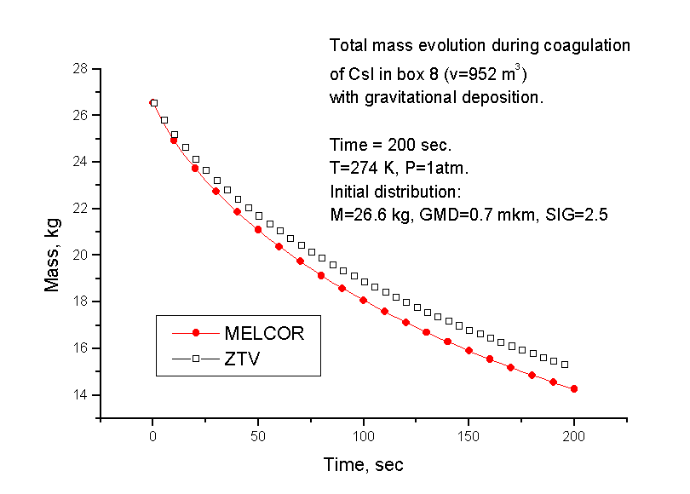
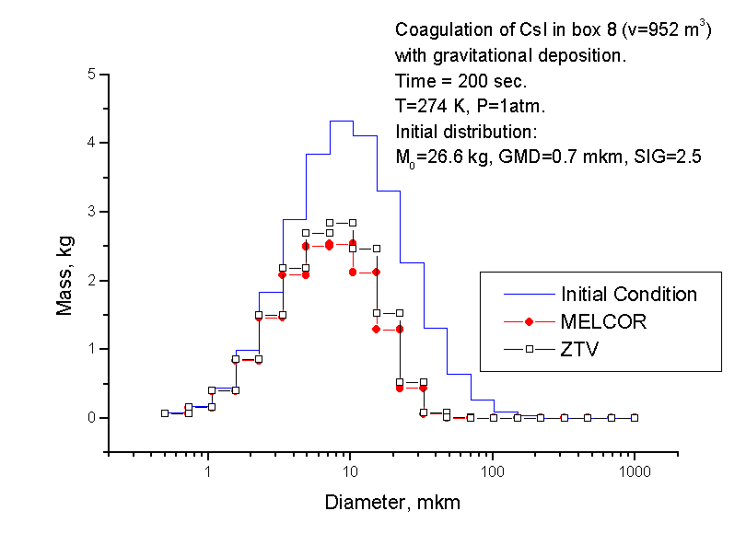
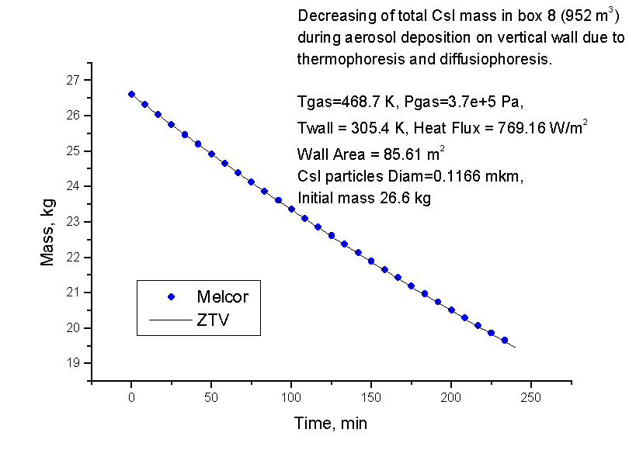
Aerosol code verification: comparison with MELCOR simulations

Slide 30
Results of aerosol code integrated with KUPOL-M thermohydraulic code
Conclusion
Aerosol code was developed, verified and integrated with thermohydraulic code KUPOL-M
Farther development:
Take into account aerosol hygroscopicity
Use new experimental data for code validation
Integrate aerosol code with 3D hydrodynamic code
Comparison between calculated aerosol output (1) and data obtained according to project recommendations (2). Slow aerosol output at the beginning stage is caused by relatively small size of aerosol particles and absence of water vapor condensation due to superheated media.

Slide 31
TASK 1:The analysis of severe accidents for the NPP with WWER-type reactors gives the boundary conditions for the following tasks
Experimental tasks:
Task 2 – composition and amount of low-volatile fission products in the molten pool
Task 4 – behavior of aerosol in experiment
Task 6 – iodine escape to the containment, and dose rate levels in the containment
Calculation tasks:
Task 3 – FP release from molten pool modeling
Task 5 – Modeling of aerosol deposition in a nuclear reactor during
a severe accident
Task 7 – containment parameters impact on iodine species behavior
The executed calculations have allowed to increase accuracy of aerosols source for containment at the expense of the aerosol sedimentation in the primary side of NPP.
The executed EVAN researches will allow to improve aerosol behavior models in the computational codes.
After models improvement it is necessary to make some calculations with joined simulations of the containment and the primary side NPP. It will allow to reduce conservatism of release evaluations.

Slide 32

Thank you for your attention. Questions, please!
sidorov@nio.spbaep.ru

