Slide 1

EVAN ISTC Project # 3345:
Source Term Assessment at Ex-Vessel Stage of Severe Accident
Task 2: Experimental study of FP release from molten corium pool
A.P. Alexandrov Research Institute of Technology
Presented by S. Bechta
Progress meeting of EVAN ISTC project
Budapest, Hungary, March 4, 2008

Slide 2
Contents
Objectives
Test matrix
Methodology of evaporation study and post test analysis
Installation:
- Induction furnace
- Gas-aerosol sampling system
EVAN-1FP test procedure
EVAN-1FP test results:
- Pyrometer readings and melt surface temperature during the 1st part of the test
- Pyrometer readings and melt surface temperature during the 2nd part of the test
- Evolution of corium oxidation index
- Crucible and ingot after the test
- Mass balance of corium
- Composition of aerosol samples in comparison with melt composition
- Aerosol transport losses
- Aerosol mass release rates
- Element specific release rates
- Temperature dependence of release rates at C 70 and C 85
- Influence of oxidation index on the release rates
- Aerosol phase composition
- Aerosol size distribution
- Uranium species partial pressure
Thermodynamic modeling by Gemini2/NUCLEAiv-07_1
Conclusions

Slide 3
Objectives
Determination of release rates of FP and corium components at different melt surface temperatures and corium oxidation indexes C_{n}
FP simulants: Ba, Sr, Ce, La, Mo, Ru
Corium components: U, Zr
С_{n}=100(M_{Zr,Σ} - M_{Zr,met})/ M_{Zr,Σ} %
M_{Zr,Σ} – integral mass of Zr in oxidized and free form;
M_{Zr,met} – mass of Zr-free

Slide 4
Test matrix
Pr1-EV1: pretest carried out for facility functional check and determination of melt
oxidation rate
Pr2-EV1: pretest carried out for preparation of the crucible charge of high density
(m=1390 g, grading 200-300 µm)
EVAN-1FP: main test
BaO and SrO were added in the form of their zirconates

Slide 5
Method of evaporation study
Mass transfer (dynamic) method: saturation of carrier gas by the vapour
of the studied substance at constant temperature and gas flow rate
Flow reactor
Gas\aerosol mixture out
Carrier gas in
Substance
T const
Methods of transferred mass determination:
Weighting
Radiotraces
Chemical analysis of solid depositions
…

Slide 6


Methods of post test study of samples (1)
Analysis of solid depositions and corium ingot
XRF, EDX,
Chemical analysis
(U⁺⁴, U⁺⁶ and Zr_{free})
ICP MS
Errors of measurements (rel. %):
XRF - 5%
ChA - 5%
ICP MS -10%(Sr, Ba) and 50% (Ce, La, Ru, Mo)
EDX - 3- 5 %

Slide 7
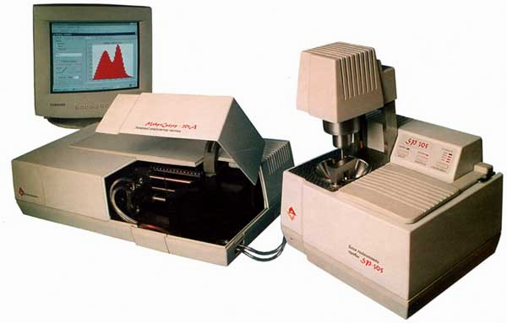
Methods of post test study of samples (2)
XRD → phase composition
(qualitative)
Small angle light scattering → aerosol size distribution
(Error: 2 rel. %)
MICROSIZER-201A setup
Optical cell
Sensor array
Lens
Amplifier
He
-
Ne
Laser
Range of detectable aerosols: 0.2-300 µm
Laser wave length: 0.63 µm
Detector: diode target array
Registration channels: 38
Sample preparation: ultrasonic dispersion
Dispersion cell volume: 150-1000 ml
Ultrasonic frequency: 50 kHz
Power of ultrasonic pulser: up to 200 W
Pump
Ultrasonic
disperser
Mixer
PC

Slide 8
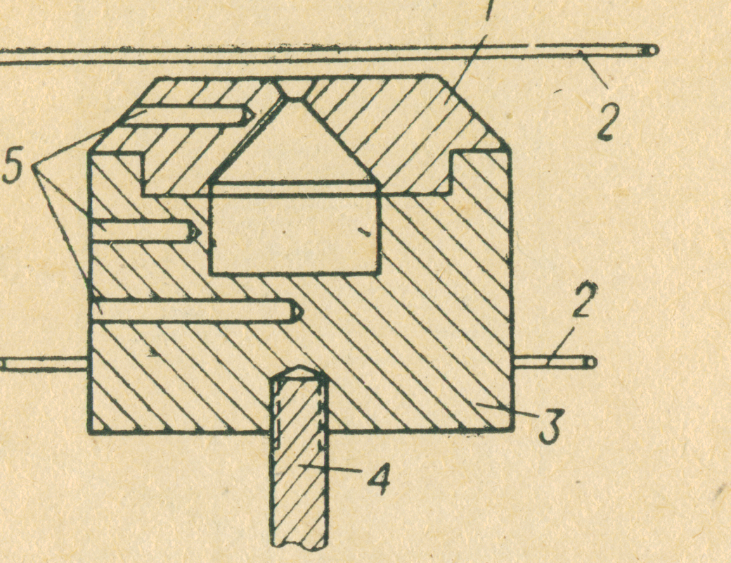
Methods of post test study of samples (3)
High temperature Knudsen MS → partial pressures of species in vacuum
(Error: 10 rel. %)
Knudsen cell
1 – Lid
2 – Cathodes
3 – Vessel
4 – Support bar
5 – Ports for pyrometry

Slide 9
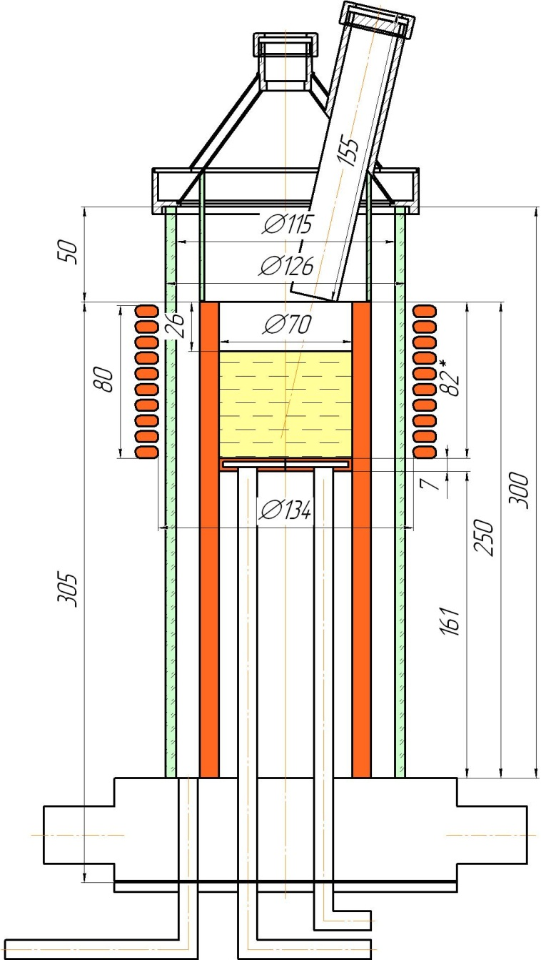
Induction furnace for the EVAN-1FP test (1)
1 - Lid
2 - Pyrometer shaft
3 - Quartz partition
4 - Quartz vessel
5 - Cold crucible
6 - Corium melt
7 - Inductor coil
8 - Corium crust
9– Bottom calorimeter
1
2
3
4
5
6
7
8
9
Reduction of aerosol transport losses:
Molten pool is placed in the top of cold
crucible for reduction of cold surface area
Quartz partition is separating above the
melt area from the furnace internals
Pyrometer shaft was moved out from the
furnace during sampling (only short-term
temperature measurements at the
beginning and the end of every regime)

Slide 10
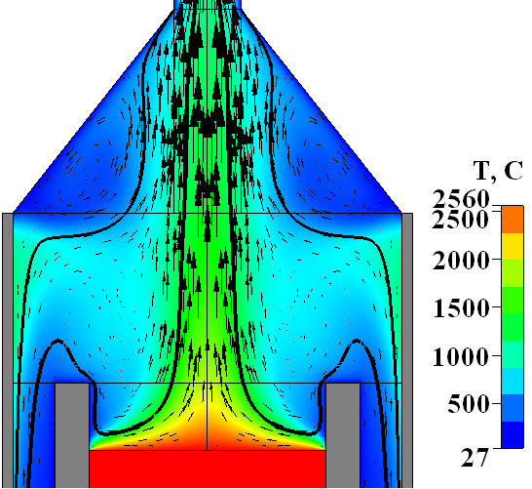
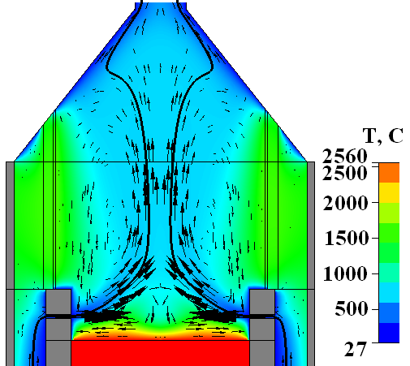
Induction furnace for the EVAN-1FP test (2)
Pretest DNS of gas flow structure: Q = 10 l/min, Ar:O₂=80:20
Gas temperature and velocity vectors:
No quartz partition With quartz partition
Effective aerosol capture by axial upward gas flow
Reduction of recycling zone and area of furnace cold surfaces, which
are in contact with hot gas-aerosol flow

Slide 11
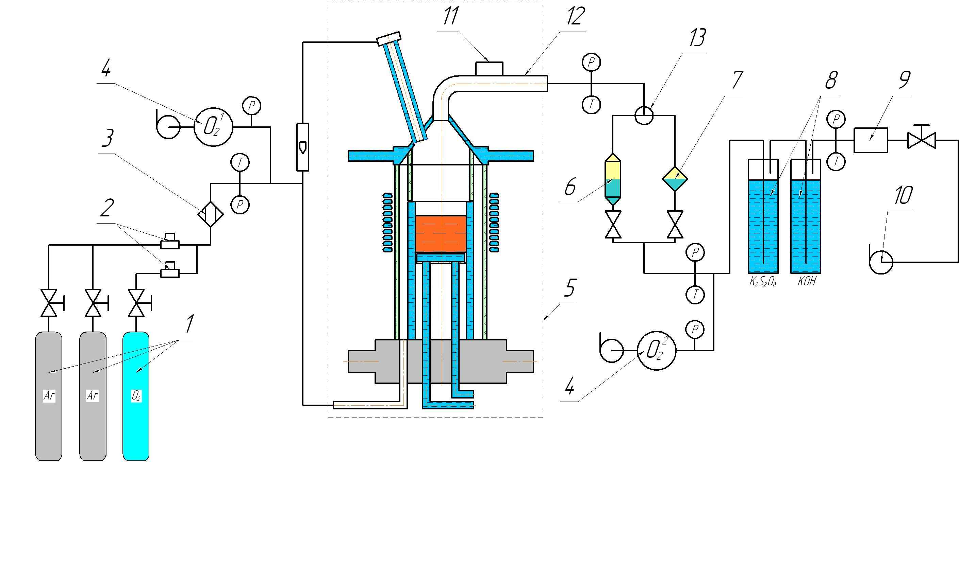
Gas-aerosol sampling system
1 - Gas canisters
2 - Gas flow regulators
3 - Gas mixing unit
4 - Electrochemical
oxygen sensors
5 - Induction furnace
6 - F2: large exposition
aerosol filter (replaceable)
7 - F1: small exposition
analytical filter (replaceable)
8 - Bubblers
9 - Gas flow meter
10 - Fun
11 - Vibrator
12 - Main line
(electrochemically polished
copper tube)
13 -Three-way valve
F1 filters were often replaced, while F2 filters were continuously used during
every regime
Electromechanical vibrator was installed for reduction of aerosol depositions
in the main line
Two bubblers (the first one with 0.1mol K₂S₂O₈ solution and the second – with
1mol KOH) were used for adsorption of RuO₄

Slide 12
General procedure of EVAN-1FP test (1)
Molten pool formation in argon, power in the melt control in order to reach
specific melt surface temperature
Melt sampling
Short-term temperature measurements
Exposition of the molten pool in steady-state with continuous aerosol
sampling
Change of melt surface temperature, it’s measurements and repetition of
aerosol sampling
Sampling from bubblers
Supply of Ar/O₂ mixture into the furnace and corium oxidation up to
specific C_{n}
Control of melt surface temperature
Repetition of melt, aerosol and bubblers sampling
Heating disconnection, melt crystallization and ingot cooling in argon
! It was not possible to maintain equal melt surface temperature at different C_{n}, because it’s increase resulted in higher liquidus temperature of corium

Slide 13
General procedure of EVAN-1FP test (2)
Steady-state( ) and transient ( ) regimes
Aerosols were collected at different melt surface temperatures of C 70
and C 100 corium

Slide 14
EVAN-1FP test results (1)
Pyrometer readings and melt surface temperature during the 1st part of the test
EVAN-1FP
(1st part)

Slide 15
EVAN-1FP test results (2)
Pyrometer readings and melt surface temperature during the 2nd part of the test
EVAN-1FP
(2nd part)

Slide 16
EVAN-1FP test results (3)
Mass of adsorbed oxygen and evolution of corium oxidation index
Pr1-EV1
EV1-1
EV1-2
Pr1-EV1
1st phase: 9.3 ±0.3 (О₂ mg) /s
2nd phase: 7.3 ±0.2 (О₂ mg) /s
EV1
15.0 ±0.8 (О₂ mg) /s
Different melt oxidation rate in EV1 and Pr1-EV1 due to the change of furnace hydrodynamics
(quartz partition installation)
Different melt oxidation rate in the 1st and the 2nd phase of Pr1-EV1 due to the change of furnace
hydrodynamics (pyrometer shaft was moved down in the 2nd phase)
Kinetics of melt oxidation is controlled by the supply of oxidizer to the pool surface

Slide 17
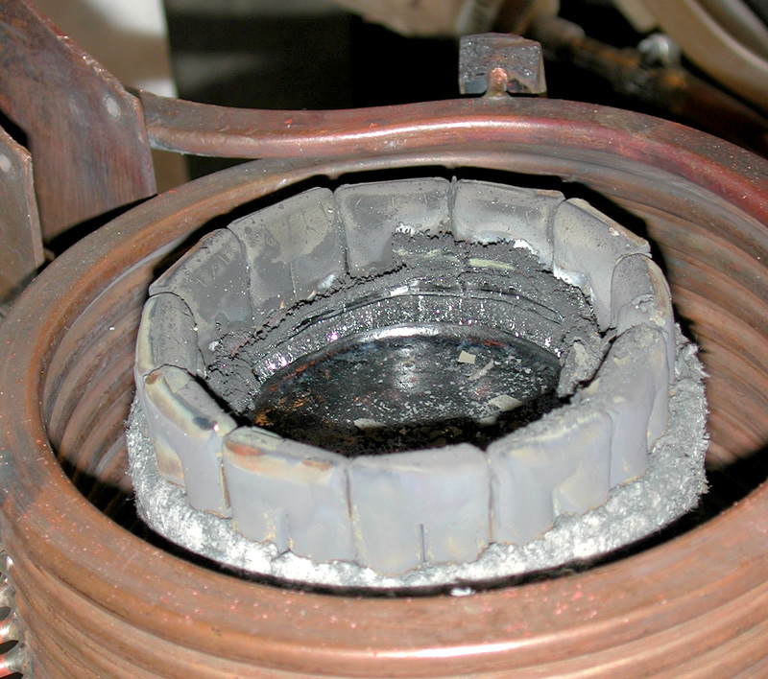
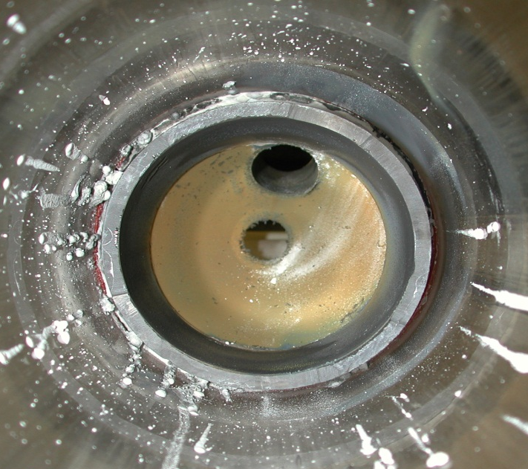
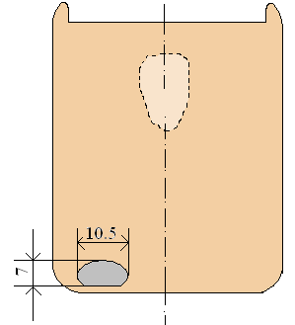
EVAN-1FP test results (4)
Crucible and ingot after the test
Crust above the melt
Aerosol depositions on the cold crucible
Ingot surface
Aerosol depositions inside the lid and partition
Shrinkage pore
Metal inclusion in the oxidic ingot
Mass: 5.1г
Composition, mass % (XRF):
88.8 - Ru; 11.0 - Mo; 0.2 – Zr
Liquid immiscibility
indication for the final C 100
composition
What was in C 70 and C 85
melt?
1 cm

Slide 18
EVAN-1FP test results (5)
Mass balance of corium
*-ZrO₂ used for Ba and Sr zirconate preparation and for the cold crucible insulation
Mass debalance corresponds to the mass of absorbed oxygen
Element specific debalance does not exceed 1.5 rel.% for U, 4.5% for Zr, 4.0%
for Sr, 1.9% for Ba, 3.5% for Ce, 5.9% for La, 0.2% for Ru and 0.4% for Mo

Slide 19
EVAN-1FP test results (6)
Composition of aerosol samples in comparison with melt composition
Aerosols are enriched in U and depleted in Zr in comparison to the melt composition
Reduction of Sr/Ba and increase of Mo releases following C_{n} increase
No indication of RuO₄ release according to results of ICP MS of samples taken from the bubblers

Slide 20
EVAN-1FP test results (7)
Aerosol transport losses
Aerosol mass (g) collected in
Main line
Three-way valve
F1 filters
F2 filters
Cold crucible
Quartz partition and vessel
Total aerosol mass of 64.38 g
Significant transport losses ∼60%
The transport losses were taken into account by the coefficient:
        where m_{MAF}, m_{AAF} and Mº_{Σ} are masses of aerosols collected in F1, F2 filters and integral aerosol mass, respectively
Thus the transport losses were assumed to be proportional to integral aerosol mass.
Aerosol mass release rates were calculated as:
        where Δτ_{α} and S are exposition of a-regime and melt surface area

Slide 21
EVAN-1FP test results (8)
Aerosol mass release rates
Significant increase of aerosol release rate at elevated temperatures
Influence of oxidation index is suppressed by temperature effect

Slide 22
EVAN-1FP test results (9)
Element specific release rates
Uranium
Sr, Ba, Mo, Zr
La, Ce, Ru
Increase of aerosol release rate at
elevated temperatures
Influence of oxidation index is suppressed
by temperature effect

Slide 23
EVAN-1FP test results (10)
Temperature dependence of release rates at C 70 and C 85
Uranium
Strontium
Barium
Molybdenum

Slide 24
EVAN-1FP test results (11)
Influence of oxidation index on the release rates at 2652ºC
Sr, Ba, La, Ce
Uranium
Ru, Mo
Significant reduction of U, Zr and FP release
rates following corium oxidation (except Mo)
Ruthenium release rate was not sensitive to
melt oxidation index in the range C 70…100

Slide 25

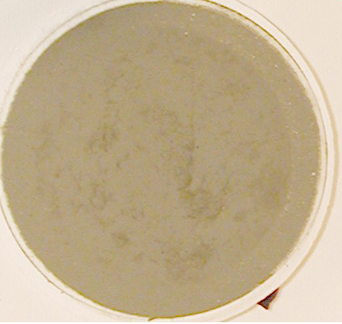
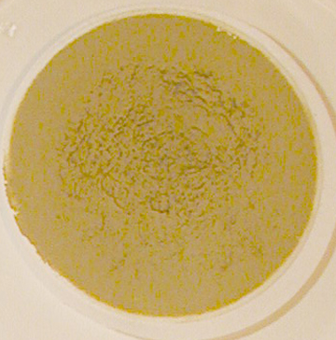
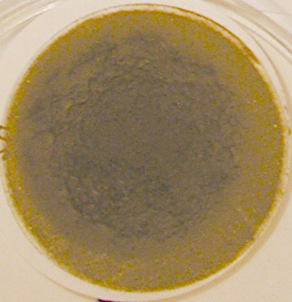
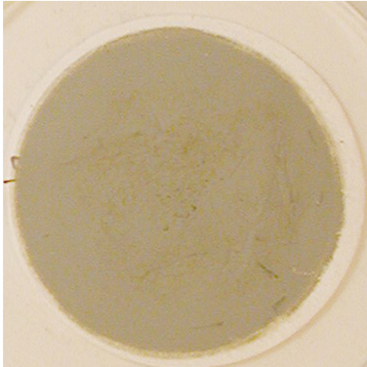
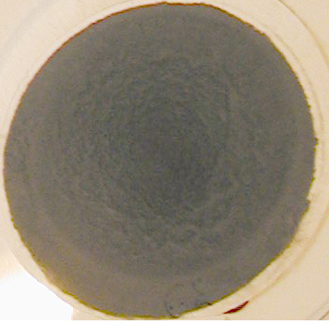
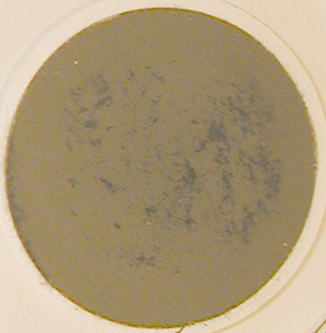
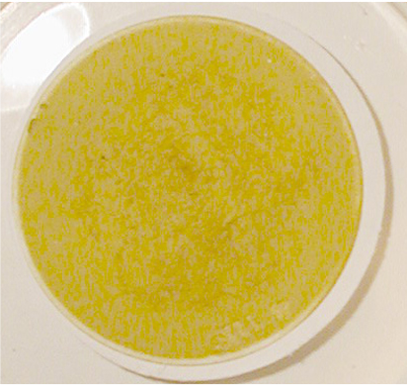
EVAN-1FP test results (12)
Aerosol phase composition
С100
#F1
62
С85-100
56
50
40
С85
35
24
21
С70-85
18
9
30
35
40
45
50
55
60
65
70
75
2Θ
UO₂(ASTM: 73-1715) UO₂(ASTM:13-225) UO₃(ASTM:31-1416) U₃O₈(ASTM:31-1425)
SrUO₄(ASTM: 75-1946)
С70
Phases identified by XRD: - UO₂ - based solid solution in the aerosols released in inert conditions
- UO₃, U₃O₈, UO₂ and SrUO₄ phases (the last two in small quantities) in the aerosols released in oxidizing condition

Slide 26
EVAN-1FP test results (13)
Aerosol size distribution
4 main ranges of aerosol sizes: <1 µm, 1.59-3.63 µm, 3.63-5.49 µm, 9.54-12.6 µm
Temperature effect
Influence of oxidation index
F1 №5
(I regime), T_{melt}=2595°C, C 70
F1 №9
(II regime), T_{melt}=2535°C, C 70
F1 №9
(II regime), T_{melt}=2535°C, C 70
F1 №64
(VIII regime), T_{melt}=2652°C, C 100
Increase of fine particle fraction and reduction of
agglomerate fraction with temperature increase
Increase of agglomerate fraction (9.54-
12.6 µm) after melt oxidation

Slide 27
EVAN-1FP test results (14)
Aerosol size distribution
Effect of atmosphere
F1 #35 (V regime), Ar
F1 #50 (VII regime), Ar/O₂
Significant increase of fine aerosol fraction in oxidizing atmosphere
Practically no agglomeration of particles in oxidizing atmosphere

Slide 28
EVAN-1FP test results (15)
Integral partial pressure of uranium species determined by HT MS
Conditions of HT MS of corium samples:
Sample mass ∼ 20 mg
Error of sample weighting ±0.1 mg
Reference sample for
pressure calibration gold
High vacuum
Integral pressure of
all species less than 13 Pa
- Exposition at every temperature 60 min
About the same effect of C_{n} in vacuum: higher values of integral partial pressures
of U at smaller C_{n}

Slide 29
Thermodynamic modeling by Gemini2/NUCLEAiv-07_1 (1)
Comparison of release data of the I regime of the test
T_{melt}=2595°C, C 70
Volume of gas to be in local equilibrium with the melt was determine from oxidation régimes (as the volume of
gas, from which all oxygen was absorbed)
Reasonable agreement in U, Zr, Ba releases, but discrepancy in Ru (liquid immiscibility?)
and Sr (salting-out?)

Slide 30
Thermodynamic modeling by Gemini2/NUCLEAiv-07_1 (2)
Evolution of phase composition versus temperature
Final C 100 corium
No miscibility gap at 2850-2950 К. Solid HCP Ru-containing phase forms during
crystallization of the last remaining liquid. Contradiction with metal inclusion location

Slide 31
Conclusions (1)
The following qualitative effects have been detected:
Decrease of the evaporation rate of melt components and fission
products, excluding molybdenum, after the increase of the corium
oxidation index. Therefore, melt oxidation in the catcher has in general
a positive influence on the radiation situation in the containment
Strong adhesion of the chemically prototypic corium aerosols, especially
to cold metallic surfaces. This also reduces the release of aerosols into
atmosphere of the containment, but may influence efficiency of such
safety systems as SPOT GO/PG (Passive Heat Removal System from
Containment/Steam Generator), hydrogen catalytic recombiners, etc.
Kinetics of melt oxidation is controlled by the supply of oxidizer to the pool
surface, i.e., depends on characteristics of the steam-gas mixture natural
convection in the reactor at the in-vessel stage of a severe accident, or in
the reactor pit at the ex-vessel stage

Slide 32
Conclusions (2)
Qualitative effects (2):
The submicron particles fraction in the release is noticeable. Their inertia
and gravitational deposition are weak. This fraction keeps increasing
during the melt surface oxidation. Characteristics of the aerosol release
during melt oxidation at its interaction with sacrificial material have not
been determined yet
There exists evidence that ruthenium and a part of molybdenum, which
concentrate in the metallic melt, stratify in molten corium C 100. Under
conditions of the test, no release of gaseous RuO₄ was measured until
free zirconium in the melt has oxidized completely

Slide 33
Conclusions (3)
The obtained quantitative results can be used for the development and verification of models and codes which describe the release of FP during a severe accident.
These results include:
Correlations of the element release rates with the melt temperature and
oxidation index
Aerosols chemical and phase composition
Dispersion and masses of aerosols collected along the facility duct at
different distances from the release source
For verification use of the data, the report offers the facility’s design and geometry, in particular, of its gas-aerosol duct, as well as characteristics of the gas-aerosol flow

