Slide 1
THEORETICAL ANALYSIS AND COMPUTATION OF FISSION PRODUCT RELEASE FROM MOLTEN POOL
V. Ozrin, O. Tarasov
Nuclear Safety Institute of Russian Academy of sciences
Budapest, 04.03.2008
Notes:
The topic of our talk is theoretical analysis and computation of fission product release from molten pool.

Slide 2
OVERALL PICTURE
FP RELEASE
FROM MOLTEN POOL
evaporation from open
surface of the melt
FROM CORE CATCHER
MCCI, FP release in gas bubbles
TWO MODELS
Atomic
by V. Zagryazkin
Molecular
by V.Ozrin, O. Tarasov
NOT MODELED
Notes:
In general, the problem of FP release splits into two independent problems: release from the molten pool in the reactor vessel and from core-catcher. The mechanisms of FP release in these cases are different. In vessel we expect FPs to evaporate from open surface of the melt. In core catcher corium can interact with concrete which will lead to creation of the gas bubbles. They are expected to be the main mechanism of FP release in this case.
We investigated only the first case. Two models of FP release from the melt have been developed. One of them is based on the assumption that the melt can be described as an atomic mixture. The other, developed by us, uses molecular approach. Both of them are described in the final report. In this talk I’d like to tell only about our model.

Slide 3
GENERAL IDEAS
Main assumptions:
GAS
Liquid is uniform;
Thermodynamic equilibrium near the melt surface:
T = const everywhere
P_{UO2}, P_{U}, P_{Ba}, P_{BaO}, P_{O2}, … (Pa)
μ_{U}, μ_{O}, μ_{Ba}, … (kJ/mol)
μ_{Zr}^{gas} = μ_{Zr}^{melt}
μ_{Ru}^{gas} = μ_{Ru}^{melt}
…
μ_{U}, μ_{O}, μ_{Ba}, … (kJ/mol)
x_{U}, x_{Zr}, x_{O}, x_{Ru}, … (at. %)
FPs are blown away
by an air flux
Notes:
Molecular model supposes that the melt is a uniform liquid which is in a equilibrium with the vapor near its open surface. This means that the temperatures and the chemical potentials of each element in the near-surface gas layer and in the melt are equal. The mechanism of FP release is blowing these vapors away by an air flux.

Slide 4
RELEASE RATES: MAIN FACTORS
MOST IMPORTANT
FP pressures in saturated vapor near the melt boundary
  molecular model, acting mass law
Rate of gas phase blowing away
  given in the EVAN experiments
Finite rate of the diffusion in the gas phase
Corium oxidation (in oxygen-containing atmosphere)
simplified models
Finite diffusion rate in the melt
Finite rate of evaporation
not taken into account
Notes:
There are several factors which have influence on FP release rate. The most important factors are FP partial pressures in saturated vapor near the boundary of the melt which are obtained by our thermochemistry model and and the rate of their blowing away which is known from the experiment. It is necessary also to take into account the finite rate of FP diffusion in the gas phase and to describe the corium oxidization under oxygen-containing atmosphere. This was made in a simplified way. Finite rate of other kinetic processes is ignored.

Slide 5
SATURATED VAPOR MODEL
Gas phase
Ideal molecular gas
Chemical potentials from IVTANTHERMO and other bases
Liquid phase
Regular molecular solution
Chemical potentials from IVTANTHERMO and other bases
Activities of FPs: fitting to EV-1 experiment
Species | γ | μ^{ex}, kJ/mol
Mo | 500 | 144.7
Ru | 30 | 79.2
BaO, SrO, La2O3, CeO2, Ce2O3 | 0.05 | –69.7
Gas phase composition obtained from acting mass law
Notes:
The main part of our model is calculation of saturated vapor partial pressures. Gas phase is considered as an ideal molecular gas, liquid phase is a regular molecular solution. Chemical potentials of molecules in pure substances were taken from IVTANTHERMO and other databases. Activities of FPs in the liquid phase were fitted to the results of EVAN experiments. In the table their values are shown. Mo and Ru do not like the oxide melt and have positive excess chemical potentials while Ba, Sr, La and Ce oxides have negative excess energy.
Saturated vapor pressures are obtained from the solution of acting mass law equations system.

Slide 6
DIFFUSION MODEL
p_{bulk}
bulk
p_{bulk} (required)
h
DIFFUSION GAS LAYER
p_{eq} (known)
MELT
J – release rate (mol/s)
W – rate of gas blowing away (L/s)
P_{eq} – saturated partial pressure of FP
S – melt surface area
D – diffusion coefficient
Notes:
In this slide the model of diffusion of FP in the gas phase is shown. According to it, between the bulk of the gas phase and the surface of the melt there is a diffusion gas layer. At the bottom of this layer the partial pressures of FPs are equilibrium, they are obtained by the model from the previous slide. But the release rate is proportional to the partial pressure in the bulk. Striclty speaking, it is necessary to solve the diffusion equation with chemical reactions but we use the simplified formula with right asymptotics. The release rate is proportional to equilibrium pressure of FP near the melt surface. If the diffusion coefficient is small the factor is proportional to diffusion coefficient and to the area of the melt surface. If the rate of the gas flux is small, the release rate is proportional to the flux.

Slide 7
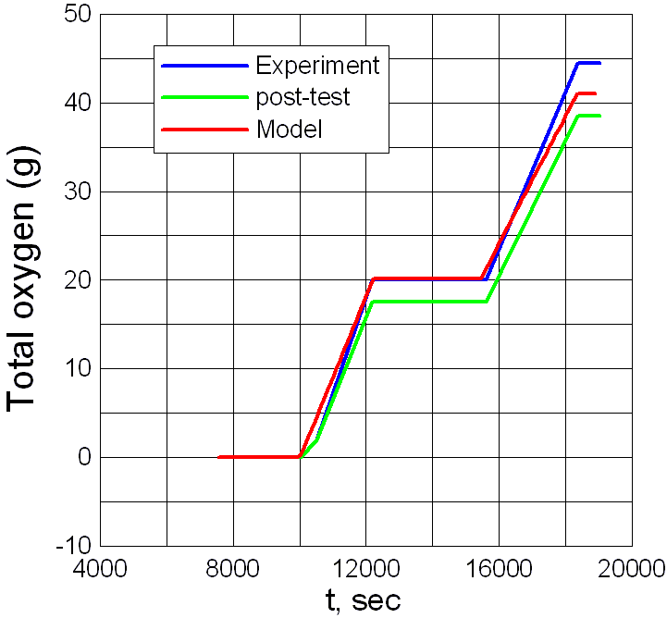
MELT OXIDATION MODEL
1/3 of oxygen in atmosphere takes part in oxidization
dissolved oxygen molecule in the melt is introduced
Notes:
Now I’d like to say a few words about melt oxidation model. It is very simple, but however it is necessary in order to describe the experiments under oxygen-containing atmosphere. According to it, the a third part of oxygen in an air flux reaches the melt. In the EVAN pretest experiment the overoxidized melt has been watched so we introduced a new molecule into our molecular database: soluble oxygen. It allows to describe melt over-oxidization which is very important for obtaining correct FP release.
In the graph the modeling of the melt oxidization in pretest experiment is shown. Horisontal axis shows time, vertical axis is total oxygen mass change. Blue line is online experimental measurement, green line is the post-test analysis, red line is model. Inclined parts of the lines correspond to the regimes with oxygen-containing atmosphere over the melt and horizontal ones correspond to regimes pure argon atmosphere. The agreement is satisfactory.

Slide 8
REALIZATION
INPUT DATA:
Initial corium composition
Time grid
Atmosphere composition
Gas flow rate (m³/s)
Area of of the melt surface (m²)
Thickness of diffusion gas layer (m)
Diffusion coefficients
OUTPUT DATA:
Corium composition
Gas phase composition
FP release
Notes:
The model is realized as a stand-alone code. Its input data are:
Initial corium composition, time grid, atmosphere composition, gas flow rate, area of of the melt surface, thickness of the diffusion gas layer and diffusion coefficients.
The output data are time-dependent corium composition, gas phase composition and FP release.

Slide 9
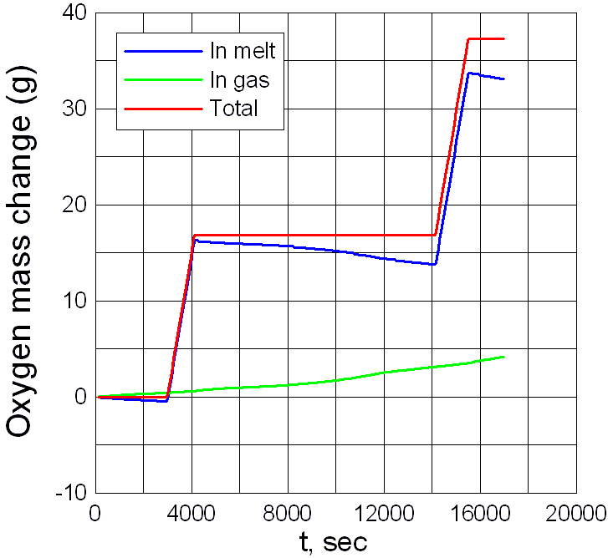
EV1 MODELING: OXIDIZATION
Argon atmosphere:
decrease in melt compensated by increase in gas
Notes:
In this slide the modeling of oxidization process for the conditions of the main EVAN experiment is shown. In fact it consists of two parts but we use the unified time scale. Blue line shows the change of the oxygen mass in the melt. Green line corresponds to this change for the gas phase. Red line is the total oxygen mass change in the system. It is what has been observed in the experiment.
The most interesting periods correspond to regimes with neutral atmosphere over the melt. Red line is horizontal there, it has been observed in the experiment. Total amount of oxygen in the system is constant. However, it does not mean that the masses of oxygen in the melt and in the atmosphere are constant.

Slide 10
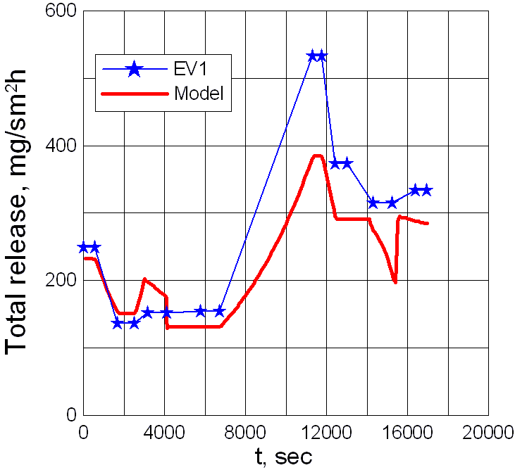
EV1 MODELING: TOTAL RELEASE
Notes:
In this slide modeling of total aerosol release in the main EVAN experiment are shown. The model predictions are compared with the experiment. It can be seen that the agreement is very good. It means that the model describes uranium release correctly.

Slide 11
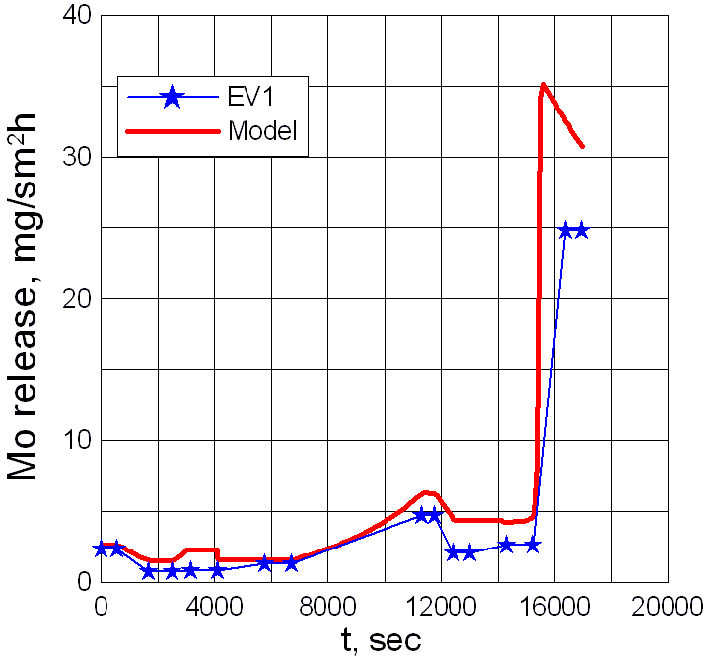
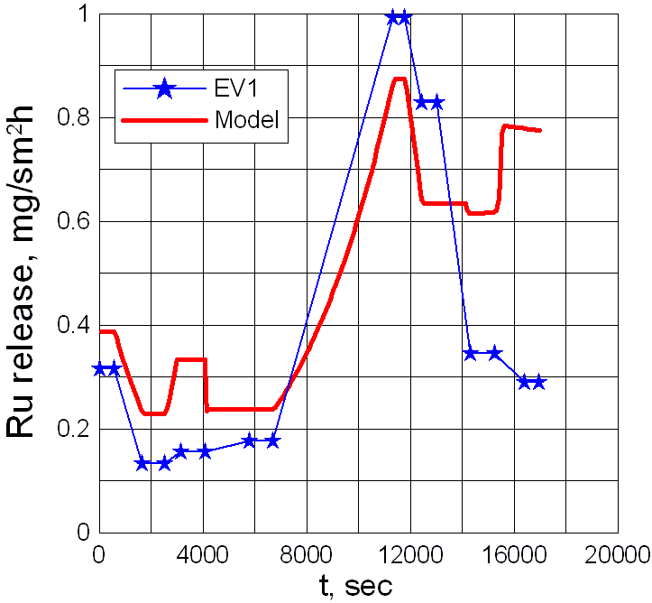
EV1 MODELING: FP RELEASE
Good agreement is the result of excess potentials choice
Notes:
It is the release rates if fission product simulants: experiment vs. model. In this slide Molybdenum and Ruthenium are shown. It is remarkable that the model guesses the growth of the Molybdenum release rate at the end of the experiment. The explanation is that at this stage the melt has become over-oxidized and the oxygen potential became much higher. That allows molybdenum to evaporate as MoO3 which evaporates much better than Mo.
I must say that the agreement with the experiment is the result of fitting of FP excess energies. If it were zero the release of Mo and Ru would be hundred times lower.

Slide 12
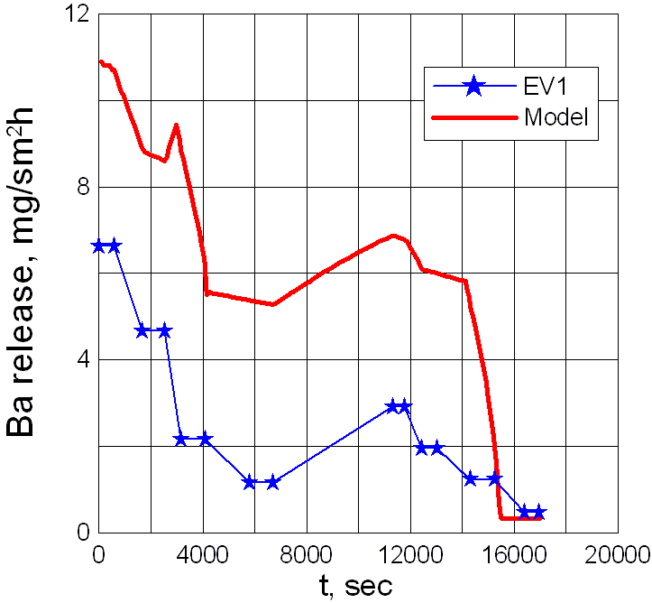
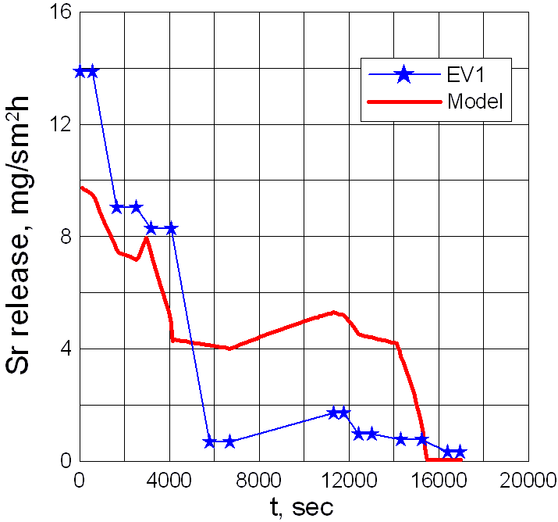
EV1 MODELING: FP RELEASE
Notes:
Here are the results for Ba and Sr.

Slide 13
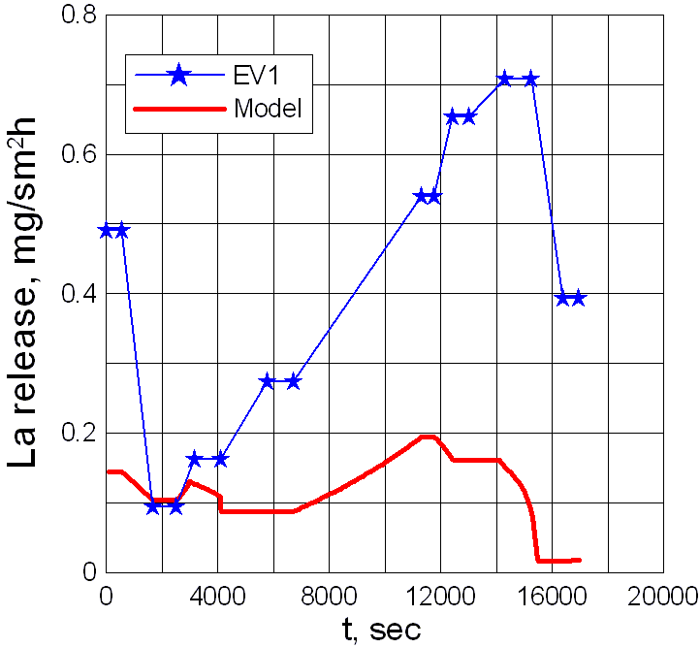
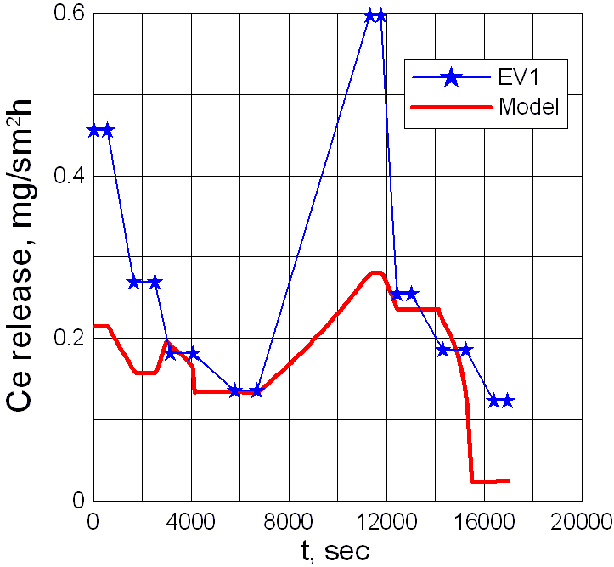
EV1 MODELING: FP RELEASE
Notes:
And these are the results for La and Ce. The agreement is satisfactory.

Slide 14
CONCLUSION
Two models of FP release have been developed: atomic and molecular. In the presentation only molecular model has been discussed.
It can describe:
Melt oxidization (in a simplified manner)
Finite rate of FP diffusion in the gas phase (in a simplified manner)
FP release rate
The model is realized as a stand-alone FORTRAN program
Agreement with the results of EVAN experiments is satisfactory. However, to some extent it is the result of choice of the adjustable parameters (FP activities, effective oxygen concentration in atmosphere). More serious models of FP and oxygen diffusion in the gas phase are necessary. The model of the melt is also simplified: the rate of convection is finite, oxygen and metal phase can appear. Solving these problems is a thing of a future.
Notes:
Now I’d like to make a conclusion.
Two models of FP release have been developed: atomic and molecular. In the presentation only molecular model has been discussed.
It can describe:
Melt oxidization (in a simplified manner)
Finite rate of FP diffusion in the gas phase (in a simplified manner)
FP release rate
The model is realized as a stand-alone FORTRAN program
Agreement with the results of EVAN experiments is satisfactory. However, to some extent it is the result of fitting of the adjustable parameters (FP activities, effective oxygen concentration in atmosphere). More serious models of FP and oxygen diffusion in the gas phase are necessary. The model of the melt is also simplified: the rate of convection is finite, oxygen and metal phase can appear. Solving these problems is a thing of a future.

