Slide 1
SPb SPU SPAEP
Dispersed Particles
Deposition-Resuspension
from Rough Surfaces
in Turbulent Flow
Yuriy E. Gorbachev, Dmitriy Wiebe
yuriy.gorbachev@gmail.com wiebe@nio.spbaep.ru
Progress meeting, March, 4 – 6, 2007

Slide 2
Content
Introduction
Resuspension model
Tube flow simulations
Generalised resuspension model
Experimental setup simulation
Conclusions

Slide 3
Particle Removal Process
Removal process is caused by the lift force F_{L} and aerodynamic drag force F_{D} acting on the particle stuck to the surface
Holding particles to the surface (sticking) is caused by the adhesive forces f_{a} that are of the van der Waals origin
Particles can rock about asperity contact P due to the action of the lift and drag couples counteracted by the adhesive couple at asperity contact Q.

Slide 4
Resuspension Models
Dynamic models assume the energy accumulation and resuspension after overcoming its critical value.
Quasi-static models assume that the resuspension is the result of the breakdown of the equilibrium of forces or moments.
Quasi-static models are the special case of the dynamic ones, when there is no energy accumulation at the natural resonance frequency of the particle-surface vibrations. The resuspension condition in this case is determined by the balance between the instantaneous aerodynamic forces/couples and adhesive forces/couples at each location/deformation in the adhesive surface potential well.
Both types of model are essentially statistical, based on either a Monte-Carlo simulation or on formulae for rate constant for resuspension: such models are referred to as kinetic models because of the analogy with kinetic models for the desorption of molecules a surface and the escape of Brownian particles from a potential wall

Slide 5
Rock ‘n’ roll Resuspension Model
The condition of the particle remove from the surface consists in that the removal force F_{t}(t) exceeds the adhesive one f_{aQ}.
The removal force is determined from the balance of the aerodynamic and adhesive couples F_{t}∙a = F_{L}∙r_{L} + F_{D}∙r_{D}, where r_{L} and r_{D} are corresponding arms of the forces and a is a typical of the distance between asperities, r_{L} ≈ a/2:
F_{t}(t) = F_{L}/2 + F_{D}∙r_{D}/a > f_{aQ}.
For spherical particles r_{D} ≈ r that is the sphere radius.
For non spherical particles the minimal characteristic dimension of the particle can be chosen for r_{D} estimation

Slide 6
Resuspension Rate Constant
, where the integration over the removal force
is done in the range where it force exceeds the adhesive force.
For a Gaussian distribution of the removal force the Resuspension Rate Constant has the form
where
and
are mean and fluctuating
component of a force F_{t}(t), with
being the typical frequency
of the forcing motion and is given by
where is time derivative of . In practice is taken to be the maximum resuspension rate for a given adhesive force.

Slide 7
Mean Lift and Drag Force
Rate Constant parameters can be determined experimentally.
For mean Lift Force the following scaled dependence on the fluid density ρ, kinematic viscosity ν and friction velocity u_{τ}
can be used while for mean Drug Force
Thus the Removal Force
Accounting the experimental result the rms
and neglecting correlations between those forces one obtains
Value for the typical frequency of the forcing motion derived from the experimental data

Slide 8
Resuspension Rate
The log-normal distribution for normalized adhesive forces is
assumed:
where ; is the adhesive force for perfectly smooth contact; is the geometric mean of the normalized adhesive forces and is a measure of the reduction in adhesion due to surface roughness; and is the geometric standard deviation.
Evolution equation for the deposited particles
=> mean particle density
and similarly the Resuspension Rate

Slide 9
Model Parameters
To close the model the following parameters should be determined:
a that is the typical distance between asperities;
r_{D} that is the Drag Force arm (minimal characteristic particle size);
F_{a} that is the Adhesive Force for perfectly smooth contact;
that is the geometric mean of the normalized Adhesive Forces;
that is the geometric standard deviation of the normalized Adhesive Forces.
a and r_{D} are the particle characteristics;
F_{a} is the particle-surface interaction characteristics while
and are universal surface characteristics.
Listed above parameters should be obtained from the experimental data, that set up a claim to the experimental matrix.

Slide 10
Tube Flow Simulation
Ammonium chloride is deposited on the inner wall of the vertical tube with the fixed density.
Gas is flowing from the bottom side of the tube with a fixed flux.
Resuspension rates should be calculated at different gas flow velocities.
Additionally it is assumed that:
gas flow is turbulent;
particles are of the spherical form and of the size mach larger than of the gas molecules;
particles form the mono-layer deposit;
collisions of resuspended and deposited particles a negligible and removed particles are carried by the flow.

Slide 11
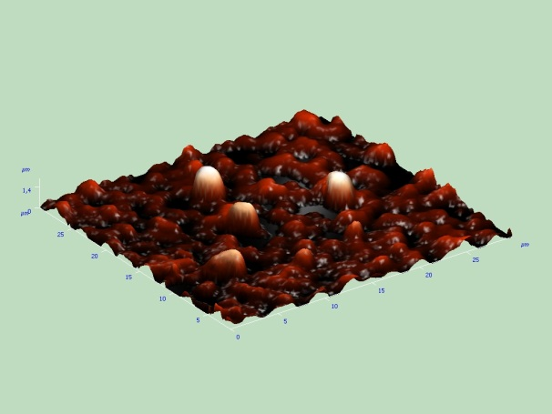
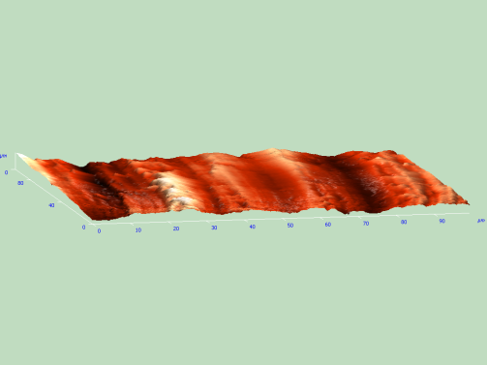
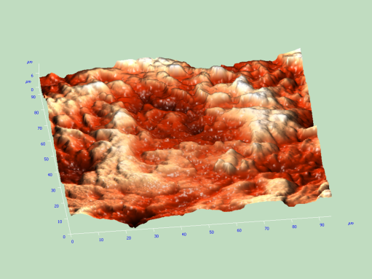
Flow Problem Parameters
Tube length: L = 5.0 m;
Tube diameter: D = 0.050 m;
Gas density: ρ_{g} = 1.2 kg/m³;
Gas kinematic viscosity: ν = 1.5*10⁻⁵ m²/s;
Adhesive surface energy of the interaction of spherical particles for perfectly smooth contact with the surface: γ = 0.56 J/m²;
Ammonium chloride density: ρ_{NH4Cl} = 1.53*10³ kg/m³.
Deposited particles size distribution function of the ammonium chloride and initial surface density are determined experimentally using the electron microscope technique.
Estimations of the model parameter a that characterize the roughness of the inner tube surface were done on the base of the experimental results obtained by using the electron microscope technique also.

Slide 12
Simulation Results
Computation was done for eight values of roughness parameter from 1 to 32 mkm. Figs show the relative mass resuspension rates (that is the ratio of the mass removed per second to the initial deposited mass) as a function of time for mean flow rates varied from 20 m/s to 80 m/s.

Slide 13
Simulation Results
Relative mass resuspension rates:
as a function of time for different roughness parameters and for mean flow rate 80 m/s (left fig).
as a function of roughness parameter at the initial time (right fig).

Slide 14
Preliminary Conclusions
The effectiveness of the resuspension depends essentially on the gas flow velocity. While gas flow rate changes from 20 to 80 m/s, the relative mass resuspension rate increases by a factor of 10⁸ to 10⁹.
The surface roughness influences essentially on the resuspension rate only if roughness parameter a is lower or of the same order as the mean particle diameter, i.e. when the drag force effect prevails on the lift one. When the roughness parameter is much larger than the mean particle diameter the lift force prevails in the removal and therefore in the resuspension process, that no longer depends on a.

Slide 15
Particles Distributed Over the Size
Deposited particles are distributed over the size with the distribution function .
Then the resuspension rate can be calculated by the formula:
can be fixed or calculated during simulation of the deposition process.
Dependence over r_{D} is via the removal force.

Slide 16
Resuspension of Non-spherical Particles
Ellipsoid shaped particles with two identical semi-axes b and and one semi-axis that is α times longer than those two a = αb
I. The largest ellipsoid axes is parallel to the flow. Then the dependence over particle characteristic dimensions is determined by force shoulders: r_{effD} = b, r_{effL} = α^{1/2}b.
II. The largest ellipsoid axes is perpendicular to the flow. Then r_{effD} = r_{effL} = α^{1/2}b.

Slide 17
Resuspension from Multilayer Coverage
Mono-disperse particles
Monolayer thickness is equal to 2b.
Density of the layer will be estimated as 0.7ρ, where ρ is the mass density of the particles (that corresponds to the density packing).
Up to the moment when only one monolayer remains, the resuspension rate will be determined according to the formula
The roughness in this case is determined by the particle size: a = α^{1/2}b.
The duration of this time period is where is a number of deposited monolayers.

Slide 18
Resuspension from Multilayer Coverage
Polydisperse particles (with deposition)
Deposited layer is distinguished into two sublayers: the upper partly filled one and the lower one fully filled. Particles from the upper sublayer can be removed from it and particles from the bulk can be deposited on it .
The evolution of the layer can be described by the set of equations
for layer thickness h
P_{Dk} and P_{Rk} are deposition and resuspension rates for the particles of sort k respectively.
for upper sublayer surface mass density σ_{k}
for the bulk mass density near the surface by:
By solving of these equations one can calculate the value of the particles surface density on the tube wall that is measured in the experiments.

Slide 19
Particle Watering Effect
Particle removal condition can be written in the form:
F_{t}(t) = F_{L} + 2F_{D}∙r_{D}/a > f_{as} + f_{af} /2.
Then the representation for the resuspension rate constant will take the form:
The resuspension rate at time t (in 1/s) is derived from this expression by its differentiation over time, namely

Slide 20
Experimental Setup Simulation
Comparison of the simulation results and experimental data for the surface mass density of the deposited particles after deposition process is completed (left) and after resuspension process is completed (right).

Slide 21
Experimental Setup Simulation
Comparison of the simulation results and experimental data for the surface mass density of the deposited particles after deposition process is completed (left) and after resuspension process is completed (right).

Slide 22
Experimental Setup Simulation
Comparison of the simulation results and experimental data for the surface mass density of the deposited particles after deposition process is completed (left) and after resuspension process is completed (right).

Slide 23
Conclusions
Deposition of large particles predominantly occurs near the tube entry.
During the resuspension process the particle size distribution along the tube is smoothed.
Comparison of the simulation results for dusty turbulent flow with the obtained experimental data shows that at the whole range of studied flow velocities (20–110 m/s) the resuspension and deposition process are of the same value of importance.
Good agreement of the simulation results with experimental data is achieved. This allows to conclude that the proposed model adequately describes the resuspension/deposition processes in the turbulent dusty flows and catches the main physics of the event. Hence the suggested model can be recommended for further investigations.

Slide 24
Questions please
Thank you for your attention
yuriy.gorbachev@gmail.com
wiebe@nio.spbaep.ru

