Slide 1
LES simulation of aerosol transport and deposition in turbulent flow in the channel.
Alexey. A. Ignatyev
Saint Petersburg Research and Design Institute ATOMENERGOPROEKT,
St.Petersburg

Slide 2
LES simulation of aerosol transport and deposition in turbulent flow in the channel. (Task5)
Objective: numerical simulation of aerosol particles turbo-phoresis in the channel.
Main advantages of LES (Large Eddy Simulation) method: LES is able to resolve realistic turbulent pulsations in contrast of classical RANS (Reynolds Average Navier-Stokes)
1

Slide 3
LES simulation of aerosol transport and deposition in turbulent flow in the channel. (Task5)
Mathematical model consists of two parts:
1) Hydrodynamic model for incompressible viscous fluid:
For subgrid transport coefficients K_{m} calculation two Smagorinsky type subgrid models are used.
1. Classic Smagorinsy model
2. Shear-improved Smagorinsky model (Leveque,Toschi,Shao,Bertoglio, 2007)
Where angle brackets < > denote an ensemble average in homogeneous direction.
is the strain tensor.
is the filter width
is the Smagorinsky constant (0.16)
2

Slide 4
LES simulation of aerosol transport and deposition in turbulent flow in the channel. (Task5)
2) Particle motion model:
where
N_{p} is the number of particles,
x_{k} is the radius-vector of the particle k,
v_{k} is the velocity vector of the particle k,
u_{k} is the fluid velocity at x_{k} .
τ_{p} is the particle relaxation time.
f_{k} is the normal-wall directed lift force (assumed as f_{k} = 0 ).
is the Saffman’s lift force due to velocity gradient.
is the Brownian force which depends on particle diffusivity D_{B} and which was modelled as random value.
Relaxation time depends on particle and fluid densities, Reynolds and Knudcen numbers.
Here and after we will use dimensionless form of relaxation time
where
is the molecular kinematic visosity and,
is the friction velocity.
3

Slide 5
LES simulation of aerosol transport and deposition in turbulent flow in the channel. (Task5)
Numerical methods used for governing equations solving.
Momentum equations are approximated on fully staggered grid.
Advection terms are solved by the second-order Piacsek & Williams approximation.
Viscous terms are second-order central differences.
The forth-order Adams-Bashforth predictor-corrector time stepping is used for time integration.
To solve the Navier-Stokes system fractional two steps method is used by Kim & Moin (Kim, J., Moin, P., 1985,).
Second step of this method leads to Poisson equation for scalar field φ.
Intermediate velocity u* is then projected into divergence free field to get velocity at new time level (n+1):
Poisson equation is solved with iterative conjugate gradient method.
For solving the system of ordinary differential equations describing particle motion second-order Adams-Bashfoth method was used.
4

Slide 6
LES simulation of aerosol transport and deposition in turbulent flow in the channel. (Task5)
Check up of model accuracy using Taylor Green vortex decay.
The accuracy of the basic dynamic framework of this model was checked by directly simulating the 3D Taylor and Green vortex flow (1937).
Computational domain (in dimensionless form) was a cube with edge 2π and with periodic boundary conditions applied in all directions.
The initial conditions were sinusoidal form:
Subgrid parametrization was switched off.
Kinematic viscosity Km was set equal to 1/Re, where Reynolds number Re = 200
One run was carried out for dimensionless period 10 with a grid number 32 × 32 × 32 cells
5

Slide 7
LES simulation of aerosol transport and deposition in turbulent flow in the channel. (Task5)
Check up of model accuracy using Taylor Green vortex decay.
Time evolution of constant velocity iso-surface (|u|=0.5).
The nonlinear advection terms induce vortex stretching and tilting which increase the mean quadratic vorticity and cause the kinetic energy cascade from the larger to smaller scales. The molecular dissipation terms reduce both mean quadratic vorticity and kinetic energy.
6

Slide 8
LES simulation of aerosol transport and deposition in turbulent flow in the channel. (Task5)
Check up of model accuracy using Taylor Green vortex decay.
The numerical results were compared with two analytical approximations which are rather accurate for short period (t<3…4):
Taylor and Green solution
Goldstein solution:
where
is the mean quadratic vorticity :
7

Slide 9
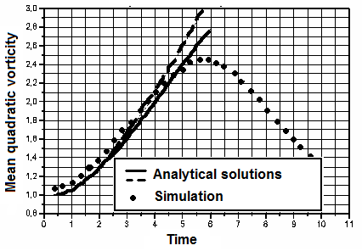
LES simulation of aerosol transport and deposition in turbulent flow in the channel. (Task5)
Check up of model accuracy using Taylor Green vortex decay.
Comparison of numerical solution with analytical one for Taylor-Green vortex problem
The figure shows good agreement between analytical and numerical solutions within initial short period.
8

Slide 10
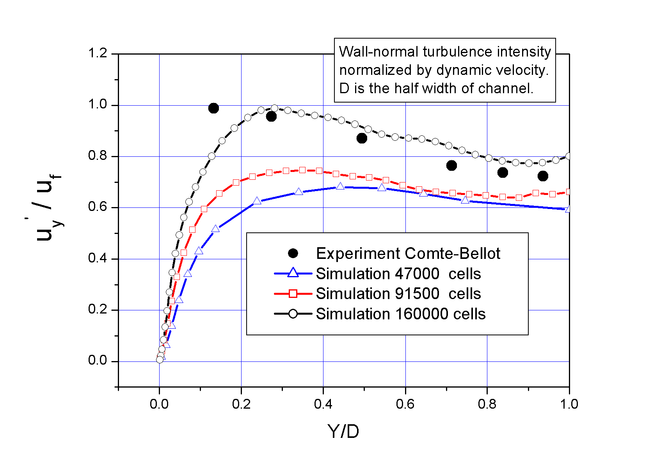
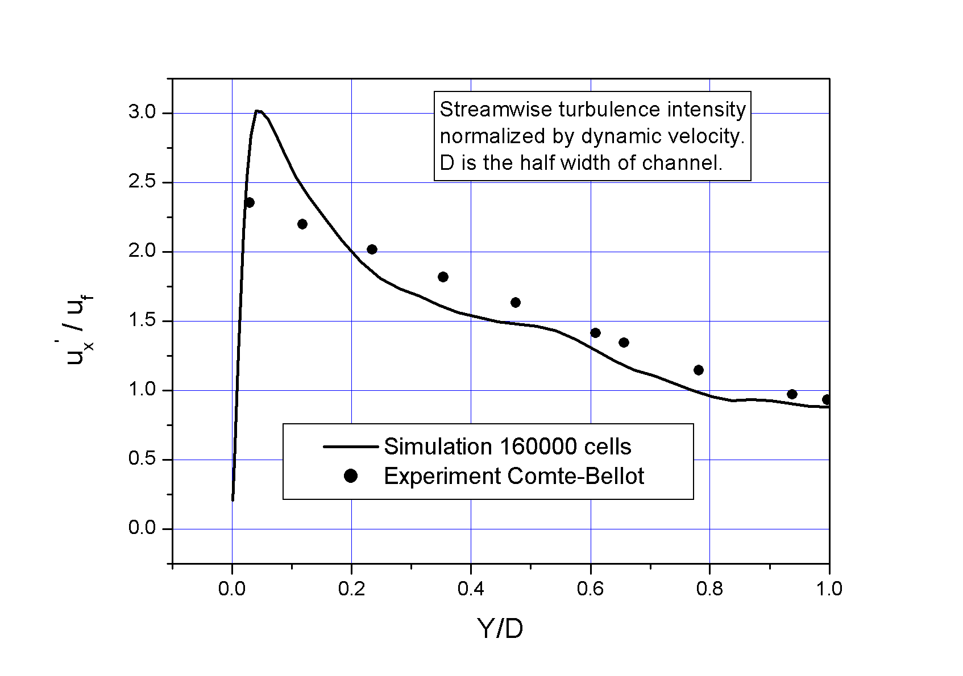
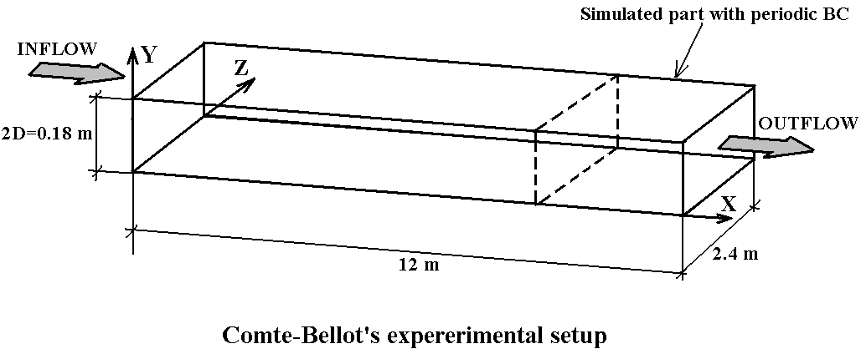
LES simulation of aerosol transport and deposition in turbulent flow in the channel. (Task5)
For validation of a hydrodynamic part of developed code a simulation of turbulent flow in rectangular channel with Reynolds's number 120000 has been carried out.
Conditions of this simulation corresponded Comt-Bellot experiment (Genevieve Comte-Bellot, Ecoulement turbulent entre deux parois paralleles, Paris, 1965)
a)
b)
9

Slide 11
LES simulation of aerosol transport and deposition in turbulent flow in the channel. (Task5)
Simulated vertical component of velocity (color flood)
and vector velocity field in the cross section of the channel (animation).
10

Slide 12
LES simulation of aerosol transport and deposition in turbulent flow in the channel. (Task5)
Simulated vertical component of velocity (color flood)
and vector velocity field in the longitudinal section of the channel (animation).
11

Slide 13
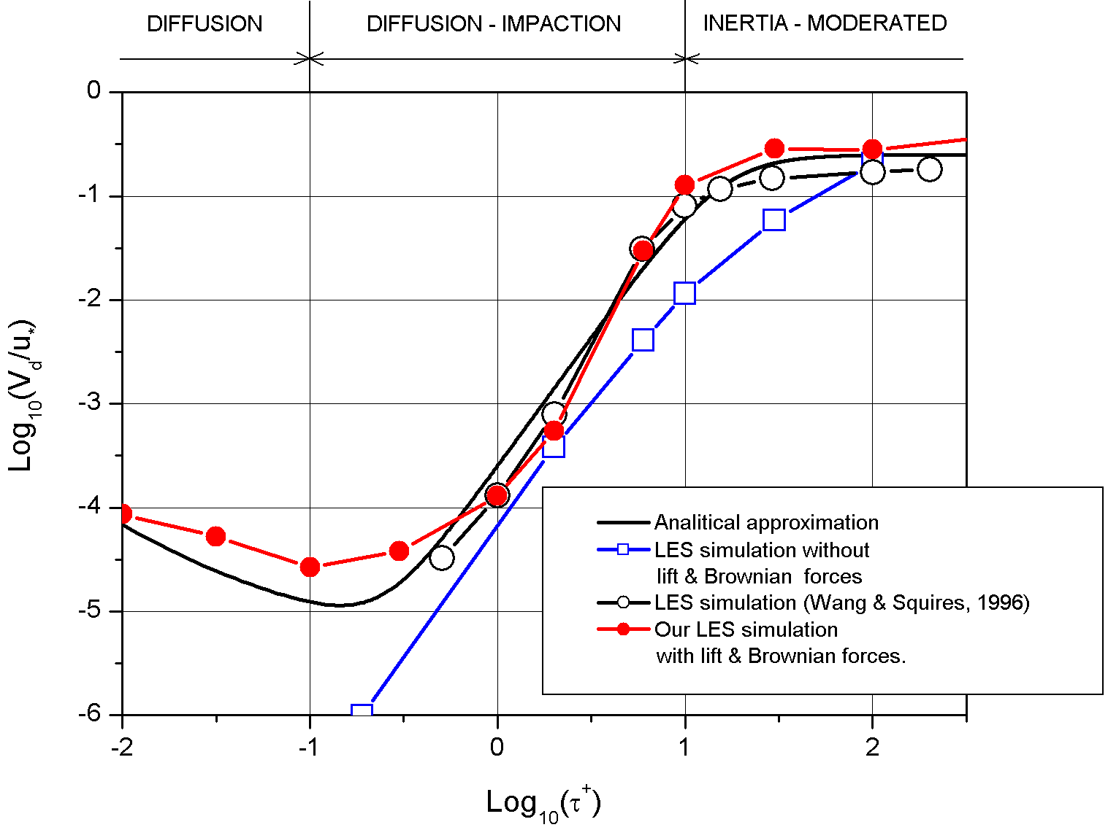
LES simulation of aerosol transport and deposition in turbulent flow in the channel. (Task5)
The next case presents LES simulation of turbulent flow with Reynolds number 3200 in rectangular channel with mono-sized particles motion and their deposition. Number of particles: 260 000 and 5000 000
Boundary conditions: X and Z periodic, Y – no-slip wall.
12

Slide 14
LES simulation of aerosol transport and deposition in turbulent flow in the channel. (Task5)
Particle motion in the longitudinal section (animation)
13

Slide 15
LES simulation of aerosol transport and deposition in turbulent flow in the channel. (Task5)
Particle motion in the cross section (animation)
14

Slide 16
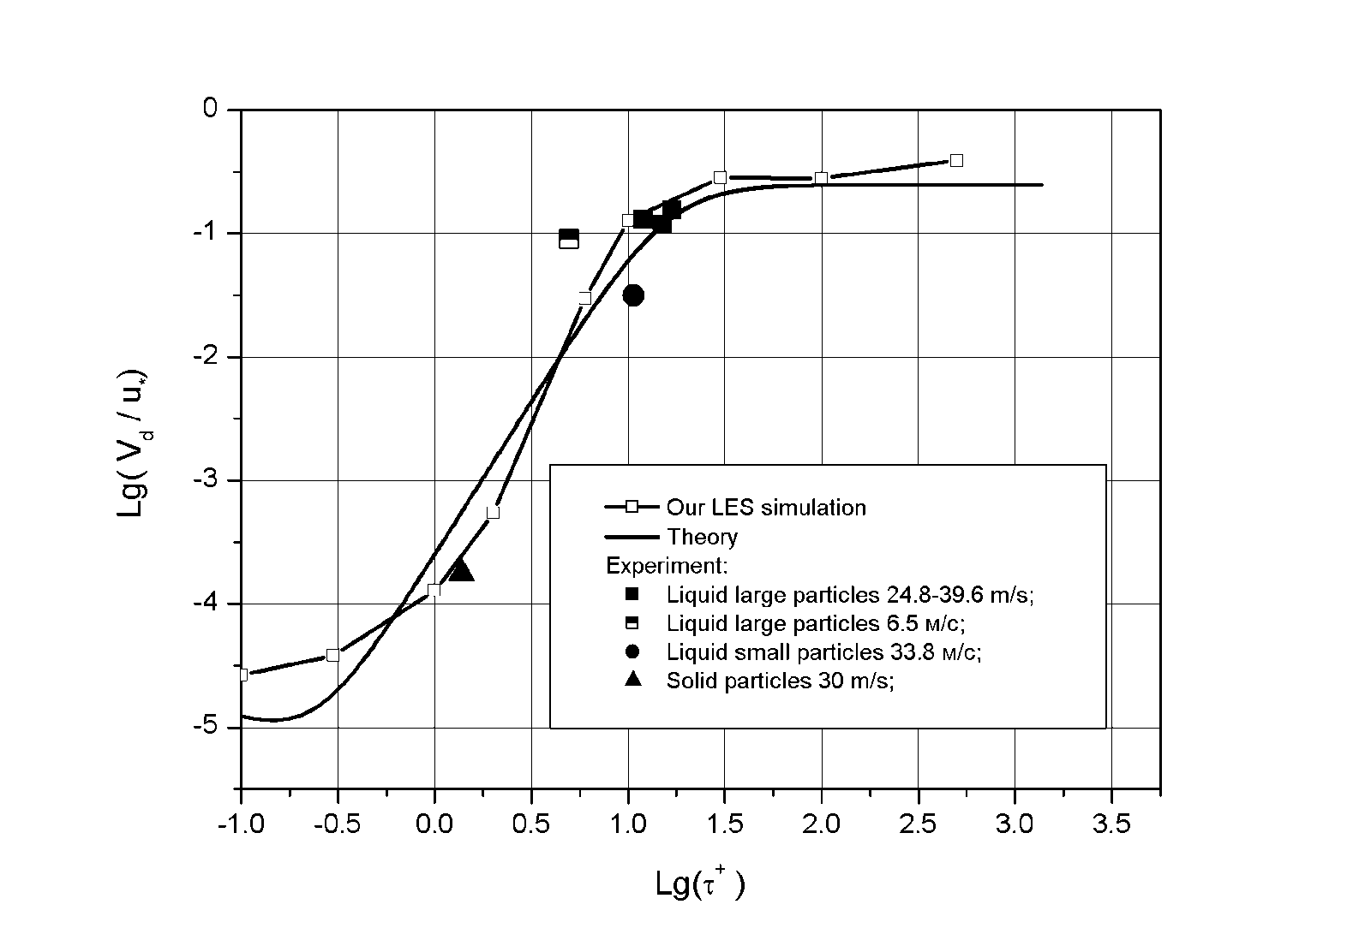
LES simulation of aerosol transport and deposition in turbulent flow in the channel. (Task5)
Comparison with EVAN experimants
15

Slide 17
LES simulation of aerosol transport and deposition in turbulent flow in the channel. (Task5)
Conclusions
Hydrodynamic model and code based on LES model for simulation of turbulent flows in rectangular channels has been developed.
Comparison of experimental and numerical results show satisfactory agreement and confirm code ability to calculate turbulent flows with particles in channels.
Due to small time step caused by strong grid stretching near the wall, total number of time iterations required for achievement of stationary level of turbulence may reach one million and such calculation may take time about a month on PC P4 3 GHz, especially for high Reynolds numbers. Therefore more powerful computers for multiple calculations are needed.
16

