Slide 1

Institute of Physics and Power Engineering
ISTC CEG-CM 5th Meeting
Dr. A. Lukyanov
Determination of parameters of fission product
release from VVER irradiated fuel under
beyond design basis accident conditions
February 9-13, 2004, CEA, Paris, France
Presented by Alexander Lukyanov

Slide 2
Institute of Physics and Power Engineering
Proposal Content

Slide 3
Aerosol’s Terms Definition in Containment Code KUPOL-M
Institute of Physics and Power Engineering
Concentration
Water content
Dustiness

Slide 4
Institute of Physics and Power Engineering
Aerosols Transport Models in Containment Code KUPOL-M

Slide 5
Coagulation Modeling
Institute of Physics and Power Engineering
Line Time
0
3
7

Slide 6
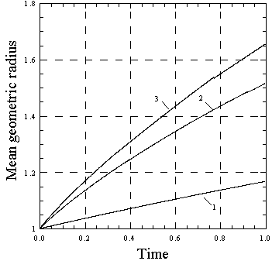
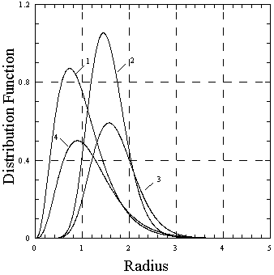
Aerosol Dynamics Modeling
Institute of Physics and Power Engineering
1 - Starting value
2 - Condensation influence
3 - Condensation + coagulation
4 - Coagulation influence
1 - Coagulation influence
2 - Condensation influence
3 - Condensation + coagulation

Slide 7
Aerosol Dynamics Modeling – What is new
Institute of Physics and Power Engineering
Thermohydraulic code itself (KUPOL-M version 1.10) took part in the first stage of the international standard problem on containment thermohydraulics (ISP-47) which was performed during 2002-2003 on the basis of French experiments on TOSQAN and MISTRA facilities in Saclay;
Special procedure of solving integral-differential equation for the dispersed particles distribution function was developed and tested numerically;
Coupling between thermohydraulic KUPOL code and aerosols dynamics model presented was performed giving possibility for tied analysis of the fission products propagation toward and into containment;

Slide 8
What is new – semi empirical model of low-volatile FP release by combination of intra- and inter-granular diffusion:
Institute of Physics and Power Engineering
Gas phase diffusion (accounting porosity of the pellet)
In combination with Si(r) determined by solid state diffusion in the grain

Slide 9
Aerosol Dynamics Modeling – What is new
Institute of Physics and Power Engineering
Some row results of Cs isothermal release

Slide 10
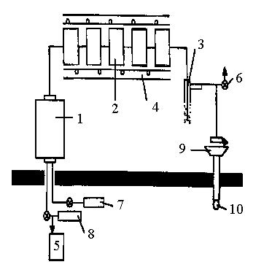
FP Aerosol Source Term Experimental Definition
Institute of Physics and Power Engineering
1 - High temperature furnace
2 - Filters set
3 - Bubble condensor
4 - Heater
5 - Flowmeter
6 - Ventillation
7 - Steam supply
8 - Gas supply
9 - Kr detector
10 - Gas sampler

Slide 11
Institute of Physics and Power Engineering
Source Term Definition for VVER Irradiated Fuel

Slide 12
Institute of Physics and Power Engineering
Conditions Of Performed Experiments With Irradiated Fuel
Nuclide | Fuel Specimen Parameters |  |  | Conditions
 | Mass, g | Burn up, MW*Day/ kg U | Activity, Bc | T, °С | Carrier Gas
Cs-137 | 8 | 23 & 17 | 2.4⋅10⁷÷3.4⋅10⁸ | 900,1000, 1100,1200 | Ar
Cs-137 | 8 | 23 и 17 | 4.0⋅10⁸÷1.6⋅10⁹ | 900,1000, 1100,1200 | Аг - Steam
Cs-137 | 21 | 6.3 и 9.6 | 4.0⋅10⁸÷1.7⋅10⁹ | 1200,1600, 2100 | He
Cs-137 | 24 | 8 и 17.6 | 2.6⋅10⁷÷2.3⋅10⁸ | 1200,1600 | Steam - Ar
Ru-106 | 8 | 23 и 17 | 6.010⁵÷1.210⁶ | 900,1000, 1100,1200 | Ar
Ru-106 | 8 | 23 и 17 | 2.0⋅10⁶÷2.5⋅10⁶ | 1100,1200 | Ar-Steam
Ru-106 | 21 | 6.3 и 9.6 | l.0⋅l0⁴÷5.0⋅10⁴ | 1200,1600, 2100 | He

Slide 13
FP Aerosol Source Term Experimental Definition
Institute of Physics and Power Engineering
What is new:
Comparative measurements in steam containing atmosphere were conducted;
Oxygen partial pressure measurement in inert atmosphere is provided;
Temperature range is to be extended up to 2500 ºC;
Influence of the structure materials in hot zone (Zr, stainless steel) on FP aerosol formation is to be determined.

