Slide 1

Institute of Physics and Power Engineering
ISTC CEG-SAM 6-th Meeting
Determination of parameters of fission product
release from VVER irradiated fuel under
beyond design basis accident conditions
September 14-17, 2004, Dimitrovgrad, Russia
Revised proposal presented by Alexander Lukyanov

Slide 2
Institute of Physics and Power Engineering
Proposal Content

Slide 3
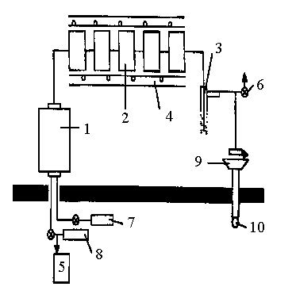
FP Aerosol Source Term Experimental Definition
Institute of Physics and Power Engineering
1 - High temperature furnace
2 - Filters set
3 - Bubble condenser
4 - Heater
5 - Flow meter
6 - Ventilation
7 - Steam supply
8 - Gas supply
9 - Kr detector
10 - Gas sampler

Slide 4
Test Procedure
Institute of Physics and Power Engineering
1 - Specimen preparation:
- γ-scanning
- cutting
- weighing
- dissolution and radiochemical analysis of the witness
- porosity determination by electron microscopy
2 - Heating up in furnace:
- isothermal mode
- controlled rate of the temperature rise
3 - Isotope balance determination (0.1 – 2%)
+ elution of the deposited material from communications
+ bubbler content and gas phase analysis

Slide 5
Institute of Physics and Power Engineering
Source Term Definition for VVER Irradiated Fuel

Slide 6
Institute of Physics and Power Engineering
Conditions Of Performed Experiments With Irradiated Fuel
Nuclide | Fuel Specimen Parameters |  |  | Conditions
 | Mass, g | Burn up, MW*Day/ kg U | Activity, Bq | T, °С | Carrier Gas
Cs-137 | 8 | 23 & 17 | 2.4⋅10⁷÷3.4⋅10⁸ | 900,1000, 1100,1200 | Ar
Cs-137 | 8 | 23 & 17 | 4.0⋅10⁸÷1.6⋅10⁹ | 900,1000, 1100,1200 | Аг - Steam
Cs-137 | 21 | 6.3 & 9.6 | 4.0⋅10⁸÷1.7⋅10⁹ | 1200,1600 | He
Cs-137 | 24 | 8 & 17.6 | 2.6⋅10⁷÷2.3⋅10⁸ | 1200,1600 | Ar - Steam
Ru-106 | 8 | 7 & 23 | 6.010⁵÷1.210⁶ | 900,1000, 1100,1200 | Ar
Ru-106 | 8 | 17 & 23 | 2.0⋅10⁶÷2.5⋅10⁶ | 1100,1200 | Ar-Steam
Ru-106 | 21 | 6.3 & 9.6 | l.0⋅l0⁴÷5.0⋅10⁴ | 1200,1600 | He

Slide 7
FP Aerosol Source Term Experimental Definition
Institute of Physics and Power Engineering
What is new:
Comparative measurements in inetr and steam containing atmosphere were conducted;
Oxygen partial pressure measurement in atmosphere is provided;
Furnace was tested for temperature range 1700 - 2100 ºC;
Influence of the structure materials in hot zone (Zr, stainless steel) on FP aerosol formation is to be determined.

Slide 8
Analytical activity
Institute of Physics and Power Engineering
pretest and posttest simulation by MELCOR code;
- development of FP aerosol formation, transport and depletion models

Slide 9
Expected contribution Expected outcome
Institute of Physics and Power Engineering
extended data base on FP release from VVER fuel
- validation of FP behavior models, implemented in different codes
test matrix specification;
- analytical accompaniment of experimental efforts

