Slide 1
Progress Report on the ISTC project #3592
“Investigation of Corium Melt Interaction with NPP Reactor Vessel Steel”
(METCOR-P)
A.P. Alexandrov Research Institute of Technology (Russia)
Prepared by V. Granovsky and A. Sulatsky
Presented by S. Bechta
18th CEG-SAM meeting
St. Petersburg, Russia
September 28-30, 2010

Slide 2
Contents
Essential information
Objectives of METCOR-P project
Experimental matrix for METCOR-P project
Interaction of the suboxidized molten corium with European vessel steel. Test MCP-5
Oxidation of the uranium-containing metallic melt in steam. Test MCP-6
Oxidation of the suboxidized molten corium in steam. Test MCP-7
Preparation of Test МСР-8 on the interaction of metallic melt with vertical specimen
Planning
Publications

Slide 3
METCOR-P project general information
Investigation of Corium Melt Interaction with NPP
Reactor Vessel Steel (#3592 METCOR-P)
Project participants and coordination
Collaborators
FZK, Germany
FORTUM, Finland
JRC ITU,
EU
CEA,
France
AREVA NP,
Germany
Coordinator
ISTC, Moscow
Steering committee
Operation Agent: A.P. Alexandrov RIT, Russia
SPb Technological University, Russia
SPb Electrotechnical State University, Russia

Slide 4
Objectives of METCOR-P project
Qualification and quantification of physicochemical phenomena of corium melt interaction with reactor vessel steel with particular interest to:
Interaction characteristics at the vertically positioned interface
Peculiarities of interaction with European vessel steel
Corium melt oxidation transients

Slide 5
Experimental matrix for METCOR-P project
*) In accordance with the 1st project meeting decision it is replaced by MCP-2 test with UO_{2+x}– ZrO₂
corium in air and horizontal position of interface
**) In accordance with a decision taken at the 3rd project meeting, the test was performed in air (instead
of steam) and regimes with UO_{2+x} - ZrO₂ - FeO_{y} melt were added
***) MCP-6, 7 test procedure was discussed at the 4th project meeting

Slide 6
Interaction of suboxidized molten corium with European vessel steel
TEST MCP-5
Objectives
Comparison of the corrosion rate and depth for European and Russian vessel steel at its interaction with suboxidized molten corium

Slide 7
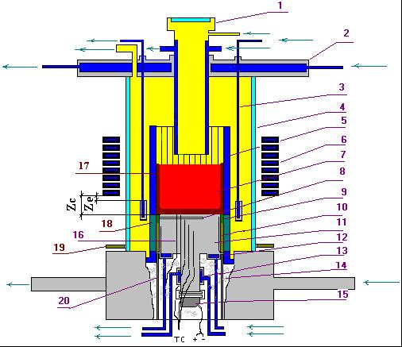
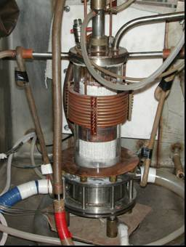
RASPLAV-3 Installation
Furnace schematics
1 –pyrometer shaft; 2 –cover; 3 –electromagnetic screen; 4 – quartz tube; 5 – crucible section;
6 – inductor; 7 –melt; 8 – acoustic defect; 9 – molten ZrO₂; 10 –ZrO₂ powder thermal insulation;
11 – vessel steel specimen; 12 –top calorimeter of the specimen;
13 – bottom calorimeter of the specimen; 14 – kaolin wool insulation; 15 –ultrasonic sensor;
16 –thermocouples; 17 – crust, 18 – electromagnetic screen; 19 – uncooled electromagnetic screen; 20 – cylindrical support of the specimen

Slide 8
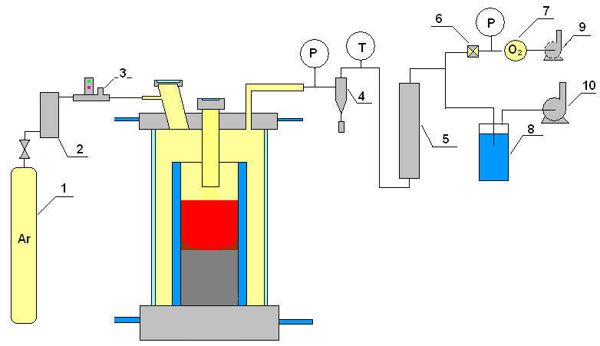
Gas-aerosol system
1 – Ar tank; 2 – silica gel drier; 3 – flow-rate transducer; 4 – cyclone; 5 – LAF filter; 6 – AFA filter;
7 – electrochemical oxygen detector; 8 – hydro lock;
9,10 – vacuum pump

Slide 9
Experimental procedure

Slide 10
Specimen temperatures versus time
Thermocouple readings in the plot are interrupted when a TC breaks down
As the heated top-level TCs break down, the stationary regime is controlled using the
indications of lower and cooler thermocouples

Slide 11
Corrosion depth dynamics
MCP-5
12
10
8
h, mm
6
4
Uncertaint sounding interpretation
2
Uncertaint sounding
interpretation
0
0
10000
20000
30000
40000
50000
Time, s
⎯ – US measurement; • – Post test measurement of specimen section
Long incubation period - approximately 20 000 s
Corrosion decreases as its front progresses into the specimen bulk –
a lower-temperature region
Corrosion process is not finished ?

Slide 12
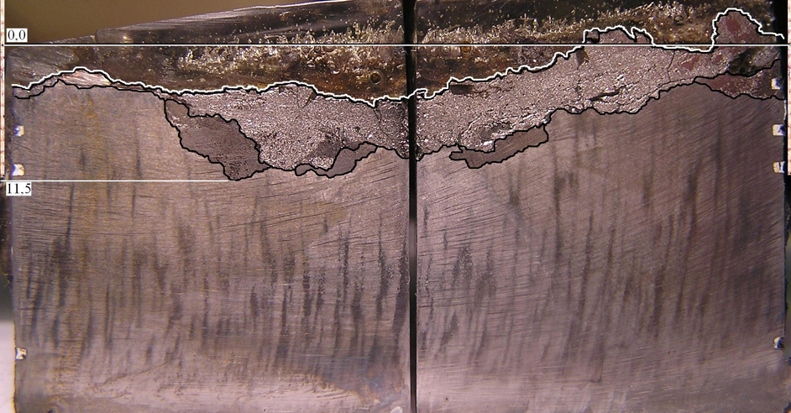
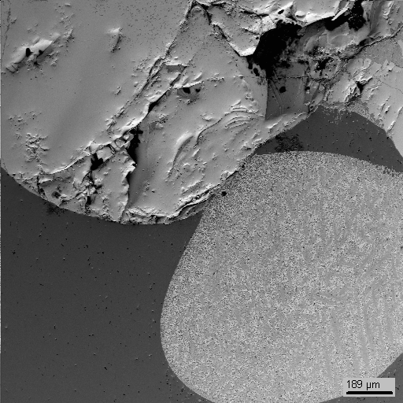
Specimen axial section
SEM/EDX
SQ1
SQ2
mass.%
U – 40; Zr – 16; Fe – 42
U – 38; Zr – 4; Fe – 50
mass.%
The section is perpendicular to the ultrasonic defect axis
Non-even boundary of the interaction zone
2 different structures in the IZ visible at the macrolevel
 | U | Zr | Fe
SQ1 | 34.8 | 1.2 | 53.3
SQ2 | 37.8 | 11.4 | 40.7

Slide 13
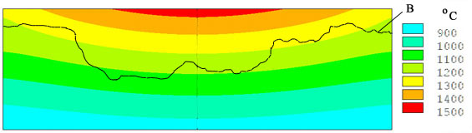
Specimen temperature conditions and IZ final boundary position in the end of the test
Т,ºC
A
h, m
A – initial position of the specimen surface, В – final boundary of the interaction zone
Calculated by the ANSYS code using the measured boundary conditions and temperatures in TC locations
The IZ boundary is located in the 1060 - 1250° C temperature region

Slide 14
Comparison with corrosion of Russian vessel steel
Test | Corium oxidation index, C_{n} | Temperature on the IZ boundary, T_{B}, °C | Mass fraction of the interacting specimen steel, ,% | IZ composition, mass.%
 |  |  |  | U | Zr | Fe
MC6 * | C-30 | 1120…1200 | 4.1 | 25.6 | 5.4 | 64.4
MC7 | C-30 | 1030…1100 | 0.4 | 44.0 | 2.2 | 50.0
MC8 | C-70 | 1200 | 2.9 | 22.0 | 6.1 | 68.2
MC9 * * | C-30 | 1060…1100 | 11.5 | 33.3 | 8.3 | 53.0
MCP-1 * | C-17 | 1000…1090 | 5.9 | 44.4 | 14.0 | 40.0
MCP-5 * * | C-30 | 1060…1250 | 5.6 | 40.0 | 14.0 | 44.0
* - metallic body in the ingot
* * - molten oxidic pool with free surface
The crust-free pool surface guarantees the absence of “hot” metallic liquid in the oxidic liquid due to Fe evaporation
In terms of conditions, the most similar test to МСР- 5 is МС9 (С_{n} and the absence of crust)

Slide 15
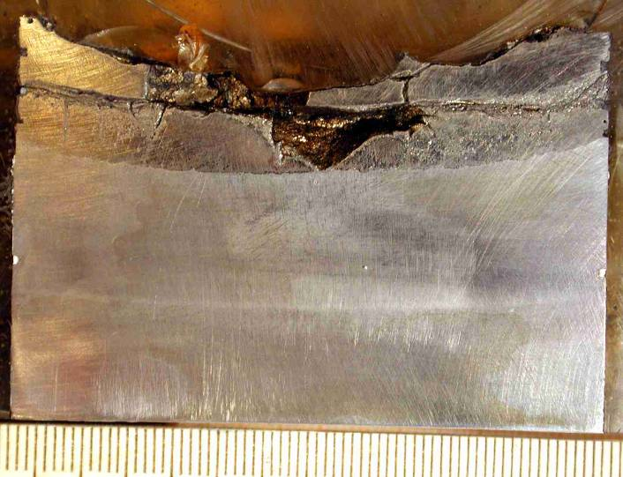
Comparison with corrosion of Russian vessel steel (2)
MCP- 5
MC9
U – 40; Zr – 16; Fe – 42
U – 38; Zr – 4; Fe – 50
mass.%
U – 27.0
Zr – 11.0
Fe – 56.0
U – 39.5
Zr – 5.4
Fe – 50.0
Temperature at the specimen upper top
Т, °С
mass %
R, mm

Slide 16
Comparison with corrosion of Russian vessel steel (3)
 | MCP-5 | MC9
IZ structure | 2-layer, no uniform | 2-layer, ordered
Corrosion depth along the specimen axis, mm | 10 | 15
 | Consequences of differences in the specimen temperature condition
Fe fraction in IZ, mass. % | 44 | 53
 | Consequences of different mass of dissolved Fe
Temperature at the final IZ boundary, °C | 1060…1250 | 1060…1100
 | Consequence of no process saturation?
Incubation time, s | 20000 | 600
 | Metal melt in the pool bottom layer in MC9

Slide 17
Comparison with corrosion of Russian vessel steel (6)
Correlations for corrosion rates
Russian steel ( generalization of 4 tests)
European steel (1 test)

Slide 18
Conclusions
Qualitative and partially quantitative agreement in corrosion results for the European and Russian vessel steels at the interaction with suboxidized molten corium
The irregular structure of IZ and the large scattering of the final temperature of the IZ boundary may be due to the lack of process saturation
A single test wit the European steel is insufficient for a more comprehensive analysis and model development

Slide 19
Oxidation of the uranium-containing metallic melt in steam. Test MCP-6
Objectives
Study of oxidation kinetics of the U- and Zr- containing metallic melt through the oxidic surface crust after neutral atmosphere replacement by steam

Slide 20
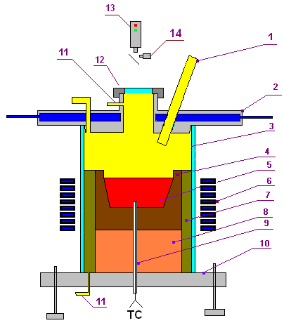
Furnace schematics
Crucible (4) was made of ZrO₂ concrete
To prevent melt oxidation through crucible walls, its outer surfaces were coated with alumosilicate binder with ZrO₂ filling.
The crucible outer surface was separated from the water-cooled inductor with thermal insulation (7)
To reduce steam condensation on the water-cooled furnace cover (2), its thickness was increased
The molten pool surface was located at the crucible upper top
The furnace volume including thermal insulation (7) was separated from the ambient atmosphere with quartz tube (3)
1 – two ports of corrosion-resistant tube: for steam supply and for the introduction of W/Re thermocouple in a tungsten sheath; 2 – water-cooled furnace cover; 3 – quartz tube; 4 – crucible made of ZrO₂ concrete; 5 – metallic melt; 6 – inductor; 7 – thermal insulation; 8 – lightweight bottom; 9 – two W/Re thermocouples in the ZrO₂ sheath; 10 – corrosion-resistant bottom; 11 – Ar supply port; 12 – lid of monitoring window; 13 – pyrometer; 14 – video camera

Slide 21
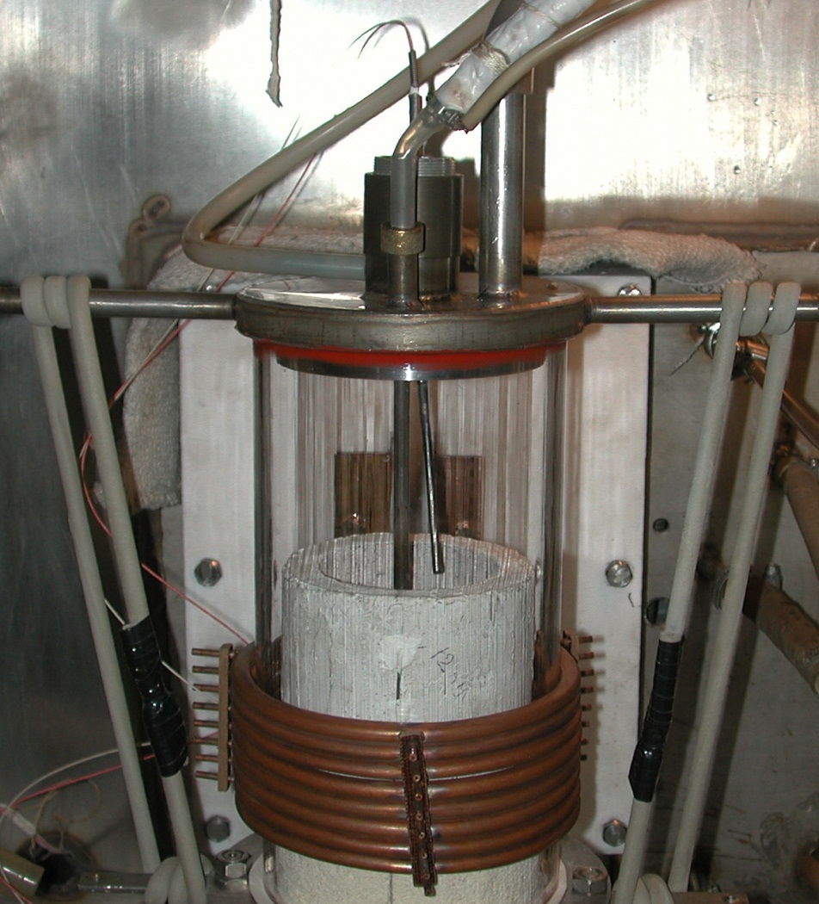
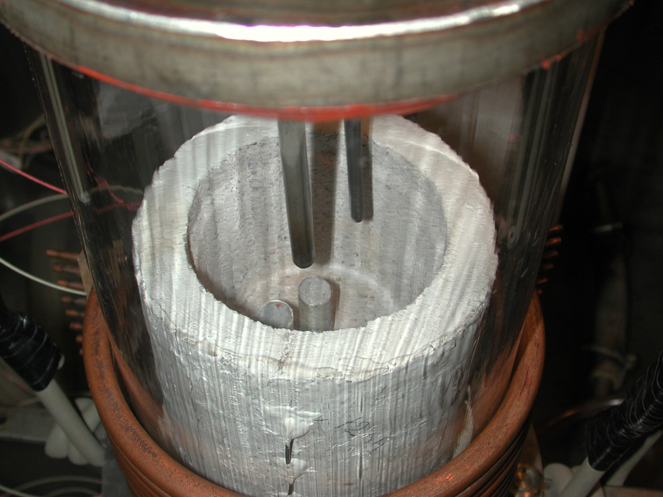
Furnace schematics (2)
Pt/PtRh thermocouple in alumina sheath
Steam supply
Steam supply
Pt/PtRh thermocouple in alumina sheath
2 W/Re thermocouples in the ZrO₂ sheath
Alumosilicate coating with ZrO₂ filling
2 W/Re thermocouples in the ZrO₂ sheath
Ar supply line

Slide 22
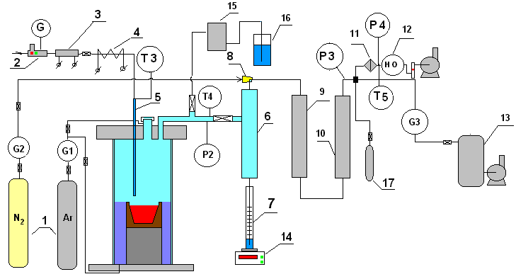
Gas-aerosol sampling system
1 – Ar, N₂ tanks; 2 – water regulator – flow rate meter to the direct-flow steam generator; 3 – direct-flow once-through steam generator; 4 – heated steam supply line; 5 – corrosion-resistant tube of steam supply into the furnace; 6 – steam condenser; 7 – condensate collector; 8 – ejector; 9 – large-area filter (LAF); 10 – silica gel dehumidifier; 11 – Petrianov filter (AFA); 12 – electrochemical sensors of O₂ and H₂; 13 – vacuum receiver; 14 – tensiometric weight sensor; 15 – medium-area filter (MAF); 16 – hydrolock

Slide 23
Crucible charge
Component | Mass, g
SS: 08Kh18N10T | 1475
U | 487
Zr | 324
Total mass | 2286

Slide 24
Experimental procedure
1. 0…560 s – furnace deoxygenation by argon
2. 560…6550 s – smooth heating up, charge melting, melt heating up to ≈1500°C
3. 6550…6800 s – Addition of metallic zirconium into the melt followed by the melt exposure, monitoring of the melt temperature condition
4. 6800…9700 s –cleaning of the melt surface from crust
5. 9700 s – steam supply into the furnace at 103 g H₂O/hr, start of melt
oxidation (melt temperature within 1380 – 1580°C), steam-gas mixture sampling into vacuum burettes
6. 9900 s – crust surface temperature measurement by the Pt/PtRh thermocouple
7. 10696 s – registration of the beginning of condensate accumulation in the collector
8. 16200 s – an increase in steam flow rate up to 197 g H₂O/hr
9. 20037 s – steam supply replacement by argon
10. 22036 s – HF heating disconnection after the concrete crucible drying

Slide 25
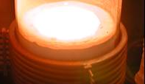
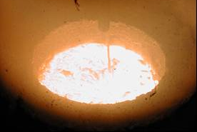
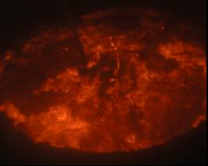
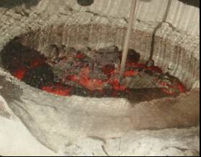
Surface view during the test
Molten pool preparation, 5000 s
Beginning of the oxidation, 10000 s
Thick crust with cracks, 20000 s
Melt crystallization, 25000 s

Slide 26
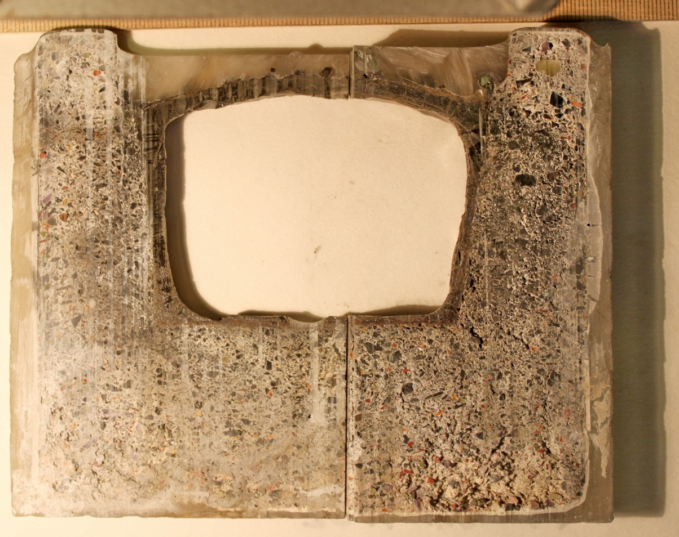
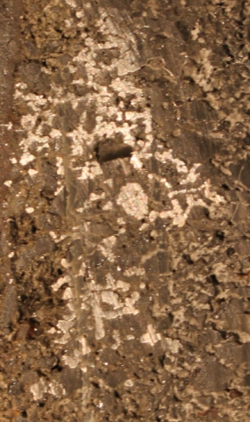
Post-test analysis (in progress)
Crucible and oxidic crusts cross-section
No visible crucible walls erosion
Crust thickness:
upper surface – 5…6 mm,
lateral – 3…4 mm,
bottom – about 2 mm
Metallic inclusions in crucible walls
Metallic inclusions

Slide 27
Post-test analysis (2)
Beginning of steam supply
Increase in steam consumption
Steam supply termination
Steam absorption calculated from steam/condensate balance
Oxidation of the melt by steam can be fairly well approximated by the linear interpolation with the steam absorption rate which equals
23 (±3) mg H₂O/s
Some decrease in the oxidation rate was observed at the beginning of steam supply (until 16200 s) when the oxidic crust growth occurred

Slide 28
Primary Conclusions
Even in the relatively small scale experiments the oxide crust on the metal melt surface is found to be broken
Linear dependence of absorbed steam mass (oxide crust thickness) versus time can be explained by:
Steam starvation regime (absorption of all steam and evacuation of all hydrogen from the crust surface) in the test conditions
Lack of crust integrity

Slide 29
Oxidation of suboxidized corium melt in steam. Test MCP-7
Objectives
Study of oxidation kinetics of the suboxidized molten pool through surface oxidic crust after neutral atmosphere replacement by steam

Slide 30
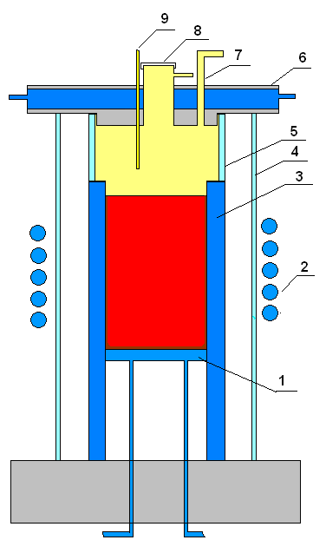
Furnace schematics
Measures to reduce steam condensation:
rise of melt surface to the crucible top
separation of above-melt volume from the furnace volume by quartz tube (5)
seal of the gaps between cold crucible tubes
increase of thickness of water-cooled furnace cover (6)
To suppress meniscus the melt surface was moved above the top inductor
To form the oxidic crust the melt surface temperature was reduced
1 – water-cooled bottom calorimeter; 2 – inductor; 3 –water-cooled crucible; 4 – quartz tube; 5 – quartz ring; 6 – water-cooled furnace cover with down-looking hot surface; 7 – gas-aerosol out; 8 –observation port; 9 – steam supply pipe

Slide 31
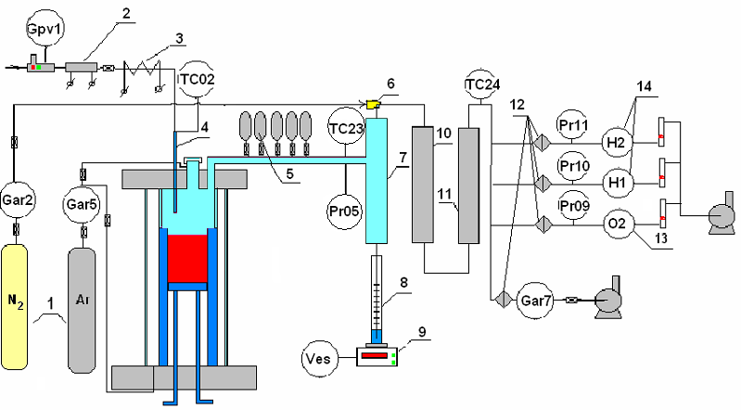
Gas-aerosol sampling system
1 –Ar, N₂ tanks; 2 – direct-flow once-through steam generator; 3 – heated steam supply line; 4 – stainless steam supply pipe; 5 – vacuum burettes; 6 – ejector; 7 – steam condenser; 8 – condensate collector; 9 – tensiometric weight sensor; 10 – large-area filter (LAF); 11 – silicagel dehumidifier; 12 –Petrianov filter (AFA); 13–14 electrochemical sensors of oxygen and hydrogen

Slide 32
Crucible charge
Component | Mass, g
UO₂ | 772.5
ZrO₂ | 94.0
Zr | 147.9
Total mass | 1014.4
C-32, U/Zr = 1.2

Slide 33
Experimental procedure
1. 0…190 s – furnace deoxygenation by argon
2. 190… 3586 s – gradual heating, charge melts, the pool is formed
3. 3586…4500 s – crust is formed on the surface, its temperature is 2030°C
4. 4500 s – steam is supplied into the furnace at the flow-rate of 59.2 g H₂O/hr; melt oxidation starts. Steam-gas mixture is sampled into vacuum burettes.
5. 4800 s – readings of hydrogen sensor gradually go up
6. ≈5000 s – readings of condensate weight sensor go up
7. 4998, 5236, 5296, 5395, 5521, 5811 s – flow-rate of carrier gas is adjusted
8. 5911…7860 s – carrier gas flow-rate is steady, at this H₂ concentration in furnace gases shows instability; cracks on the oxidic crust surface appear and disappear
9. 7900…8319 s – sharp increase in H₂ concentration followed by the carrier gas regulation
10. 8134…8507 s – decrease of H₂ content in furnace gases
11. 8935 s – sharp increase of H₂ content accompanied by the observed crust bulging and crumbling
12. 9042 s – steam supply is replaced by argon
13. 9479 s – HF heating is disconnected, ingot is frozen.

Slide 34
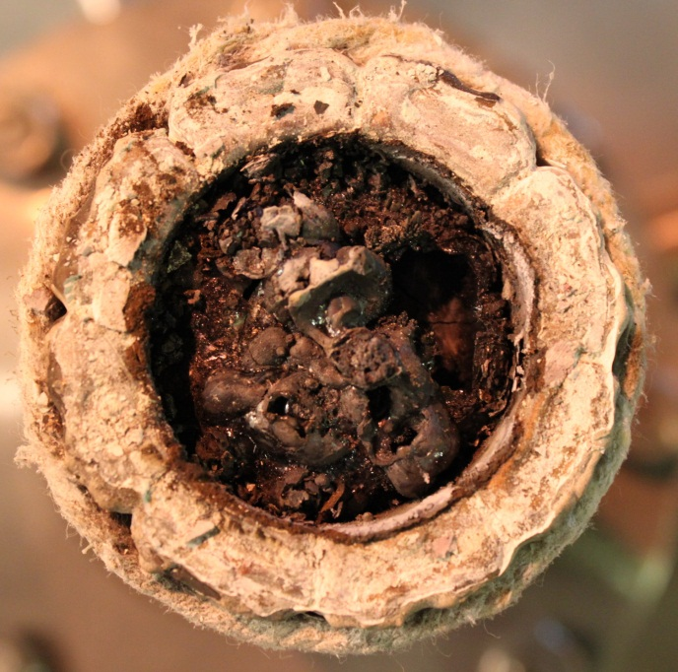
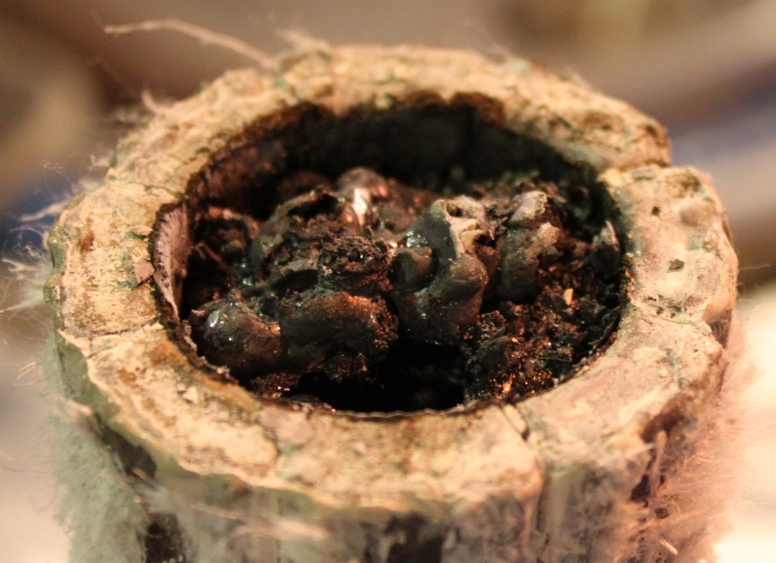
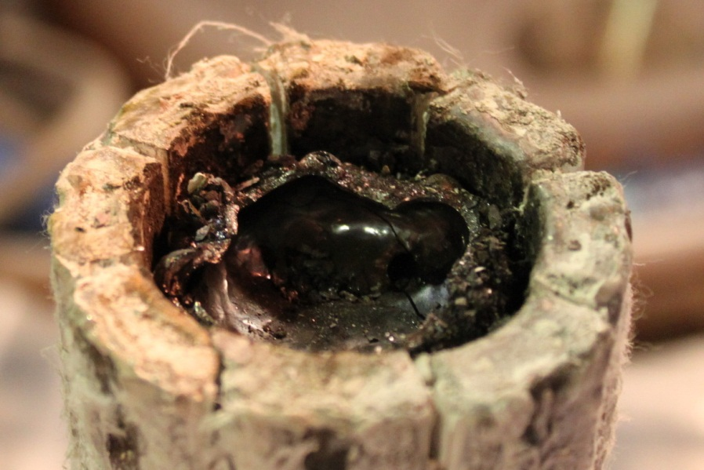
Crust surface after experiment
Crust irregularity, its mechanical weakness, melt ejections and spillages observed during the test, as well as its bulging, testify to a large number of pores and cracks in the crust, i.e. to its permeability

Slide 35
Post-test analysis (3)
Steam supply started
Steam supply stopped
Melt oxidation by steam is rather well approximated by the linear interpolation with the steam absorption rate equal to
11 (±1) mg H₂O/s

Slide 36
Primary Conclusions
Kinetics of suboxidized corium melt oxidation by steam through the crust is described by the linear law with the steam absorption rate of 11 (±1) mg H₂O/s
Constant oxidation rate, in spite of the growing crust thickness, testifies:
oxidant starvation regime in the test conditions
influence of crust cracking
Formation of cupola-shape crust with the gap between the crust and the melt surface can be explained by mechanical loads from the forming crystallites or/and gas (hydrogen?) release from the melt surface

Slide 37
Preparation of Test МСР-8 on the interaction of metallic melt with vertical specimen

Slide 38
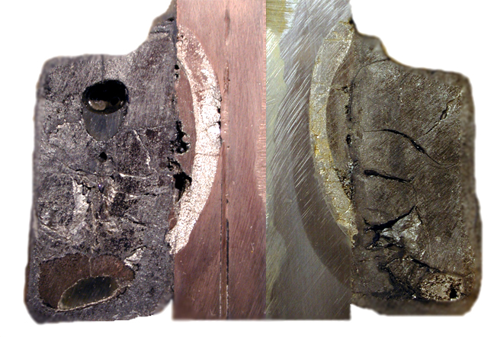
Test MCP-1
Test MCP-1 (2007): Study of vessel steel corrosion at its interaction with molten suboxidized corium
Main MCP-1 differences from the tests with horizontal interaction interface (prototype test of MC6):
Considerably shorter incubation period (or completely absent)
Different structure and composition of the interaction zone
Unaffected steel
Thermal impact zone
Interaction zone I
Interaction zone II
Metallic inclusion in the ingot - ring
Main problem during MCP-1 and posttest processing of its results: No data on steel corrosion kinetics during the test

Slide 39
Objectives of test MCP-8
Determine corrosion kinetics of vertically positioned vessel steel specimen at its interaction with Fe-Zr-U melt
Method for determining kinetics:
On-line US monitoring of steel corrosion

Slide 40
Objectives of pretest Pr1-MCP-8
Check the efficiency of the vertical specimen cooling systems and US monitoring
Controlled conditions and parameters:
no DNB water cooling in the central channel of the
specimen
depth of ablation/melting of the outer specimen surface

Slide 41
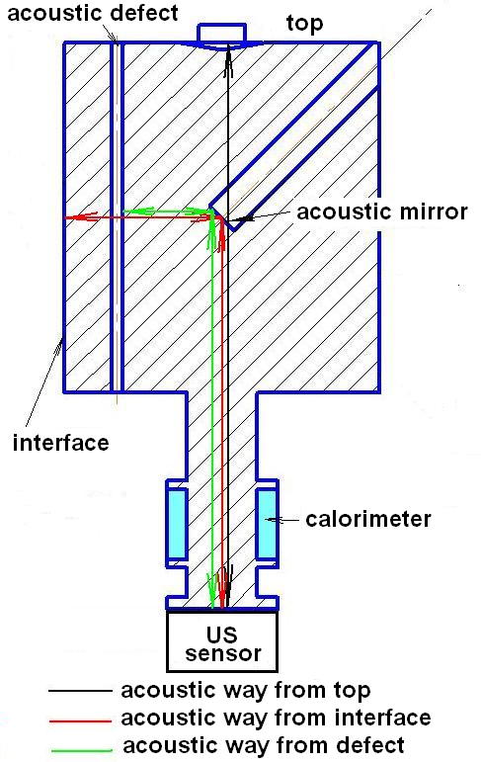
Principle of US monitoring

Slide 42
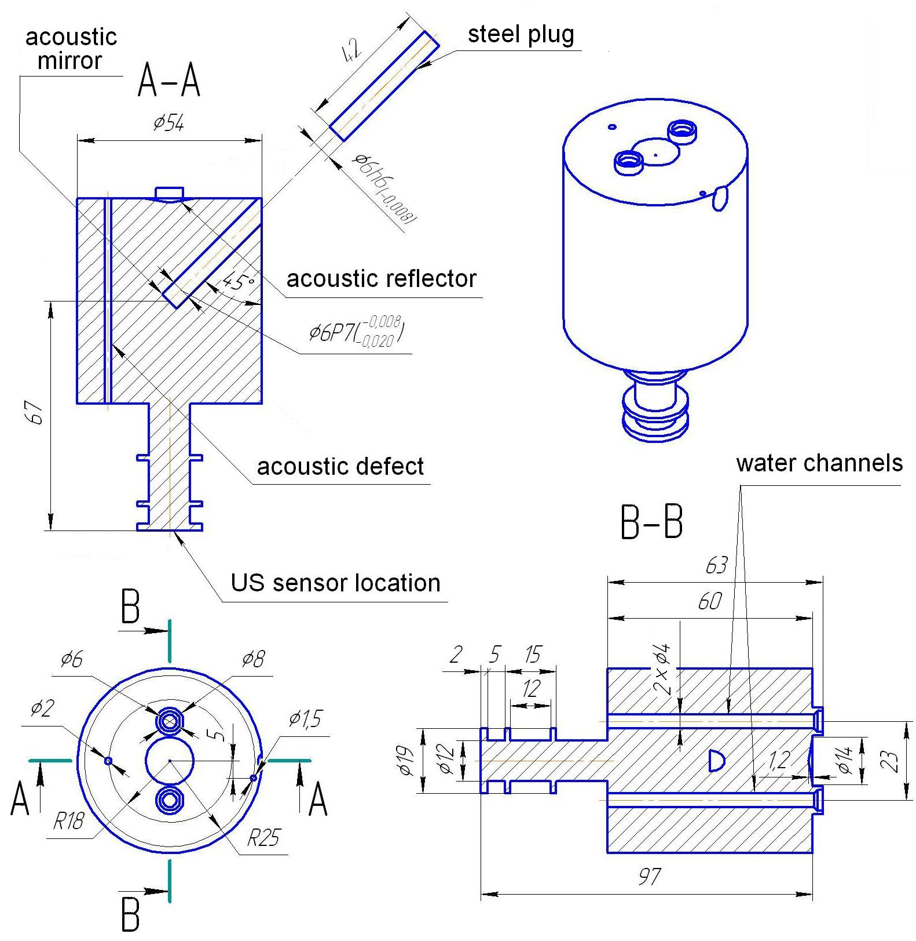
Specimen schematics

Slide 43
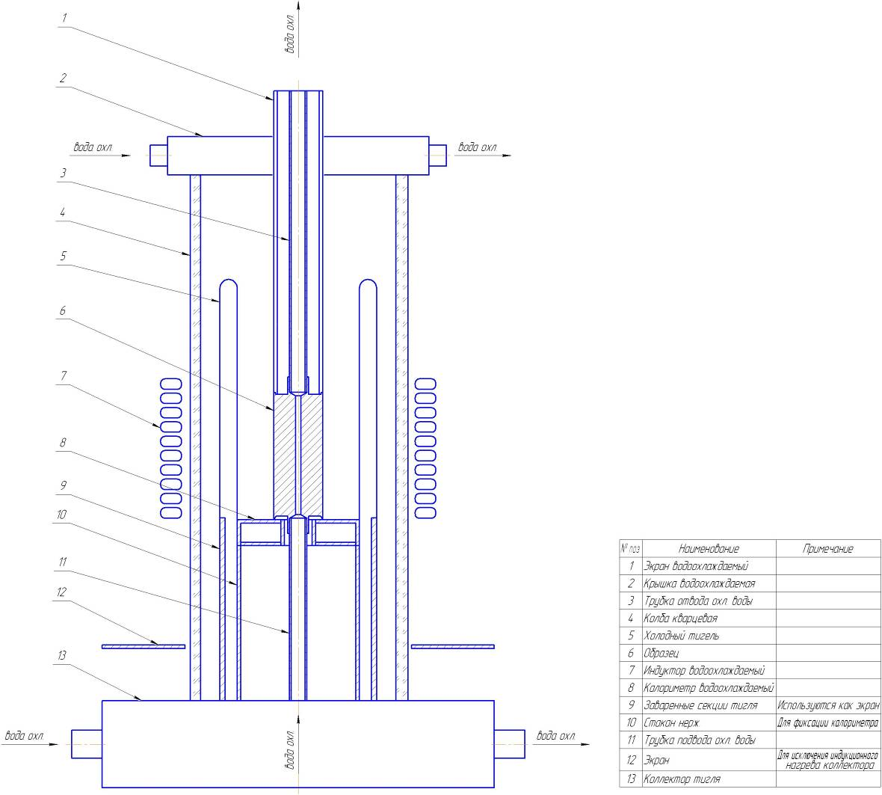
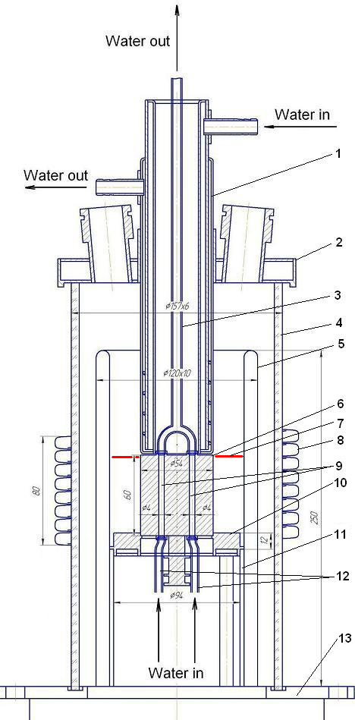
Furnace schematics
water
1 – water cooled
screen
2 – water cooled cover
3 – water-off pipe
4 – quartz tube
5 – crucible sections
6 – specimen
7 – melt surface position
8 – inductor
9 – two cooling channels
10 – bottom calorimeter
11 – CC holder
12 – water supply pipes
13 – furnace basis
water
water
water
water
water

Slide 44
Modeling of specimen cooling
Approximations:
stationary conditions
2D geometry (radius and azimuth angle) with uniform
distribution of heat flux on specimen surface
temperature dependence of vessel steel heat conductivity
CHF Lookup Table of Groeneveld & Kirillov (1997)
Evaluated parameters:
specimen diameter – 54 mm
diameter of water channels – 4 mm
length of specimen – 60 mm
water volumetric rate – 2.8 m³/hr (velocity ≈ 31 m/s)
outlet water pressure – 1 bar
inlet water temperature – 20°C
maximum surface temperature – 1400°C
temperature of surface of water channels – 100°C

Slide 45
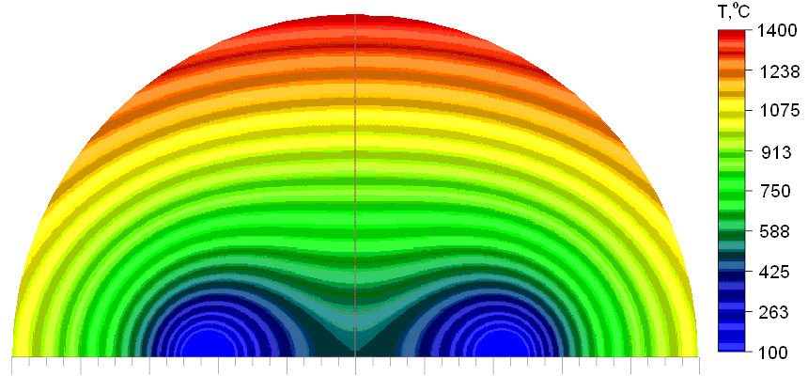
Modeling of Specimen Cooling (2)
Calculation results:
outlet water temperature – 23°C
power extracted from the specimen – 9.9 kW
heat flux on external surface of specimen opposite acoustic mirror
– 0.97 MW/m²
maximum heat flux at the surfaces of water channels – 7.4 MW/m²
DNB margin > 1.6
N.b.!
Uneven temperature field explained by the peculiarities of the cooling system provokes faster ablation right across the acoustic mirror

Slide 46
Pr1-MCP-8 results
Power extracted from the specimen
Start of specimen ablation in accordance with post-test processing of the US monitoring data
Beginning of distinctly observed specimen melting
Heating disconnection
Maximum power into
the specimen:
12.2 kW
Average heat flux:
1.20 MW/m²
No DNB indications

Slide 47
Pr1-MCP-8 results (2)
TC readings
Specimen ablation start in accordance with post-test processing of US monitoring data
Observed beginning of specimen melting
Heating disconnection

Slide 48
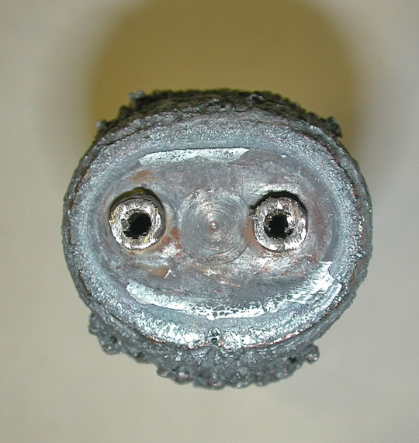
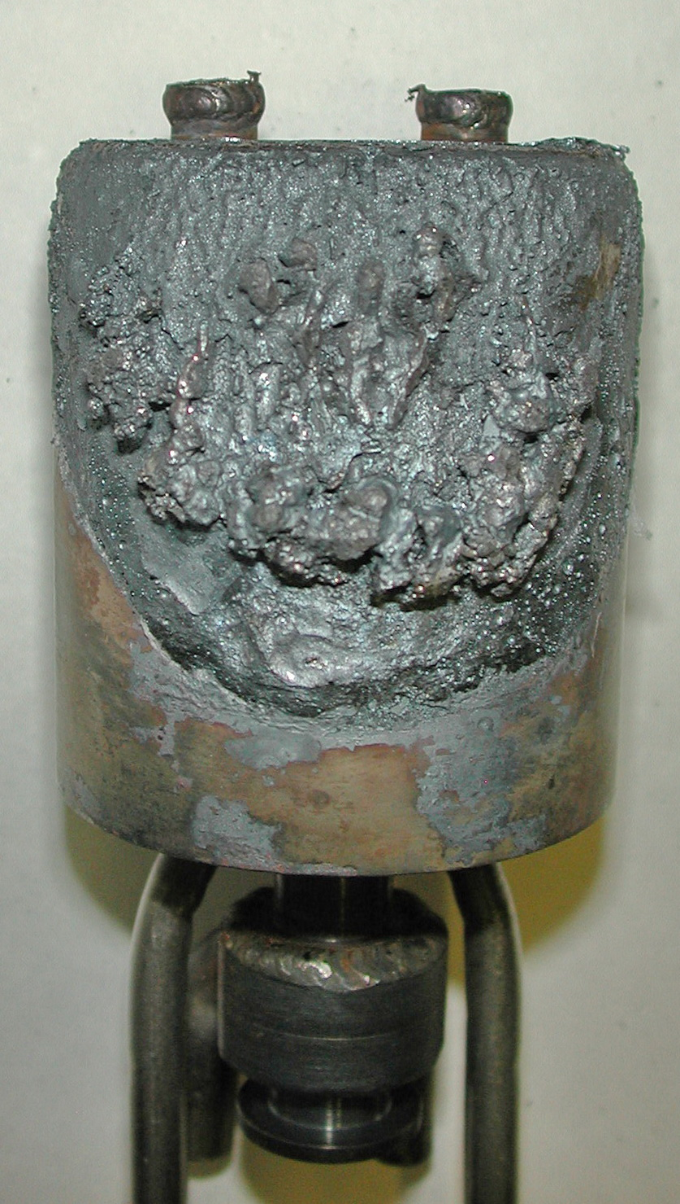
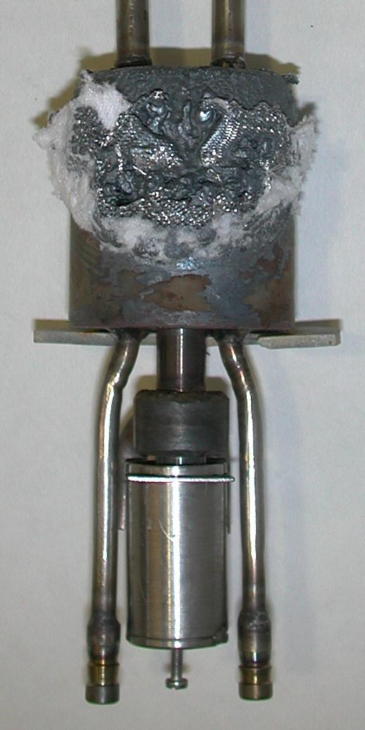
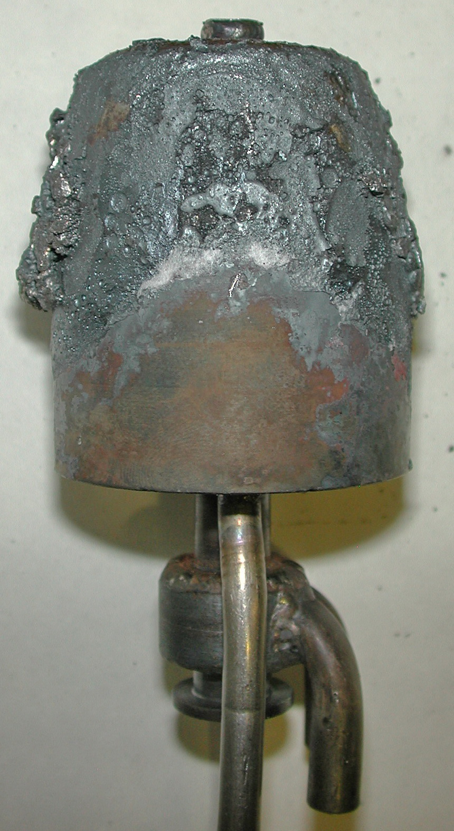
Pr1-MCP-8 results (3)
Specimen view after the pretest
Acoustic defect
Zone of US monitoring
Water supply pipes
US sensor

Slide 49
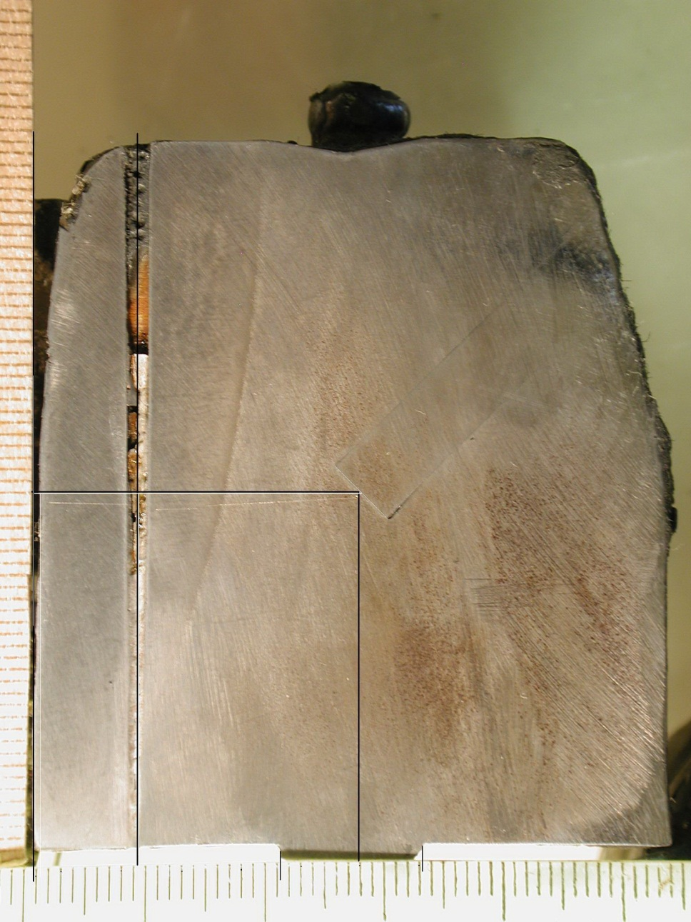
Pr1-MCP-8 results (4)
View of specimen axial section
Acoustic defect
Acoustic mirror
Boundary of thermal influence (≈730°C)
Molten layer is removed!
Acoustic way
≈ 0.9 mm

Slide 50
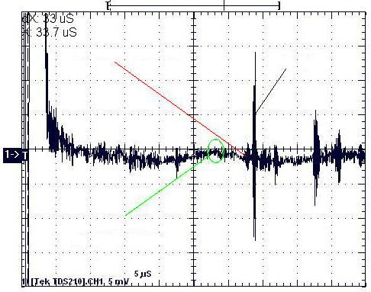
Pr1-MCP-8 results (5)
US monitoring of ablation
Signal from
interface
Signal from
top edge
Signal from
defect
Wanted signal reflected from the interface surface is several times weaker than the signal reflected from the specimen top edge
Signal from the defect is barely detectable above the level of noise
Explanation: double sound transfer through the small acoustic mirror

Slide 51
Pr1-MCP-8 results (6)
Ablation depth
Specimen ablation start in accordance with post-test processing of US monitoring data
Inleakage of molten metal from the specimen top
Ablation:
0.9…1.0 mm
In the post-test
processing of the US data
only the signal from
the interaction interface
was used. Signal from
acoustic defect was not
used due to its
weakness
Start of the distinctly observed specimen melting
Heating disconnection

Slide 52
Pr1-MCP-8 results (7)
DNB margin and efficiency of specimen cooling are experimentally confirmed
Maximum corrosion in the experiment is expected in the US monitoring zone
The US monitoring system efficiency is demonstrated, though its sensitivity is lower than for specimens with horizontal orientation of the interface

Slide 53
Conclusions
Designs for steel specimens with a vertical interface orientation is developed
The efficiency of cooling system and US monitoring is experimentally proven
Preparation of MCP-8 has been completed. The test will be conducted soon

Slide 54
Planning
According to the Experimental Matrix of the Project, 1 more test is to be performed
Due to a delay in Project implementation a 6-month project time extension without additional funding has been approved by the ISTC

Slide 55
METCOR-P project reporting
First three reports have been sent to ITU under export control conditions

Slide 56
Publications during METCOR-P
Bechta S.V., Granovsky V.S., Khabensky V.B., Krushinov E.V., Vitol S.A., Sulatsky A.A., Gusarov V.V., Almjashev V.I., Lopukh D.B., Bottomley D., Fischer M., Piluso P., Miassoedov A., Tromm W., Altstadt E., Fichot F., Kymalainen O. Interaction between Molten Corium UO_{2+x}-ZrO₂-FeO_{y} and VVER Vessel Steel // Proceeding of ICAPP’08, Anaheim, CA USA, June 8-12, 2008, Paper 8052.
Bechta S.V., Granovsky V.S., Khabensky V.B., Krushinov E.V., Vitol S.A., Sulatsky A.A., Gusarov V.V., Almjashev V.I., Mezentseva L.P., Krushinov E.V., Kotova S.Yu., Kosarevsky R.A., Barrachin M., Bottomley D., Fischer M., Fichot F. Corium Phase Equilibria from MASCA, METCOR and CORPHAD Results // Nucl. Eng. and Design, 238, p. 2761-2771 (2008).
Bechta S.V., Granovsky V.S., Khabensky V.B., Krushinov E.V., Vitol S.A., Sulatsky A.A., Gusarov V.V., Almjashev V.I., Lopukh D.B., Bottomley D., Fischer M., Piluso P., Miassoedov A., Tromm W., Altstadt E., Fichot F., Kymalainen O. VVER Vessel Steel Corrosion at Interaction with Molten Corium in Oxidizing Atmosphere // Nucl. Eng. and Design, 239 (2009),
p. 1103-1112.

Slide 57
Publications during METCOR-P (2)
4. Bechta S.V., Granovsky V.S., Khabensky V.B. et.al. VVER Steel Corrosion during In-Vessel Retention of Corium Melt // Proceeding of the 3rd European Review Meeting on Severe Accident Research (ERMSAR 2008), Paper 2.7, Nesseber, Bulgaria, September 23-25 (2008).
Bechta S.V., Granovsky V.S., Khabensky V.B. et.al. Interaction between Molten Corium UO_{2+x}-ZrO₂-FeO_{y} and VVER Vessel Steel // J. Nucl. Technology, Vol. 170, №1 (2010), p. 210-218.
Bechta S.V., Granovsky V.S., Khabensky V.B. et.al. The influence of thermogradient conditions on physicochemical interaction of the suboxidized molten corium with steel during in-vessel retention of the melt. (Russian version).

