Slide 1


Presentation of SAMARA Project
A.Kiselev, T.Yudina
(IBRAE RAN)
Presented by S.Guentay (PSI)
20th Meeting of Contact Expert Group
on Severe Accident Management (CEG-SAM),
11 -12 October 2011, Moscow

Slide 2
ERCOSAM-SAMARA
ROSATOM-EURATOM cooperation: high priority for the Projects “Containment thermal hydraulics of current and future LWRs for severe accident management”
European ERCOSAM (partially funded by EURATOM) and Russian SAMARA (funded by ROSATOM) - parallel running coordinated Projects
SAMARA Project have been launched on January 15, 2010
Coordination agreement (July 1, 2010) establish links between the Projects → basis for information exchange, common Workprogramme
Participants:
  ERCOSAM project : PSI (Switzerland) – the project coordinator, IRSN (France), CEA (France), KIT (Germany), NRG (Netherlands), AECL (Canada)
  SAMARA project: IBRAE RAN – the project coordinator, SSC RF-IPPE (Russia)
Fukushima Daiichi NPP accident impact: 3 new comers:
  ERCOSAM project - FZJ (Germany), NRC (USA)
  SAMARA project: JSC “Afrikantov OKBM” (Russia)

Slide 3
The objectives of the Projects
generation of high quality database on the physical phenomena occurring in the containment of light water reactors during postulated accident sequences involving SAM operation (spray, cooler, PAR) for CFD and lumped parameter codes
code verification and demonstration of predictive capability of state-of-the-art analytical tools (both LP and CFD codes)

Slide 4
Activities in framework of SAMARA Project
Analysis of VVER severe accidents; scaling down analysis from the plant to facilities; development of initial and boundary conditions for SAMARA tests (WP1, 2010-2011)
Planning, pre- and post-test calculations (WP2, 2011-2012)
Experimental and benchmarking tests (WP3, 2012-2013)
Synthesis of experimental and analytical work: phenomenology and codes (3D, CFD and LP) capabilities (WP4, 2013-2014)
Notes:
Курсивом выделены новые участники (new comers), изъявившие желание участвовать. Соглашение с ними пока не подписано.

Slide 5
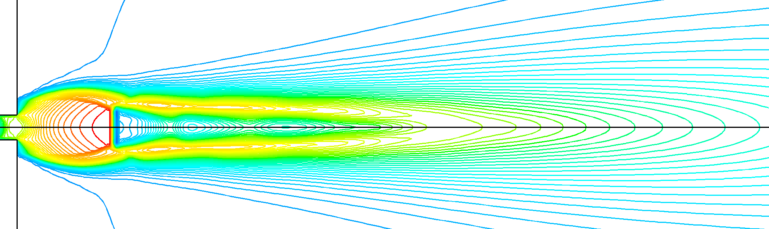
Performed activities within WP1
Numerical analysis of severe SBLOCAs which constitutes the highest contribution to the core damage frequency at VVER-1000 NPP with SOCRAT/KUPOL code
Analysis of impact of accident mitigation measures and recombiner operation
Determination of the reference VVER-1000 plant conditions (were provided to ERCOSAM partners to develop generic containment (GC) and generic conditions)
Calculations of parameters of supersonic underexpanded jet at a sonic section during steam and hydrogen high pressure release into the containment with FLUENT code (were provided to ERCOSAM partners for coupled calculations by IRSN-IBRAE-KIT to estimate of stratification stability criteria for GC)
Determination of initial and boundary conditions for the tests at HYMIX ant SPOT facilities
Initial phase of steam hight pressure release

Slide 6
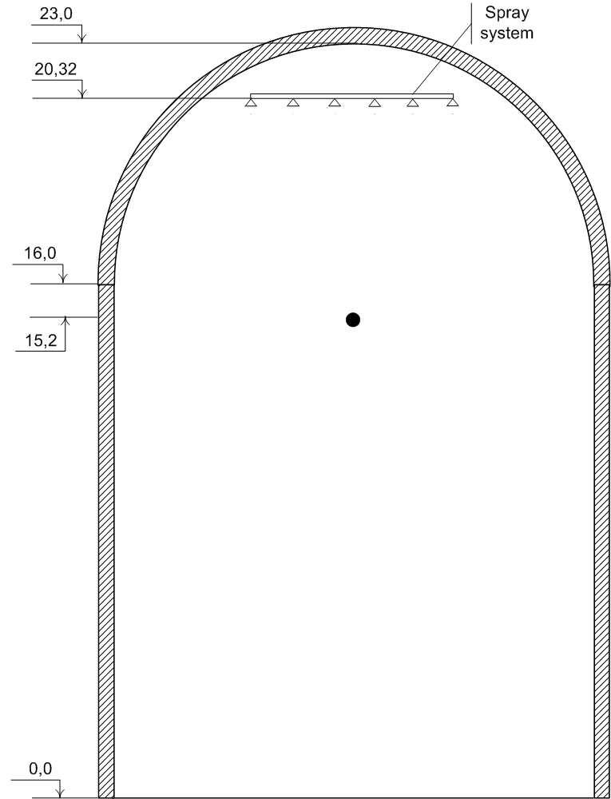
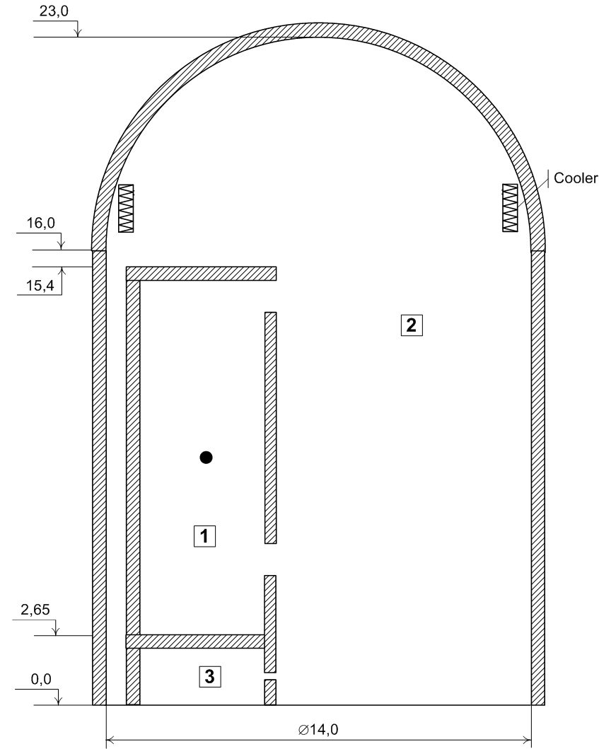
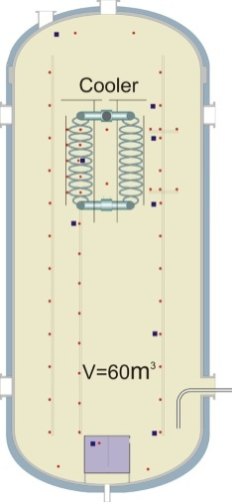
Tests in SAMARA Projects (WP3)
Two tests with cooler at small-scaled SPOT facility
Two code benchmarking tests with cooler and spray at “nearly full scale” concept HYMIX facility
Common approach (as in ERCOSAM Project) to develop initial and boundary conditions
for the tests (common generic conditions,
common scaling down consideration)
SPOT, 60m3
HYMIX, 3180 m3

Slide 7
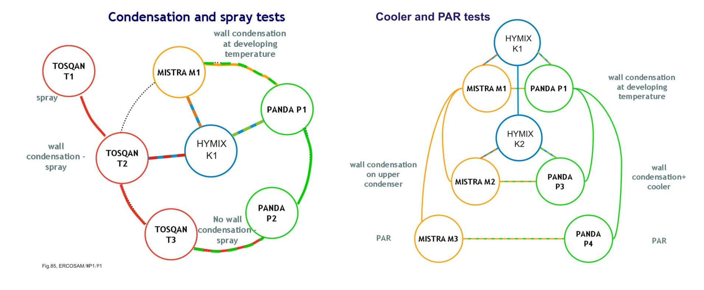
Coupling of HYMIX tests with ERCOSAM tests

Slide 8
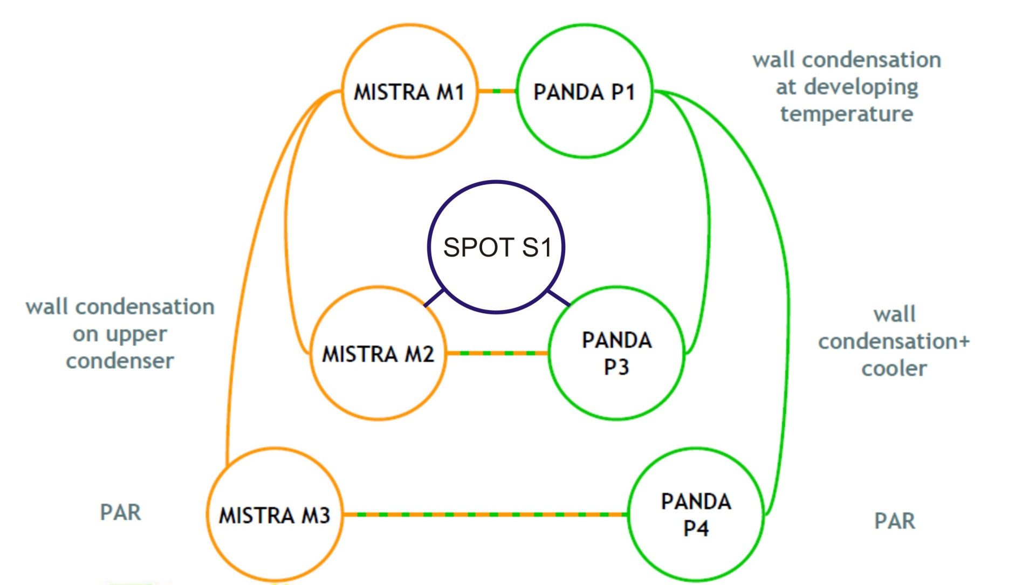
Coupling of SPOT tests with ERCOSAM tests

Slide 9
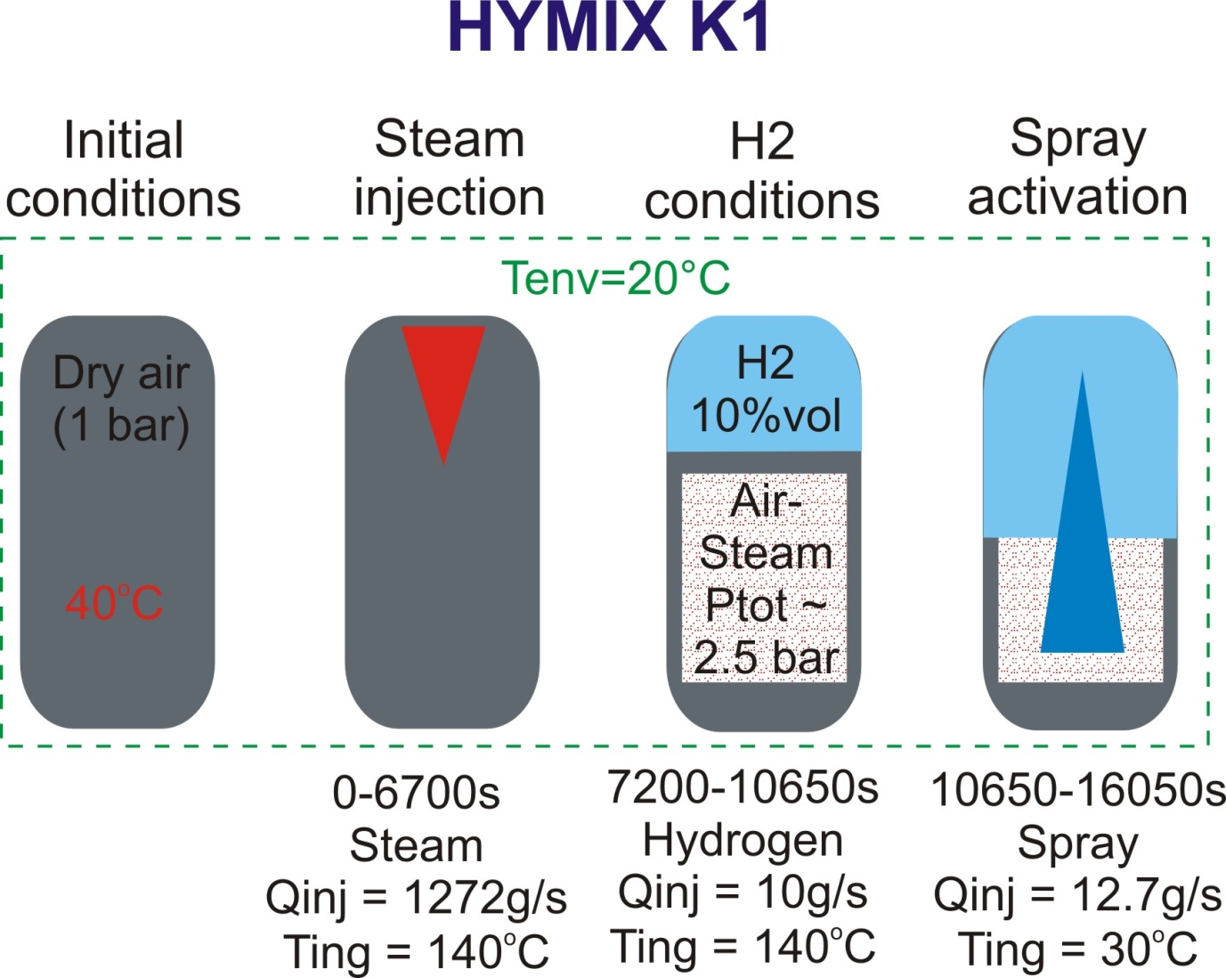
SAMARA test sequence
Test sequence is the same as in ERCOSAM tests
Configuration (geometry, safety system) and boundary conditions are developed on the basis of GC calculations and WP1 scaling consideration

Slide 10
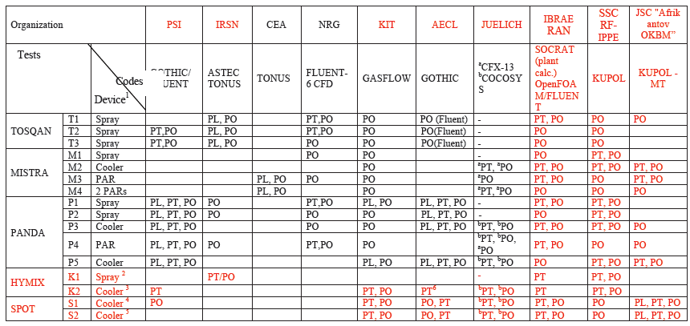
Numerical analysis (WP2)
12 ERCOSAM tests will be simulated by 3 SAMARA organizations
4 SAMARA tests will be simulated by 7 ERCOSAM organizations
SAMARA Project activities : synthesis Report on code capabilities against SAMARA tests (WP4)

Slide 11
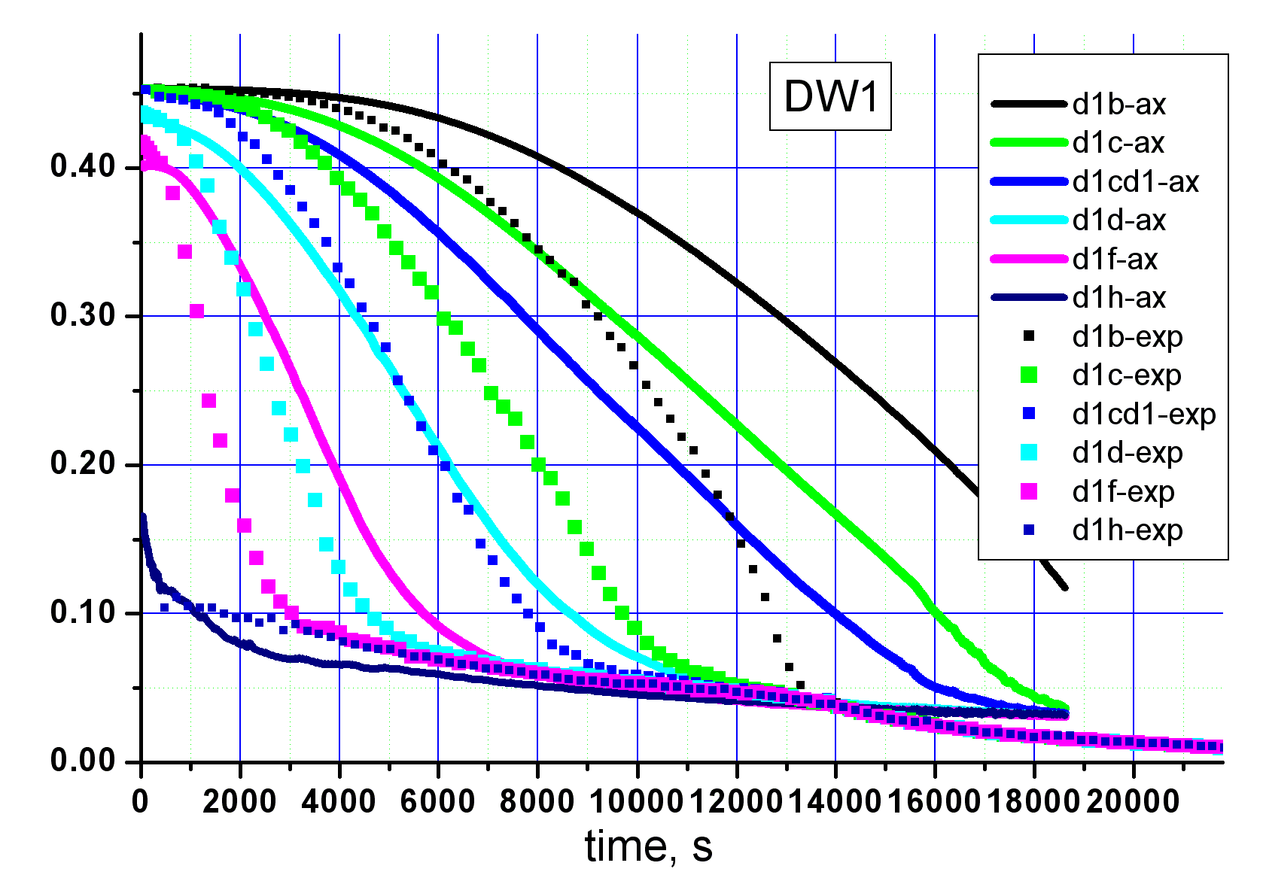
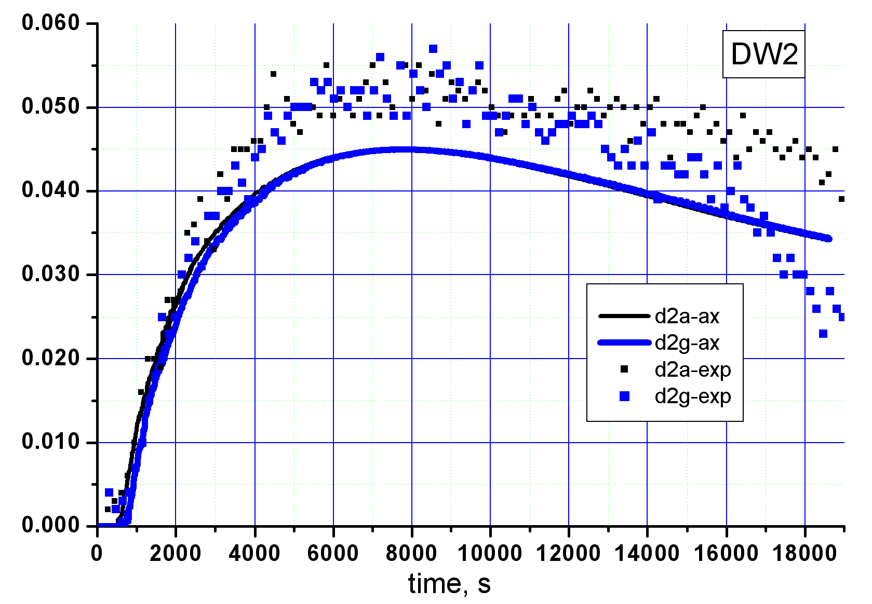
Analytical activities to support WP2
Numerical analysis of SETH-2 open tests (performed)
Numerical analysis of TOSQAN 101 and 113 tests (on-going)
The data were provided by ERCOSAM partners
He concentration, PANDA ST1_7_2. Simulation with FLUENT code

Slide 12
Summary
SAMARA Project have been launched since January 15, 2010
Signed Coordination Agreement between ERCOSAM Project and SAMARA Project constitutes a basis for cooperation between SAMARA and ERCOSAM partners
Current SAMARA activities are performing following common ERCOSAM - SAMARA Workprogramme on the basis of common approach to the investigations
Partner relationships established between SAMARA and ERCOSAM organizations promotes successful projects implementations

