Slide 1
Paul Scherrer Institut
(PSI)
(www.psi.ch)
Nuclear Energy and Safety
Research Department
(NES)
Laboratory for thermal-hydraulic Research
(LTH)

Slide 2
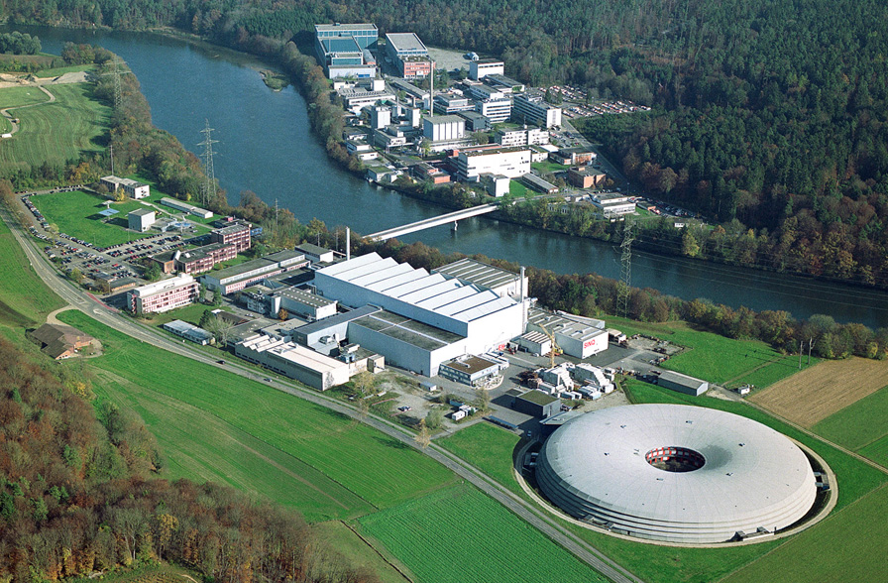
PSI East
Aare
psi forum
Auditorium
PSI West

Slide 3
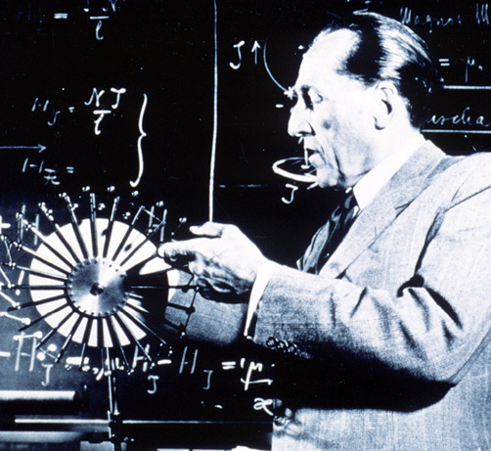
Paul Scherrer (1890 – 1969)
  Studied physics and mathematics at
  the Swiss Federal Institute of Technology (ETH) Zurich, in Königsberg and Göttingen in Germany
  1920: Director of The Institute of Physics at the ETH Zurich. Became well-known for the clarity of his lectures
  Researched X-ray scattering on crystals, liquids and gases. Later research work was in nuclear physics
  1946: President of the Swiss Study Commission on Atomic Energy
  Involved in the founding of CERN

Slide 4
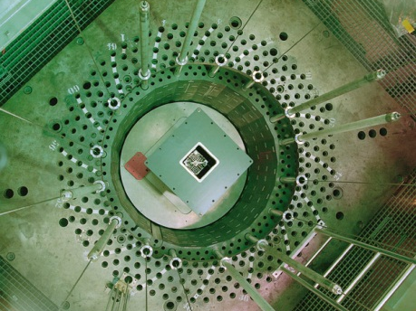
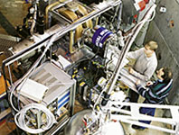
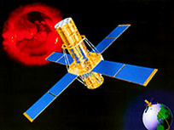
PSI-Research Fields
Synchrotron Radiation
and Nano-Technology
SYN
Nuclear Energy
and Safety NES
General Energy
ENE
Condensed Matter Re-
search with Neutrons
and Muyons NUM
Large Research
Facilities GFA
Particles and
Matter TEM
Life Sciences BIO

Slide 5
Political embedding
Swiss Federal Government
EDA
EDI
EJPD
VBS
EFD
EVD
UVEK
Board of the Swiss Federal
Institutes of Technology
ETHZ
Swiss Federal
Institute of
Technology
Zurich
EPFL
Swiss Federal
Institute of
Technology
Lausanne
PSI
Paul Scherrer
Institute
Empa
Swiss Federal
Laboratories
for Materials
Testing
WSL
Swiss Federal
Research
Institute for
Forestry, Snow
and Landscape
Eawag
Swiss Federal
Institute for
Water Resour-
ces and Water
Pollution
Control
Universities

Slide 7
Our Mission
  To play a leading role on an international level in
  – physics of condensed matter and materials sciences
  – structural biology
  – radiochemistry, radiopharmacy and proton radiation therapy
  – particle physics
  by using large-scale facilities
  (SLS, SINQ, SμS, particle beams)
  To be a UserLab for external science community
  Energy research, primarily using complex facilities, towards an efficient, environmentally friendly and reliable energy supply

Slide 8
Guiding principles
Quality: PSI is committed to scientific excellence, promotes and practises interdisciplinary
research, is market-oriented, and develops quality of leadership.
User laboratory: PSI co-operates with national and international research communities in the
design, construction and operation of large-scale facilities, for their benefit.
Research: PSI uses its complex facilities for its own research in physics, chemistry, biology,
energy technology, environmental science and medicine.
Further education PSI provides further education and training, in close collaboration
and training: with universities.
Transfer of skills: PSI acts in partnership with industry to promote the transfer and application of
research results into new products, techniques and processes.
Social aspects: PSI strives for social relevance by performing research into matters of national and
international significance, cultivates open dialogue with the general public, and is
accountable.

Slide 9
Key figures 2008
PSI funds (global budget) 238 MCHF
External funding 55 MCHF
Staff ~ 1280 PJ
Of which externally financed ~ 300 PJ
Doctoral students ~ 270
Apprentices 80
External users ~ 1700
Number of scientific publications ~ 800
PSI-employees with teaching duties at ETH and universities ~ 70

Slide 10
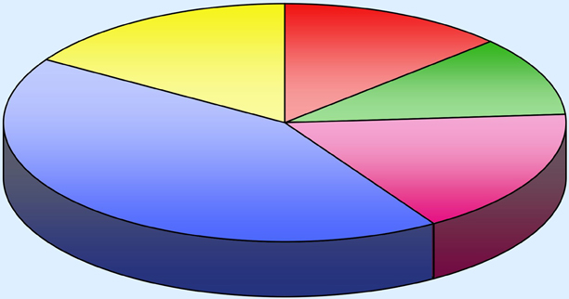
Budget 2008
Distribution by points of emphasis. 238 MCHF (PSI funds)
Nuclear Energy
Research
13 %
Particle Physics
16 %
General
Energy Research 11 %
Solid State Physics
and Materials Sciences
43 %
Life Sciences
17 %

Slide 11
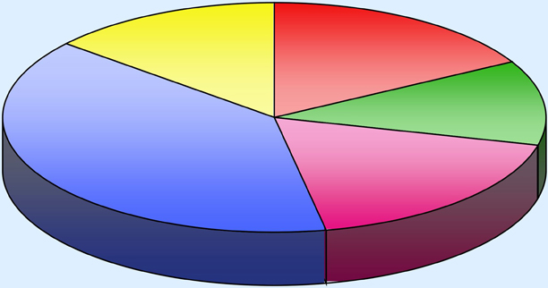
Budget 2008
Distribution by points of emphasis. 293 MCHF (PSI and third-party contributions)
Particle Physics
14 %
Nuclear Energy
Research
17 %
General
Energy Research 12 %
Solid State Physics
and Materials Sciences
39 %
Life Sciences
18 %

Slide 12
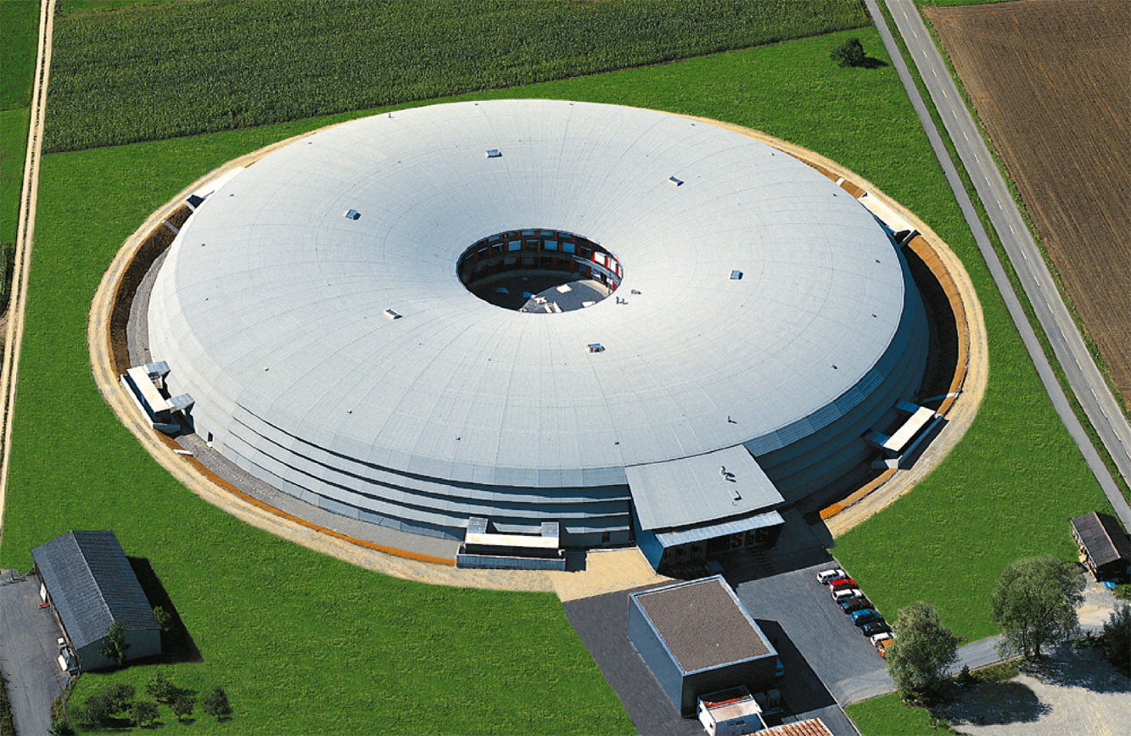
Synchrotron Light Source Switzerland SLS
A third-generation synchrotron light source. With an energy of 2.4 GeV,
provides photon beams of high brightness for research in materials science, biology and chemistry.
Operational since 1.8.2001

Slide 13
Synchrotron light
Is sharply focused electro-magnetic radiation
Has got wave lengths of UV-light up to hard x-rays
Is emitted by extremely fast flying electrons
Why synchrotron light?
Investigation of new kinds of materials, bio molecules, surfaces, micro- and nano- structures
Helps progress in semi-conductor-technology, high temperature supra- conductivity, magnetic data storage, specific development of medical drugs or materials for energy and environment research
SLS uses
600 magnets
300 vacuum pumps
600m vacuum pipes
45 km power supply cables
4 MW power
Building size
outside diameter: 138 m
height: 14.3 m
covered surface: 14’000m²
Building stability
vibrations: less than 0,5 µm (up to 50 Hz)
Subsidence: less than 0.2 mm per year over 10m
temperature inside SLS-tunnel: max. deviation of 0.2° at 26°

Slide 14
SLS Beam lines
X01DC (IR) Infrared (IR) the absorption of infrared radiation based spectroscopy.
X02DA (TOMCAT) TOmographic Microscopy and Coherent rAdiology experimenTs
X03MA (ADRESS) Advanced Resonant Spectroscopies
X04DB (VUV) A beamline for Vacuum Ultraviolet Radiation
X04SA (MS-SDiff) The Material Science beamline producing a high flux of hard X-rays from a wiggler source
X04SA (MS-Powder) Powder diffraction
X05LA (MicroXAS) The microXAS beamline will focus on X-ray absorption spectroscopy (XAS) and X-ray
fluorescence (XRF) experiments requiring high spatial resolution.
X07DA (PolLux) A Highly Versatile Scanning Transmission X-Ray Microspectroscope
X09LA (SIS) Surface and Interface Spectroscopy
X09LA (SIS-XIL) The X-ray Interference Lithography (XIL) beamline provides spatially coherent beam in the
Extreme Ultraviolet (EUV) energy range.
X10DA (SuperXAS) dedicated beamline to X-ray Absorption Spectroscopy (XAS) in the applied sciences
X11MA (SIM) Surfaces / Interfaces Microscopy
X12SA (cSAXS) Small-angle x-ray scattering (SAXS) of liquid and solid samples,
Grazing-incidence small-angle x-ray scattering (GISAXS),
Coherent diffractive imaging (CDI, SXDM),
Scanning x-ray microscopy (STXM, scanning SAXS),
X-ray photon correlation spectroscopy (XPCS).

Slide 15
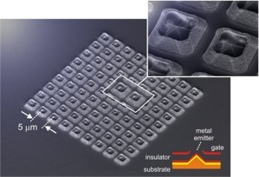
The X-ray Free Electron Laser (XFEL)
A new development in laser and accelerator-technology intended to introduce the excellent characteristics of conventional laser systems into the X-ray spectral region.
Enable scientists in physics, chemistry, biology and medicine to study nature down to the atomic level at a time-scale that fits this resolution.
Because of its performance, the XFEL is also labeled the next- or 4th generation light source, after the currently state of the art 3rd generation synchrotron light sources like the Swiss Light Source SLS.
Field Emitter Array tests to generate ultra-bright electron beams.
The devices are fabricated at the Laboratory for Micro- and Nanotechnology at the PSI

Slide 16
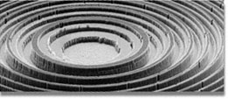
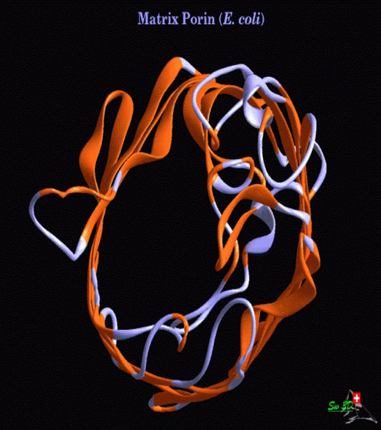
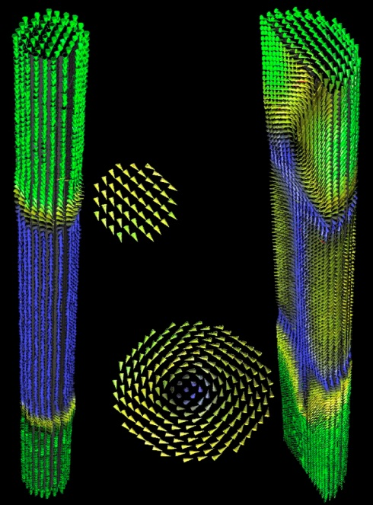
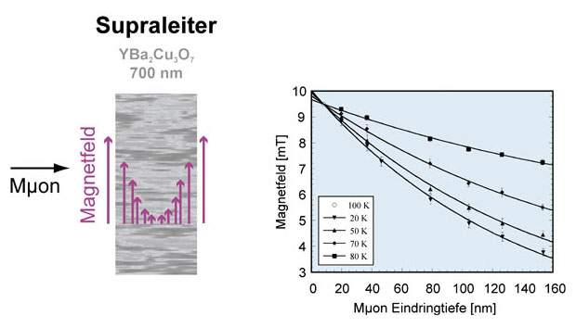
Solid Matter Research and Materials Sciences
Microscopic structures and new materials
Solid matter research and materials sciences with neutrons, synchrotron light, muon rays and nanotechnology lead to new insights in physics, biology and medicine as well as in modern technologies, energy technology und environmental research.

Slide 17
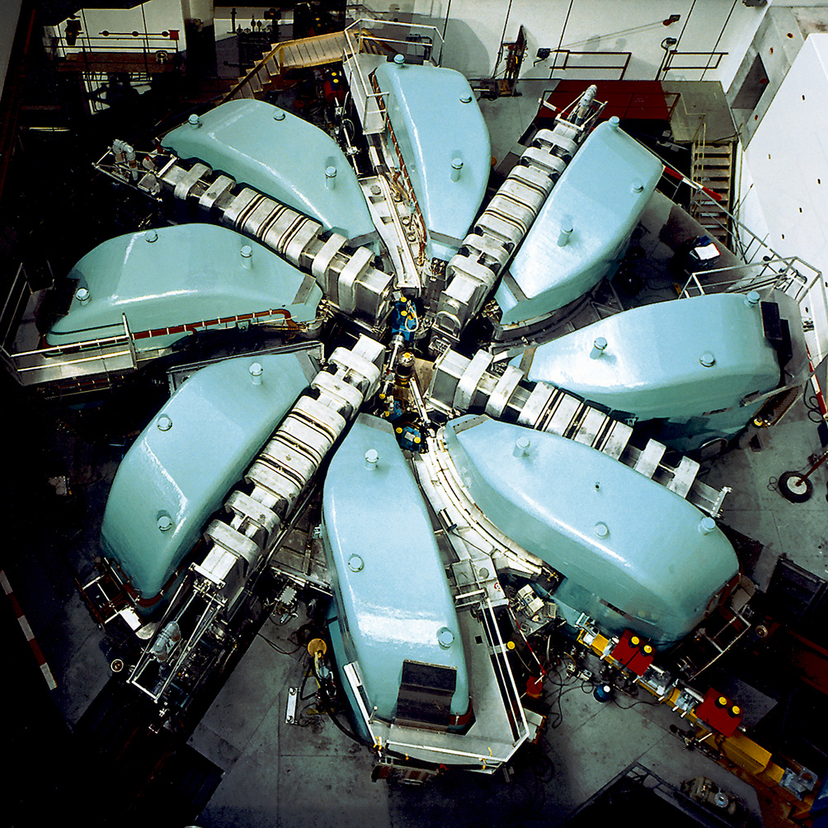
The Proton Accelerator
Spinning around at 236‘000 km/s !
The PSI ring cyclotron produces a proton beam with the highest intensity worldwide.
The protons are accelerated to nearly 80 % of light speed (approximately 236’000 km/sec).

Slide 18
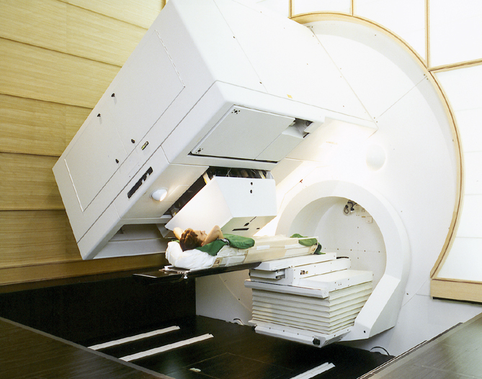
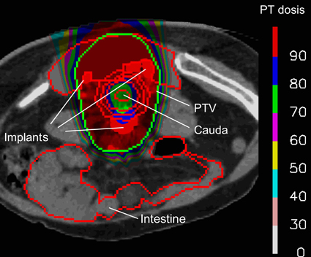
Humans and health
Efficient spot-scanning technique: irradiation plan for a tumour at the lower spine
Radiation facility (Gantry) for proton therapy

Slide 19
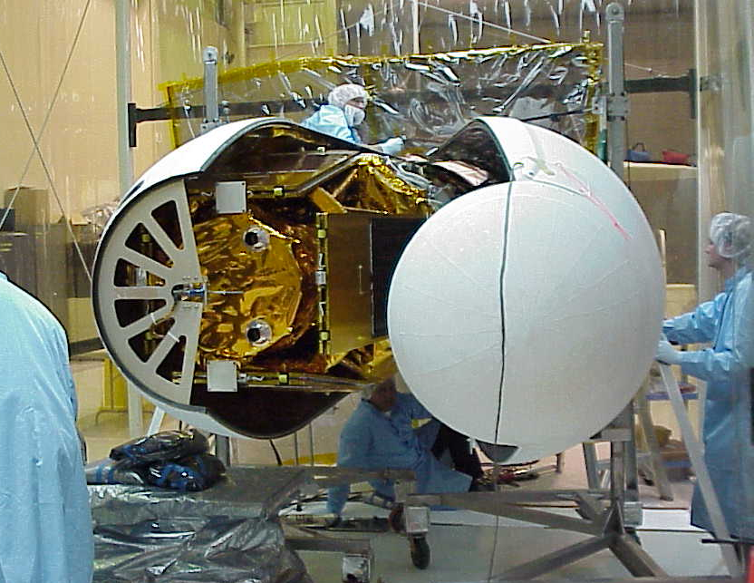
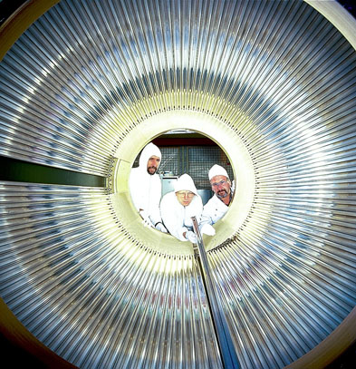
Astrophysics and elementary particle physics
The smallest and the largest
Astrophysics On space missions PSI instruments investigate the universe. PSI detectors orbit on satellites around the earth and transmit measurement data on cosmic radiation.
Elementary particle physics A speciality of PSI is the development of new kinds of detectors through participation in particle physics experiments outside PSI.

Slide 20
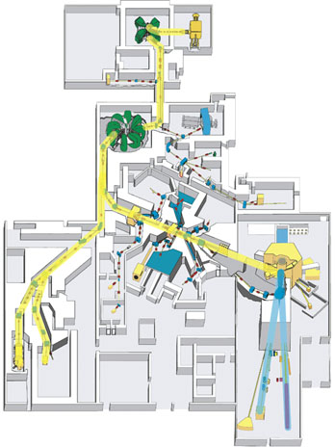
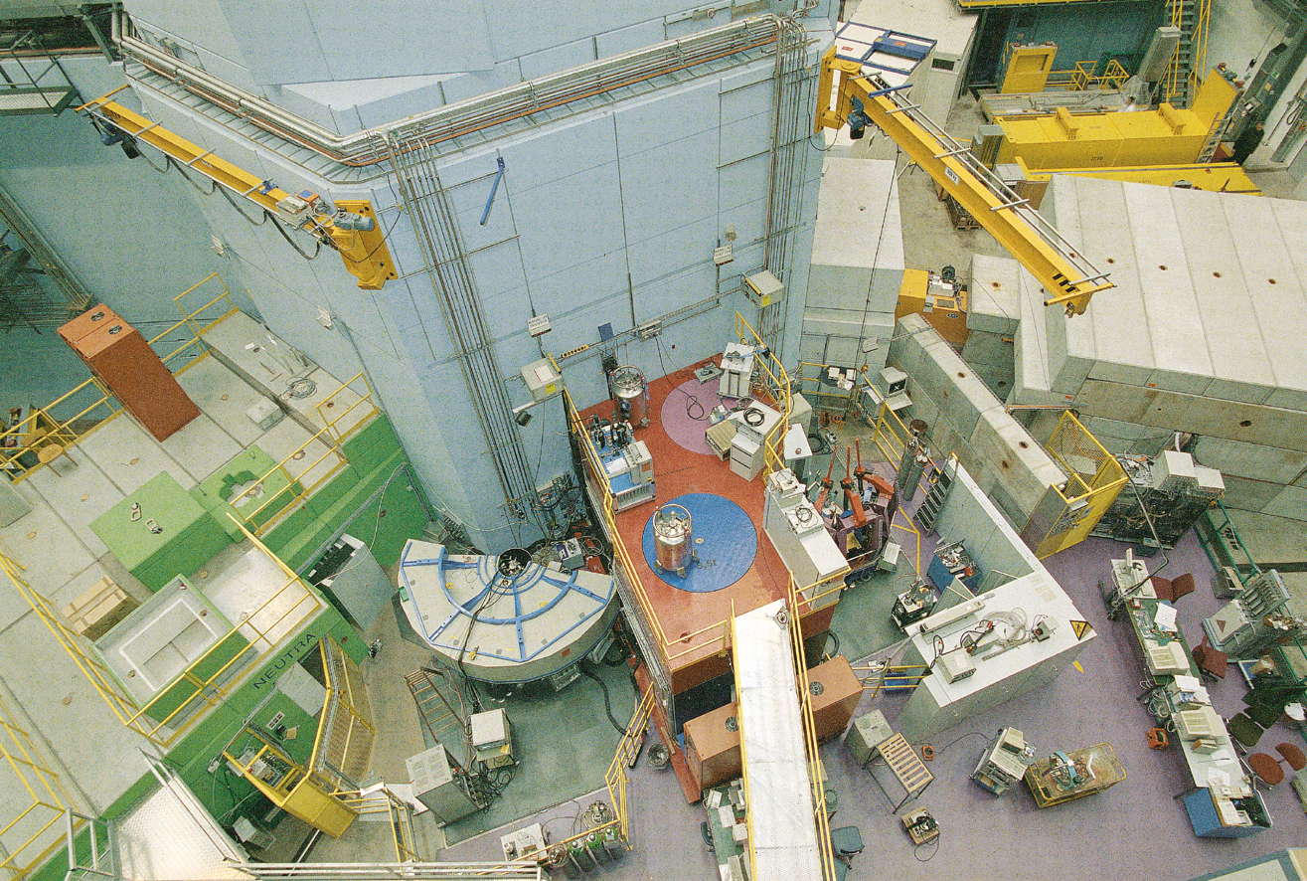
The Neutron Source SINQ
The proton beam hitting the lead target releases neutrons (spallation).

Slide 21
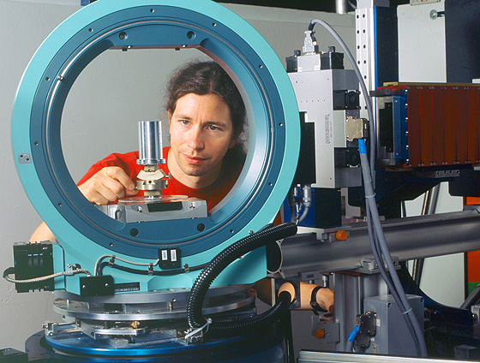
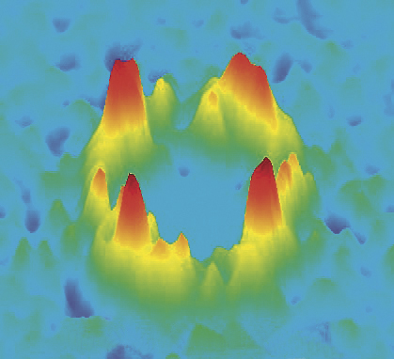
Tiny structures and new materials
Neutrons as compasses: magnetic flux lines in a superconductor
Experiments at the Spallation Neutron Source

Slide 22
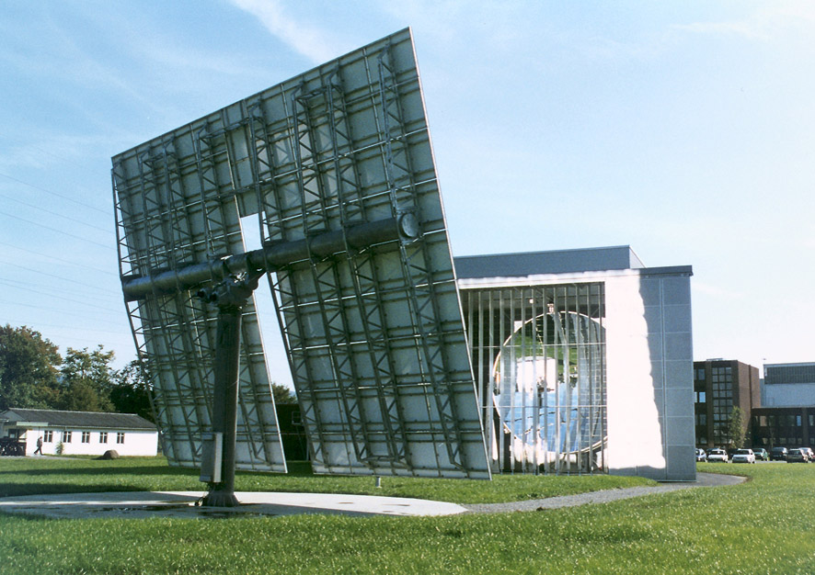
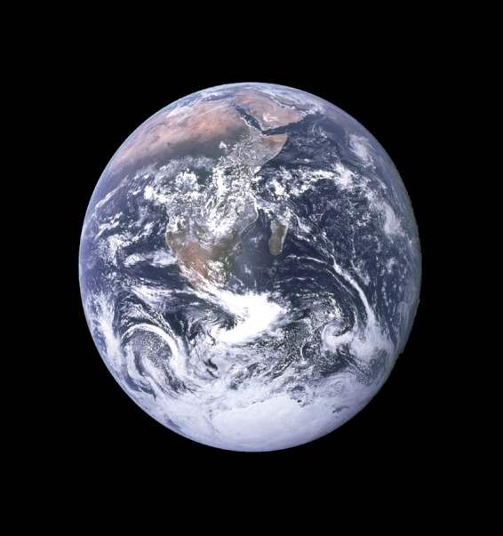
For Sustainability and Environmental Compatibility
General Energy
Promotion of renewable energies as well as storage and conversion of energy.
Development of new technologies for the reduction of emissions.
Development of fuel cells for manifold uses.
Investigation of transport of air pollutants and their associated chemical conversion.

Slide 23
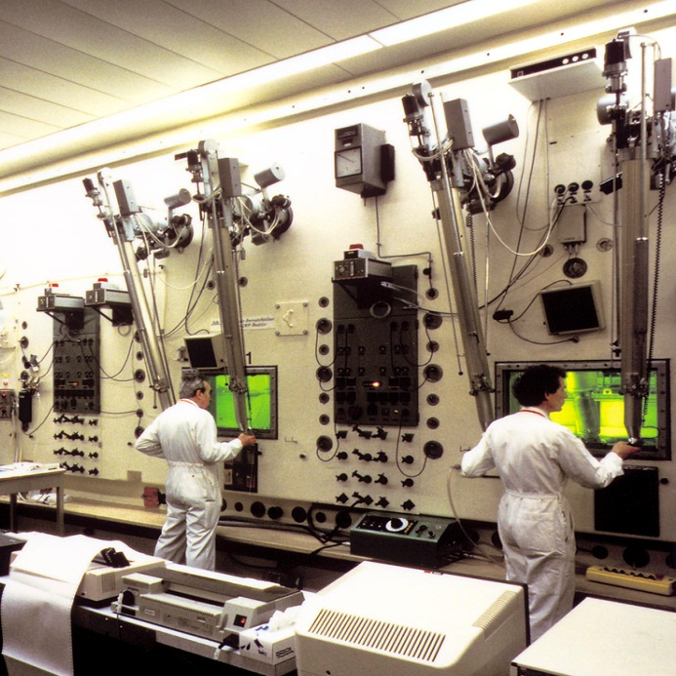
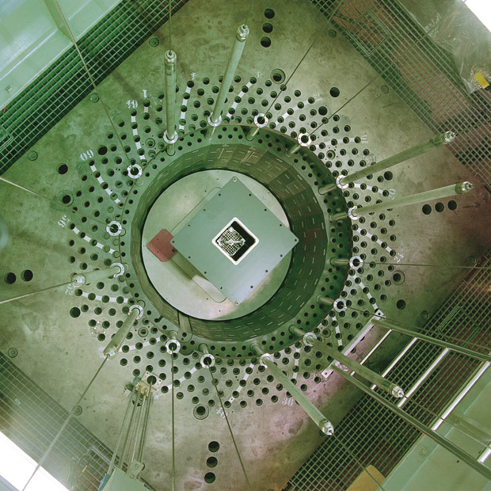
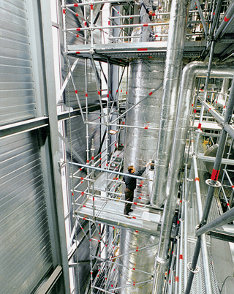
Nuclear energy and safety
Contributions to the safety of the Swiss nuclear power plants
Investigation of safety characteristics of future reactor concepts and associated nuclear fuel cycles
Evaluation of the safety of future repositories for radioactive waste

Slide 24

Safe and CO₂-free Energy
Nuclear Energy and
Safety
NES is partner of the Swiss Safety authorities and utilities,
Contributes to the development of new sustainable reactor systems with increased economic efficiency, safety and minimization of wastes (Generation IV),
Promotes the option of nuclear energy for a future environment friendly and safe Swiss electricity supply

Slide 26
Strategic Working Fields of NES
Contributing to the safe and economic operation of the existing Swiss NPPs and to the safety assessment for the geological final disposal of wastes in Switzerland by reinforcing the scientific bases,
Supporting power plant operators and the safety authority as well as assuring a stand-by-function in key areas, especially those requiring a hot laboratory,
Providing input for decision-making of stakeholders,
Promoting the option “nuclear energy” by R&D aiming at increased sustainability, incl. safety and economics,
Offering a broad spectrum of opportunities for the education of young nuclear specialists knowledgeable also of other energy sources,
Supporting and using the worldwide positive signals for a “renaissance” of nuclear energy

Slide 27
Nuclear Research and Education
Element of the Swiss R&D-Policy, as formulated in the Swiss Roadmap for Energy Research 2004-2007 .
R&D on international level under the demanding guidelines and control of the ETH-domain
Performed at the Nuclear Energy and Safety Department of Paul Scherrer Institut, financed with federal and other institutional means (~60/40%).
Education at university level at the Federal Institutes of Technology
  In Lausanne : Chair in Reactor Physics
  In Zurich : Chair in Nuclear Systems Engineering – new: financed by the Swiss nuclear utilities
  Masters in Nuclear Systems Engineering

Slide 28
Age Pyramid of NES 1998-2004

Slide 29
Current NES Projects
GaBE Energy Systems Analyses and Evaluation, Life Cycle Analysis, Stakeholders Involvement
LWR-PROTEUS Experimental reactor physics with modern core loadings and high burn-up fuels for code and data validation
STARS Deterministic analysis of the behaviour of Swiss NPPs, expertise for HSK and NPP operators
FAST Code system development for safety analyses of fast-spectrum reactors
ALPHA Study and modelling of mixing and 2-phase phenomena; qualifi-cation of passive heat removal systems through integral and separate effect tests, validation of (new) TH codes

Slide 30
Current NES Projects (cont.)
Severe accident research Characterization and understanding of aerosol and iodine behaviour during severe accidents; integral and separate effects experiments, model development, plant safety evaluation
Core Materials High burn-up behaviour of fuel cladding, explanation of failure causes
Components safety Environment and irradiation assisted corrosion;
ageing mechanisms; damage characterisation and monitoring (diagnostics)
HT-Materials Characterisation of materials for applications in very high-temperature reactors, development of models for their behaviour
Waste Management Geochemistry of repository systems, transport phenomena for substances from a final repository, contributions to safety assessments

Slide 31
LTH Research Areas
Laboratory for Thermal-Hydraulics
3D fluid and particle dynamics
Multi-scale modeling
Multiphase flows
Unity of Theory & Experiment
Main target
Liquid vapor flows
Iodine and aerosol transport
LWR problems
Theory
Model
Simulation
Validation
Experiment
Instrumentation

Slide 32
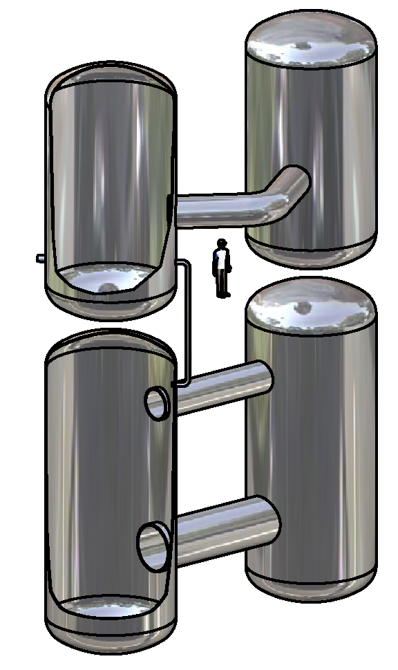
LWR Thermal Hydraulics
Unique experiments combined with novel instrumentation and computational capabilities
Development of advanced simulation tools for LWR safety
  Containment TH codes + CFD
  TOPFLOW-PTS
Contributions to Gen-III and Gen-III+ reactor development, in particular performance of passive safety systems
Plant Lifetime Management
Gen-4, e.g. HPLWR
Other applications: MEGAPIE, IFMIF...

Slide 33
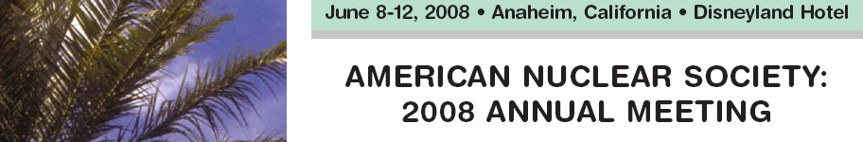
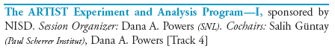
LTH Severe accident research
Leading position in Aerosol Research (Experiments, TH modeling, fundamentals)
Competence centre for Severe Accident analyses (MELCOR, SCDAP/RELAP, training)
Industrial technology developments (e.g. Iodine retention)
Contribution to teaching (PhDs, students projects, lectures)

Slide 34
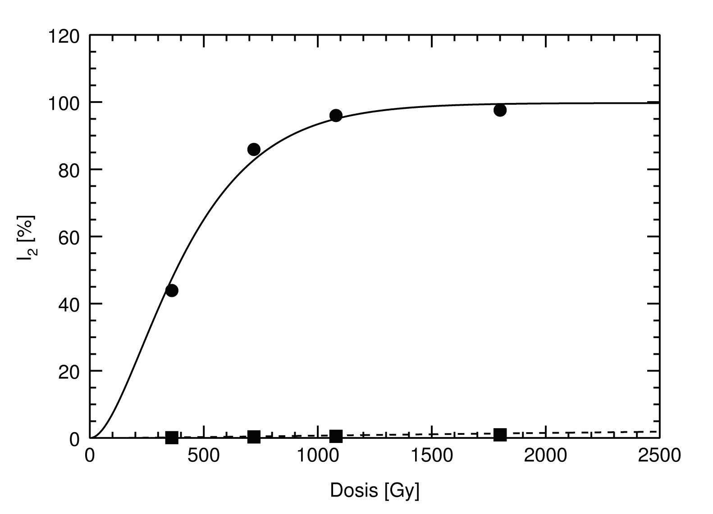
Iodine Management designed for SAM
Radiolytic oxidation of iodide solutions
Radiolytic oxidation of iodide solutions doped with PSI additives

Slide 35
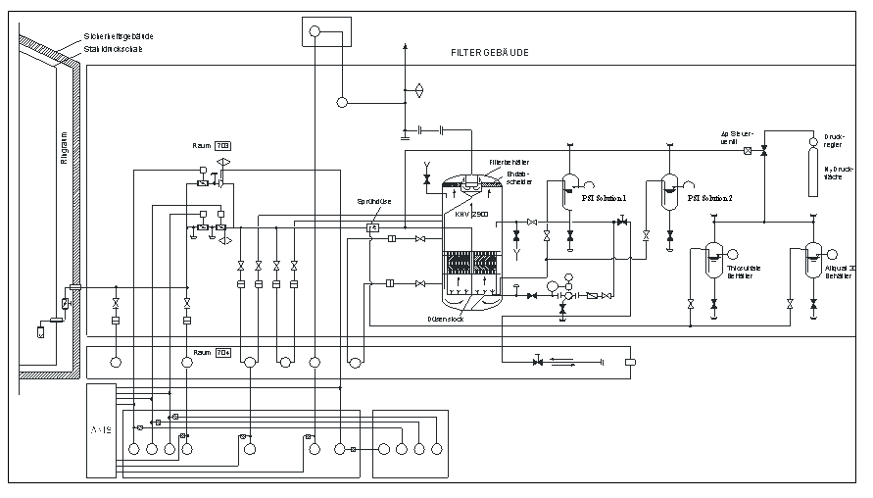
Application for Back fitting Containment Venting Filter Systems

