Slide 1
ISTC/STCU CONTACT EXPERT GROUP ON SEVERE ACCIDENT MANAGEMENT (CEG-SAM) Status and Future in October 2011
Michel Hugon
Unit ‘Fission’
Directorate Energy
DG Research & Innovation European Commission
E-mail: michel.hugon@ec.europa.eu
20th CEG-SAM Meeting – Moscow – 11-12 October 2011

Slide 2
OUTLINE
ISTC/STCU Contact Expert Group on Severe Accident Management (CEG-SAM)
Activities in DG RTD
FP7 + 2 (Euratom) (2012 – 2013)
Horizon 2020 - Common Strategic Framework or “FP8” (2014 – 2020)
Activities in DG ENER
Safety and risk assessments (stress tests)
Notes:
2

Slide 3
ISTC/STCU CEG – SAM (Contact Expert Group on Severe Accident Management)
Interaction between SARNET and CEG-SAM (ISTC/STCU) well established according to document entitled “Interaction between EC-SARNET and CEG-SAM activities”, which was endorsed by both groups in 2005 and 2010
Results of SARNET activities periodically presented to CEG-SAM members
Transmission of ISTC/STCU proposals and project reports related to SAM to SARNET topical co-ordinators
Experimental results of ISTC/STCU projects used for development of knowledge as part of SARNET Joint Programme of Activities (JPA)

Slide 4
Status of CEG-SAM in October 2011 (1)
Quite successful since its launching in April 2002
Excellent interaction with SARNET
About 5.5 M€ funding from EC for 14 ISTC projects from 2002 to 2011:
11 ISTC projects funded and completed
3 ISTC projects funded and running
1 STCU project funded by Canada (300 k$) and running
A paper to summarise the main results of the 15 ISTC/STCU projects is being written to be published in a peer-reviewed journal

Slide 5
Status of CEG-SAM in October 2011 (2)
ISTC and STCU funding from EC
It has decreased from ~ 25 M€ in 2007, ~ 15 M€ in 2008 to ~ 8 M€ in 2009 and in 2010
No more projects funded since 2009
ISTC will be closed on 31/12/2014
Collaboration with Russia will continue through the Euratom-ROSATOM Working Group on nuclear fission (Under the cooperation agreement on nuclear safety between Euratom and Russia in 2002)
Next meeting on 13 October 2011 in Moscow

Slide 6
Status of CEG-SAM in October 2011 (3)
Collaboration with Ukraine:
Structured dialogue between Euratom and Ukraine ?
Discussion between NASU and Euratom at standstill
Possible role of STCU ?
Two cooperation agreements between Euratom and Ukraine:
Nuclear safety in 2002
Peaceful uses of nuclear energy in 2006

Slide 7
FP7 + 2 (Euratom) 2012 - 2013
Same programme, same instruments, SNETP and ESNII mentioned
1 call each year with ~ M€ 50 per year with deadline in April-May
Proposal adopted by Commission on 7 March 2011:
Nuclear fission and radiation protection: M€ 118
JRC nuclear research activities: M€ 233
Fusion energy research: B€ 2.2
M€ 1892 for ITER France
Following Fukushima, new FP7+2 text, which maintains research on Gen IV systems, but exclusively on safety aspects, resulting from agreed political approach, noted by Council On 28 June
Beginning of December 2011: proposal expected to be adopted by Council
Delays due to B€ 1.3 funding missing for ITER
6th Call Fission – 2012:
Publication: Dec. 2011 or Jan. 2012
Deadline: April 2012 ?

Slide 8
Horizon 2020 - Framework Programme for Research and Innovation (2014 - 2020)

Slide 9
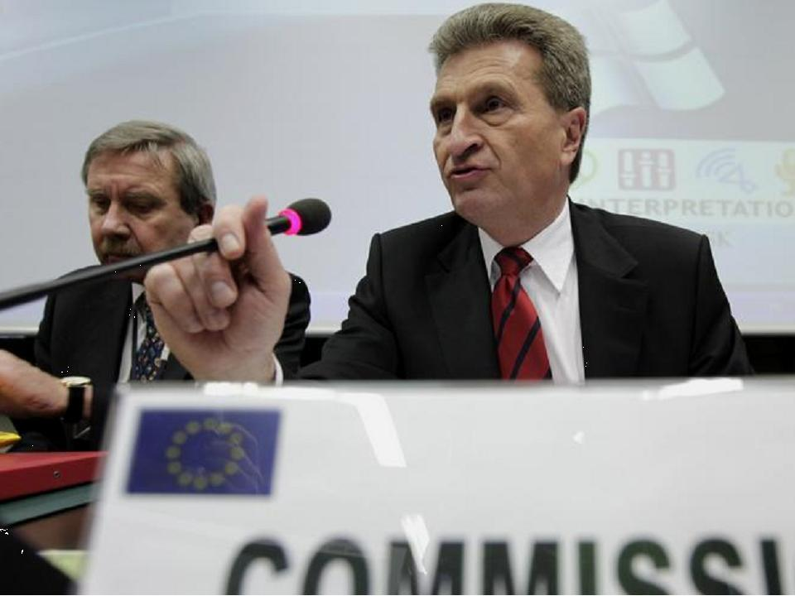
Safety and risk assessments Milestones
●
15 March: Commissioner Oettinger announces stress tests of nuclear facilities in the EU
21 March: Energy Council (energy ministers from MS) endorses the Commission proposal to carry out comprehensive safety and risk assessments
24–25 March: European Council (Heads of State and Government) calls on the Commission and the European Nuclear Safety Regulators’ Group (ENSREG) to develop the scope and modalities of the assessments
24 May: the Commission and ENSREG reach agreement on the methodology and the timetable

Slide 10
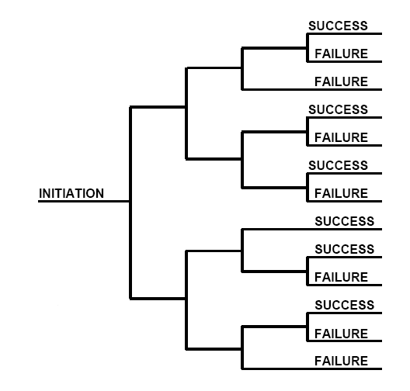
Assessments – technical scope – Safety
●
Definition based on - but not limited to – Fukushima
Initiating events:
Earthquake, flooding (incl. internal)
Bad weather, Large grid disturbance, forest fire,
airplane crash…
Consequence of loss of safety functions from any initiating event conceivable at the site:
Loss of electrical power, incl. station blackout
Loss of ultimate heat sink
Combination of both (dependent failures)
Severe accident management issues:
Licensee’s provisions related to:
Means to protect from and to manage loss of core cooling function
Means to protect from and to manage loss of cooling function in the fuel storage pool
Means to protect from and to manage loss of containment integrity
Off-site support for maintaining the plant’s safety functions

Slide 11
Assessments – timetable - Safety
●
1 June: national regulators initiate the tests process
15 August: operators carry out reassessments and submit progress reports to national regulators
15 September: regulators consolidate the data into national progress reports
31 October: operators’ final reports
By 9 December: progress report from the Commission to the European Council, which assesses preliminary findings
31 December: national final reports
30 April 2012: completion of peer reviews
June 2012: consolidated report from the Commission to the European Council

Slide 12
Thank you
Information on FP7 and access to programmes and calls: http://cordis.europa.eu/fp7/home_en.html

