Slide 1
ISTC project K-1265:
Experimental study of core melt in-vessel retention
IN-VEssel COrium Retention (INVECOR)
CEG-SAM 8th Meeting,
September 14 – 16, 2005
Podolsk, Russia

Slide 2
Presented by
Vladimir S. Zhdanov
Head of lab for fuel and structural materials research
Institute of Atomic Energy
National Nuclear Centre of Kazakhstan Republic
phone, fax: +7(322-51)2-31-25
E-mail: zhdv@nnc.kz

Slide 3
Presentation contents
Introduction
Calibration tests objectives
Integral tests scenarios
Planned experiments for Working Plan validation
  Experimental study of electrode parameters for plasma heating device
  Experimental study of power supply equipment for plasma heater
  Calculations for justification of PVR model dimension
  Study of zirconium coating technique on graphite with various porosity
Conclusions

Slide 4
Introduction
Key questions of project #K-1265 working plan validation are:
Evaluation of workload list for project performing.
Definition of the list of materials and the equipment, which is necessary for buying for project performance.
Specification of a design of the basic units of LAVA-B facility.
Specification of personnel list for project performing.

Slide 5
Calibration tests goals
To specify the loaded burden heating mode
To prove the possibility of corium melt obtaining without impurities (carbon and carbides)
To specify the parameters of device for decay heat modeling
To itemize the scenario of integral tests

Slide 6
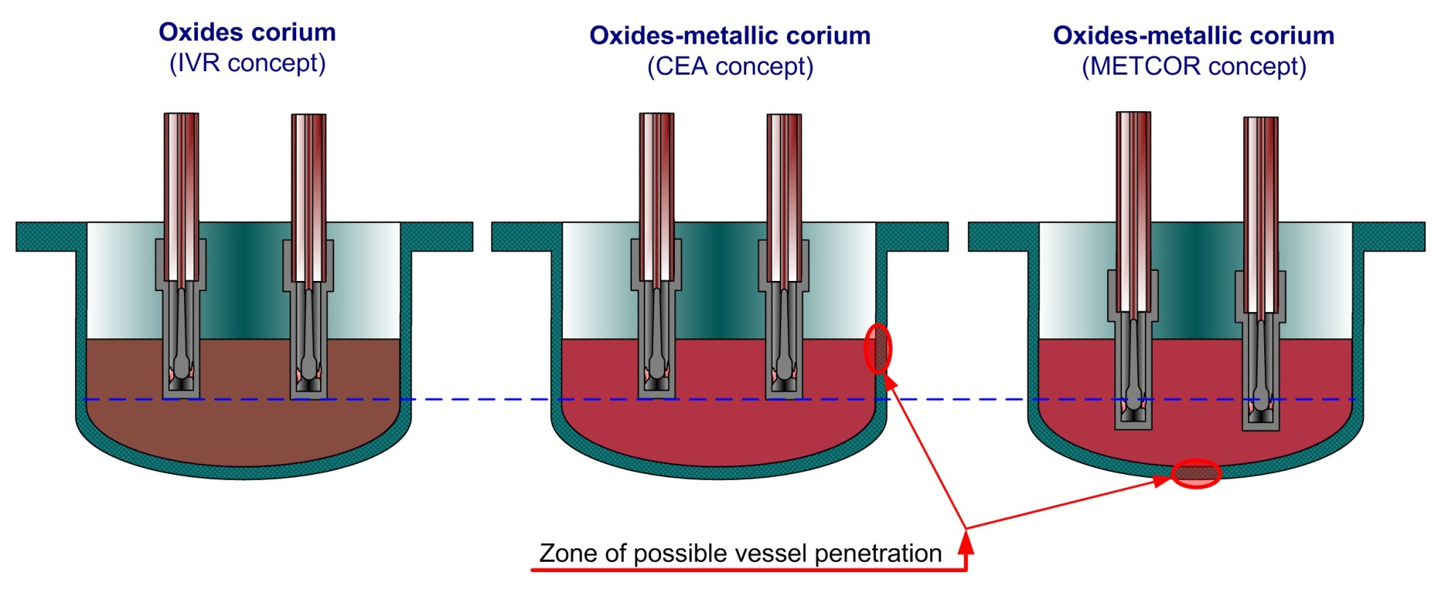
Integral tests concept
First test. Obtaining of oxidic corium pool with convection during more than 2 hours
Second and third tests. Providing of oxide-metal corium melt interaction with RPV wall during 1.5 hours and melt penetration through RPV wall according to different scenarios

Slide 7
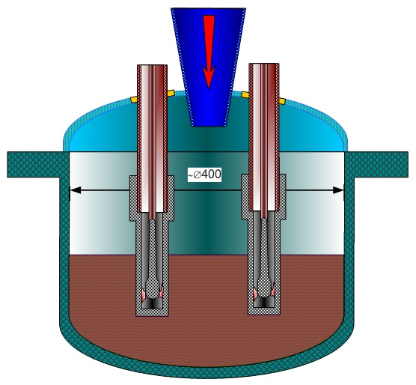
Research of in-vessel retention tests (IVR)
Approximate scheme of IVR test with decay heat modeling
Melt guide cone
Thermal screen
Cupper coaxial electrodes (3 pieces)
Lower head model
Coaxial electrode nozzle
Molten corium pool

Slide 8
Main questions are:
What is the method of plasma device maximum power increase:
Via increase the power in each electrode via electrode nozzle design or power supply device change?
Via increase the number of electrodes in test section at the existing design?
What is the method of quasi-uniform temperature field in the RPV model achievement:
Via increase the number of electrodes in test section?
Via modify the outer electrode nozzle shape?
Method of electrode life time increase:
Via modify the shape of inner electrode?
Via choose the working medium in the clearance between coaxial electrodes?
Via use the protective coating of electrode nozzle surface?

Slide 9
Design of electrode unit
Working medium supply into
the inter-electrode space
Cooling water supply
Inner electrode
Centering ring
Outer electrode
Electrode unit
Nozzle of inner electrode
Nozzle of outer electrode

Slide 10
Variations during electrode unit testing
Material of electrode nozzle | Graphite Tungsten
Temperature of outer electrode nozzle | Maximum at existing power supply (1700 degree C) 2300…2500 degree C using thermal insulation
Working gas medium | Argon gas Nitrogen
Plasma arc power | 18 kW using Ar-gas for working medium 20.3 kW using N₂ for working medium 18 kW at temperature of outer electrode nozzle 2400 deg. C and N₂ as working medium
Time of testing | 5…10 minutes (for estimation of maximum arc power) Up to 2 hours (life time testing)
Preliminary results | No erosion of between-electrode surface (Ar-gas, temperature 1700 deg. C, about 2 hours) About 2 mm erosion depth of between-electrode surface (N₂, temperature 2400 deg. C, about 40 minutes)

Slide 11
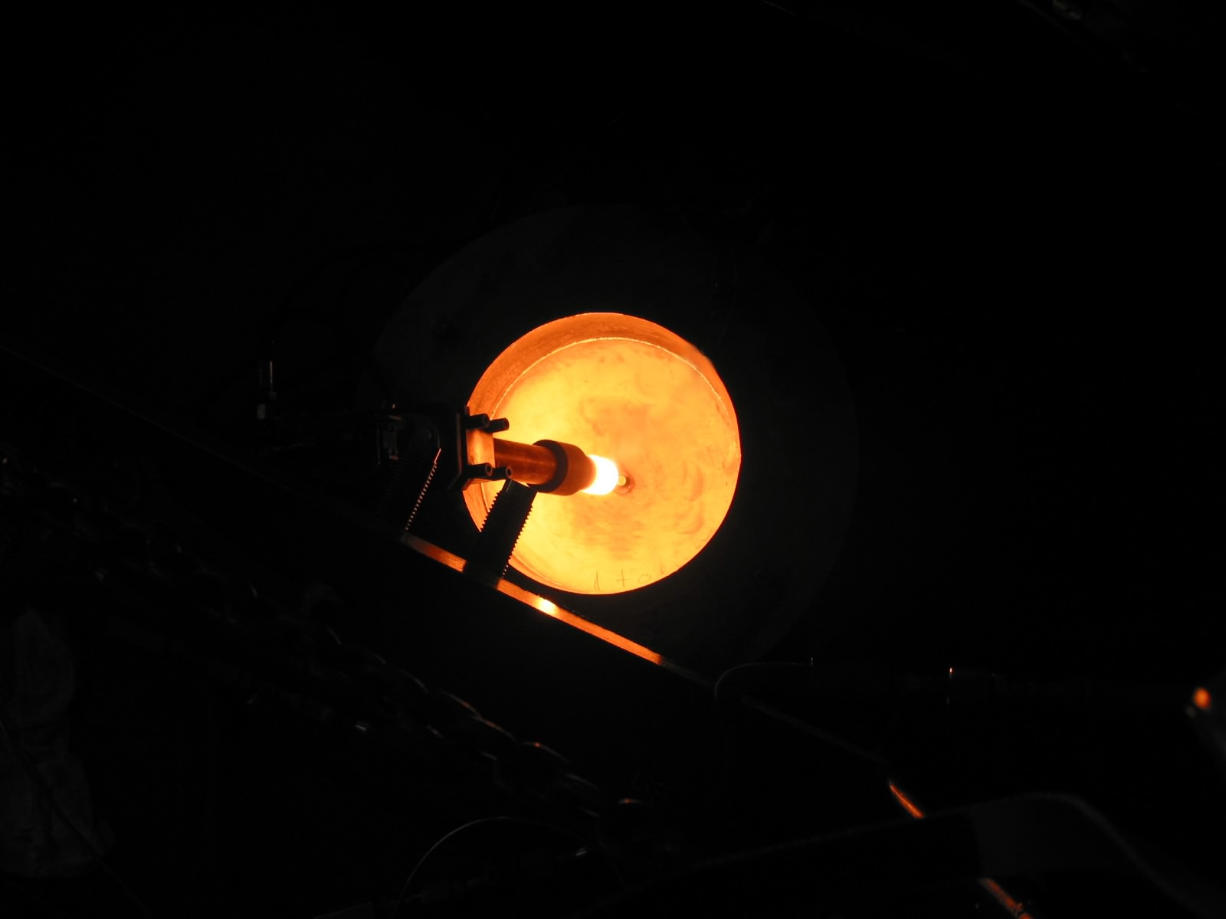
View of electrode nozzle at plasma arc burning

Slide 12
Pre-test calculation
3000
2500
Temperature history of electrode and RPV model at pre-heating before melt discharging
(Start of plasma ignition not early then 5…10 minutes before melt discharging)
2000
1500
Temperature, deg.C
1000
500
0
0
500
1000
1500
2000
Time, seconds
Electrode
RPV model

Slide 13
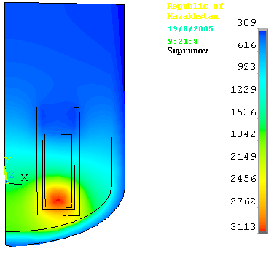
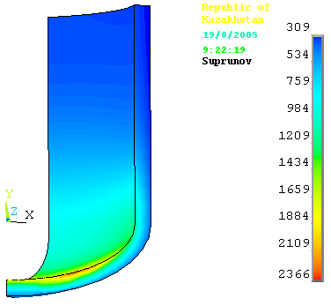
Pre-test calculation
Temperature field in RPV model
Temperature maximum 2840 deg. C in 30 minutes after start of heating
Total plasma power is 90 kW, 3 electrodes, Electrode outer diameter is 80 mm

Slide 14
Zr-coating of graphite surface
Objectives:
To specify the technique of Zr application on graphite surface during small-scale tests
To estimate the best graphite type for reliable coating using molten zirconium
To develop the technique of large sized crucibles coating with Zr
To estimate the long timed stability of obtained coating
To develop the technique of electrode nozzle coating

Slide 15
Zr-coating of graphite surface
(initial test parameters)
# | Test | Graphite type | ρ×10⁶ (ohm*m) | Density, kg/m³ | Porosity, % | Mass of loaded Zr, g | Maximum temperature deg. C | Keeping at Tmax, s
1 | MD-4 | ARV-1 | 12.1 | 1680 | 19.9 | 7.19 | 1850 | 90
2 | MD-10 | ARV-1 | 12.1 | 1680 | 19.9 | 5.24 | 1980 | 240
3 | MD-12 | R4340 | 11.8 | 1739 | 12.4 | 5.55 | 1900 | 180
4 | MD-23 | ARV-1 | 9.7 | 1634 | 20.3 | 12.4 | 1950 | 300
5 | MD-29 | 3OPG | 11.3 | 1764 | 13.1 | 12.11 | 1930 | 150
6 | MD-30 | ARV-1 | 12.1 | 1680 | 19.9 | 52 | 1930 | 300

Slide 16
Zr-coating of graphite surface
(Dimensions of experimental crucibles )
# | Test | Outer diameter, D_{o}, mm | Inner diameter D_{i}, mm | Height of outer wall, h_{o}, mm | Height of inner wall, h_{i}, mm | Thickness of lateral wall d, mm
1 | MD-4 | 35 | 27 | 54 | 44 | 4
2 | MD-10 | 35 | 27 | 54 | 44 | 4
3 | MD-12 | 35 | 27 | 54 | 43 | 4
4 | MD-23 | 41 | 27 | 54 | 43 | 7
5 | MD-29 | 50 | 35 | 58 | 47 | 7,5
6 | MD-30 | 35 | 27 | 54 | 44 | 4

Slide 17
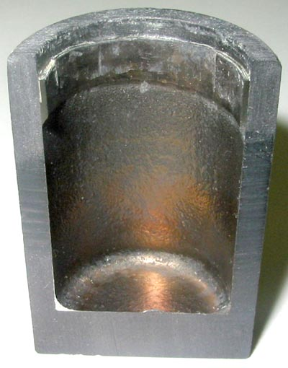
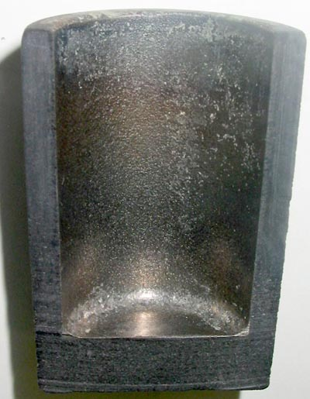
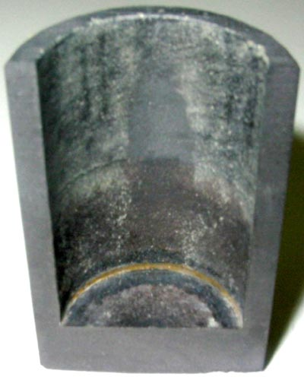
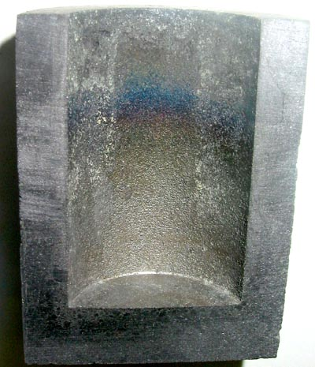
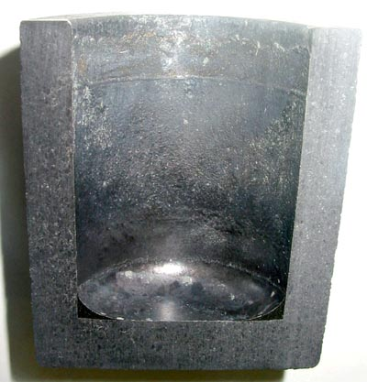
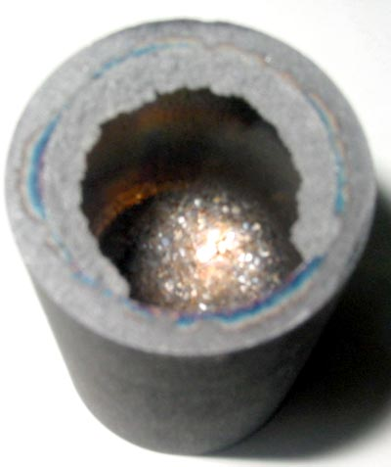
Zr-coating of graphite surface
(view of tested crucibles)
MD-4
MD-10
MD-12
MD-23
MD-29
MD-30

Slide 18
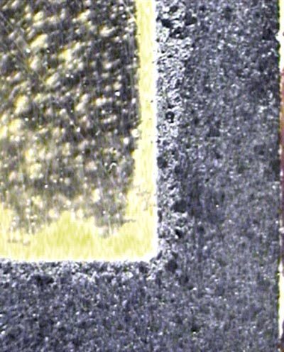
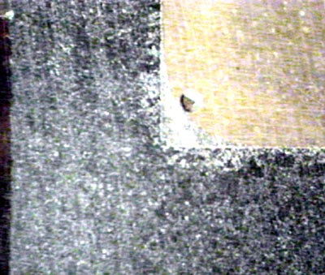
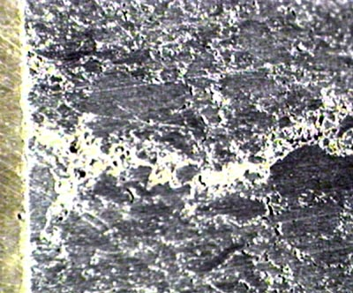
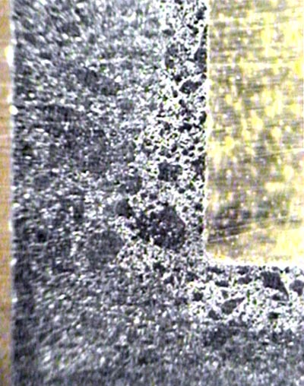
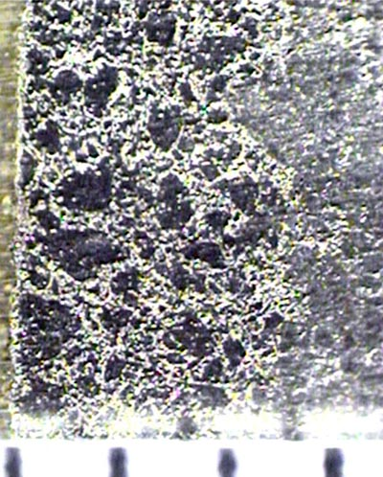
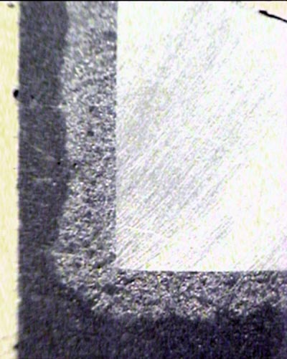
Zr-coating of graphite surface
(view of Zr infiltration in graphite wall)
MD-10
MD-12
MD-29
MD-23
MD-30

Slide 19
Preparatory operations before
LAVA-B tests
Definition of corium mass and composition
Protective coating application on the graphite crucible inner surface and electrode nozzle outer surface
Estimation of RPV model dimension and design
Estimation of parameters of device for decay heat modeling
Calculation of burden heat-up modes (improvement of EMF instrumentation and obtaining of data on EMF materials thermal properties at elevated temperature)
Specification of each test scenario

Slide 20
Conclusions
The main results of the preparatory operations will be experimental data for estimation of:
Specification and agreement of integral tests scenarios
Workload on project preparation and performing
Development of technique of large scale crucibles and electrode nozzles coating
Specified list of project participants
List of necessary materials and equipment

