Slide 1
ISTC project K-1265: Experimental study of core melt in-vessel retention IN-VEssel COrium Retention (INVECOR)
Presented by Vladimir S. Zhdanov
IAE NNC RK
CEG-SAM 10th Meeting,
September 5 – 8, 2006
Kurchatov, Kazakhstan

Slide 2
Presentation contents
Introduction
Main directions of work and results
Electric melting furnace (EMF) improvement
Test section (TS) design (RPV model)
Device for decay heat modeling (DDHM) design and testing
Testing and modernization of technological systems
Pre-calculation of above items
Testing and modernization of data measurement system
Zirconium coating tests results
Development of technique of Zr application on the electrode nozzle outer surface
Conclusions

Slide 3
Introduction
Project K-1265 has been started from May 1, 2006
Operations are fulfilled according to the confirmed Working Plan (for today while there are no terminated operations)
Detailed work schedule for current quarter is made. Each item of this plan is terminated by the correspondent interim report. The annual report will be issued on the basis of these interim reports
Requests for procurement of materials and equipment were sent to ISTC office. First lot of equipment is delivered in IAE

Slide 4
Work structure and objectives
EMF
DDHM
Test section
Technological systems
DAS
Choice of RPV model material
Experimental diagnostic of technological systems capacity
Diagnostic of measuring system
Increase of loading mass
Increase of plasma power
Increase of heating efficiency
Increase of energy release uniformity
Choice of RPV model optimal dimensions
Detection of electrical noise sources
Performance of necessary modernization and additional units purchase
Diminish of temperature gradient
Suppression of carbon activity
Elaboration of instrumentation and critical points of measurement
Purchase of additional units
Suppression of carbon activity
Increase of Zr-coating efficiency
Mounting and engineering setup
Mounting and equipment check-out
Choice of RPV model manufacturer
Supporting experiments using small-scale test facility
Calculations

Slide 5
Electrical melting furnace
Calculation of graphite crucible heating mode for Zr-coating application on large scale crucible is performed
(The basic requirement is the fast warming of crucible up to temperature of zirconium melting point at minimally possible gradient of temperature on crucible height. Heating up to temperature 1900 deg. C for 15 minutes is possible at presence of preliminary warming–up of crucible up to temperature 500 deg. C)
Preparation for the first experiment for a Zr-coating on an interior surface of the large-scale crucible is under way (experiment will be fulfilled in September 2006)

Slide 6
Device for decay heat modeling
Testing of the plasma ignition device reliability is continued
Designing of new plasmatrons is begun (in the concept of new plasmatrons the forced movement of an arc in an azimuth direction and magnification of a resource of nozzles is included). New design of plasmatrons will be made under sketches and tested for checkout and an improvement of the concept
Development of zirconium coating technique on the outer electrode outer surface is under way

Slide 7
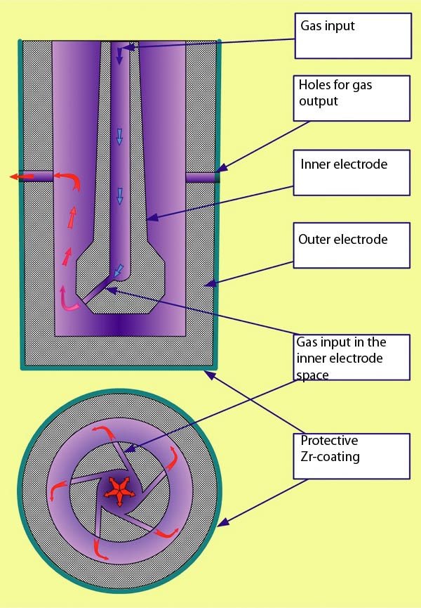
Concepts of electrode design for DDHM
(Possibility of application of an outer electrode with demountable bottom for checkout of an exactitude of coaxial installation of electrodes is considered)

Slide 8
Test section (RPV model)
The shape and diameter of RPV model are finally chosen
The RPV model wall thickness calculation is under way
Points of temperature measurement will be determined after calculation finishing
Safety of tests is estimated (control points of measurements and limiting values of parameters in these points are defined).
Two candidate materials of RPV model:
Steel used for VVER pressure vessel fabrication (Izhora factory)
Steel used for French reactors pressure vessel fabrication (AREVA)

Slide 9
Technological systems
Not used equipment was removed
Lay-out of room for additional transformers installation for electric power supply of two additional plasmatrons was estimated
Life-time testing of transformers for plasmartons power supply is under way (necessity of additional transformers cooling will be certain on the basis of these trials)

Slide 10
Data measurement and acquisition system
For enhance of noise immunity of measuring system following action are performing:
Inspection of existing DAS and found out of electrical noises source
Optimization of communication lines between test facility and control panel
Purchase of new equipment
Replacement of out of date gauges and transformers
Mounting and check-out of DAS

Slide 11
Supporting experiments
Zr-coating life time testing will be continued (including tests with addition of stainless steel components).
Research of molten Zr spreading on the graphite outer surface is under way.
Research of molten Zr spreading on the graphite crucible inner surface at the temperature gradient along the crucible height was finished. Recommendations on Zr-coating of large-scale crucible were made.

Slide 12
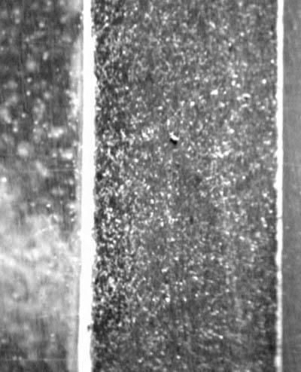
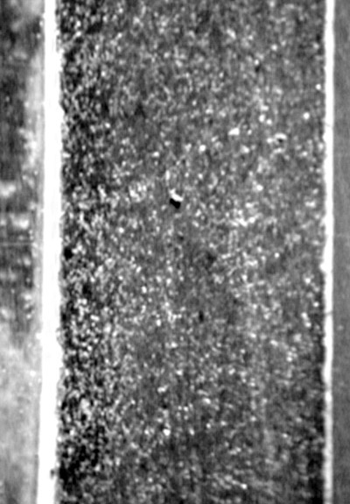
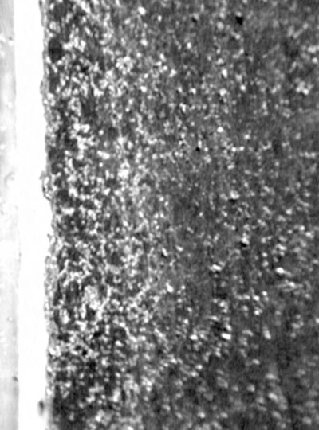
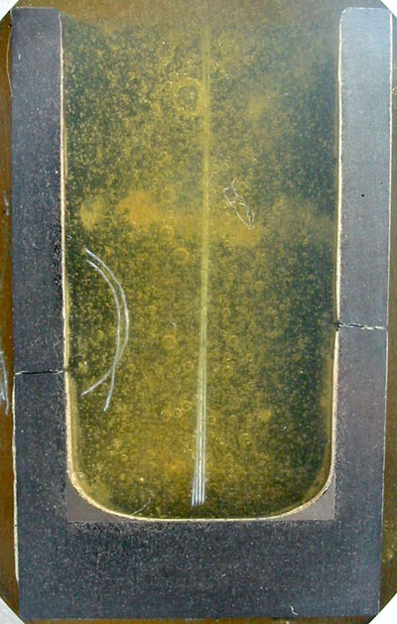
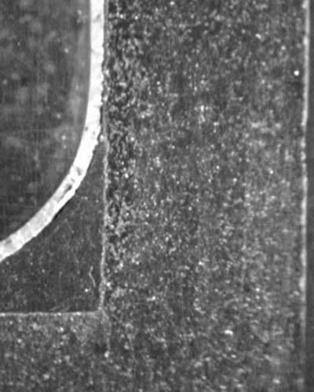
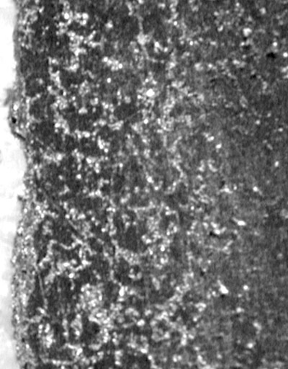
Results of Zr-coating research
Zr-coating structure

Slide 13
Results of Zr-coating research
Total thickness of Zr-coating is 60…70 microns
Outer layer of coating is solid solution of carbon in alpha-Zr matrix
Layer adjoining to graphite, is ZrC_{1-X} phase
Thickness of carbide phase is 30…40 microns
ZrC layer after life time tests (with molten corium) as a whole have appeared more thick, and consist, as a rule, of a zirconium carbide. The outer layer (about 5-7 microns thickness) is zirconium oxicarbide and intermediate layer is, supposedly, substoichiometric zirconium carbide.

Slide 14
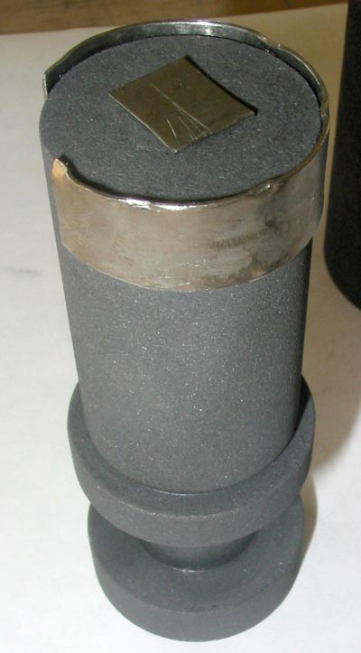
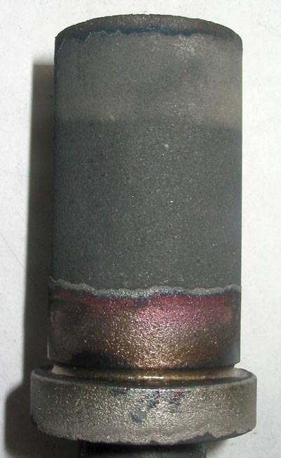
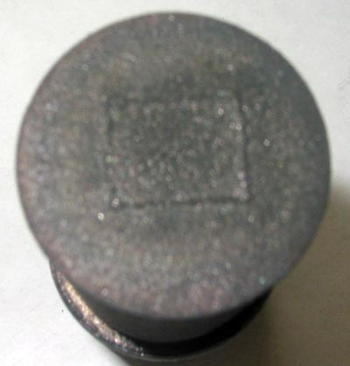
Molten zirconium spreading
Spreading of molten zirconium on the outers surface of graphite cylinder

Slide 15
Equipment and materials procurement
List of materials, equipment and suppliers is itemized.
Requests for procurement were sent to ISTC office.
First lot of equipment is delivered in institute
The query in the ministry for deriving the license to import of graphite from Germany is made
Agreement of the contract on delivery of necessary amount of uranium dioxide is under way
Note. Procedure of materials and equipment procurement is appreciably impeded concerning the stated terms

Slide 16
Conclusions
Basic works of project Working Plan are under way
Calculation of electric melting furnace for improving of heating mode and increase of loaded mass are under way
Testing of heater for molten corium is continued and new electrodes design is developed
RPV model and corium pool behavior have been calculated
Technique of Zr- coating application on large scale crucible and electrode nozzles is under way
Data measuring and data acquisition system improvement is performed

