Slide 1
Fast reactor self protection under ULOF and sodium boiling conditions
IPPE ISTC #1411 Project
D. Juhel J.M. Seiler
CEA Grenoble
Jean-marie.seiler@cea.fr
Presented by Christophe Journeau

Slide 2
CEA Program on SFR
Gen IV
Preferred option Sodium-cooled fast reactors
Objective: Prototype by 2020 (ASTRID)
Severe accident issues:
  Similar to LWR (except LOCA – pool reactor), plus
  Re-critically risk
    Core normal operation is not most critical state
      Sodium voidage => several $

Slide 3
Reactor Problematic
ULOF (Unprotected Loss Of Flow) accident
  Normaly leads to Na boiling, flow excursion, voiding of fissile zone and Transient Over Power
Possibility to stabilise boiling in the outlet zone of subassembly
  avoid flow excursion
  avoid voiding of fissile zone
  contribute to decrease power (plenum effect)

Slide 4
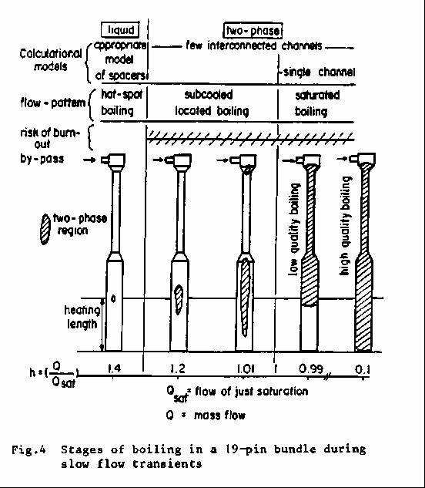
Stages of boiling during slow flow transients (pump excursion)
Hot spot boiling
Subcooled located boiling
Saturated generalized boiling
  Single tube tests : flow excursion (instability)→ high quality boiling in the all channel (dry out)
  Bundle tests : possibility of stable low quality boiling located in the downsteam region

Slide 5
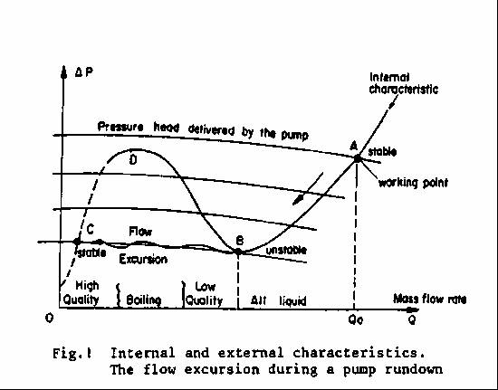
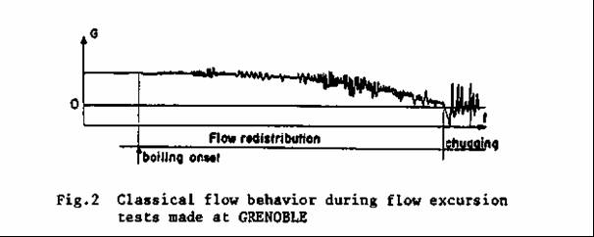
Theoretical approach to the
Stability of a working point
LEDINEGG criterion
Internal characteristic has typically a S shape
External characteristic rather horizontal
Ledinegg criterion :
Working point stable if
(dΔP_{EC}/dQ) <d(ΔP_{IC}/dQ)
Internal characteristics are determined under steady state boiling conditions
Unstable conditions result in flow excursion

Slide 6
Internal characteristic different shapes
Single channel,
small hydraulic diameter
Single channel,
large hydraulic diameter
Possibility of stable boiling

Slide 7
GR19 experiment
Conducted in 1984 in Grenoble*
With real fluid (sodium)
19 pins rod bundle
At real temperatures (inlet about 400°C, outlet up to 900°C) and pressure (atmospheric)
Scale 1:1 in elevation
Main measurements : pressure drops and mass flow rate
(*In parallel with a large programme involving USA, Germany, Italy, UK and Japan)

Slide 8
GR19 experiment;
CFNa test rig

Slide 9
Test sections
GR19 SPX
271 pins

Slide 10
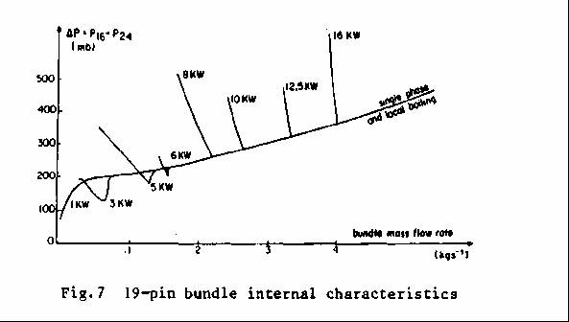
GR19BP internal characteristic
19 pin bundle
Internal characteristics have been measured
Possibility of stable boiling in subassembly outlet

Slide 11
Theoretical approach:
Recalculation with
Lockhart Martinelli friction corelation

Slide 12
Reactor application
ULOF accident
=> question: what would be optimum geometry of outlet zone of reactor subassembly to maximise power extraction by stable boiling ?

Slide 13
Reactor application
After experimental validation on existing experiments, the model has been applied to reactor. Results:
  The performance depends on the geometry
  It is easily possible to have stable boiling convection up to 50% of nominal power
    Without voiding the fissile length
    Without risk of power excursion

Slide 14
Example of parametric reactor calculations;
Suppression of upper fertile cover;
Effect of subassembly outlet tube diameter
Diameter of oulet tube: 5 cm
  Other characteristics: standard
Diameter of outlet tube: 18 cm
  Other characteristics: standard
=> Stability up to ~22% nominal power
=> Boiling is always stable

Slide 15
Future needs
To demonstrate the stability for reactor size conditions
To analyse effects of LOF transient on boiling stability
To analyse effect of dynamic instabilities on flow stability
  => May dynamic oscillations between parallel subassemblies induce flow excursion ?

Slide 16
1) to demonstrate the stability for reactor size conditions
SENSAS tests (water + gas) will be performed at CEA
IPPE sodium tests
  Complementary needs to existing tests:
    Full size in axial direction (~1 meter heating zone)
    Tests up to 50% nominal power (or even higher)
    Maximum possible size in radial direction (37 pins at 50% PN => ~ 600 kW)(less than 19 pins: no interest)
    If possible variable subassembly outlet geometries
    Precise pressure difference measurements at different levels (required precision: < +/- 500 Pa or +/- 5 mbar)
    Steady state boiling tests (requires a specific external characteristic (pump, by-pass and valves) in order to explore precisely the minimum of the internal characteristic; flow variation steps of ~ <1% of flow at boiling inception )

Slide 17
2) to analyse effects of LOF transient on boiling stability
Request for simulation of variable ULOF kinetics
  => Determination of the minimum pump inertia that is needed for successful boiling stabilisation

Slide 18
3) to analyse effect of dynamic instabilities on flow stability
Requires tests with parallel subassemblies
  at least: 2 subassemblies with stable boiling conditions
  Flat external characteristic
  Measurements of flow and pressure oscillations

Slide 19
    Tests should bring complementrary information to existing data
    CEA has an interest in principle but,
    would like to discuss details of test arrangements
      Loop design (in particular: external characteristics)
      Geometries,
      Heater technology
      Measurements
      Test conditions

