Slide 1
Severe
Accident
Facilities in
Europe and
Russia (SAFER)
Christophe JOURNEAU
Commissariat à l’Energie Atomique et aux Energies Alternatives
Alexei MIASSOEDOV
Karlsruhe Institute of Technology
Sevostyan BECHTA Kungliga Tekniska Högskolan
Vladimir KHABISNSKY
NITI Sosnovy Bor
Alexander GORYACHEV
RIIAR Dimitrovgrad
Vladimir ZHDANOV
IBRAE Novosibirsk
DEN/DTN/STRI/LMA
October 2011

Slide 2
Existing EURATOM Severe Accident Infrastructure Projects
PLINIUS FP6: The PLINIUS prototypic corium platform at CEA Cadarache
    VULCANO ~50 kg: MCCI, spreading, cooling…
    COLIMA ~3 kg : aerosols, material interactions
    KROTOS ~5 kg: Fuel Coolant Interaction
    VITI < 10 g: Thermophysical properties, interaction, phase diagrams
LACOMECO: Karlsruhe Institute of Technology experimental platform for high temperature simulant and hydrogen
    QUENCH: Quench behaviour of Fuel Rod simulators
    LIVE: Melt Behaviour in Lower Head
    DISCO-H: Dispersion of corium, DCH…with aluminothermite
    HYKA: Hydrogen behaviour and Mitigation

Slide 3
Transnational Access to Large Infrastructures (1)
Community support will be provided to cover costs of Transnational Access to Large Infrastructures (TALI) for researchers from Member States and Associated States, other than the state where the infrastructure is established, in order to promote access for researchers to infrastructures that provide essential and unique services to the European research community.
Access to researchers from 3rd countries could also be envisaged, where such access is part of the promotion of broader international cooperation with the countries concerned. The active participation of major infrastructure operators and potential users will be required to achieve the objectives.
Expected impact: Optimised use of existing nuclear research infrastructures in Europe in all activities of the programme and facilitated access to these infrastructures by researchers throughout Europe and from 3rd countries.

Slide 4
Transnational Access to Large Infrastructures (2 - in practice)
Access for visiting scientists from EU (except Country of Infrastructure) and Associated/Third Countries to perform tests in selected facilities.
The EU will pay all facility costs + travel and expenses.
Visitor institution pays only visitors salary(ies).
Submission of Proposals by potential visitors
These access grants are offered either for students (Master or PhD thesis, post-docs,…) or for more experienced scientists and engineers working on severe accidents or any other field for which access to our platform would be fruitful.
Selection by International Panel, including one SARNET Representative
Visit by 1-4 scientist(s) during 1 day to ~1 month for the performance of experiment(s) with iinfrastructure’s scientific and technical team.
Visitors may bring specific apparatus to install in our facility.
Visitors must disseminate results in the open literature
Typically 3 to 10 accesses will be funded by the EU.

Slide 5
ALISA [EURATOM-China project]
Enhanced transnational access to large research infrastructures in Europe and in China is offered to allow the optimal use of the resources in the extremely complex field of severe accident analysis for the existing power plants. This research involves very substantial human and financial resources and, in general, the research field is too wide to allow investigation of all phenomena by any national programme.
To optimise the use of the resources, the collaboration between nuclear utilities, industry groups, research centres and safety authorities, at both European and Chinese levels is very important. This is precisely the main objective of the ALISA project, which aims to provide these resources and to facilitate this collaboration by providing large scale experimental platforms in Europe and in China for transnational access.
The ALISA project offers a unique opportunity for all parties to get involved in the networks and activities supporting safety of existing and advanced reactors and to get access to large scale experimental facilities in European and in Chinese research organisations to enhance understanding of material properties as well as reactor core behaviour under severe accident conditions.
Activities within the ALISA project will focus on the large scale experiments under prototypical conditions addressing the remaining R&D issues on severe accident management in light water reactors.

Slide 6
FP7 EURATOM (Call 2010 excerpts)
Cooperation with Third Countries: A structured dialogue has already been established with Russia.
    If bodies from 3rd countries do not wish to, or cannot for legal reasons, sign the Euratom Grant Agreement, alternatively two administratively separate projects (so-called ‘coordinated’ or ‘parallel’ projects) could be established, each set up according to the respective rules and procedures, but strongly coupled via a Coordination Agreement (based on the format of a Consortium Agreement) to be signed by all partners engaged in the cooperative action.
    Transnational Access to Large Infrastructures is one of the items open for collaboration between EURATOM and Russia.
DEN/DTN/STRI/LMA
Référence…
3 juin 2010

Slide 7
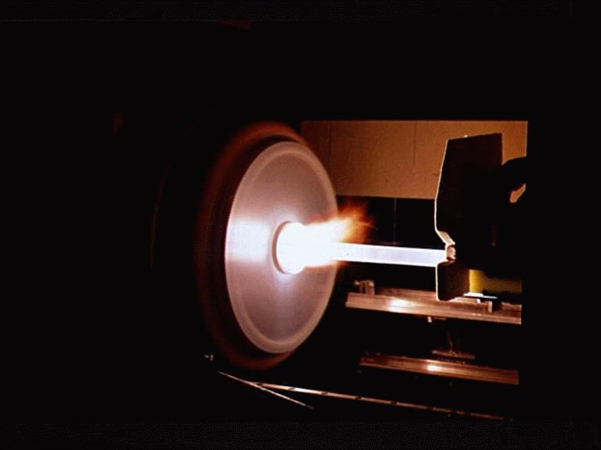
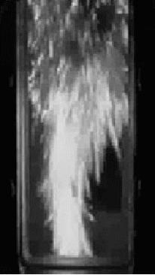
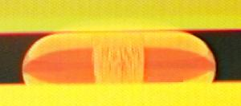
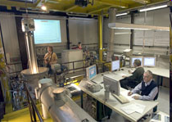
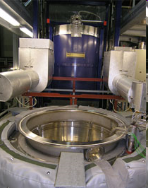
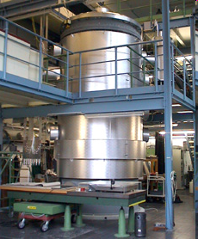
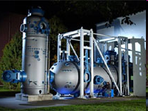
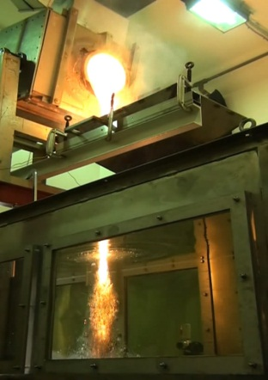
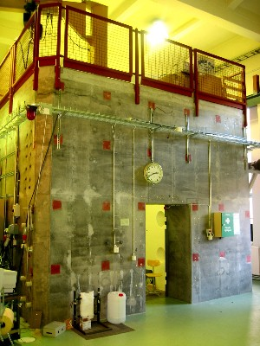
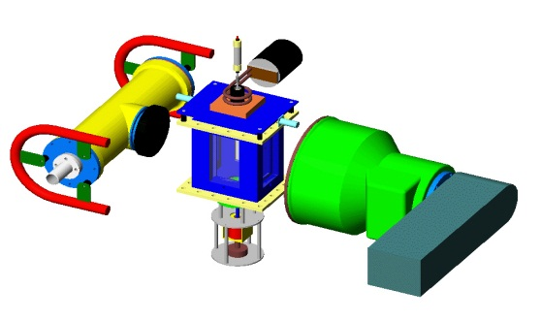
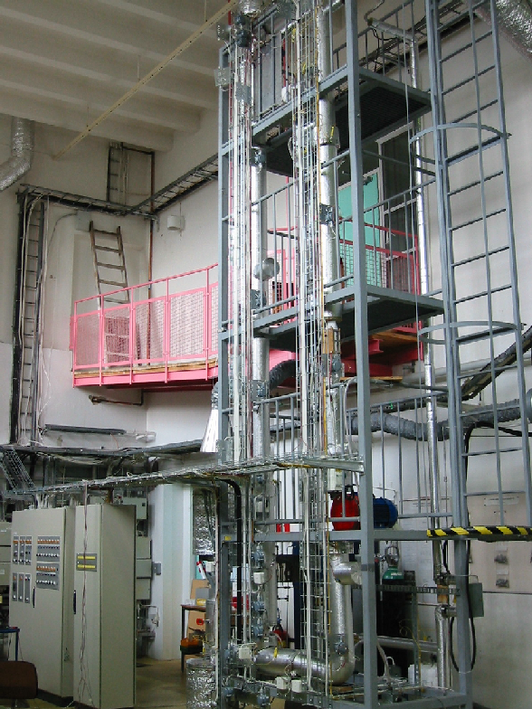
Proposal: European Side
PLINIUS platform
LACOMECO platform
KTH platform
Melt
Release Plug
Induction
Furnace
X-ray
Detector/
Intensifier
X-ray Tube
External
Trigger
Camera
7

Slide 8
Proposal: European Side (2)
DEFOR: Debris Bed Formation in melt-coolant interaction
PULiMS: Pouring and Underwater Liquid Melt spreading. Up to 10 litres of molten ceramics melt.
Pre-stressed concrete containment (4x4x4 m) up to 5 bar overpressure.
POMECO: Porous Media Coolability study of volumetrically heated debris bed
MISTEE: Micro Interactions in single drop steam explosion with simultaneous X-ray and photo video high steed imaging
TALL: 7m high heavy liquid metal thermal hydraulics loop
Micro dynamics of liquid film and bubbles on heated surfaces
Facility for study of fuel pellet interaction with liquid metal coolant
8
KTH platform

Slide 9
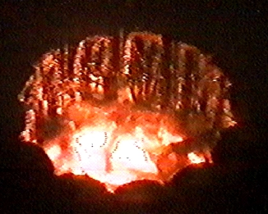
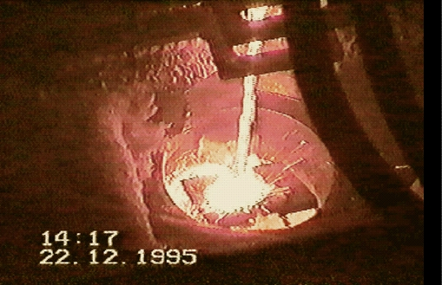
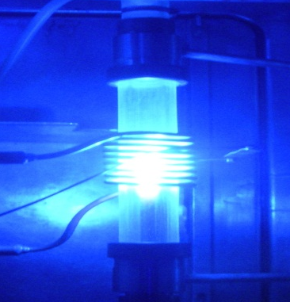
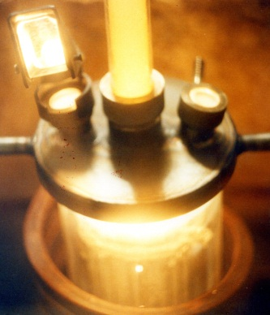
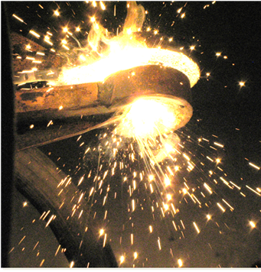
Proposal: Russian side 1) NITI (Sosnovy Bor)
RASPLAV platform for chemically prototypic corium
Small scale facilities for phase diagram study
Levitation furnace for material property study
9

Slide 10
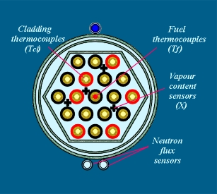
Proposal: Russian side 2) RIIAR (Dimitrovgrad)
Simulation of loss of coolant and partial core dryout accident (LOCA)
Tests are carried out on the VVER fuel assembly fragments (7 - 19 fuel rods) in the PVP-2 loop channel of MIR Reactor.
Dryout and overheating of the upper part of the fuel rods up to 1200^{о}С is carried out at the given pressure, flowrate and fuel assembly power. The tests are terminated by increasing the flowrate and/or decreasing the fuel assembly power.
The following parameters are controlled: temperature of some fuel rod claddings and cores, fuel rod pressure; flowrate, temperature, pressure and steam content in the coolant; neutron flux , hydrogen concentration in coolant.
9 tests had been performed under the LOCA conditions. The refabricated VVER fuel rods with burnup up to 60 MWd/kg U were tested.

Slide 11
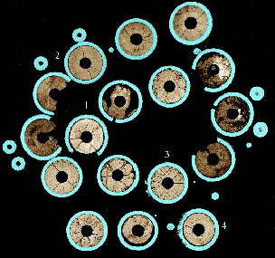
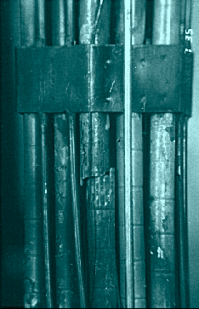
Proposal: Russian side 2) RIIAR (Dimitrovgrad)
Appearance and cross-section of the fuel assembly fragment tested under LOCA conditions (above 1200ºC) followed by reflood.

Slide 12
Proposal: Russian side 3)IBRAE (Novosibirsk)
IBRAE Novosibirsk: new facilities for FR severe accidents
Small scale facilities currently under preparation at Academy of Science Siberian branch will be dedicated to the study of severe accident configurations for metal (lead) cooled fast reactors.
    Interaction Pb-cladding steel, within accelerator

Slide 13
Proposal Financial constraints
No transfer of money over the border between EU and Russia
    EURATOM pays for the tests in Europe and for the Russian visitors’ expenses.
    ROSATOM pays for the tests in Russia and for the European visitors’ expenses.
EURATOM contribution is limited to 1 M€ for the whole project
    Pays 100% (with a cap on overheads)
ROSATOM contribution should be of same magnitude.

Slide 14
Tentative Schedule
Proposal to be submitted to EC in April 2012 (Date not yet decided)
Negotiation phase ~ 1 year
    EU partners with EURATOM
    RU partners with ROSATOM
    Consortium and Cooperation Agreements
Start of project in 2013
Preparation of rules of access and of call for proposals
Selection panels
Experiments to start in 2014
Duration of project : 3-4 years

Slide 15
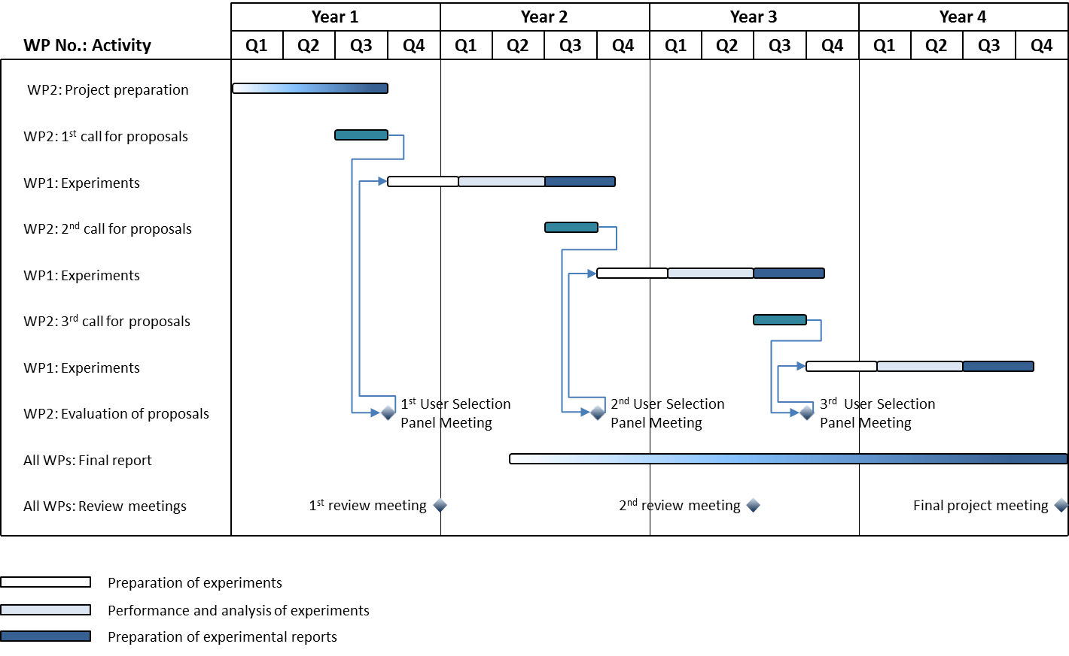
Example of project time schedule

