Slide 1
ISTC project K-1265: Experimental study of core melt in-vessel retention IN-VEssel COrium Retention (INVECOR)
Presented by Vladimir Zhdanov
IAE NNC RK
CEG-SAM 13th Meeting,
March, 05 – 06, 2008
Budapest, Hungary

Slide 2
Presentation contents
Introduction
Main directions of work and results
Test section (TS) design (RPV model)
Zirconium coating of electrode nozzle
Testing of device for decay heat modeling (DDHM) in prototypic corium (TOP-1…TOP-3 tests)
Comparative analysis
Supporting tests on corium melting
Additional plasmatrons testing objectives
Summary on TOP tests results
Conclusions

Slide 3
Introduction
Project K-1265 has been started from May 1, 2006.
Operations are fulfilled according to the confirmed Working Plan (for today while there are no terminated operations).
Ongoing task are:
Modernization of test facilities, optimization of melting process and simulation of decay heat.
Calculation support of experiments.
Post-test analysis.
Problem of major task performance (large scale tests) because to materials and equipment delivery delay.
Notes:
Result of work were described in Annual report.
We should start Major task “Large-scale experiments “ from May 1, 2007. It includes 2 calibration tests and 3 integral tests.
We solved to perform one plasmatrons tests with prototypic corium using available in institute materials because of materials and equipment delivery problem.
Results of three one plasmatrons tests were placed in FTP-server.

Slide 4
Test section (RPV model)
The shape and dimension of RPV model are finally chosen.
It was solved to make RPV model from usual carbon steel (matrix) and insert the samples of RPV steel into the matrix wall in chosen points.
Samples of RPV steel will be equipped with thermocouples for different dept.
Experimental estimation of thermal insulator effect was conducted at different condition (including tests with one plasmatrons in prototypic corium).
Notes:
Main RPV model matrix made from carbon steel and RPV steel samples were delivered to institute.

Slide 5
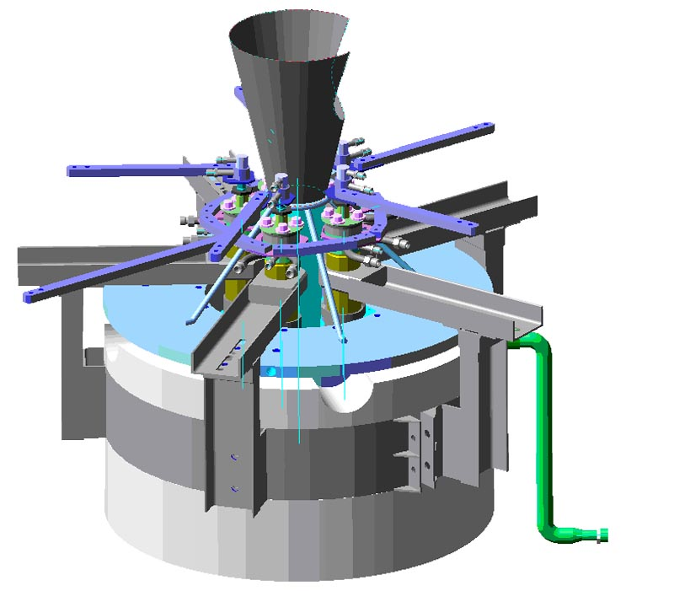
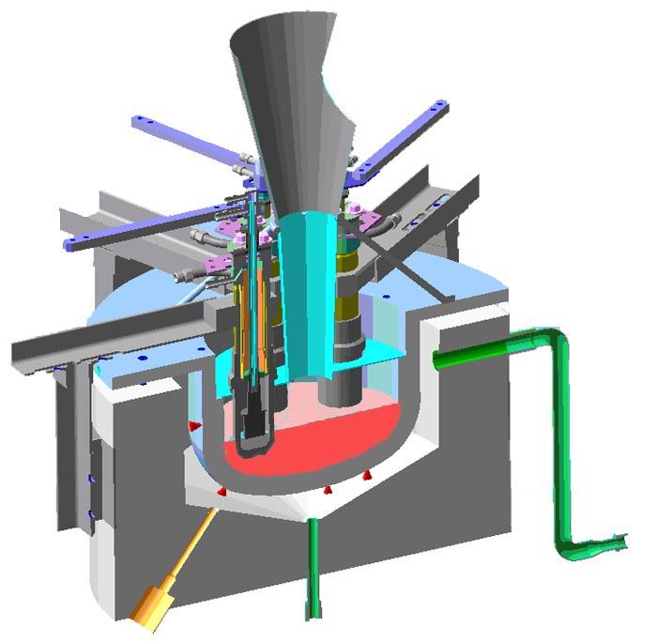
Test section (2)
Outside view of test section including device for decay heat modeling
Longitudinal section of experimental assembly including device for decay heat modeling

Slide 6
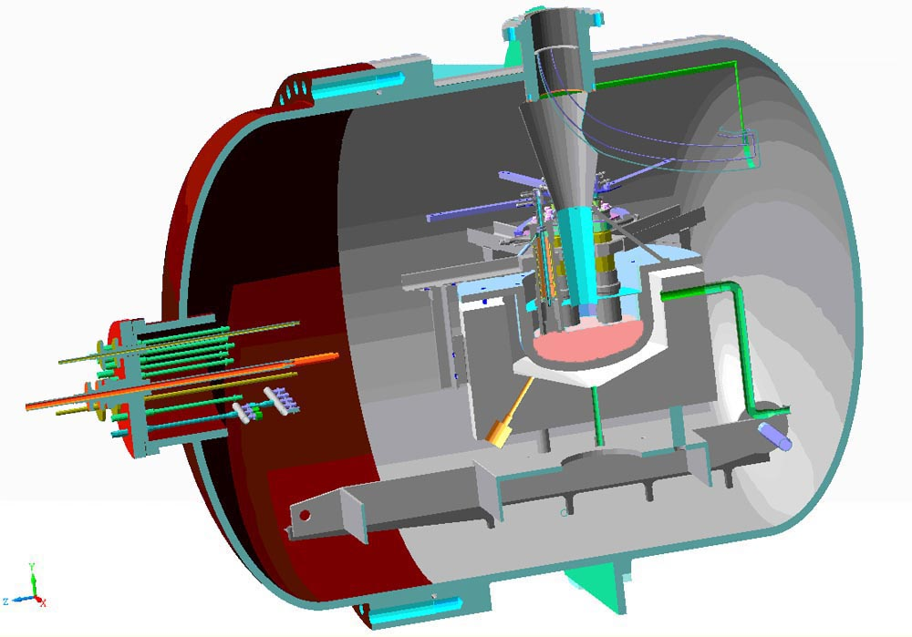
Test section (3)
Test section including device for decay heat modeling inside pressure vessel of large scale facility

Slide 7
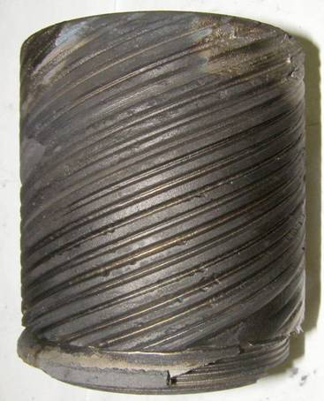
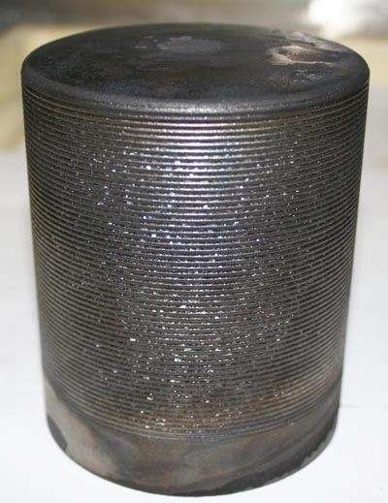
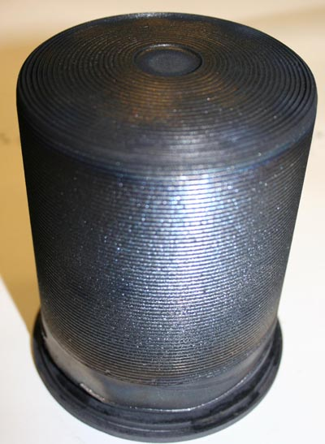
Zirconium coating of electrode nozzle
for TOP-1 test
for TOP-2 test
for TOP-3 test
Coated electrodes for TOP tests

Slide 8
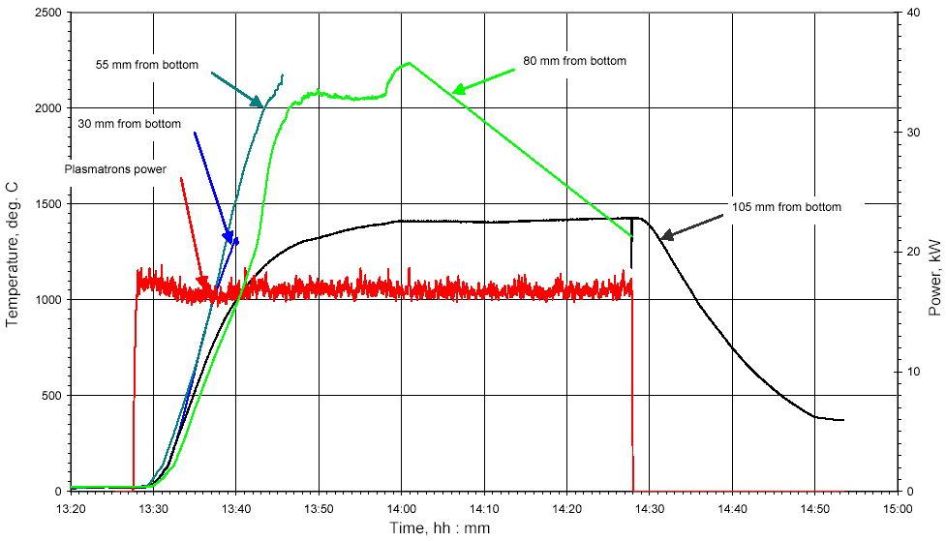
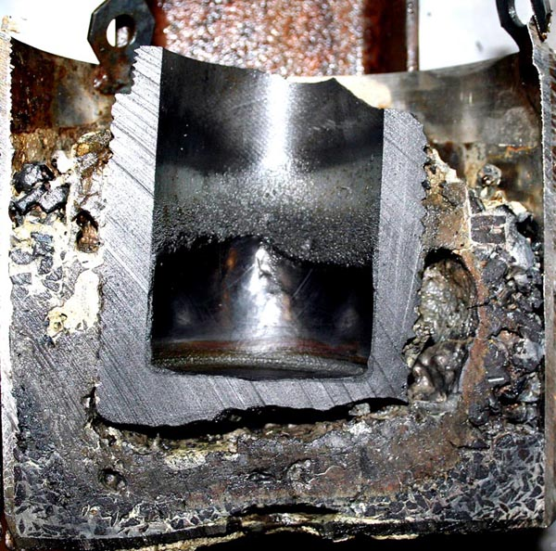
Testing of device for decay heat modeling (1)
Cross section of experimental cell
Temperature of corium
(distance is 10 mm from sidewall of inner vessel)
TOP-1 test

Slide 9
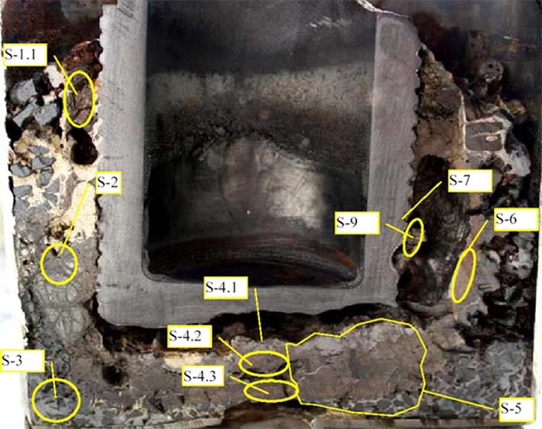
Testing of device for decay heat modeling (2)
Main phases are:
(U_{A},Zr_{B})O_{2-X}
Zr(O,C)
Zr(N,O,C)
(U,Zr)(O,C,N)
ZrC
Other phases are:
ZrO2
α-Zr(O)
UC₂
Scheme of corium sampling
Results of TOP-1 post test research
Notes:
Carbides were found in the samples which were taken close to eroded graphite

Slide 10
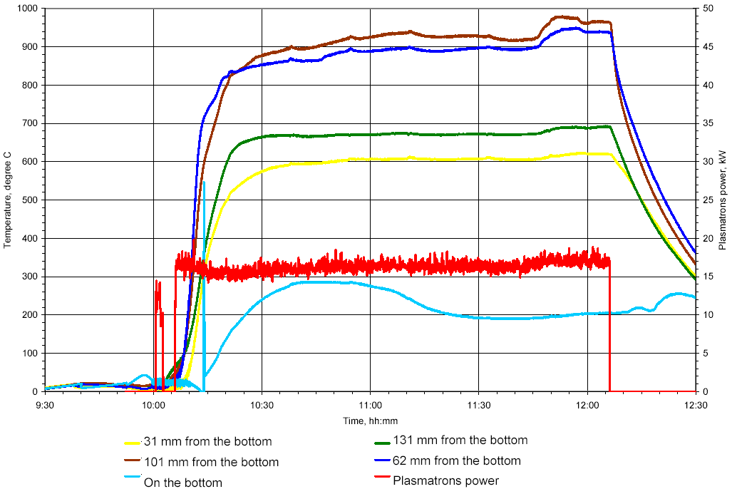
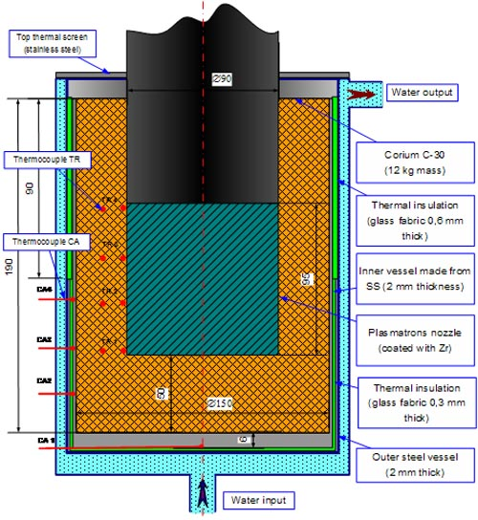
Testing of device for decay heat modeling (3)
Scheme of loading
Temperature of inner vessel wall
TOP-2 test

Slide 11
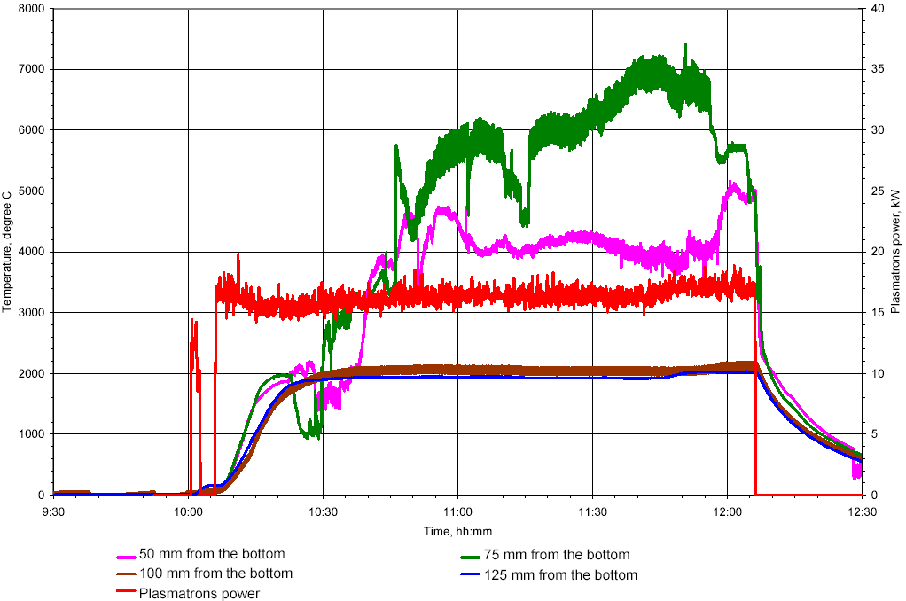
Testing of device for decay heat modeling (4)
Thermocouples location in the corium
Temperature of corium
TOP-3 test

Slide 12
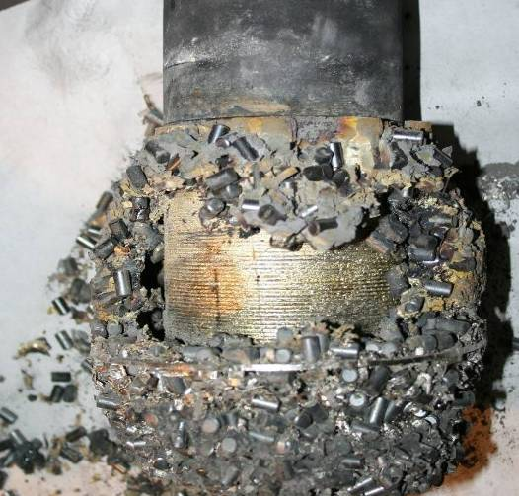
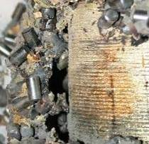
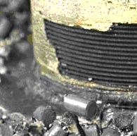
Testing of device for decay heat modeling (5)
Results of experimental cell disassemble after TOP-2

Slide 13
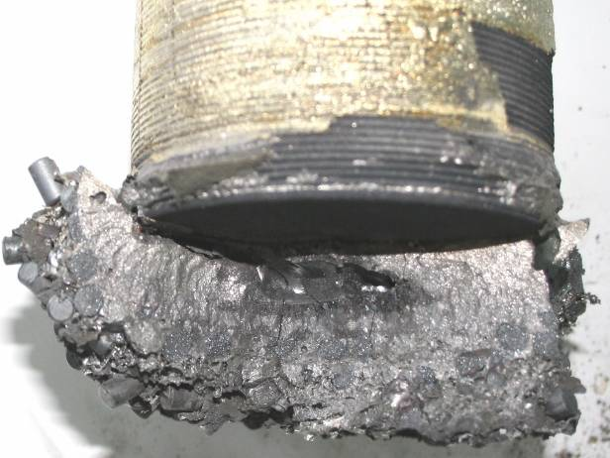
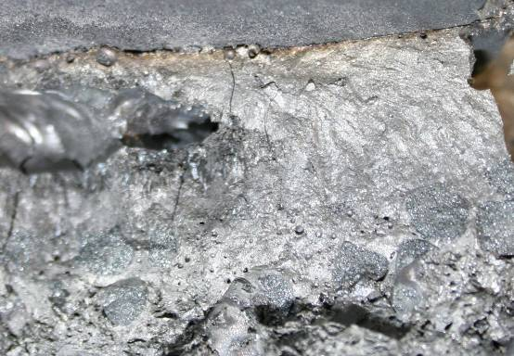
Testing of device for decay heat modeling (6)
Main phases are:
U_{0,9}Zr_{0,1}O₂
U_{0,8}Zr_{0,2}O₂ − U_{0,4}Zr_{0,6}O₂
UO₂
Other phases are:
α-Zr(O)
Zr(O,C)
S5
S6
S7
Pellet UO₂
Scheme of corium sampling
Notes:
It is difficult to discriminate Zr(O,C) and Zr(O,N) via X-ray phase analysis

Slide 14
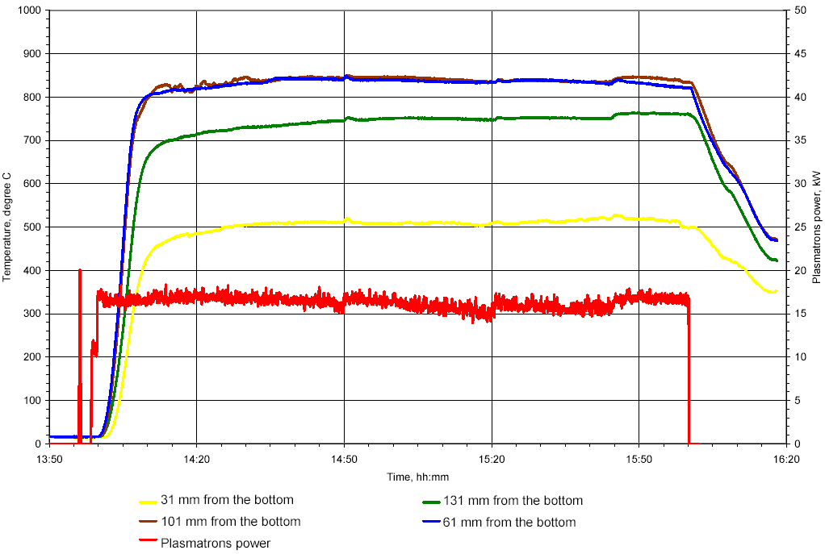
Testing of device for decay heat modeling (7)
Temperature of inner vessel wall
TOP-3 test
Notes:
Scheme of initial loading was similar to TOP-2 test
Cavity of experimental cell was filled with nitrogen before start of test

Slide 15
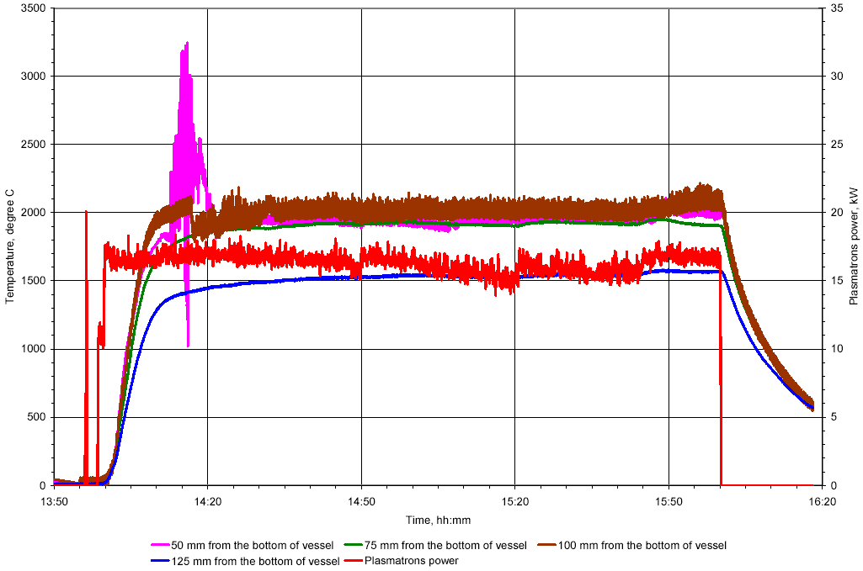
Testing of device for decay heat modeling (8)
Temperature of corium
TOP-3 test

Slide 16
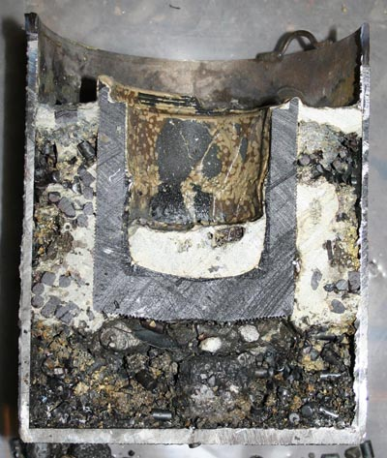
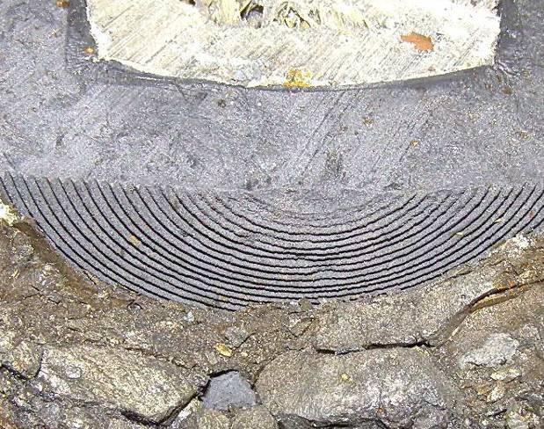
Testing of device for decay heat modeling (9)
Experimental cell disassemble after TOP-3
Notes:
Generally, view of corium after test was similar to TOP-2, but corium ingot under electrode was very fragile.
Protective coating crumbled from graphite surface but no graphite erosion was observed.

Slide 17
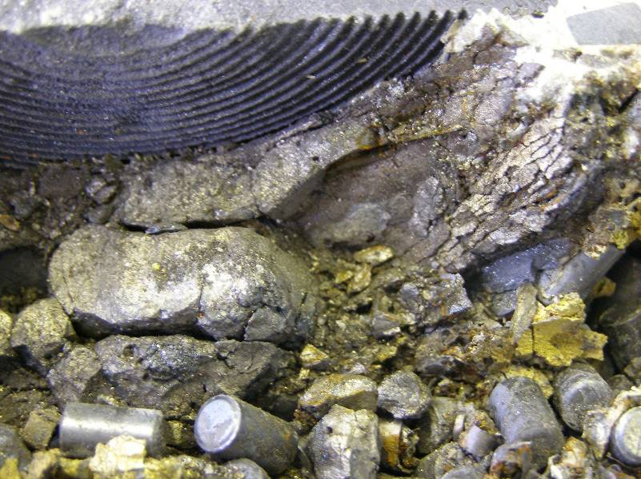
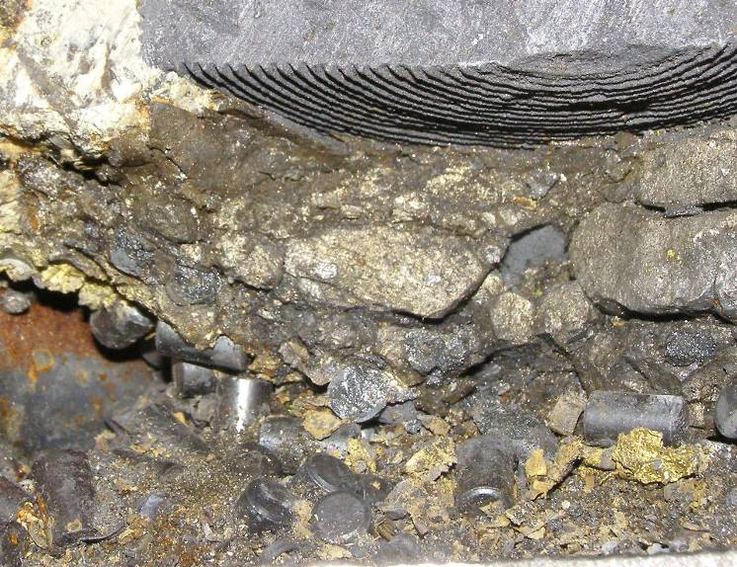
Testing of device for decay heat modeling (10)
S3
S4
S7
S1
S5
S8
S2
S6
Scheme of corium sampling
TOP-3 test

Slide 18
Testing of device for decay heat modeling (11)
Main phases in corium samples are:
U_{0.85}Zr_{0.15}O₂ - U_{0.6}Zr_{0.4}O₂
UO₂
(U,Zr)(C,O,N)
Zr(N,O,C)
Other phases are:
ZrO₂*
α-Zr(O)
*) It were found both monoclinic and tetragonal types of ZrO₂
TOP-3 test

Slide 19
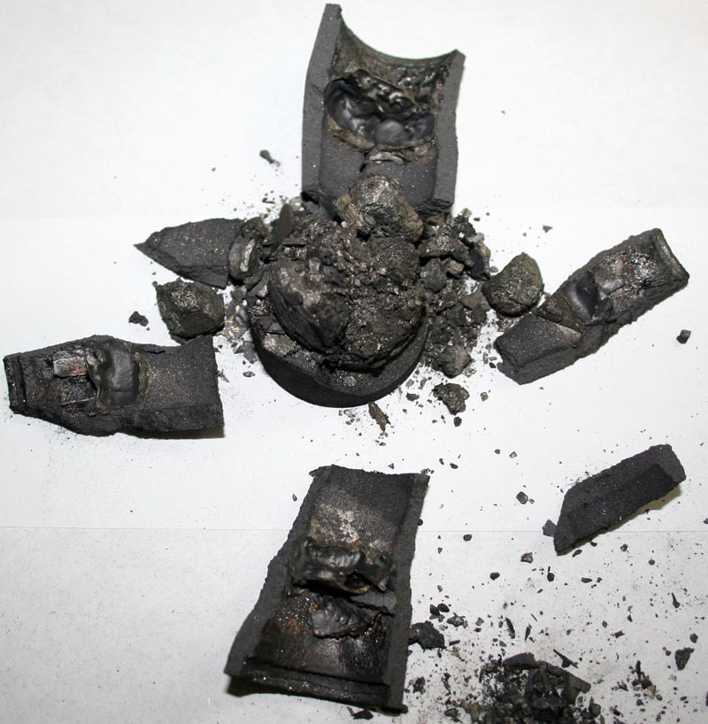
Supporting experiment on research of nitrogen influence
Main phase is U_{0,85}Zr_{0,15}O₂
Other phase (approximately): (Zr,U)(O,N,C,)_{X}
Result of corium melting in nitrogen atmosphere
Notes:
Corium expanded after test and disrupted graphite crucible.
It is difficult to resolve presence of carbon and nitrogen in oxides.
No difference was found during the melting of corium based on BN-350 pellets and pellets

Slide 20
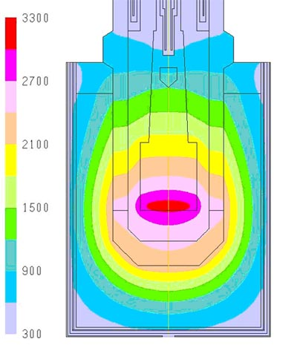
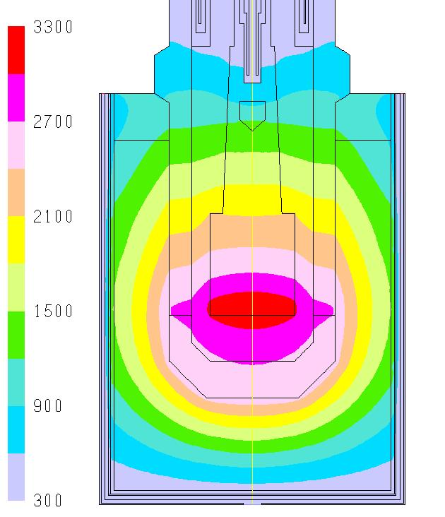
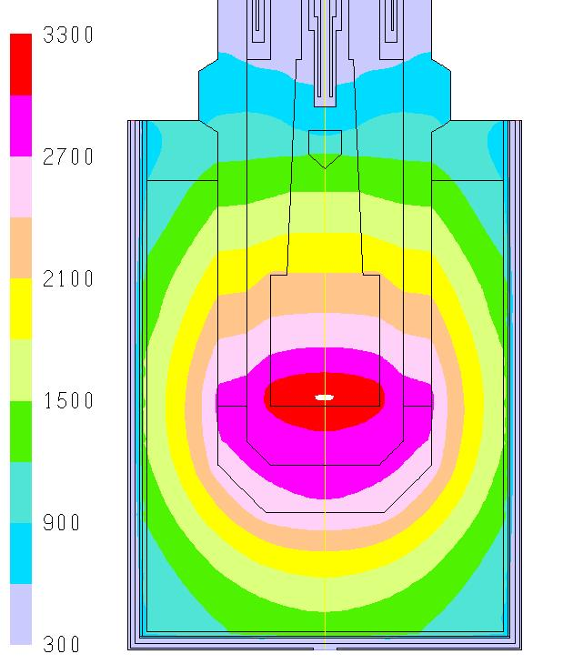
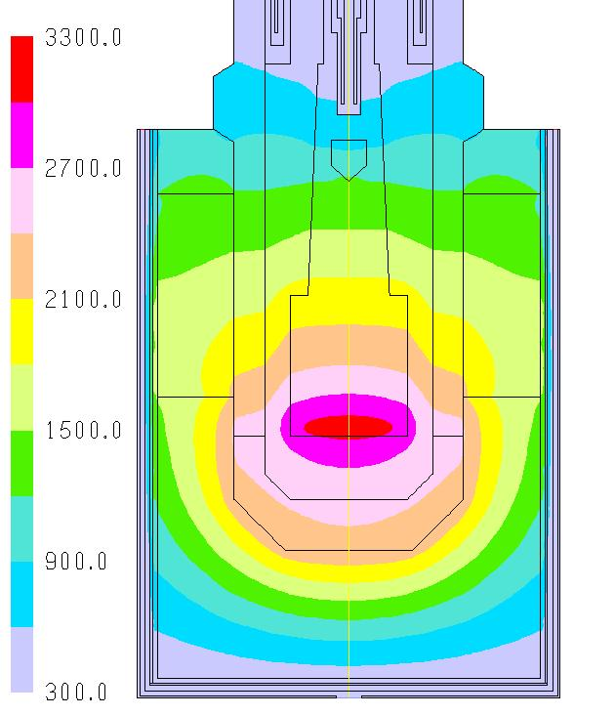
Post test calculation (TOP)
a) Uniform gap between walls of inner and outer vessels (0,3 mm) (plasmatrons power is 17 kW)
b) Gap between walls of inner and outer vessels is 0,5 mm (plasmatrons power is 18 kW)
c) Gap between walls of inner and outer vessels is 1,0 mm (plasmatrons power is 18 kW)
d) Similar to (b), but electrode dipped for 60 mm into corium

Slide 21
Additional testing of plasmatrons
Objectives
To find the optimal gas composition and pressure in the pressure vessel of experimental facility.
To increase the average electric power of plasmatrons.
To research the possibility of additional loading of corium components into experimental vessel for increase of corium pool depth.
Varied parameters
Gas composition
Ratio between pressure inside coaxial plasmatrons and pressure vessel volume
Changes of electrical circuit components
Notes:
Nowadays we’re repairing gas and water lines of large scale facility which were damaged because extremely cold weather during 2 month

Slide 22
Summary on TOP tests results
Main results of TOP tests are:
Application of thermal insulation on the outer surface of RPV model allows temperature increase up to level of phisico-chemical interaction “corium-steel”
Protective coating on graphite electrodes showed its reliability against molten corium attack
Design of plasmatrons ensures the operation of device for decay heat modeling during 2 hours and more
Electrodes should be dipped into corium for 100 mm (at least) for providing of sufficient efficiency of heating
Increase of plasmatrons power up to 18…19 kW could allow to increase of corium mass via preliminary approx 10 kg loading of corium into test section

Slide 23
Conclusions
Basic works of project Working Plan are under way.
Technique of Zr- coating application on electrode nozzles was worked out.
Three tests with one plasmatrons in prototypic corium were conducted. Post-test research was almost finished.
Testing of plasmatrons in “free” condition was restarted to improve the future tests conditions.
Problem of materials and equipment necessary for large scale have been continued.

