Slide 1
Alexandrov Research Institute of Technology (RIT­NITI)
Numerical modeling of corium molten pool in the lower section of INVECOR facility
Presented by S. Bechta
1st INVECOR Meeting

Slide 2
AUTHORS
Dr. Sergey Smirnov, D.V.Efremov Scientific Research Institute of Electrophysical Apparatus
Dr. Vladimir Granovsky, RIT-NITI
Dr. Andrey Sulatsky, RIT-NITI

Slide 3
OBJECTIVES
Support of facility design
Pre-test calculations
Post-test analysis

Slide 4
DYMELT FEM CODE
The numerical code is based on the model of melt thermohydrodynamics, melting and crystallization taken into account
2D and 3D equations of Navier-Stokes, continuity and energy are solved
Stationary and non-stationary calculations
Laminar or turbulent convection (k-ε, k-ω models), DNS
Boundary conditions: temperature, radiation
The numerical code has been verified by METCOR tests

Slide 5
PRELIMINARY CALCULATIONS
Objectives:
Qualitative analysis:
possibilities of maintaining corium in the molten condition in the RPV model
influence of parameters on the molten pool characteristics
Input data for calculations:
Lower head geometry corresponds to VVER-440
Linear scaling of model ~ 1:6 (Ø_{in}400 x 200)
Vessel wall thickness - 25 mm
Corium C-30, melt mass - 60 kg
Heater parameters: Ø70 mm, P_{nom} = 18 kW, n = 5 units
Heat losses along electrodes are disregarded

Slide 6
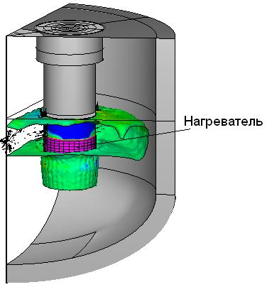
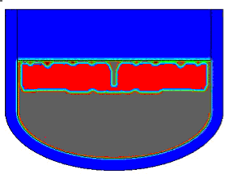
PRELIMINARY CALCULATIONS (2)
Total power 90 kW, crust conductivity 2 W/(m·K)
3D model
2D model
electrode
5 electrodes
The 2D model is applicable for preliminary calculations

Slide 7
PRELIMINARY CALCULATIONS (3)
Series of three calculations:
1. N = 90 kW, high screen position
2. N = 90 kW, low screen position
3. N = 120 kW, high screen position

Slide 8
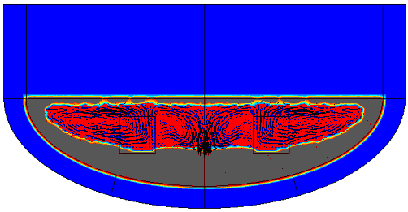
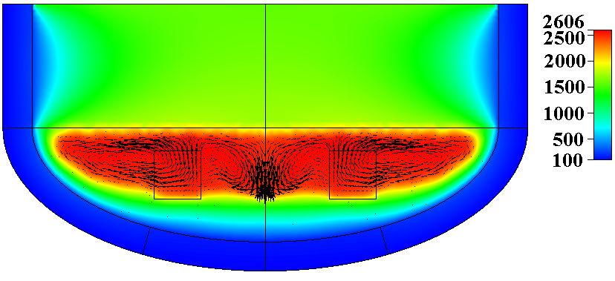
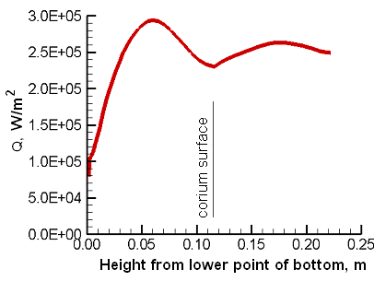
PRELIMINARY CALCULATIONS (4)
Shape of corium crust
N = 90 kW
High screen position
Distribution of heat flux density along the
external surface of the section
Temperature field

Slide 9
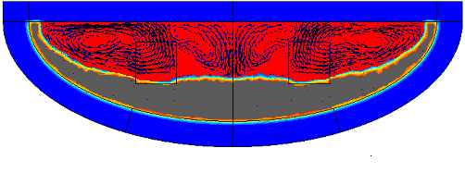
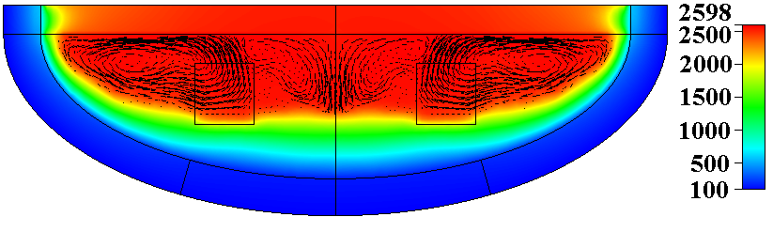
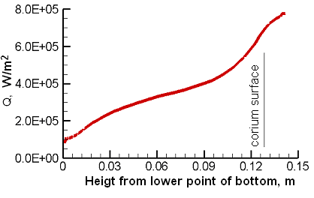
PRELIMINARY CALCULATIONS (5)
N = 90 kW
Low screen position
Shape of corium crust
Distribution of heat flux density along the
external surface of the section
Temperature field

Slide 10
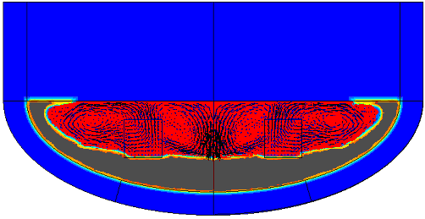
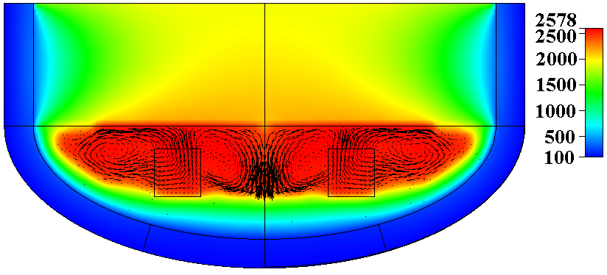
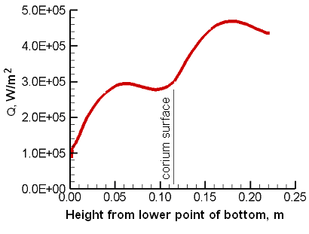
PRELIMINARY CALCULATIONS (6)
N = 120 kW
High screen position
Shape of corium crust
Distribution of heat flux density along the
external surface of the section
Temperature field

Slide 11
CONCLUSIONS
DYMELT code enables to calculate the molten core behavior on the bottom of RPV model
Preliminary calculations have confirmed the possibility of molten pool formation, if the total power of electrodes is close to 90 kW, but the volume fraction of a liquid phase in the pool is below 50 %
Ways to increase the volume of liquid phase and temperature:
- to raise electrode power
- to reduce distance between the screen and melt surface
- to increase the vessel wall thickness

