Slide 1
ISTC project K-1265: Experimental study of core melt in-vessel retention IN-VEssel COrium Retention (INVECOR)
Presented by Vladimir S. Zhdanov
IAE NNC RK
CEG-SAM 9th Meeting,
March 8 – 9, 2006
Paris, France

Slide 2
Presentation contents
Introduction
Main directions of work and results
Electric melting furnace (EMF) improvement
Test section (TS) design (RPV model)
Device for decay heat modeling (DDHM) design and testing
Testing and modernization of technological systems
Pre-calculation of above items
Testing and modernization of data measurement system
Zirconium coating life time tests results
Conclusions

Slide 3
Introduction
Work plan of K-1265 project has been prepared and sent to ISTC office In January 2006
List of project participants is specified
List of materials, equipment and suppliers is itemized.

Slide 4
Work structure and objectives
EMF
DDHM
Test section
Technological systems
DAS
Increase of loading mass
Increase of plasma power
Choice of RPV model material
Experimental diagnostic of technological systems capacity
Diagnostic of measuring system
Increase of heating efficiency
Increase of energy release uniformity
Choice of RPV model optimal dimensions
Detection of electrical noise sources
Performance of necessary modernization and additional units purchase
Diminish of temperature gradient
Suppression of carbon activity
Elaboration of instrumentation and critical points of measurement
Purchase of additional units
Increase of Zr-coating efficiency
Mounting and engineering setup
Suppression of carbon activity
Mounting and equipment check-out
Choice of RPV model manufacturer
Supporting experiments using small-scale test facility
Calculations

Slide 5
Electrical melting furnace
Summary of pre-calculation:
Temperature of crucible and rate of crucible heating increases at crucible wall thickness decrease;
Part of induction power in the crucible is diminished with decrease of crucible mass;
Use of thermal insulation SGL carbon improves considerably the efficiency of heating
Diminishing of crucible wall thickness allows to increase of melt mass
Calculation of loading heating mode for monotone temperature increase considering phases change and UO2 dissolution in molten zirconium are under way

Slide 6
Device for decay heat modeling
Testing of plasma burning up
Testing of the plasma ignition device reliability
Life time testing of plasmatrons
Testing of different working mediums for plasmatrons
Calculation and testing of the cooling water flow rate
Designing of plasmatrons for new condition
Development of zirconium coating on the outer electrode outer surface

Slide 7
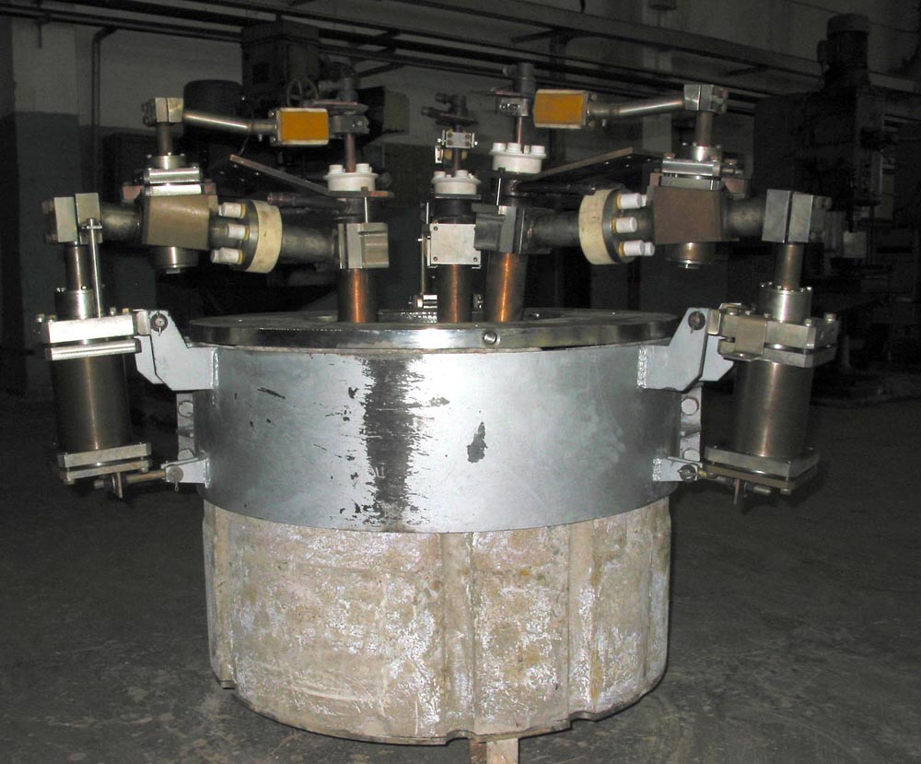
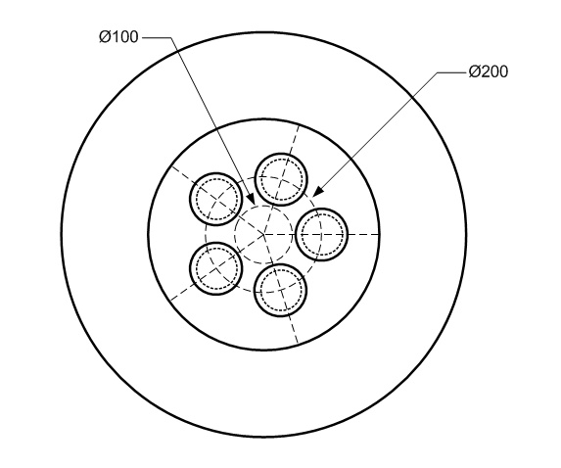
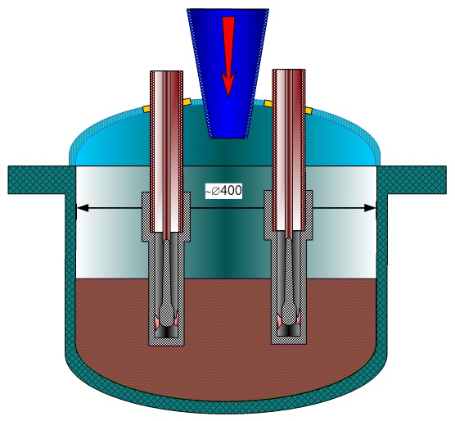
Concepts of DDHM design
Former configuration
Configuration for INVECOR

Slide 8
Results of DDHM testing
Gained power of single plasmatrons
Up to 20 kW with argon-gas
Up to 23 kW with nitrogen
Maximum time of plasma burning
Up to 2 hours
Reliability of oscillator
100% ignition of plasma in different combinations (ignition of each plasmatrons separately, ignition of single plasmatrons while two other plasmatrons are burning up etc.)

Slide 9
Test section (RPV model)
The shape and diameter of RPV model are finally chosen
The RPV model wall thickness calculation is under way
Points of temperature measurement will be determined after calculation finishing
Safety of tests is estimated (control points of measurements and limiting values of parameters in these points are defined).
Two candidate materials of RPV model:
Steel used for VVER pressure vessel fabrication (Izhora factory)
Steel used for French reactors pressure vessel fabrication (Framatom)

Slide 10
TS calculation using DYMELT FEM CODE
The numerical code is based on the model of melt thermohydrodynamics, melting and crystallization taken into account
2D and 3D equations of Navier-Stokes, continuity and energy are solved
Stationary and non-stationary calculations
Laminar or turbulent convection (k-ε, k-ω models), DNS
Boundary conditions: temperature, radiation
The numerical code has been verified by METCOR tests

Slide 11
PRELIMINARY CALCULATIONS
Objectives:
Qualitative analysis:
possibilities of maintaining corium in the molten condition in the RPV model
influence of parameters on the molten pool characteristics
Input data for calculations:
Lower head geometry corresponds to VVER-440
Linear scaling of model ~ 1:6 (Ø_{in}400 x 200)
Vessel wall thickness - 25 mm
Corium C-30, melt mass - 60 kg
Heater parameters: Ø70 mm, P_{nom} = 18 kW, n = 5 units
Heat losses along electrodes are disregarded

Slide 12
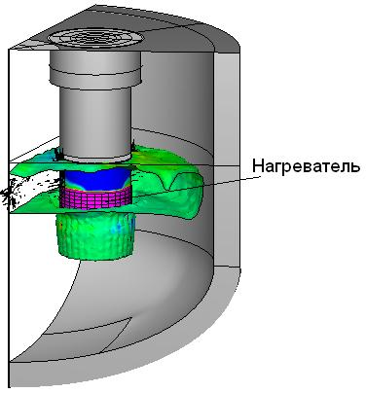
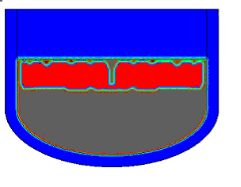
PRELIMINARY CALCULATIONS (2)
Total power 90 kW, crust conductivity 2 W/(m·K)
3D model
2D model
electrode
5 electrodes
The 2D model is applicable for preliminary calculations

Slide 13
PRELIMINARY CALCULATIONS (3)
Series of three calculations:
1. N = 90 kW, high screen position
2. N = 90 kW, low screen position
3. N = 120 kW, high screen position

Slide 14
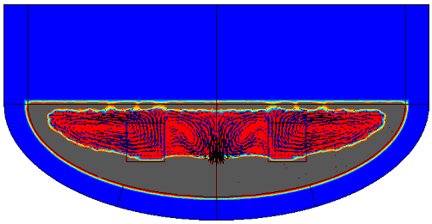
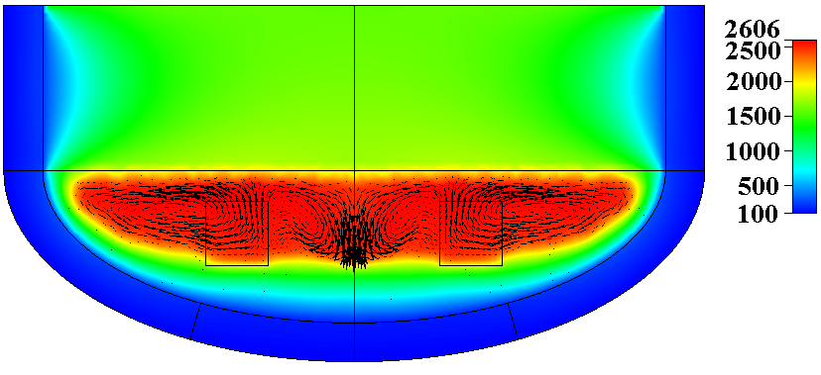
PRELIMINARY CALCULATIONS (4)
Shape of corium crust
N = 90 kW
High screen position
Distribution of heat flux density along the
external surface of the section
Temperature field

Slide 15
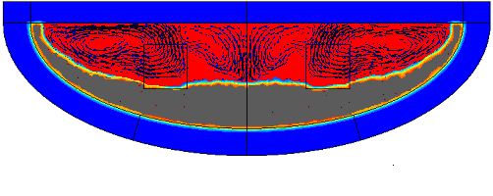
PRELIMINARY CALCULATIONS (5)
N = 90 kW
Low screen position
Shape of corium crust
Distribution of heat flux density along the
external surface of the section
Temperature field

Slide 16
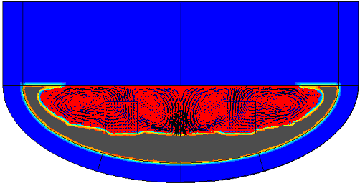
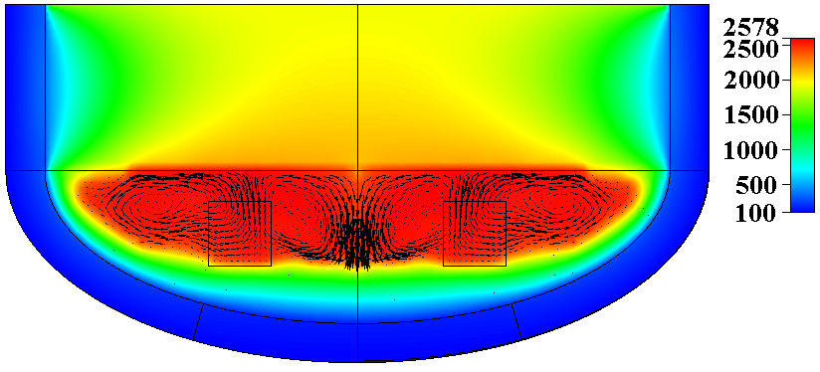
PRELIMINARY CALCULATIONS (6)
N = 120 kW
High screen position
Shape of corium crust
Distribution of heat flux density along the
external surface of the section
Temperature field

Slide 17
CONCLUSIONS of calculation
DYMELT code enables to calculate the molten core behavior on the bottom of RPV model
Preliminary calculations have confirmed the possibility of molten pool formation, if the total power of electrodes is close to 90 kW, but the volume fraction of a liquid phase in the pool is below 50 %
Ways to increase the volume of liquid phase and temperature:
- to raise electrode power
- to reduce distance between the screen and melt surface
- to increase the vessel wall thickness

Slide 18
Melt receiver
It is decided to use the pyrometer combined with video camera for corium pool surface temperature monitoring;
Type of pyrometer is chosen;
Possibility of five plasmatrons installation for decay heat modeling in corium pool from the point of view of electrical connections and available nipples for cooling water supply;
License of MR housing usage was renewed until 2008 year

Slide 19
Technological systems
Capability of cooling water supply was tested
Possibility of additional transformers installation for electric power supply of two additional plasmatrons was estimated

Slide 20
Data measurement and acquisition system
For enhance of noise immunity of measuring system following action are performing:
Inspection of existing DAS and found out of electrical noises source
Optimization of communication lines
Purchase of new equipment
Replacement of out of date gauges and transformers
Mounting and check-out of DAS

Slide 21
Supporting experiments
Zr-coating life time testing
Tests with initial corium components
Test with re-melting of sub-oxidized corium
Test with addition of steel in corium
Research of molten Zr spreading on the graphite outer surface
Research of molten Zr spreading on the graphite crucible inner surface at the temperature gradient along the crucible height

Slide 22
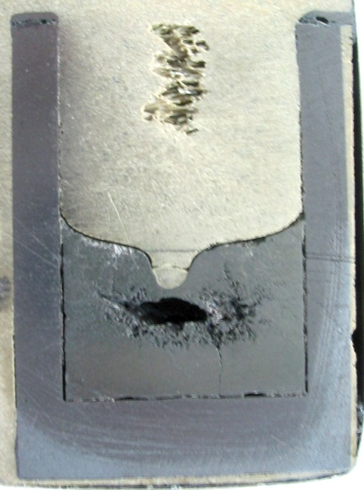
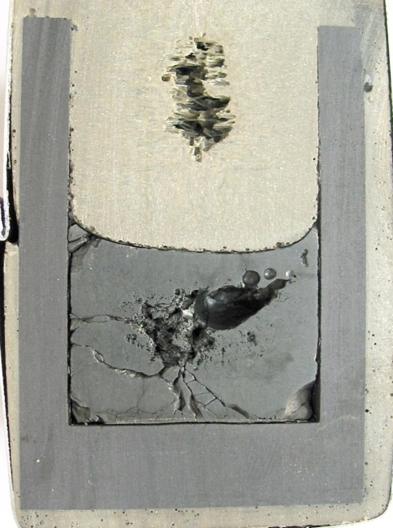
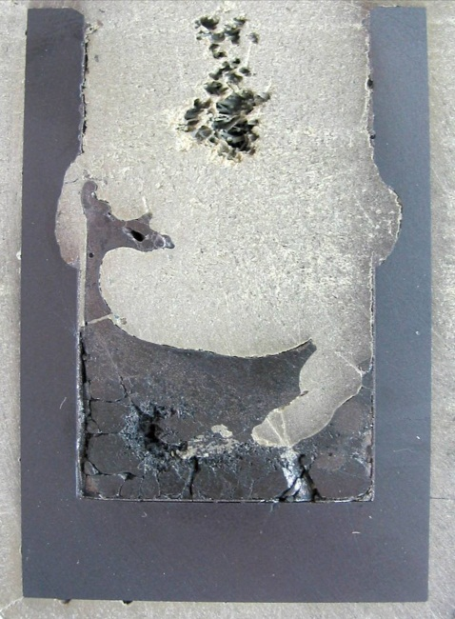
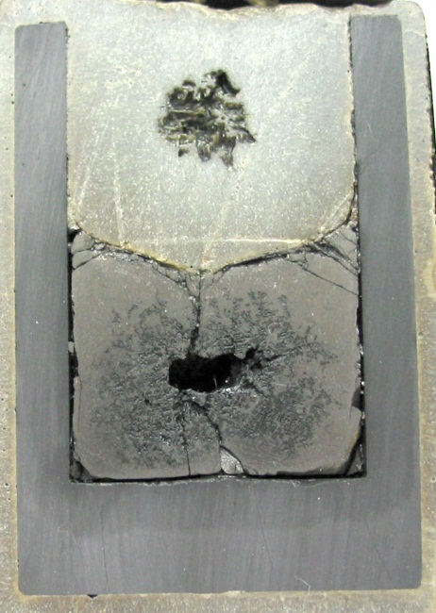
Zr coating life time testing
Corium C-30
Re-melting
Corium C-30
Initial components
Corium C-50
Initial components
Corium C-30
Re-melting
2600 deg. C
Time 30 minutes
2600 deg. C
Time 40 minutes
2800 deg. C
Time 90 minutes
2500 deg. C
Time 120 minutes

Slide 23
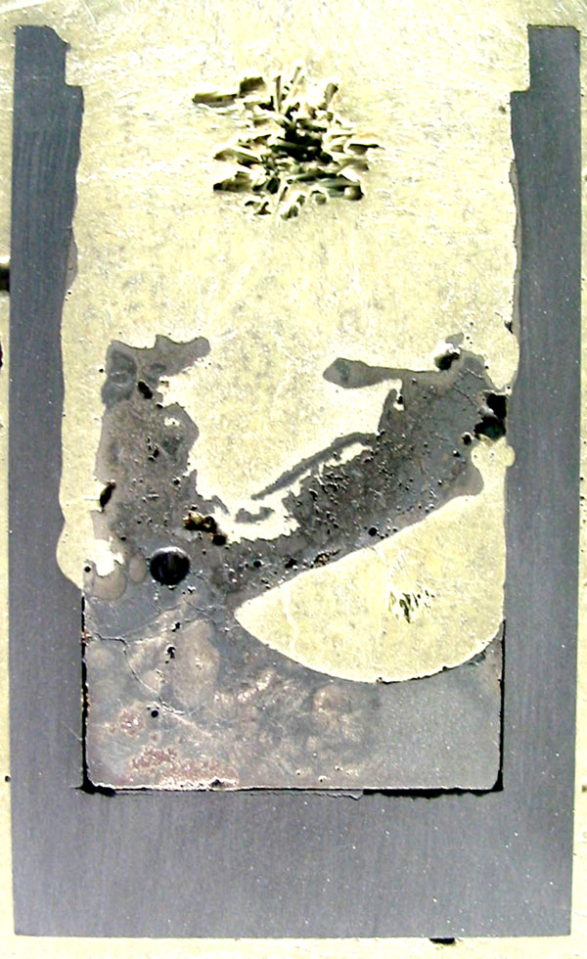
Zr-coating testing Test with addition of stainless steel components in the charge
Three tests were performed using initial components and re-melting of C-30 corium
Strong induction power absorption was observed at 2300 deg. C
Strong crucible wall erosion was observed in all tests
Test with addition of steel in molten corium C-30 at high temperature is proposed

Slide 24
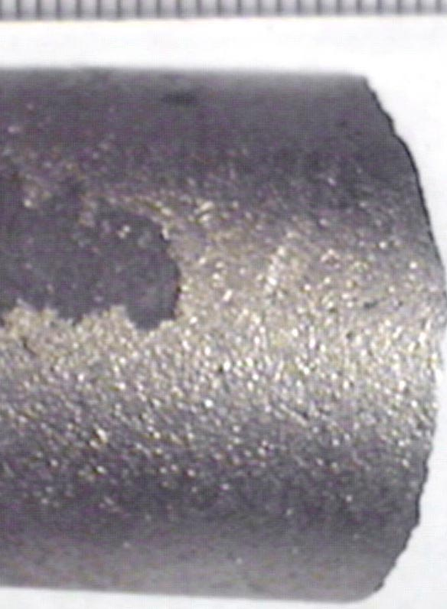
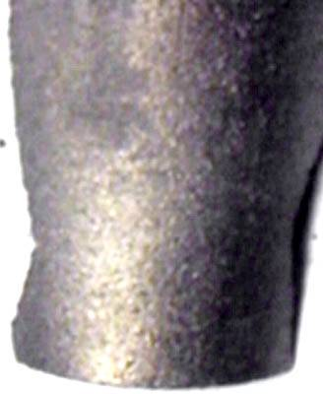
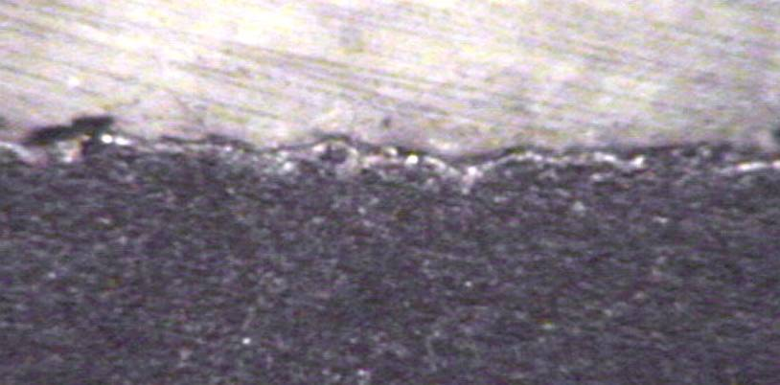
Molten Zr spreading
Spreading of molten zirconium on the outers surface of graphite cylinder

Slide 25
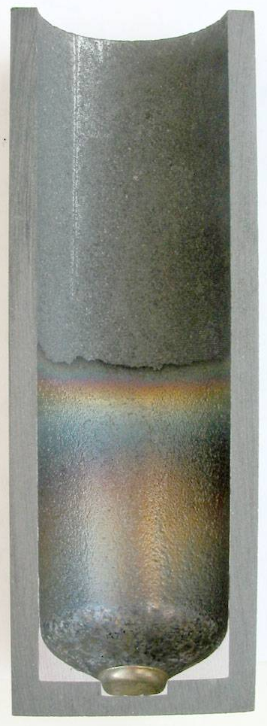
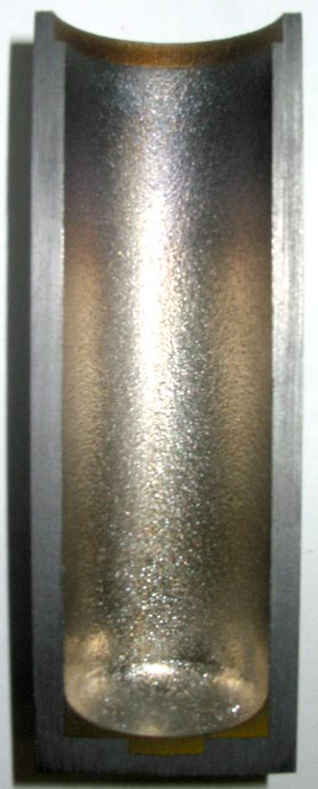
Molten Zr spreading
Spreading of molten zirconium on the inner surface of graphite crucible at presence of temperature gradient along the crucible height
(about 150 deg. C)

Slide 26
Conclusions
Basic directions of work were assigned
Calculation of electric melting furnace for improving of heating mode and increase of loaded mass are under way
Testing of heater for molten corium is continued and new electrodes design is developed
RPV model and corium pool behavior is calculated
Technique of Zr- coating application is under way
Reliability of Zr-coating is continued in different condition
Data measuring and data acquisition system is improved

