Slide 1
ISTC project K-1265:
Experimental study of core melt in-vessel retention
IN-VEssel COrium Retention (INVECOR)
Presented by Vladimir Zhdanov
IAE NNC RK
CEG-SAM 17th Meeting,
March, 29 – 31, 2010
Madrid, Spain

Slide 2
General information
Project K-1265 has been started from May 1, 2006. It is 16th quarter of Project performance. Planned date of project finishing is April 30, 2010
Technical report on 3 years of Project performance is available in CEG-SAM web-site
Operations have been fulfilled according to the specified Work Plan.

Slide 3
Project tasks short description
Task 1: Modernization of test facilities and optimization of melting process and simulation of decay heat
technique for protection coating of the graphite crucible and electrode nozzles of plasmatrons has been developed and tested
corium melting mode and its discharge into experimental section has been improved (2 large scale calibration tests)
design and operating modes of the device for decay heat simulation have been developed and tested (7 TOP tests and many plasmatrons tests without corium)
design and manufacturing of RPV model have been done
Task 2: Calculation support of experiments
Pre-test and post test calculation have been performed
Task 3: Large-scale experiments
Four large scale integral tests on transient processes of IVR imitation have been conducted
Task 4: Post-test analysis
Post-test analysis of corium and RPV steel is under way

Slide 4
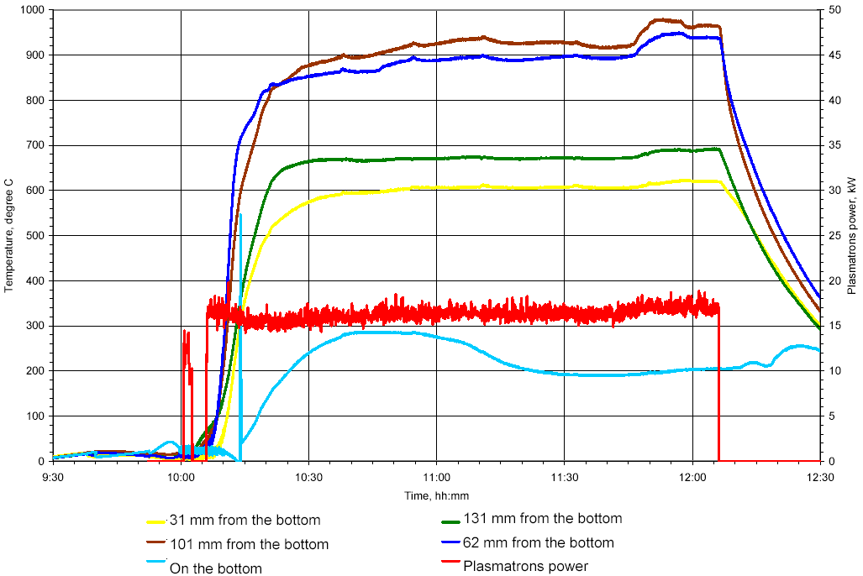
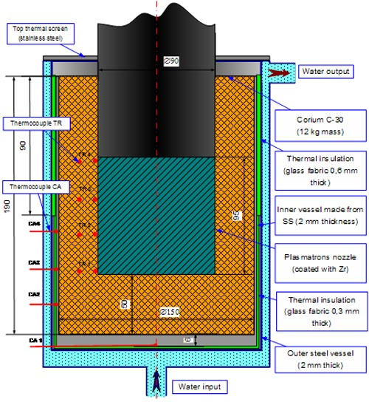
Testing of device for decay heat modeling
Temperature of inner vessel wall
(temperature of plasmatrons surface was ∼2650 °C)
Scheme of loading
TOP-2 test

Slide 5
Corium melt preparation
Pyrometer
Heat exchanger
Water cooled housing
Graphite crucible
Thermal insulation
Inductor
Bottom supporting sleeve
Device for plug splitting
Electric melting furnace (EMF)

Slide 6
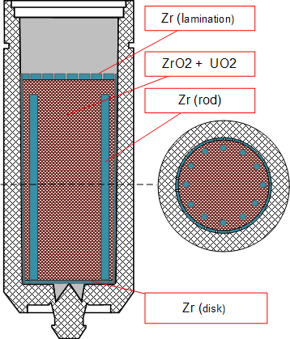
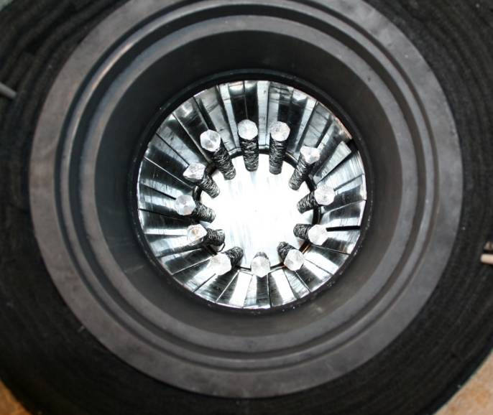
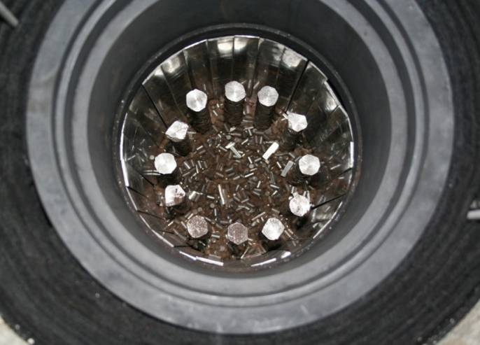
Loading of the melting crucible in EMF
Zirconium rods
Material in electric melting furnace
UO₂, g | Zr, g | ZrO₂, g | m (Total), g
45720 | 8815 | 5580 | 60115
6
UO₂+ZrO₂ mix

Slide 7
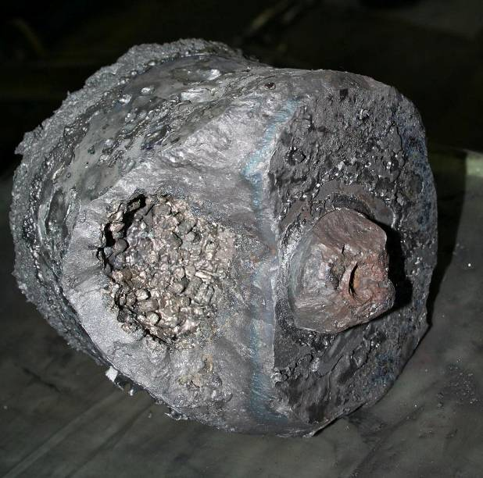
Second calibration test
Corium ingot
after test (U_{0,9}Zr_{0,1}O₂)
(this corium was used for additional loading
in the RPV model)
Diagram of corium heat-up

Slide 8
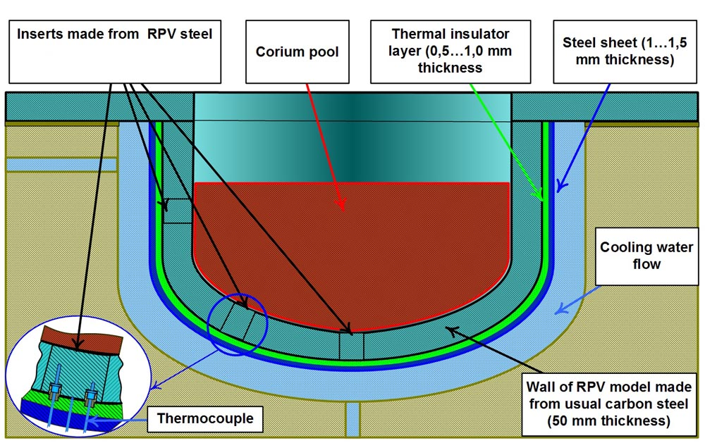
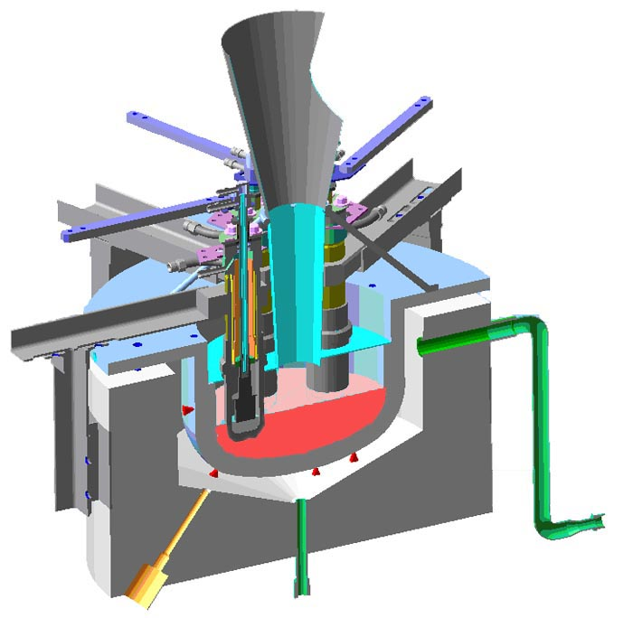
Test section (RPV model)
Main concept of RPV model design
Longitudinal section of experimental assembly including device
for decay heat modeling

Slide 9
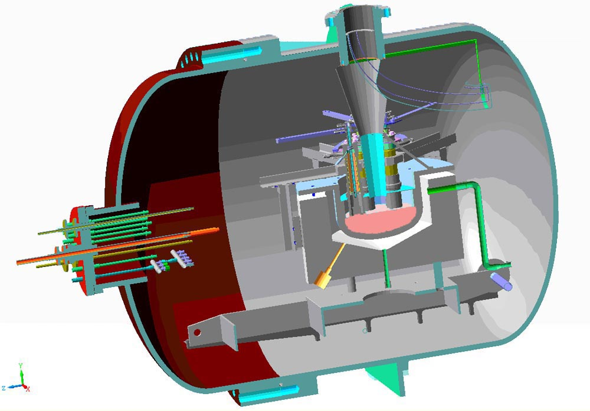
Test section
Test section including device for decay heat modeling
inside pressure vessel of large scale facility

Slide 10
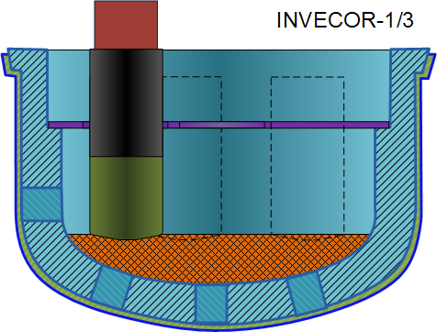
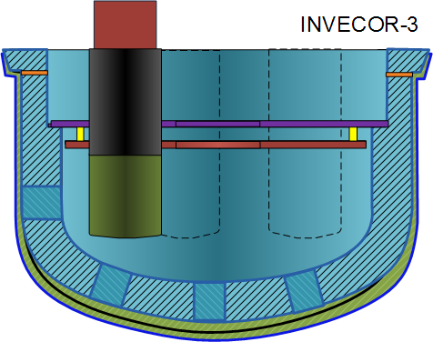
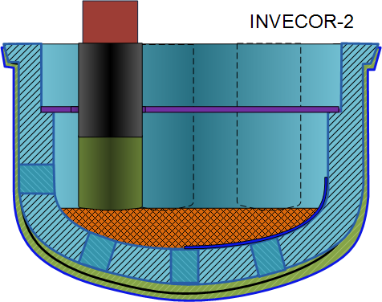
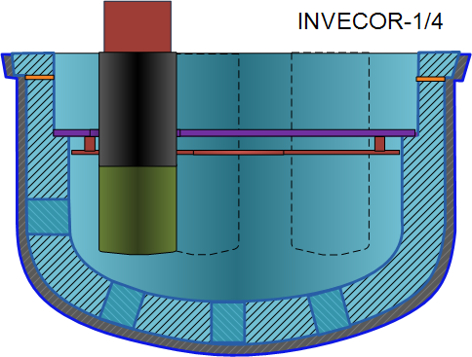
RPV models before tests
Thermal insulation (asbestos)
Copper brackets
Thermal insulation (glass cloth)
Thermal insulation (asbestos)
The tantalum screen
Steel screen
Graphite felt
Solidified corium
SS clad
Test | Material in electric melting furnace |  |  |  | Add corium in RPV model | Total in test | Corium in RPV model after test
 | m (UO₂), g | m (Zr), g | m (ZrO₂), g | m (Total), g | g | g | g
INECOR-1 | 45720 | 8815 | 5580 | 60115 | ‑ | 60115 | ‑
INECOR-1/2 | 45720 | 8430 | 4830 | 58980 | ‑ | 58980 | ‑
INECOR-1/3 | 46200 | 8530 | 5285 | 60015 | 10000 | 70015 | 47040
INECOR-2 | 46200 | 8485 | 5340 | 60025 | 9400 | 69425 | 68928
INECOR-3 | 46200 | 8491 | 5326 | 60017 | ‑ | 60017 | 58445
INECOR-1/4 | 46200 | 8495 | 5340 | 60035 | ‑ | 60035 | 55370
10
Notes:
10

Slide 11
Thermocouples placement in RPV model
Additional thermocouples have been installed for INVECOR-1.4 test between MDT.14 and MDT.24

Slide 12
Diagrams of IVR modeling
INVECOR-1.3
Test duration – 1 hour
Maximum temperature of RPV model – 820 °C
Maximum plasmatrons power – 65 kW
INVECOR-2
Test duration – 50 minutes
Maximum temperature of RPV model – 1050 °C
Maximum plasmatrons power – 74 kW
Test duration time from melt discharging
to plasmatrons switching off

Slide 13
Diagrams of IVR modeling
INVECOR-3
Test duration – 1 hour
Maximum temperature of RPV model – 1350 °C
Maximum plasmatrons power – 78 kW

Slide 14
Diagrams of IVR modeling
INVECOR-1.4
Test duration >2 hours
Maximum temperature of RPV model – 1400 °C
Maximum plasmatrons power – 75 kW

Slide 15
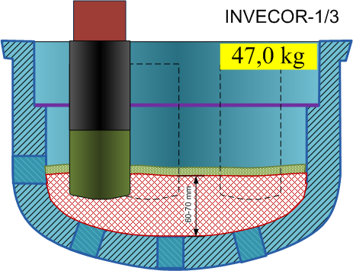
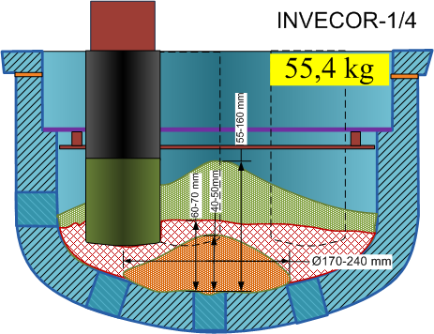
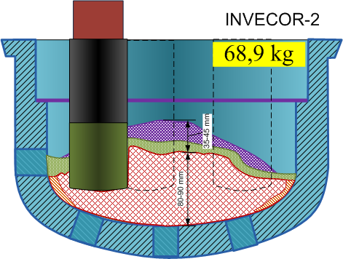
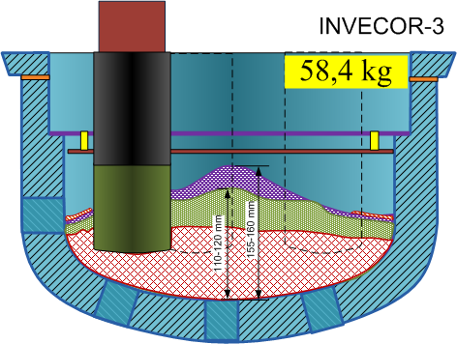
Corium placement in RPV model after tests
Fragmented material dropped from tantalum cone (during melt discharging)
Fragmented debris bed
Corium ingot
Corium ingot containing stainless steel components
Adhered ingot
15
Fraction of fragmented debris above corium ingot is higher at highest temperature in RPV model
Notes:
15

Slide 16
Results of post-test calculation (1)
Test INVECOR-1.3: Temperature field in RPV model in 1 hour after melt discharging
Test INVECOR-2: Temperature field in RPV model after plasmatrons switching off

Slide 17
Results of post-test calculation (1)
Test INVECOR-3: Temperature field in RPV model after plasmatrons switching off
Test INVECOR-1.4: Temperature field in RPV model after plasmatrons switching off
Note. Maximum measure temperature was in the central part of RPV model

Slide 18
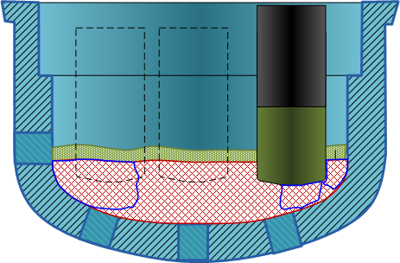
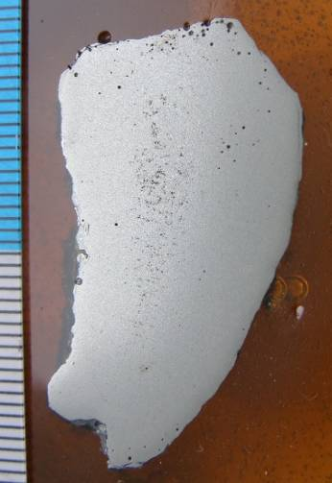
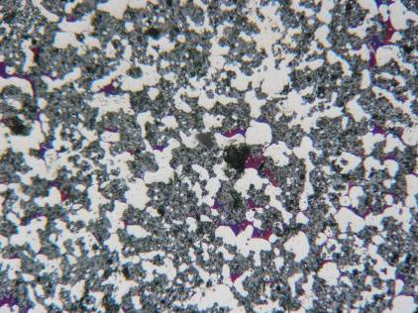
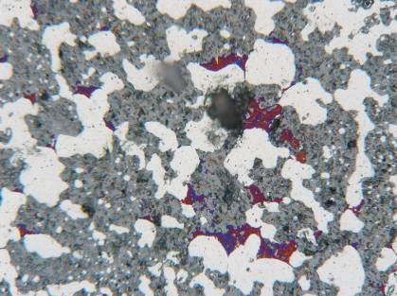
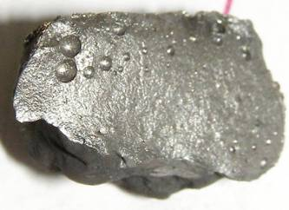
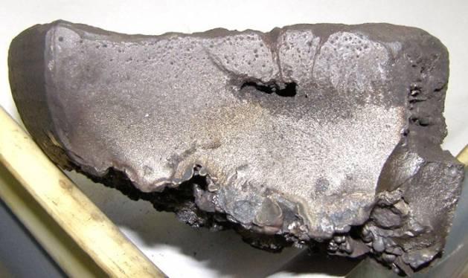
Post-test research after INVECOR-1/3 test
F1
F2
200 μm
S 4
S5
S6
100 μm
Sample | Phase composition | Element composition, wt.%
 |  | Zr | U | U/Zr
F1 | U_{0.95}Zr_{0,05}O₂; α-Zr(O); ZrO₂^{MKL}; Zr(O,N,С)_{1-x}; (Zr,U)O₂ | 31,6% | 68,4% | 2,17
F2 | U_{0.95}Zr_{0,05}O₂; α-Zr(O); (Zr,U)O₂ ZrO₂^{MKL}; | 34,0% | 66,0% | 1,94
S 1 | U_{0.95}Zr_{0,05}O₂ α-Zr(O); α-(U,Zr) | 31,6% | 68,4% | 2,16
S 2 | U_{0.9}Zr_{0,1}O₂ α-Zr(O); α-(U,Zr) | 30,3% | 69,7% | 2,30
S 3 | U_{0.9}Zr_{0,1}O₂ α-Zr(O); α-(U,Zr) | 31,7% | 68,3% | 2,16
S 4 | U_{0.9}Zr_{0,1}O₂ α-Zr(O); α-(U,Zr) | 31,2% | 68,8% | 2,20
S 5 | U_{0.9}Zr_{0,1}O₂ α-Zr(O); α-(U,Zr) | 32,4% | 67,6% | 2,08
S 6 | U_{0.9}Zr_{0,1}O₂ α-Zr(O); α-(U,Zr) | 31,2% | 68,8% | 2,20
S 1
S2
S3
18

Slide 19
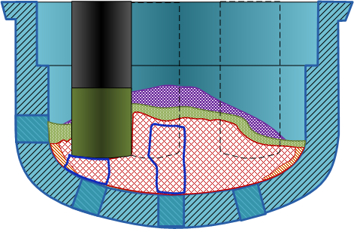
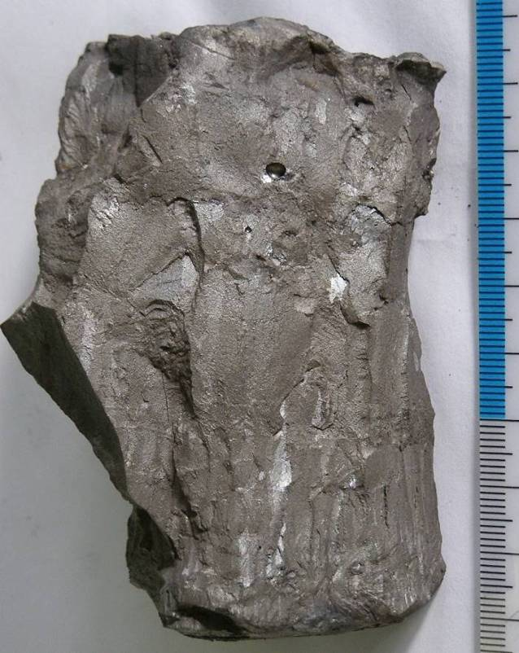
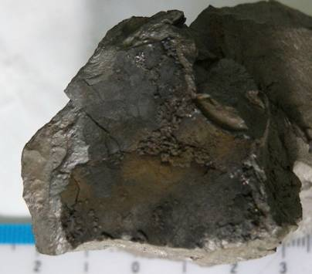
Post-test research after INVECOR-2 test (1)
Corium ingot fragment from central part of RPV model
F 1
S 1
F 2
S 2
S 4
S 5
S 6
S 3
S 7
Sample | Phase composition | Element composition, wt.%
 |  | Zr | U | U/Zr
F 1 | U_{0.95}Zr_{0,05}O₂); ZrO₂^{tetrag}; ZrO2^{mcl}; (U,Zr)(C,O)_{1-x} | 20,4% | 79,6% | 3,89
F 2 | U_{0.95}Zr_{0,05}O₂; ZrO₂^{tetrag}; ZrO₂^{mcl}; (U,Zr)(C,O)_{1-x} | 19,4% | 80,6% | 4,15
S 1 | U_{~0.95}Zr_{~0,05}O₂; α-(U,Zr) | 23,6% | 76,4% | 3,23
S 2 | U_{~0.95}Zr_{~0,05}O₂; α-(U,Zr) | 25,0% | 75,0% | 3,00
S 3 | U_{~0.95}Zr_{~0,05}O₂; α-(U,Zr) | 22,7% | 77,3% | 3,41
S 4 | U_{~0.95}Zr_{~0,05}O₂; α-(U,Zr) | 24,9% | 75,1% | 3,02
S 5 | U_{~0.95}Zr_{~0,05}O₂; α-(U,Zr) | 23,8% | 76,2% | 3,21
S 6 | U_{~0.97}Zr_{~0,03}O₂; α-(U,Zr) | 21,6% | 78,4% | 3,64
S 7 | U_{~0.97}Zr_{~0,03}O₂; α-(U,Zr); (U,Zr)Fe₂ | 20,3% | 79,7% | 3,93
S 8 | U_{~0.9}Zr_{~0,1}O₂; α-(U,Zr); (U,Zr)Fe₂ | 22,4% | 77,6% | 3,47
S 8
19
Ingot surface faced to RPV model

Slide 20
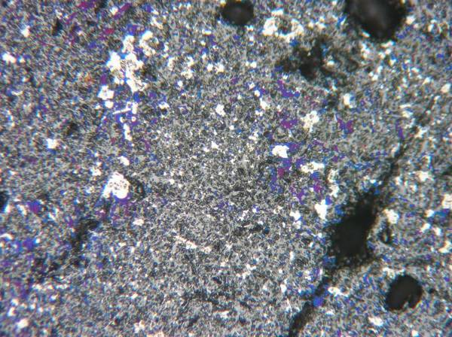
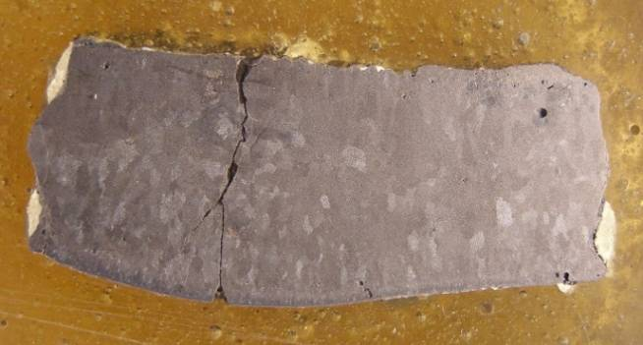
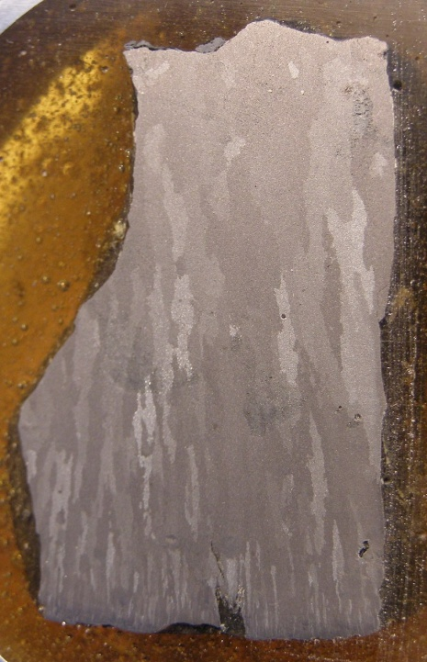
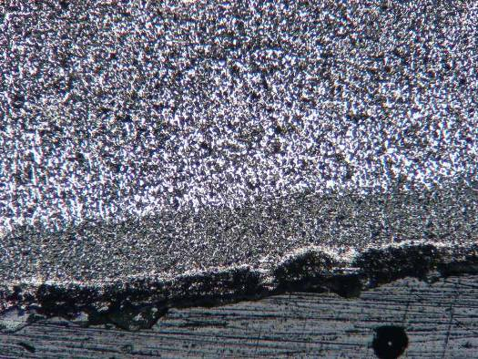
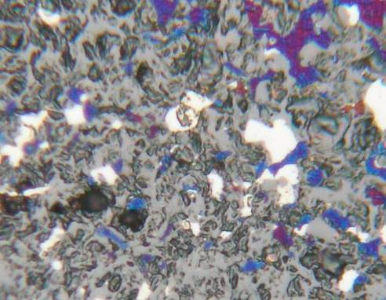
Post-test research after INVECOR-2 test (2)
Section of corium ingot
in central part of RPV model
Section of corium ingot under plasmatrons
150 μm
500 μm
25 μm
α-(U,Zr)
(U, Zr)O₂
Zr(O,N,С)_{1-x}
20

Slide 21
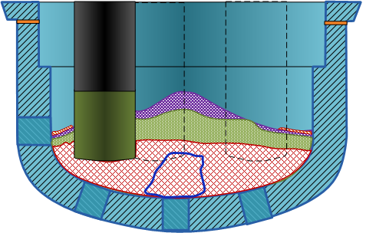
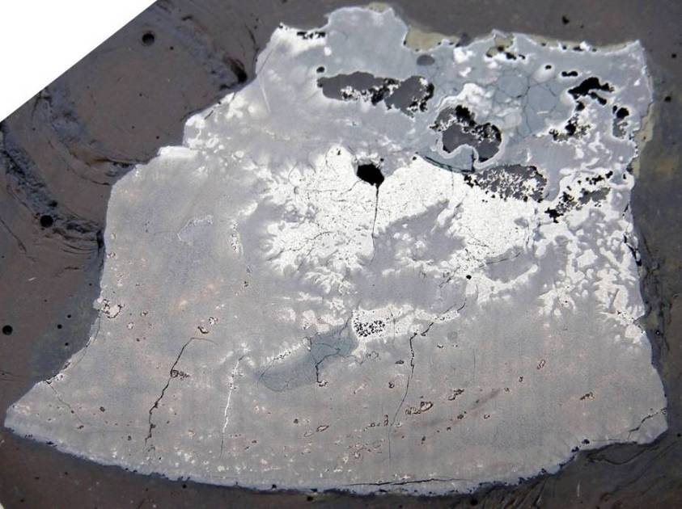
Post-test research after INVECOR-3 test
F 1
F 2
S 5
S 4
S 3
S 2
S 1
Sample | Phase composition | Density, g/cm³ | Thermal conductivity (at 20 deg. C), Wt⋅m⁻¹⋅K⁻¹
F 1 | U_{0.95}Zr_{0,05}O₂; ZrO₂^{tetr}; ZrO₂^{mcl}; (U,Zr)(C,O)_{1-x} | ⎯ | ⎯
F 2 | U_{0.95}Zr_{0,05}O₂; ZrO₂^{tetr}; ZrO₂^{mcl}; (U,Zr)(C,O)_{1-x} | ⎯ | ⎯
S 1 | U_{~0.97}Zr_{~0,03}O₂; U₆Fe(?); α-(U,Zr); (U,Zr)Fe₂ | 9,85 | 6,93
S 2 | U_{~0.98}Zr_{~0,02}O₂; (U,Zr)Fe₂; U₆Fe(?); | 10,0 | 6,90
S3 | U_{~0.95}Zr_{~0,05}O₂; UO₂; (U,Fe)C₂; | ⎯ | ⎯
S4 | (U,Zr)Fe₂ ; U_{~0.75}Zr_{~0,25}O₂; U_{~0.95}Zr_{~0,05}O₂; Zr₂FeO_{x} | ⎯ | ⎯
S5 | U_{~0.95}Zr_{~0,05}O₂; UO₂; (U,Fe)C₂ | ⎯ | ⎯
21

Slide 22
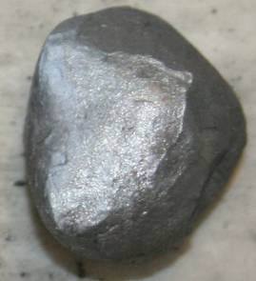
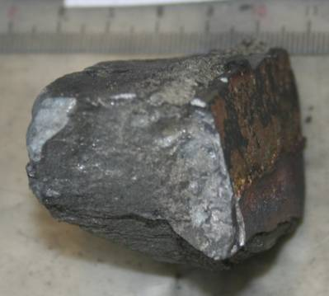
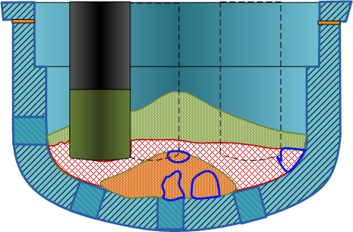
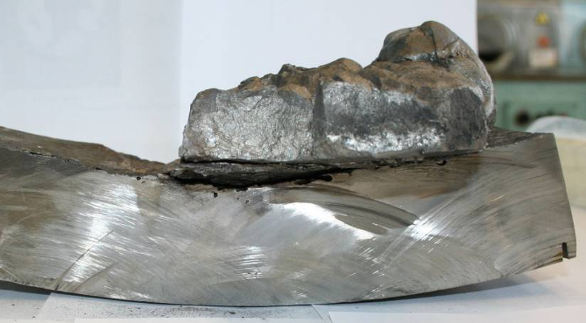
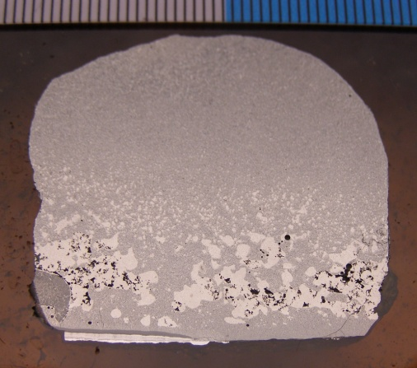
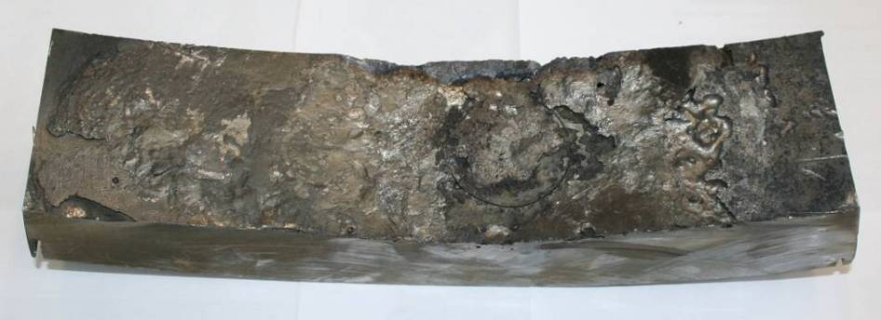
Post-test research after INVECOR-1/4 test (1)
F 1
F 2
S 1
S 2
Fragment of corium ingot from the contact with RPV model wall
S 3
Fragment of RPV wall from the central part
(top view)
S 6
S 4
S 5
22

Slide 23
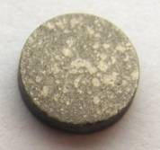
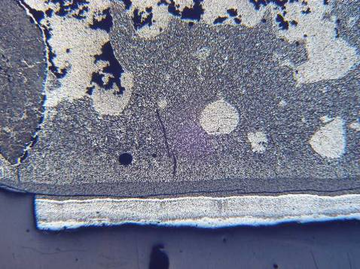
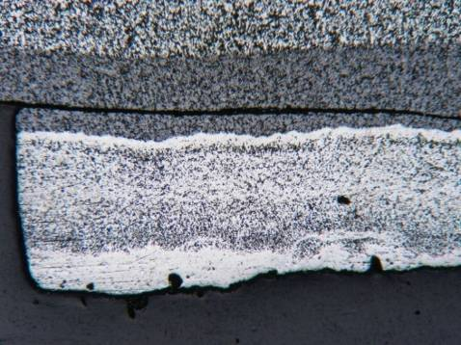
Post-test research after INVECOR-1/4 test (2)
Sample | Phase composition | Element composition, wt.% |  |  | U/Zr
 |  | U | Zr | Fe
F 1 | U_{0.85}Zr_{0,15}O₂; ZrO₂^{mcl}; ZrO₂^{tetr} ; U_{0.5}Zr_{0, 5}O₂; UO₂; U₃O₈ | ⎯ | ⎯ | ⎯ | ⎯
F 2 | U_{0.94}Zr_{0, 06}O₂; U_{0.8}Zr_{0,2}O₂; ZrO₂^{mcl}; ZrO₂^{tetr}; α-Zr(O); U_{0.5}Zr_{0, 5}O₂; U₃O₈ | ⎯ | ⎯ | ⎯ | ⎯
S 1 | U_{~0.95}Zr_{~0,05}O₂; α-Zr(O); α-(U,Zr); Zr₂FeO_{x} | 29,8 | 69,8 | 0,46 | 2,3
S 2 | U_{~0.95}Zr_{~0,05}O₂; α-Zr(O); α-(U,Zr); Zr₂FeO_{x} | 31,8 | 67,7 | 0,46 | 2,1
S 3 | U_{~0.85}Zr_{~0,15}O₂; (Zr,U)O₂^{tetr}; (Zr,U)O₂^{mcl}; (U,Zr)(C,O)_{1-x}; Zr₂FeO_{x} | 31,1 | 68,6 | 0,32 | 2,2
S 4 | U_{~0.95}Zr_{~0,05}O₂ ; α-Zr(O); α-(U,Zr);Zr₂FeO_{x;} α-Fe | 29,8 | 69,3 | 0,83 | 2,3
S 5 | U_{~0.95}Zr_{~0,05}O₂; (U,Zr)Fe₂ ; ZrFe₃; α-Fe; (Zr)(C,O)_{1-x}; α-Zr(O); α-(U,Zr);Zr₂FeO_{x} | 25,3 | 58,0 | 16,7 | 2,3
S 6 | U_{~0.95}Zr_{~0,05}O₂; (U,Zr)Fe₂ ; ZrFe₃ α-Fe; (Zr)(C,O)_{1-x}; α-Zr(O); α-(U,Zr);Zr₂FeO_{x} | 27,5 | 57,2 | 15,3 | 2,1
Sample | Phase composition | Density, g/cm³ | Thermal conductivity (at 20 deg. C), Wt⋅m⁻¹⋅K⁻¹
C 1 | U_{~0.95}Zr_{~0,05}O₂; α-Zr(O); α-(U,Zr); (Zr)(C,O)_{1-x} ;Zr₂FeO_{x} | 9,76 | 5,8
C4 | α-Zr(O); (Zr)(C,O)_{1-x}; U_{~0.95}Zr_{~0,05}O₂; α-(U,Zr); Zr₂FeO_{x} (U,Zr)Fe₂ ; α-Fe | 10,01 | 5,7
C5 | U_{~0.95}Zr_{~0,05}O₂; α-Zr(O); α-(U,Zr); (Zr)(C,O)_{1-x} ;Zr₂FeO_{x}; (U,Zr)Fe₂ ; α-Fe | 9,43 | 5,9
C6 | U_{~0.95}Zr_{~0,05}O₂; α-Zr(O); α-(U,Zr); (Zr)(C,O)_{1-x};Zr₂FeO_{x}; (U,Zr)Fe₂ | 9,42 | 6,3
С 6
С 5
С 1
С 4
23

Slide 24
Summary
1) Low thermal fluxes from corium through a wall of RPV model were received in the course of experiments that it is possible to explain by:
thermal insulation presence on an external surface of the model leading to redistribution of thermal fluxes to perpendicularly wall and along a wall to the top massive flange of RPV model;
incomplete dissolution of uranium dioxide in the molten zirconium in the electric melting furnace and continuation of endothermal dissolution of urania in the course of IVR modeling;
gap formation between a corium crust and a RPV wall caused by initial thermal expansion of RPV model;
layered character of a lower corium crust, that leads to decrease of effective heat conductivity of a crust.
2) Steady-state phenomena during IVR substantially depend on:
previous transient processes connected with formation of corium pool in a reactor core;
time of existence of this pool in an average elevation of core;
character and speed of the melt dropping on the lower head.
The final report by results of work on the project will be placed in CEG web-page after finishing of the project (May-June, 2010)

Slide 25
Acknowledgments
Project INVECOR was carried out at financial support of EC.
I am very grateful to collaborators of the project from
СЕА, Saclay and Cadarache;
FZK and JRC-ITU, Karlsruhe;
FZR, Dresden;
Pisa University;
for recommendations on test conditions and useful discussions and the analysis of obtained results.
I am grateful also to employees of the NITI for active participation in the project and to IBRAE employees for useful discussions.
Thanks a lot to all CEG-SAM participants and to ISTS employees for supporting of INVECOR project.
I hope for the further fruitful cooperation

