Slide 1
Results of PARAMETER –SF3 pre- and post-test numerical modeling
15th CEG-SAM Meeting, Villigen, Switzerland, 10-12 March 2009 г.
Presented by A.Kiselev

Slide 2
Used codes and participants for SF3 calculations
SOCRAT –IBRAE
ICARE/CATHARE - NSI RRC KI
ATHLET-CD – GRS
RELAP/SCDAPSIM MOD3.2 (RELAP) - FSUE EDO “GIDROPRESS”
SCDAP/RELAP/IRS (RELAP/IRS) –PSI
PARAM-TG - FSUE SRI SIA “LUCH”

Slide 3
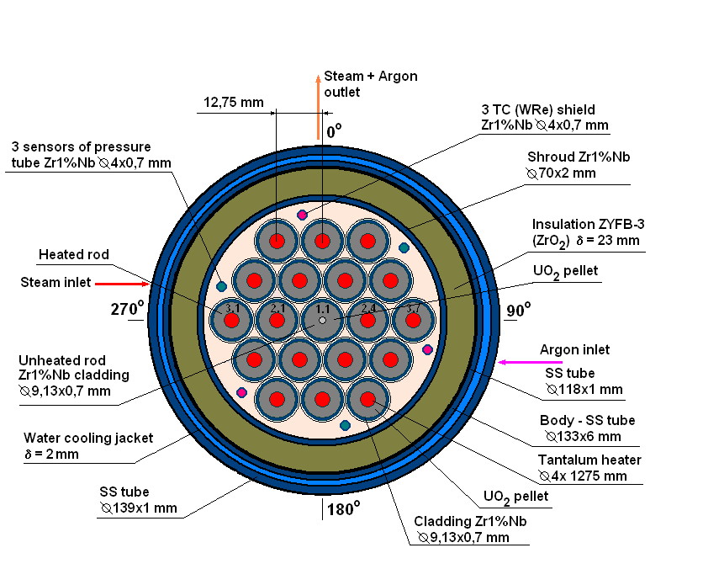
PARAMETER-SF3 test bundle for pretest calculations (Specification)
Bundle type VVER-1000
- number of fuel rods 19
- heated 18
- unheated 1
Fuel rod
- cladding, mm ∅ 9,13/7,73
(Zr1%Nb)
pellets UO₂
- heater length , mm 1275
Spacer grid Zr1%Nb Shroud Zr1%Nb
-SF3, -SF4 cylindrical
Heater Ta
Thermal insulation ZrO₂ ZYFB-3

Slide 4
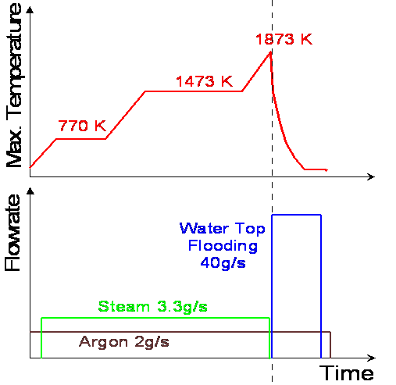
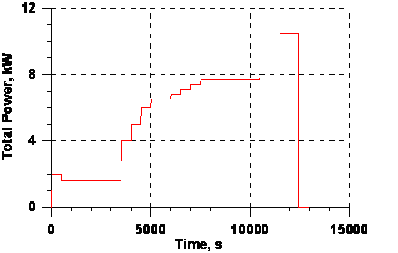
PARAMETER-SF3 pre-test calculations Initial and Boundary conditions
Electrical power:
Pre-oxidation phase ~ 7.7 kW
Transient phase ~ 10.5 kW

Slide 5
Heat balance
PARAMETER-SF3 pre-test analysis

Slide 6
Heat balance
PARAMETER-SF3 pre-test analysis
Heat loss through shroud
at pre-oxidation phase
~15% of core power over 0-1275 mm

Slide 7
Claddings temperature evolution - hottest zone PARAMETER-SF3 pre-test analysis

Slide 8
Claddings temperature evolution: 700-900 mm
PARAMETER-SF3 pre-test analysis

Slide 9
Shroud temperature evolution
PARAMETER-SF3 pre-test analysis

Slide 10
Temperature profile
PARAMETER-SF3 pre-test analysis

Slide 11
Oxide scale thickness
PARAMETER-SF3 pre-test analysis

Slide 12
Hydrogen release
PARAMETER-SF3 pre-test analysis
Hydrogen release predicted ~ 13-32 g
No extra hydrogen release at the flooding stage

Slide 13
Flooding Phase (SOCRAT calculations)

Slide 14
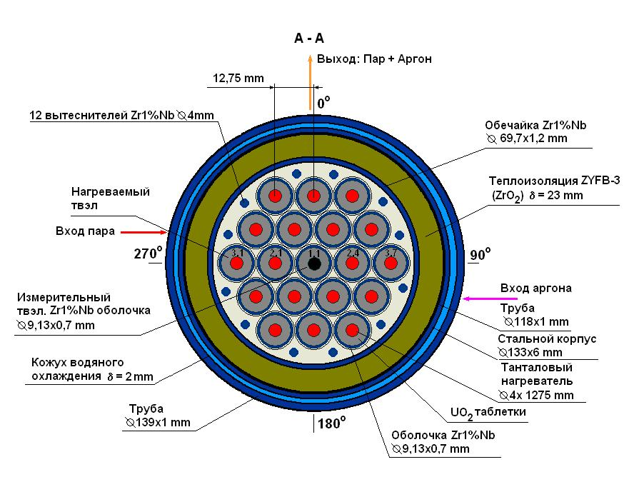
Modified SF3 test bundle

Slide 15
PARAMETER-SF3 post-test calculations
Initial and boundary conditions

Slide 16
Heat balance
PARAMETER-SF3 post-test analysis
Joel heating power
Pre-oxidation phase~ 6-8 kW
Before flooding onset ~ 9-11 kW
Oxidation reaction power
Pre-oxidation phase - up to 1kW
Before flooding up to 10 kW

Slide 17
Heat balance
PARAMETER-SF3 post-test analysis
Radial heat loss through shroud
Pre-oxidation phase ~ 0.5-1 kW
Transient and flooding phase ~ 2 kW
Coolant heating power
Pre-oxidation phase ~5- 6 kW
Before flooding onset ~ 8-10 kW

Slide 18
Claddings temperature evolution PARAMETER-SF3 post-test analysis

Slide 19
Shroud temperature evolution
PARAMETER-SF3 post-test analysis

Slide 20
Hydrogen release
PARAMETER-SF3 post-test analysis
Hydrogen release
Experimental ~34 g
ICARE ~ 33 g
PARAM-TG – 32 g
SOCRAT ~ 26 g
RELAP – 32 g
No hydrogen release at flooding phase

Slide 21
Cladding oxide scale thickness PARAMETER-SF3 post-test analysis

Slide 22
Main outcomes from SF3 post-test calculations
Post-test calculations and experimental data on temperature evolution are in a good agreement
The most codes estimate hydrogen total amount well.

