Slide 1
FSUE SRI SIA “LUCH”
IBRAE RAS
FSUE EDO “GIDROPRESS”
Results of post-test examinations of SF2 fuel bundle and numerical simulations of the experiments PARAMETER-SF3 and -SF4
Presented by A.Kiselev
14th CEG-SAM Meeting, Kiev, Ukraine, September 9-11, 2008

Slide 2
Contents
PARAMETER-SF2 bundle material investigations results
Post-test PARAMATER-SF2 numerical analysis results
Pre-test PARAMATER-SF3 calculations
Proposed PARAMATER-SF3 scenario

Slide 3
Part 1: SF2 bundle material investigations
Post-test appearance of the shroud
Z = 850-1050 mm
Z=1100-1300 mm
Shroud kept its integrity
Thin oxide scale on the outer surface

Slide 4
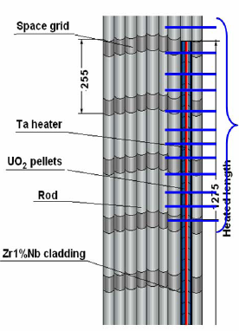
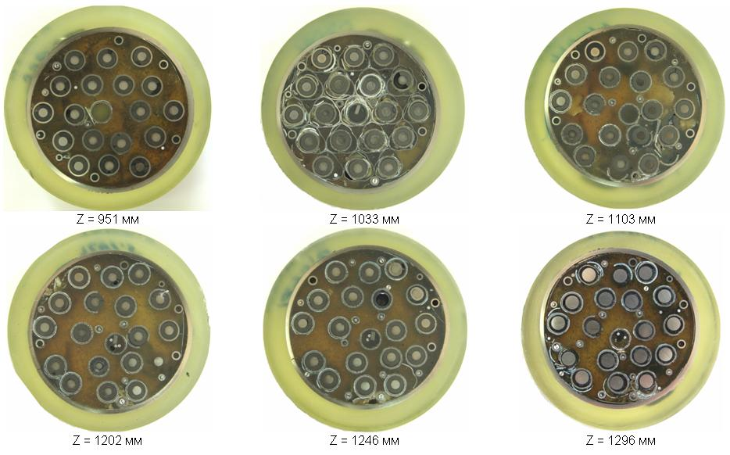
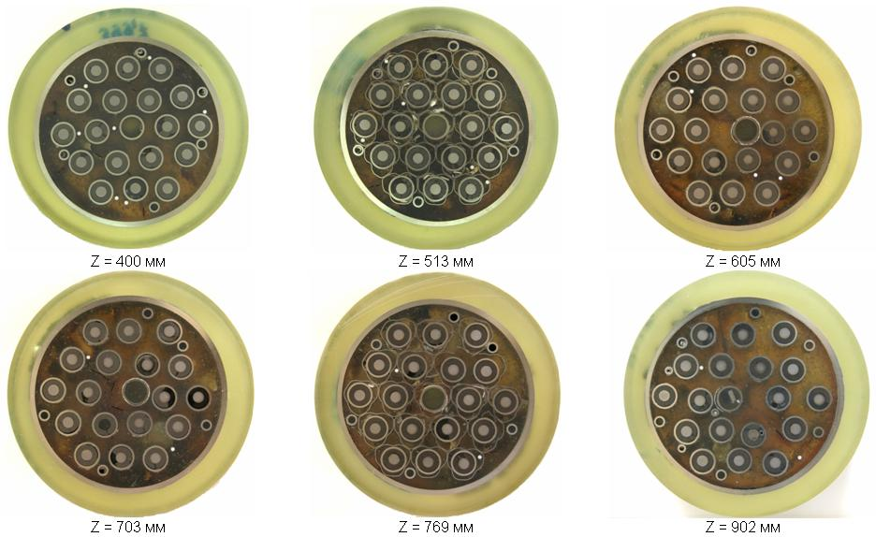
Overview of sectioning map for metallographic examination
At 400-1300 mm
30 crosscuts were
made
12 cross-sections
were chosen for
studies
5 selected cross
section are considered
in detail
in the presentation

Slide 5
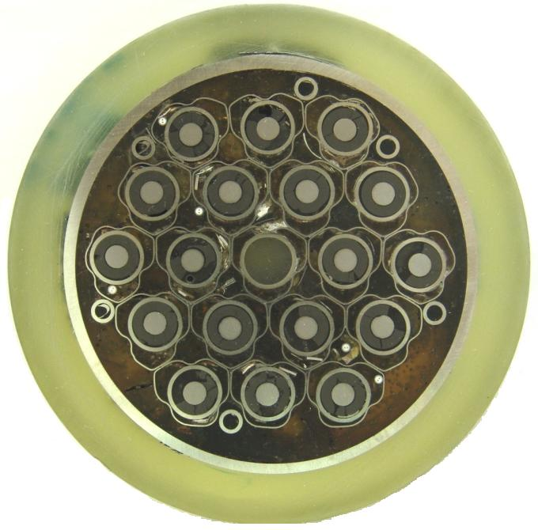
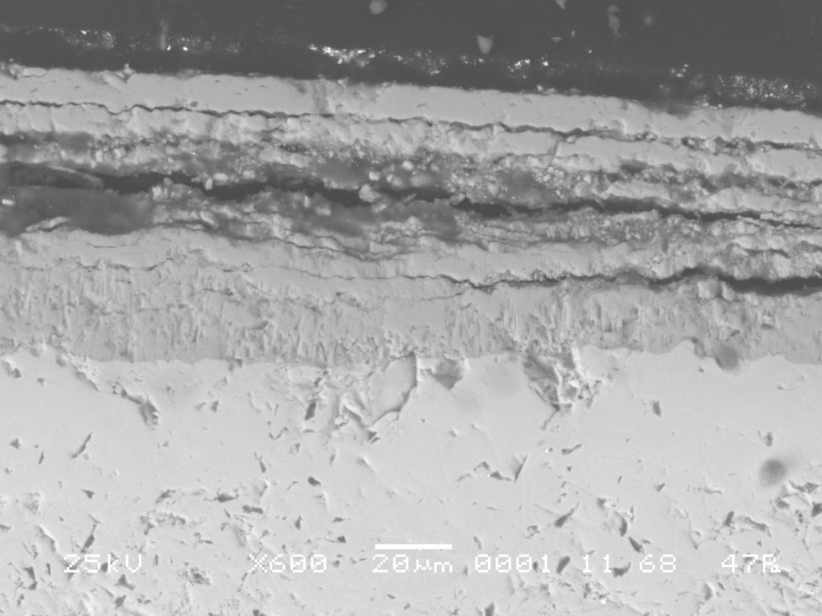
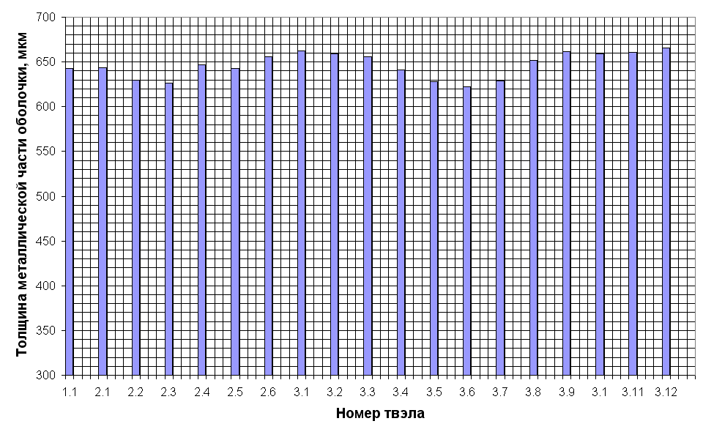
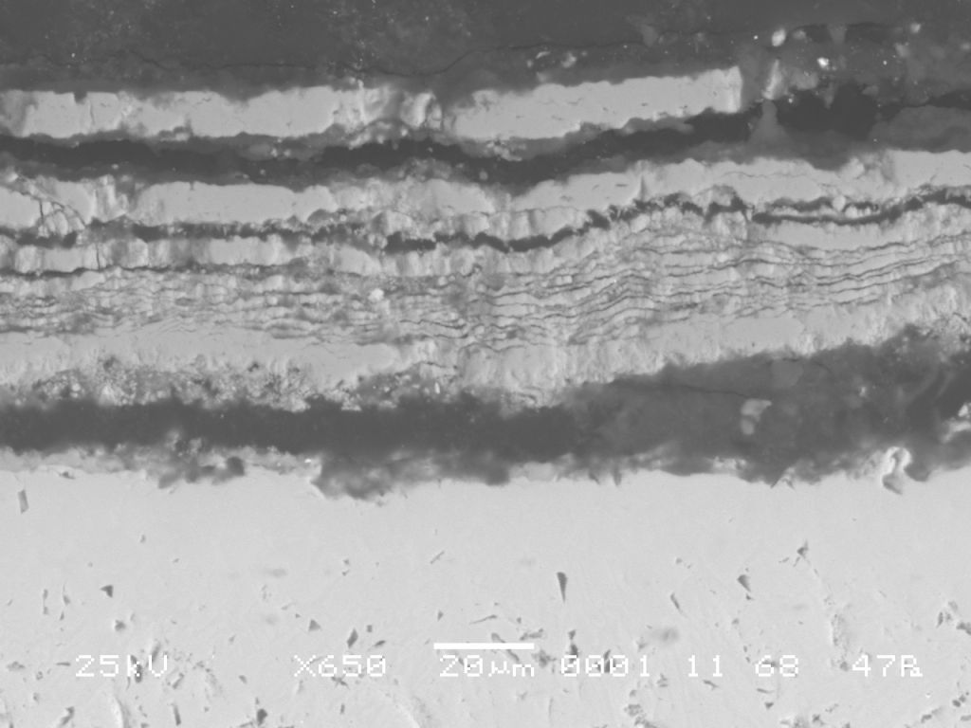
Metallographic examination of the cross -section at Z=513 mm
Rod 2.1
Rod 2.3

Slide 6
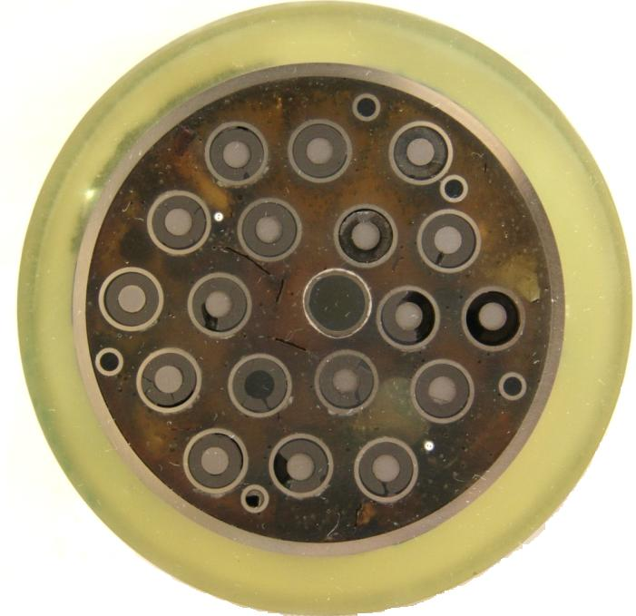
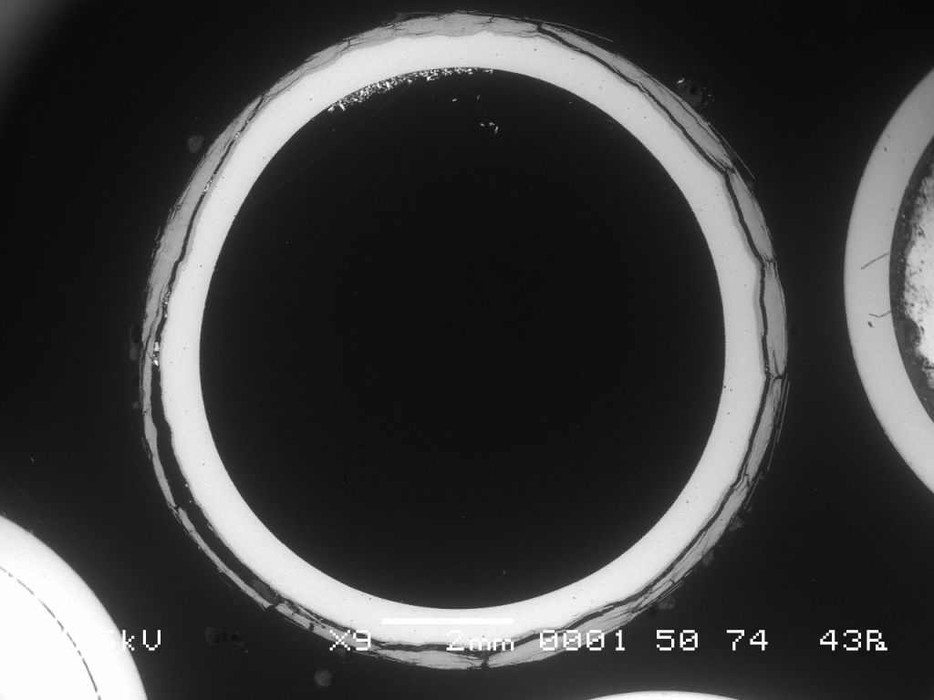
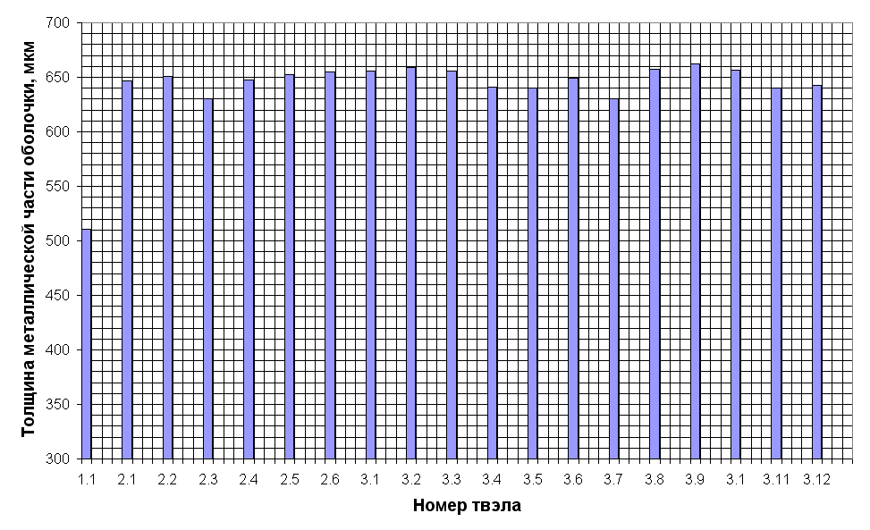
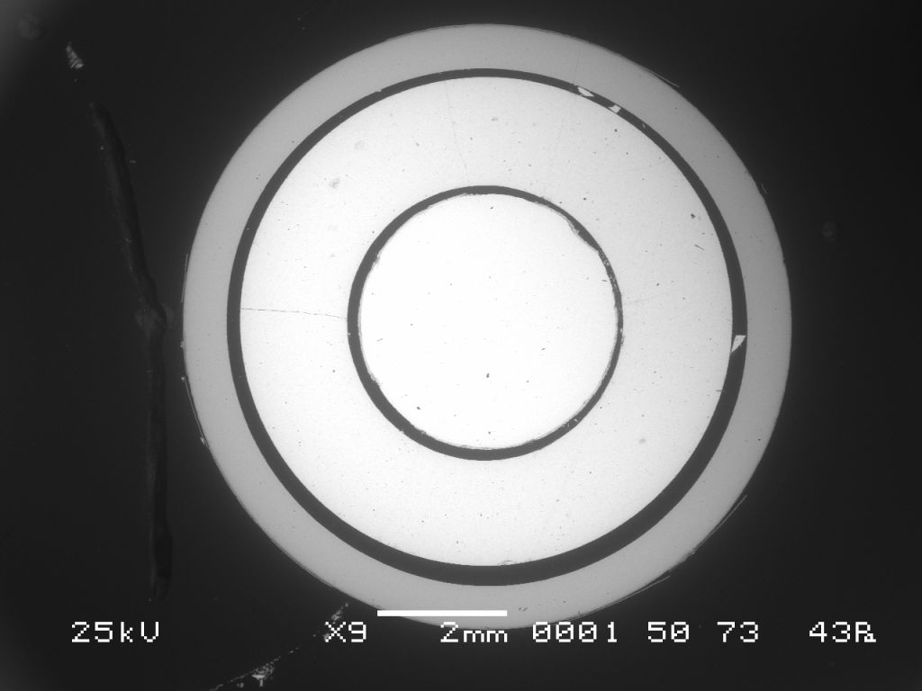
Metallographic examination of the cross section at Z=702 mm
Rod 1.1
Rod 2.1

Slide 7
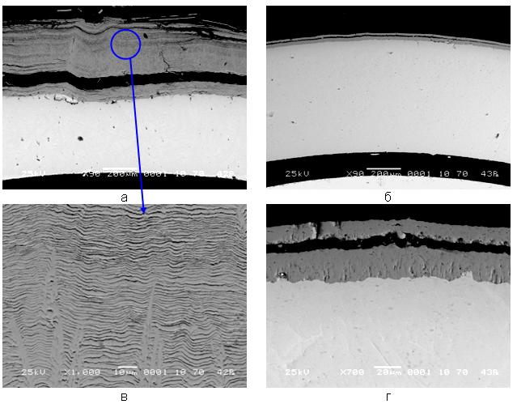
Layers structure at Z=702 mm
Rod 1.1
Rod 2.1

Slide 8
Metallographic examination of the cross- section at Z=1033 mm
Through wall cracks on the claddings
A lot of oxide scale remnants between rods

Slide 9
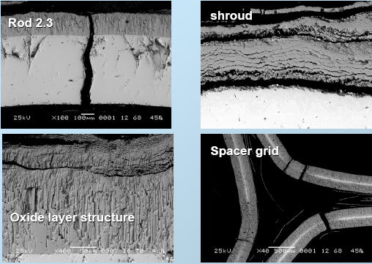
Layers structure at Z=1033 mm
Tmax ~1350◦C
Internal oxide of columnar
structure with multi-layer
spalling-off films
No oxidation of cracks

Slide 10
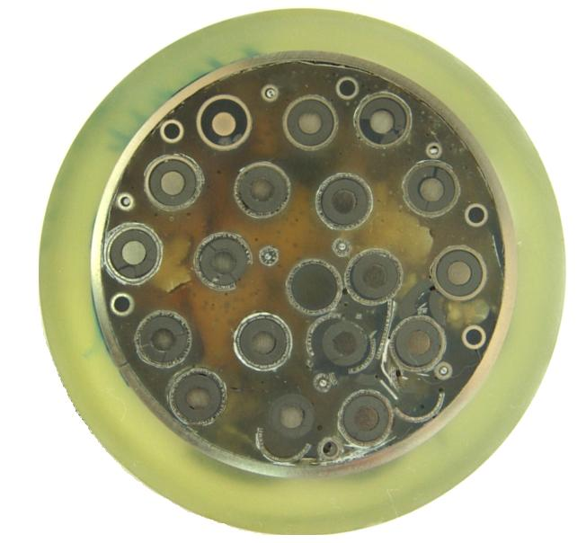
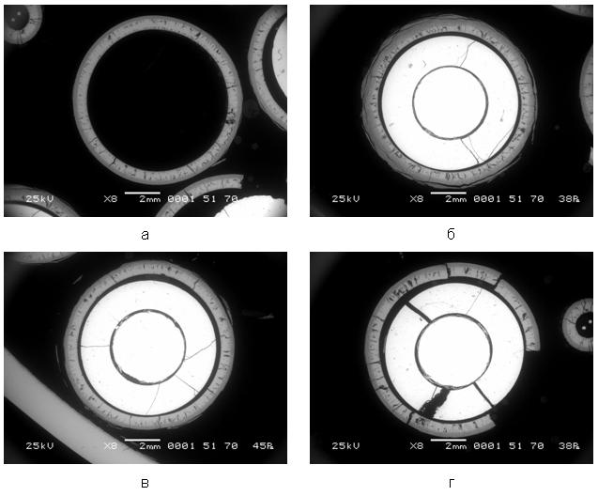
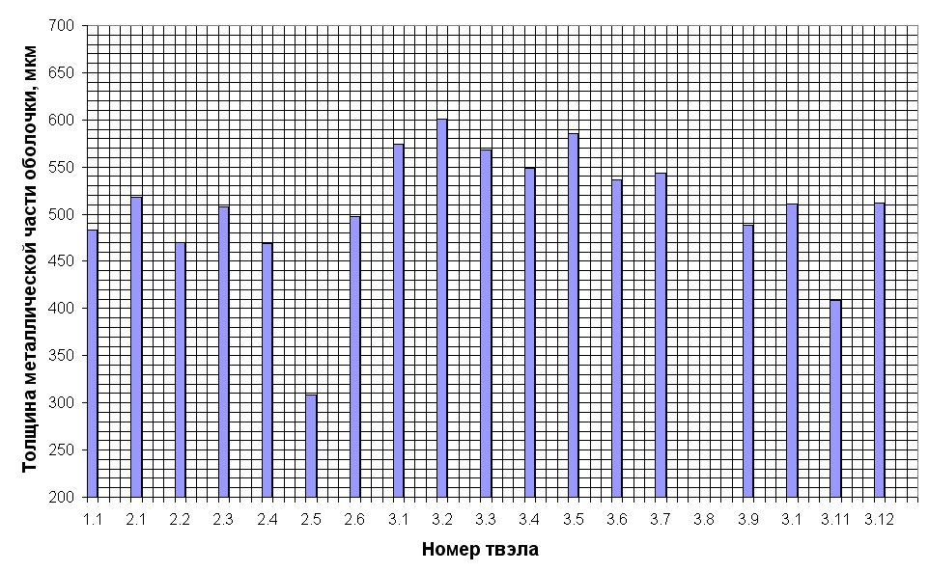
Metallographic examination of the cross section at Z=1103 mm
Rod 1.1
Rod 2.5
Rod 3.9
Rod 2.6

Slide 11
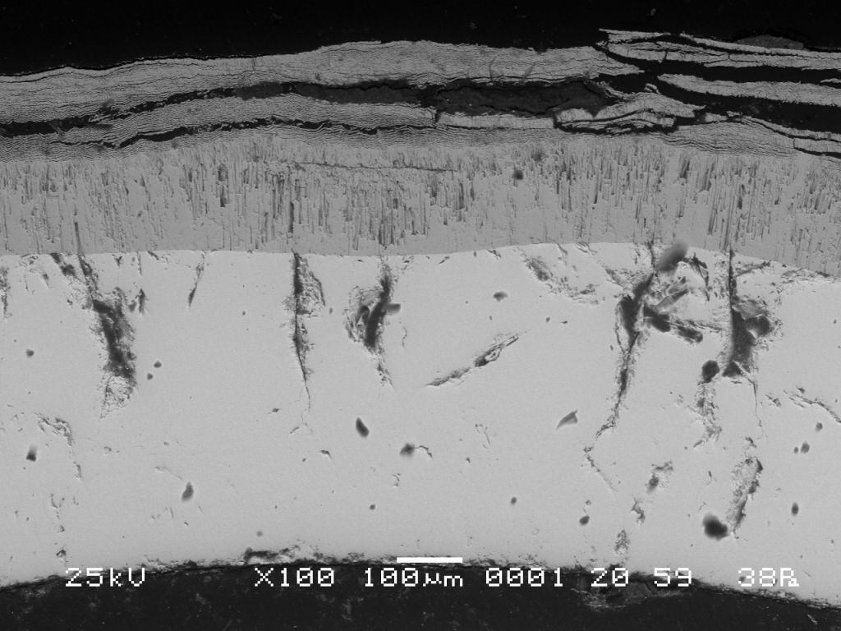
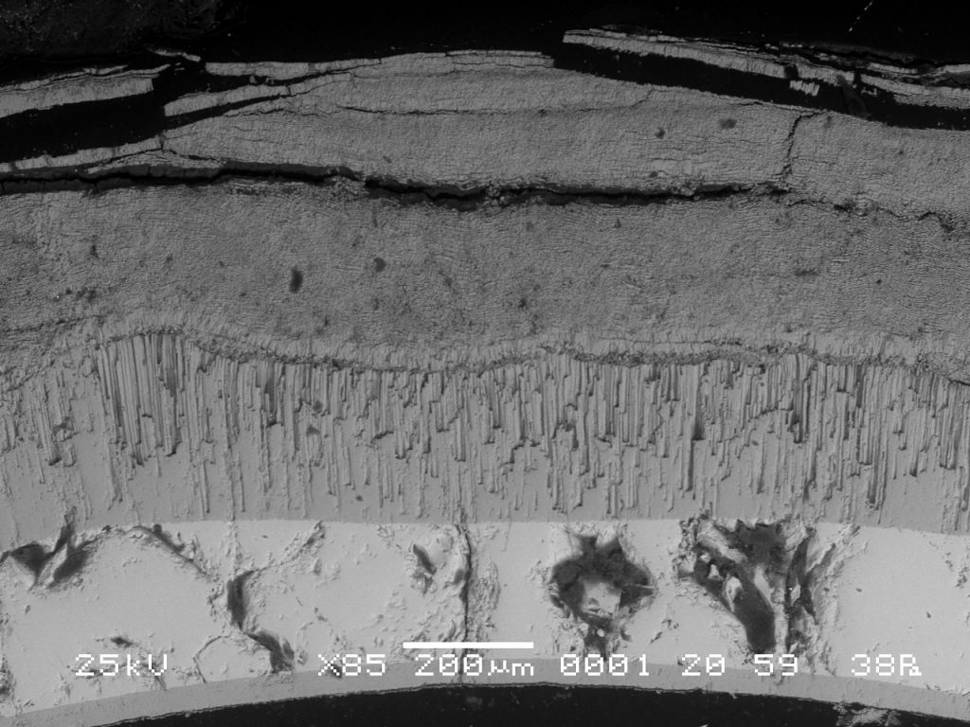
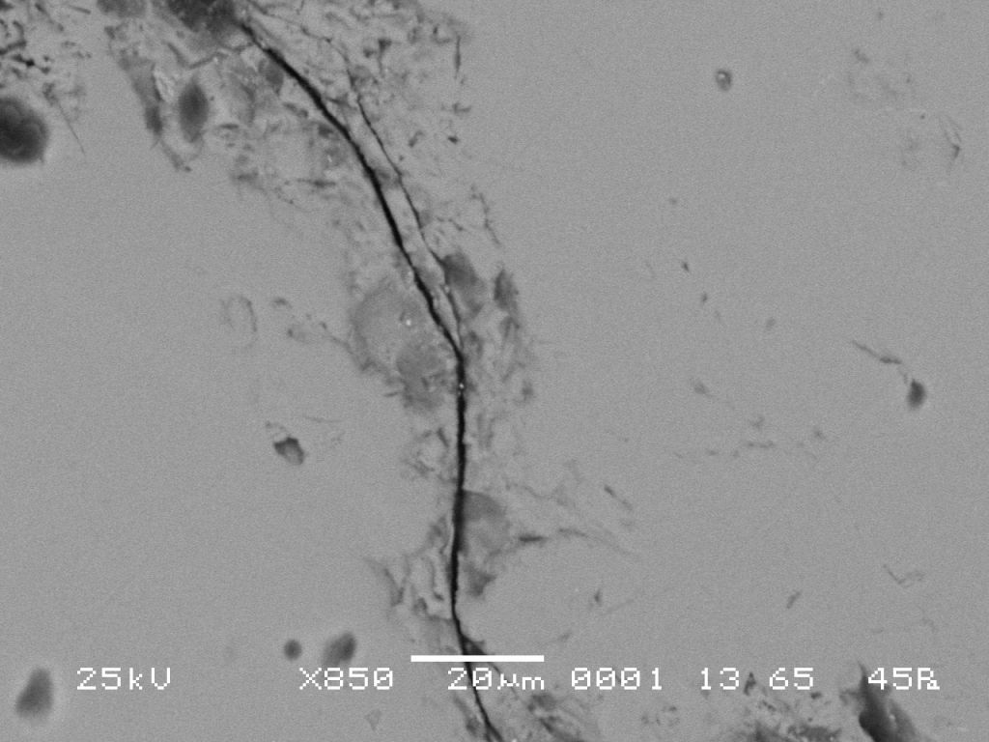
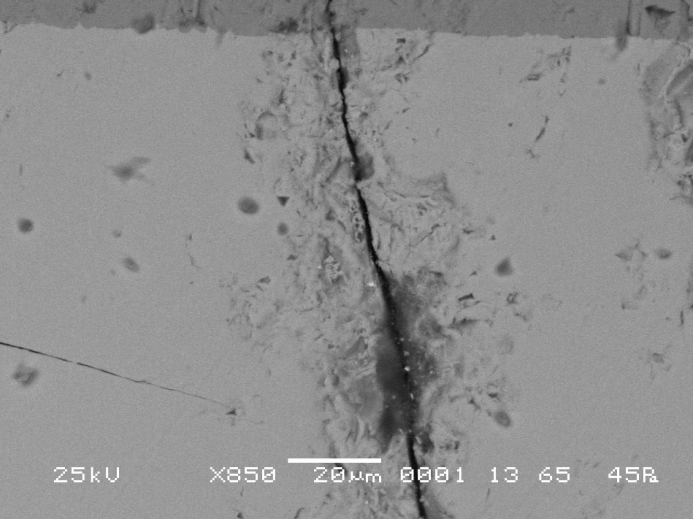
Layers structure at Z=1103 mm
Rod 2.2
Rod 2.5
Rod 2.4
Rod 3.5

Slide 12
Metallographic examination of the cross section at Z=1250 mm

Slide 13
Layers structure at Z=1250 mm
Tmax ~1500◦C
Columnar structure of inner
oxide and spalling-off
multi-layers
on the external surface
No oxidation of cracks

Slide 14
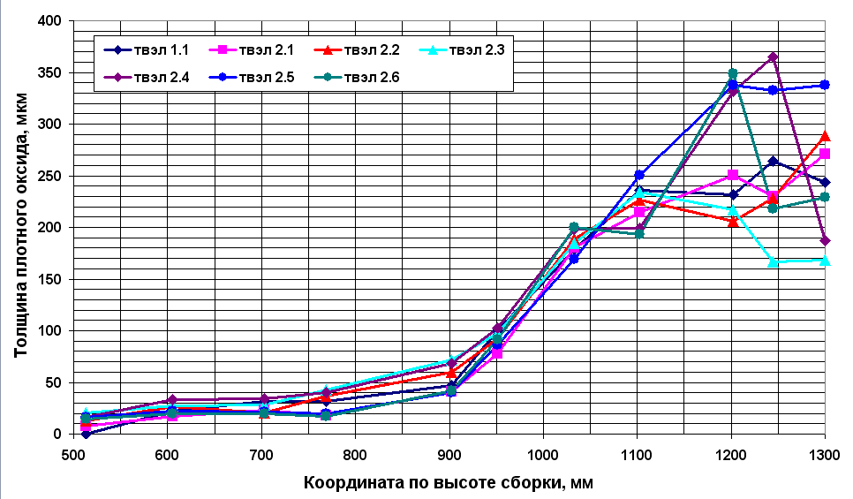
Distribution of the compact dioxide zirconium thickness along heated zone

Slide 15
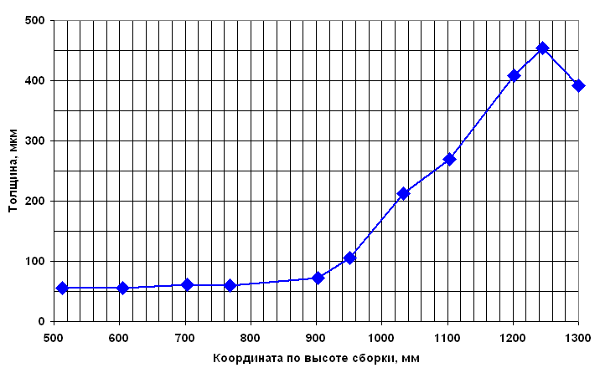
Averaged cladding zirconium dioxide thickness*
* exhausted metal layer *1.56

Slide 16
Hydrogen pickup
Applied method – X-ray analysis
No possibility for claddings investigations because of their brittleness
The shroud hydrogen pickup was measured for Z=250, 500, 900 and 1200 mm.

Slide 17
X-ray analysis results

Slide 18
Some outcomes from SF2 material investigations
Material investigations of the PARAMETER-SF2 bundle are completed.
  The fuel assembly was filled with epoxy and cut on the cross-section
  12 cross section were chosen for metallographic measurements
  5 cross section have been investigated and described in detail (Z=513, 702, 1033, 1103, 1250 mm)
There is no fuel relocation.
Pronounced oxidation of the claddings at Z=1000-1300 mm elevations have been revealed. No oxidation of through wall cracks.
ZrO₂ oxide on the claddings surface includes inner compact one-layer dioxide zirconium with columnar structure on the metallic layer and external multi-layer spalling-off films.
Metallic layer thickness of the fuel rod claddings together with compact dioxide zirconium thickness were measured.
Shroud hydrogen pickup was investigated by X-ray analysis (Z=250, 500, 900, 1200 mm).
Maximum hydrogen pickup in the shroud was revealed at Z= 900 mm (23 at%)

Slide 19
Part 2: SF2 post-test numerical analysis
Used codes and participants
SOCRAT –IBRAE
ICARE/CATHARE - NSI RRC KI
ATHLET-CD – GRS
RELAP/SCDAPSIM MOD3.2 (RELAP) - FSUE EDO “GIDROPRESS”
PARAM-TG - FSUE SRI SIA “LUCH”

Slide 20
Initial and boundary conditions
PARAMETER-SF2 post-test analysis
ICARE/CATARE
Experimental thermoinsulation temperature used as boundary conditions

Slide 21
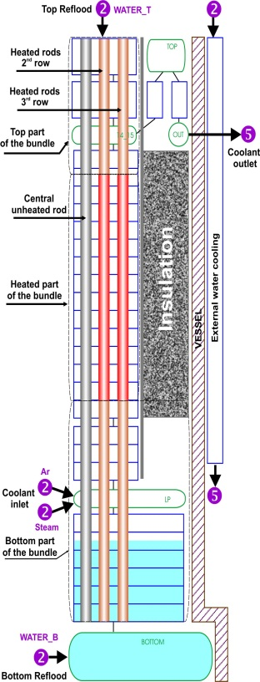
Heat balance
PARAMETER-SF2 post-test analysis
ATHLET

Slide 22
Heat balance
PARAMETER-SF2 post-test analysis
Pre-oxidation phase
Joel heating power ~ 7kW
Coolant heating power ~ 6kW
Before flooding onset
Joel heating power ~ 9.5kW
Coolant heating power ~ 9kW
Oxidation reaction power
Pre-oxidation phase - up to 1kW
Before flooding up to 2.3kW
Flooding phage up to 2.5 kW

Slide 23
Claddings temperature evolution PARAMETER-SF2 post-test analysis

Slide 24
Shroud temperature evolution
PARAMETER-SF2 post-test analysis

Slide 25
Hydrogen release
PARAMETER-SF2 post-test analysis
Hydrogen release
Experimental ∼28 g
ICARE ~ 25.5 g
ATHLET ~ 23 g
SOCRAT ~ 20 g

Slide 26
Main outcomes from SF2 post-test calculations
Post-test calculations and experimental data on temperature evolution are in a good agreement except temperature “hump” at 12000 s
The most codes underestimate hydrogen total amount.
In the course of post-test SF2 calculations heat loss due to external resistance and heat loss through shroud were specified.

Slide 27
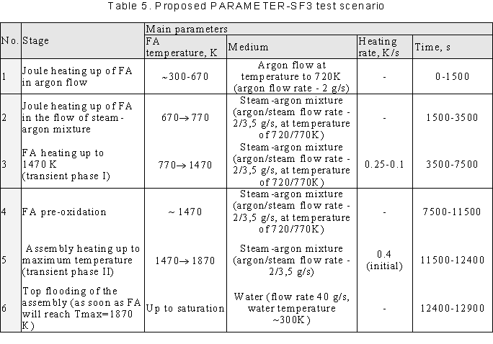
Part 3 and 4: Proposed PARAMETER-SF3 test scenario and pre-test calculations results

Slide 28
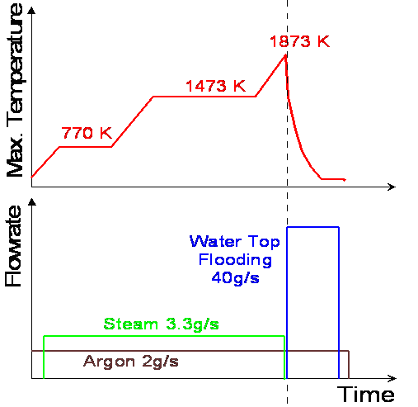
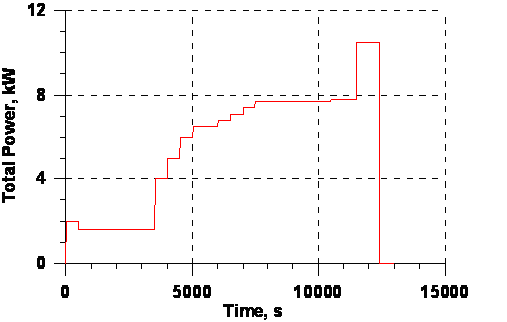
Initial and Boundary conditions
Electrical power
Pre-oxidation phase ~ 7.7 kW
Transient phase ~ 10.5 kW

Slide 29
Used codes and participants
SOCRAT –IBRAE
ICARE/CATHARE - NSI RRC KI
ATHLET-CD – GRS
RELAP/SCDAPSIM MOD3.2 (RELAP) - FSUE EDO “GIDROPRESS”
PARAM-TG - FSUE SRI SIA “LUCH”
SCDAP/RELAP/IRS (RELAP/IRS) -PSI

Slide 30
Heat balance
PARAMETER-SF3 pre-test analysis

Slide 31
Heat balance
PARAMETER-SF3 pre-test analysis
Heat loss through shroud
at pre-oxidation phase
~15-20% of core power over 0-1275 mm

Slide 32
Claddings temperature evolution - hottest zone PARAMETER-SF3 pre-test analysis

Slide 33
Claddings temperature evolution: 700-1000 mm
PARAMETER-SF3 pre-test analysis

Slide 34
Shroud temperature evolution
PARAMETER-SF3 pre-test analysis

Slide 35
Temperature profile
PARAMETER-SF3 pre-test analysis

Slide 36
Oxide scale thickness
PARAMETER-SF3 pre-test analysis

Slide 37
Hydrogen release
PARAMETER-SF3 pre-test analysis
Hydrogen release predicted ~ 22-27 g
No extra hydrogen release at the flooding stage

Slide 38
Flooding Phase (SOCRAT calculations)

Slide 39
Conclusions
SF2 post-test and SF3 pre-test runs have been performed by SOCRAT, ICARE/CATHARE, ATHLET-CD, RELAP, PARAM-TG codes
(IBRAE, RRC KI, GRS, PSI, GIDROPRESS, LUCH)
Scenario for SF3 test was numerically justified.
Predicted temperatures are similar.
Predicted hydrogen release is estimated as 22-27g

