Slide 1
FSUE SRI SIA “LUCH”
IBRAE RAN
OKB “GIDROPRESS”
Results of PARAMETER–SF4 numerical modelling
Presented by A.Kiselev
18th CEG-SAM , St. Petersburg, Russian Federation, September 28-30, 2010

Slide 2
Used codes and participants
(pretest calculations)
SOCRAT – IBRAE
ICARE/CATHARE – NSI RRC KI-IRSN
ATHLET-CD – GRS
RELAP/SCDAPSIM MOD3.2 (RELAP) – OKB “GIDROPRESS”
MAAP4 – EdF
SCDAP/RELAP/IRS (RELAP/IRS) – PSI

Slide 3
SF4 test scenario
Agreed parameters and conditions:
Oxide scale thickness – 300 µm (~514 µm in QUENCH-10)
Cladding temperature before air ingress start – 900ºC (as in QUENCH-10)
Significant period of oxygen starvation at air ingress phase (about 2 min in QUENCH-10)
Target temperature – 1750ºC to avoid significant excursion/degradation during reflood (~1950ºC in QUENCH-10)

Slide 4
Air oxidation model availability
Code | Heat of reaction | Kinetic
SOCRAT | √ | as in steam
ICARE/CATHARE | √ | √
ATHLET-CD | √ | √
MAAP4 | √ | √
RELAP/SCDAPSIM | - | -
SCDAP/RELAP/IRS | √ | √
Air oxidation models are available but need verifying
↓
unreliability of predicted data

Slide 5
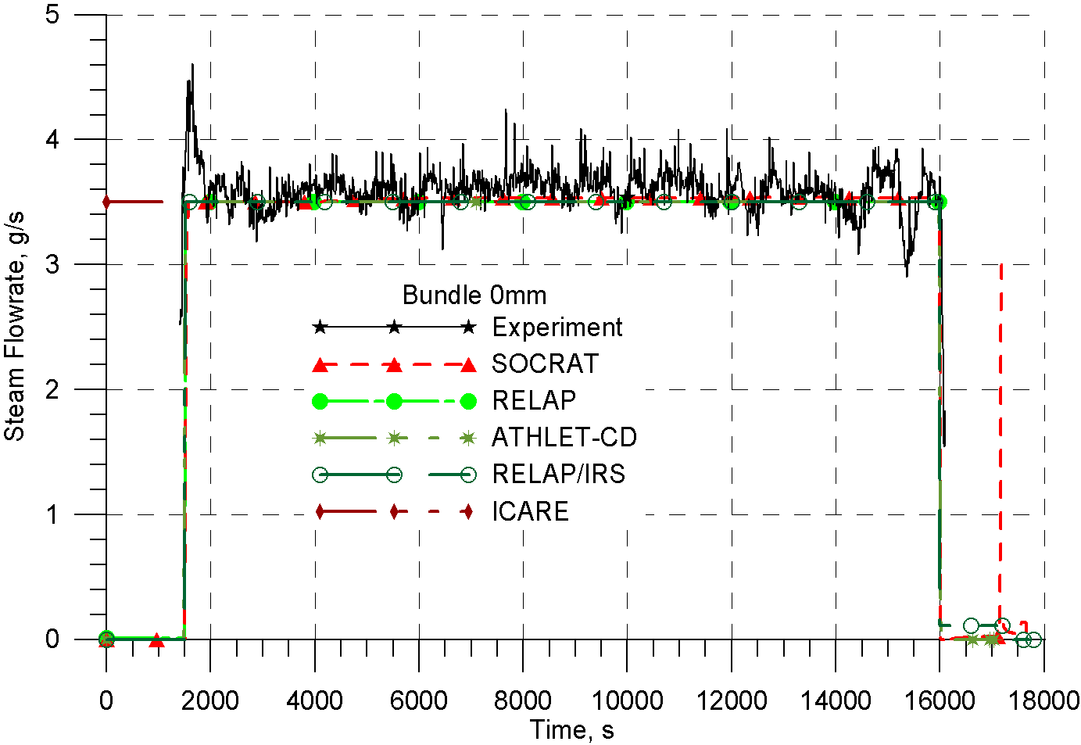
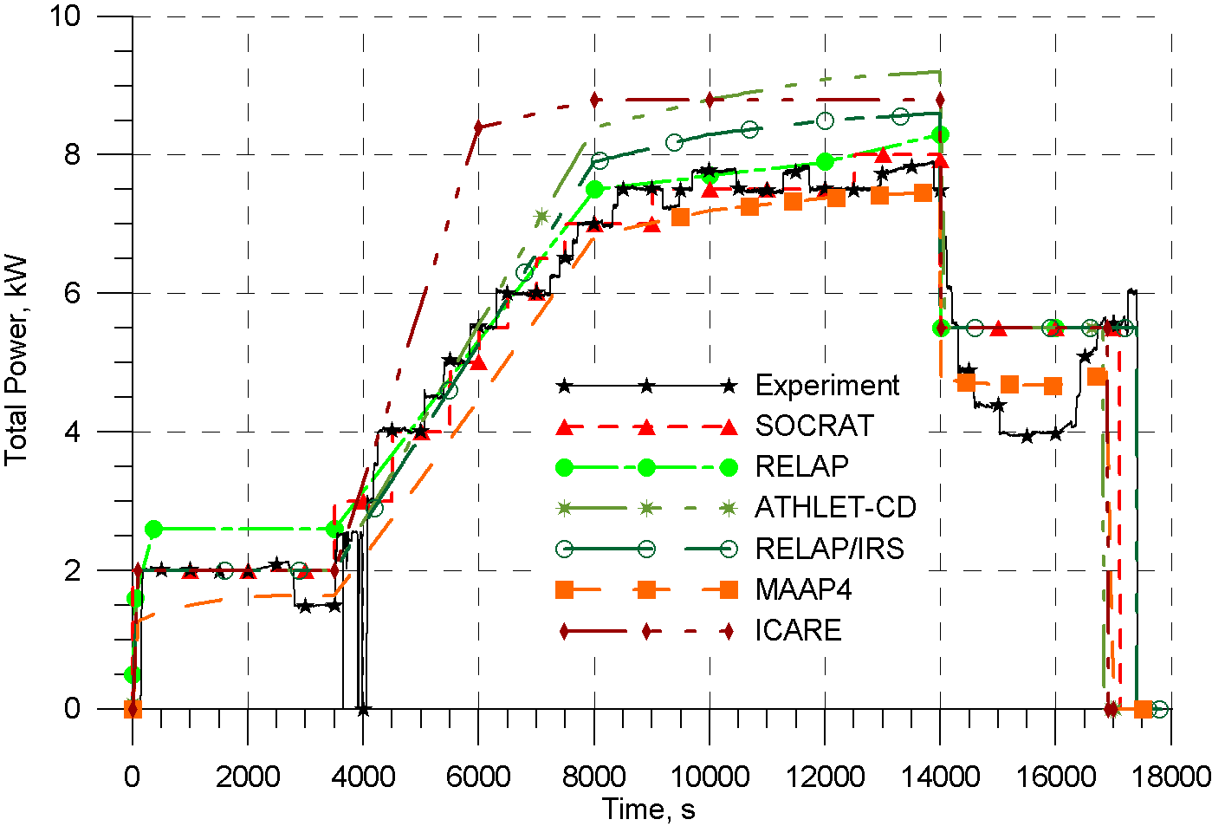
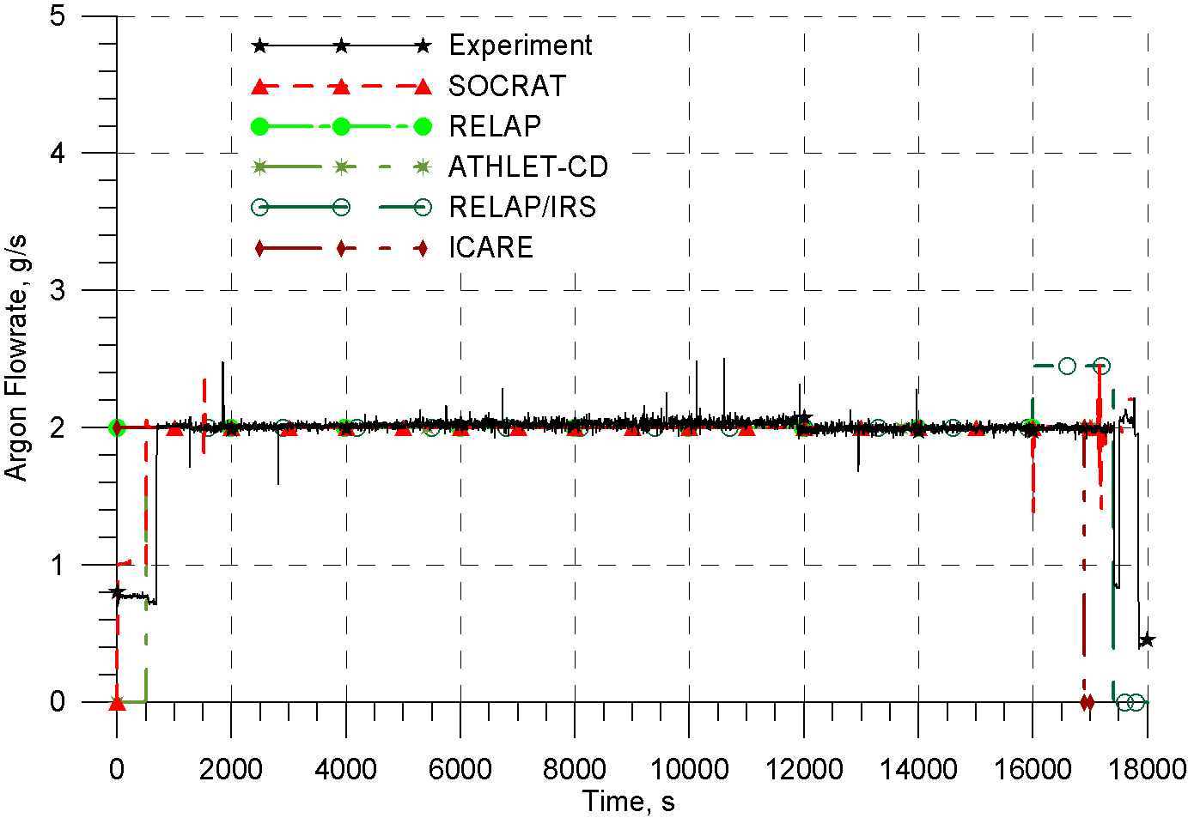
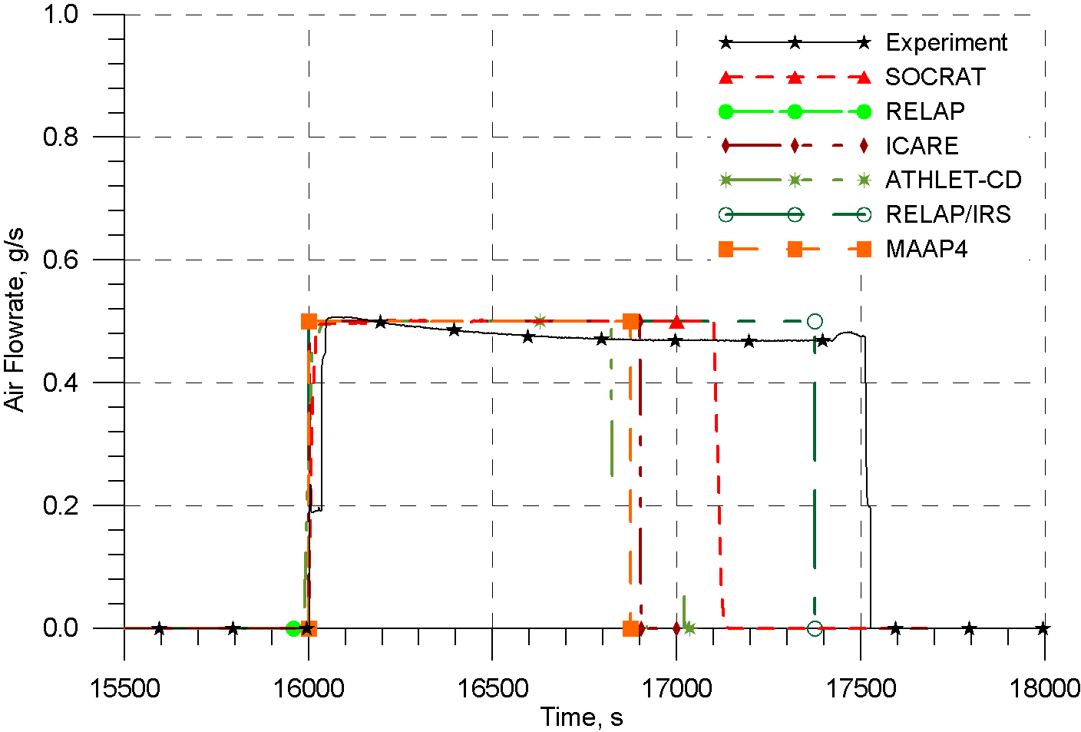
Boundary conditions (proposed by Jon Birchley)
PARAMETER-SF4 pretest analysis

Slide 6
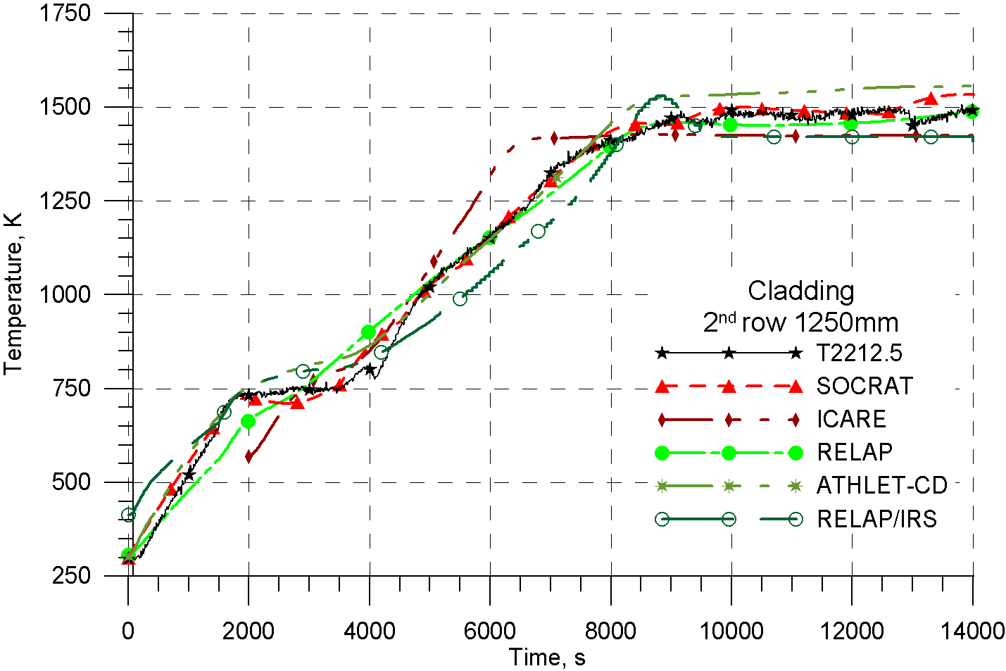
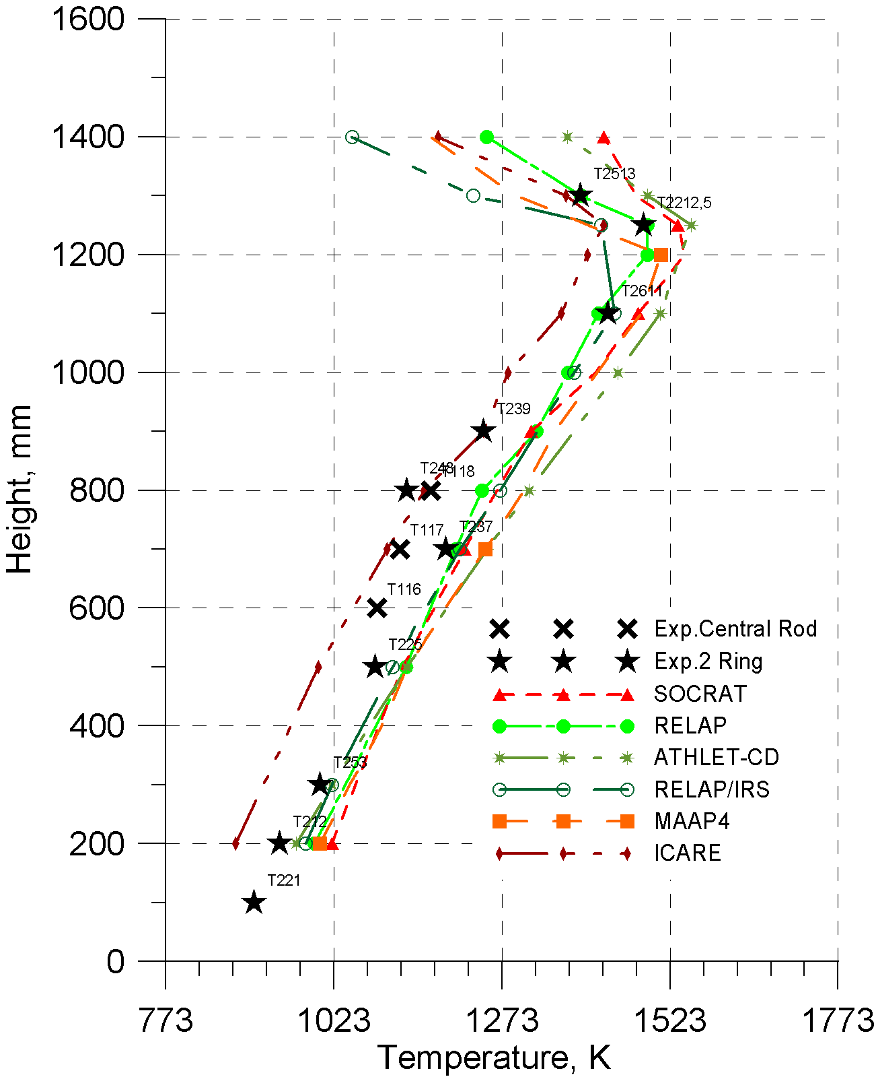
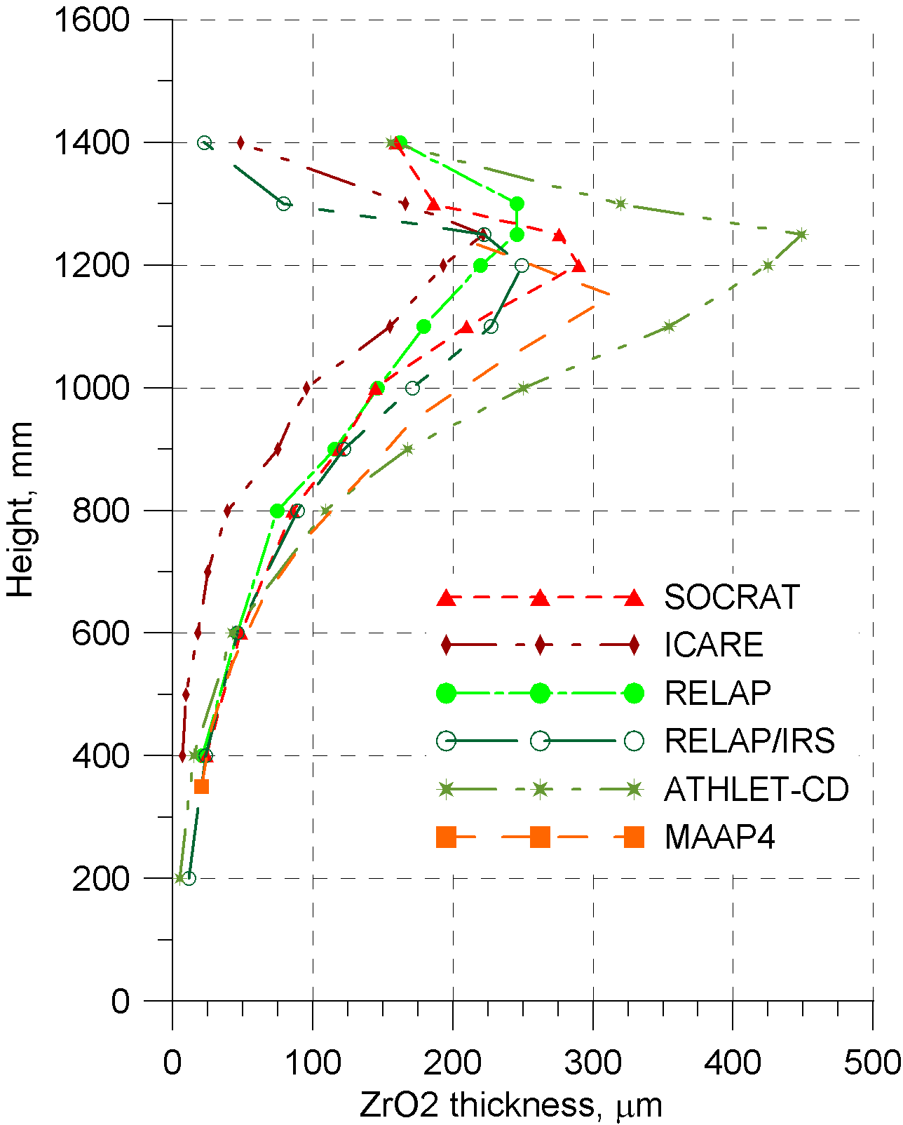
SF4 pretest calculations against experimental data. Pre-oxidation phase. Cladding temperature
t=13950 s

Slide 7
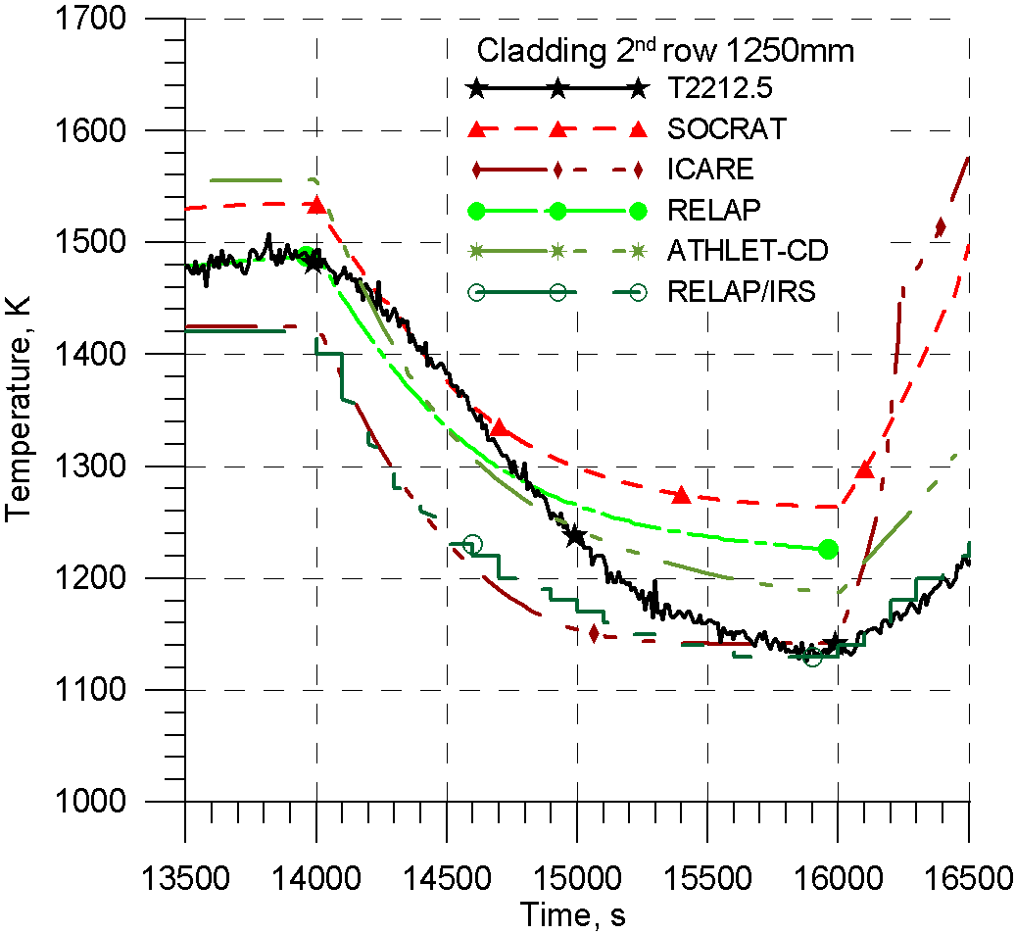
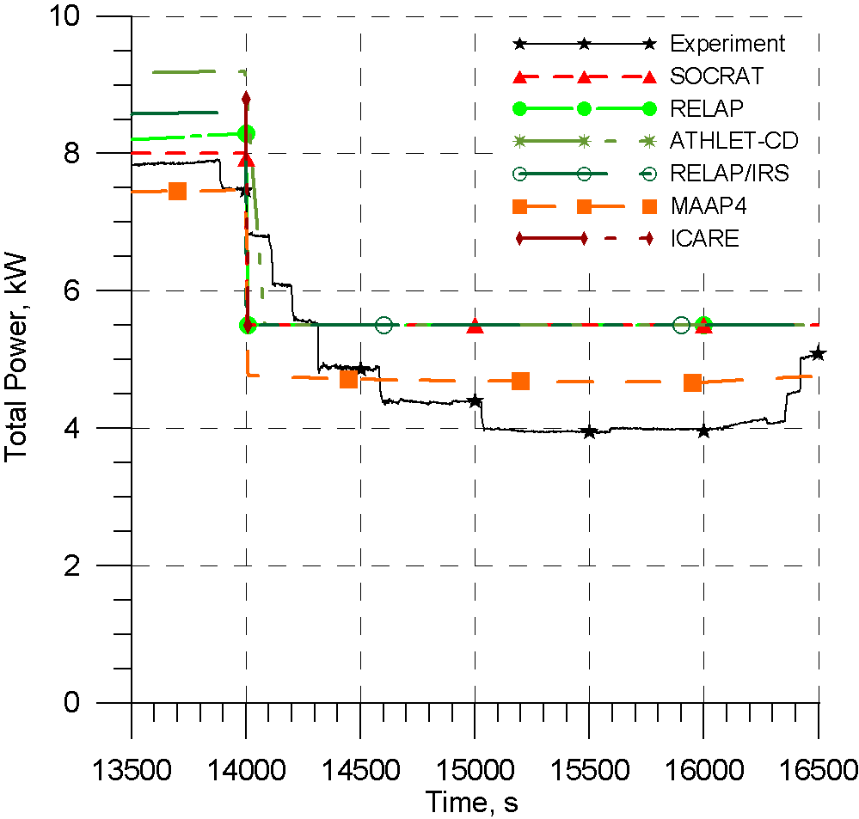
SF4 pretest calculations against experimental data. Cool-down phase

Slide 8
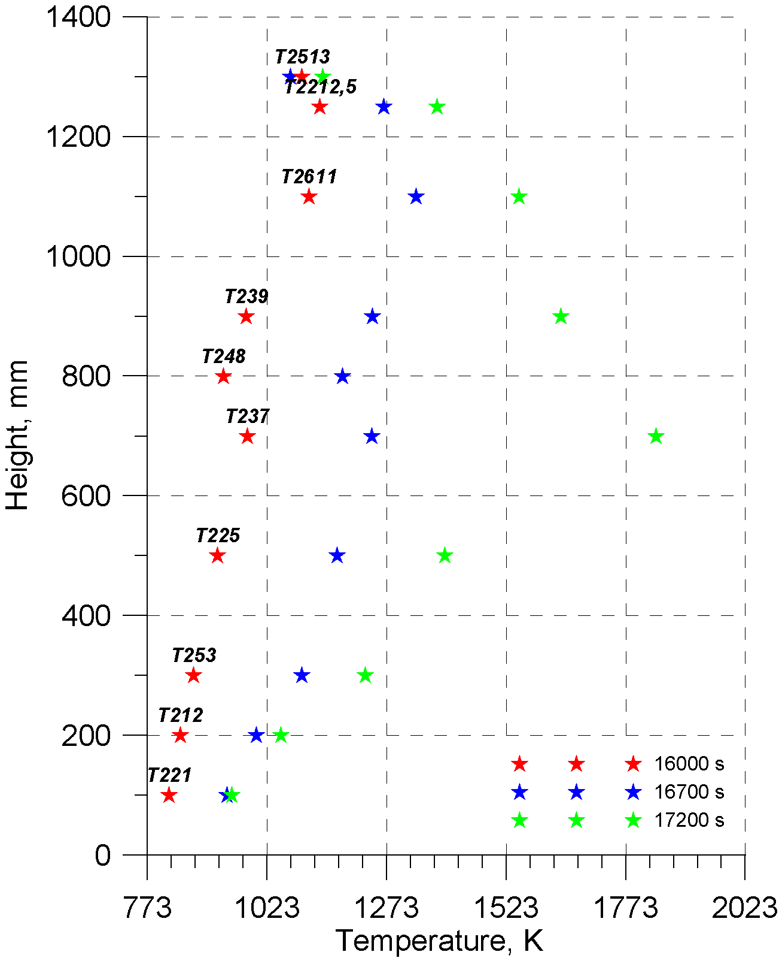
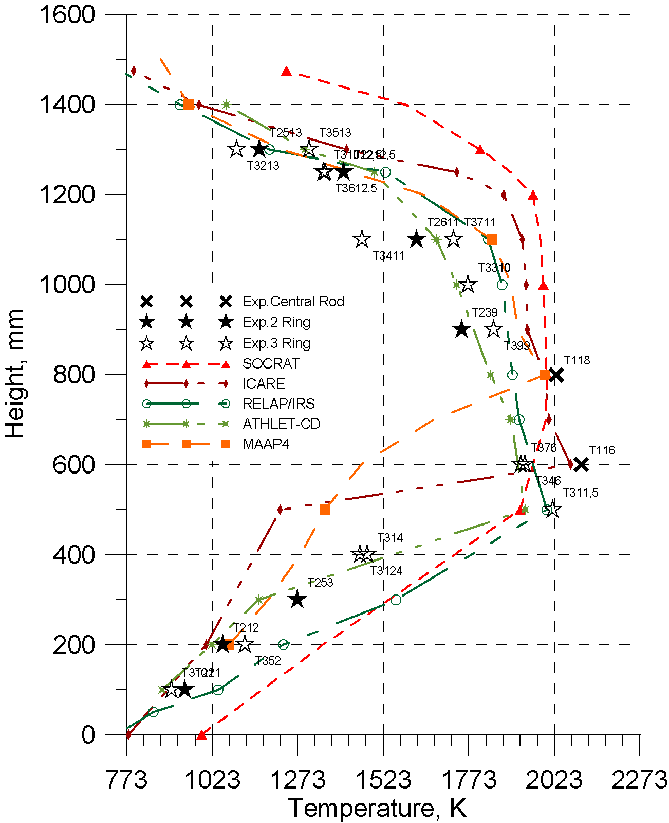
SF4 pretest calculations against experimental data. Air ingress phase (1).
Cladding temperature profile at air ingress phase
Cladding temperature profile before flood onset

Slide 9
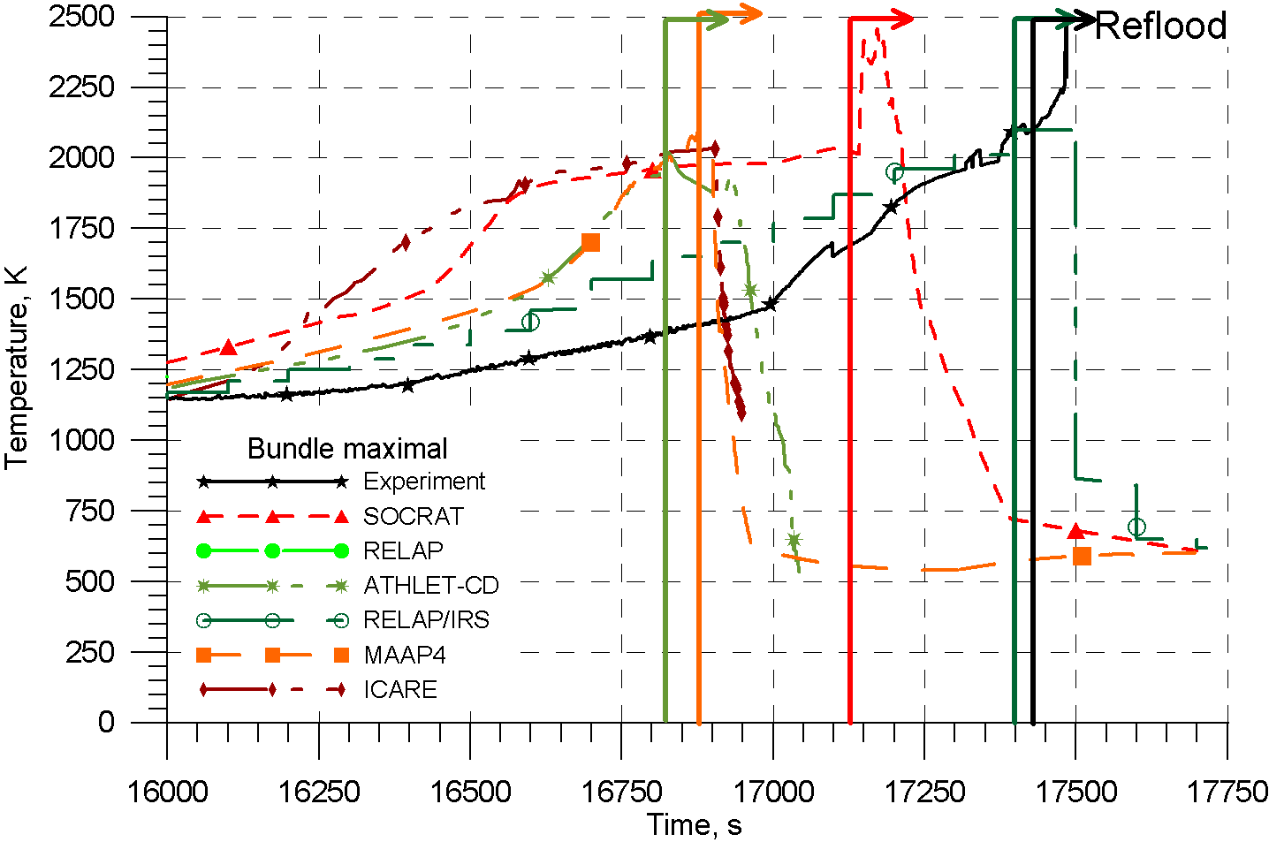
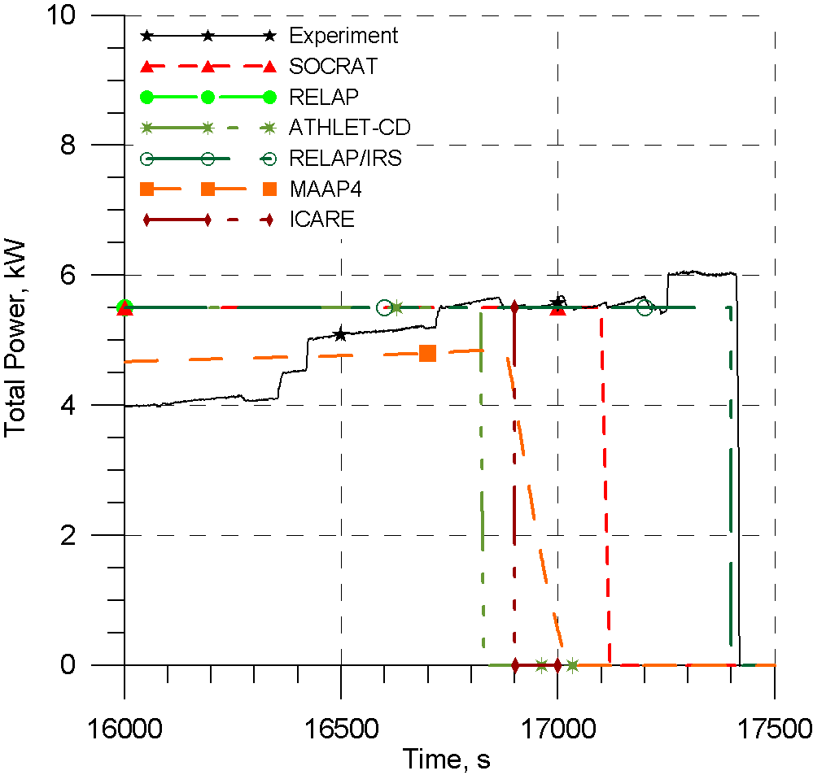
SF4 pretest calculations against experimental data. Air ingress phase (2).

Slide 10
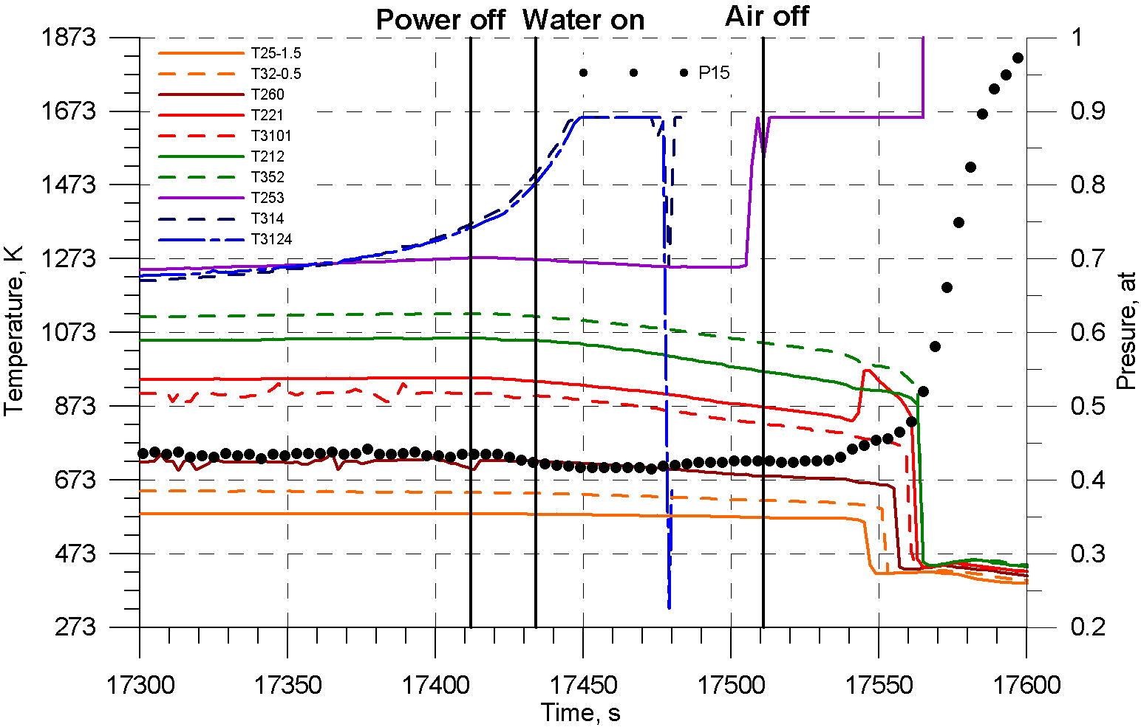
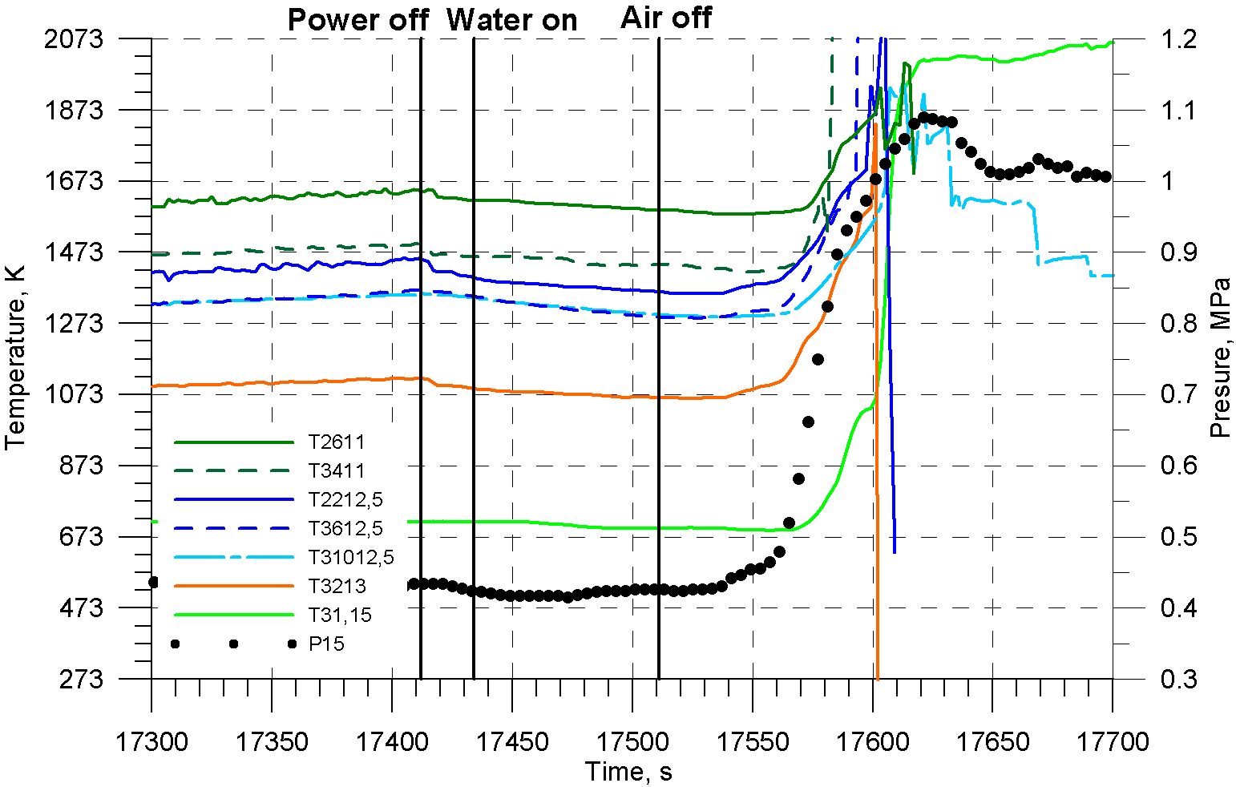
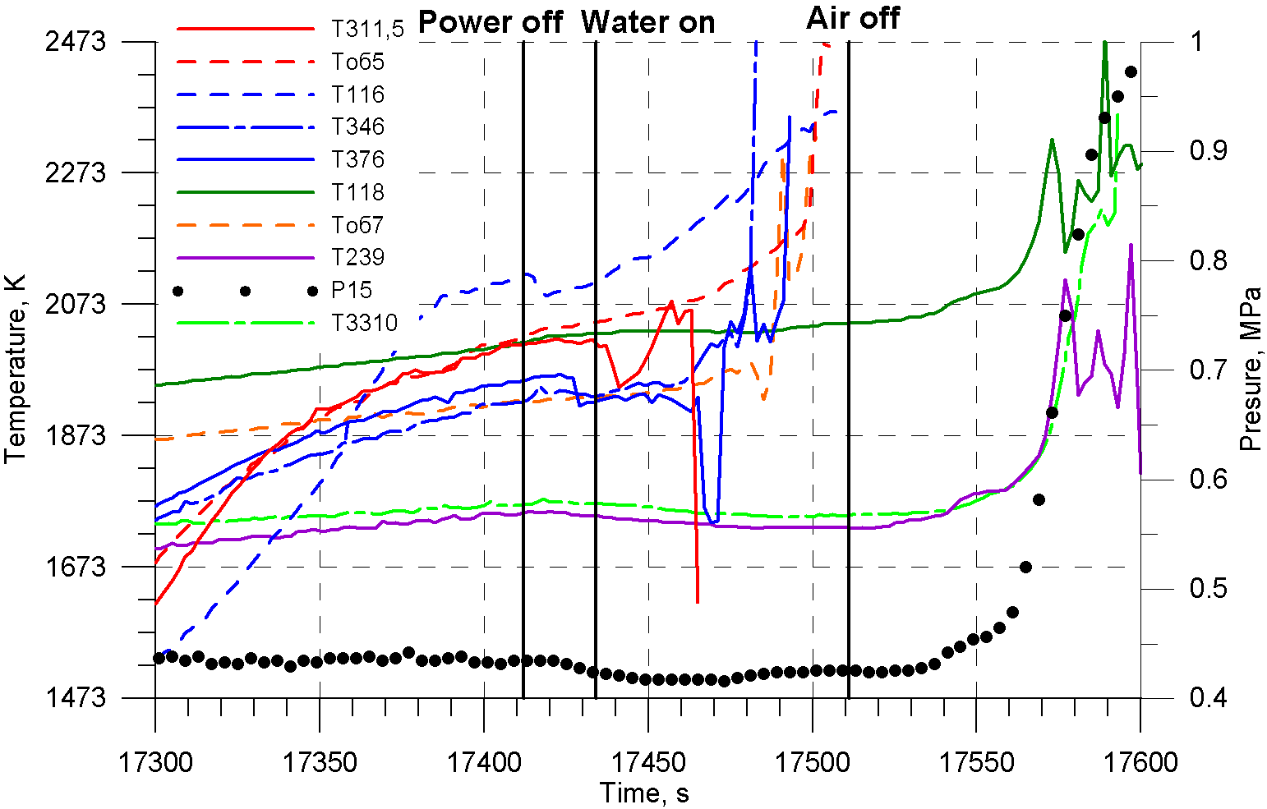
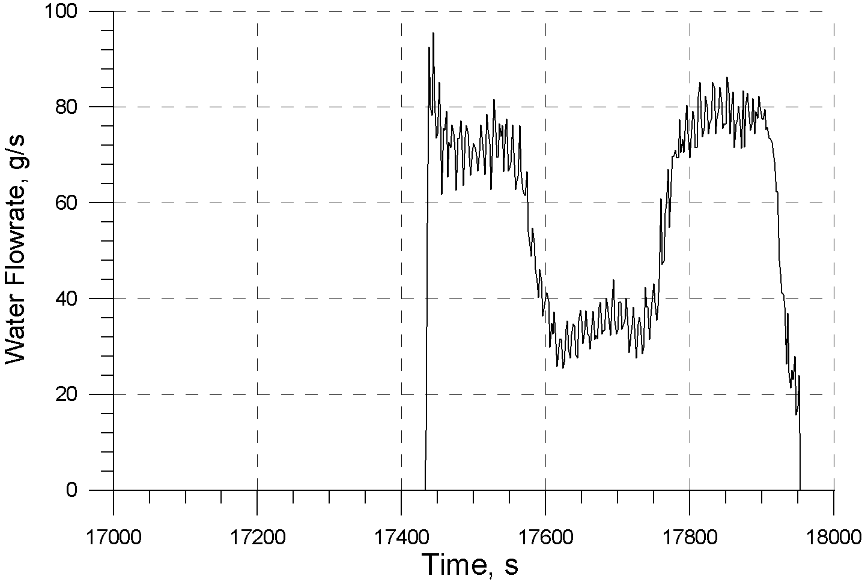
Flooding phase

Slide 11
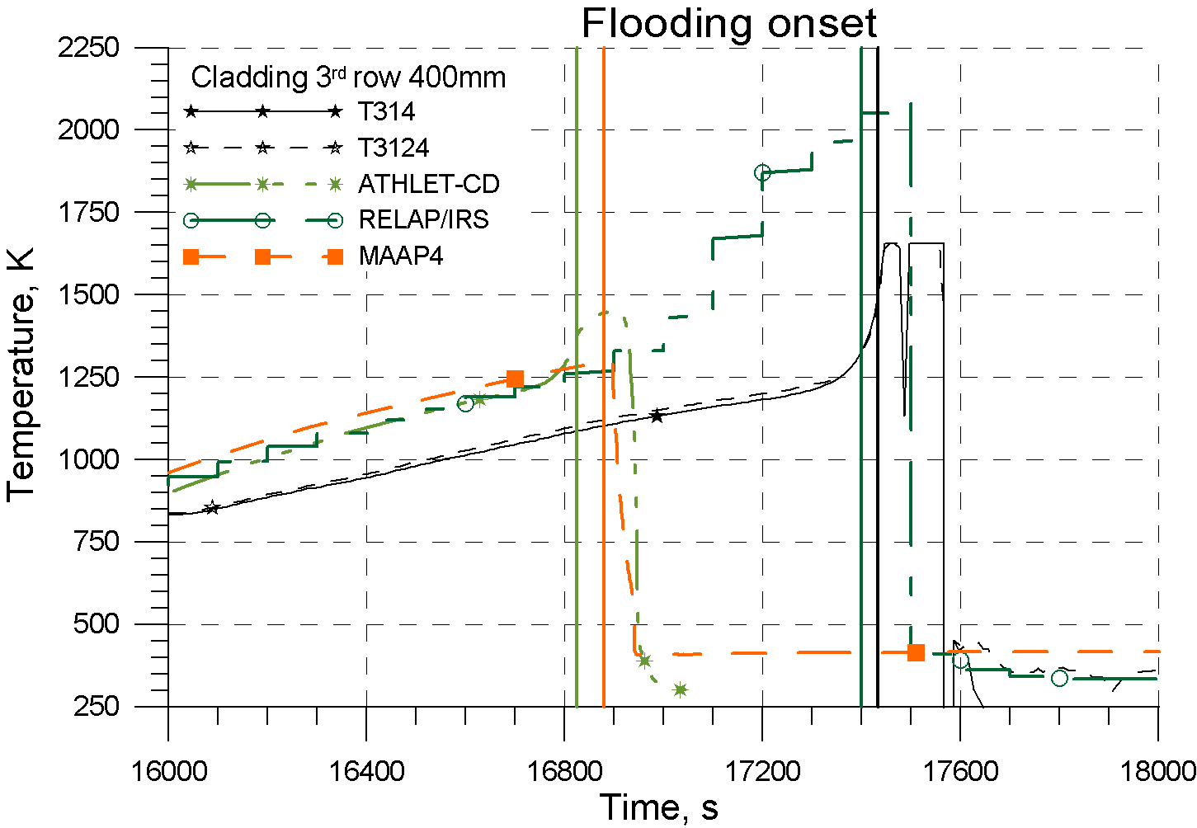
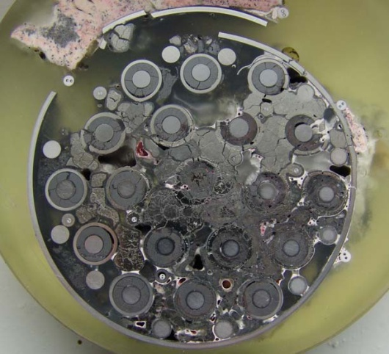
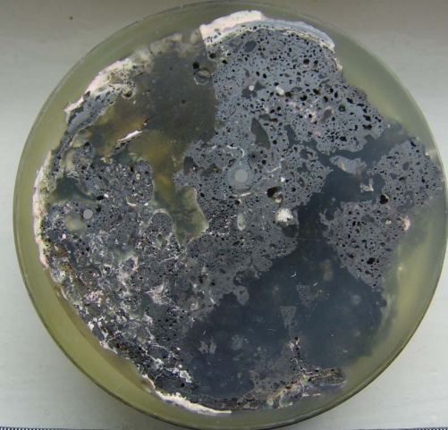
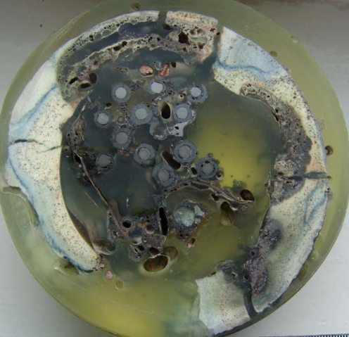
Flooding phase
SF4 bundle, 260 mm
SF4 bundle, 300 mm
SF4 bundle, 1300 mm

Slide 12
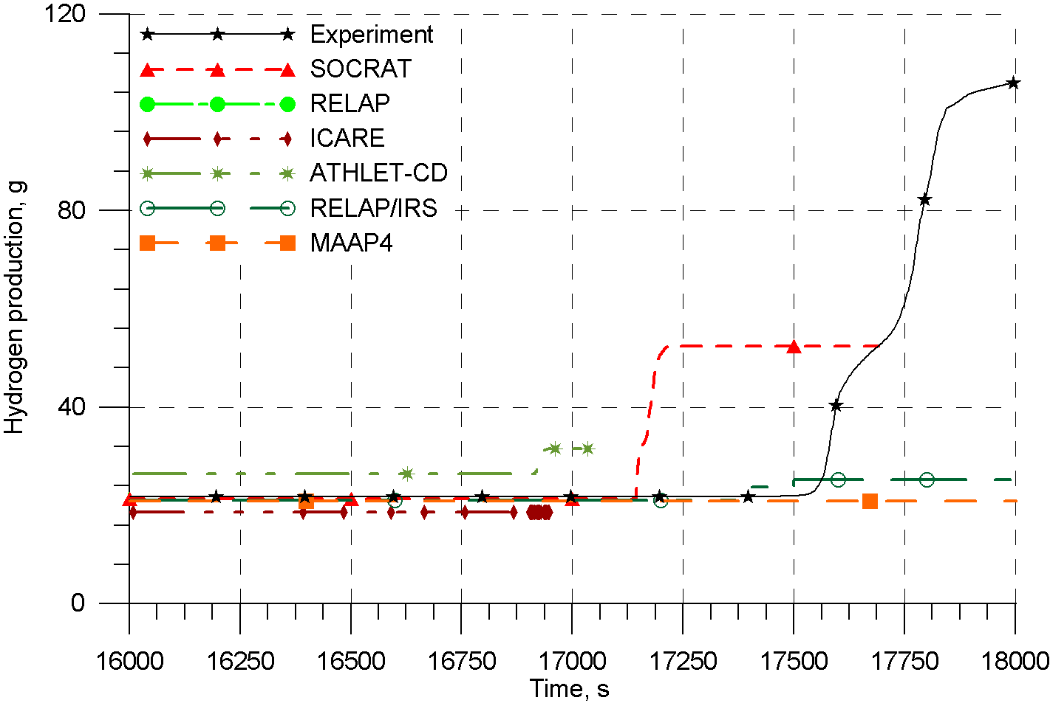
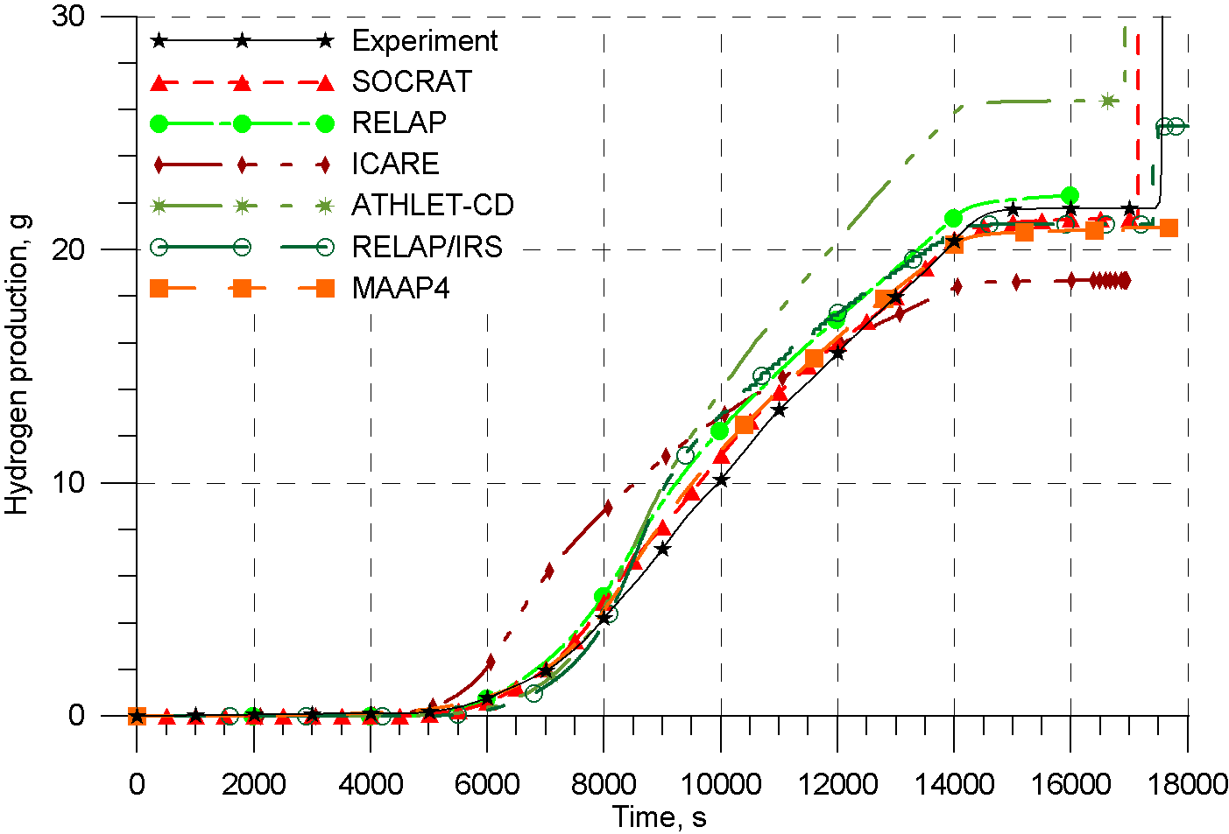
Hydrogen release

Slide 13
SF4 posttest calculations with ICARE/CATHARE (RRC KI team) against experimental data. Initial and boundary conditions
Initial cladding and shroud temperatures correspond to measured data at t=1500 s (~500K);
Thermoinsulation temperature as measured one during the test;
Tar,Tst,Tair as measured Tin
Electrical power as in the test
Gar,Gst,Gair, Gw as in the test
Rext is equal to be 3*10⁻⁴ Om to fit T measured at preoxidation phase (4*10⁻⁴ Om at SF3 post- and SF4 pretest calculations)

Slide 14
SF4 posttest calculations with ICARE/CATHARE against experimental data. Cladding temperature
good agreement at
“steam” phases
-calculated the hottest zone at air ingress phase before el. power switching off at 500 mm (2250К)
Heat up of upper (600-800 mm) and lower elevations after flood onset
slight melting of 450-550 mm but intact
geometry is maintained
Model limitation?

Slide 15
SF4 posttest calculations with ICARE/CATHARE against experimental data. Hydrogen generation
“steam” phases:
18.5 g calculated;
21.8 g measured.
flooding phase:
7.5 g calculated;
86 g measured.

Slide 16
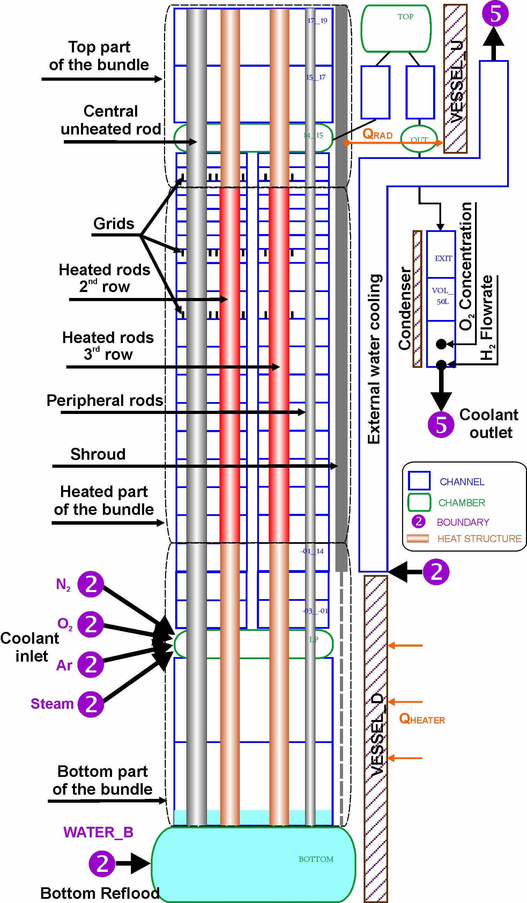
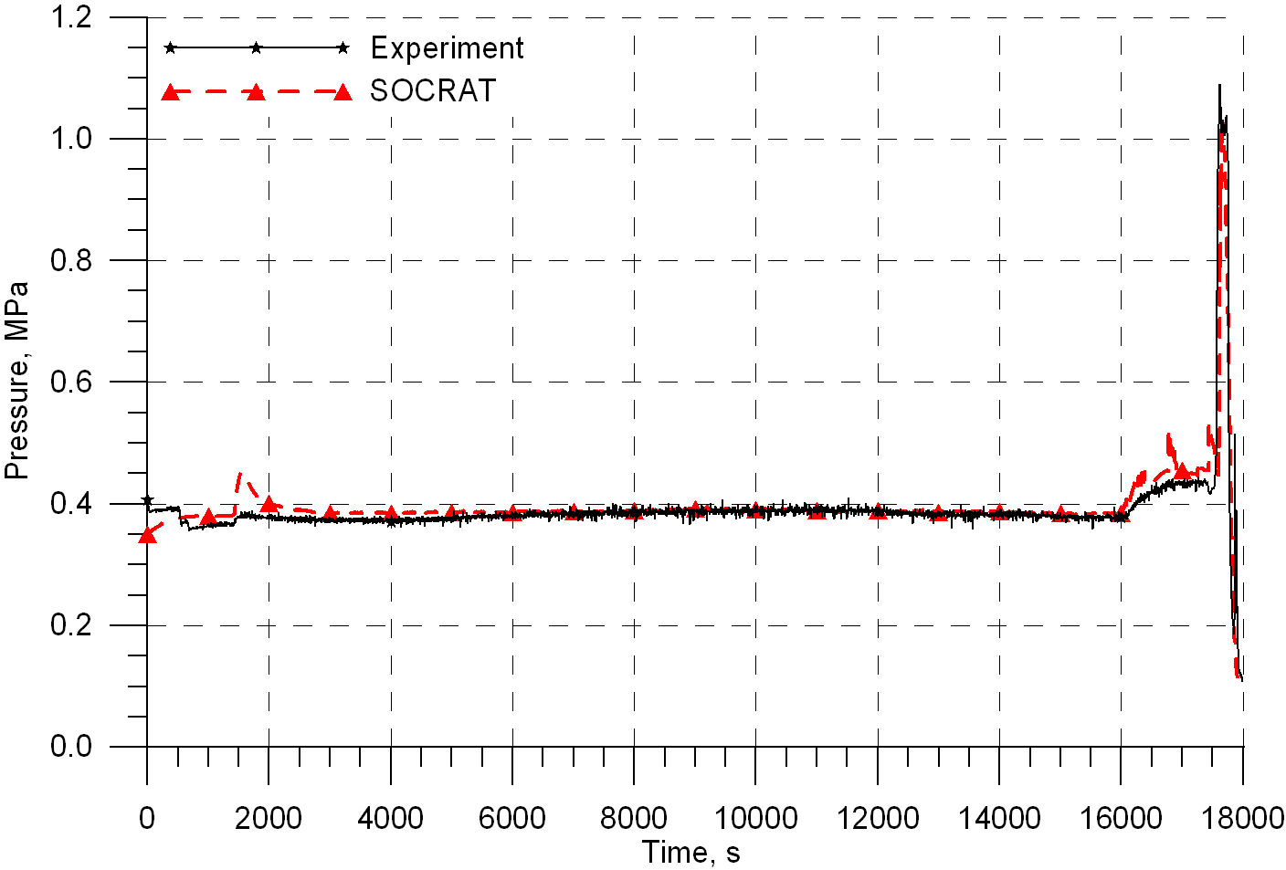
SF4 posttest calculations with SOCRAT (IBRAE RAN team) against experimental data.
Initial and boundary conditions:
Steam, argon and air flowrate as in the test
Electrical power as in the test
Cooling jacket water flowrate as in the test
Modification in nodalization scheme:
Detailed simulation of pipe line from outlet to hydrogen measurement device location with assumption of perfect condense capability to estimate if significant hydrogen release at flood phase could lead to sharp pressure increase.

Slide 17
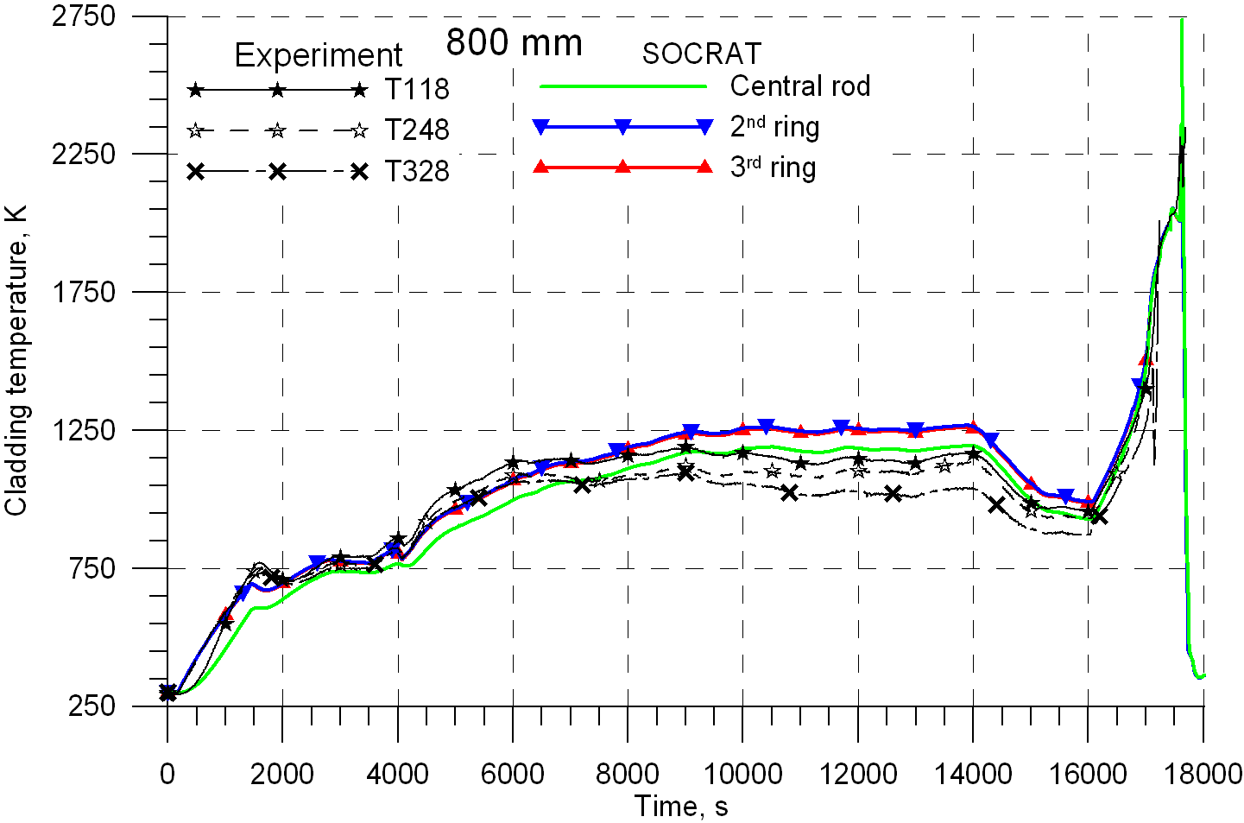
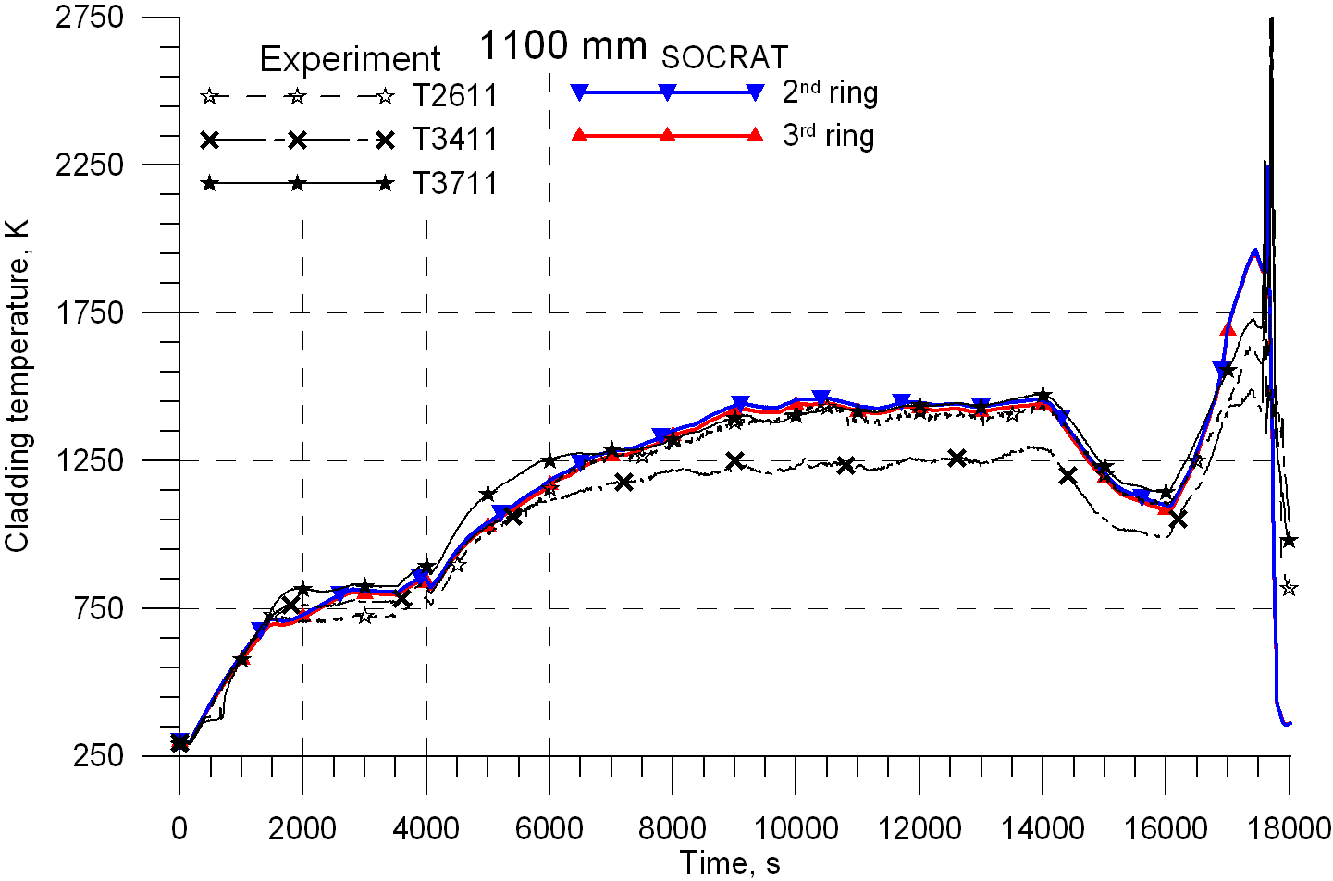
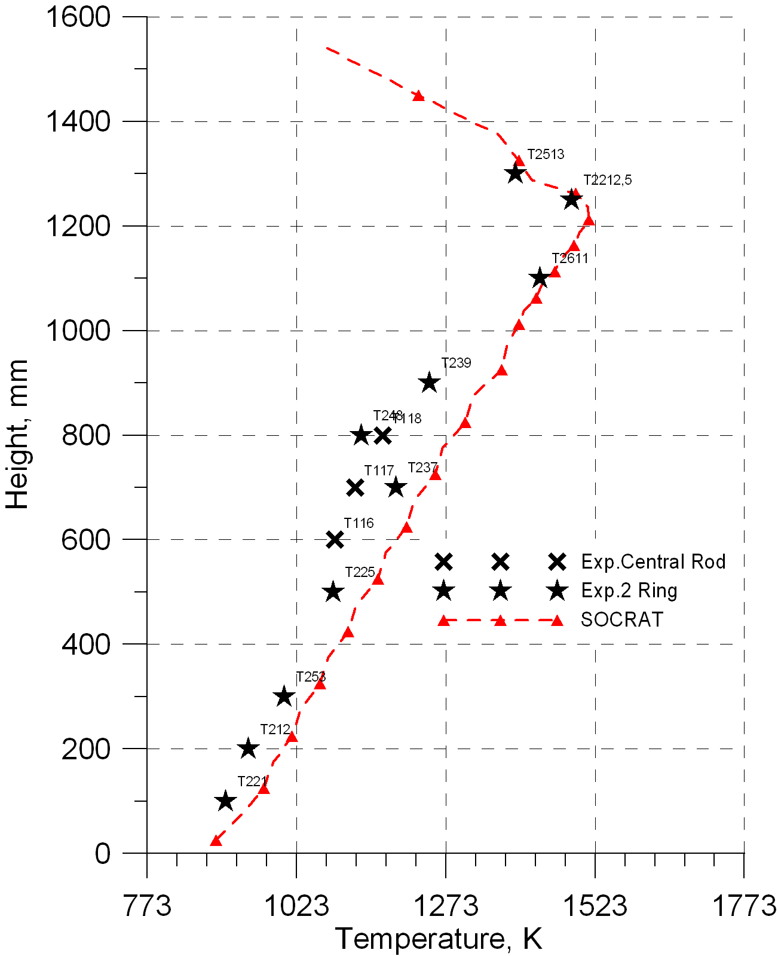
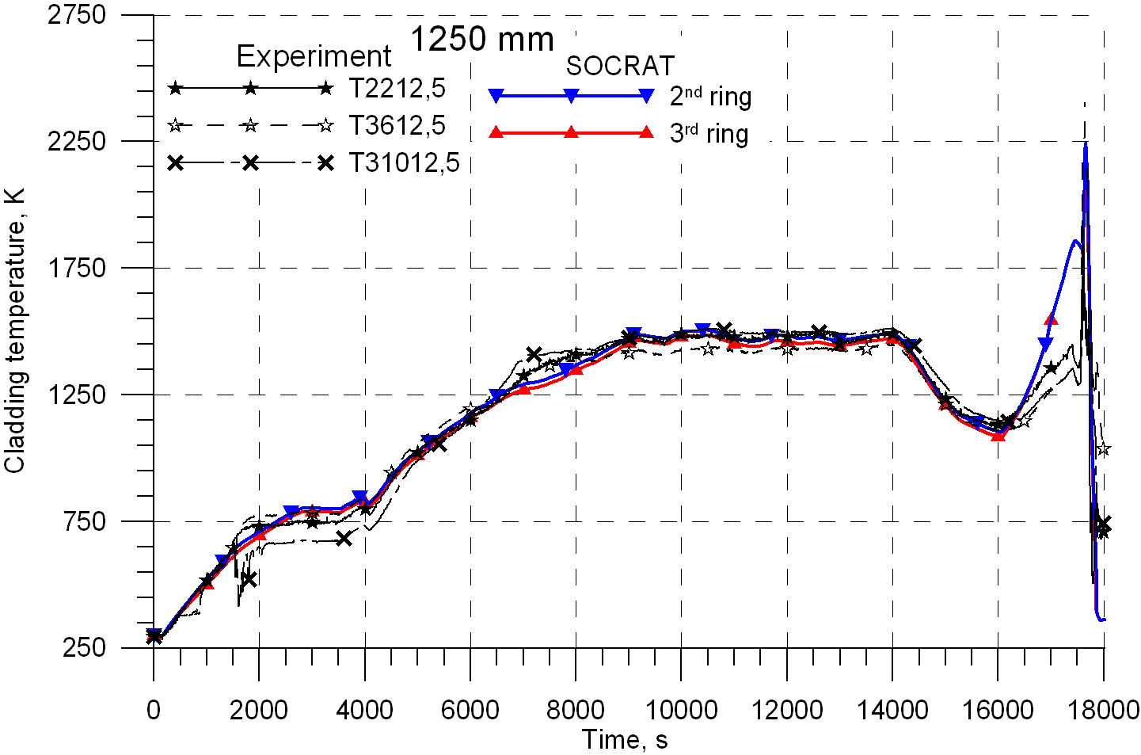
SF4 posttest calculations with SOCRAT against experimental data. Cladding temperature. “Steam” phases
Good agreement at “steam” phases
Cladding temperature profile towards the end of preoxidation phase

Slide 18
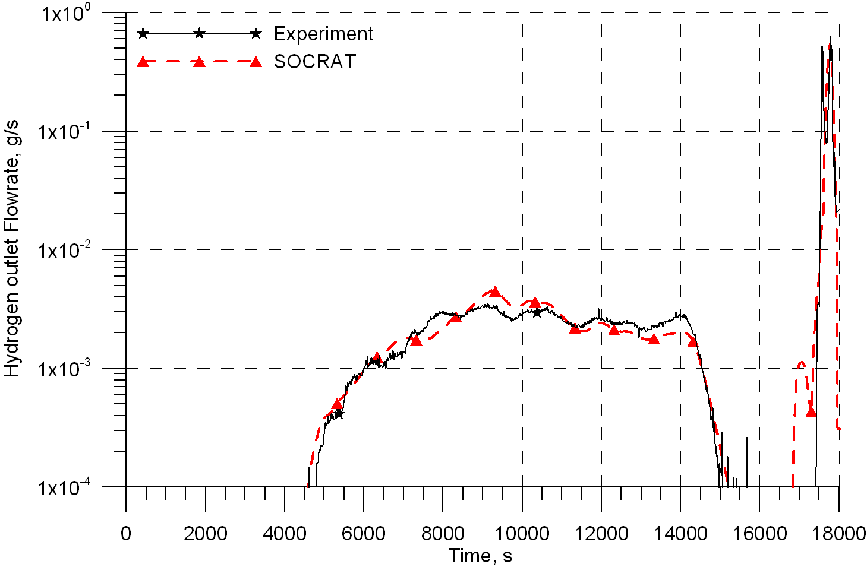
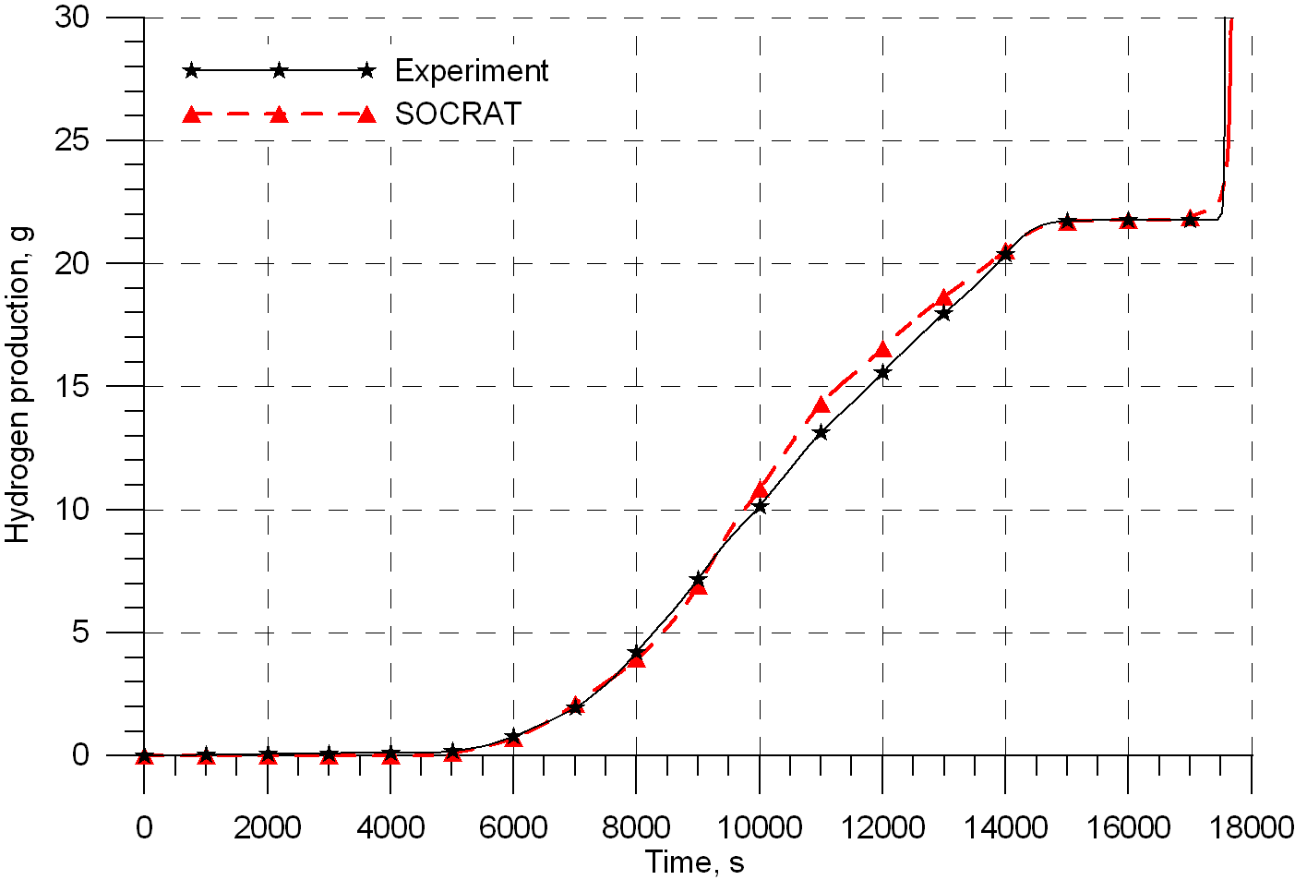
SF4 posttest calculations with SOCRAT against experimental data. Hydrogen generation. “Steam” phases
21.8 g calculated
21.8 g measured

Slide 19
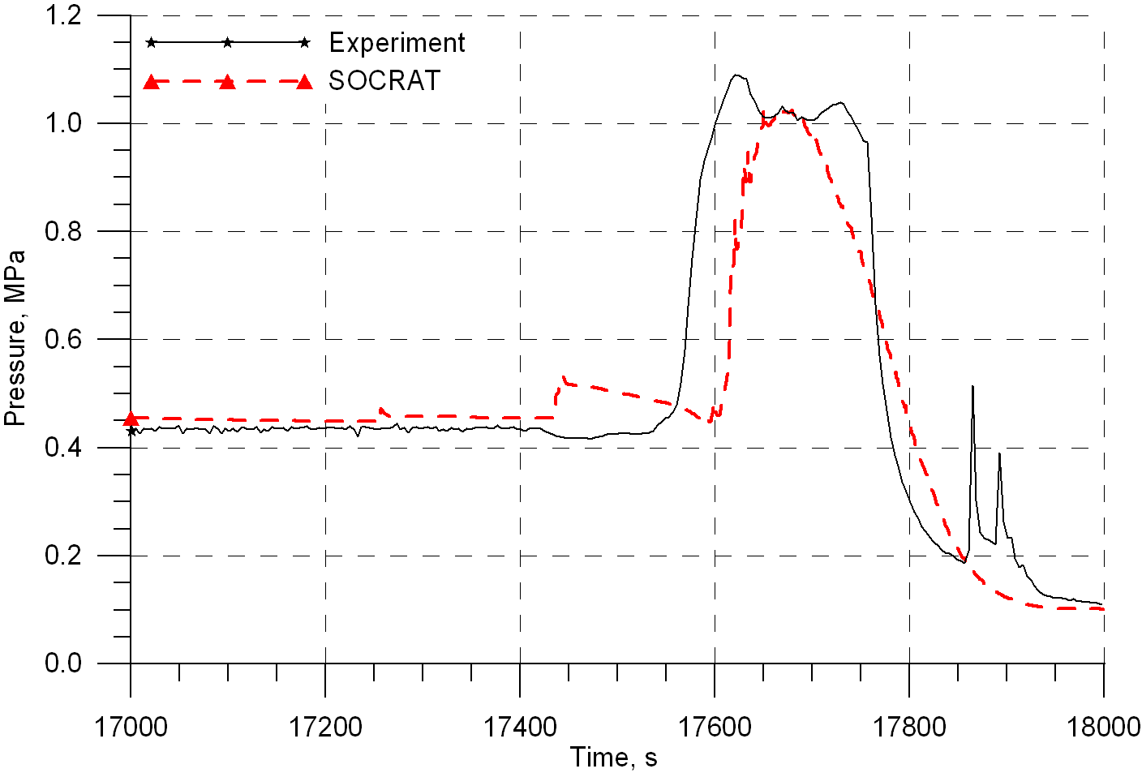
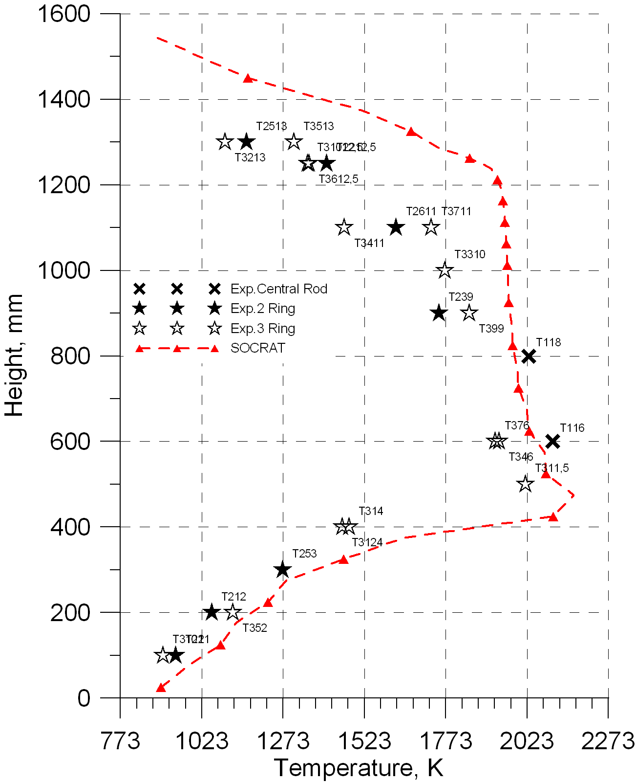
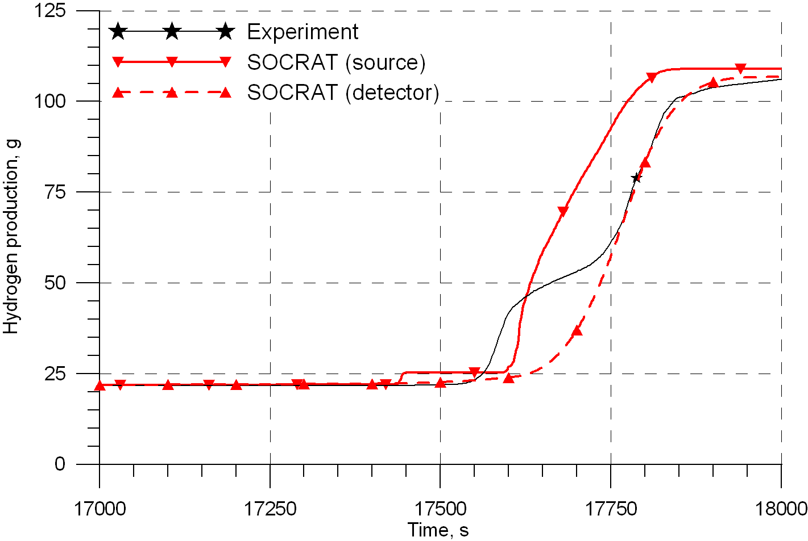
SF4 posttest calculations with SOCRAT against experimental data. Cladding temperature.
Flood phase
Cladding temperature profile before flood onset

Slide 20
Main outcomes
SF4 pretest calculations are in a good coincidence with measured data except flooding phase.
Hot spot location before flood onset was predicted over rather extended zone 500-800 mm. Most codes predicted the elevation of 500-550 mm to be the hottest zone before flood onset. It agrees with measured data (500 mm).
Slight melting at the elevation of 400 mm but intact geometry at flood phase could be expected from pretest calculations.
Calculated (pretest) and measured temperature histories at flood stage are different. Posttest calculations are needed to interpret the obtained experimental results.

Slide 21
Main outcomes
SF4 posttest analysis with ICARE/CATHARE code indicates slight melting of 450-550 mm elevations but intact geometry is maintained.
Posttest analysis with SOCRAT code (no air oxidation model) indicates that high system pressure and reduction of water injection in the bundle at flood phase might be caused by design features of PARAMETER facility rather than processes occurring in the test section.

Slide 22
Acknowledgement
J. Burchley (PSI)
Ch. Bals (GRS)
E. Beuzet, J.-S. Lamy (EdF)

